Slide 1


MIDDLE LEADERS LEADING CHANGE
MIDDLE LEADERS LEADING CHANGE
Introductory Session
Notes:
Slide 1.
Information for presenters:
All information is correct as of September 2026
This PowerPoint is intended to support senior leaders, middle leaders and local authority staff to deliver an introductory session to a group on the Middle Leaders Leading Change (MLLC) programme. ​
​This PowerPoint is a template that presenters can adapt to suit their own context and style of presenting. It can be added to, but please do not remove any slides as they are all essential to the Introductory session. You may wish to add the date, a logo alongside the Education Scotland one, and /or to add a link to a feedback form into the last slide.​
​Within the slides, suggested timings, key messages, facilitator notes and reflective questions are included.​
The session this PowerPoint is intended to support has been designed to be delivered by facilitators in 50-60 minutes. If you have longer, we would encourage you to use that time for (more) discussion and perhaps invite some feedback. Suggested approximate timings can be found in the notes for each slide.​
​
IMPORTANT NOTES:​
This PowerPoint refers to the Education Scotland Middle Leaders Leading Change programme, which can be found here:
https://education.gov.scot/professional-learning/professional-learning-programmes-webinars-and-events/programmes/middle-leaders-leading-change/
It is anticipated the presenter will be familiar with the content of these pages.
​If facilitating in person, you may wish participants to bring their devices for slides 9-11, when you present ‘The Learning ahead’ that is accessed through the website. Alternatively, you could share your screen whilst viewing the MLLC area of the website, to show/remind participants how and where to access the Professional Learning Activities (PLAs). If facilitating online, be ready to share your screen to show these webpages.
​While use of the MLLC Reflective Journal is optional, we would encourage its use as part of this programme. If used, it will be helpful for participants to have it to hand during this session.​
​You might also want to consider planning follow up sessions to check in/support those engaged in the learning and to share learning from Professional Learning Activities (PLAs) undertaken throughout the programme.​ If dates are in place, you can add these to the slides if you wish. You may also decide to add a timeline with expected timings for completing the 6 PLAs, for example: Autumn term 1 – PLAs 1-3; Spring term – PLAs 4-5; Summer term – PLAs 6.
​
Learning outcomes for this resource:
• Set the scene for professional learning
• Familiarise colleagues with the programme
• Consider a timeline for working together.

Slide 2
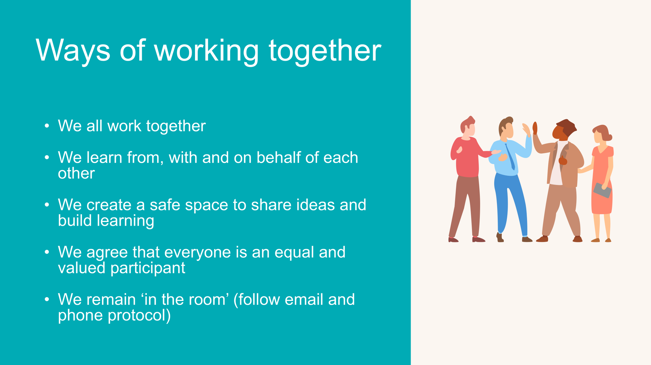
Notes:
Slide 2.
Suggested timing:
​5 minutes​
​Key messages:​
Why establish group protocols?​
​Effective professional learning goes beyond simply delivering information. It fosters a learning community where educators can learn with, from, and on behalf of one another. To achieve this, the facilitator of this learning should establish clear protocols and a positive learning environment at the outset. The general notes below will support the facilitator to help everyone feel comfortable participating and contribute to a rich learning experience. ​
​Facilitator notes:​
Take some time to establish group protocols (ways of working together) for this session and any further MLLC sessions you may deliver. ​
Ask participants to comment on anything they would like to add or amend. ​
Is there anything that participants feel is missing or anything they would like to remove?​
The protocols on the slide are suggestions to be amended for your context or group. ​
​
Further notes on creating protocols:​
​1. Contract a safe space​
​Co-create a safe space agreement with your group. This agreement outlines expectations for respectful communication and active listening. A safe space allows trust to flourish, fostering a collaborative environment where everyone feels comfortable sharing ideas and taking risks. ​
​2. Shift from top-down to collaborative learning ​
​Move beyond the traditional model where one person imparts knowledge. Embrace a collaborative approach where all participants actively engage. This means learning with, from, and on behalf of one another. By leveraging the diverse perspectives within the group, gaining a richer understanding and creating a more impactful learning experience for everyone. ​
​3. Holding the ladder: Shared expertise and recognition ​
​Holding the ladder signifies a two-fold approach: ​
​Sharing expertise: Those with experience can share their knowledge and insights. ​
​Recognising everyone’s contribution: Actively listen and be open to learning from the unique perspectives and experiences of colleagues. Build on each other's ideas to foster a collaborative environment where everyone feels valued, and their contributions are respected. ​
​4. Hold space for silence and respectful discussion ​
​Hold space for silence after someone speaks or asks a question. It can be tempting to jump in to fill silence but allowing time for quiet can avoid interrupting thought and produce more thoughtful responses. Everyone deserves to be heard and understood. ​
​Adapt the time allocation based on the size of the group and the complexity of the topic. ​
​5. Schedule regular breaks ​
​Schedule a break into the session (as a minimum, one 5–minute break per hour). This allows participants to process information, refocus, and return with renewed energy, leading to a more productive learning experience. ​
​6. Centre learning in real life ​
​Connect the learning to real-life experiences by encouraging participants to share relevant personal anecdotes or applications. This strengthens understanding and makes the learning more relatable and impactful for all. ​

Slide 3

    Introduce the Education Scotland MLLC programme ​
    Take a look at the four pillars explored through MLLC
    ​
    Familiarise with the programme ahead, including
    ​
    - using the PLAs​
    - undertaking a change initiative
    Cover how to complete the programme
    Think about our next immediate next steps
In today’s session we will
Notes:
Slide 3.
Suggested timing: ​
2 minutes​
​Facilitator notes:​​
​​This slide shows what will be looked at in this session, to be shared with participants. Invite any questions they may have.

Slide 4
    Self-awareness: develop awareness of individual areas of strength / development needs and how this awareness can inform improvements to leadership
    Anti-racism: develop an understanding of identity, privilege and power and learn how to be activity anti-racist in your practice
    Leadership of change: develop knowledge, understanding and confidence in the use of different models to lead and scaffold change
    Coaching approaches: enhance awareness and knowledge of coaching approaches for leadership and increase confidence in practising these
Programme aims
Notes:
Slide 4.
Suggested timing:
​2 minute​s
​Facilitator notes:​​
​​This slide shows what we call the 'four pillars' of the programme:
self-awareness
anti-racism
leadership of change
coaching approaches.
These are threaded throughout the 5 core PLAs.

Slide 5
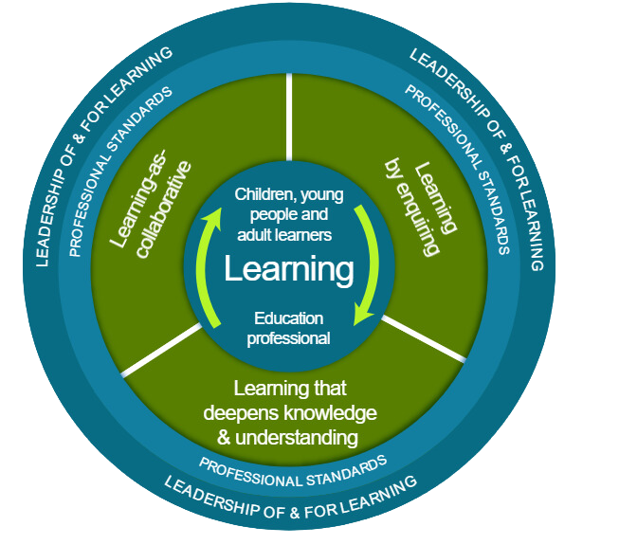
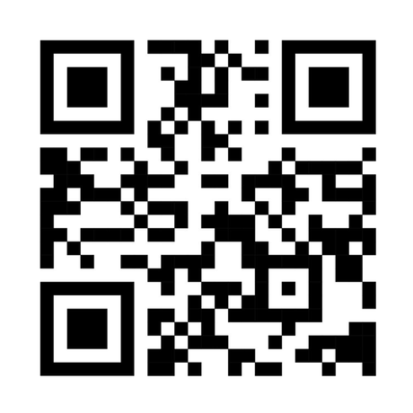
National Model of Professional Learning
Notes:
Slide 5.
Suggested timings:
2 mins
Key messages:
The national model of professional learning describes the main principles and features of effective learning. These can help to build capacity and promote collaborative practices.
The national model of professional learning | National approach to professional learning | Professional Learning | Education Scotland
Middle Leaders Leading Change has been designed using the national model of professional learning and the principles of adult learning or andragogy.
Facilitator notes:
Briefly talk through each part of the model:
The heart (centre) of the model - the professional learning in this programme should impact on you as educators and in turn impact on your learners. All effective professional learning links the educator’s learning with that of the children, young people or adult learners you work with. You will be in the role of a learner in this programme too. Please reflect throughout on the potential of your learning to impact on your learners.
The next three elements in green – the programme involves enquiry, collaboration and learning that deepens your knowledge and understanding, because these approaches are known to support effective learning that can transform practice.
The programme is linked to professional standards, whether the General Teaching Council (Scotland) (GTCS) Standard for Middle Leadership, the Scottish Social Services Council (SSSC) Codes of Practice or Standard for Childhood Practice (2015), or the Community Learning and Development Standards Council (CLDSC) Competent Practitioner Framework.
Leadership of and for learning is about creating a culture of learning in a setting, with everyone playing a part in creating that ethos, not just leadership teams.
Reflective question:
Is there anything that resonates with you and if so, why?

Slide 6
Connector
    Think of a time when you have led change or improvement in your setting.
    What are your top three strategies for leading a team through change?
Notes:
Slide 6.
Suggested timing:
10 minutes
Facilitator notes:
This is an example of a simple connector activity. It is recommended that facilitators use a connector activity that allows participants to take part in an informal discussion.
This is to ensure that participants are relaxed, focused and ready for an interactive workshop.
Facilitator notes:​
If time permits, you may wish to ask each small group to feed back any key points or themes from their discussion.
​
​
​

Slide 7
Our why
“...be the leader you wish you had.”
Simon Sinek
“...be the educator you wish you had.”
  What is your why?
  Why educate?
  What is education for?
  Why aspire to lead?
Notes:
Slide 7.
Suggested timing:
3 minutes
Facilitator notes:
Reflecting on your own professional 'why' will help you remember why you educate and get you thinking about what kind of leader you want to become.
Facilitator notes:
Simon Sinek says, 'Be the leader you wish you had'. For the purposes of today's session, perhaps we can think about this as 'Be the educator you wish you had', because this will our focus minds on the learners (our reason for educating!)
Reflective questions:
What is your why?
Why educate?
What is education for?
Why aspire to lead?
Invite the group to share any reflections.

Slide 8
Our how
"Middle leaders are the crucial conduits of change. They interpret and implement policy, influence their peers, and translate school-wide priorities into classroom practice."
"Performance Beyond Expectations: A Recipe for Leaders."
Andy Hargreaves and Alma Harris, 2011
Notes:
Slide 8.
Suggested timing:
3 minutes
Key messages:
Our 'how' is also very important - our skills, experiences, knowledge, abilities, attitudes, values and unique qualities matter!
Facilitator notes:
Another quote on this slide that might tell us something about how to effect real change in education through our leadership roles.
Mention that the professional standards and values also help us with the 'why' and the 'how' and encourage participants to check in with them from time to time as they as they proceed through the programme.
Invite the group to share any reflections.

Slide 9
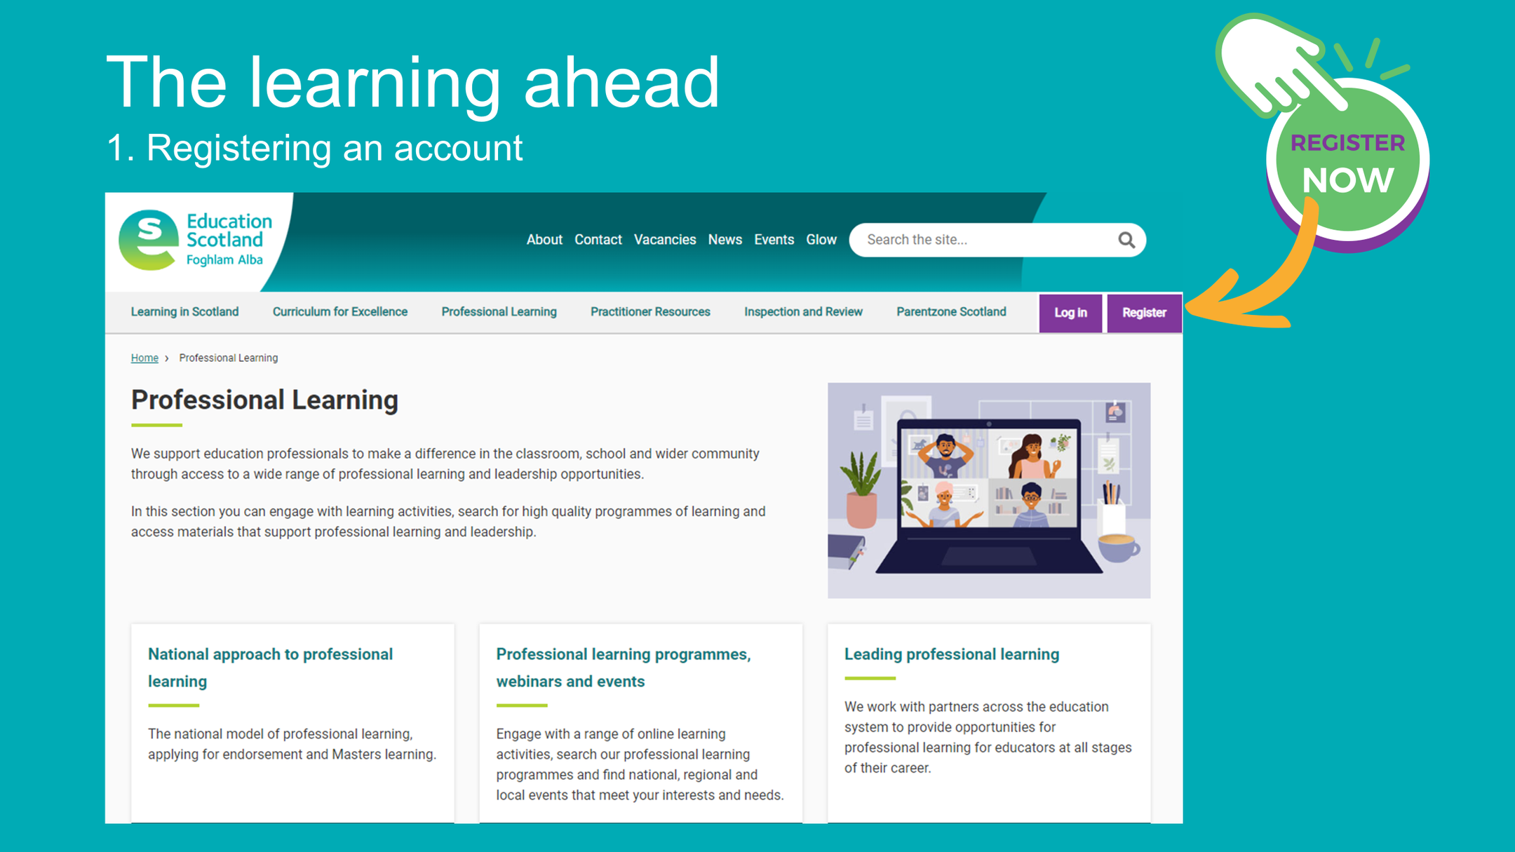
Notes:
Slide 9.
Suggested timing:
3 minutes
Key messages:
Participants need an account at the Education Scotland website to access the self-directed PLAs. It is easy to set up an account using the ‘Register’ button shown on the slide.
Facilitator notes:
On the ES website there is a suite of self-directed Professional Learning Activities (PLAs). These are interactive learning materials that allow you to write responses and reflections to prompts, to save your progress and to keep a record of your learning. The MLLC programme uses specific PLAs. You can download a summary of your learning at the end of each PLA, which can be used in to support your Professional Review and Development (PRD) discussions with your line manager. This information can only be accessed by you and therefore you need to create a website profile and log in to access the PLAs.
You need to create an account on the Education Scotland website to access the self-directed PLAs.
There is a link in the MLLC webpages which explains how to do this. Register using your work or personal email address and create a website profile.
To register using your work or personal email address and create a website profile: https://education.gov.scot/professional-learning/ and click on the purple register button on the right-hand side.
This will bring up a short registration pop up form for you to complete which includes a few basic details about you and your role in the education sector. Once you have registered and created your password for the website you will have access to the suite of self-directed Professional Learning activities (PLA).
You may wish to invite any questions at this point.

Slide 10
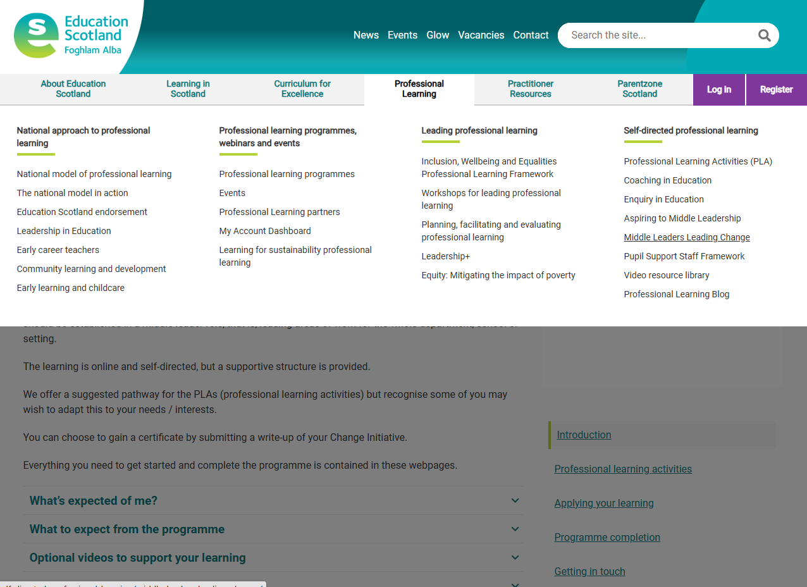
The learning ahead
2. Getting started
Notes:
Slide 10.
Suggested timing:
2 minutes
Key messages:
The MLLC programme is self-directed through the Education Scotland website. Use the Professional Learning tab on the home page, then go to Middle Leaders Leading Change under the 'Self-directed professional learning' menu.
You can find out more and get started with the learning at the page shown on the slide:
https://education.gov.scot/professional-learning/professional-learning-programmes-webinars-and-events/programmes/?orderAlias=default

Slide 11


The learning ahead
3. The core PLAs
MLLC 1 Self-awareness for middle leaders
Leadership of self, The concept of emotional intelligence, Knowing our values, Anti-racism as a baseline value
MLLC 2 Middle Leadership: Knowing the role
Conditions, Characteristics, Leading from the middle, Standard for ML
MLLC 3 Change Models
Exploring your ‘Why’ , Kotter, The Lippitt-Knoster model, Logic models, Managing transition
MLLC 4 Using data to lead change
What is data? Data and improvement, Examples of data use, Data driven dialogue
MLLC 5 Engaging others in change
Who? Our learners, Parents, carers and partners, Wider community, Colleagues
Notes:
Slide 11.
Suggested timing:
3 minutes
Key messages:
Remind the group that all the learning for the programme is contained in the MLLC webpages. There are 6 PLAs to complete in total.
This slide shows the 5 core PLAs and their broad content. This is the suggested order but can be changed if that makes sense in your context.
The optional PLAs are on the next slide (1 to be chosen)
Facilitator notes:
You may wish to screen-share the relevant webpage as part of the session, or if participants have devices, allow some time for them to access the pages and read through them.
Tell the group each PLA takes 3-4 hours and is in ‘bite-sized’ steps that can be saved as they go along. There are reflective questions in each step with space to record reflections. Every PLA ends with an ‘impact step’. A PDF summary of each PLA, with reflections, can be downloaded once complete. An individual certificate can be printed for their records. There is also an evaluation form for each PLA, if they have time.
Stress the importance of hitting the 'save' button before they end each session, and the 'Complete activity' at the end of each PLA.
Participants can also use the Reflective Journal to record thoughts as they go through the PLA and perhaps when they have completed it as well. It's an option for them.
A suggested time frame is to complete 2 -3 PLAs a term, but this should be negotiated and agreed with the group and /or leadership team.
Reflective questions:
Invite any questions at this point. How are the group feeling about the learning now? Are there any hopes / concerns?

Slide 12
The learning ahead
4. The option PLAs - choose 1
MLLC option Anti-racism
Becoming an Anti-Racist Educator
or
MLLC option Coaching
Establishing and building the coaching relationship
or
MLLC option Curriculum
Leading curricular change
Notes:
Slide 12.
Suggested timing:
1-2 minutes
Key messages:
At least one optional PLA should be selected from the three options.
Facilitator notes:
There are other Anti-racism and Coaching PLAs available at the Education Scotland website. You may wish to direct the group to particular ones, give them the choice, or stick with the ones shown on the slide.

Slide 13

Reflective Journal
A Reflective Journal is provided at the programme webpages to support you in your learning. You are encouraged to download this and populate it throughout the programme. This is just for you and doesn’t need to be shared with anyone else.
Notes:
Slide 13.
Suggested timing:
1 minute
Key messages:
The Reflective Journal is provided as a further support. It is not to be submitted and is not for sharing, unless you choose to. There are known benefits to journalling in that it can help you to work through issues, crystallise your thinking, and provide a useful resource to revisit when considering changes over time.

Slide 14
Applying your learning
While completing the PLAs, you should
consider how you will apply the learning from them in your context, through a change initiative, and reflect on the following themes:
Start with the why.
What’s the approach?
What are the challenges?
What’s the learning?
What’s the impact?
Notes:
Slide 14.
Suggested timing:
2 minutes
Key messages:
Once the 6 PLAs are complete, or perhaps during this time, participants are encouraged to apply their learning through a change initiative they have started, are currently leading or have completed.
Facilitator notes:
A suggested timeframe for completing the 6 PLAs and the change initiative is 12 working months, but this needs to be negotiated and agreed, with flexibility built in.
Reflective questions:
Which existing or planned change initiatives might provide a good context for you to apply your learning?

Slide 15

Completing the programme
You should complete the 5 core and your selected 1 option PLA.
You should also be well enough through your change initiative to see some early impact.
A Change Initiative template is provided in the programme webpages so you can write up your work.
Make sure to celebrate your achievements as a group if you can!
Notes:
Slide 15.
Suggested timing:
2 minutes
Key messages:
To finish the programme, participants should complete the 5 core PLAs and the 1 option PLA as well as any additional requirements you may add locally.
They should also complete the change initiative.
A template for writing up the change initiative is available at the website.
Facilitator notes:
You can adapt this slide if required to show your local completion requirements and deadlines.
Education Scotland does not invite submissions from local-authority-led participants, as of session 2026-27.

Slide 16



Aims review
  Introduce the Education Scotland MLLC programme ​
  Take a look at the four pillars explored through MLLC
  Familiarise with the programme ahead, including​
- using the PLAs​
- undertaking a change initiative
  Cover how to complete the programme
  Think about our next immediate next steps
Notes:
Slide 16.
Suggested timing:
2 minutes
Facilitator notes:
Refer back to the session aims shown on the slide. Have these been met? Are there any questions?

Slide 17

Reflection activity
growth
Consider your thoughts as you embark on this professional learning journey:
    What do you hope to gain?
    What are possible blockers and how might you overcome these?
    What is the potential for those you work with?
challenge
potential
Notes:
Slide 17.
Suggested timing:
5 minutes
Key messages:
The focus should be on the potential for impact, on both educators and learners, that professional learning can bring, and that this time is for the group to reflect on this.
Facilitator notes:
You might like to remind the group of the benefits of keeping all professional learning and leadership thoughts in their Reflective Journal.
If there is time you might like to discuss any blockers and how the group will overcome these / help each other.

Slide 18

"The important bit isn't how high you fly. The important bit is that you take off and give it your all."
Carol CC Miller
Notes:
Slide 18.
Suggested timing:
1 minute
Key messages:
This is something we often say to our learners, but it's equally important for us.
We are all very busy but we must ring fence time for our own professional learning, because it has the potential to bring about transformation in our thinking and practice, which in turn impacts positively on our learners.
This is the start of an exciting flight, and it could lead anywhere...!

Slide 19

Any questions?
Notes:
Slide 19.
Invite any questions.

Slide 20


We hope you found this session useful.
Notes:
Slide 20.
Suggested timing:
1 minute
Key messages:
Thank the group for their engagement and time in the session. Wish them luck for the learning ahead. Let them know about any ongoing support and how to access it, if relevant.
Facilitator notes:
You may wish to add your name and contact details to this slide. You are welcome to insert a link to your own evaluation form here too, if you want to gather feedback on the session.
If you would like to provide feedback to Education Scotland on this resource, we’d love to hear from you!
Please use the following link: https://forms.office.com/e/kb2vqVxuKQ

