Slide 1
Summary Presentation
Notes:
Note
This presentation is designed to be used by practitioners who seek to explain the youth voice toolkit to leaders and peers. The reasons for this include:
Gain leadership support to utilise the toolkit within a school setting
Gain leadership support to utilise the toolkit in a community setting
Gain leadership support to begin cascading the toolkit model within a local authority in various establishments
Agree board/CEO approval for use of toolkit within an organisation
Share the toolkits main components and methods with colleagues and stakeholders
Slides 1- 19 should be used for individual settings
Slides 20 onward are for when the toolkit is implemented beyond one setting

Slide 2
Purpose of this presentation
This presentation is designed to support practitioners to explain Education Scotland’s Youth Voice Toolkit to colleagues, leaders and partners.
It provides an overview of the toolkit and describes the change it aims to make and highlights key pieces of guidance.
Notes:
Share
Read out the contents of the slide
Confirm that this presentation will help the adoption of the Youth Voice Toolkit in your setting

Slide 3
Why Youth Voice?
Children and young people have the right to be heard on issues that affect them. This is detailed in the UNCRC and was incorporated in Scots Law in July 2024.
The way in which youth voice activities are conducted is very important, as detailed in the Lundy model
Notes:
Share
With UNCRC being law in Scotland it is important that children and young people are listened to when it comes to things that affect them
Furthermore the way this is conducted is also important as detailed within the Lundy Model
This model details the “way” Article 12 of UNCRC should be realised by creating a specific environment for children and young people. This is detailed in the tiles.

Slide 4
Youth Voice Toolkit Contents
1. Implementation Guidance – Guidance outlining the toolkit and how to implement it within different settings. This includes the need for leadership support and the creation of a youth voice charter for establishments or local authorities.
2. Empowering Youth Voices Resource Pack – A downloadable resource for practitioners to use with children and young people involved in youth voice structures, giving them the skills needed to consult their peers.
3. Support Materials – a suite of extra materials to be used by stakeholders to share and embed the youth voice toolkit.
Notes:
Share
The toolkit has three sections which are detailed above. The next few slides discuss these elements in more detail.

Slide 5
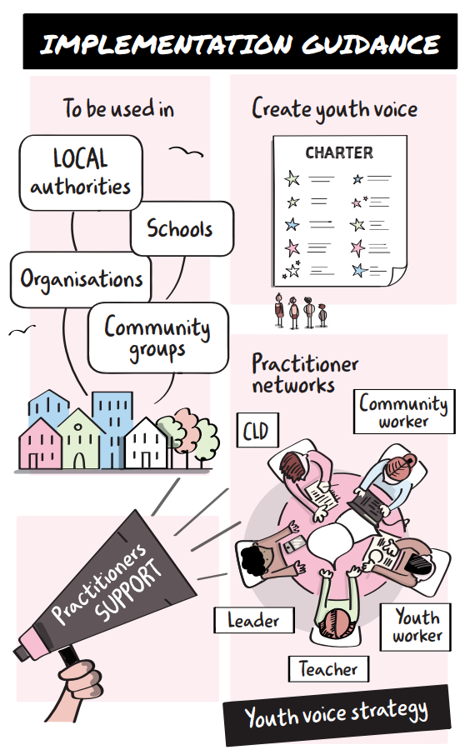
Implementation Guidance
This guidance contains directions for implementing the youth voice toolkit, it includes:
Securing leadership support
Creating a youth voice charter
Facilitator guidance for resource pack
Developing Practitioner Networks
Key considerations in using the toolkit
Notes:
Share
The guidance is designed to present a step by step process for those leading on youth voice to implement this toolkit within their setting. It discusses all the parts which are required to make this successful and how to ensure they are done effectively.
Guidance for some settings is different to others however the main parts are overall the same.

Slide 6
Implementation Guidance
The implementation guidance details one of the most vital steps – the creation of a Youth Voice Charter.
The Charter gives practitioners a clear set of principles to follow when consulting with children and young people.
The Charter only needs to be created once, however it can be refreshed over time.
Notes:
Share
Special mention is given to the development of a youth voice charter as part of the guidance. It is essential before any work is conducted in regards to the youth voice approach within the toolkit.
This slide shows an example of page 1 of the Forth Valley and West Lothian youth voice charter which was developed using a regional youth voice approach

Slide 7
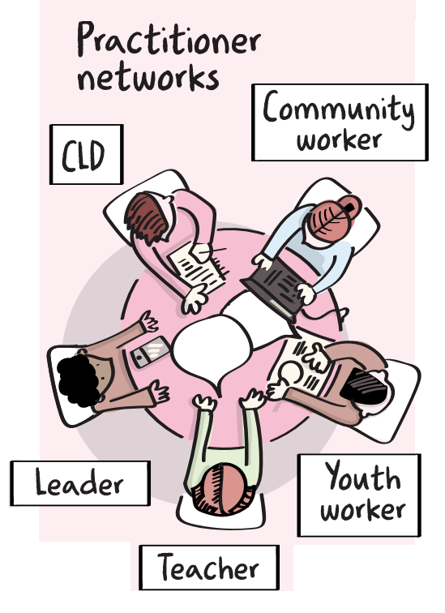
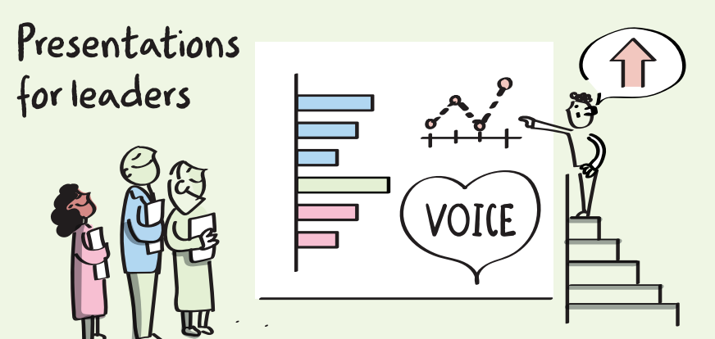
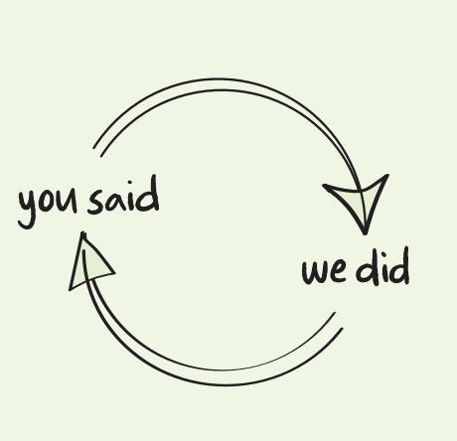
Support Materials
Includes a range of different checklists, presentations and glossaries to help practitioners understand and share the youth voice toolkit.
Notes:
Share
The second part of the toolkit is additional supporting materials which can be used by practitioners to support implementation. This presentation is one of the supporting materials however it also contains:
Quick guides
Checklists
Network guidance
Glossary
FAQs
This section is not limited to these resources and will grow as the toolkit is utilised.

Slide 8
Empowering Youth Voice Resource
The resource can be used by practitioners who support youth voice structures. It allows them to upskill groups of children and young people so they can consult their peers on any theme or issue.
What are youth voice structures? Why are they so important?
This is detailed in the next slides…
Notes:
Share
The empowering youth voices resource pack is a key resource that is used with youth voice structures to help them shift their approach to be one of peer research and representation.
It is a programme of activities which a key practitioner delivers with a particular group of children and young people, allowing them to be upskilled in the methods within the toolkit. The sections are seen on the image above.
Crucially, when children and young people are trained within this resource pack they have the skills to consult their peers on any issues/theme and present the findings in a clear manner.

Slide 9
Youth Voice Structures
A Youth Voice Structure
What do youth voice structures normally look like?
Youth Forums
Pupil Councils
Ambassadors
Thematic Groups
Members of Scottish Youth Parliament (MSYP’s)
Key Staff
Notes:
Share
Read slide contents
Youth voice structures are usually established groups that exists in schools or communities with typical names or common thematic focus areas

Slide 10
Youth Voice Structures
Who is in Youth Voice Structures?
Group of Children/Young People
Involvement based on interest or selection
Consulted on their views and opinions
They help in creating ideas
Who are the staff who support them?
Youth workers, teachers etc
A facilitator of participation for voice
An advocate for the children and young people involved
Notes:
Share
Youth voice structures are normally a group of children and young people who are there by choice and wish to be involved in some sort of democratic of decision making process. They are consulted on their views around a range of different topics and often lead on activities designed to benefit their peers
They structures are supported by a lead practitioner normally. They often create the space for the children and young people to participate while also acting as a champion for the ambitions of the group.

Slide 11
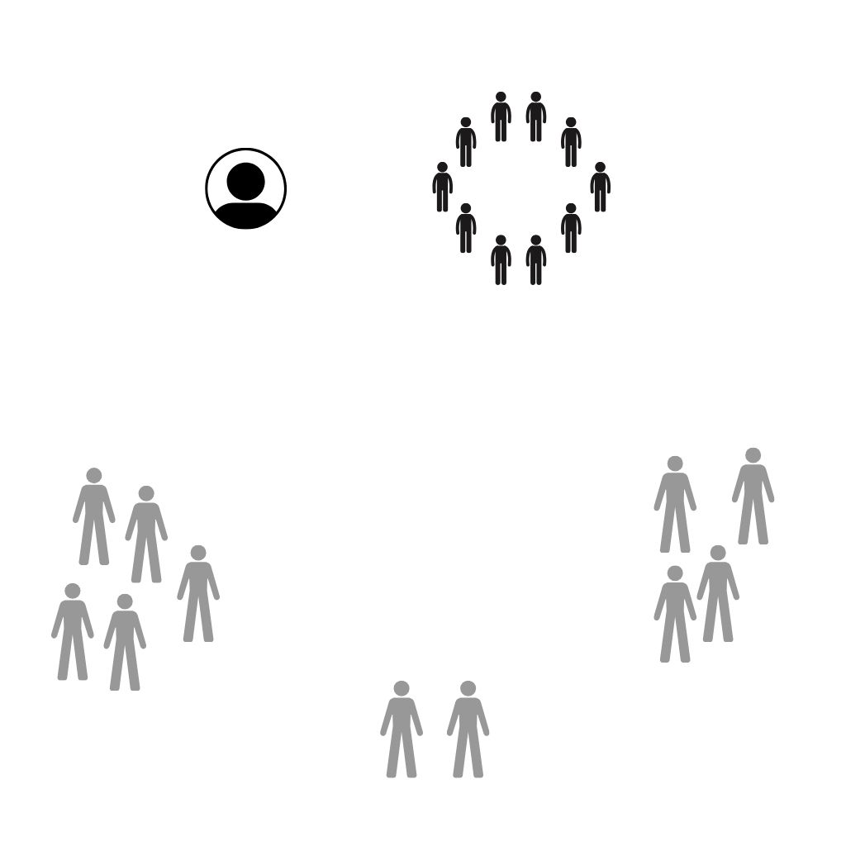
Who is represented?
Those involved in a Youth Voice Structure
Key Staff
In these structures which voices are informing change?
Do they truly represent “all children and young people?”
Those not involved in a Youth Voice Structure
Notes:
Share
Unfortunately, in many youth voice structures the voice of children and young people who aren’t involved in the group isn’t heard or sought out.
This means that often these structures are not fully representative.

Slide 12
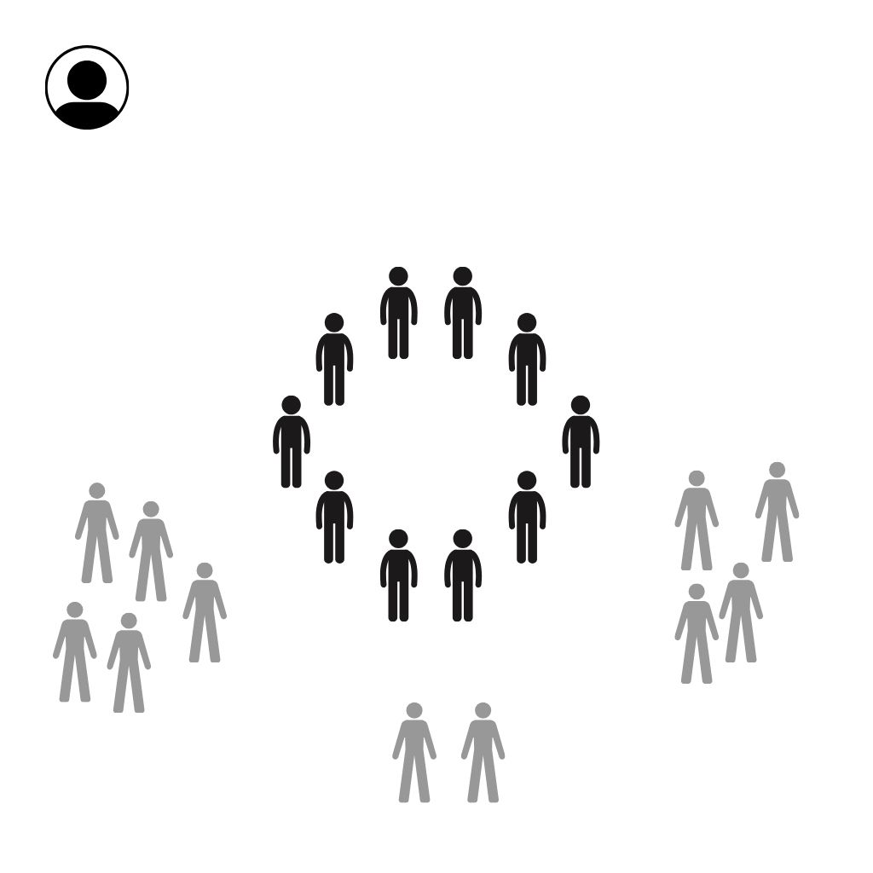
Representation
Time? Personal opinions? Confidence? Purpose? Action? Frustration?
It is important to consider the make-up of youth voice structures and the potential challenges that they pose.
No change? Don’t understand? Rushed? Purpose? Don’t know what's being asked?
Do I have a voice?
Does it matter?
I don’t know where to go?
Where does my idea go? No one explains it to me?
Notes:
Share
Many challenges exist with this model including the numerous statements detailed in this slide. This creates a core issue with youth voice that those who are often consulted don’t represent the views of their wider peer group, resulting in a narrow perspective. This is further compounded by risks around:
Consultations being rushed
Children and young people not fully understanding what they are being consulted on
No feedback loop on action taken
Poor questions being asked and evidence being gathered
Read some of the floating quotes

Slide 13
A new way of facilitating genuine youth voice
With this could we…
Create an approach that allows more children and young people opportunities to have their views heard?
Create consistency between methods used within schools, groups, communities, organisations etc?
Make simple guidelines and resources that are easy to use?
Allow practitioners around this theme to learn from each other and provide support?
Notes:
Share
With a national youth voice toolkit there is hope for a new way of facilitating youth voice which aims to address the above questions

Slide 14
How the Youth Voice Toolkit changes the status quo and creates effective practice
Notes:
Share
By using the youth voice toolkit it looks to change the way youth voice is conducted across the country to make it more representative

Slide 15
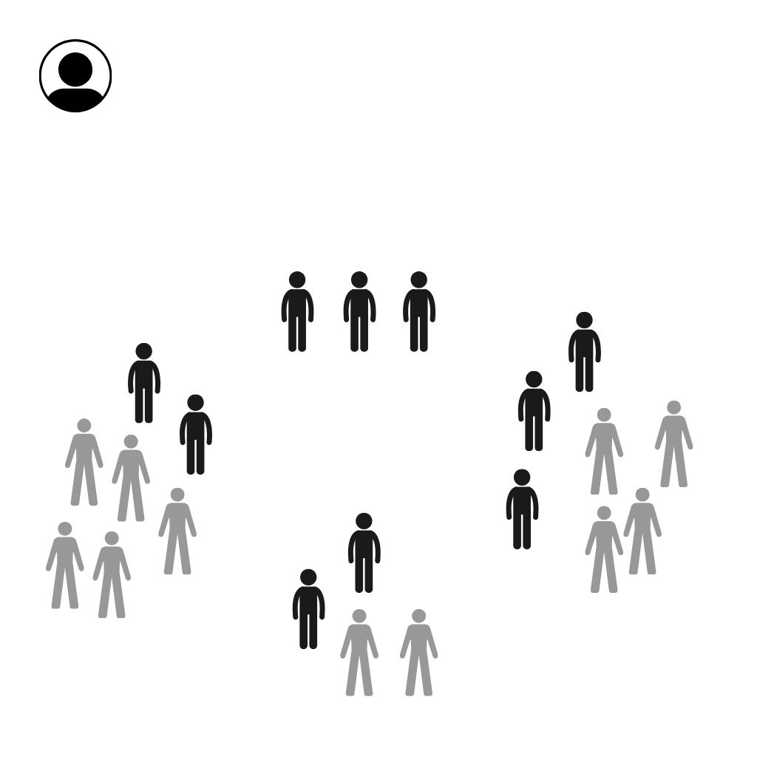
Peer Representation In this model practitioners are guided by the charter and deliver the contents of the resource pack to their groups
Practitioners guided by a Youth Voice Charter
Children and young people who are empowered by practitioners that have delivered the Empowering Youth Voices resource pack to them, allowing them to consult their peers
Notes:
Share
Within the implementation of the toolkit we would now have the following elements
Key staff who support youth voice structures would be guided by a youth voice charter to ensure the approach they are taking is meaningful and non-tokenistic
Staff also have a resource that they can utilise with their youth voice structures that gives them the skills, knowledge and motivation to consult their peers

Slide 16
All views captured
Children and Young People asking the questions on different themes, gathering the views and analysing findings. This means the views on an issue are more representative
Notes:
Share
With this new approach the views of a wider group of children and young people are captured around themes that are important to them.
It also ensure that the questions being asked are designed by children and young people so that they make sense to their peers on a given theme
With a wider range of views it means that consultation on a particular theme is now more accurate and less selective

Slide 17
Research Informed
Children and Young People who have researched a theme fully, consulted a wide range of their peers and can present it those who make decisions
Notes:
Share
With a wider range of views a more robust set of data and evidence is gathered.
This means children and young people can better advocate on what is important to them and that those that make decisions can make more informed decisions

Slide 18
The Change Made..
By adopting the Youth Voice Toolkit children and young people in different settings:
Feel like their views are heard
Understand topics, themes and issues that affect them
Can research information and present it to decision makers
See the action taken because of consultation and evidence gathering
Influence change
Notes:
Share
The above items are achieved however the staff who support youth voice structures should now also feel a greater sense of confidence on how to consult children and young people in a more meaningful and non-tokenistic way
Read through bullet points if appropriate

Slide 19
What now?
Now the Youth Voice Toolkit is understood it becomes the responsibility of practitioners who lead on youth voice and participation to implement it with leadership support
Education Scotland recommends at this point leader(s) endorse the toolkits use so this implementation process can begin in an individual setting
*For a multi setting environment the remaining slides must be shown
Notes:
Note
At this point you are looking to achieve leadership buy in to implement the youth voice toolkit in your setting.
If you are planning to do this across a multitude of settings continue to show the remaining slides.

Slide 20
Multi setting/Wider Implementation

Slide 21
Implementation beyond an individual setting
The information ahead details additional steps required if the toolkit is being implemented beyond an individual setting. This would apply to if the toolkit is being implemented:
Across an entire local authority
Across a cluster area
Across an organisation with sub structures
Across multiple communities
If it is only being implemented in one setting, please disregard the forthcoming slides
Notes:
Share
Read out the contents of the slide
Confirm that this presentation will help the adoption of the Youth Voice Toolkit beyond just one setting

Slide 22
Connections and Consistency
The toolkit is designed to be a cultural shift in how practitioners approach youth voice.
Multiple establishments should be encouraged to adopt the toolkit allowing for greater cohesion.
If key staff are connected and using this approach it creates a more impactful approach and better alignment.
Notes:
Share
The toolkit applied across multiple settings provides an opportunity for key staff who have responsibility over facilitating youth voice structures to connect.
The benefits of this are detailed in future slides however the responsibility of creating this “network” should fall to practitioners who have a leadership role in youth participation across an organisation or local authority.

Slide 23
Practitioner Makeup and Connections
We know staff who support youth voice are from a range of different backgrounds and sectors
Notes:
Share
Many staff from different places facilitate youth voice structures

Slide 24
Silo working
Often these staff work separately from their youth voice colleagues, focusing solely on topics within their setting and using different approaches
Notes:
Share
With staff working separately it means the youth voice for a given setting can be fragmented as different approaches may be used.

Slide 25
Connections
The youth voice toolkit encourages staff to be brought together through multi setting youth voice networks.
This ensures consistency of approach and means that practitioners can support one another.
Notes:
Share
Although the youth voice toolkit encourages this approach it is not required to allow the toolkit to be used in individual settings
Creating a youth voice network would be the responsibility of key lead practitioners within education and community contexts, details for this can be found in the “Creating of a Youth Voice Network” support material

Slide 26
Culture of non-tokenistic approaches
With multiple staff using the toolkit it means they would all use a charter to inform principles, the resource pack to upskill children and young people to consult their peers and the implementation guidance to follow a set process for different settings.
Notes:
Share
Connecting these practitioners creates the foundations for a stronger culture around youth voice

Slide 27
The difference made
If staff who support youth voice and participation connect and collaborate, it means children & young people have a stronger platform to share their views on key themes.
Notes:
Share
Beyond consistency it also means better collaboration
Settings can work together to consult children and young people on a common theme. This would mean an abundance of views and evidence on this theme with greater chance for larger scale change.

Slide 28
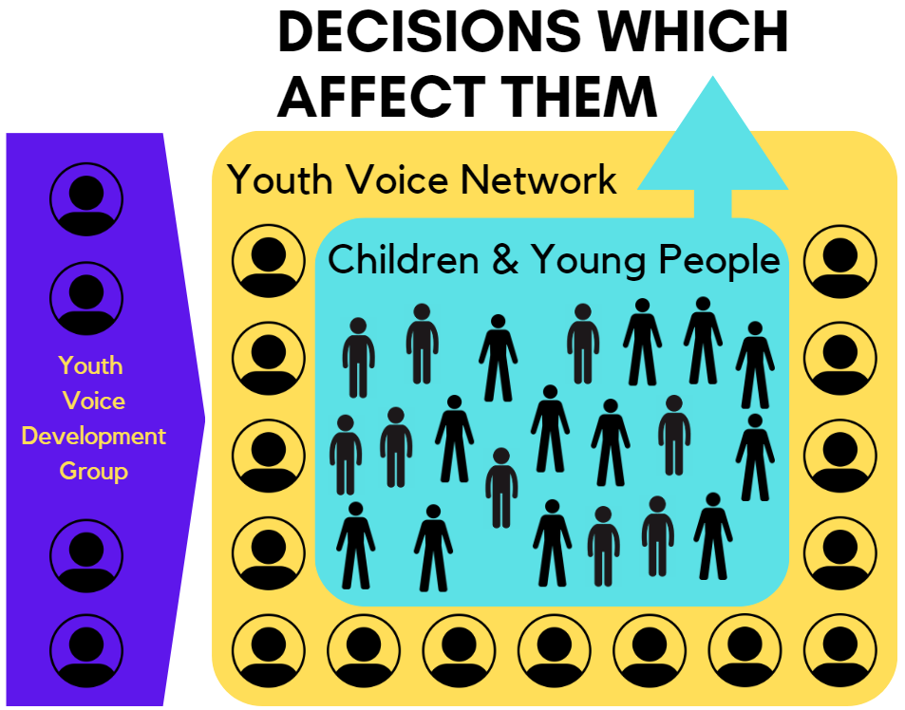
Support given
This network will be given support and direction from lead practitioners in each authority within the youth voice development group
Notes:
Share
To support a youth voice network it is recommended that a multi setting development group is established. This should be comprised of practitioners across settings/local authority/sectors/organisations who lead on youth voice and participation. It should be a small strategic group to facilitate linkage, support and collaboration

Slide 29
What now for across settings?
All key staff who work in youth voice structures should be part of an multi setting practitioners youth voice network
A strategic youth voice development group should be created to facilitate this network and support consistent use of the toolkit
Practitioner involved in this development group should identify and contact practitioners in different settings who are using the toolkit and encourages others to begin to implement it
Notes:
Share
At this stage you are looking to achieve leadership buy in to take forward the implementation of the toolkit across multi settings.
This crucially involves the creation of a multi setting youth voice network and to connect with teachers, youth workers, practitioners etc who lead on youth voice in these settings.

