Slide 1
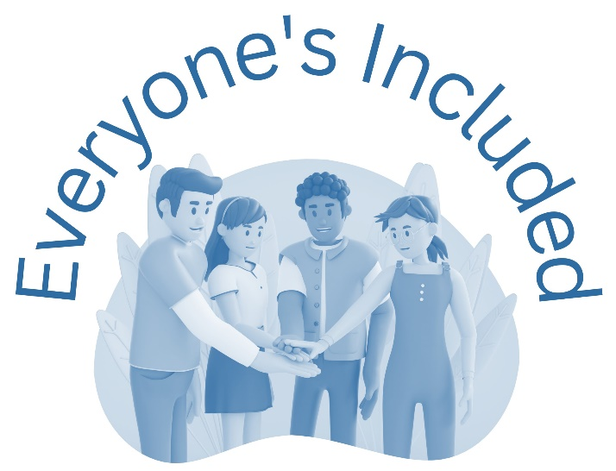
GROUP CHAT

Slide 2
Learning Intentions
To explore the impact of making hurtful/nasty comments about someone online
To consider the role of bystanders and ways in which bystanders can intervene
Success Criteria
I can describe how people might feel when they read comments or messages which are nasty or hurtful
I can discuss some options that I could take to be an active bystander when I see someone making nasty comments online

Slide 3
GROUP CHAT
You are part of a group chat with friends from school. Someone in the group starts to make fun of another friend. Their comments are really nasty. Some of the others are laughing and making similar remarks. Your friend doesn’t respond although you can see that they have read the comments.
Notes:
Scenario

Slide 4
TRAIN OF THOUGHT
Why are they doing this? … I feel bad about what is happening … Why isn’t anyone challenging it? We’re all meant to be friends ... And why didn’t my friend respond? … Is it my place to get involved? … If I say something will I be next? … But I feel really uncomfortable when I see someone treated like this … Is this any of my business? …
What should I do?
Notes:
Train of Thought

Slide 5
Insulting a person online isn’t as bad as doing it to their face
AGREE --- UNSURE --- DISAGREE
Notes:
ADU

Slide 6
GROUP CHAT - DISCUSSION
You are part of a group chat with friends from school. Someone in the group starts to make fun of another friend. Their comments are really nasty. Some of the others are laughing and making similar remarks. Your friend doesn’t respond although you can see that they have read the comments.
Notes:
Scenario discussion

Slide 7
OPTIONS
1. Do nothing. It’s none of your business.
2. Try to change the subject in the group chat.
3. Remove yourself from the group and contact your friend to let them know you don’t agree with what was being said.
4. Post on the chat that you think what they’re saying and doing is wrong.
5. Outwith the group chat, speak to some of your friends who didn’t comment, and ask whether they think what’s happening is fair. Discuss together what you should do.
6. Talk about your concerns with a parent/carer or a teacher/adult you trust and ask their advice on what to do.
7. Personal Option.
Notes:
OPTIONS

Slide 8
CONCLUSION
Being abusive to someone else whether online or face to face is not right and is hurtful.
There are many reasons why a person might choose to be abusive. Whatever the reason given, there is never an excuse to do this.
A person who is being abused can be impacted in a variety of ways that will be harmful to their mental and physical health.
There are a number of options we can choose from to challenge behaviour when we don’t agree with it.
We have a responsibility to help our friends and keep ourselves safe

Slide 9
WHERE CAN I GET SUPPORT?
Pastoral Care/guidance/pupil support staff
Childline 0800 1111 https://www.childline.org.uk/get-support/
Respect Me https://respectme.org.uk/
Young Minds https://youngminds.org.uk/find-help/feelings-and-symptoms/bullying/
Local organisations to be included
Notes:
supports

