Slide 1


‘Ask Us, Hear Us, Include Us!’
A film by the Young Ambassadors for Inclusion

Slide 2



This professional learning resource has been developed based on the work of the Young Ambassadors for Inclusion to help raise awareness and support opportunities to improve inclusion in our school communities.

Slide 3
Aim of this session
We will use the film and accompanying resources to:
Understand the views of the Young Ambassadors about what is working and what could be improved in relation to Inclusion
Consider how we currently seek the views of young people with additional support needs in this school
Explore ways that we can make our school more inclusive
Notes:
This resource can be used as stimulus for a short awareness raising session or it can be the springboard to support reflection on practice, identify areas of improvement and agree actions which will deliver this improvement.

Slide 4
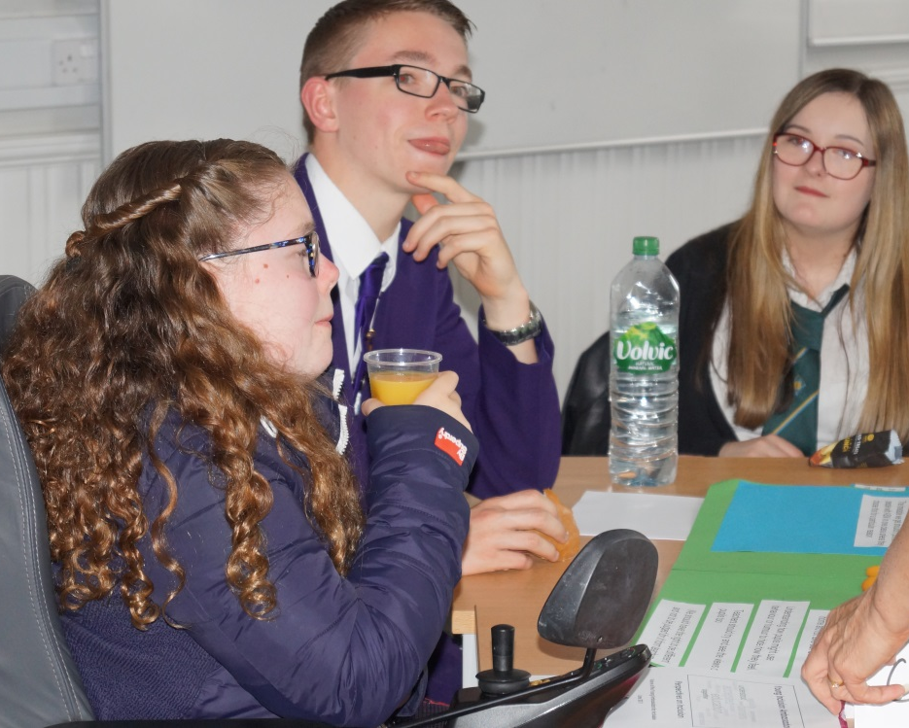
Who are the Young Ambassadors for Inclusion?
We are a group of young people with additional support needs who have been invited by our local authorities to work with Education Scotland, Scottish Government and Enquire to share our views and experiences of inclusion. We work together to:
Consider ways to develop and support inclusive education in Scotland
Provide support for each other
Reduce the stigma of additional support needs
Notes:
The Young Ambassadors for Inclusion are young people with additional support needs who have been nominated by their local authority to join a network which provides an opportunity for them to share their views and experiences of Scottish education. Twenty-six local authorities have been represented since the network began in 2015.
Through discussion and activities the Young Ambassadors have identified the ways they feel schools are doing well in their provision of inclusive education and also where improvements could be made. They have shared their ideas with the Deputy First Minister on a visit to Parliament.
The network is funded by Scottish Government and supported by staff from Education Scotland and Enquire.

Slide 5
Our Themes
These are the recurring themes that have featured in our work which we feel are important in relation to inclusion.
Friendship and belonging
Support
Awareness
Asking for
help
Positive attitudes
Notes:
Following a number of activities over time a number of recurring themes emerged which the Young Ambassadors felt were important in relation to inclusion. Some of their thoughts on these themes are included in Appendix 3- 7 of the Professional Learning Resource.

Slide 6
The Inclusion Pledge
We have developed an Inclusion Pledge which can be used as a reflective tool supporting schools to improve inclusion and experiences for all learners
Our school community aims to be inclusive.
We respect and welcome all those within it ensuring they feel safe and are treated with dignity and equality.
Notes:
The Young Ambassadors devised a pledge . They hope that many schools will sign up to this pledge and work towards creating a fully inclusive environment that will benefit all learners.

Slide 7

General Teaching Council for Scotland Professional Standards
Social Justice
1.1.2 I am committed to the principles of democracy and social justice through fair, transparent, inclusive and sustainable policies and practices in relation to: age, disability, gender and gender identity, race, ethnicity, religion and belief and sexual orientation
Trust and Respect
1.3.3 I demonstrate a commitment to motivating and inspiring learners, acknowledging their social and economic context, individuality and specific learning needs and taking into consideration barriers to learning
Notes:
The General Teaching Council of Scotland (GTCS) has developed standards that are required of all registered teachers and a set of professional values. These values include a professional commitment to social justice (see above exemplar) and to trust and respect (see above) including a commitment to taking the individual need of the child or young person into account.
The reflective log in Appendix 8 can be used to record your reflections and can contribute towards your folio for evidence for the GTCS Professional Update.

Slide 8
Activity 1
Imagine that one month ago you moved to a new place of work and took on a new role. You feel included in your new workplace. What has happened that has helped you to feel included?
Share ideas with the group on a flipchart (5 minutes)
Read the descriptions the young people gave about what inclusion means to them (Appendix 1)
Discuss:
What are the similarities to your list?
What is unique to the young people? (5 minutes)
Notes:
Aim of the activity:
To encourage participants to identify what helps them to feel included
To understand what helps/hinders young people with additional support needs to feel included

Slide 9

‘Ask Us, Hear Us, Include Us!’
Click here for the film
Notes:
What was the purpose of the film?
Keen to share their views on what works in inclusion, the Young Ambassadors decided to create a film which could allow their views to be heard and could help staff know how to support young people with additional support needs.

Slide 10
Activity 2
Discuss with a partner
Your first thoughts about what you have heard (5 minutes)
Discuss in the group
  How do we currently seek the views of young people with additional support needs in this school? (5 minutes)
Notes:
Aim of Activity 2
To identify the key message participants have taken from the film
To consider how young people with ASN are currently consulted
The Young Ambassadors are keen to stress that young people with additional support needs are individuals and it is important to avoid making assumptions about what will work.
Appendix 2 gives suggestions for ways in which the views of young people can be obtained. Both Children in Scotland (see https://childreninscotland.org.uk/wp-content/uploads/2017/11/Principles-and-Guidelines-FINAL.pdf) and Education Scotland ( forthcoming on Improvement Hub) have developed participation resources. The Children Commissioner’s website suggests a list of key principles for participation which they have named ‘The Golden Rules of Participation’ https://www.cypcs.org.uk/education/golden-rules

Slide 11
Activity 3
Choose one of the following themes identified by the Young Ambassadors and explore it further:
Friendship and belonging
Positive attitudes
Awareness of Additional Support Needs
Asking for help
Support
Notes:
Appendix 3- 7 gives details of all five themes which have emerged during dialogue with the Young Ambassadors. The staff are asked to choose one theme to explore further: other themes can be explored if there is more time or if a follow up is arranged.

Slide 12
Friendship and belonging
Read the views of the Young Ambassadors in Appendix 3
In trios: On a scale from 0 to 10 draw an X where you feel your school is currently in relation to this area
Supporting friendship and belonging for learners with Additional Support needs
What is happening at present that lets you give your school this score?
Imagine that you have moved one point up the scale. Discuss:
What would the learner see happening that lets them know that things have improved?
How will other staff know … what will they see that is different? What else?
What will you be doing differently or be doing more of?

Slide 13
Positive Attitudes
Read the views of the Young Ambassadors in Appendix 4
In trios: On a scale from 0 to 10 draw an X where you feel your school is currently in relation to this area
Staff and pupils show positive attitudes towards learners with additional support needs
What is happening at present that lets you give your school this score?
Imagine that you have moved one point up the scale. Discuss:
What would the learner see happening that lets them know that things have improved?
How will other staff know … what will they see that is different? What else?
What will you be doing differently or be doing more of?

Slide 14
Awareness of Additional Support Needs
Read the views of the Young Ambassadors in Appendix 5
In trios: On a scale from 0 to 10 draw an X where you feel your school is currently in relation to this area
We develop awareness of additional support needs amongst all staff and peers
What is happening at present that lets you give your school this score?
Imagine that you have moved one point up the scale. Discuss:
What would the learner see happening that lets them know that things have improved?
How will other staff know … what will they see that is different? What else?
What will you be doing differently or be doing more of?

Slide 15
Asking for Help
Read the views of the Young Ambassadors in Appendix 6
In trios: On a scale from 0 to 10 draw an X where you feel your school is currently in relation to this area
We create a climate in which learners with additional support needs are comfortable asking for help
What is happening at present that lets you give your school this score?
Imagine that you have moved one point up the scale. Discuss:
What would the learner see happening that lets them know that things have improved?
How will other staff know … what will they see that is different? What else?
What will you be doing differently or be doing more of?

Slide 16
Support
Read the views of the Young Ambassadors in Appendix 7
In trios: On a scale from 0 to 10 draw an X where you feel your school is currently in relation to this area
We individualise support and empower learners with Additional Support needs
What is happening at present that lets you give your school this score?
Imagine that you have moved one point up the scale. Discuss:
What would the learner see happening that lets them know that things have improved?
How will other staff know … what will they see that is different? What else?
What will you be doing differently or be doing more of?

Slide 17
The Inclusion Pledge
Our school community aims to be inclusive.
We respect and welcome all those within it ensuring they feel safe and are treated with dignity and equality.
Choose one action that you can take forward to improve inclusion in your school.
Notes:
This is an internal page in green and can be duplicated to create additional pages. Always keep the heading and footer as shown. Use the corresponding green front and back pages if you are using this page.

Slide 18
Some key messages from the Young Ambassadors
Put yourselves in the shoes of learners who have additional support needs: imagine they are your child
Take time to listen to us
Don’t assume-ask
Remember we are individuals
Everyone should have equal opportunities to participate in lessons and activities
Notes:
This is an internal page in green and can be duplicated to create additional pages. Always keep the heading and footer as shown. Use the corresponding green front and back pages if you are using this page.

Slide 19
The Inclusion Pledge
Our school community aims to be inclusive.
We respect and welcome all those within it ensuring they feel safe and are treated with dignity and equality.
Choose one action that you can take forward to improve inclusion in your school.
Notes:
This is an internal page in green and can be duplicated to create additional pages. Always keep the heading and footer as shown. Use the corresponding green front and back pages if you are using this page.

Slide 20
Education Scotland
Denholm House
Almondvale Business Park
Almondvale Way
Livingston EH54 6GA
T +44 (0)131 244 5000
E enquiries@educationscotland.gsi.gov.uk
Notes:
This is a back cover page in green. You may edit the address if needed only. It can only be once and at the end of the PowerPoint presentation. Use the corresponding green front and internal pages if you are using this page.

