Slide 1


Introduction to Enquiry in Education
Notes:
All information is correct as of May 2024
These slides are intended to support senior leaders, middle leaders and practitioners in schools and local authorities to explore Practitioner enquiry.
You might also want to consider planning follow up sessions to check in/support those engaged in practitioner enquiry and an opportunity to share learning from enquiries undertaken throughout the year.
This workshop links to the new Enquiry in Education Open Access Professional Learning resource: LINK
The PowerPoint is a template that presenters can adapt to suit their own context and style of presenting.
This workshop has been designed for facilitators to deliver in 1 to 2 hours.
Suggested timings can be found on the content coverage slide 6.
Within the slide notes key messages, suggested tasks, ‘talking-points’ and reflective questions are included.
It is anticipated the presenter will be familiar with Enquiry in Education Open Access Professional Learning resource and/or practitioner enquiry.

Slide 2
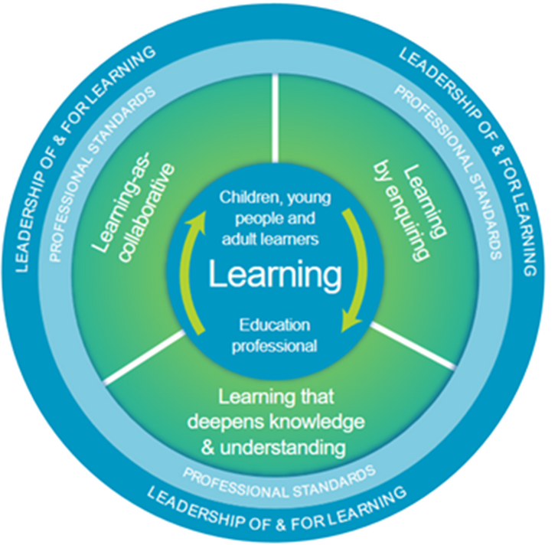

National Model of Professional Learning
“Anything that furthers your practice, courses, conversations and how you’re supported. The most reflective is what makes the most change, but you need the opportunity to affect change. It’s not just a course it’s the environment you’re in.”
“Learning undertaken to develop your practice, should be pupil led and needs driven”
“It’s all the things that build confidence, new things you’d not thought of that widen your horizons. It’s about what makes us better practitioners.”
The national model of professional learning | Education Scotland
The quotes you are reading come from practitioners across Scotland who reflected on "What is Professional Learning?"
Notes:
Key Messages:
This module has been designed using the national model of professional learning and the principles of adult learning or andragogy. It has been designed to think about:
The why – opportunities for participants to understand the rationale through professional standards, research, current policy landscape and national/local priorities.
The what – opportunities for participants to consolidate and develop relevant knowledge and skills
The how – opportunities for participants to take part in peer discussion, explore case studies or share experiences
Apply – a chance to reflect on learning, next steps and further support
A link to further information about the national model of professional learning can be found below.
https://education.gov.scot/professional-learning/the-national-model-of-professional-learning/
Talking Points:
The quotes you are reading come from practitioners across Scotland who reflected on "What is Professional Learning?“
Reflective Question:
What resonates with you and why?

Slide 3

Ways of working together
We all work together
We learn from, with and on behalf of each other
We create a safe space to share ideas and build learning
We agree that everyone is an equal and valued participant
We remain ‘in the room’ (follow email and phone protocol)
Notes:
Key Messages
Take a moment to establish group protocols.
Ask participants to comment on anything they would like to add or amend.
Is there anything that participants feel is missing or anything they would like to remove?
The protocols on the slide are suggestions to be amended for your context.
- Why establish group protocols
Effective professional learning goes beyond simply delivering information. It fosters a learning community where educators can learn with, from, and on behalf of one another. To achieve this, the facilitator of this learning should establish clear protocols and a positive learning environment at the outset. The general notes below will support the facilitator to help everyone feel comfortable participating and contribute to a rich learning experience.
1. Contract a Safe Space:
Co-create a Safe Space agreement with your group. This agreement outlines expectations for respectful communication and active listening. A safe space allows trust to flourish, fostering a collaborative environment where everyone feels comfortable sharing ideas and taking risks.
2. Shift from Top-Down to Collaborative Learning:
Move beyond the traditional model where one person imparts knowledge. Embrace a collaborative approach where all participants actively engage. This means learning with, from, and on behalf of one another. By leveraging the diverse perspectives within the group, gaining a richer understanding and creating a more impactful learning experience for everyone.
3. Holding the Ladder: Shared Expertise and Recognition
Holding the ladder signifies a two-fold approach:
Sharing Expertise: Those with experience can share their knowledge and insights.
Recognize Everyone's Contribution: Actively listen and be open to learning from the unique perspectives and experiences of colleagues. Build on each other's ideas to foster a collaborative environment where everyone feels valued, and their contributions are respected.
4. Hold Space for Silence and Respectful Discussion:
Hold space for silence after someone speaks or asks a question. It can be tempting to jump in to fill silence but allowing time for quiet can avoid interrupting thought and produce more thoughtful responses. Everyone deserves to be heard and understood.
Adapt the time allocation based on the size of the group and the complexity of the topic.
5. Schedule Regular Breaks:
Schedule regular breaks throughout the session. This allows participants to process information, refocus, and return with renewed energy, leading to a more productive learning experience.
6. Centre Learning in Real Life:
Connect the learning to real-life experiences by encouraging participants to share relevant personal anecdotes or applications. This strengthens understanding and makes the learning more relatable and impactful for all.

Slide 4

Connector
In groups or pairs:
Choose one of the following big questions to discuss:
How is your professional learning informed by learners' experience, voice and needs?
What interests, informs and influences you?
What have you read that has stuck with you?
Notes:
Connector - Exploring our Professional Learning Why
Key Messages:
This is an example of a simple connecter activity.
It is recommended that facilitators use a connector activity that allows participants to take part in an informal discussion.
This is to ensure that participants are relaxed, focused and ready for an interactive workshop.

Slide 5

Session Aims
In this workshop we will consider:
  why we enquire and reflect on our professional why
  what enquiry is and consider examples of enquiry
  how we enquire and look at professional learning resources that support the process
  our own ideas, areas of focus or enquiry questions
Notes:
Key Messages​
​
This slide shows the aims of the session to be shared with participants.

Slide 6
Content Coverage
Reflecting on our professional why
Connecting with our Professional Standards and the National model of professional learning
Building a Culture of Enquiry
Practitioner Enquiry – why, what and how
Examples of Enquiry in Action
Next steps
Notes:
Key Messages
This slide shows the content covered throughout the workshop. Further details and suggested timings are provided below. Facilitators can amend content and timings to suit their needs and context.
​Reflecting on our professional why - Allow up to 20 mins for this section. It can be extended to 30 mins if facilitators wish to provide extra time for reflection.
Connecting with our Professional Standards and the National model of professional learning – Allow up to 20 mins for this section.
Practitioner Enquiry – why, what and how – Allow between 40-60 mins for this section.
Building a Culture of Enquiry – This section may be of most relevance to those leading professional learning in their setting. Allow up to 10 mins for this section. It can be extended to 20 mins if facilitators wish to provide extra time for discussion.
Examples of Enquiry in Action – Slides 28,29 and 30 are optional to show examples. Allow 5 mins for this section. It will extend up to 15 mins if you wish to review examples with participants.
Next steps – Allow 5 mins for this section
In total, this workshop can be expected to take between 1 hour 40 mins and 2 hours 30 mins depending on tasks chosen and time allocated.

Slide 7
Reflecting on our professional why
Introduction to Enquiry in Education

Slide 8

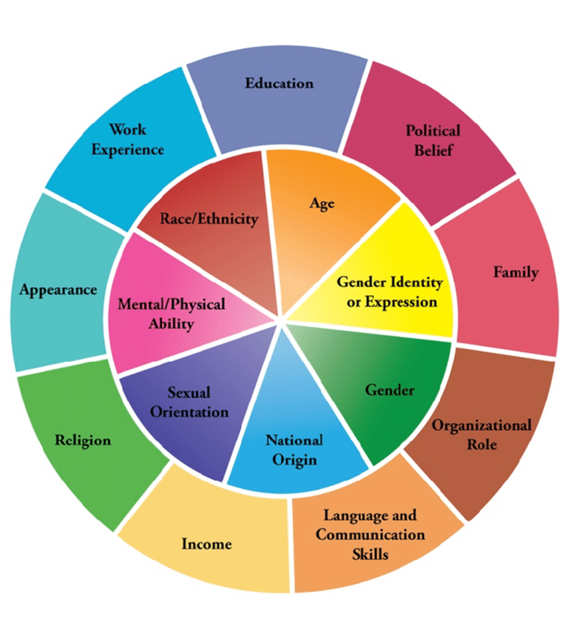
Who am I as an Educator?
TASK
Look at this social identity wheel and reflect on the following:
  Your own social identities that have the strongest effect on how you perceive yourself as an educator
  Identities that have the strongest effect on how you perceive the people you work with including learners
  Social Identities you feel you don’t understand as much and would like to learn more about
  Identities that influence your professional learning interests
  You might also consider how others perceive you!
Notes:
This section connects to the Enquiry in Education resource – Plan
Here you will find resources to help you reflect on your why, to consider the purpose of enquiry and start developing an enquiry question.
Key Messages:
Researchers have found that some educators have an identity-practice gap whereby they mask parts of their identity/ wear different identity hats for different audiences.
Clearly, we have valid reasons for choosing to do this however, in the long run, this inability to be authentically yourself can be detrimental to our wellbeing and career longevity.
Our experiences in life also influence the messages we take from our professional reading as we bring our prior thinking and biases with us.
Link to research: Understanding teacher identity in teachers' professional lives: A systematic review of the literature by Elizabeth A. C. Rushton, Emma Rawlings Smith, Sarah Steadman, Emma Towers
https://bera-journals.onlinelibrary.wiley.com/doi/epdf/10.1002/rev3.3417
Talking Points:
This question is more complex than you first anticipate. Why we do what we do as educators, the way that we do this, why we are interested in enquiring into our practice and how we go about doing these things comes from who we are as people.
This is also important when we think that our role is all about our interactions and relationships with others.
Researchers have found that some educators have an identity-practice gap whereby they mask parts of their identity/ wear different identity hats for different audiences.
Clearly, we have valid reasons for choosing to do this however, in the long run, this inability to be authentically yourself can be detrimental to our wellbeing and career longevity.
Our experiences in life also influence the messages we take from our professional reading as we bring our prior thinking and biases with us.
Task (10 mins):
Reflective Questions (on slide) - it would be helpful to suggest reflecting on these individually/using a reflective journal.

Slide 9

What is leadership?
TASK
Notes:
Key Messages:
Leadership is often equated with a specific job role, however when we consider the actions and ways of being a leaders, we will see that within ourselves and within our learners.
Leading learning, leading change are actions that we all take. Practitioner enquiry supports us with these actions as it encourages us to reflect on our practice/what we observe in our settings and take actions based on those reflections.
Reflective Questions:
Think about one person within education who has influenced your thinking and how you act?
What is it about them that made a difference to you?
Was it their position or their actions?
Task (5-10 mins):
As a group create your definition of leadership and/or describe some leadership actions/ways of being

Slide 10
What does research say about educator leadership?
Distributed leadership practice is fundamentally about capacity building rather than control, it relies on the mobilisation of others to lead through collective engagement and action. (Azorin, 2020.)
Distributed leadership moves attention away from the actions of individual leaders to their interactions with others, resulting in joint activity and joint practice (Harris & Jones, 2020)
These descriptions of leadership as a collective activity, connect to research about the impact of collective teacher efficacy:
“Collective Teacher Efficacy” is more complicated than just believing you can make a difference collectively rather it is “that combined belief that it is us that causes learning”. It is reflecting on practice, taking action and collaborative conversation based on evidence of impact. (Hattie, 2017)
Notes:
Key Messages:
All these quotes make it clear that leading in schools is not the job of one person, rather all the staff and the students have a leadership role to play.
The word “leadership” can be thought by many educators as being a formal position, the senior leadership team etc
Others consider leadership as being about “leading learning "and in the national model of professional learning Leadership of and for Learning is described.
Collective teacher efficacy is the collective belief of the staff in a school/faculty in their ability to positively influence student learning. Collective teacher efficacy has been found to be strongly, positively correlated with student achievement. A school staff that believes they can collectively accomplish great things is vital for the health of a school and if they believe they can make a positive difference they very likely will (Collective Teacher Efficacy (CTE) according to John Hattie - VISIBLE LEARNING (visible-learning.org))
Talking points:
These descriptions of leadership as a collective activity, connect to research about the impact of collective teacher efficacy:
Bandura (1993, 1997) defines collective efficacy as “a group’s shared belief in the conjoint capabilities to organize and execute the courses of action required to produce given levels of attainment”.
According to Hattie “Collective Teacher Efficacy” is more complicated than just believing you can make a difference collectively rather it is “that combined belief that it is us that causes learning”. It is reflecting on practice, taking action and collaborative conversation based on evidence of impact.
Further reading:
Jenni Donohoo “Collective Efficacy: How Educators’ Beliefs Impact Student Learning“
Reflective Questions:
What strikes you about these quotes about leadership in educational settings?
What key words or phrases are you picking out from this?
E.g. Networked leadership culture, capacity building, collective engagement and action, joint activity and practice.
How might we support or even create the environment, the culture for this to flourish in our settings?
If you are a school or setting leader, you might also want to consider the following:
How do we empower staff to be leaders of learning in their own classroom/context and beyond?
What might you need to do differently to support empowerment and leadership of all staff?
What examples of practice from your own context could you share to exemplify empowerment and leadership of learning?

Slide 11

What does this mean for me?
TASK
How do my leadership actions impact on my learners?
How do my leadership actions impact on my colleagues?
How do my leadership actions impact on our community?
How do my leadership actions impact on the wider educational system?
Notes:
Key Messages:
Pause for a moment and reflect on your actions, your influence and the impact you have or could have on learners, colleagues, your community and the wider educational system.
Talking Points:
Let's think about this in the context of preparing for and planning enquiry into our practice;
Practitioner enquiry involves us questioning our own educational beliefs, assumptions, values and practices.
Through adopting an enquiring stance to challenge and inform our professional practice, we individually and collaboratively develop knowledge to enhance, progress and lead the learning experiences of all learners, including our colleagues and partners.
Optional Task (10 mins):
Reflective Questions (on slide) - it would be helpful to suggest reflecting on these individually/using a reflective journal.

Slide 12
Connecting with our Professional Standards and the National model of professional learning
Introduction to Enquiry in Education

Slide 13
Connecting with our Professional Standards
TASK
Our Professional Values:
What similarities can we hear when our professional values are described?
Are there differences?
Is there anything you feel is missing/should be made more explicit?
Our Professional Standards:
The following 3 slides have extracts from the professional standards for teachers, ELC and CLD practitioners. Choose the most relevant slides to review in groups.
What are the key messages you take from these?
How do these connect with enquiry as a practice within education?
Notes:
This section connects to the Enquiry in Education resource – Plan and Review
Here you will find resources to support you to reflect on the impact of your professional learning
Key Messages:
Let's connect this thinking with the Professional Values of educational sectors:
CLD Standards describes the Competent, critically reflective practitioner as one who ensures that their work supports social change and social justice and is based on the values of CLD.
Their approach is collaborative, anti-discriminatory and equalities-focused and they work with diverse individuals, communities of place or interest and organisations to achieve change.
They can influence or lead people, understanding when this is or is not appropriate.
Central to their practice is challenging discrimination and its consequences and working with individuals and communities to shape learning and development activities that enhance quality of life and sphere of influence.
The Standard for Childhood Practice 2015 includes a renewed and strengthened emphasis on the role of childhood practitioners in leading learning, which is vital to support children and lay the foundations for their future attainment.
Similarly, the Professional values and personal commitment section talks about practitioners valuing and demonstrating a commitment to inclusion, diversity, social justice, anti-discrimination and protecting and caring for children and young people.
It then goes into detail on valuing professional learning, relationships with parents/carers/partner organisations, pedagogy & curriculum and we start to see a golden thread connecting the sectors…
Turning to the GTCS Standards: The professional values of social justice, integrity, trust and respect and a professional commitment are at the core of the Professional Standards.
Considering Leadership; they describe this as one of the central themes within the Professional Standards and is a key aspect of teacher professionalism.
The Professional Standards place all teachers as leaders of and for learning.
Talking Points:
When we consider this in the context of the National Model for Professional Learning: Leadership of and for learning
Leaders in the widest sense understand that people are the drivers and enactors of change for improvement.
Leaders develop a learning culture and ethos based on trust, honesty, challenge and support...
Leaders have professional courage
Leaders enact collaborative and enquiring approaches to practice
Task (10 – 15 mins)
The following 3 slides have extracts from the professional standards for teachers, ELC and CLD practitioners. Choose the most relevant slides to review in groups – you could print these off.
What are the key messages you take from these?
How do these connect with enquiry as a practice within education?

Slide 14
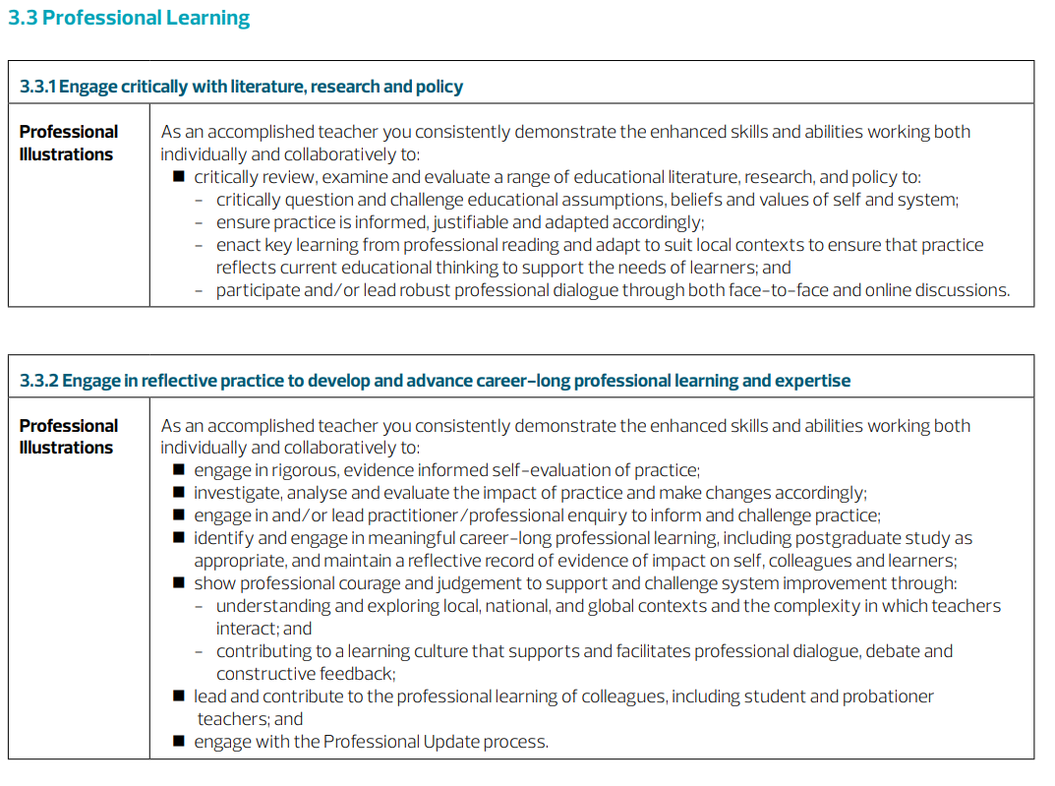
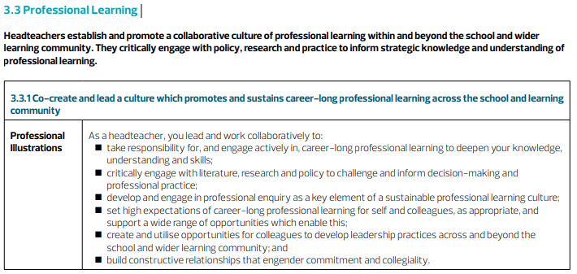
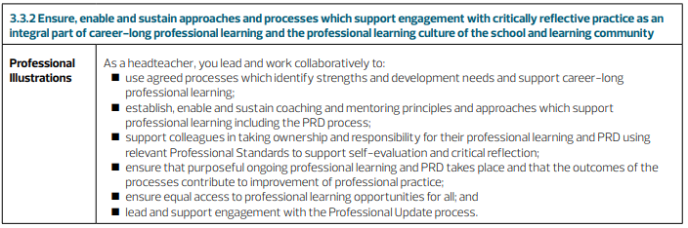
Teachers Professional Standards
GTCS Standard for Career Long Professional Learning
GTCS Standard for Headship
Notes:
Key Messages:
GTCS Professional Standards: https://www.gtcs.org.uk/professional-standards/professional-standards-for-teachers/
Supports teachers to continue to develop as accomplished, reflective and enquiring professionals
There is a focus on teacher leadership and leadership of and for learning.
All teachers are leaders of learning, who lead learning for, and with, all learners. They also work with and support the development of colleagues and other partners
Central to the Standard for Career-Long Professional Learning is the core principle of practitioner enquiry.
This involves teachers having an enquiring disposition by thinking critically and questioning their own educational beliefs, assumptions, values and practices
Standard for Headship
Acting as a leading learner to support colleagues and the learning community to enhance practice
Modelling your commitment to on-going professional learning
Set high expectations of career-long professional learning for self and colleagues, as appropriate, and support a wide range of opportunities
Develop and engage in professional enquiry as a key element of a sustainable professional learning culture

Slide 15
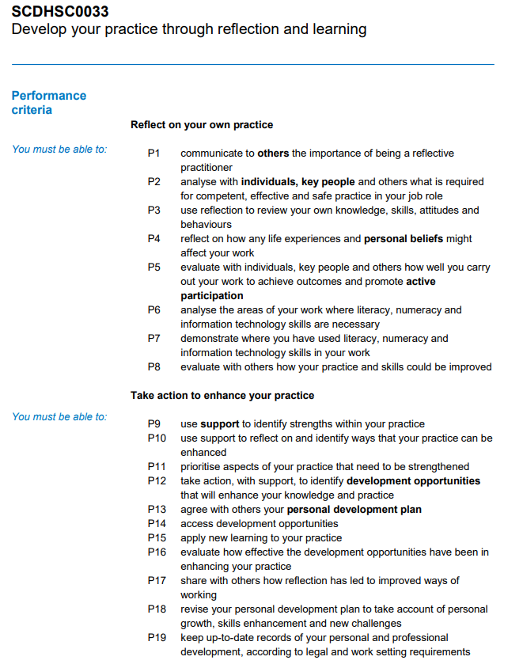
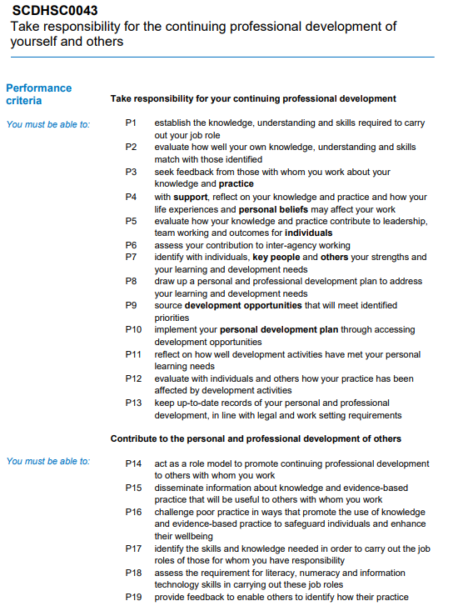
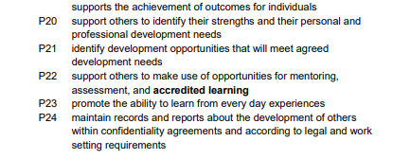
ELC Practitioners Professional Standards
SSSC NOS specific to Practitioner: pre-school services or education provision
SSSC NOS specific to Lead Practitioner/Manager: pre-school services or education provision
Notes:
Key Messages:
SSSC Professional Standards: Social Service | Children and Young People | SCQF 7 | National Occupational Standards (NOS) Navigator (sssc.uk.com) OR Social Service | Children and Young People | SCQF 9 | National Occupational Standards (NOS) Navigator (sssc.uk.com)
Extract from: Develop your practice through reflection and learning (sssc.uk.com)
Supports ELC practitioners to reflect on their own practice and to take action to enhance their practice
Specifically considers self evaluation, taking action to access learning and development and to apply this in practice and to evaluate the impact of this
Central element to share with others the importance of this, what you have learned and how this has changed how you work
Extract from: Take responsibility for the continuing professional development of yourself and others (sssc.uk.com)
Role modelling (lead learner) to support colleagues and the learning community to enhance practice
Modelling your commitment to on-going professional learning
Set high expectations of career-long professional learning for self and colleagues, as appropriate, and support a wide range of opportunities
Develop and engage in professional enquiry as a key element of a sustainable professional learning culture

Slide 16
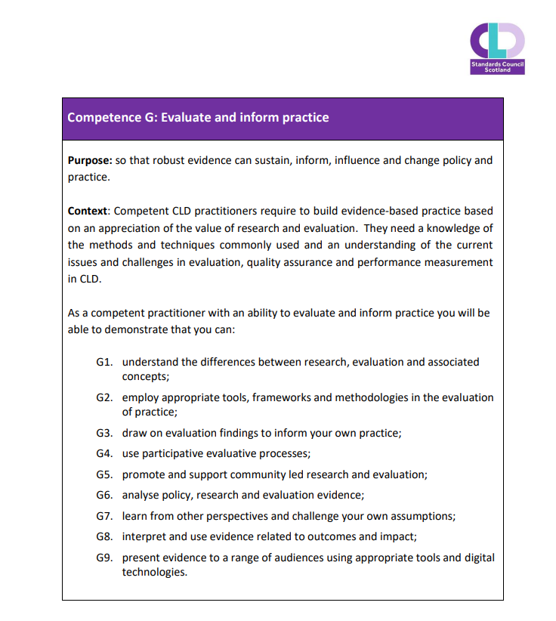
CLD Practitioners - Professional Standards
CLD Practitioners -
The Competent Practitioner Framework
Notes:
Key Messages:
CLD Professional Standards: Competent Practitioner Framework | CLD Standards Council for Scotland
Extract from: Competent Practitioner Framework 2022 (cldstandardscouncil.org.uk)
Supports CLD practitioners to reflect on their own practice and to employ appropriate tools, methodologies (enquiry?) in the evaluation of practice
Specifically considers how this evaluation informs and is applied in practice and to evaluate the impact of this
Research is explicitly referred to along with other forms of evidence
Central element to share with others the importance of this, what you have learned and how this has changed how you work

Slide 17
Taking an enquiry stance
Asking critical questions about self, and learners within your context
Reflecting on professional practice, learning and the learning of learners within your context encourages metacognitive knowledge and skills
Supporting dispositions around risk-taking, being open to change and ready to innovate
Critically examining a wide range of sources of information to inform knowledge and understanding
Asking questions about impact, about the progress of learners and their learning
Enquiry based professional learning encourages informed decision making and clearer articulation of ‘why’ we are teaching and learning in the way we are, promoting voice around the 'so what?’ and 'what now'?
Develops professional agency and voice – educators as leaders of change
Notes:
Key Messages:
There is an ethical prerogative to taking an enquiry stance, to try to improve outcomes for children, young people and adult learners - enquiry is threaded through all of our professional standards
Asking critical questions about self, and learners within your context
Reflecting on professional practice, learning and the learning of learners within your context encourages metacognitive knowledge and skills
Supporting dispositions around risk-taking, being open to change and ready to innovate
Critically examining a wide range of sources of information to inform knowledge and understanding
Asking questions about impact, about the progress of learners and their learning
Enquiry based professional learning encourages informed decision making and clearer articulation of ‘why’ we are teaching and learning in the way we are, promoting voice around the 'so what?’ and 'what now'?
Develops professional agency and voice – educators as leaders of change
Talking Points:
Highlight two of the key messages:
Enquiry based professional learning encourages informed decision making and clearer articulation of ‘why’ we are teaching and learning in the way we are, promoting voice around the 'so what?’ and 'what now'?
Develops professional agency and voice – educators as leaders of change
Having now considered our why and why we engage with practitioner enquiry we will move on to thinking about enquiry itself and how we go about it.

Slide 18
Practitioner Enquiry – why, what and how
Introduction to Enquiry in Education
Notes:
This section connects to the Enquiry in Education resources – Plan, Do and Review
In Plan you will find resources to help you reflect on your why, to consider the purpose of enquiry and start developing an enquiry question
In Do you will find resources to help you plan your enquiry process and to carry out your enquiry
In Review you will find resources to help you reflect on the impact of your enquiry on your learners and on you as a professional (this links to considering our professional standards)
Talking Points:
We are going to start considering what we mean by practitioner enquiry and how we can plan and carry out an enquiry in our setting.

Slide 19

Our experiences as enquirers
TASK
Draw what Enquiry looks like to you...
Share your drawing with your group - are there commonalities/differences?
Our experiences as enquirers:
  In what way has enquiry influenced your practice and impacted on your learners?
  How have your experiences of enquiry influenced you?
Notes:
Key Messages:
An important aspect of any professional learning session is to draw out the collective knowledge in the room.
This may mean that aspects of the next part of the session need to be delved into more deeply or may be touched on more lightly.
Talking Points:
At this stage let's find out more about what we know enquiry collectively.
Task (20 mins):
Individually draw or write what enquiry looks like to you
In groups:
Share your drawing with your group - are there commonalities/differences?
Discuss the following questions:
In what way has enquiry influenced your practice and impacted on your learners?
How have your experiences of enquiry influenced you?

Slide 20
What is practitioner enquiry
“You need to get your question right first and have the freedom to make mistakes. A good enquiry means to get your flowerbed ready for everything to grow properly but you need the basic standards of trust and collaboration first.”
“It’s being inquisitive and finding out new information.”
“It’s “scratching that professional itch” and how to make improvements. You need an open mind, and the enquirer leads the enquiry.”
“It’s research to make something better, to reflect on what’s working well and what can be better.”
The quotes you are reading come from a recent listening exercise with practitioners from all sectors who were asked: What is practitioner enquiry?
Notes:
Key Messages:
The quotes you are reading come from a recent listening exercise with practitioners from all sectors (not in promoted posts)
‘It’s more about a process with no end point. You have a critical friend in your mind and are involved in a reflective and evaluative process. It doesn’t need to be a problem, just something you want to investigate further. It’s part of everyday practice. We’re not at the point of embracing it yet.’
There was generally a good understanding of enquiry among the educators interviewed, from those who had conducted extensive research for master’s degrees to those who had undertaken small-scale enquiries within their own setting. The key theme to emerge was the importance of having a question, an ‘itch’ or something to wonder about, the freedom and trust to try out new things, make mistakes, and the time to reflect and learn.
‘It’s taking on your own initiative and utilising different ways to do that; experiences in other establishments, asking questions, seeing things in practice.’

Slide 21
The purpose of Practitioner Enquiry
We all have questions about the learning going on in our settings…
  Practitioner enquiry is about making those questions more concrete and supporting you as you find out the answers
  Helps you to find out useful information about what is going on in your setting with your learners
  It promotes better practice and better outcomes for your learners
  You are in control; you are leading practice – enquiry empowers you to consider WHY you do what you do
  In turn this supports you in conversation with learners, parents, colleagues…sharing, making your enquiry public is critical to the process
  It also generates more questions and more learning!
Notes:
Key Messages:
The National Model of PL centres around the relationship between learner and educational professional and emphasizes the need to focus our professional learning on LEARNER need with the research evidence showing that PL has a better chance of being effective if its job embedded, sustained over time and supported by local school or setting leadership (Cole, 2012; Cordingley et al 2015; Timperly et al 2007)
Reflective Question:
What resonates with you on this slide?
What questions do you now have?
Link: The Nature and Purpose of Practitioner Enquiry | University of Strathclyde this Blog Post from Kate Wall, Anna Beck and Nova Scott explains what is meant by 'practitioner enquiry' and why it is relevant to everyone from student teachers to those with retirement in their sights. The post borrows a section from Kate Wall and Lorna Arnott's new book 'Research Through Play : Participatory Methods in Early Childhood‘ which has good insight into practitioner enquiry and research in early childhood.

Slide 22
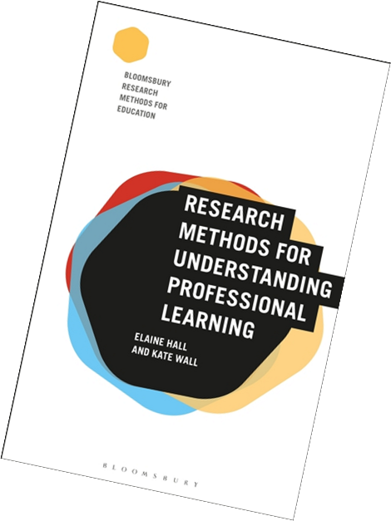
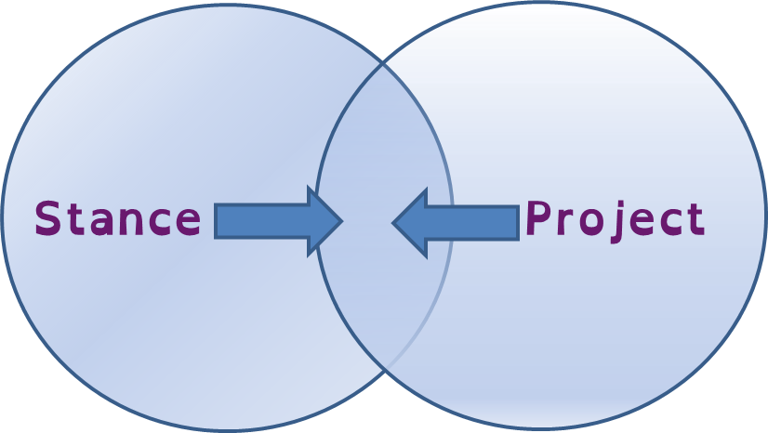
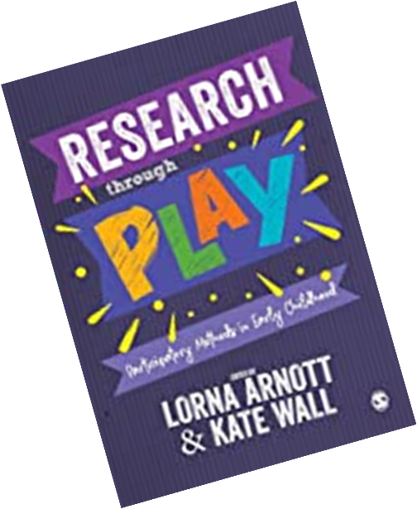
Stance Vs Project
Notes:
Key Messages:
What is Practitioner Enquiry?
We see two dominant standpoints on practitioner enquiry with a potential lack of transfer between the two resulting in a lack of opportunity for sustainability (Wall 2018).
On the one hand we have practitioner enquiry as stance. Originating in the work of researchers such as Cochrane-Smith and Lytle (2009), this position suggests practitioner enquiry is an epistemological stance, a way of understanding the world and how it is made up, arguably a way of being that is tied up with views of democratic purpose and social justice.
The other view is practitioner enquiry as project. This is far better publicised, easier to grasp, and as such is probably more dominant in the profession’s consciousness. Here practitioner enquiry tends to be driven by structures and organisations.
Talking Points:
Practitioner enquiry, as defined by Menter et al (2011), is a ‘finding out’ or an investigation with a rationale and approach that can be explained or defended. The findings can then be shared so it becomes more than reflection or personal enquiry.
This quote and the diagram shows that these stances are not in opposition, but rather a dynamic interaction.
Practitioner enquiry is a desire to question practice and then the means to strategically explore and find out.
Within both ‘types’ of practitioner enquiry we consider engaging with research – this may mean informed by or because of the process undertaken.
For many of us this word “research” might lead to the feeling that enquiry is not for us, it may conjure up specific images or feel too big…
But when you look at your learners there are probably questions that come up – those WHY, HOW, WHAT IF…
In Research through Play the Q - WHY ENQUIRE was discussed:
“Practitioners are constantly asking questions which could arise from pressing problems - the learner, stuck and frustrated, right in front of you - or from the growing awareness of a pattern in the classroom - the ‘tried and tested’ has gone stale for learners and teacher alike. Problem solving and exploratory questions - the how can I fix this? and the what’s going on? – are part of the teacher’s innate enquiry process…”
So perhaps we need to start thinking about research with a small r, as something manageable that can be done by all of us?

Slide 23
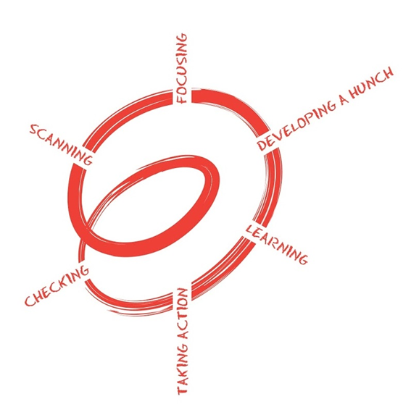
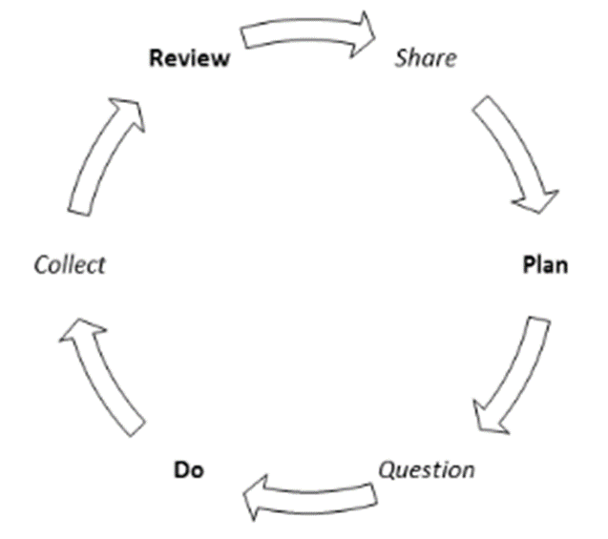
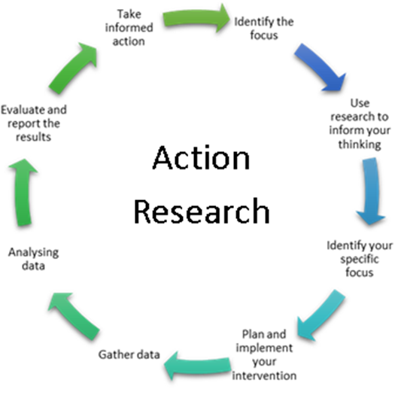
How do we enquire?
Figure 1: Spiral on Inquiry
This method of enquiry has been developed in British Columbia by Judy Halbert and Linda Kaser and the network they have supported (Network of Inquiry and Innovation).
Figure 2: Practitioner enquiry as building on the process of plan-do-review
Figure 3: Action Research Model
Notes:
Key Messages:
Give time to look at the Models of Enquiry Process
Engaging for the first time in this process may seem like a project, in that you want to enquire over a specific timeframe and set limits on what you are going to do but ithis process will support you to move towards a longer-term enquiry stance.
These are not an on/off model of enquiry, they are cycles and Professor Kate Wall encourages us to “think about a dialling up and down of the research element depending your motivations at the time, what answer you need (what are you enquiring for), your context and what evidence you feel you need to answer a particular question.”
Reflective Question:
What do you notice about all these models?

Slide 24
Practitioner Enquiry Myths
TASK
  It always starts with an issue (deficit model)
  It's time consuming
  Data collected must have numbers and graphs
  You need to have a control group
  It will have a definitive answer
Notes:
Key Messages:
There can be several myths and misconceptions associated with practitioner enquiry
It always starts with an issue (deficit model) – enquiry can be appreciative – finding out why something is working well, or it may be due to curiosity about a new technique that works elsewhere – how will this work for learners in my setting?
It's time consuming – enquiry should be do able as part of the day job as most of the learning/research takes place in your setting with your learners
Data collected must have numbers and graphs – learner feedback, narrative and observations are valid evidence about the impact of a change in practice. The evidence should fit the question and satisfy you that you have answered it.
You need to have a control group – this would be unethical; we do not withhold an opportunity from a group of learners that we feel may benefit them.
It will have a definitive answer – it just might not, we don’t know how something will work until we try it with our learners!
Reflective Questions:
What are you thinking now? What questions do you have?
Are there any other myths or misconceptions you would add to this list?

Slide 25
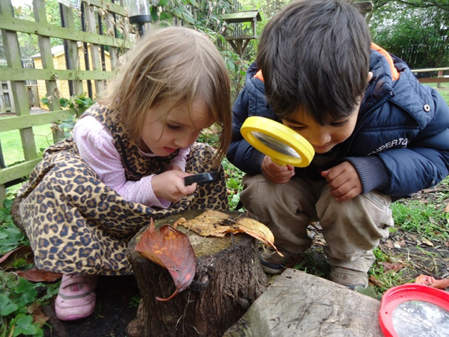
Start with your learners
Take time to consider their needs
What's the priority for them?
Consider your context
Notes:
Key Messages:
It all comes back to this...Start with the learners, take time to pause and consider their needs, that will show you the priority.
Consider your context - your settings improvement plans or priorities. The self evaluation process that goes into the improvement planning cycle will have identified learner needs and is likely to have some current data attached. Enquiry can be the process to do something with that data. After all data is collected in a whole school, setting, cluster or Local Authority BUT it moves and shifts according to what happens with you and your learners.
And all of this will lead you to your question!

Slide 26
Group Discussion
One at a time:
Briefly introduce the area and theme of your enquiry and why this interests you.
Share your enquiry question (if you have settled on this)
As a group:
Take time to discuss some of the enquiry questions
Ask what/who/when and what evidence questions to help with planning (you can use the additional coaching questions to help focus the discussion)
All together:
One or two people from each group share any questions that arise from these discussions
TASK
Notes:
Key Messages:
You might not all have an enquiry question and that's ok as the Plan section of Enquiry in Education is designed to help with this.
This is an opportunity to explore your thinking and talk through ideas.
Group Task (20 mins):
One at a time:
Briefly introduce the area and theme of your enquiry and why this interests you.
Share your enquiry question (if you have settled on this)
As a group:
Take time to discuss some of the enquiry questions
Ask what/who/when and what evidence questions to help with planning (you can use the additional coaching questions to help focus the discussion)
All together:
One or two people from each group share any questions that arise from these discussions
Here are some additional coaching questions that may help you in your discussions.
What impact do you hope to have? What's the ideal outcome?
What are you looking to change?
What do we already know about this? Can you give me an example?
What would happen if...? What are some different ways you could tackle this?
What is the first step? When do you think you might do this by?
What are you going to do? Do you want to take some specific action around this?

Slide 27
Building a culture of Enquiry
Introduction to Enquiry in Education

Slide 28
Enquiry by other names
Enquiry by any other name...
  team teaching
  TLC groups
  reflective professional dialogue/learner discussions with other colleagues
  improvement methodologies
  change initiatives
  staff explorations
  Collaborative work with partner agencies
Notes:
Key Messages:
Your setting may already be engaging in enquiry – consider the examples of enquiry by other names
TLC groups
team teaching
reflective professional dialogue/learner discussions with other colleagues
improvement methodologies
change initiatives
staff explorations
Collaborative work with partner agencies
Reflective Questions:
What dos enquiry look like in your setting?
What could it look like?

Slide 29
How do we create a culture of enquiry?
TASK
Drawing on our own experiences and what we have seen in our own contexts, how is this culture of enquiry created?
  Creating a culture where enquiry can thrive
  Building a community
  Supporting those who are undertaking enquiry as part of their own professional learning
  Leading enquiry with others
Notes:
Key Messages:
Creating a culture where enquiry can thrive – professional trust and freedom to make mistakes in a supportive environment
Building a community – building in time and opportunity for people to connect, helping people to make connections based on what they are enquiring into or with whom
Supporting those who are undertaking enquiry as part of their own professional learning – engaging with their enquiry, supporting the process, building in opportunity to share learning
Leading enquiry with others – using this PLR and resources to help other educators understand the benefit, purpose and process of enquiry and modelling this by sharing your won enquiry with them
Reflective Questions:
What actions could you take to help build or support a culture of enquiry in your setting?

Slide 30
Examples of Enquiry in Action
Introduction to Enquiry in Education

Slide 31
Enquiry in Action
Enquiry forms part of Initial Teachers Education & Teacher Induction Schemes, the Into Headship programme (Strategic Change Initiatives)
Further opportunities through MEd and PhD studies
Education Scotland’s Enquiry in Education webpage has examples from:
  Teacher Leadership and Educator Leadership programmes
  Enquiry through leading a change initiative as a middle leader
  Collaborative enquiry through EiH Stretch - Think pieces
Notes:
Key Messages:
On the Enquiry in Education webpage there are numerous examples of Enquiry in Action: ADD LINK
The following slides show a few samples of what you can find there.
If you would like share your enquiry with us for review, sharing on this page and to receive an Education Scotland Enquiry in Education completion certificate go to the Share and Receive a Certificate Tile on the Enquiry in Education webpage.

Slide 32
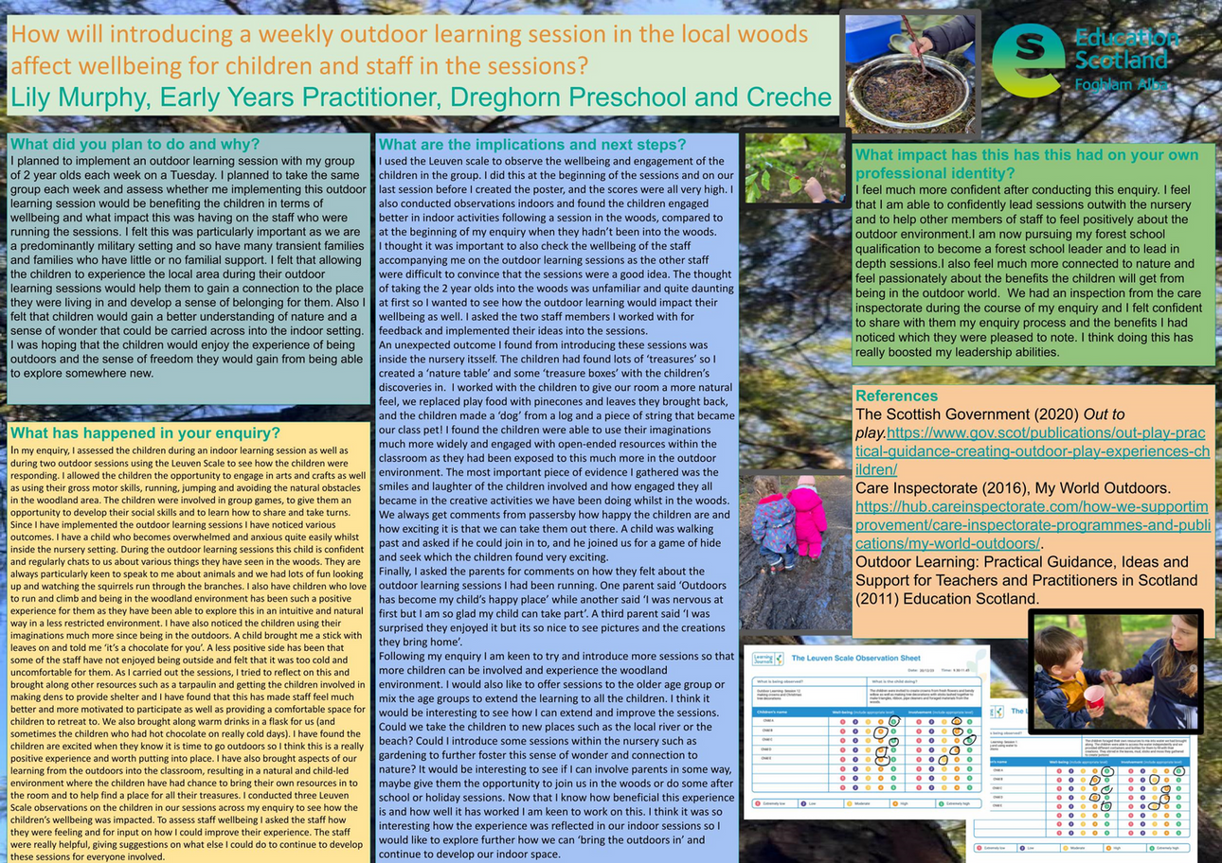
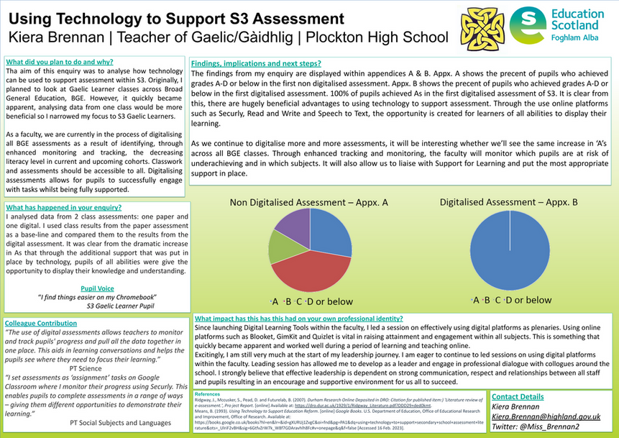
Examples from Teacher and Educator Leadership programmes
“I think my enquiry has encouraged me to question my practice...
it has empowered me to take action...
and I am keen to use enquiry on a regular basis to promote and bring about positive change” ELP participant 2022 to 2023
Notes:
Examples slide – can be skipped
We now have a bank of over 570 Enquiry Posters covering a range of themes including:
Inclusion, Wellbeing & Equalities
Meeting Learners Needs
Science and STEM
LfS and Outdoor Learning
Positive Relationships, Learner Participation & Pupil Voice
Digital
Pedagogy
Literacy
Numeracy
Feedback & Assessment
Parental & Wider Community Engagement
Self-regulation & Metacognition
Coaching & Mentoring
Curriculum
Andragogy
DYW
Professional Learning
Curriculum Design
ELC

Slide 33
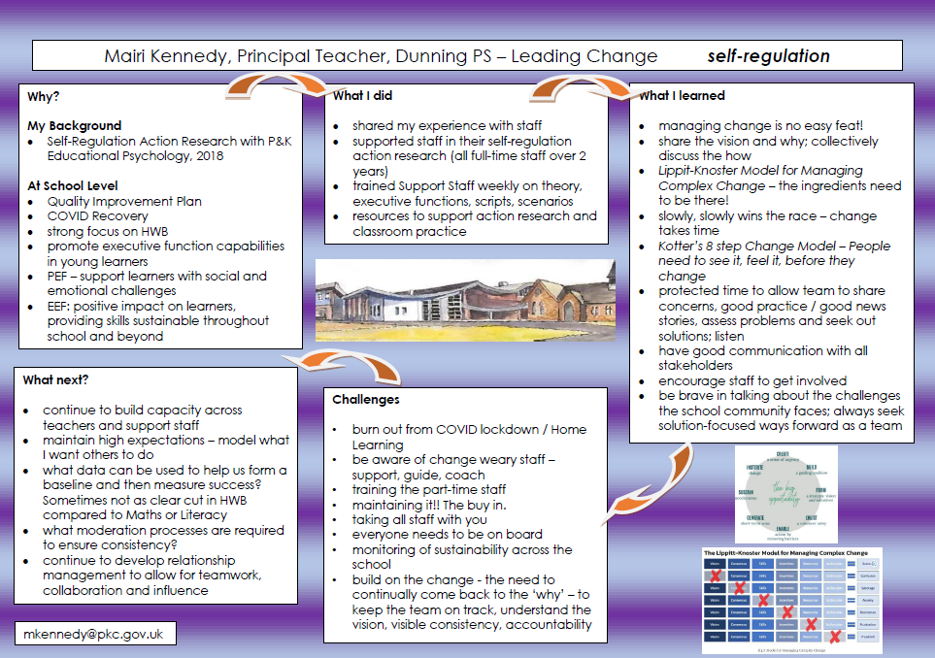
Examples from Middle Leaders Leading Change programme
Notes:
Examples slide – can be skipped
We now have a bank of over xxx Change Initiatives covering a range of themes including:

Slide 34
Examples from Headteacher collaborative enquiry
  Observations and recommendations were made addressing the following collaborative enquiry questions:
  Does Scottish Education have a connectivity problem? Would empowering all school leaders to be at the heart of system change increase its bandwidth and improve the capacity of the leadership network?
  How could the system ensure quality and consistency of career long professional learning (CLPL) offer to classroom teachers?
  Can the voice of the Head Teacher be amplified to shape Scottish education policy for system gains?
  The Evolution of Profiling in Scottish Education: How can equitable pupil profiling be implemented successfully to achieve the aims of Scotland’s Curriculum?
  'Count us in!' Headteacher Voice: How can more headteachers be included in the formation and development of policy and scrutiny in the local and national contexts?
  If systemic structures that support Head Teachers are prioritised would there be a positive impact on recruitment and retention?
  The impact on staff of working with learners who display behaviour that challenges?
Notes:
Examples slide – can be skipped
We now have a bank of 14 ‘Think Pieces’ over the course of two EiH Stretch cohorts with the current Connected and Collaborative Systems group due to add to this number later this year.
The topics of the ‘Think Pieces’ are diverse and include:
• System Connectivity
• System Quality Career Long Professional Learning
• Amplification of Head Teacher Voice
• Evolution of Profiling
• Count Us In
• Head Teacher System Support Structures
• Impact of Behaviour
The impact of this leadership professional learning has directly contributed to headteachers influencing and contributing to a range of work in the system including, the national empowerment policy driver, the Scottish Attainment Challenge and as we previewed recently the exciting collaboration with Public Health Scotland and the Scottish Prevention Hub, linking health, justice and education data for the purpose of improved system collaboration.
EiH Stretch participants were encouraged to consider a range of system issues and formed collaborative enquiry groups addressing the following aspects:

Slide 35
Next Steps
Introduction to Enquiry in Education

Slide 36
Aims Review
In this workshop we will consider:
  why we enquire and reflect on our professional why
  what enquiry is and consider examples of enquiry
  how we enquire and look at professional learning resources that support the process
  our own ideas, areas of focus or enquiry questions
Notes:
Key Messages
This slide shows the aims of the session to be reflected on at the end of the session.

Slide 37
Reflection Activity
How confident are you to engage in an enquiry or to lead others in enquiry?
What key messages or actions have you taken from the workshop?
What might you do differently in school?
TASK
Notes:
Reflective Questions
A final reflective task. Ask participants to consider the question and then feedback into the room.

Slide 38
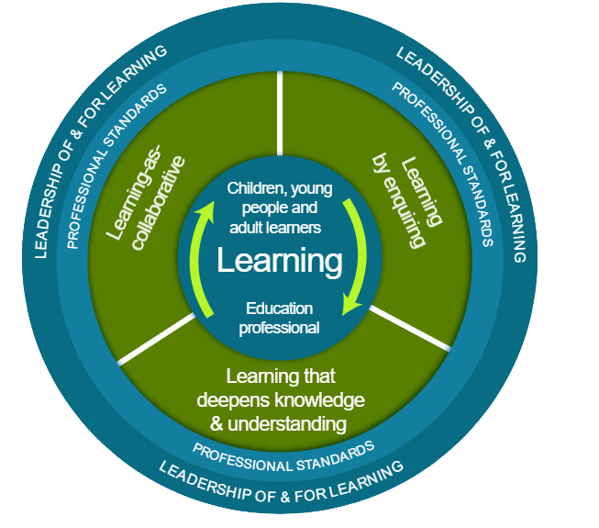
Thank you
Notes:
Facilitator Evaluation: As a facilitator of this workshop we would be grateful if you would complete the following evaluation about this resource, thank you - https://forms.office.com/e/peiYJF1jFn

