Slide 1
Inclusion, Wellbeing and Equalities Framework – Rights and Equalities
Develop Your Religious Literacy Part 2 Level – Informed
@ESInclusionTeam
For Scotland's learners, with Scotland's educators
Do luchd-ionnsachaidh na h-Alba, le luchd-foghlaim Alba
Notes:
Slide 1
This resource has been developed in partnership with Interfaith Scotland and Education Scotland. Information about the work of Interfaith Scotland can be found at www.interfaithscotland.org
Further information and signposts to further reading, resources and professional learning can be found in the related Information Note entitled “Develop Your Religious Literacy Part 2.”

Slide 2
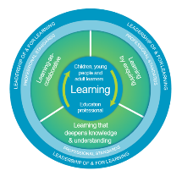
How to use this resource
Pause for Thought…
These slides can be used to facilitate professional learning in a group or whole-setting, or as a self-directed learning activity as an individual.
Facilitation notes are included at the bottom of each slide
Please do not remove or change any of the slides included.
Facilitators are welcome to add slides or activities relevant to your own setting, to support discussion and exploration of the topic. Facilitators will know their participants’ needs best.
Anyone who works in an educational setting can be a facilitator and use these slides.
For reflection or discussion activities, it is important to establish a safe space which encourages respect and honesty to ensure that everyone is able to participate.
Notes:
Slide 2
These slides can be used to facilitate professional learning in a group or whole-setting, or as a self-directed learning activity as an individual.
Facilitation notes are included at the bottom of each slide
Please do not remove or change any of the slides included.
Facilitators are welcome to add slides or activities relevant to your own setting, to support discussion and exploration of the topic. Facilitators will know their participants’ needs best.
Anyone who works in an educational setting can be a facilitator and use these slides.
For reflection or discussion activities, it is important to establish a safe space which encourages respect and honesty to ensure that everyone is able to participate.

Slide 3
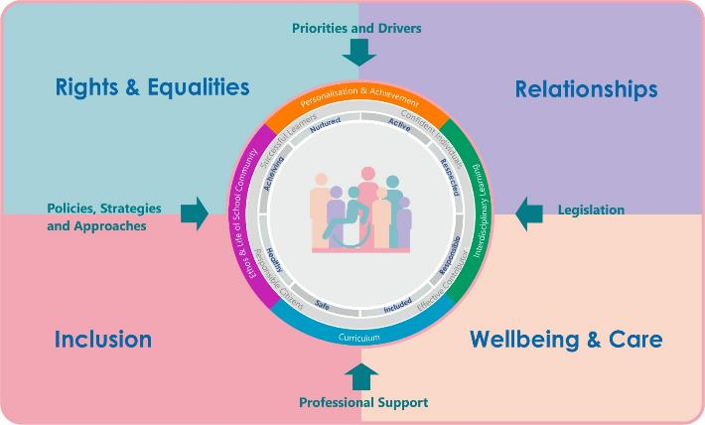
IWE Professional Learning Framework
Notes:
Slide 3
This professional learning resource comes under the Rights and Equalities theme of the Inclusion, Wellbeing and Equalities Professional Learning Framework.

Slide 4
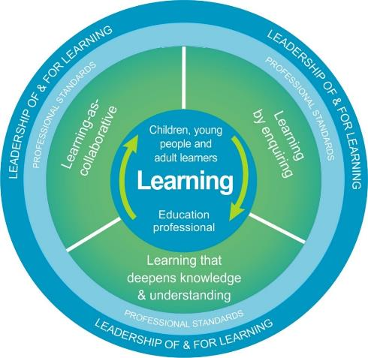
National Model for Professional Learning
This professional learning resource will support you to deepen your knowledge and understanding.
You will have the opportunity to consider how to take this learning forward on your own and with others.
The National Model of Professional Learning (education.gov.scot)
Notes:
Slide 4
On completion of this professional learning, you will be asked to consider what your next steps will be
Take some time to consider the reflection questions

Slide 5
Welcome
Pause for Thought…
This session provides an opportunity to help you develop your religious literacy by promoting inclusion and increase awareness of some of the diverse experiences and needs linked to religion and belief in Scotland, including:
Festivals, pilgrimages and religious observance
Dietary needs, fasting, prayer and support
Clothing, religious symbols, participating in sport and physical contact
Notes:
Slide 5
This session provides an opportunity to help you develop your religious literacy by promoting inclusion and increasing awareness of some of the diverse experiences and needs linked to religion and belief in Scotland, including:
Religious discrimination and bullying
Festivals, pilgrimages and religious observance
Dietary needs, fasting, prayer and support
Clothing, religious symbols, participating in sport and physical contact
By religious literacy, there resources refer primarily to the ability to develop an understanding of elements of different religions, faiths and belief systems in order to meet the needs of diverse communities, promote inclusion and prevent discrimination.

Slide 6
Diversity
Linguistic
Religion / Belief
Pause for Thought…
Socioeconomic
Ethnic/Cultural/Racial
Disability
Gender/Sex
Neurodiversity
Sexual Orientation
Age
Family
Notes:
Slide 6
The features of diversity represented on the diagram have been inspired by the protected characteristics (disability, age, race, religion & belief, sex, gender reassignment, pregnancy and maternity, sexual orientation and marriage and civil partnership) from the Equality Act 2010, the non-protected characteristics that are most relevant in the context of Scottish education and groups that are protected under the Education (Additional Support for Learning) (Scotland) Act 2004.
While this resource draws on traditional beliefs and practises of different religions and provides guidance on the needs of people of different religions and beliefs, it is important to remember that there is also diversity of belief and practice both within each religion and in the individuals who practise those religions.
Some religious groups will have different interpretations of their religious texts and practises. For example some religious groups within a religion may have stricter interpretations of what is appropriate ‘modest’ dress or stricter rules on what they will eat and drink. For example, some Christian groups might expect their followers not to drink alcohol while others would find it acceptable in moderation.
In addition to this, every individual will choose to practise their beliefs and practices in their own way. Not all followers of a particular religion or religious group will follow all of the traditions outlined and their choices should be respected. It is always best to ask individuals rather than presume that everyone from that religion believes and practises the same way.
This resource looks at the practises of seven of the world religions, all of which currently have followers in Scotland. It is important to remember that the examples of religions and associated needs are not exhaustive.
If in doubt about an aspect of religion and belief, consider contacting one of the religious groups in the appendix for advice and/or seek views of the religious groups which are a part of your community.

Slide 7
Festivals and pilgrimage
Buddhist - Vesak Day / Buddha Day (full moon in May), Sangha day (full moon in November)
Christian - Christmas, Easter (including Good Friday, Easter Saturday and Easter Sunday)
Hindu - Diwali, other festivals depending on the god worshipped in that household
Jewish - Yom Kippur, Pesach/Passover, Hanukkah, Rosh Hashanah, Shavuot, Succoth*
Muslim
Eid ul Fitr, Eid ul Adha
Sikh - Birth of Guru Nanak, Vaisakhi, Bandi Chhor Divas
Pilgrimage: A pilgrimage that Muslims take to Mecca in Saudi Arabia called ‘Hajj’
*Jewish festivals start at sunset the night before the date of their festivals.
Notes:
SLIDE 7:
Festivals
School and public holidays are arranged to coincide with most Christian festivals but people from other faith communities should be allowed time off school, college or work to celebrate their own festivals. It is best to avoid putting on special events for the whole community on those days so as not to exclude those celebrating. Some faiths have many festivals but a few of the main ones are outlined below:
Buddhist - Vesak Day / Buddha Day (full moon in May), Sangha day (full moon in November)
Christian - Christmas, Easter (including Good Friday, Easter Saturday and Easter Sunday)
Hindu - Diwali, other festivals depending on the god worshipped in that household
Jewish - Yom Kippur, Pesach/Passover, Hanukkah, Rosh Hashanah, Shavuot, Succoth
*Please note that Jewish festivals start at sunset the night before the date of their festivals.
Muslim - Eid ul Fitr, Eid ul Adha
Sikh - Birth of Guru Nanak, Vaisakhi, Bandi Chhor Divas
Quite a number of festivals will fall on different dates from year to year.
RE Online offers a calendar of festivals with information about each one at: https://www.reonline.org.uk/festival-calendar
Pilgrimage
A pilgrimage to Mecca in Saudi Arabia, known as Hajj’, is a requirement for all Muslims who can afford it to undertake at least once in their lifetime. The pilgrimage takes nearly two weeks at a fixed time in the calendar each year.

Slide 8
Holy days of the week
Different religions observe a holy day during the week. Followers may be expected to attend a religious service on that day. Some may not be allowed to undertake certain activities on that day.
Friday is the holy day for Muslims and some will attend the mosque for midday prayers
In Judaism, Shabbat starts at sunset on Friday and continues until sunset on Saturday. It is a day of rest and some Jewish people will not write, travel or cook during this time.
Sunday is the traditional day of rest for Christians and some will not work on a Sunday. Religious services are generally held on Sunday morning (plus Saturday and/or Sunday evenings in some churches).
In the UK, many Hindus and Sikhs will hold a religious service at their places of worship on a Sunday morning.
Notes:
SLIDE 8:
Different religions observe a holy day during the week. Followers may be expected to attend a religious service or public prayers on that day. Some may not be allowed to undertake certain activities on that day.
Friday is the holy day for Muslims and some will attend the mosque for midday prayers
In Judaism, Shabbat starts at sunset on Friday and continues until sunset on Saturday. It is a day of rest and some Jewish people will not write, travel or cook during this time.
Sunday is the traditional day of rest for Christians and some will not work on a Sunday. Religious services are generally held on Sunday morning (plus Saturday and/or Sunday evenings in some churches).
In the UK, many Hindus and Sikhs will hold a religious service at their places of worship on a Sunday morning.
It would be advisable to avoid holding events during festivals and holy days so that people from that religion or belief group are not excluded.

Slide 9
Religious observance
Religious Observance is defined as:
“community acts which aim to promote the spiritual development of all members of the school's community and express and celebrate the shared values of the school community”
Religious Observance should reflect the diversity of religions and beliefs in Scotland. For example, marking festivals of different faiths can increase learners’ sense of belonging and can also be a celebration of this rich diversity for all learners.
Parents have the right to withdraw children from Religious Observance including Christian events and assemblies.
Pupils do not have the right to withdraw themselves, but schools should include them in any discussions about aspects of their school experience, ensuring their views are taken into account.
Notes:
SLIDE 9
Religious Observance is defined as "Community acts which aim to promote the spiritual development of all members of the school's community and express and celebrate the shared values of the school community“: Curriculum for Excellence: religious observance - gov.scot (www.gov.scot)
Religious Observance should reflect the diversity of religions and beliefs in Scotland. For example, marking festivals of different faiths can increase learners’ sense of belonging and can also be a celebration of this rich diversity for all learners. It is important to do so in authentic and sensitive ways so this does not become a tokenistic ‘show and tell’ of different religions and their festivals/traditions.
Parents have the right to withdraw their children from participation in Religious Observance, including Christian events and assemblies, and some parents may choose not attend nativity plays at Christmas. Pupils do not have the right to withdraw themselves from Religious Observance but schools should include children and young people in any discussions about aspects of their school experience, ensuring their views are taken into account.
Useful guidelines on religious observance have been produced by Education Scotland and can be found at the link below.
Religious Observance - Time for Reflection | Resources | National Improvement Hub (education.gov.scot)

Slide 10
Case study
Pupil's experience of food-related religious discrimination
“The first time I really realised that people made assumptions about me based off the colour of my skin was in Primary 4 when a teacher tried to force me to eat beef, even though I’m Sikh and not allowed. My year group was last for lunch that day and there wasn’t much else left. I told the teacher that I couldn’t eat it because I’m Sikh but she just kept shouting at me that it’s halal and that I could, taking no notice of me explaining that Islam and Sikhism are different.”
https://www.theantiracisteducator.com/post/pupils-in-scotland-call-for-change-it-s-time-for-an-anti-racist-decolonised-curriculum
Question to discuss:
What did the teacher do wrong and what could she have done differently?
Notes:
SLIDE 10
Here is a quote from a young person in Scotland that demonstrates a pupil’s experience of food-related religious discrimination.
“The first time I really realised that people made assumptions about me based off the colour of my skin was in Primary 4 when a teacher tried to force me to eat beef, even though I’m Sikh and not allowed. My year group was last for lunch that day and there wasn’t much else left. I told the teacher that I couldn’t eat it because I’m Sikh but she just kept shouting at me that it’s halal and that I could, taking no notice of me explaining that Islam and Sikhism are different.”
https://www.theantiracisteducator.com/post/pupils-in-scotland-call-for-change-it-s-time-for-an-anti-racist-decolonised-curriculum
Question to discuss:
What did the teacher do wrong and what could she have done differently?
If you have time ask the group their thoughts and then discuss the points below.
Don’t make assumptions about someone’s religion or belief based on their ethnicity or skin colour
Don’t make assumptions about what a person eats based on their religion – not everyone from that religion or belief will hold those practices (e.g. a Muslim could choose to be a vegetarian)
It is always best to ask an individual what they can and can’t eat
Don’t get impatient about people’s food choices. Many people of that religion will not see it as a ‘choice’ but rather as mandatory in their faith or practice
Despite our best intentions, our biases and assumptions about our learners can negatively impact their experiences of education and lead to unintended discrimination. Becoming more aware of the diversity of religions and beliefs, and the diverse needs related to these, can help us become more inclusive in our practice.
If you would like to find out more about bias and discrimination, please check out the Inclusion, Wellbeing and Equalities Professional Learning resource on Bias and Inequality: Informed Level | Inclusion, Wellbeing and Equalities Professional Learning Framework | Resources | Education Scotland

Slide 11
Dietary needs of different religions: Vegetarian food
Buddhist: Many Buddhists are vegetarian or vegan
Hindu: Many Hindus are vegetarian. Some do not eat eggs and some will not eat onion and garlic. Those who eat meat will not eat beef
Sikh: Many Sikhs are vegetarian. Baptised Sikhs will also not eat eggs. Those Sikhs that do eat meat will avoid beef and pork
Christian: Some Roman Catholic Christians will eat fish rather than meat on Fridays
Advice for vegetarians:
Make sure vegetarian and vegan food is available. Check ingredient labels and make sure to clearly label for recipients. Be aware that some cheeses contain animal rennet and some sweets and desserts contain animal products such as gelatine. Vegetarian food should always be separated from meat, for example sandwiches should be on separate plates/platters with separate utensils.
Notes:
SLIDE 11
The following slides provide information and advice on serving food and drink that is appropriate for people of different faiths. Not all followers of that faith will follow these traditions so it is always best to ask rather than presume!
Buddhist: Many Buddhists are vegetarian or vegan
Sikh: Many Sikhs are vegetarian. Baptised Sikhs will also not eat eggs. Those Sikhs that do eat meat will avoid beef and pork. (Baptised Sikhs are those who have gone through an initiation ceremony called ‘Amrit’)
Hindu: Many Hindus are vegetarian. Some do not eat eggs and some will not eat onion and garlic. Those who eat meat will not eat beef
Christian: Some Roman Catholic Christians will eat fish rather than meat on Fridays
Advice for vegetarians: Make sure vegetarian and vegan food is available. Make sure the cheese does not contain animal rennet and be aware that some sweets and desserts can contain animal products, such as gelatine found in jelly desserts and sweets, so check the ingredients labels on prepared foods and make sure it is clearly labelled for recipients. Vegetarian food should always be separated from meat, for example sandwiches should be on separate plates/platters with separate utensils.

Slide 12
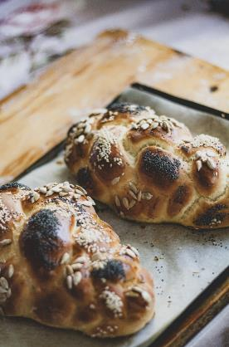
Dietary needs of different religions: Kosher food
For Jewish people, food that is considered acceptable to eat is known as ‘kosher.’
Animals that are kosher have a split hoof and chew the cud such as cows, goats and sheep. Fish must have fins and scales so shellfish is not kosher. Chicken and turkey are permitted. Pigs and rabbits are not kosher.
Animal products such as milk and eggs must come from a kosher animal.
To be kosher, meat must be slaughtered according to Jewish food laws.
Traditionally, meat and milk are never served together at the same meal.
Fresh fruits, vegetables and grains are kosher in their natural unprocessed state and if checked to be free of insects.
Notes:
SLIDE 12
Kosher Food
For Jewish people, food that is considered acceptable to eat is known as ‘kosher’
Animals that are kosher have a split hoof and chew the cud such as cows, goats and sheep. Fish must have fins and scales so shellfish is not kosher. Chicken and turkey are permitted but not birds of prey. Pigs and rabbits are not kosher.
Animal products such as milk and eggs must come from a kosher animal
To be kosher meat must be slaughtered according to Jewish food laws
Meat and milk are never served together at the same meal
Fresh fruits, vegetables and grains are kosher in their natural unprocessed state and if checked to be free of insects

Slide 13
Dietary needs of different religions: Catering for Jewish People
Some Jewish people will eat vegetarian food served at an event.
Some Jewish people will only eat food that has been certified as kosher by a rabbi. However, fruit that can be peeled is generally acceptable.
Orthodox Jews will not use crockery or cutlery that has previously been used for serving food that is not kosher. Serve the kosher meal in its original wrapping, with disposable cutlery and plates.
There is only one kosher caterer in Scotland, based in Glasgow but will deliver across Scotland
Some kosher food is available to purchase at supermarkets. The food will be labelled with a kosher symbol. The most commonly found kosher symbols are below:
Notes:
SLIDE 13:
Catering for Jewish People
Some Jewish people will eat vegetarian food served at an event
Some Jewish people will only eat food that has been certified as kosher by a rabbi. However fruit that can be peeled such as a banana is generally acceptable for everyone.
Orthodox Jews will not use crockery or cutlery that has previously been used for serving food that is not kosher. They should be served the kosher meal in its original wrapping, with disposable cutlery and plates.
There is only one kosher caterer in Scotland, based in Glasgow but will deliver across Scotland
Some kosher food is available to purchase at supermarkets. The food will be labelled with a kosher symbol. The most commonly found kosher symbols are below
Details of the kosher caterer are below:
Mark's Deli: Scotland's Only Kosher deli and catering in Glasgow (marksdeli.co.uk)
Useful information on obtaining kosher food in Scotland can be found on page 9 of the following publication:
Guide to Jewish Facilities in Scotland (scojec.org)

Slide 14
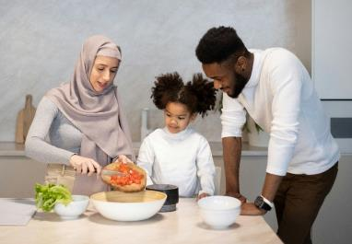
Dietary needs of different religions: Halal food
‘Halal’ food is that which is considered acceptable for Muslims to eat.
Halal meat is that which is slaughtered according to Islamic law.
Some Muslims will eat kosher meat if halal meat is not available.
Muslims are expected not to eat pork or carnivorous animals.
If meat is served, include some halal meat for Muslims.
Please be aware that some Sikhs who eat meat will not eat halal or kosher meat as it must be slaughtered according to their own rites known as jhatka.
Notes:
SLIDE 14: HALAL FOOD
‘Halal’ food is that which is considered acceptable for Muslims to eat.
Halal meat is that which is slaughtered according to Islamic law.
Some Muslims will eat kosher meat if halal meat is not available.
Muslims are expected not to eat pork or carnivorous animals.
If meat is served, include some halal meat for Muslims.
Please be aware that some Sikhs who eat meat will not eat halal or kosher meat as it must be slaughtered according to their own rites known as jhatka.

Slide 15
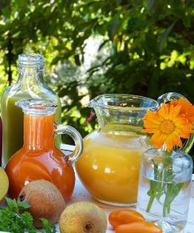
Dietary needs of different religions: Alcohol
Muslims and Sikhs are expected never to drink alcohol.
Some Christians, Hindus and Buddhists will also choose not to drink alcohol.
Those who drink alcohol are expected to do so in moderation.
Non-alcoholic drinks should always be available at events.
Some religious people may find it unacceptable for any alcohol to be served at events and some will not enter a public space that serves alcohol.
Be aware there may be alcohol in foods (e.g. mince pies) that some will not eat.
Notes:
SLIDE 15: ALCOHOL
Muslims and Sikhs are expected never to drink alcohol
Some Christians, Hindus and Buddhists will also choose not to drink alcohol
Those who drink alcohol are expected to do so in moderation
Non-alcoholic drinks should always be available at events
Some religious people may find it unacceptable for any alcohol to be served at events and some will not enter a public space that serves alcohol
Be aware there may be alcohol in foods (e.g. mince pies) that some will not eat

Slide 16
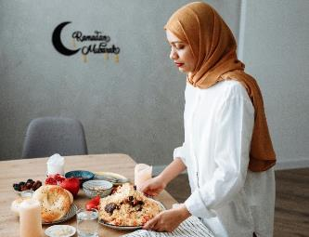
Dietary needs of different religions: Muslim Fasting during Ramadan
Ramadan is the ninth month of the Islamic calendar and lasts 30 days.
During Ramadan, Muslims are expected not to eat or drink between sunrise and sunset. Families will tend to eat together to break the fast
The start date for Ramadan moves back 10 or 11 days each year and may be particularly challenging in the summer months with long daylight hours.
Fasting is expected from puberty but children from the age of seven are encouraged to fast for a few hours a day.
Certain people are exempt from fasting – those below the age of puberty, people who are unwell, menstruating, pregnant, breastfeeding, the elderly and people on a long journey.
Notes:
SLIDE 16
Ramadan is the ninth month of the Islamic calendar and lasts 30 days.
During Ramadan, Muslims are expected not to eat or drink between sunrise and sunset. Families will tend to eat together to break the fast
The start date for Ramadan moves back 10 or 11 days each year and may be particularly challenging in the summer months with long daylight hours.
Fasting is expected from puberty but children from the age of seven are encouraged to fast for a few hours a day.
Certain people are exempt from fasting – those below the age of puberty, people who are unwell, menstruating, pregnant, breastfeeding, the elderly and people on a long journey.

Slide 17
Dietary needs of different religions: Fasting in other religions
Jewish: On Yom Kippur, many Jewish people will observe a 25 hour fast beginning before sunset on the evening before and ending at nightfall. During Pesach, no leavened bread or cakes will be eaten for eight days.
Hindu: Some devout Hindus observe fasting on special occasions as a mark of respect to personal Gods or as part of their penance. Fasting is commonly practised on new moon days and during festivals such as Shivaratri, Saraswati Puja and Durga Puja. Some fasts may only require abstinence from certain foods.
Christian: Some Christians choose to fast during the 40 days of Lent before Easter Sunday. This is not a total abstinence from food or drink but may involve ‘giving something up’, such as meat or sweets.
Notes:
SLIDE 17:
There are also fast days in other religions.
Jewish: On Yom Kippur, many Jewish people will observe a 25 hour fast beginning before sunset on the evening before and ending at nightfall. During Pesach, no leavened bread or cakes will be eaten for eight days.
Hindu: Some devout Hindus observe fasting on special occasions as a mark of respect to personal Gods or as part of their penance. Fasting is commonly practised on new moon days and during festivals such as Shivaratri, Saraswati Puja and Durga Puja. Some fasts may only require abstinence from certain foods.
Christian: Some Christians choose to fast during the 40 days of Lent before Easter Sunday. This is not a total abstinence from food or drink but may involve ‘giving something up’, such as meat or sweets.

Slide 18
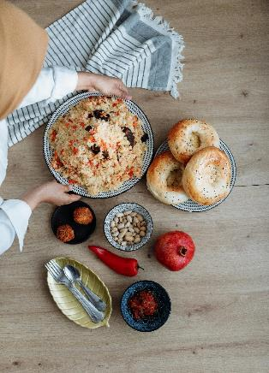
Supporting people who are fasting
Consideration should be given to the fact that as the day goes on, people who are fasting may experience fatigue, loss of energy, light-headedness, headaches and mood swings. Learners may find it harder to concentrate.
Activities during this time shouldn’t be too physically demanding to avoid dehydration and exhaustion.
Those who are fasting may wish to opt out of residential field trips, afternoon or evening activities.
You may wish to avoid putting on events during fast days or holding events focusing on a meal during the daytime so not to exclude those fasting from sunrise to sunset.
Notes:
SLIDE 18:
To support people who are fasting, consideration should be given to the fact that as the day goes on, people who are fasting may experience fatigue, loss of energy, light-headedness, headaches and mood swings. Learners may find it harder to concentrate.
Activities during this time shouldn’t be too physically demanding to avoid dehydration and exhaustion.
Those who are fasting may wish to opt out of residential field trips, afternoon or evening activities.
You may wish to avoid putting on events during fast days or holding events focusing on a meal during the daytime so not to exclude those fasting from sunrise to sunset.
More information on ways to support people who are fasting (particularly during Ramadan) can be found here: https://leithacademy.uk/wp-content/uploads/2022/03/Edinburgh-Ramadan-Guidance-for-schools-2022.pdf

Slide 19
MUSLIM PRAYER
Muslims are expected to pray five times a day from the age of puberty. Children from the age of seven are also encouraged to do so.
Prayers take place at dawn, around midday, late afternoon, after sunset and late evening. The exact times of the prayers change throughout the year depending on the times of sunrise and sunset where the prayers are taking place.
Muslims can pray anywhere that is clean. A prayer mat is often used for this. Muslims must pray towards Mecca. A compass can be used for this or a compass app on a mobile phone.
Prayers are always preceded by a washing ritual called Wudu. During Wudu the following parts of the body are washed in running water: hands, face, hair, mouth, nose, ears, arms (up to the elbow) and feet (up to the ankle).
Muslims welcome privacy or a quiet space during prayer times if this can be provided plus an area to wash before saying the prayers. Daily prayer times can be found online for every day of the year to the nearest town and city.
.
Notes:
SLIDE 19:
Practising prayer or meditation is an aspect of all religions. Many people pray in the morning and evening. The Muslim faith is unique in that followers are expected to pray five times a day at set times which may require special provisions for them.
Muslims are expected to pray five times a day from the age of puberty (except for those who are menstruating or who have recently given birth). Children from the age of 7 are also encouraged to do so.
If a prayer time is missed, the prayer should be done as soon as possible.
Prayers take place at dawn, around midday, late afternoon, after sunset and late evening. The exact times of the prayers change throughout the year depending on the times of sunrise and sunset where the prayers are taking place.
Muslims can pray anywhere that is clean. A prayer mat is often used for this. Muslims must pray towards Mecca. A compass can be used for this or a compass app on a mobile phone.
Prayers are always preceded by a washing ritual called Wudu. During Wudu the following parts of the body are washed in running water: hands, face, hair, mouth, nose, ears, arms (up to the elbow) and feet (up to the ankle).
Muslims welcome privacy or a quiet space during prayer times if this can be provided plus an area to wash before saying the prayers. Daily prayer times can be found online for every day of the year to the nearest town or city.

Slide 20
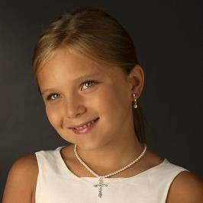
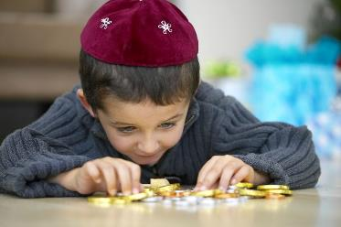
Clothing & Wearing Religious Symbols
Christian: Some Christians wear a cross at all times.
Jewish: During synagogue services, all men are required to keep their heads covered. Most use a skullcap called a kippah. Orthodox Jewish men are expected to keep their heads covered at all times. Some boys will wear the kippah at all times while some will wear it for worship only.
Muslim: Muslims are expected to dress modestly at all times. Boys from the age of puberty may cover themselves from above the navel to below the knee. When in public, girls from the age of puberty may wear loose fitting clothes that cover the body apart from their hands, feet and face. Many (but not all) women and girls wear a headscarf or hijab which covers the head and hair.
Notes:
SLIDE 20:
People from different faiths may wear a number of different types of clothing or religious symbols. Some of these have a particularly religious significance, and some include covering different parts of the body to preserve modesty. In the UK to preserve religious rights and inclusion people of different faiths are permitted to wear their religious symbols in public and this should include public spaces such as schools and the workplace.
Some Christians wear a cross at all times. In the Jewish faith, during synagogue services, all men are required to keep their heads covered. Most use a skullcap called a kippah. Orthodox Jewish men are expected to keep their heads covered at all times. Some boys will wear the kippah at all times, while some will wear it for worship only.
Muslims are expected to dress modestly at all times. Boys from the age of puberty may cover themselves from above the navel to below the knee. When in public, girls from the age of puberty may wear loose fitting clothes that cover the body apart from their hands, feet and face. Many (but not all) women and girls wear a headscarf or hijab which covers the head and hair.
There are different types of head covering worn by Muslim women and a list with illustrations can be found at: What's the difference between a hijab, niqab and burka? - BBC Newsround

Slide 21
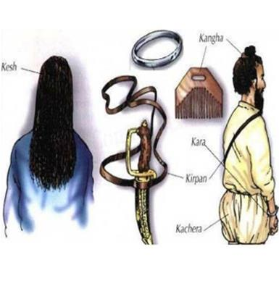
Clothing & Wearing Religious Symbols (Continued)
Hindu: Some Hindu women and girls will only wear clothing that fully covers their legs. They should be allowed to wear long skirts or trousers. Some Hindus may wear a rakhi or cotton bracelet.
Sikh: Baptised Sikhs are expected to wear the Five Ks at all times (see image). Many Sikhs never cut their hair, including facial hair. Many male Sikhs wear a turban. Younger children may wear a patka (a smaller piece of material similar to a headscarf) for activities such as sports.
Hindu, Muslim and Sikh: Many women and girls wear Mehndi (henna) patterns on their hands and feet for important occasions such as weddings and festivals. These cannot be washed off and will remain in place for several days.
Notes:
SLIDE 21:
Some Hindu women and girls will only wear clothing that fully covers their legs. They should be allowed to wear long skirts or trousers. Some Hindus may wear a rakhi or cotton bracelet which shouldn’t be removed.
Baptised Sikhs are expected to wear the Five Ks at all times. These are the Kesh (uncut hair), Kangha (wooden comb used to keep the hair in place), Kara (steel bangle), Kirpan (small sword) and Kachera (white cotton shorts worn as underwear). Some schools may have a policy of only allowing a small symbolic representation of a kirpan to be worn in school, for example on a necklace.
Many Sikhs never cut their hair. This includes the shaving of facial hair. Many male Sikhs wear a turban. Younger children are more likely to wear a patka (a smaller piece of material similar to a headscarf) for activities such as sports.
Many Hindu, Muslim and Sikh women and girls wear Mehndi (henna) patterns on their hands and feet for important occasions such as weddings and festivals. These cannot be washed off and will remain in place for several days.

Slide 22
Participating in Sport
With the emphasis on modesty of dress within Muslim, Hindu and Sikh faiths, the following should be put in place for those engaging in sporting activities.
Girls from puberty should be allowed to wear tops with long sleeves and tracksuit bottoms. Boys from puberty should be allowed to wear long baggy shorts or tracksuit trousers.
For swimming, girls from puberty should be allowed to wear full length body swimsuits which cover the arms and legs, or long sleeve t-shirts with footless tights or leggings. Boys should be allowed to wear long baggy swimming trunks.
Muslim girls should be allowed to wear the hijab at all times.
For Sikhs, the 5 Ks are expected to be kept on at all times. A kara (steel bangle) could be covered by a sweatband or taped to the arm during sporting activities.
There should be separate changing rooms and private shower cubicles provided for males and females with areas to change in private.
Notes:
SLIDE 22:
With the emphasis on modesty of dress within Muslim, Hindu and Sikh faiths, the following should be put in place for those engaging in sporting activities.
Girls from puberty should be allowed to wear tops with long sleeves and tracksuit bottoms. Boys from puberty should be allowed to wear long baggy shorts or tracksuit trousers.
For swimming, girls from puberty should be allowed to wear full length body swimsuits which cover the arms and legs, or long sleeve t-shirts with footless tights or leggings. Boys should be allowed to wear long baggy swimming trunks.
Muslim girls should be allowed to wear the hijab at all times.
For Sikhs, the 5 Ks are expected to be kept on at all times. A kara (steel bangle) could be covered by a sweatband or taped to the arm during sporting activities.
There should be separate changing rooms and private shower cubicles provided for males and females with areas to change in private.
Some Muslim women will only swim in a female-only setting. More information regarding supporting Muslim women to engage in swimming can be found at: http://www.swimming.org/assets/frontier-two-resources/Guide-to-engaging-Muslim-women-in-swimming.pdf

Slide 23
Physical Contact
Some Orthodox Jewish people, particularly the Ultra-Orthodox, and some Muslims will be expected not to have any physical contact with members of the opposite sex. This extends to shaking hands.
Activities involving physical contact between the sexes or where opposite sexes are going to be in close proximity can present significant difficulties for some children, young people and adult learners due to their religious beliefs. Options to participate in physical activities such as gymnastics, dance and swimming in same-sex groups may help meet their religious and cultural needs.
Notes:
SLIDE 23:
Some Orthodox Jewish people, particularly the Ultra-Orthodox, and some Muslims will be expected not to have any physical contact with members of the opposite sex. This extends to shaking hands.
Activities involving physical contact between the sexes or where opposite sexes are going to be in close proximity can present significant difficulties for some children, young people and adult learners due to their religious beliefs. Options to participate in physical activities such as gymnastics, dance and swimming in same-sex groups may help meet their religions and cultural needs..

Slide 24
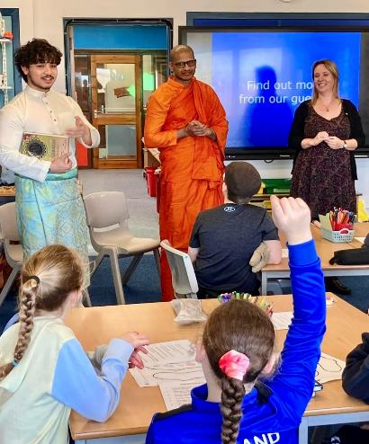
Encouraging Encounter and Learning about Diversity
Scotland’s Anti-Racist Curriculum Principles promote learning about the diverse communities in Scotland and beyond. To improve understanding of different religion and belief groups and cultures it would be helpful to create opportunities for engagement with them.
You could have visiting speakers from different faiths give a presentation about their faith.
Include books in libraries with stories from different faiths and cultures.
Have religious artefacts / objects young people can interact with, e.g. religious instruments they can play.
Increasing these opportunities can increase learners’ empathy for and understanding of others.
Notes:
SLIDE 24:
Scotland’s Anti-Racist Curriculum Principles (Breaking the mould: Principles for an anti-racist curriculum | Resources | Education Scotland) promote learning about the diverse communities in Scotland and beyond. This might include
Having speakers from different faiths give a presentation about their faith.
Including books in libraries with stories from different faiths and cultures
Having religious artefacts / objects young people can interact with, e.g. religious instruments they can play such as a singing bowl
Increasing these opportunities can increase learners’ empathy for and understanding of others.
If someone does choose to explain their faith then it should be noted that this may not necessarily be representative of all followers of that faith.
It is recommended that those speaking to pupils have some training in how to share their faith appropriately. Having an agreement between speakers and the setting about the broad content of any talk so that parents/carers and learners can be in informed in advance is also recommended. This could be provided by Interfaith Scotland. The organisation also has trained volunteers from different faiths who can speak at schools across Scotland. Contact admin@interfaithscotland.org for details.
An example of books for children showing religious and cultural diversity is ‘Hats of Faith’: Home - Hats of Faith
Religious objects can be purchased from various online sources, one of which is Religion (starbeck.education)
To find out more about the importance of embedding diversity in the curriculum, using practical approaches, please visit the Inclusion, Wellbeing and Equalities Professional Learning Framework resource on Diversity in the Curriculum: Mirrors and Windows.

Slide 25
Mood check-in
Enraged | Jittery | Shocked | Surprised | Excited | Ecstatic
Livid | Frustrated | Restless | Energised | Motivated | Cheerful
Anxious | Annoyed | Nervous | Pleased | Focussed | Hopeful
Troubled | Concerned | Uneasy | Calm | Content | Fulfilled
Pessimistic | Sad | Apathetic | Relaxed | Thoughtful | Balanced
Hopeless | Sullen | Drained | Sleepy | Peaceful | Serene
High energy
Low energy
Negative
Positive
Notes:
SLIDE 25
Today we have explored some issues which may be challenging to discuss and think about, including our own biases and harmful stereotypes. It's important that we take time to reflect and acknowledge the emotional impact having these discussions can have on us.
Ask participants to take a couple of minutes to look at the mood meter on the slide and think about how they might be feeling after this session. Which word summarises their feeling most accurately? Invite to share if they feel comfortable.

Slide 26
Reflection
From what you have learned so far, think about:
How has this made you feel?
What has this made you think about?
What one action would you like to take forward?
How can you link what you plan to do with others in your setting?
How you will know that this learning has made a difference?
Notes:
SLIDE 26
Participants can do this in groups.
Encourage educators to look at reflection questions and consider how they may be taken forward in enquiry.

Slide 27
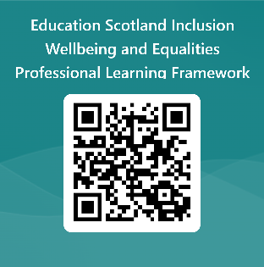
We value your feedback
Education Scotland is taking feedback on these resources so that we can continue improving our professional learning resources.
Your feedback could help us improve this resource
Please complete this short form, using the link or QR code, to let us know what you thought of it and any suggestions you have on how it could be improved
LINK: https://forms.office.com/e/J2NQUuCHji
Notes:
Slide 27: Feedback slide
Education Scotland is taking feedback on these resources so that we can continue improving our professional learning resources.
Your feedback could help us improve this resource
Please complete this short form, using the link or QR code, to let us know what you thought of it and any suggestions you have on how it could be improved

Slide 28
For Scotland's learners, with Scotland's educators
Do luchd-ionnsachaidh na h-Alba, le luchd-foghlaim Alba
Education Scotland
Denholm House
Almondvale Business Park
Almondvale Way
Livingston EH54 6GA
T +44 (0)131 244 5000
E enquiries@educationscotland.gsi.gov.uk

