Slide 1
Inclusion, Wellbeing and Equalities Professional Learning Framework
Impact of Inequality
Level – Informed
@ESInclusionTeam
For Scotland's learners, with Scotland's educators
Do luchd-ionnsachaidh na h-Alba, le luchd-foghlaim Alba
Notes:
Title slide
This professional learning is pitched at an informed level and suitable for anyone working with children and young people in an educational context.

Slide 2
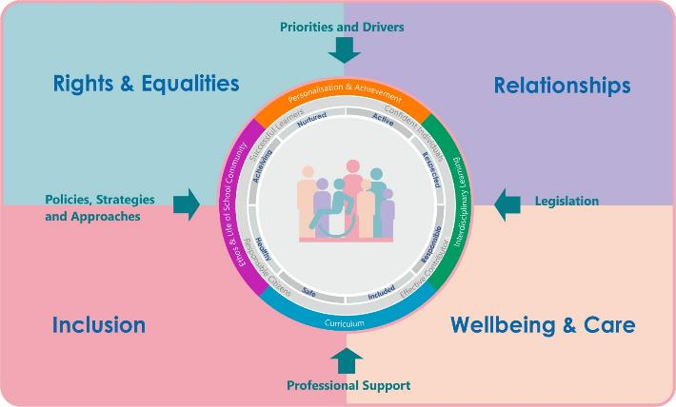
IWE Professional Learning Framework
Notes:
Slide 3
This professional learning resource comes under the Rights and Equalities theme of the Inclusion, Wellbeing and Equalities Professional Learning Framework.

Slide 3
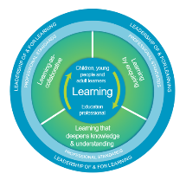
How to use this resource
Pause for Thought…
These slides can be used to facilitate professional learning in a group or whole-setting, or as a self-directed learning activity as an individual.
Facilitation notes are included at the bottom of each slide
Please do not remove or change any of the slides included.
Facilitators are welcome to add slides or activities relevant to your own setting, to support discussion and exploration of the topic. Facilitators will know their participants’ needs best.
Anyone who works in an educational setting can be a facilitator and use these slides.
For reflection or discussion activities, it is important to establish a safe space which encourages respect and honesty to ensure that everyone is able to participate.
Notes:
Slide 3
Option to skip slide as these are instructions for facilitators only. No need to read to audience.
These slides can be used to facilitate professional learning in a group or whole-setting, or as a self-directed learning activity as an individual.
Facilitation notes are included at the bottom of each slide
Please do not remove or change any of the slides included.
Facilitators are welcome to add slides or activities relevant to your own setting, to support discussion and exploration of the topic. Facilitators will know their participants’ needs best.
Anyone who works in an educational setting can be a facilitator and use these slides.
For reflection or discussion activities, it is important to establish a safe space which encourages respect and honesty to ensure that everyone is able to participate.

Slide 4
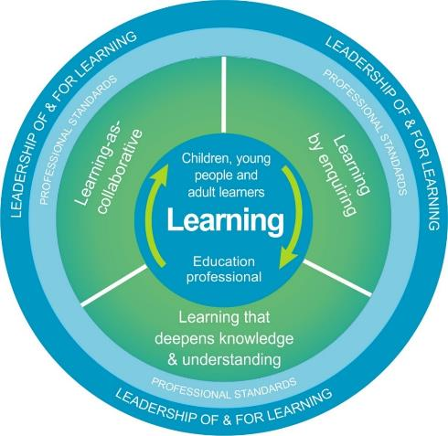
National Model for Professional Learning
This professional learning resource will support you to deepen your knowledge and understanding.
You will have the opportunity to consider how to take this learning forward on your own and with others.
The National Model of Professional Learning (education.gov.scot)
Notes:
Slide 4
This professional learning forms part of the national model for professional learning and is designed to help you gain more knowledge and have a deeper understanding of inclusion, wellbeing and equalities
On completion of this professional learning, you will be asked to consider what your next steps will be
Please take some time to consider the reflection questions at the end

Slide 5
Welcome
Pause for Thought…
This session aims to provide an opportunity to:
Explore what impact different forms of inequality can have on individuals who experience them
Consider how these barriers may present themselves in education
Notes:
Slide 5
This session aims to provide an opportunity to:
Explore what impact different forms of inequality can have on individuals who experience them
Consider how these barriers may present themselves in education

Slide 6
Linguistic
Religious
Pause for Thought…
Socioeconomic
Ethnic/Cultural/Racial
Diversity
Disability
Gender/Sex
Neurodiversity
Sexual Orientation
Age
Family
Notes:
Slide 6
You might have explored the concept of diversity and different identities/characteristics in the professional learning 'Mirrors and Windows: Diversity in the Curriculum. In the next few slides we will be focusing on the impact of inequality on some of the characteristics listed above.

Slide 7
Allport's scale
Societal inequality
Harmful behaviours
Discrimination
Avoidance
Antilocution
Pause for Thought…
Mass discrimination, violence, political and economic inequality
Violence, hate crimes
Denying jobs, services and rights
Avoiding interaction, excluding people
Stereotypes, bias, discriminatory speech 'banter'
Notes:
Slide 7
This image shows Allport's scale which was created by Gordon Allport after the second world war to show how antilocution (or negative speech and propaganda) can pave the way for societal violence, and in the case of WW2, genocide. But it can be adapted to explore the impact of all forms of inequality, if we consider gender inequality as an example, Allport's scale displays how everyday gender stereotypes build towards societal violence and create excuses for it. This lays the foundation for discrimination, and harmful behaviours both on an individual and a wider society level.
The behaviours at the bottom of the pyramid provide a strong foundation for the behaviours at the top and allow for the progression through the stages. The most effective way to prevent the impact of inequality, in terms of gender based violence for example, is through early intervention and disrupting and deconstructing the low level language and behaviours we see at the bottom.

Slide 8
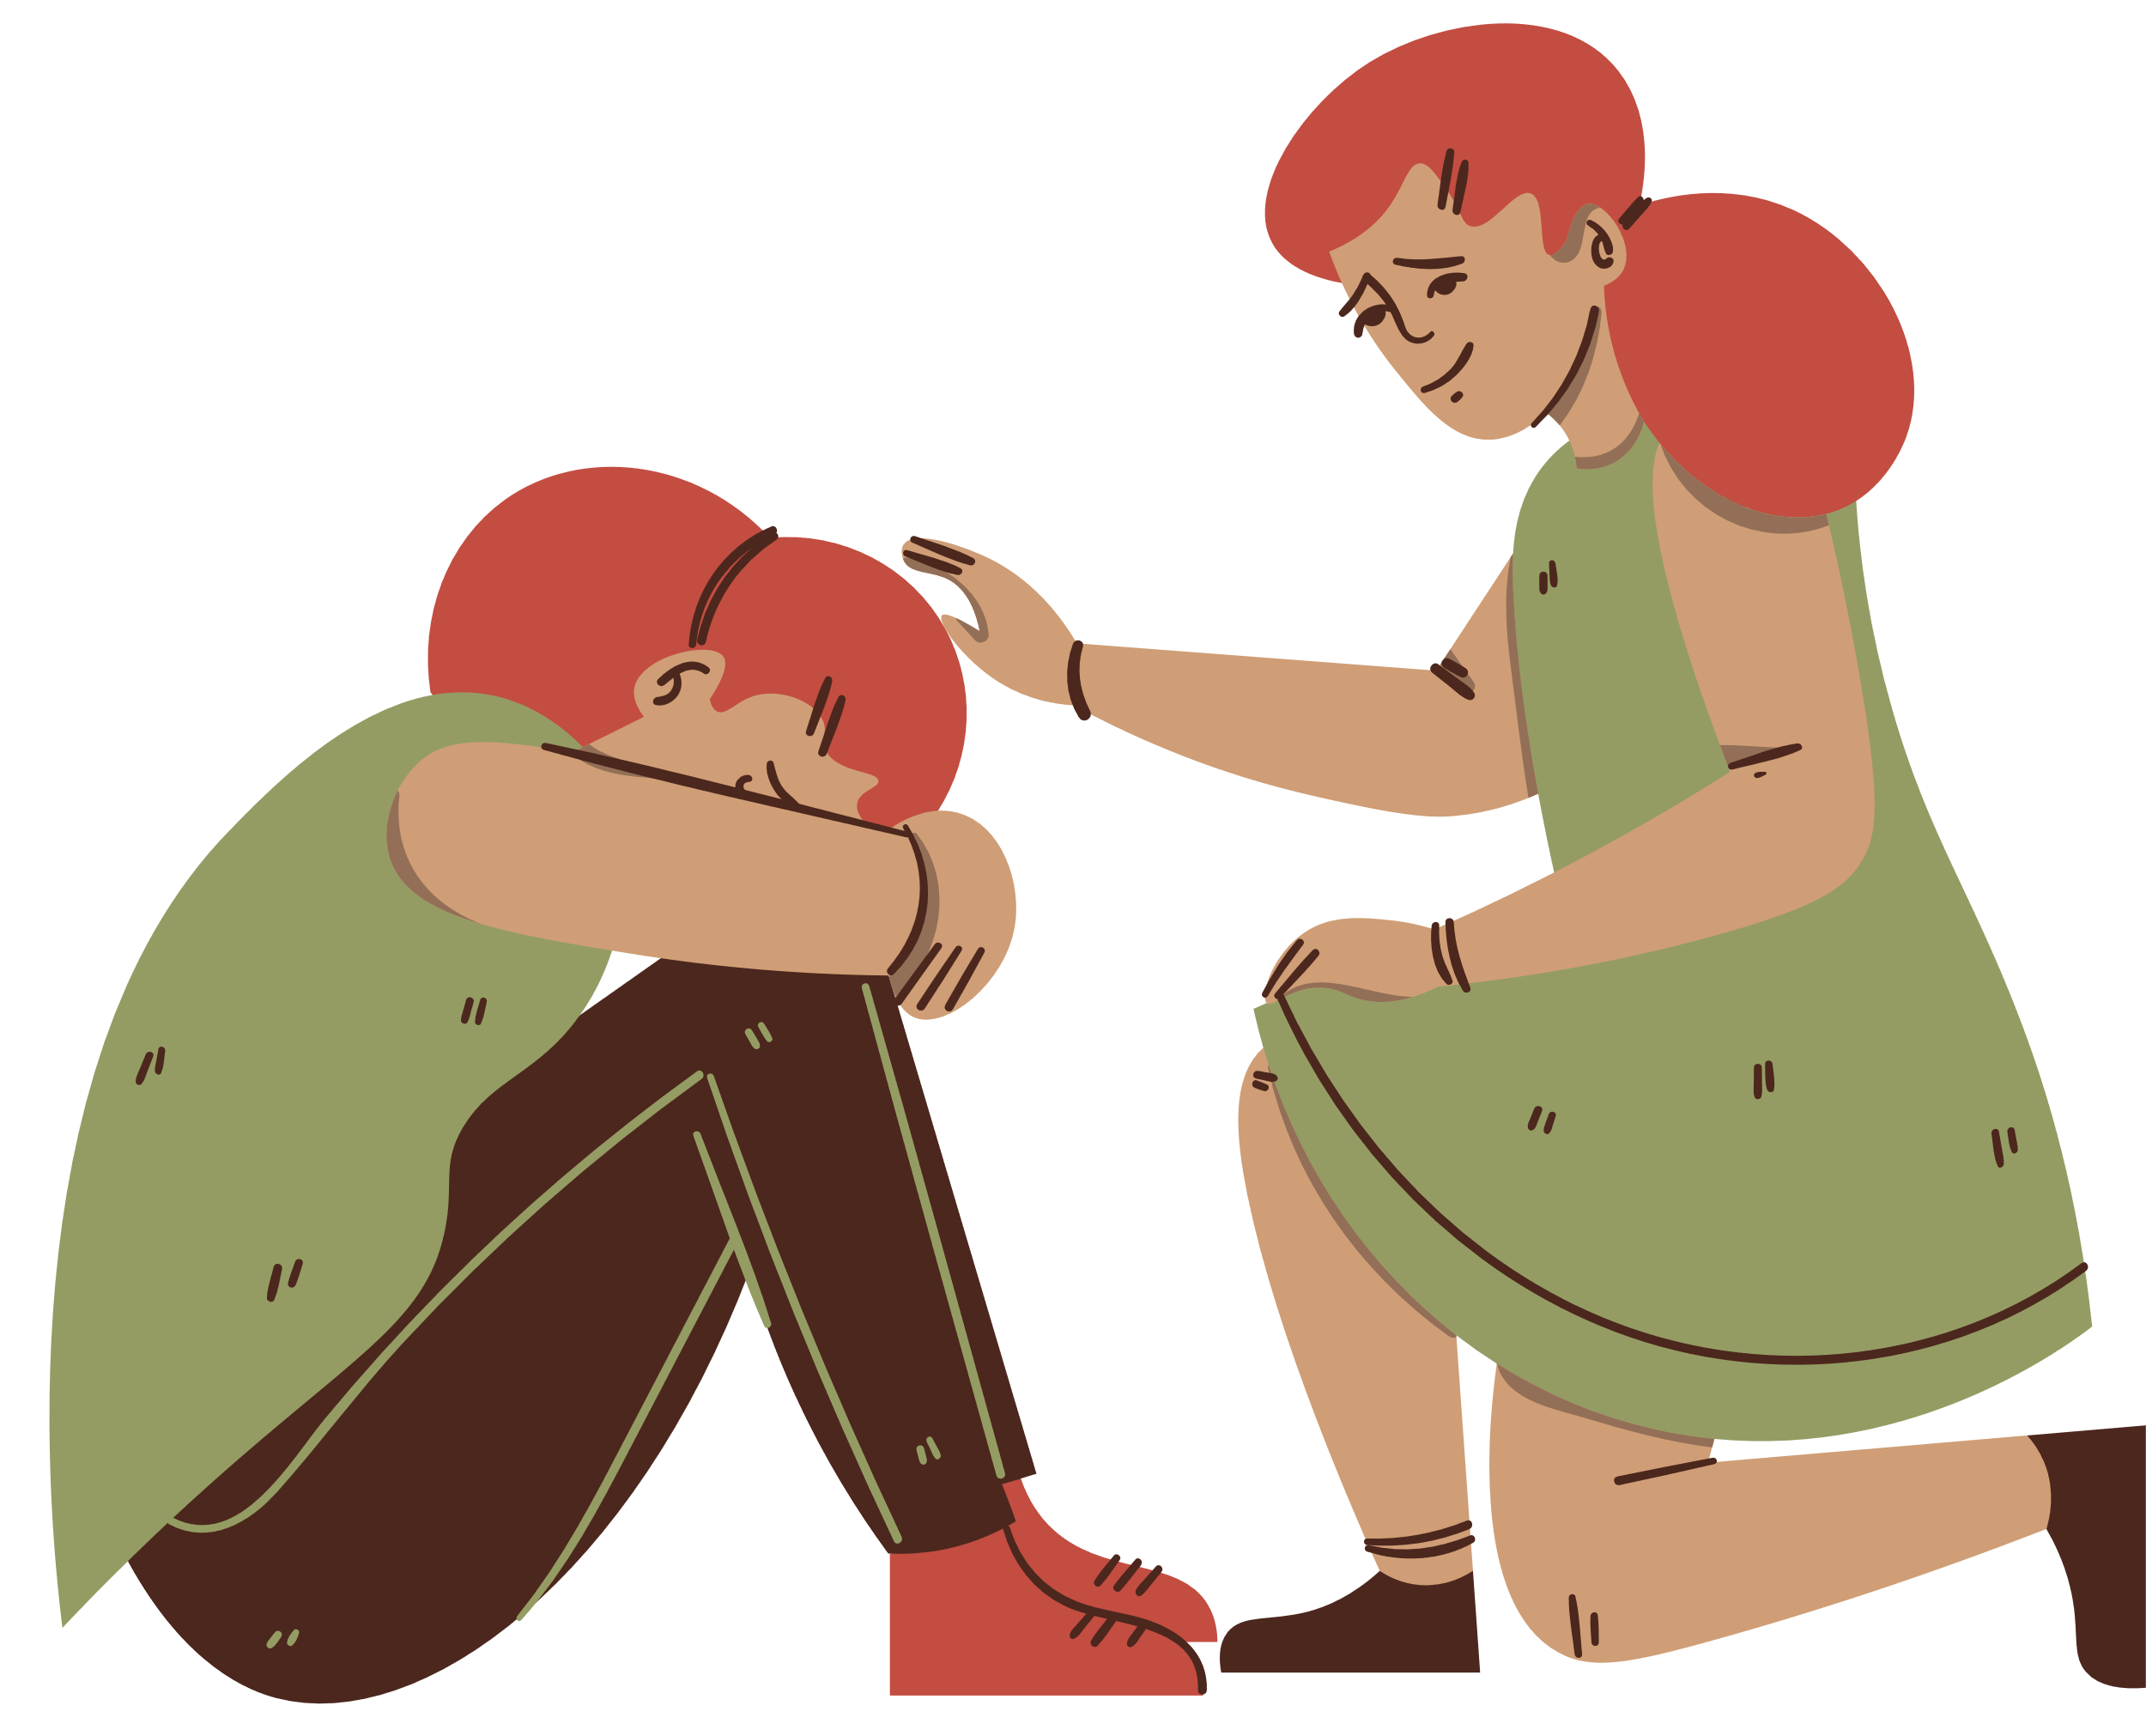
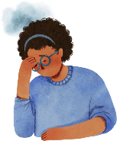
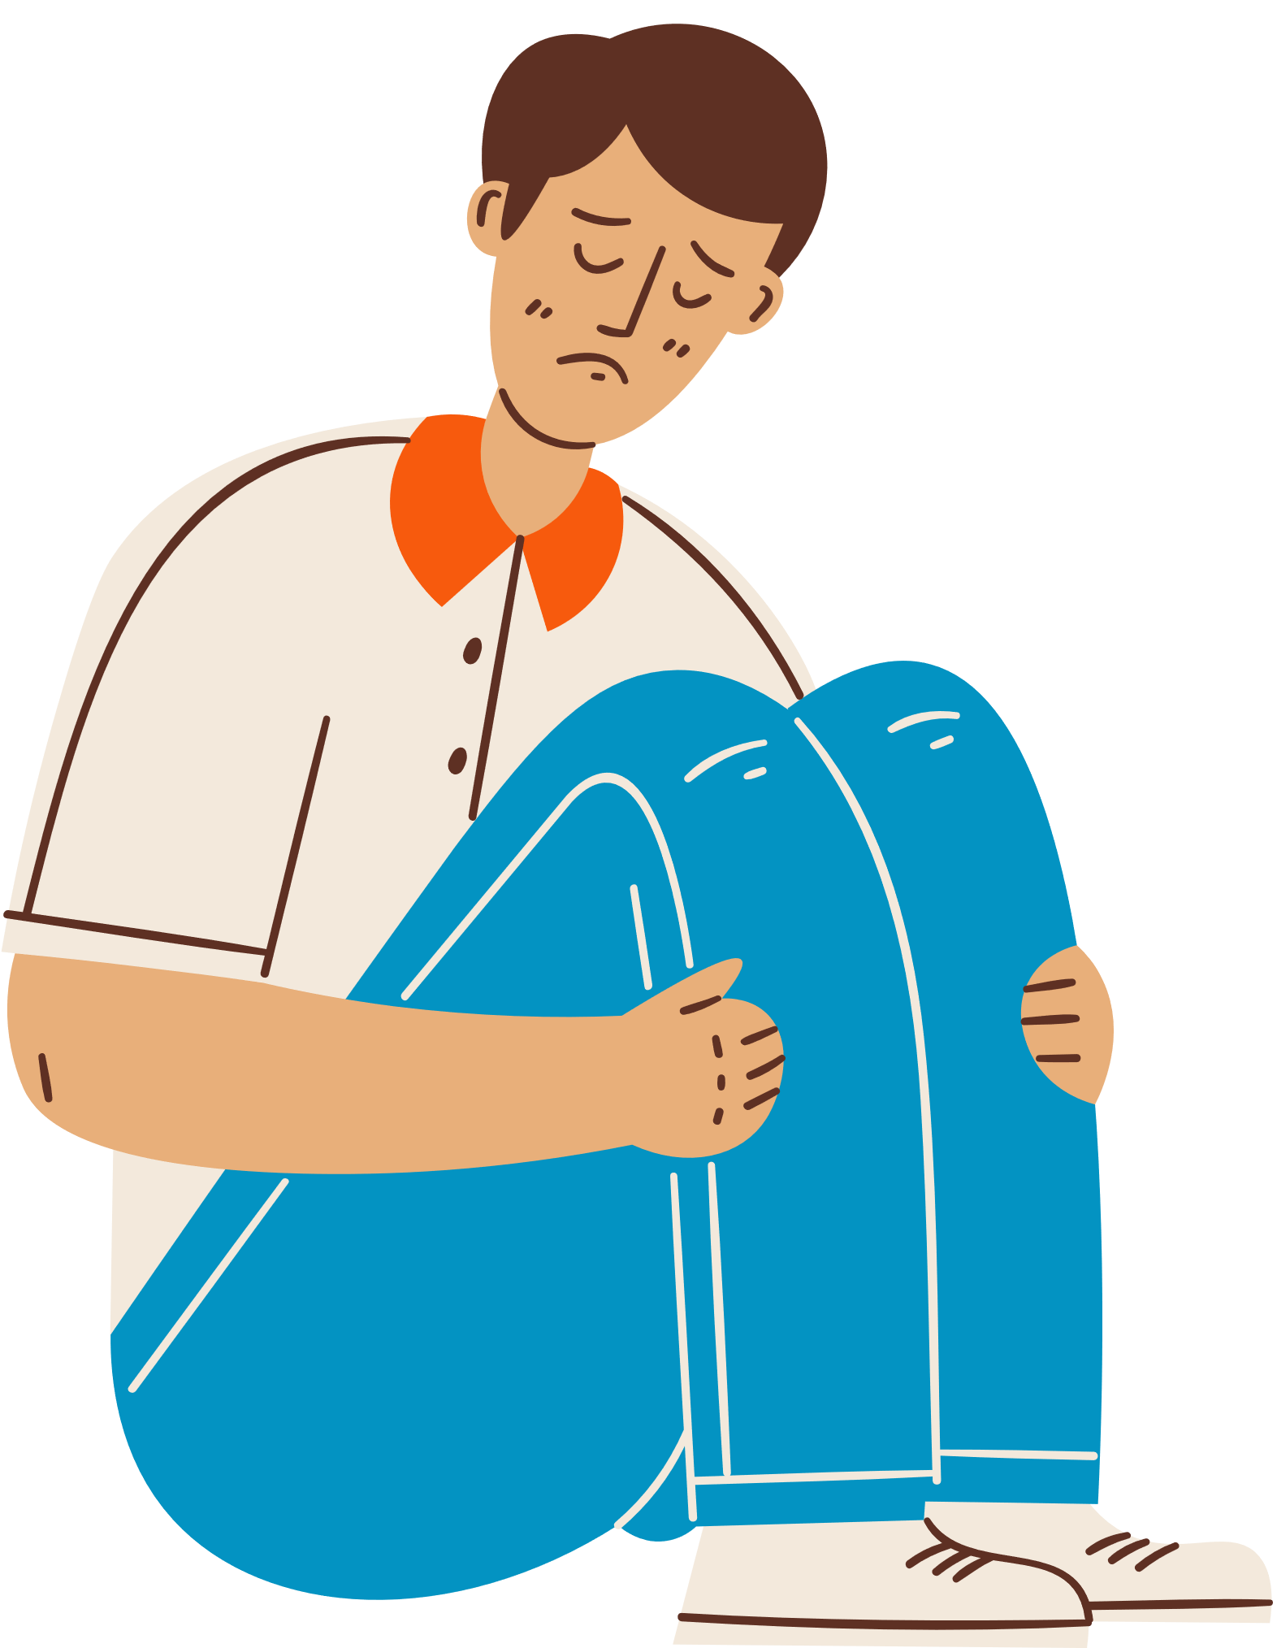
Impact
Inequality
Bias
Stereotypes
Violence
Notes:
Slide 8
Unfortunately, inequality can result in a vicious cycle that causes more inequality. This is because inequality causes stereotypes and bias, which can result in increased inequality. All of this can in turn result in societal violence which again can cause further inequality.

Slide 9
Impact of Inequality on Wellbeing
LGBT Discrimination
Gender Based Violence
Racism
Poverty
Disability Discrimination
Care Experienced Discrimination
Notes:
Slide 9
Above are a few examples of the impact of inequality on wellbeing but there are many more that we haven’t had space to include.
LGBT Discrimination
Stonewall and LGBT Youth Scotland identify inequality as a root cause of homophobia, biphobia and transphobia. 67% of participants report experiencing homophobic, biphobic or transphobic bullying during their time in school. (LiS Education Report 2023 (lgbtyouth.org.uk)
Gender Based Violence
Gender Based Violence refers to crimes such as rape, domestic abuse, stalking, and forced marriage that are overwhelmingly but not exclusively carried out by men against women. Gender Based Violence is a symptom of gender inequality. Research shows that the root cause of gender-based violence is gender inequality and that levels of violence against women are significantly and consistently higher in societies, communities and relationships where there are more rigid distinctions between the roles of men and women. 91% of school aged girls considered sexual harassment to be a problem at their school, but a report that came out recently found that 97% of women in the UK have experienced sexual harassment. (YWL-Report-FINAL.pdf (parliament.scot))
Racism
The mental health impacts of racism can lead to children and young people disengaging with education and feelings of alienation and isolation. Young people from racialised minorities described ways in which they were categorised and seen as ‘Other’ by accent, colour, faith, dress, nationality and ethnicity. Racial slurs were experienced as well as more recently recognised forms of racism such as islamophobia (anti-Muslim prejudice), anti-immigration attitudes and religious intolerance. In schools, racist comments were more common in primary and lower secondary stages. Experiencing anti-Muslim racism was also described by some participants; this was felt to be gendered as the wearing the hijab or niqab by girls was a more visible marker of being Muslim. (Insight 16 (2005) ‘Minority Ethnic Pupils’ Experiences of School in Scotland’, Guyan K 2019 The Perceptions and experiences of Black, Asian and Minority Ethnic young people in Scottish schools)
Poverty
Children are more likely to be in poverty across all measures compared to adults. Some types of households with children are known to be at a particularly high risk of poverty. These include households with single parents, three or more children, disabled household members, of a minority ethnic background, with a child aged under one, or a mother aged under 25. Poverty can often overlap with other areas of inequality. (Poverty and Income Inequality in Scotland 2019-22 (data.gov.scot))
Disability Discrimination
The World Health Organisation in collaboration with the World Bank recently stated that 15% of the world’s population, approximately one billion, live with some form of disability. Across the world, people with disabilities have poorer health outcomes, lower educational achievements, less economic participation and higher rates of poverty than people without disabilities. This is partly because people with disabilities experience significant barriers in accessing basic services, including health, education and employment. Studies have highlighted that disabled children have poorer experiences of school, lower expectations in teen years and experiences of social isolation that all impact on children and young people's wellbeing.
(Disabled Children and the Equality Act 2010: What Early Years providers need to know and do (councilfordisabledchildren.org.uk), Children with disabilities are being denied equal opportunities for a quality education across the world, including in the UK | University of Cambridge
Care Experienced Discrimination
Discrimination against care experienced children and young people has a significant impact on mental health. The latest measure of the emotional and behavioural health of looked after children using the Strengths and Difficulties Questionnaire (SDQ) found that 37% had scores considered a cause for concern, compared to 12% of children in the general population. Barnardo’s surveyed care leavers and found that 46% were identified as having mental health needs, with 65% of them not receiving any form of statutory support (The Care Leavers’ Association, 2017; Social Market Foundation, 2018, Alliance For Children In Care And Care Leavers, 2017).

Slide 10
Impact of Gender Inequality: Gender Based Violence
5.37 mins
Notes:
Slide 10
Out of the Box - Together for Gender Equality aims to engage the viewers to understand the key concepts around gender stereotypes, violence against women and girls and gender inequality in our society: Out of the Box - Together for Gender Equality - YouTube
International research and Scottish strategy identify gender inequality as a root cause of violence against women and girls, and despite the many advances being made there remain persistent inequalities between men and women. Evidence shows that levels of violence against women are significantly and consistently higher in societies, communities and relationships where there are more rigid distinctions between the roles of men and women.
One in three women will experience gender based violence in their lifetime, one in five children in the UK will have experienced domestic abuse by the time they reach 18. This means that all staff are in unique positions to support children and young people experiencing domestic abuse and ensure they are safeguarded. As a result of the COVID-19 lockdown measures, children and young people experiencing domestic abuse are at increased levels of risk. They are recognised in Scottish Government guidance as a vulnerable group who may need to attend school in person during lockdown.
We need to also consider how we talk about gender based violence with children and young people. How young people understand violence, and in particular, gender based violence, is seriously impacted by gender stereotypes and roles. Research conducted by Nancy Lombard at Glasgow Caledonian University explored young people's interpretation of the term 'violence'. This research found that young people only regarded an act as violent when it involved a physical altercation, between two men or boys, with an intervention from someone in a position of authority and a consequence. This means that forms of gender based violence are not considered to be 'real' violence by young people, which may result in minimisation and normalisation of incidents, and an unwillingness to report.
Domestic abuse guidance: https://education.gov.scot/improvement/self-evaluation/domestic-abuse-information-for-educators/

Slide 11
Impact of Inequality: Racism
6.53mins
Notes:
Slide 11
This short video highlights the impact of racism and the need for anti-racist education: We Are All Special: Newark Primary Against Racism - YouTube
Research with learners from racialised minorities over the last two decades suggests that for these learners, even if they are not part of a visible minority, racism is a part of everyday life (Insight 16 2005, Guyan 2019). An online survey of 110 young people racialised minorities from Scottish secondary schools (Guyan 2019) found that a high proportion of girls and young women and over half of boys and young men felt that other pupils did not understand their culture, heritage or background and this figure rose to 70-80% of respondents in relation to staff understanding.
Scotland’s teaching profession does not reflect the demographics of Scotland. The Educational Institute of Scotland conducted a survey of members from racialised minorities in 2018 on this matter, which found that a significant majority (71%, or nearly three-quarters) of all respondents had experienced racism in their capacity as a teacher or lecturer.
The mental health impacts of racism can lead to children and young people disengaging with education and feelings of alienation and isolation. It’s worth also highlighting that if a young person is facing multiple inequalities this will compound the impact of inequality and increase barriers to wellbeing, participation and achievement in a learning environment.

Slide 12
When Diversity is Lacking in the Curriculum
Missing perspectives
Absorption of biases & prejudice
Masking
diversity
Less empathy & understanding
Internalising stereotypes
Discrimination & bullying
Notes:
Slide 12
Inequality can show up in the curriculum as well. When diversity is lacking in the curriculum...
Perspectives are missing. The curriculum is incomplete and inaccurate. Knowledge is shared from a monocultural, monolinguistic, narrow perspective of the world. The dominant perspective (often white, male, middle class, cisgendered, heterosexual, able-bodied, neurotypical, English-speaking, Christian...) is seen as "normal" and everything else is considered "other."
As a result, learners put in a lot of effort to fit into the narrow "norm." This often means spending a lot of time masking their diversity (e.g. pretending to be neurotypical, not speaking any other language than English, hiding their religion/home culture and food, changing their name and accent, pretending they don't experience or provide care, pretending they aren't experiencing poverty, etc.)
Diverse learners also risk internalising stereotypes and negative messages about themselves that limit their potential and their aspirations (e.g. choosing career paths based on gender, race, social class, etc., believing they can't do well in X subject because of their diverse identity, etc.)
Every learner risks absorbing biases and prejudiced ideas that exist in a curriculum that lacks diversity (e.g. believing stereotypes about groups that don't share the same identities as them and developing unconscious/implicit biases about girls, LGBT people, Black people, Jewish people, etc.)
As a result of prejudiced ideas and narrow perspectives on diverse people, learners have less empathy and less of an understanding of the lives and perspectives of diverse people
This can lead to an increase in discrimination and bullying.

Slide 13
Impact of inequality on confidence and identity
Perceptions of cleverness
Race
Class
Gender
“Identifications with ‘cleverness’ are not simply derived from academic attainment but are profoundly racialised, classed and gendered - cleverness is aligned with middle-class, white, masculinity.” (Archer et al., 2020)
For Scotland's learners, with Scotland's educators
For Scotland's learners, with Scotland's educators
Do luchd-ionnsachaidh na h-Alba, le luchd-foghlaim Alba
Notes:
Slide 13
The Aspires 2 Report, a 10 year longitudinal study run by UCL on young people’s perceptions of science examines cultural understanding of cleverness. The report then disaggregates the data so we’re able to see a full picture of who sees themselves as clever and why.
The Aspires 2 Report confirms that ‘Identifications with ‘cleverness’ are not just based on academic attainment but are very racialised, classed and gendered. Cleverness is aligned with middle-class, whiteness and masculinity. In other words, girls, working-class and minority ethnic students found it hard to be recognized as ‘clever’, regardless of their attainment.
For young people who don’t feel they fit this definition of ‘clever’ – whether they are attaining well or not, their self-efficacy is likely to be impacted. It is important to emphasise that this is not because of innate ability or ‘real’ cleverness but because of perceptions of cleverness.
(Archer, L., Moote, J., MacLeod, E., Francis, B., & DeWitt, J. (2020). ASPIRES 2: Young people’s science and career aspirations, age 10-19. London: UCL Institute of Education.)

Slide 14
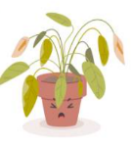
Mood check-in
Enraged | Jittery | Shocked | Surprised | Excited | Ecstatic
Livid | Frustrated | Restless | Energised | Motivated | Cheerful
Anxious | Annoyed | Nervous | Pleased | Focussed | Hopeful
Troubled | Concerned | Uneasy | Calm | Content | Fulfilled
Pessimistic | Sad | Apathetic | Relaxed | Thoughtful | Balanced
Hopeless | Sullen | Drained | Sleepy | Peaceful | Serene
High energy
Low energy
Negative
Positive
Notes:
Slide 14
We have explored some issues which may be challenging to discuss and think about, including our own biases and harmful stereotypes. It's important that we take time to reflect and acknowledge the emotional impact having these discussions can have on us. T
Ask participants to take a couple of minutes to look at the mood meter on the slide and think about how they might be feeling after this session. Which word summarises their feeling most accurately? Invite to share if they feel comfortable.

Slide 15
Reflection
From what you have learned so far, think about:
How has this made you feel?
What has this made you think about?
What one action would you like to take forward?
How can you link what you plan to do with others in your setting?
How you will know that this learning has made a difference?
Notes:
Slide 15
Participants can do this in groups or as an individual.
Encourage educators to look at reflection questions and consider how they may be taken forward in enquiry.
Consider the impact of the actions on learning.

Slide 16
Reflection
From what you have learned so far, think about:
How has this made you feel?
What has this made you think about?
What one action would you like to take forward?
How can you link what you plan to do with others in your setting?
How you will know that this learning has made a difference?
Notes:
Slide 15
You can do this individually or in a group.

Slide 17
Resources and Information to Help
Equally Safe at School | A whole school approach to preventing gender based violence
The Cost of the School Day Programme, Child Poverty Action Group
Promoting race equality and anti-racist education
Time for Inclusive Education (TIE)
Improving Gender Balance Self-evaluation Framework
Guiding principles for developing and selecting resources that promote equality and diversity
Notes:
Slide 16
These links provide opportunities to further explore the impact of equalities and how we can remove barriers for children and young people.

Slide 18
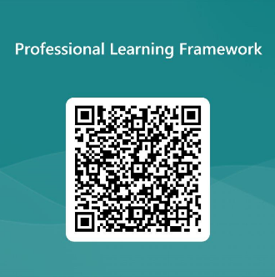
We value your feedback
From now until March 2024 we will be taking feedback on these resources so that we can make changes in advance of a formal launch of the Professional Learning Framework in June 2024
Your feedback could help us improve this resource
Please complete this short form, using the link or QR code, to let us know what you thought of it and any suggestions you have on how it could be improved
LINK: https://forms.office.com/e/b5PCpJJJ3P
Notes:
Slide 17

