Slide 1
Modern and Historic Enslavement
Level 3

Slide 2
Use of Pictures
Images used in this resource are ones that can be used under copyright rules and there is a direct link and their citation in the Notes section of each slide.

Slide 3
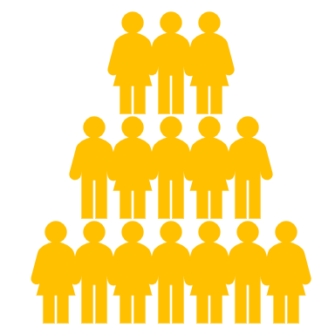
The key questions
Class discussion
What is slavery?
How do people become enslaved?
Why does slavery exist?
What are the different forms of slavery?
When and where did slavery occur in the past?
Where does slavery occur in the present day?

Slide 4
What is slavery?
How do people become enslaved?
Why does slavery exist?
What are the different types of slavery?
When and where did slavery occur in the past?
Where does slavery occur in the present day?

Slide 5
How do people become enslaved?
People become enslaved for lots of reasons. Often, because they are poor and their basic rights are not protected.
Lack of access to work, land, education and the lack of enforcement of laws prohibiting the holding of people in bondage, result in slavery. Slavery provides ‘employers’ with a form of extremely cheap labour which they will fight to hold on to.
A person who is poor and in need of money, perhaps for an emergency or because one of the family is ill, finds it hard to get a loan. The only option is to pledge their labour to repay their debt.
Some resort to selling one of their children. People who are enslaved are usually unaware that they have legal rights to freedom or are unable to take action to defend their rights, because of the threat of violence.
They may be bound by a sense of misplaced duty or may be mentally accustomed only to slavery. Slavery is illegal in virtually every country worldwide, but governments are rarely willing to enforce the law or to punish those who profit from slavery.

Slide 6
Modern Day Slavery
What is slavery?
How do people become enslaved?
Why does slavery exist?
What is slavery?
How do people become enslaved?
Why does slavery exist?
What are the different types of slavery?
When and where did slavery occur in the past?
Where does slavery occur in the present day?
What are the different types of slavery?
When and where did slavery occur in the past?
Where does slavery occur in the present day?

Slide 7
The G20 are 19 of the world’s most advanced and powerful countries including the European Union.
You’ll be split into groups of three.
Once you are in your group, the youngest member gets the first pick of a country, then the next youngest, then the oldest.
For now, record your group and country.
Group A
Argentina
Brazil
Mexico
Group B
Australia
Canada
United States
Group C
China
India
Russia
Group D
Indonesia
Japan
South Korea
Group E
France
German
Italy
Group F
Saudi Arabia
South Africa
Turkey
Notes:
Picture is taken from Wikipedia commons: https://commons.wikimedia.org/wiki/File:Equipe_de_Jair_Bolsonaro_e_de_Lee_Hsien-Loong_na_14.%C2%AA_reuni%C3%A3o_de_c%C3%BApula_do_G20.jpg
https://www.flickr.com/photos/palaciodoplanalto/48149896372/in/photostream/

Slide 8
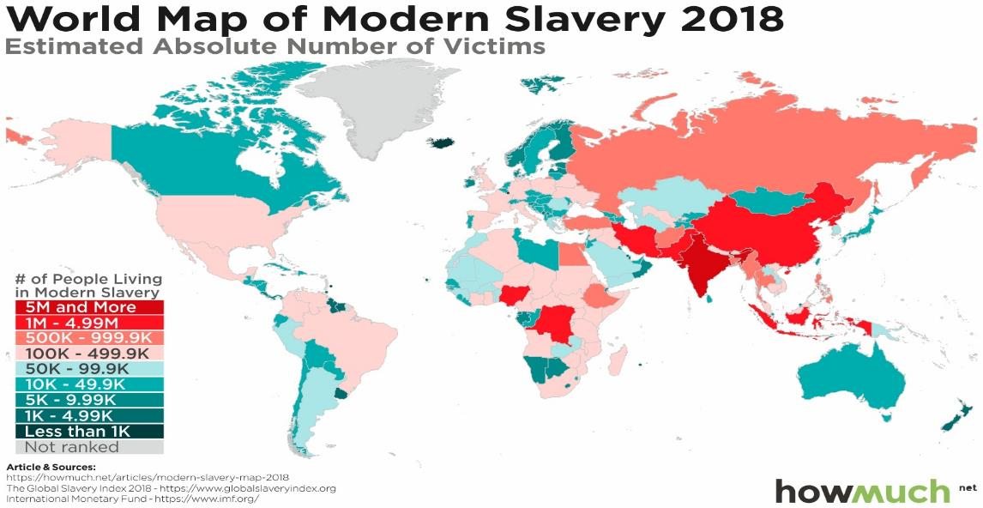
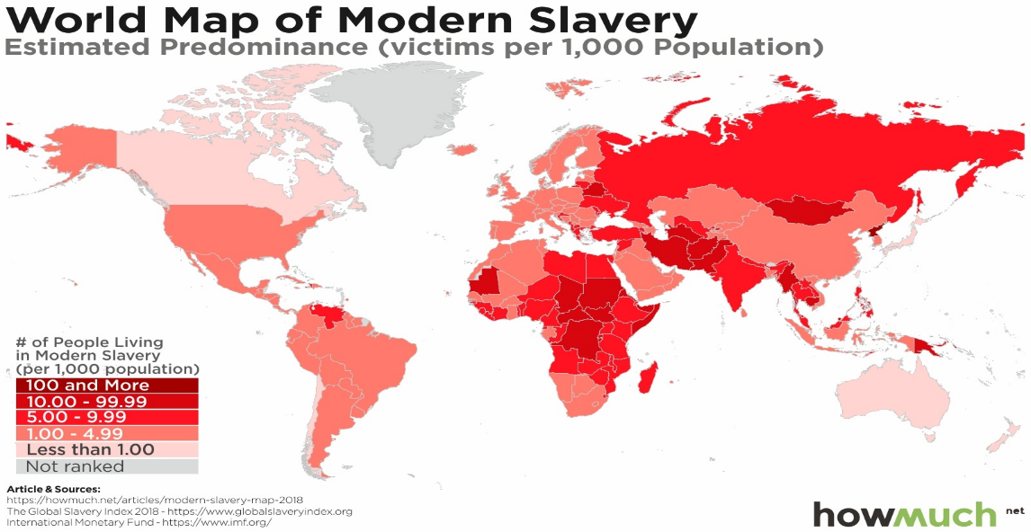
Where does slavery happen in the present day?
You are going to be given access to two maps that track modern day slavery in different ways.
The first map shows the estimated number of people in a country that are a victim of modern-day slavery (click here to go to map 1).
The second map shows how common it is to be enslaved in that country, as it shows how many enslaved there are per 1,000 people (click here to go to map 2).
Notes:
Answers:
First map – Britain is in the 99-

Slide 9
Where does slavery happen in the present day?
Before you do it for the country you’ve picked, what do the maps tell us about the United Kingdom?
Now do it for the country you have chosen, writing it out in the same format as above.
There are between 100k-499k enslaved people living in the UK.
For every 1000 people in the UK, between 1-4.9 are enslaved.
Group A
Argentina
Brazil
Mexico
Group B
Australia
Canada
United States
Group C
China
India
Russia
Group D
Indonesia
Japan
South Korea
Group E
France
German
Italy
Group F
Saudi Arabia
South Africa
Turkey

Slide 10
Click to
return
Notes:
Source: HowMuch.net, a financial literacy website.
Direct link: https://cdn.howmuch.net/articles/Estimated-absolute-number-of-victims-2-97a8-b9a4.jpg
Usage policy: must link image to their website and use text in first line of notes.

Slide 11
Click to
return
Notes:
Source: HowMuch.net, a financial literacy website.
Direct link: https://cdn.howmuch.net/articles/Estimated-prevalence-%28per-1%2C000-population%29-52b5-eb17.jpg
Usage policy: must link image to their website and use text in first line of notes.

Slide 12
Individual work
Once you have discovered details for your country, record them.
Then, using the internet, find out three facts about the country you have been focusing on and modern-day slavery. Record these.
Internet work
Group A
Argentina
Brazil
Mexico
Group B
Australia
Canada
United States
Group C
China
India
Russia
Group D
Indonesia
Japan
South Korea
Group E
France
German
Italy
Group F
Saudi Arabia
South Africa
Turkey
Notes:
Answers:
First map – Britain is in the 99-

Slide 13
With your group:
Find the total number of estimated enslaved people across your group’s three countries.
Share the three facts about your country and modern-day slavery, and as a group decide the most important or interesting fact for each country.
The total number of est. enslaved people in [first country], [second country] and [third country] is ________.
The country that has the highest proportion of enslaved people is ________, with ____ number of enslaved people per 1000.

Slide 14
Class feedback
Reporting back to the class, you need to
State which three countries your group investigated.
State the total number of enslaved people across your group’s three countries.
State which country had the highest number of enslaved people.
State which country had the highest proportion of enslaved people (number of enslaved people in every 1000 people).
State the most important or interesting fact for each country.

Slide 15
The different forms of slavery
Bonded labour – people become bonded labourers after falling into debt and being forced to work for free in an attempt to repay it. Many will never pay off their loans, and debt can be passed down through the generations.
Early and forced marriage – women continue to be married without consent, often while still girls, and forced into sexual and domestic servitude.
Child slavery – children are in slavery as domestic workers, forced labour – in, for example, the cocoa, cotton and fisheries industries – trafficked for labour and sexual exploitation, and used as child soldiers.
Debt bondage occurs when a person is forced to work to pay off a debt. They are tricked into working for little or no pay, with no control over their debt.
The United Nations says people trafficking is the third-largest global criminal industry behind drugs and arms trafficking.
Forced labour – where people are forced to work, usually with no payment, through violence or intimidation. Many find themselves trapped, often in a foreign country with no papers, and unable to leave.
Descent-based slavery – where people are born into slavery because their families belong to a class of "slaves" within a society. The status of "slave" passes from mother to child.
Trafficking – the transport or trade of people from one area to another and into conditions of slavery.
Your teacher will read out several different scenarios – which type of slavery are they describing?
Notes:
Definitions taken from: https://www.theguardian.com/global-development/2013/apr/03/modern-day-slavery-explainer

Slide 16
You should be able to answer or add to your answers for some of the key questions
What is slavery?
How do people become enslaved?
Why does slavery exist?
What is slavery?
How do people become enslaved?
Why does slavery exist?
What are the different types of slavery?
When and where did slavery occur in the past?
Where does slavery occur in the present day?
What are the different types of slavery?
When and where did slavery occur in the past?
Where does slavery occur in the present day?

Slide 17
Slavery throughout history
What is slavery?
What is slavery?
How do people become enslaved?
Why does slavery exist?
How do people become enslaved?
Why does slavery exist?
What are the different types of slavery?
When and where did slavery occur in the past?
Where does slavery occur in the present day?
What are the different types of slavery?
When and where did slavery occur in the past?
Where does slavery occur in the present day?

Slide 18
How long has slavery existed?
Evidence of slavery can be found in every major civilisation, from the ancient world to the modern day.
Discuss in pairs – why do you think slavery has existed throughout human history?
Paired work

Slide 19
Over the next few lessons you are going to focus on slavery across different time periods, examining primary and secondary sources to understand the similarities and the differences in the various contexts.
First, though, you are going to be given an article to read on each of these types of slavery:
Ancient Greek & Roman slavery
Viking slavery

Slide 20
Your task is to create a PowerPoint presentation on one of the versions of slavery you have read about.
Your presentation must address:
What roles the enslaved had in the chosen society?
Where were the enslaved mostly taken from, and why?
How the chosen society felt about the enslaved?
Each answer should include:
Use of a primary source.
Use of a secondary source.
Your own writing that tries to answer the question.

Slide 21
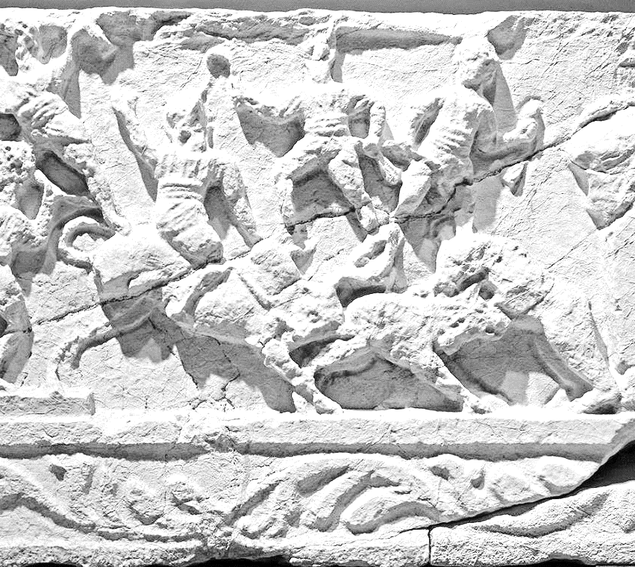
Ancient Greek & Roman slavery resources
Main article
Slavery in ancient Rome: how important were enslaved people to Roman society?
The Principles of Slavery in Ancient Greece
Primary sources mentioning "slave“
Spartacus Educational article with primary sources
“A free man?—There is no such thing! All men are slaves; some, slaves of money; some, of chance; others are forced, either by mass opinion, or the threatening law, to act against their nature.”
- Euripides
Spartacus the Gladiator podcast
Slavery in Ancient Greece
Notes:
“Burdur Museum Gladiator scene 3090.jpg”, Dosseman, https://commons.wikimedia.org/wiki/File:Burdur_Museum_Gladiator_scene_3090.jpg

Slide 22
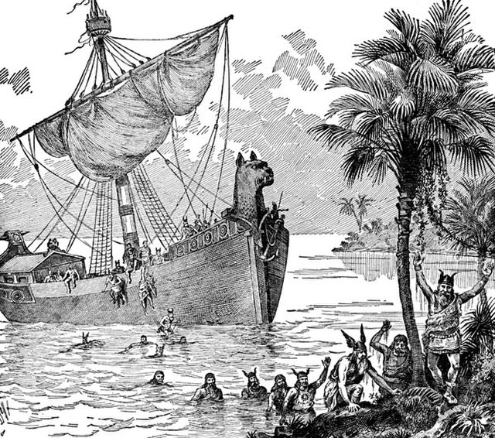
Viking slavery resources
Main article
What We Know About Vikings and Slaves
Danish museum on Viking slaves
Vikings abused and beheaded their slaves
Written sources for the Viking age
More primary sources on a range of Viking history
Vikings Primary Sources
“The Vikings were not only slavers, but the kidnapping, sale and forced exploitation of human beings was always a central pillar of their culture.”
- Professor Neil Price
The Vikings’ Slave Trade podcast
The Viking Slave Trade
Notes:
“An illustration of Vikings on a boat.”, John Clarke Ridpath, http://ushistoryimages.com/viking-boats.shtm

Slide 23
You should now be able to answer or add to your answers for some of the key questions
What is slavery?
How do people become enslaved?
Why does slavery exist?
What is slavery?
How do people become enslaved?
Why does slavery exist?
What are the different types of slavery?
When and where did slavery occur in the past?
Where does slavery occur in the present day?
What are the different types of slavery?
When and where did slavery occur in the past?
Where does slavery occur in the present day?

Slide 24
The Transatlantic Slave Trade
What is slavery?
What is slavery?
How do people become enslaved?
Why does slavery exist?
How do people become enslaved?
Why does slavery exist?
What are the different types of slavery?
When and where did slavery occur in the past?
Where does slavery occur in the present day?
What are the different types of slavery?
When and where did slavery occur in the past?
Where does slavery occur in the present day?

Slide 25
.
The Transatlantic Slave Trade involved the trade between the continents of Europe, Africa, and North & South American.
Merchants from Europe went south and brought African tribes cheap goods.
They exchanged these for African slaves, which they then transported over to the New World – North and South America.
The enslaved worked plantations and harvested different products, which were then taken back to Europe and sold.
Britain had lots of plantations in the West Indies.
These islands formed the West Indies. It is now called the Caribbean.
The enslaved produced raw materials such as:
Cotton Sugar Tobacco
Coffee Rice
Notes:
These are icons from within Powerpoint.

Slide 26
Video time
Crash Course: The Atlantic Slave Trade
Black American History:
The Transatlantic Slave Trade
Why did Europeans enslave Africans?
All of these videos are fast and information heavy – don’t worry about not understanding or remembering everything, you’re not expected to at this stage.
They are being shown to give you a rough overview of the topic.
When you watch them again, at the end of the lesson, think about how much your understanding has progressed.

Slide 27
The main European countries that were involved with the slave trade were:
The British
The Portuguese
The Spanish
The French
The Dutch
Britain was the biggest slaving nation after Portugal: it helped sell three million African people into slavery.

Slide 28
This map shows the volume and destination of the African enslaved transported across the Atlantic ocean
Europe had enough manpower to run its farms and other industries in its own countries, but needed more men for the labour-intensive plantations in their New World colonies

Slide 29
Historian Professor James Walvin has written an article that answers 7 of the key questions people have about the Transatlantic Slave Trade.
Your task is to summarise his answers as best as possible for each of the 7 questions.
7 Questions about the Transatlantic Slave Trade answered

Slide 30
How do you create an effective summary?
A summary provides a brief rundown of the main points of a text.
It means you can return to your notes and find what the text was discussing, without having to read it all again.
It is not a straight copy of the parts of the text that were important – instead it is a rewriting of the main ideas of the text.
So, with James Walvin’s article:
Find the main idea(s) contained in his answer for a question
Write this down in your own words, so that it is shorter than the answers he gave.

Slide 31
The questions
Why was it Africans who were enslaved?
Why did the slave trade last so long?
Why did the West turn against slavery?
How did slavery tie into the global economy?
What happened to slavery after abolition?
Was the slave trade a holocaust?
Have reparations been made since abolition?

Slide 32
Video time pt. 2
Crash Course: The Atlantic Slave Trade
Black American History:
The Transatlantic Slave Trade
Why did Europeans enslave Africans?

Slide 33
Summary questions
Working with a partner, answer these questions:
Which countries benefited from the Atlantic Slave Trade?
What goods were bought and sold in the Triangular Trade?
Why was New World slavery different from slavery in Greece/Rome, and Viking slavery?
Roughly how many Africans were transported during the slave trade?

Slide 34
You should now be able to answer or add to your answers for some of the key questions
What is slavery?
How do people become enslaved?
Why does slavery exist?
What is slavery?
How do people become enslaved?
Why does slavery exist?
What are the different types of slavery?
When and where did slavery occur in the past?
Where does slavery occur in the present day?
What are the different types of slavery?
When and where did slavery occur in the past?
Where does slavery occur in the present day?

Slide 35
Africa before Colonisation
What is slavery?
How do people become enslaved?
Why does slavery exist?
What is slavery?
How do people become enslaved?
Why does slavery exist?
What are the different types of slavery?
When and where did slavery occur in the past?
Where does slavery occur in the present day?
What are the different types of slavery?
When and where did slavery occur in the past?
Where does slavery occur in the present day?

Slide 36
True or false?
Did slavery exist in African cultures before the Europeans arrived?
Of course it did! Remember – slavery has been a feature of almost every civilisation on earth.
However slavery increased in Western Africa as a result of European traders wanting more enslaved Africans.

Slide 37
You will have to match the data to the kingdom
Kingdom | Ruler | Religion | Interesting facts
The Kingdom of Benin
The Mali Empire
The Kingdom of Kongo
The Songhai Empire
The Asante Empire

Slide 38
Match up: the religion
Christianity
Akan religion
Islam, traditional empire religion and Paganism
Islam
Edo

Slide 39
Match up: the ruler
This empire had kings known as Mansas.
The ruler of this Kingdom was known as the Mwene Kongo.
The King was known as the Asantehene.
Ruled by a king, known as the Oba.
The rulers of this Empire were known as Sonni or Shi.

Slide 40
Match up: the interesting facts
Sonni Ali is remembered as a strong military leader who greatly expanded the empire. After conquering Tuareg, he brought the Saharan trade routes to his kingdom.
The palace was decorated with intricate bronze work, made by skilled craftsmen.
The Golden Stool was a sacred object and symbol of unity and good fortune.
The kingdom produced vibrant embroidered textiles and sculptures made from ivory.
Some people remember this empire’s leader, Mansa Musa, as the wealthiest man who has ever lived.

Slide 41
Kingdom | Ruler | Religion | Interesting facts
The Kingdom of Benin | Ruled by a king, known as the Oba. | Edo | The Oba’s palace was decorated with intricate bronze work, made by skilled craftsmen.
The Mali Empire | Mali had kings known as Mansas. | Islam | Some people remember Mali’s leader, Mansa Musa, as the wealthiest man who has ever lived.
The Kingdom of Kongo | The ruler of the Kingdom of Kongo was known as the Mwene Kongo. | Christianity | The kingdom produced vibrant embroidered textiles and sculptures made from ivory.
The Songhai Empire | The rulers of the Songhai Empire were known as Sonni or Shi. | Islam, traditional Songhai religion and Paganism | Sonni Ali is remembered as a strong military leader who greatly expanded the empire. After conquering Tuareg, he brought the Saharan trade routes to his kingdom.
The Asante Empire | The King of the Asante was known as the Asantehene. | Akan religion | The Golden Stool was a sacred object and Asante symbol of unity and good fortune.

Slide 42
Posters
Your group is going to design a poster that will be filled with information about Africa, before parts of it were colonised.
You will use the information you have already learned, and you will watch an episode from the documentary series History of Africa.
The episode on ‘City States and Civilisations’ can be watched on the following slide.

Slide 43
Click below to watch the History of Africa episode:
City States and Civilisations

Slide 44
What was Africa like before colonisation?
You should now have a good understanding of what Africa was like before colonisation.
Pre-Colonial Africa Understanding Slavery Initiative article
Using what you have learned during this lesson, the two articles above and the internet if you require further evidence, write two or three paragraphs that describe what Africa was like before parts of it were colonised by European countries.

Slide 45
Scotland and the Transatlantic Slave Trade
What is slavery?
How do people become enslaved?
Why does slavery exist?
What is slavery?
How do people become enslaved?
Why does slavery exist?
What are the different types of slavery?
When and where did slavery occur in the past?
Where does slavery occur in the present day?
What are the different types of slavery?
When and where did slavery occur in the past?
Where does slavery occur in the present day?

Slide 46
Britain and the Atlantic Slave Trade
We have seen in the last lesson how Britain used the Atlantic Slave Trade to make great riches at home and abroad.
Britain has a longer history with Africa, having colonised some parts of the continent.

Slide 47
While Britain used enslaved people on its plantations in North America and the Caribbean, merchants also took Africans to sell in Britain.
Plantation owners would sometimes bring one or two African servants with them when they returned to Britain.
These Africans were often younger men and women, and there were quite a few who were footmen and servants for the richest families in England and Scotland.
These individuals became a prominent sign of wealth – to have a young African pageboy was to show how much money you had.

Slide 48
https://www.historyextra.com/period/early-modern/who-was-olaudah-equiano-facts-british-slavery-abolitionist/
Many people tried to defend slavery during the 18th century. Thomas Thompson, a missionary, said:
“Slavery then had its origins from a principle of humanity, and averseness to shedding blood. Conquerors, rather than slay those whom they took in war, chose to dispose of them in a milder way, and sold them into servitude.”

Slide 49
The work these individuals carried out was not as harsh as the work that those in the Caribbean or North American plantation fields faced.
Some of owners thought they were doing the Africans a favour by bringing them to work as their personal servant in Britain.
However, these individuals still did not have their freedom – they couldn’t quit or leave, they had to follow orders or be punished, they barely saw any money that they had earned through their work, and they could be sent away or sold on the whim of their owner.
There is one newspaper report of an African servant killing himself after he heard his owner talk about sending him to the plantations

Slide 50
Most of the surviving evidence about these enslaved individuals was created when they escaped from their situation.
When some ran away from their owners, and many did try to escape, their owners placed advertisements in newspapers across Britain, to try and have them recaptured.
The next slide contains an advertisement that was taken out in a newspaper in 1727 by Dr Gustavus Brown. He wanted the enslaved woman, Ann, to be recaptured and returned to him.

Slide 51
RUN away on the 7th Instant from Dr. Gustavus Brown’s Lodgings in Glasgow, a Black Woman, named Ann, being about 18 Years of Age, with a green Gown and a Brass Collar about her Neck, on which are engraved these Words [“Gustavus Brown in Dalkieth his Black, 1726.”] Whoever apprehends her, so as she may be recovered, shall have two Guineas Reward, and necessary Charges allowed by Laurance Dinwiddie Junior Merchant in Glasgow, or by James Mitchelson, Jeweller in Edinburgh.
Edinburgh Evening Courant
13 February 1727

Slide 52
The Challenge!
Each group will be given a real advertisement from Scotland to analyse, and must find the answers to specific questions
You will be given different roles during the challenge and will help your team by fulfilling them
Your teacher will split you into groups of six

Slide 53
TIMEKEEPER
RECORDER
REPORTER
Keeps the group aware of how long is left to complete the challenge.
Writes down the results of the group’s findings on the paper.
Reports back to the room on the group’s work and findings.
Team roles
FACILITATOR
REFLECTOR
RESEARCHER
Keeps the group on task and makes sure everyone manages to speak.
Checks that the team members are doing their role correctly, and that what is written down makes sense.
Quickly finds the relevant pages in Freedom Bound and informs the rest of the team.

Slide 54
Questions to answer
1. What features of the runaway enslaved person are described in all the advertisements, and why are these mentioned?
2. What else do you notice about your individual advertisement?
3. These adverts appeared in the everyday newspapers of the period. What does that tell us about Scottish society’s thoughts on slavery during this period?

Slide 55
Edinburgh Advertiser, 21 November 1769
ABSENTED himself from Edinburgh about 14 days ago, an American Black boy, by name James, about 16 years of age, with short curled hair, had on when he went away, a brown coat and vest and black stocking [trousers], he is very [tricky] and may endeavour to pass under some fictitious name. He took with him some shirts and silk stockings of his master’s, which he may offer for sale. Any person to whom he may offer them, or himself for service, will be so kind as to stop him, and [tell] the printer of this Paper, shall be satisfied for their trouble. All masters of [ships] and others are hereby cautioned against employing the said boy, as they may depend upon being prosecuted with the utmost rigour of the law. He has been seen [around Edinburgh] and may, if he cannot get service here, make off for the Highlands. Any person seeing him, please stop him and give notice as above.

Slide 56
Caledonian Mercury, 15th October 1739
Runaway from the Ship CHARLES, Henry Haramond [his] Master, now in the Road of Leith, a BLACK BOY named TONT, and known in Leith by the name of SIMONS. He had a blue Coat with white Metal Buttons and Canvas Trowsers on when he went away, which was on Sunday last. He speaks pretty plain English, and is supposed to be lurking about Edinburgh or Leith. Whoever can secure him so as to be delivered to Mr. John Jolly at Edinburgh, or Mr. James Crockatt at Beanstone near Haddington, shall be sufficiently rewarded.

Slide 57
Edinburgh Evening Courant, 23 July 1760
Run Away from the 20th Inst. From Mr David Fraser, at Hospital Field, near Arbroath, under indenture.
A BLACK LAD, going by the name of Samuel Ramsay, about eighteen years of age, smooth faced with short curly wool instead of hair. He went off in a [coarse wool] coat with white [metal] buttons and leather[trousers]. Whoever shall apprehend him shall have a reward of twenty shillings sterling and all charges born - Inform the publisher.

Slide 58
Caledonian Mercury, 2 February 1748
Gone from Castle-Semple, twelve miles from Glasgow, on Saturday the 30th January.
A BLACK LAD named CATO, the property of Colonel McDowall of Castle-Semple. Whoever secures him, so as to be returned to Colonel McDowall the Owner, or sends notice of his being in Custody to Alexander Houston, Merchant in Glasgow, or Andrew Wallace Writer to the Signet at Edinburgh, shall be sufficiently rewarded: And it is earnestly desired that no person may entertain him, as he has left his Master’s Service without any just cause.

Slide 59
Glasgow Journal, 20 September 1764
Since Thursday morning Last [a Native American] Young Lad about fourteen years of age, having black hair cut short about equal to his neck in length, with a hole cut through each ear about half an inch long, strayed or deserted from Glasgow, when he left his house he was bare leg’d and bare footed, a farmers hat on his head, a coarse very dark coat or frock, his vest of cloath chocolate colour, and blew gray [trousers], one of his eyelashes quite white and the other black. It [is requested] that whoever sees him may secure him, and send notice to the Printer of this paper, who will get them a proper reward, and payment for their trouble, the lad can scarce speak a word of English, and a little French tho’ not good.

Slide 60
Edinburgh Evening Courant, 14 September 1765
A MIXED RACE BOY… with only a short grey coat, vest and breeches of the same colour, without shoes or stockings. The name he went under was Sam, but same time names himself Donald; he has a squeaking voice; made his [escape] from Balnaguard on Atholle, Wednesday the 11th September, in the afternoon and was seen on his way to Perth, above eight miles above that place, Thursday the 12th. Therefore any person apprehending the said BOY shall be sufficiently rewarded and may write to Patrick Stewart senior merchant in Perth or to the proprietor Charles Robertson of Balnaguard. Which advertisement is ordered to be published in the Newspapers. All Shipmasters are desired not to carry the boy abroad; if found they may expect to be prosecuted.

Slide 61
Edinburgh Advertiser, 15 September 1769
Run Away from his master, upon Monday last, an EAST INDIA BLACK BOY called MERCURY about 13 years of age, well looked and pretty long featured, with long straight hair; - had on, when he went away, a blue cloth coat, with a red neck of scarlet cloth, and red button holes, and a waistcoat of the same with leather trousers, and stockings. His master will take it as a particular favour, in any person will give notice of him to the Publisher of the Edinburgh Courant; and if any persons shall be found concealing said black boy after this advertisement, they will prosecute in terms of law.

Slide 62
Caledonian Mercury, Wednesday 22nd December 1779
RUN AWAY from his Master at Greenock, on the 22nd of November last, A BLACK LAD, about 15 years of age, a stout healthy fellow, has been several voyages at sea, called NEPTUNE. –When he eloped, he was dressed in a new grey duffle coat and trousers, with a red vest, and plated buckles, but which probably he may have changed. He is an excellent barber, and shaves well, and is supposed to be lurking about Edinburgh or Leith, as he told some of his acquaintances, in passing through Glasgow, that he was going to Dalkeith, and where it is informed he was lately seen. He is under indentures to Mr Roger Stewart merchant in Greenock, for seven years from the 30th January 1778; but as he is [a tricky] fellow, he will [pretend to be] a free man.
Whoever can give information of the said Nepture, so as he may be apprehended for the breach of his indentures, will receive TEN GUINEAS of Reward, by applying to Mr Roger Stewart at Greenock, or to John Logan, at Robert Sym junior’s, writer to the signet.

Slide 63
At the same time as African children were being trafficked to Britain to work as unfree servants, free African children were also being sent to Britain by the families of rich Africans.
These individuals were being sent by their parents, who wanted them to learn from British businessmen and tradesmen, so that their children would learn the English language and the customs and traditions of the country.
This was an attempt to integrate their child with English society, so that the family would have a good network of contacts to use for business and grow their own social status and wealth.

Slide 64
Missionaries and Africa
British missionaries would travel to Africa to bring the Christian religion to the continent. They hoped they could save Africans by converting them to Christianity.
The British government hoped that converting locals to Christianity would strengthen their ties to Britain.
Missionaries are men and women of religion who travel to distant lands to spread the word of their God and convert new people to their religion.

Slide 65
Some of these missionaries came across small children in what they considered uncivilised conditions.
Some missionaries would ‘free’ the children from their situation and take them back to Scotland, where they thought they could provide a better life for the African children.
Usually this involved buying them from slavers, or sometimes purchasing them directly from their own families.
Many of the children living with their families would have been living a relatively normal life, but their family, being offered a lot of money, would have taken the offer and sold the child.

Slide 66
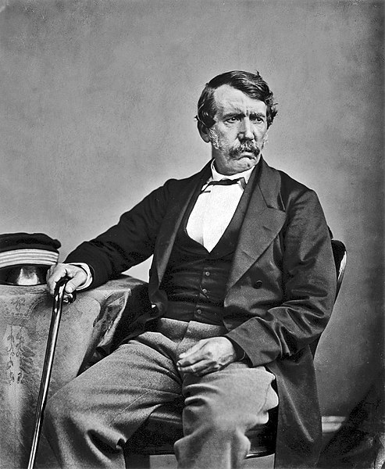
David Livingstone
One of Scotland’s most famous missionaries is David Livingstone.
Born in 1813 in Blantyre, Livingstone would be celebrated as one of Europe’s greatest explorers, as he spent long periods uncovering Africa for Britain.
Watch this short documentary of David Livingstone
In pairs, answer: What legacy does Livingstone have at the University of Glasgow?
Notes:
Picture is taken from Wikipedia commons: https://commons.wikimedia.org/wiki/File:David_Livingstone_-1.jpg

Slide 67
You are going to write an essay that will answer the question “How did David Livingstone impact African life?”
You will need to pick three moments of his life that best highlight how he impacted on African life.
It can be an individual African’s life, or it can be a wider impact on many Africans.
Use this Britannica profile of Livingstone as a start for information for your essay.
Remember, it must be in your own words.

Slide 68
Build a History Essay Burger!
Answer the question directly, and back up your answer by summarising the evidence you discussed in paragraphs 1-3. If relevant, state which of the three issues was most important in helping you reach your answer, and why.
Conclusion:
Paragraph 3:
Write about a third issue that helps to answer the question. Use evidence from sources to back up your ideas.
Link to Paragraph 3
Paragraph 2:
Write about a second issue that helps to answer the question. Use evidence from sources to back up your ideas.
Link to Paragraph 2
Make sure that you are writing about an issue that helps to answer the question. Use evidence from sources to back up your ideas.
Paragraph 1:
This is the ‘base’ on which you will build your essay, so make it strong! Mention the 3 main things you are going to talk about in your essay so that your teacher can see that you have a plan.
Introduction:

Slide 69
Students can use the PEEQS format for each paragraph to help them structure their arguments:
Point – the argument is presented.
Evidence – the learner provides evidence to back up their argument.
Explain – an explanation and importantly analysis of the evidence.
Qualify/contrast – the learner puts the argument in context, examining the other sides of the debate.
Summary – the learner summarises the paragraph.

Slide 70
Scotland, the Transatlantic Slave Trade, and Legacies of slavery
What is slavery?
How do people become enslaved?
Why does slavery exist?
What is slavery?
How do people become enslaved?
Why does slavery exist?
What are the different types of slavery?
When and where did slavery occur in the past?
Where does slavery occur in the present day?
What are the different types of slavery?
When and where did slavery occur in the past?
Where does slavery occur in the present day?

Slide 71
Scotland benefited from the Transatlantic Slave Trade in a number of ways:
The trade provided employment for thousands of people in Scotland who worked in cotton mills, tobacco warehousing, as well as on ships
There were lots of Scots who owned plantations abroad and made their fortune there, such as Robert Wedderburn and Richard Oswald
Some brought enslaved people back with them, while others used the money they made to purchase enslaved people and have them work as servants, maids, cooks or pageboys
Many Scots worked on plantations abroad (Robbie Burns nearly did!) or as accountants or managers linked to the slave trade

Slide 72
Overall, the massive amount of money made from slavery was felt across Scotland as newly rich families invested in agriculture, education, business, religion, improving Scotland’s countryside, towns and cities.
The money also helped fund the Industrial revolution, which accelerated the growth of Scotland (and Britain) as they and the Western world became developed powers on the World stage.
What kind of state do you think the Caribbean was left in, after hundreds of years of plantations?
What stunted Africa’s growth as a continent?

Slide 73
Think about some of the street names or statues in your nearest city, there will be at least one which was named after links to slavery.
Click the links below to find out more, then research your nearest city.
Edinburgh
Henry Dundas monument
Seven streets, buildings and statues linked to slavery
Glasgow
Gallery of Modern Art
Every street name in Glasgow that’s linked to slavery
Aberdeen
Aberdeen’s Slave Trade street names
Inverness
Historian finds far more links to slavery than he expected
Dundee
Dundee made lots of money selling linen sold to slave plantations
Dunfermline
Dunfermline street names & slavery

Slide 74
Legacies
In your groups, talk through the following questions:
If the technology company Apple was to stop tomorrow, what would its legacy be?
Are legacies important?
What are the legacies of the Transatlantic Slave Trade?

