Slide 1
Donald MacRitchie
Head of Projects
Go!Gaelic

Slide 2
Go! Gaelic
Overview of resource
Go! Gaelic App + other support resources
Current new resource developments
Resource wish list!

Slide 3
Go! Gaelic
GLE resource – L2 + L3
20 topics – Introductions, Days of the Week, Colours ….
Teacher training material – pupil material – power points - videos – animations - sound files - all downloadable

Slide 4
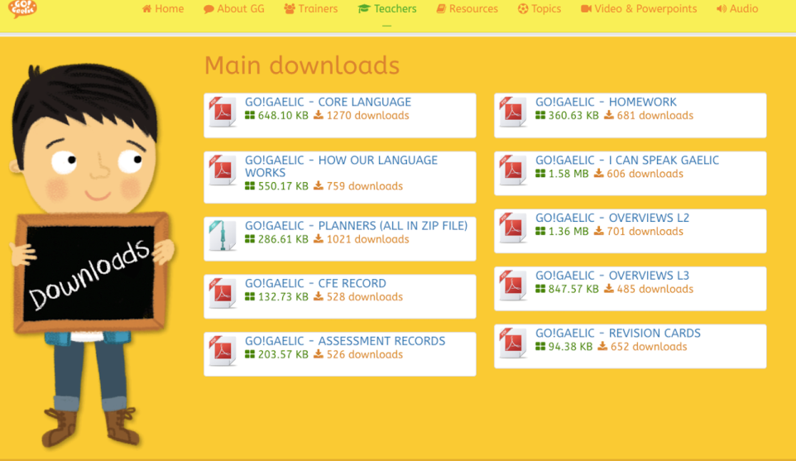
Teacher resources

Slide 5
Teacher content

Slide 6
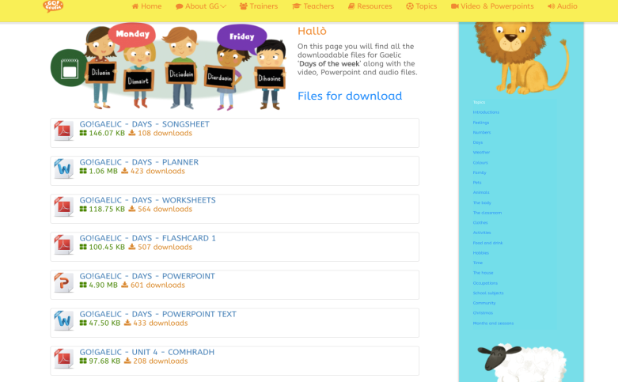
Pupil resources

Slide 7
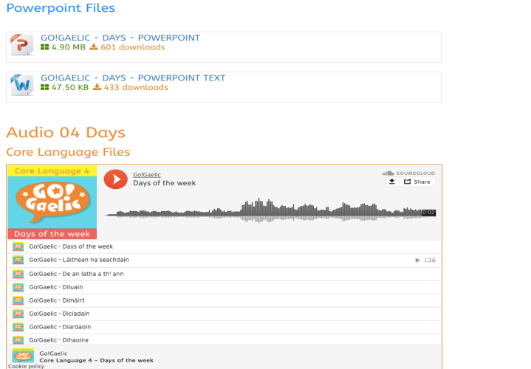
Pupil resources

Slide 8
20 x Animations

Slide 9
20 x Videos

Slide 10
Additional GLE support resources
Go!Gaelic App – android & ios
www.smathsin.co.uk
www.gaelic4parents.co.uk
www.storlann.co.uk/bisunndach
Notes:
GLPS - games

Slide 11
Go! Gaelic 2017-2018 new resources
Series of 5 books with 4 Topics in each
Café Lilidh videos - grammar points explained
Interactive language games
Go!Gaelic@Home – 0-5

Slide 12
Online games

Slide 13
Statistics

Slide 14
Resource Pot!
Go! Gaelic
Your thoughts on the next
Go! Gaelic Resource?

Slide 15
Tapadh leibh!
www.storlann.co.uk
oifis@storlann.co.uk 01851 700 880
Notes:
You can also find us on twitter, flickr etc

