Slide 1
Autism & Inclusive Practice
Professional Learning Module
Session 5. Supporting Learners and Families
For Scotland's learners, with Scotland's educators
Do luchd-ionnsachaidh na h-Alba, le luchd-foghlaim Alba
Notes:
The module An Introduction to Autism and Inclusive Practice is designed to provide an introduction for educational staff and anyone with an interest in supporting autistic learners in the settings that they work and support. This introductory module aims to help you develop an awareness of what autism is, its impact and how it can be supported within an inclusive school community. It may also be of interest if you work in the voluntary sector or simply have an interest in autism and inclusive practice.

Slide 2
This week’s session
Terminology
The Scottish context for autism and inclusion
Understanding Autism
Assessment and Monitoring
Supporting Learners and Families
Social and Emotional Wellbeing
Transitions
Notes:
The module and this supporting programme for reflection is split into seven sections:
Terminology
The Scottish context for autism and inclusion
Understanding Autism
Assessment and Monitoring
Supporting Learners and Families
Social and Emotional Wellbeing
Transitions
Today we will explore the fifth section of the module, Supporting Learners and Families.

Slide 3
Recap of Section 5 Supporting Learners and Families
5.1 | Effective communication and collaborative partnerships
5.2 | Visual supports
5.3 | Supporting activities of daily living
5.4 | Considerations for educational staff
Notes:
These are the subsections, included within the section on Supporting Learners and Families:
5.1 Effective communication and collaborative partnerships
5.2 Visual supports
5.3 Supporting activities of daily living
5.4 Considerations for educational staff

Slide 4
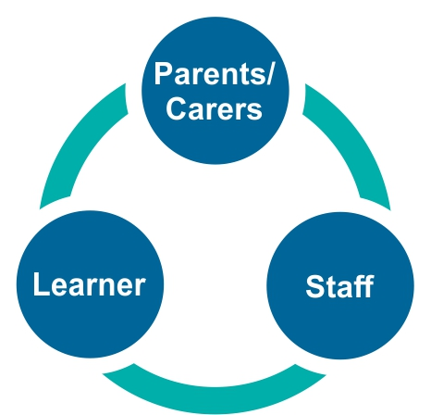
5.1 Effective communication and collaborative partnerships
http://enquire.org.uk/ Independent and impartial advice on additional support needs.
https://enquire.org.uk/service/lets-talk-asn-national-advocacy-service-for-additional-support-needs/ Children's service which provides independent advice and information, advocacy support and legal representation.
https://reach.scot/myrightsmysay/ An advocacy and legal representation service.
Notes:
Notes from module:
Each learner and their family are unique and supporting the development of positive relationships between practitioners and the family is critically important to provide effective support. These relationships are interconnected as highlighted in Figure 16. Parents, carers and learners each have different experiences of the journey through the diagnostic pathway, and reactions to diagnosis vary from distress and disbelief to relief and positive feelings that they now better understand how autism affects them and their family.
Effective communication, respect and collaborative partnership working between schools and families are key requirements. They are essential in supporting appropriate and effective learning and teaching. Practitioners must recognise and sensitively respect the experiences of autistic learners and their families who will naturally have queries and concerns during their educational journey. At all times, good communication will keep parents and staff informed in a two-way exchange to support their unique autistic child/learner.
A positive partnership, with mutual respect between the teacher/practitioner and parent/carer, is essential to achieve progression in the autistic learner’s life and learning. It is important for everyone in the partnership to recognise that social and emotional development and skills for resilience in life are equally as important as academic learning.
Building an effective partnership with families to support their autistic child through their educational journey and helping them prepare for post-school settings is required by all practitioners and local authority education staff. This is required at both the individual level and the wider level. For example:
School management and staff should be aware of the autistic learners in their community.
The local authority should work proactively with local autism networks and support groups and ensure information on additional support within their region is easily accessible. It is helpful to include information on the autism network support group and should include support services for learners, families and practitioners funded by the Scottish Government. For example:
Further details of services can be found on the Toolbox and in Section 9. Helpful Signposting and Information.

Slide 5
5.2 Visual supports
Types of visual support
Benefits
Notes:
Notes from module:
Visual supports can be very helpful in helping learners with a range of additional support needs. They support communication and can be used in various environments and locations and in many situations. For some autistic learners, they are a vital communication support. It is helpful to have consistency at home and in the early years setting/school.
Visual supports can be presented in a variety of ways and using a variety of content. For example, they can be created very easily with:
drawings
photographs, including photographs of objects and rooms/areas the autistic learner uses
symbols
clip art
objects
written word.
Visual supports can be printed and laminated on A4-size paper or made smaller and attached to a keyring, which is accessible by the learner. Staff may carry a keyring as well to prompt and model use.
It can be tempting not to use visual supports with cognitively able or more competent communicators. However, even if these supports are not relied upon day to day, they can often become crucial when this competent learner is under stress.
Benefits
Visual supports can:
be personalised
help to provide structure and routine
encourage independence
develop confidence
improve understanding
reduce frustration and anxiety
support opportunities for positive social communication
provide a consistent and visual approach to communication which the autistic learner may find easier to access and process than the spoken language.
All autistic learners are likely to benefit from developmentally appropriate visual supports. This information can be explored during transition planning, parental/carer meetings, professional meetings and, of course, with the learner who may have their own preferences of presentation styles and images.

Slide 6
5.3 Supporting activities of daily living
Notes:
Notes from module:
This module and the Toolbox highlights that each learner is an individual and effective communication between practitioners and the family can support the autistic learner to engage in activities of daily living. Developing the skills to carry out activities of daily living are crucial to a person’s independence and their ability to take part in the wider world. As well as the individual skill, opportunities or adaptations in the environment can help or hinder meaningful participation in these activities. Independence in activities of daily living can be an area of support need. For a child to dress independently, they don’t just need the motor skills, they also need motivation, understanding of why they are doing it and might be assisted by, for example, laying clothes out in the order that they will be put on, a visual sequencer or physical prompts (handing items to them). For example, sensory processing differences, difficulties in social understanding and motor issues may all impact together negatively for the task of being able to dress independently.

Slide 7
Activity 15
http://www.autismtoolbox.co.uk/activities-daily-living

Slide 8
5.4 Considerations for educational staff
Notes:
Notes from module:
It is highly likely that all staff will have an autistic learner in their class at some stage.
This module and the Toolbox provide a range of appropriate information, guidance and resources to help education staff meet the needs of their autistic learners and their families and welcome them into the school community.
Staff need to consider their pedagogical approaches to ensure their early years setting, school and classroom are environments in which autistic learners feel safe, healthy and happy, active, nurtured, achieving, respected, responsible, and included.

Slide 9
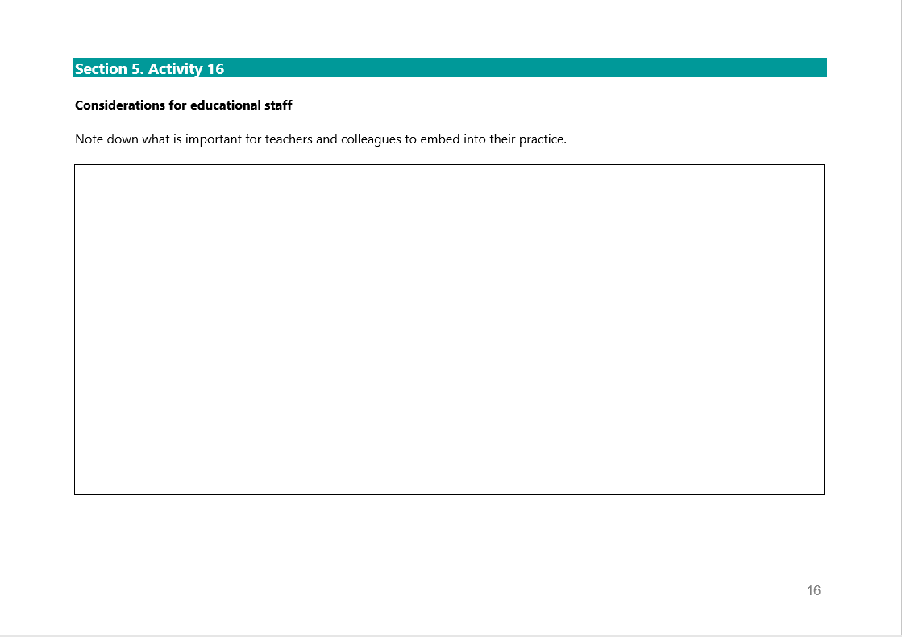
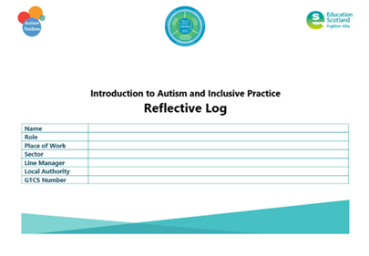
Activity 16
Notes:
Reflective log, page 16

Slide 10
Gap Task
Complete sections:
6. Social and Emotional Wellbeing
Activity 15 – Autism Toolbox
Reflective Log: Activity 16, page 16
Notes:
Tasks for completion between this session and next. 4-6 weeks between each group learning session is optimal.

Slide 11
Next session
Terminology
The Scottish context for autism and inclusion
Understanding Autism
Assessment and Monitoring
Supporting Learners and Families
Social and Emotional Wellbeing
Transitions
Notes:
Next session, we will explore the section Social and Emotional Wellbeing.

Slide 12
Education Scotland
Denholm House
Almondvale Business Park
Almondvale Way
Livingston EH54 6GA
T +44 (0)131 244 5000
E enquiries@educationscotland.gsi.gov.uk
For Scotland's learners, with Scotland's educators
Notes:
This is a back cover page in blue. You may edit the address if needed only. It can only be once and at the end of the PowerPoint presentation. Use the corresponding blue internal and back pages if you are using this page.

