Slide 1

Aspiring to Middle Leadership
Touchpoint session
Notes:
All information is correct as of August 2026.
This PowerPoint is intended to support senior leaders, middle leaders and practitioners in schools and local authorities to deliver an introduction session to a group on the Aspiring to Middle Leadership (AML) programme. It is the second of a set of 3 to accompany the AML programme.
This PowerPoint is a template that presenters can adapt to suit their own context and style of presenting. It can be added to, but please do not remove any slides as they are all essential to the Introductory session. You may wish to add the date, a logo alongside the Education Scotland one, add dates for future sessions (1 further session is suggested after this one) or to add a link to a local feedback form into the last slide. You can use these slides in person or online.
Within the slides, suggested timings, key messages to get across, facilitator notes and reflective questions are included.
The session this PowerPoint is intended to support has been designed to be delivered by facilitators in 60 -75 minutes. If you have longer, we would encourage you to use that time for (more) discussion of the reflective questions and perhaps invite some feedback. Suggested approximate timings can be found in the notes for each slide.
IMPORTANT NOTES:
This PowerPoint refers to the open access, self-directed Education Scotland Aspiring to Middle Leadership programme, at Aspiring to Middle Leadership | Self-directed professional learning | Professional Learning | Education Scotland. It is anticipated the presenter will be familiar with the content of the programme, which can be found at the Education Scotland website pages. Before using this session, participants should have attended the AML Introductory session and ideally completed their first 2 Professional Learning Activities (PLAs) on the roles of middle leadership. This session reviews learning already undertaken and introduces the next section of learning on inclusion, wellbeing and equalities (IWE).
If facilitating in person, you may wish participants to bring their devices for slide 14 , when you present ‘The IWE PLAs’ that are accessed through the website. Alternatively, you could share your screen whilst viewing the AML pages of the website, to show/remind participants how and where to access the PLAs. If online, be ready to share your screen to show these webpages.
While use of the AML Reflective Journal is optional, we would encourage its use as part of this facilitated programme. If used, it will be helpful for participants to have it to hand during this session.
Learning outcomes for this resource:
• Set the scene for continued professional learning
• Review previous learning and introduce new learning options
• Remind participants about how to complete the programme, date of the final session and any deadlines set.

Slide 2
Ways of working together
We all work together
We learn from, with and on behalf of each other
We create a safe space to share ideas and build learning
We agree that everyone is an equal and valued participant
We remain ‘in the room’ (follow email and phone protocol)
Notes:
Suggested timing:
3 minutes
Key messages:
This is a reminder of our agreed ways of working from the first session. (If you and the group adapted these at the Introductory session, you will need to update them here to reflect that).
Effective professional learning goes beyond simply delivering information. It fosters a learning community where educators can learn with, from, and on behalf of one another. To achieve this, the facilitator of this learning should establish clear protocols and a positive learning environment at the outset. The general notes below will support the facilitator to help everyone feel comfortable participating and contribute to a rich learning experience.
Facilitator notes:
Do these still work? Ask participants to comment on anything they would like to add or amend.
Is there anything that participants feel is missing or anything they would like to remove?
If everyone is happy, you can move on fairly quickly.

Slide 3
Today
Review and preview
Reflect and connect
Why inclusion, wellbeing and equalities (IWE)?
What does inclusion mean to you?
The IWE PLAs
Next steps
Notes:
Suggested timing:
1 minute
Facilitator notes:​
​
This slide shows what will be looked at in this session, to be shared with participants. Invite any questions they may have.

Slide 4
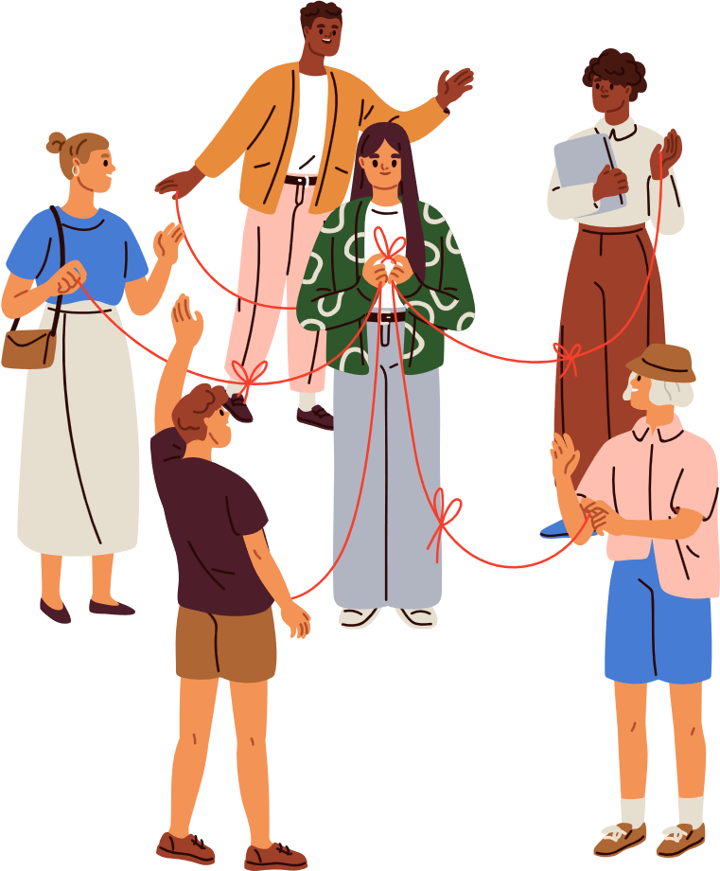

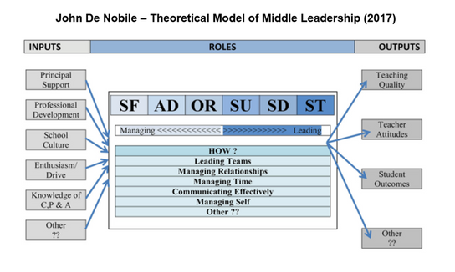
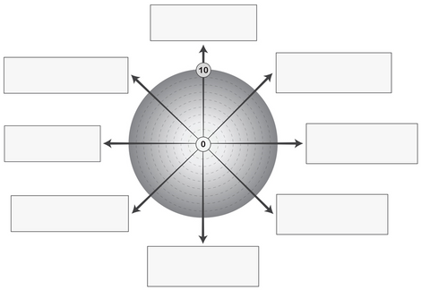
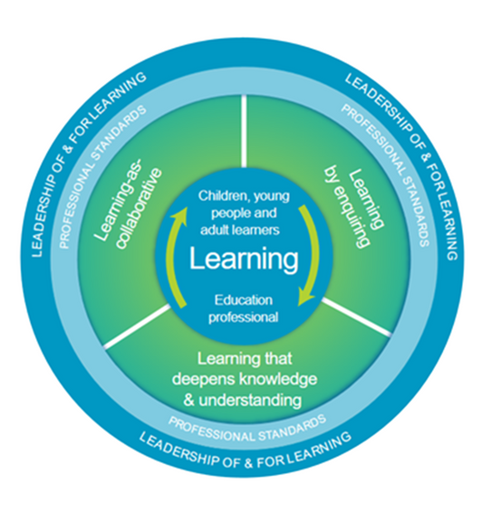



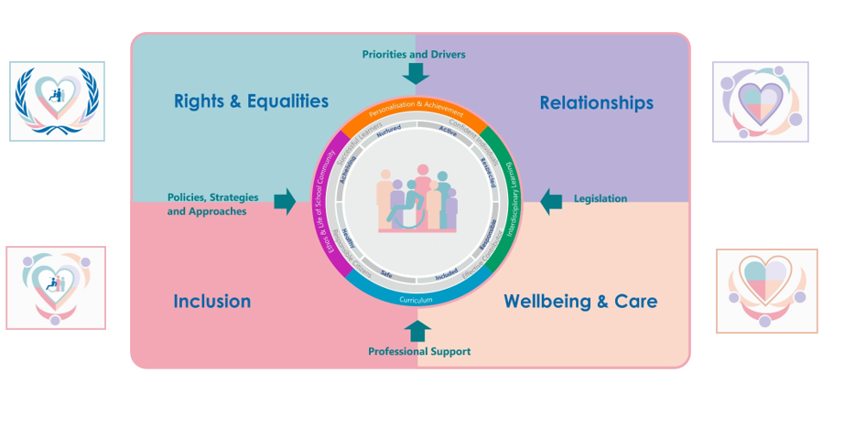
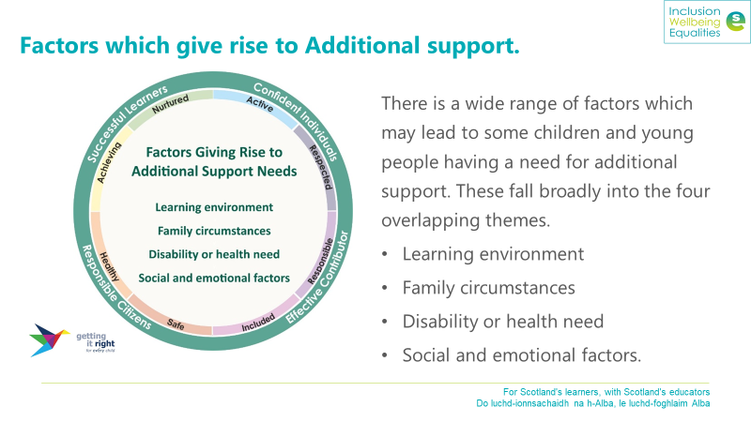

Review and preview
Review.....and preview
Student-focused
Staff health and wellbeing
Administrative
External liaison
Organisational
Strategic
Supervisory
Staff development
Notes:
Suggested timing:
5 minutes
Key messages:
The purpose of this slide is to look back at the previous session using the images as prompts, and to look forward to what’s coming next, hence, ‘review and preview’. From the top left, the first image of people is from the first session when we looked at ways of working together. Following the red arrows, we looked at the 3 fields of knowledge and the national model of professioanl learning which underpin the programme, then moved onto John DeNobile’s theoretical model of middle leadership – with the student-focused, administrative, organisational, supervisory, staff development and strategic roles – then the self-evaluation wheel, with a further 2 roles identified in the Scottish research which came later. We also reflected on our ‘why’ and our ‘how’, which helps to inform the kind of leader we want to be, linking to the professional standards, and the reasons we got into teaching to start with. In the middle row from right to left, the couple speaking denotes the idea of having a peer supporter and then a reflective journal to support your learning. (Has anyone used these optional tools yet?). Finally, we finished last time with the image of the droplet creating ripples in a pool and asked the group to consider their current spheres of influence and how these might reach even further as they move into middle leadership roles.
Today’s session starts at the first blue arrow where the 2 images middle left and the first image bottom left denote opportunities today to reflect on learning so far, share this in a small group, and raise any questions. The images at middle and right bottom indicate what we will look at today – the national framework for inclusion, wellbeing and equalities (IWE) and the background to this. It will then be a case of the group exploring which PLAs they want to do next.
Facilitator notes:
The red and blue arrows correspond to the red and blue words in the slide title: Red arrows for ‘review’ images and blue for ‘preview’ images. The hope is that the group recalls the first session and it grounds them into the learning for today. It may also be useful for anyone who missed the first session.

Slide 5
Reflect and connect
On your own
Quiet reflection - feel free to make a few notes.
One at a time
Say who you are and which PLA(s) you’ve done/started.
In the group
What resonated?
What will you
act on?
All together again
What are you thinking about the learning so far? What are you feeling about your experience of it?
Notes:
Suggested timing:
1 + 15 minutes
Key messages:
This is a chance to reflect on learning so far (the group many be at different stages and that is ok, but ideally, they will be as close as possible to having completed their 2 selected ‘Roles of middle leadership’ PLAs.
Facilitator notes:
Explain the 4 parts of the activity. Tell the group:
1. On your own :
A minute or two on their own first to reflect and make some notes about the learning you've done. If people have their Reflective Journal (if using) they might refer to it here.
2-3. Into small groups or breakouts:
4-5 per group / online room
15 mins
4. When you’re back together / in the main online room, open it up for feedback:
1. What are you thinking about your learning so far?
2. What are you feeling about your experience of it?

Slide 6

Time to reflect.....
What are you thinking about your learning so far?
Notes:
Suggested timing:
3 minutes
Key messages: You may want to reassure the group that it’s ok at this point not to be completely up to date with your first two PLAs, as there will normally be time to make this up before the programme ends. It can help to set aside weekly time slots to work on them.
There may be feedback for you as the programme lead or for Education Scotland about the online resources (please pass this onto us). Accept all reasonable feedback and remind the group of the transformational potential of professional learning for them and their learners, if there is any negativity. Time is often an issue. That the participants have chosen to use their time on learning shows great commitment to their role as an educator and leader.
Facilitator notes:
Once back from smaller group/ online breakout space - take some feedback on this question. If the group raises any issues, save these to the end of the session to address.
Invite people to make a private note and/or use chat pane too, if they prefer.

Slide 7


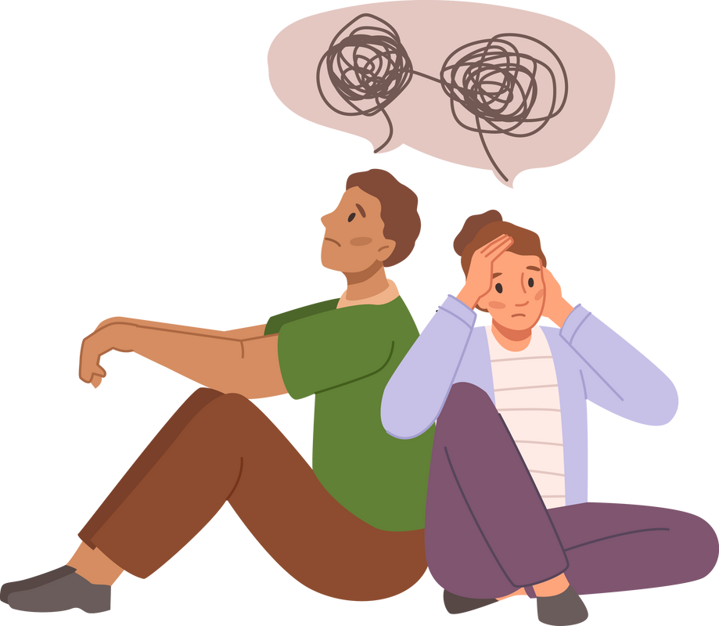
Time to reflect
Time to reflect.....
What are you feeling about your experience of the learning so far?
Notes:
Suggested timing:
2 minutes
Facilitator notes:
Take some feedback on this question. Again you can reassure the group about being able to complete the programme. If anyone raises concerns, you may need to address these 1:1 at the end of the session.
Invite people to make a private note and/or use chat pane too.

Slide 8



Why Inclusion, wellbeing and equalities?
Learners’ needs
Educators’ needs
Professional standards, values, commitments
What the research and legislation tell us
Key role of middle leaders
Notes:
Suggested timing:
3 minutes
Key messages:
Tell the group that AML used to be focused solely on the roles of middle leadership but that Inclusion, wellbeing and equalities (IWE) were added in 2024 after a deep dive review of the programme. This was in response to legislation and the evidenced need, and it also provides areas of learning which participants can use as vehicles for demonstrating the roles of middle leadership, by potentially leading an area of work based on their IWE PLAs. For example, they might deliver professional learning for colleagues (staff development or supervisory role) on supporting learners with ADHD; they might work on updating policy (administrative or strategic role) on rights-based approaches; or they might undertake direct work with learners (student-focused role) who have autism.
Facilitator notes:
Go through each line on the slide using these notes:
Learners’ needs: The rise in numbers of learners presenting with additional needs, particularly after Covid-19 lockdowns, and the complexity of needs. Presumption of mainstreaming.
Educators’ needs: These have changed in line with the needs presenting in the classroom. A Listening Exercise carried out by Education Scotland in 2024-25 with middle leaders highlighted this as a professional learning need.
Professional standards, values and commitments: Whether GTCS, SSSC or CLDSC standards, all include statements about inclusive practice that meets the needs of all learners. The GTCS value on social justice is particularly relevant.
What the research tells us: Again, the increasing numbers of learners with neurodivergence and other ASN, but also the adoption of the UNCRC in Scotland, Angela Morgan’s ASN review in 2020, The Promise, GIRFEC and The Additional Support for Learning Act (Scotland) 2009.
Key role of middle leaders: Middle leaders play a key role in creating inclusive environments for all learners (and inclusive environments benefit ALL learners, not just those with additional needs).

Slide 9
What does inclusion mean to you?
Question -
Notes:
Suggested timing:
3 minutes
Key messages:
This short activity is to get participants thinking about inclusion and what it means to them. There are no wrong answers.
Facilitator notes:
If you are working online, you could use the chat pane to collect responses. If you wanted to revisit these at a later time, you might use a padlet. If you’re in person you could flipchart responses or just invite a ‘shout out’.
Participants may respond to ‘inclusion’ in relation to their learners, or in relation to themselves, or society more generally, and that’s ok. Some participants may themselves belong to a marginalised or poorly-included group, or have a hidden disability, so keep this in mind. BUT, the concept of ‘inclusion’ can become politically-charged, and people can have varying views on it. Accept all the answers. But do remind the group that ultimately this is about the responsibility and duty of educators, through their professional standards and values, to provide as inclusive an environment for learning as possible, so that all learners have their needs and rights met.

Slide 10
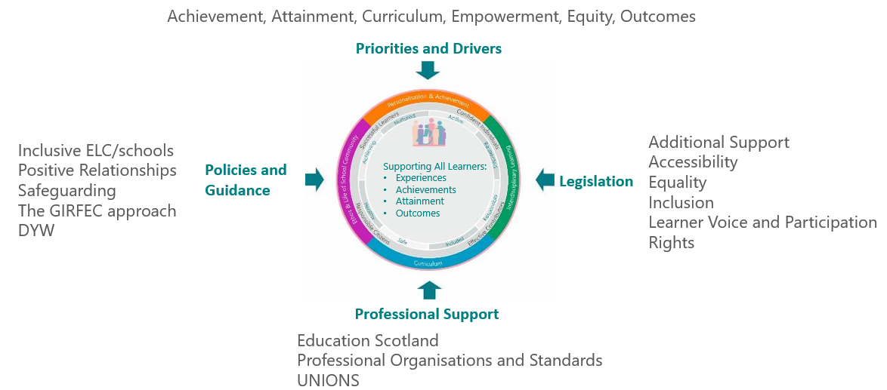

The Scottish Context for Inclusion, Wellbeing and Equalities
Notes:
Suggested timing:
3 minutes
Key messages:
This slide shows the Scottish context for IWE, with national priorities and drivers, legislation, professional support and policies and guidance all influencing how the four contexts for learning, the four capacities and the SHANARRI indicators are realised at local and establishment level, to ensure all learners are supported to achieve and attain to the best of their potential.
Facilitator notes:
You can direct learners to the Education Scotland website to find out more at Additional Support for Learning | Resources | Education Scotland

Slide 11
Inclusion, wellbeing and equalities -
The foundations
https://education.gov.scot/resources/inclusion-wellbeing-equalities-professional-learning-framework/
Notes:
Suggested timing:
2 minutes
Key messages:
This slide shows the national framework for IWE with the four quadrants: Rights and Equalities; Relationships; Inclusion; Wellbeing and Care. Middle leaders have a key role in knowing about and understanding the priorities, drivers, legislation, policies, guidance and professional support around IWE.
Facilitator notes:
Talk briefly through the slide using the key messages above. Invite the group to think about how the roles of middle leadership may connect to the 4 quadrants of the framework. (Reminder of the roles: student-focused, administrative, organisational, staff development, supervisory, strategic, staff health and wellbeing and external liaison. Invite any comments /observations about the links to leadership.
You may wish to highlight the link which is for the IWE professional learning framework. It provides slides and guidance notes for anyone leading professional learning linked to a wide range of aspects of the 4 quadrants.

Slide 12


Comfort break
Notes:
If your session lasts over an hour, we suggest taking a break here, especially if you are online. You can remove this slide if your session is an hour or less.

Slide 13
Factors which give rise to additional support
Notes:
Suggested timing:
1 minute
Key messages: The image reminds us about the 4 capacities and the SHANARRI indicators, and the circumstances that can give rise to additional support needs.
Facilitator notes:
Remind the group about the links between GIRFEC and meeting additional support needs, and the 4 factors which give rise to ASN. Remind them that additional support needs can be fixed, fluctuating, or for a specific period of time.

Slide 14

The AML PLAs
Inclusion, wellbeing and equalities PLAs - select 2
Dyslexia
Fetal Alcohol Spectrum Disorder
Intellectual disability
Anti-racism
Nurture, ACEs and trauma-informed approaches
Cost of the school day
Inclusive approach to improvement planning
Establishing a differentiated classroom
Keeping the Promise awards
LGBT inclusive education
Attendance
Youth awards
Young carers
Care-experienced learners who are adopted
Online life
UNCRC
Autism
ADHD
Optimising RC cluster and parish links
Bilingualism and EAL
Grief and loss
Supporting ASN in mainstream classrooms
Racial literacy
Positive behaviour
New Scots
Notes:
Suggested timing:
2 minutes
Key messages:
These are the IWE PLAs (professional learning activities) available at the Education website at August 2026. New ones may be added. Participants can find links to them at the AML webpages. Each PLA takes 3-4 hours to complete. Remind the group to make sure they hit the ‘Complete activity’ at the end of the PLA and to download the pdf summary. They can also download an individual PLA certificate for their records and complete an evaluation form.
Facilitator notes:
You don’t need to read out everything on the slide but pick out a few to highlight. Participants should select 2 based on their learners’ needs, their needs or current priorities in their setting.
(NB: if your authority has selected 2 or more of these PLAs that everyone is to do, ie, there is no choice about which PLAs to do, you may wish to amend this slide, to highlight the 2 that have been chosen. Participants can do more than the minimum of 2 if they want to, and /or revisit the PLAs after this programme.
You might want the group to complete 2 by the final session, if you are holding one. Agree a deadline for completion in any case.
The 4 quadrants of the national framework, are all represented:
Inclusion
Relationships
Rights and Equalities
Wellbeing and Care.

Slide 15

What is the role of a middle leader around inclusion, wellbeing and equalities?
Breakout activity
Notes:
Suggested timing:
15 minutes
Key messages:
Middle players so a great deal to help create an ethos and culture that supports inclusion, wellbeing and equality. What do they see happening in their own settings? What roles do middle leaders take on to support IWE? What is in the school or centre improvement plan around IWE?
Facilitator notes:
Breakout activity- either in small groups in the room or in online breakout rooms.
4/5 each room
15 mins – if you have time. If not, put the question to the whole group and invite some responses. You can link these to the 8 roles of middle leadership in John DeNobile.
This activity will help the group to think about their IWE PLA choices.

Slide 16
What does this mean for your next
learning steps?
Back in your setting, think about:
The discussions you’ve just had
What’s already happening?
What’s my area of interest?
How does it link to the roles of middle leadership I’m working on?
How might the Standard for Middle Leadership influence my choice?
Who can support me in my decision making?
Notes:
Suggested timing:
2 minutes
Key messages:
This slide is just to get people thinking more about their next steps in the programme, ie, which PLAs to choose (if choosing is an option).
Facilitator notes:
Go through the slide and ask the group to think later about the links to the middle leadership roles, the Standard for Middle Leadership, and the kind of leader they want to be.
After today they may want to talk to peer supporter and/or other colleagues to help decide on their next area of work.

Slide 17

Next steps
  Complete minimum 2 Roles PLAs
  Think about your IWE areas and select PLAs
  Peer supporter/ colleague dialogue
  Looking Ahead session – add date
  Final deadline for submission – add date
JAN
FEB
MAR
APR
MAY
Notes:
Suggested timing:
1 minute
Key messages:
Go through the slides – with edits if /where required.
Facilitator notes:
You can add dates here for the final group session if you are having one and the final date for completion of the 4 PLAs and the Learning Summary.
It’s not too late to engage a peer supporter if anyone in the group wants to, or to start using the reflective journal.
The final group (Looking ahead) session will be a chance to share the learning form the IWE PLAs, will cover how to complete the programme, ie, completing the Learning Summary, and consider some future learning opportunities.

Slide 18

Thank you
Notes:
Suggested timing:
1 minute
Key messages:
Thank the group for their time, engagement today and ongoing commitment to their professional learning.
Facilitator notes:
You may wish to add a contact email address for anyone needing support and/or a link or QR code for your own local feedback form, for this session, at this slide, or add an extra one.
If you would like to provide feedback on this resource, as a facilitator, please go to https://forms.office.com/e/edkPTYNNDC

