Slide 1
Pre-delivery learning for staff
Pre-delivery learning for staff

Slide 2
This is a professional learning resource designed to go through some of the psychology and research behind the Everyone’s Included lessons.
This is designed as an independent learning tool, with auditory guidance on each slide. A transcript for this professional learning resource is also provided.
Please click on the speaker on each slide to play the audio.

Slide 3
Photo of children co-operating

Slide 4
Content
Content
What is a bystander?
Bystander theory
Kitty’s story
Diffusion of responsibility
Pluralistic ignorance
Stages of bystander Intervention
Moral disengagement
Self-efficacy
Neuroimaging
Role Models
Recent research

Slide 5
What is a bystander?
A bystander is anyone who sees, hears or has knowledge of an incident, but is not directly involved.

Slide 6
Bystander theory

Slide 7
Bystander experiments

Slide 8
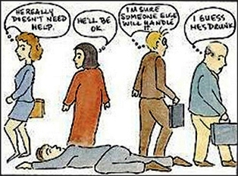
Diffusion of responsibility
Diffusion of Responsibility
(also known as the Bystander Effect)

Slide 9
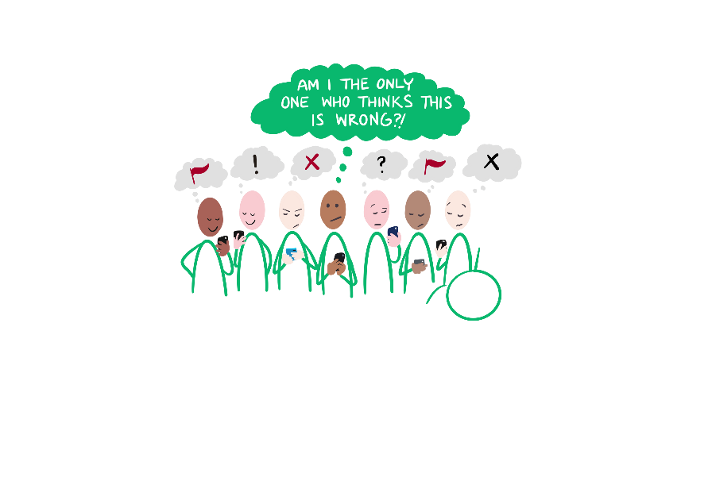
Pluralistic Ignorance
‘Ladybook’ cover

Slide 10
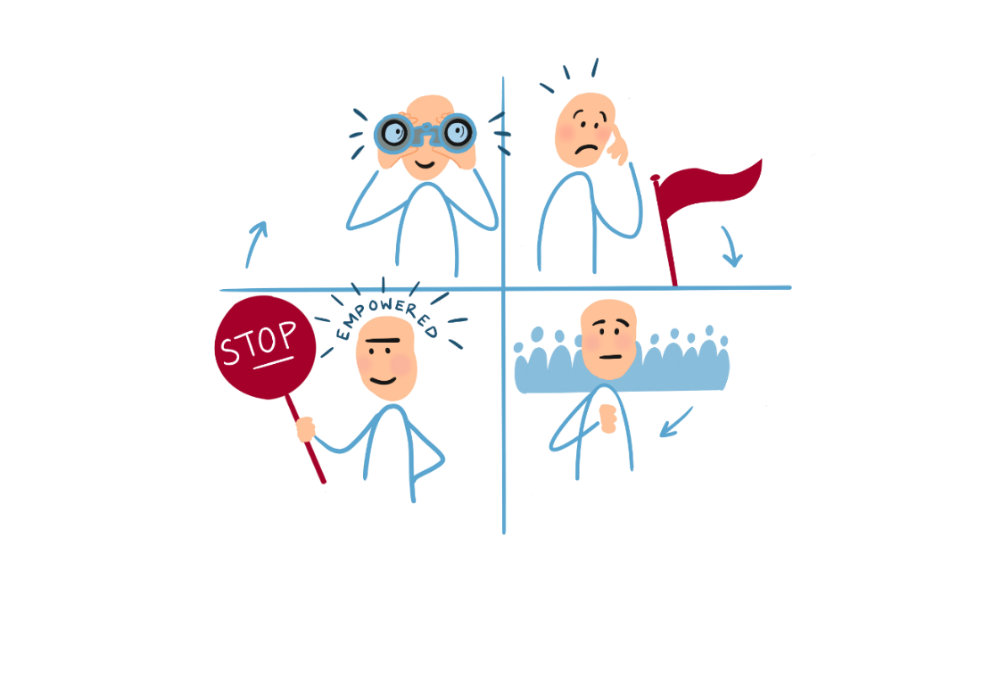
Stages necessary for Bystander Intervention
Stages necessary for Bystander Intervention

Slide 11
Moral Disengagement
Facing History and ourselves

Slide 12
Efficacy
Notes:
Get non watermarked version

Slide 13
Neuroimaging
Neuroimaging

Slide 14
Role models
Role models
Notes:
Search teenager helping people

Slide 15
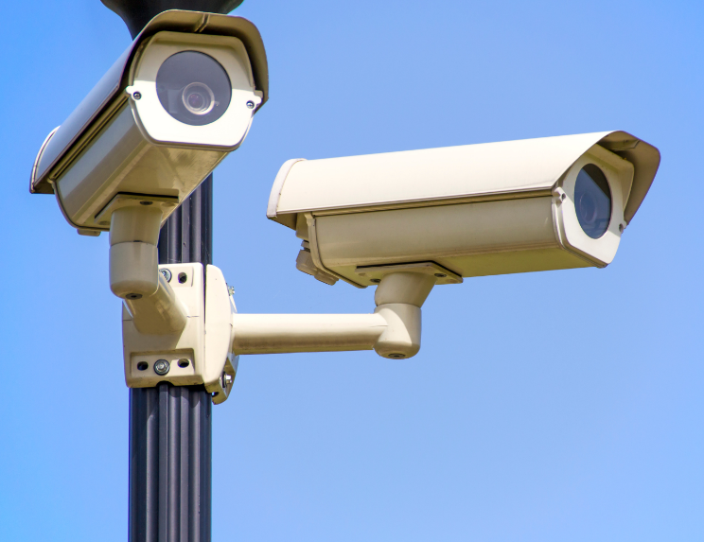
Recent research

