Slide 1
Effective use of data
4. Interpreting and analysing data
Senior and middle leaders
Notes:
All information is correct as of May 2024
These slides are intended to support senior leaders, middle leaders and practitioners in schools and local authorities to explore the effective use of data for improvement. There are a set of six workshops available for senior leaders, middle leaders and practitioners. The workshops were co-designed with educators from across Scotland and are based on an Education Scotland literature review: The Effective use of data for improvement in education.
Establishing the purpose and use of data
Defining and classifying data
Creating effective processes and systems
Interpreting and analysing data
Developing a data informed culture
Using data for improvement
(hyperlinks for each workshops can be found on the next slide)
The PowerPoint is a template that presenters can adapt to suit their own context and style of presenting. The workshops can be delivered individually or grouped together and delivered in a longer session. Individual workshops have been designed for facilitators to deliver in 1 to 1.5 hours.
Within the slide notes key messages, suggested tasks, ‘talking-points’ and challenge questions are included.
It is anticipated the presenter will have read the Education Scotland literature review: The Effective use of data for improvement in education.

Slide 2
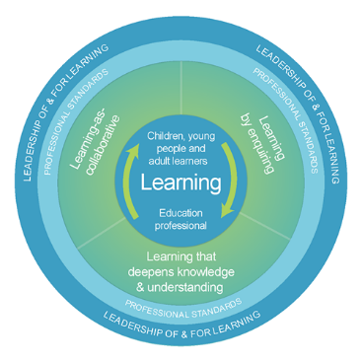
The national model of professional learning
The national model of professional learning | Professional Learning | Education Scotland
Notes:
Key Messages
This module has been designed using the national model of professional learning and the principles of adult learning or andragogy. It has been designed to think about:
The why – opportunities for participants to understand the rationale through professional standards, research, current policy landscape and national/local priorities.
The what – opportunities for participants to consolidate and develop relevant knowledge and skills
The how – opportunities for participants to take part in peer discussion, explore case studies or share experiences
Apply – a chance to reflect on learning, next steps and further support
A link to further information about the national model of professional learning can be found below.
edscot-model-of-professional-learning-outline.pdf (education.gov.scot)

Slide 3
Draft Group Agreement and Protocols
Work together
Learn from, with, and on behalf of each other.
Create a safe space to share ideas and build learning.
Agree that everyone is an equal and valued participant.
Remain in the room (emails and phone protocol)
Notes:
Key messages
Take a moment to establish group protocols.
Ask participants to check and comment on anything they would like to add or amend.
The protocols on the slide are suggestions and may be amended for your school context.

Slide 4
Connector
In groups/pairs:
Share your dream holiday destination.
Notes:
Key Messages
This is an example of a simple connecter activity. It is recommended that facilitators use a connector activity that allows participants to take part in an informal discussion.
This is to ensure that participants are relaxed, focused and ready for an interactive workshop.

Slide 5
Re-cap
In workshop 1 we looked at the purpose and use of data including: the meaning of data and evidence, the ways in which data is used and what we mean by ‘big’ and ‘small’ data.
In workshop 2 we considered different categories of data and how these may be intersected to support improvement.
In workshop 3 we looked at the importance of developing effective data systems and processes.
Notes:
Key Messages
This slide offers a brief recap of content covered in previous workshops.

Slide 6
Aims
In this workshop we will consider:
national guidance and research including signposting to national data sets
the use of comparator data
the different ways in which data is presented,
how to analyse contextual and attainment data, and
how to use a data analysis to inform next steps.
Notes:
Key Messages
This slide shows the aims of the session to be shared with participants.

Slide 7
Content coverage
National guidance and research
Using data
Nationally available data
Comparator data
Analysing data
Exploring different presentations of data
Next steps
Notes:
Key Messages
This slide shows the content covered throughout the workshop. Further details and suggested timings are provided below. Facilitators can amend content and timings to suit their needs and context.
National guidance and research – allow 10 mins for this section. It can be extended to 15-20 mins if facilitators wish to provide time for participants to read and discuss the relevant section of the evidence review.
Using data – this section provides some introductory thoughts around using data for analysis. There is an activity which provides participants with an opportunity to discuss how confident they and their staff are in effectively analysing and using data. Allow 15 mins for this section including the activity.
Nationally available data – this section provides a summary of nationally available data sets. Allow 5 mins for this section although it could be extended if facilitators wish to give time for participants to explore specific data sets as is appropriate or helpful.
Comparator data – this section covers the use of comparator data. Allow 5 mins for this section.
Exploring different data types – this section offers participants the opportunity to explore the different ways in which data is presented. This is an activity as participants can be given time to discuss and reflect. Allow 15 mins for this section. It can be extended if facilitators wish to add in local authority examples as appropriate.
Analysing data – this section supports participants to analyse ‘big’ contextual and attainment data. There are two activities within this section. Allow 40 minutes including 15 mins for each activity.
Next steps – this section considers the next steps following an analysis of gaps, patterns or trends. It assumes that participants will be familiar with the messages delivered in workshop 2. Allow 10 mins for this section. However, facilitators may wish to extend this section and include an activity on intersecting data based on some of the gaps identified in the analysing data section.
It is expected that this workshop should take between 1 hour and 30 mins and 2 hours to deliver.

Slide 8
GTCS standard for Headship
Professional responsibilities
2.2.3 analyse and define situations clearly
Self-evaluation
3.4.2 ensure that information is gathered systematically from a wide range of sources and partners developing innovative approaches to engage all groups;
3.4.2 ensure the use of a diverse range of information, qualitative and quantitative, to inform decision-making and identify priorities to shape and improve practices; and
3.4.2 enable and support colleagues in using the information to plan curriculum (pedagogy, assessment and reporting) with a focus on improving outcomes for all learners; and
The Standard for Headship
Notes:
Key Messages
To begin this module, we will consider ‘why’ interpreting and analysing data is important.
The GTCS standards for middle leadership and headship indicate the importance of the use of data to analyse from a wide range of sources, inform curriculum and pedagogy to improve outcomes and ensure that assessment evidence is robust and appropriate. (standards shown on the slide are the same for both groups).

Slide 9
GTCS standard for Middle Leadership
Professional responsibilities
2.2.3 analyse and define situations clearly
Self-evaluation
3.4.2 gather information systematically from a wide range of sources and partners using valid, reliable and innovative approaches to engage all groups;
3.4.2 use the information, qualitative and quantitative, to inform decision-making and identify priorities to shape and improve practices;
3.4.2 enable and support colleagues in using the information to plan curriculum (pedagogy, assessment and reporting) with a focus on improving outcomes for all learners; and
3.4.2 ensure assessment and evidence of assessments are robust and appropriate for internal and external purposes
Standard for middle leadership
Notes:
Key Messages
To begin this module, we will consider ‘why’ interpreting and analysing data is important.
The GTCS standards for middle leadership and headship indicate the importance of the use of data to analyse from a wide range of sources, inform curriculum and pedagogy to improve outcomes and ensure that assessment evidence is robust and appropriate. (standards shown on the slide are the same for both groups).

Slide 10
HGIOS 4
We gather a range of data and information to monitor and track progress for all learners (1.1)
We regularly interrogate data (1.1)
Staff make effective use of current available data on levels of child poverty and apply this to ensure equity (1.5)
All teachers have well-developed skills of data analysis (2.3)
Notes:
Key Messages
How Good is Our School 4 describes the ways in which schools may use data effectively for improvement. This includes:
Gathering data to monitor and track progress
Regular interrogation of data
Making effective use of data on child poverty to ensure equity, and
Ensuring that all teachers have well developed skills of data analysis
Reflective Questions
How confident are all staff in school in the effective analysis and interpretation of data?

Slide 11
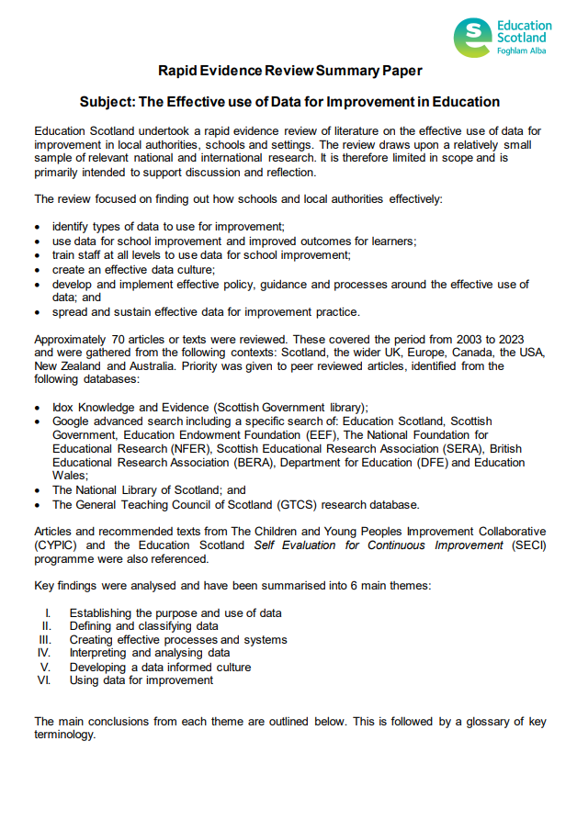
Rapid Evidence Review Paper
Section four of the Education Scotland Rapid Evidence Review on interpreting and analysing data highlights the points below.
Educators often report a lack of confidence in being able to interpret data.
Educators should be familiar with a range of key measures and measures should be embedded into improvement plans.
Educators should gather and analyse improvement data frequently and look for patterns, trends and variation.
It is important to intersect data and evidence to understand why a pattern, trend or gap exists.
Schools and settings should utilise local and national comparator data.
Notes:
Key Messages
Section four of the rapid evidence review on creating effective processes and systems highlights that:
Educators often report a lack of confidence in being able to interpret data.
Educators should be familiar with a range of key measures and measures should be embedded into improvement plans
Educators should gather and analyse improvement data frequently and look for patterns, trends and variation.
It is important to intersect data and evidence to understand why a pattern, trend or gap exists.
Schools and settings should utilise local and national comparator data
The Effective use of data for improvement in education
Talking Points
This may be a good point to ask participants to read section four on establishing the purpose and use of data.
Reflective Questions
What measures do you use for analysing and interpreting data? How do you analyse data? How do you identify patterns, trends, next steps?

Slide 12
Using data
Data analysis involves examining information and breaking it down for understanding and meaning.
To analyse data effectively educators should be confident in:
reading and interpreting a range of common tables, charts and diagrams;
analysing and utilising the information gathered to inform improvement.
Notes:
Key Messages
Data analysis involves examining information and breaking it down for understanding and meaning.
To analyse data effectively educators should be confident in:
reading and interpreting a range of common tables, charts and diagrams, and
analysing and utilising the information gathered to inform improvement
Talking Points
Facilitators may wish to draw out the different skills involved in data analysis – confidence in reading a range of charts, tables and graphs as well as the ability to interpret the information gathered.

Slide 13
Reflection activity
“Using data is not separate from planning and from routine decisions in schools. Instead, data is a necessary part of an ongoing process of analysis, insight, new learning and changes in practice.”
(Lorna M Earl and Steven Katz, 2009)
What is the confidence level of staff in analysing data?
What opportunities are staff given to engage with and interpret a range of school / classroom level data?
Are staff able to effectively utilise this data to inform improvement?
Notes:
Key Messages
An opportunity for participants to read the quote and reflect on the confidence of staff in analysing and interpreting data.
Talking Points
Facilitators may wish to draw out the range of confidence levels and whether this varies depending on the role of the educator. They may also wish to draw out whether school leaders are providing opportunities for all staff to engage with data and improve their skills of analysis.

Slide 14
Nationally available data
Data set/tool | Description
NIF Interactive Evidence Report (NIFIER) | NIFIER is the NIF Interactive Evidence report. It brings together information from across the priority areas for education. The report also contains information on closing the attainment gap between the most and least disadvantaged children.
Achievement of Curriculum for Excellence levels (ACEL) | Publication provides information on national performance in literacy and numeracy, based on all pupils in publicly funded Primary 1, Primary 4, Primary 7 and Secondary 3 classes, and for all pupils based in special schools/units.
School education statistics | Statistics on school education in Scotland, including pupil and teacher characteristics, and attainment and qualification results.
Local Government Benchmarking Framework (LGBF) | The LGBF helps councils compare their performance against a suite of efficiency, output and outcome indicators that cover all areas of local government activity.
Stretch Aims | A summary of local authority stretch aims for raising attainment and closing the poverty related attainment gap
Notes:
Key messages
This slide shows the wide range of data sources available nationally.
Most of them have data at local authority level but tools such as the Primary Dashboard and Secondary Dashboard will provide useful data (not just ACEL levels) at school level.
The BGE benchmarking tool has been recently updated and is no longer accessed through Glow. The BGE benchmarking tool can be useful for finding a comparator school outwith your local authority.
Most of these sources are publicly available through the internet.
Insight is accessible for secondary schools and local authorities but is not publicly available.
NIFIER is the NIF Interactive Evidence report and it brings together information from across the priority areas for education. These include for example, literacy, numeracy, school leaver attainment, participation of 16-19 year olds, health and wellbeing and parental engagement. The report also contains information on closing the attainment gap between the most and least disadvantaged children. Information in the NIF Interactive Evidence Report will help teachers, local authorities, and the Scottish Government learn from good practice, and develop plans where further improvements are needed.
ACEL (Achievement of Curriculum for Excellence levels) provides information on national performance in literacy and numeracy, based on all pupils in publicly funded Primary 1, Primary 4, Primary 7 and Secondary 3 classes, and for all pupils based in special schools/units.
School education statistics - Statistics on school education in Scotland, including pupil and teacher characteristics, and attainment and qualification results. The publications report on the annual pupil, teacher and early learning and childcare provision censuses. Also includes statistics from the biennial attendance, absence and exclusions collection.
Local Government Benchmarking Framework - The LGBF (produced by COSLA) helps councils compare their performance against a suite of efficiency, output and outcome indicators that cover all areas of local government activity.

Slide 15
Nationally available data for schools
Data set/Tool | Description
BGE Benchmarking tool | A Scottish Government toolkit which enables headteachers and local authority officers to consider school data in relation to national comparator schools. This is based on the impact of pupil characteristics including SIMD, Gender, FSM, Ethnicity, EAL, Gaelic Medium, Denomination and Urban/Rural.
Primary Dashboard Secondary Dashboard Special School Dashboard | Information is gathered from all publicly funded primary, secondary and special schools in Scotland. It includes information on attainment, attendance over time, SIMD profile, FSM, Ethnicity, school roll.
Insight | Benchmarking tool for analysing attainment data in the senior phase.
Summary statistics for attainment and initial leaver destinations (SSAILD) | This statistical publication provides information on the educational attainment and initial destinations of school leavers from publicly funded schools in Scotland.
Annual Participation Measure | Percentage of young adults (16-19 year olds) participating in education, training or employment.
Notes:
Key Messages
This slide continues from the previous slide and shows the wide range of data sources available nationally.
BGE Benchmarking tool - A Scottish Government toolkit which enables headteachers and local authority officers to consider school data in relation to national comparator schools. This is based on the impact of pupil characteristics including SIMD, Gender, FSM, Ethnicity, EAL, Gaelic Medium, Denomination and Urban/Rural. Access to this requires a password from the LA.
Primary dashboard – information gathered from all publicly funded primary schools in Scotland. It includes information on attainment, attendance over time, SIMD profile, FSM, Ethnicity, school roll. The Scottish Government created school information dashboards to bring this information together.
Secondary dashboard – information gathered from all publicly funded secondary schools in Scotland. It includes information on attainment, attendance over time, SIMD profile, FSM, Ethnicity, school roll. The Scottish Government created school information dashboards to bring this information together.
Special School dashboard – information gathered from all publicly funded special schools in Scotland. It includes information on attainment, attendance over time, SIMD profile, FSM, Ethnicity, school roll. The Scottish Government created school information dashboards to bring this information together.
Insight - the benchmarking tool for analysing attainment data in the senior phase. Access to Insight requires an individual username and password.
Summary statistics for attainment and initial leaver destinations (SSAILD) - This statistical publication provides information on the educational attainment and initial destinations of school leavers from publicly funded schools in Scotland.
Annual Participation Measure – Percentage of young adults (16-19 year olds) participating in education, training or employment.

Slide 16
Comparator data
Using comparator data can help to support the interrogation, interpretation and analysis of data for improvement.
It can form part of the range of data and information to understand the social, economic and cultural context of the local community.
Using comparator data can help educators to consider their attainment or achievement against schools from a similar context. This may support schools to:
ask questions about levels of attainment, achievement and progress,
reflect on expectations in relation to learner outcomes, and
collaborate with similar schools to improve outcomes.
Notes:
Key Messages
Using comparator data can help to support the interrogation, interpretation and analysis of data for improvement.
It can form part of the range of data and information to understand the social, economic and cultural context of the local community.
Using comparator data can help educators to consider their attainment or achievement against schools from a similar context. This may support schools to:
ask questions about levels of attainment, achievement and progress,
reflect on expectations in relation to learner outcomes, and
collaborate with similar schools to improve outcomes
Reflective questions
How are educators/participants using comparator data in their schools or settings?

Slide 17
Using nationally available comparator data
Attainment data can be compared against national or local authority data sets.
Some nationally available improvement tools, such as the BGE Benchmarking tool or Insight, also allow for comparisons to be made against comparator schools or virtual comparators.
Virtual comparator values are included to provide context for the data.
The virtual comparator is a sample group of pupils from other parts of Scotland who have similar characteristics to the young people in the school (e.g. matched on gender, additional support needs, stage and the social context in which they live).
Notes:
Key messages
Attainment data can be compared against national or local authority data sets.
Some nationally available improvement tools, such as the BGE Benchmarking tool or Insight, also allow for comparisons to be made against comparator schools or virtual comparators. The characteristics used for virtual comparators may differ slightly across improvement tools. For example, the BGE Benchmarking tool includes Free School Meal Entitlement but Insight does not.
Virtual comparator values are included to provide context for the data.
The virtual comparator is a benchmarking measure that schools can use.
The virtual comparator is a sample group of pupils from other parts of Scotland who have similar characteristics to the young people in the school (e.g. matched on gender, additional support needs, stage and the social context in which they live).
Reflective questions
Are participants and school staff familiar with nationally available data sets and virtual comparators? (may help to reflect on slides 14/15)

Slide 18
Observational and statistical interpretation of data
The next few slides contain different types of charts demonstrating that data can be presented in different ways.
Presentation depends on what data is being presented and how many datasets or values are being analysed.
It may be helpful to take time to stop and discuss the charts and the information that is being conveyed.
Consider:
Which types of charts are the most helpful to you?
Do you consider how data is presented when analysing data to support improvement?
Notes:
Key messages
The next few slides contain different types of charts. It may be helpful to discuss how the data is being presented and the information it provides.
This will provide participants with an opportunity to re familiarise or become familiar with a few commonly used charts and graphs.
The facilitator should consider the context of their group and whether going through the next few slides exploring types of graphs and charts would be helpful for specific audiences.
For those who are already familiar with a range of charts, tables and graphs, it provides an opportunity to reflect on the impact of using different charts and graphs and their contributions in discussion may be valuable to other participants.
Talking point
You may wish to consider your own school data, the types of charts, tables and graphs that are shared and how it can be analysed to support improvement.

Slide 19
Displaying information
This chart has been taken from the ACEL 2022/23 publication. It is used to compare data for P1, P4 & P7 by organisers, across local authorities and against the national data.
What does this chart tell you?
Taken from Achievement of Curriculum for Excellence (CfE) Levels 2022/23 publication
Notes:
Key messages
Data can be presented in many different ways. It often depends on the what data is being presented and how many values are being compared.
Talking Points
Ask participants to stop and discuss the chart on the slide. It may be helpful to discuss why this type of chart has been used here. What do you notice from the data? Are there any trends or variation?
Reflective questions
When might you use this type of chart?

Slide 20
Charts
This is the same information, displayed in two different ways.
Which chart do you find the most effective for conveying the key information?
Do you consider how to display information when analysing data?
Notes:
Key messages
This is the same data taken from the from Achievement of Curriculum for Excellence (CfE) Levels 2022/23 publication, displayed in two different ways.
On the left-hand side a back-to-back bar chart is used to compare the data and on the right-hand side the same data is displayed as a bar chart.
Reflective questions
Which chart do you find the most effective for conveying the key information? Do you consider how to display information when analysing data?

Slide 21
Line chart and tables
Academic year | % of P1, P4 & P7 combined literacy | % of P1, P4 & P7 combined numeracy
2016/17 | 69 | 76
2017/18 | 71 | 78
2018/9 | 72 | 79
2020/21 | 67 | 75
2021/22 | 71 | 78
2022/23 | 73 | 80
Notes:
Key Messages
This is an example of a line chart. A line chart is used to display trends over time (years, months and days) or when there are many data points.
Reflective questions
What do you identify from the data? Do you notice any trends?

Slide 22
Local examples of data – tables, charts, graphs
This slide is a place holder for facilitators to consider adding in any local authority examples of data.
This slide can be added to or removed as appropriate.
Notes:
Key Messages
It may be helpful for facilitators to insert local examples of commonly used data, presented in the ways in which school leaders would be expected to read and analyse.
This would provide participants with an opportunity to review and check their understanding of how to read the data that they may access through the local authority if this is additional to / different from national data examples.

Slide 23
How do we start to analyse data?
What do we wish to explore or find out?
What data sets will help us to do this?
Is the data we plan to look at easily available and reliable?
Notes:
Key Messages
Before we begin to analyse data, it is helpful to pause and consider the questions on screen.
Are we clear about ‘why’ we need to analyse data? What issue are we exploring, what question to we wish to answer? What do we want to find out?
Which data sets will be most helpful? Thinking about different categories of data explored in workshop 2 may be helpful.
Are our data sources easily available, organised and reliable or accurate. Will we have access to the data and do we have confidence in it as a source?

Slide 24
Using attainment data
An example of a pattern might be:
There is under attainment of EAL boys in writing in most year groups.
An example of a trend might be:
The attainment gap between SIMD Q1 and SIMD Q5 in the current P4 has increased for the past three years (P2 – 15%, P3 – 20%, P4 – 22%)
An example of an anomaly might be:
Girls are outperforming boys in all year groups in reading apart from P5.
An example of a gap might be:
There is a 20% gap between P4, SIMD Q1 learners and SIMD Q5 learners in numeracy.
Notes:
Key Messages
When analysing data, we often use different language such as pattern, trend, anomaly or gap. It may be helpful to reflect on what we mean by these.
An example of a pattern might be: There is under attainment of EAL boys in writing in most year groups.
An example of a trend might be: The attainment gap between SIMD Q1 and SIMD Q5 in the current P4 has increased for the past three years (P2 – 15%, P3 – 20%, P4 – 22%)
An example of an anomaly might be: Girls are outperforming boys in all year groups in reading apart P5.
An example of a gap might be: There is a 20% gap between P4, SIMD Q1 learners and SIMD Q5 learners in numeracy.

Slide 25
Using contextual information
Consider | Key demographic groups (boys, girls, English as an Additional Language (EAL), ASN, SIMD Q1 etc) Attendance and mobility
Analyse | How many learners are living in areas of disadvantage? Who are the significant demographic groups of learners within your context? What is the whole school / cohort attendance? What is the attendance of different demographic groups? What is the demographic profile of different cohorts? What stands out (i.e. because there is an imbalance or particularly large numbers of X)?
Understand | What implications might this data have for learning and teaching? Consider: Understanding needs Developing relationships Attainment and achievement including pedagogical approaches or curriculum offer What key questions might you ask?
Notes:
Key Messages
This table can be used to talk through the things to consider, analyse and understand when using contextual data (read through and discuss).
Talking Points
Facilitators may wish to draw out the difference in key demographic groups depending on context. For example, boys and girls will likely be a universal focus but not all schools will have children with an additional language or those from black minority ethnic groups (BME).
When looking at learners affected by poverty, the national approach is to compare SIMD Q1 against SIMD Q5. Where schools do not have SIMD Q1 or Q5 then other measures such as Free School Meals are sometimes used.

Slide 26
What do you notice? What implications might this have?
Category Information | Whole School Contextual Information | Whole School Contextual Information
Cohort | All | Early Years Centre | P1 | P2 | P3 | P4 | P5 | P6 | P7
Number on roll | 250 | 31 | 30 | 30 | 32 | 30 | 28 | 30 | 29
Gender balance | M -124 F - 126 | M - 20 F - 11 | M -18 F - 12 | M - 9 F - 21 | M -15 F - 17 | M -17 F - 13 | M – 15 F - 13 | M – 12 F - 18 | M – 18 F - 11
% SIMD Q1 | 26% | 10% | 16% | 40% | 25% | 32% | 18% | 35% | 38%
% Attendance | 90% | 80% | 93% | 96% | 92% | 91% | 89% | 92% | 95%
% ASN | 38% | 25% | 45% | 35% | 28% | 30% | 42% | 25% | 50%
% EAL | 23% | 12% | 20% | 18% | 30% | 25% | 20% | 38% | 22%
% Gypsy Traveller | 12% | 6% | 12% | 10% | 4% | 12% | 20% | 18% | 14%
% Refugees | 9% | 0% | 6% | 8% | 18% | 12% | 4% | 16% | 4%
Mobility %/number in school for more than 1 year. | 76% | 100% | 100% | 80% | 85% | 80% | 60% | 42% | 65%
Example data for illustrative purposes only
Notes:
Key Messages
This is a task following on from the use of contextual information slide. Read the contextual data and as participants to:
identify anything that stands out to them and jot these down in a brief observational sentence
consider the implications this may have in school.
It is important to stress the ‘may’ have as at this stage, high level or ‘big data’ (workshop 2 – big and small data) is a starting point or line of enquiry and further data may need to be intersected to understand if there are any specific impacts (workshop 2 – intersecting data).
The example is primary, but the same principles and considerations will apply in secondary.
Talking Points
Facilitators may wish to draw out examples and implications such as:
The imbalance in gender in N, P2 and P7.
The % of ASN in P1 and P7.
Overall levels of attendance.

Slide 27
Using attainment data – part 2
Consider | The attainment of cohorts and key demographic groups in different subject areas. How groups compare to each other and local/national comparators. The attainment of learners living in the areas of deprivation (SIMD Q1) against those living in the least deprived areas (SIMD Q5).
Analyse | Attainment in each subject and cohort across school. Any trends, patterns, gaps or anomalies between groups of learners / subjects / cohorts. Think about: Boys, girls, SIMD Q1, FSM, EAL, BME, ASN, CE etc. How school compares to national / local groups.
Understand | Are there any ‘gaps’ between a specific group of learners and ‘all’ learners in your class? What is the poverty related attainment gap in subjects and cohorts? Are any one group doing particularly well? Above expected expectations? How does your whole class or cohort compare to the overall school picture, national or LA cohorts? Which groups of learners are most ‘at risk’ of underachievement for their age and stage? Are learners on track to meet their predictions? Which groups may need to be supported to make rapid or accelerated progress?

Slide 28
What gaps or patterns do you see?
Category | Literacy Attainment Data %
Cohort (no) | Reading | Writing | Listening and talking | Literacy
P4 national comparator | 82% | 78% | 89% | 76%
P4 all (32) | 76% | 70% | 85% | 67%
P4 boys (20) | 73% | 65% | 81% | 62%
P4 girls (12) | 79% | 75% | 88% | 72%
P4 SIMD Q1 (12) | 68% | 61% | 78% | 58%
P4 SIMD Q5 (8) | 86% | 82% | 93% | 80%
P4 ASN (14) | 56% | 47% | 68% | 43%
P4 EAL (8) | 72% | 66% | 78% | 63%
Notes:
Key Messages
This is a task following on from the use of attainment data. Ask participants to:
identify gaps, trends of patterns
Write these down in an observational sentence e.g. attainment of P4 boys is 6% lower than the national comparator
Talking Points
Facilitators should take examples from participants and discuss the gaps, trends or patterns they have noticed in the data.
Facilitators may wish to draw out the importance of considering the number of individuals in a group or cohort. Statistical significance of ‘big data’ increased with the number of pupils in the sample.

Slide 29
Analysing attainment data - summary
Look for attainment ‘gaps’ in subjects, cohorts, across the whole school and/or within specific demographic groups.
Identify groups of learners who are working below expected standards and highlight those who are showing particularly good progress.
Explore whether common trends or patterns are present within your school.
Consider progress against local and national comparators and use this information when considering expectations, target setting or collaborating with other schools/settings.
Identify a starting point for understanding ‘why’ a pattern, trend or a gap exists.

Slide 30
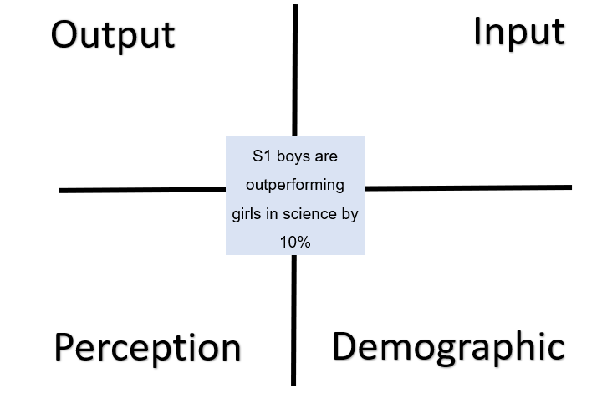
Next steps – intersecting data
Once data has been analysed, it is important to consider ‘why’ a gap, pattern or a trend may exist.
The next step may be to intersect different categories of data as, outlined in workshop 2, to understand ‘why.’
Notes:
Key messages
Once data has been analysed, it is important to consider ‘why’ a gap pattern or a trend may exist.
The next step may be to intersect different categories of data as, outlined in workshop 2, to understand ‘why.’
Facilitators may wish to recap on this activity from workshop 2 and ask participants to take one of the attainment observations and discuss which data they may need to intersect / explore further to find out the cause of the gap, pattern or trend.

Slide 31
Next steps – action planning
What did we learn from the data? Are all staff aware of the key findings?
Why is the information important? Do all staff understand the importance?
What will we do now that we know this information? Have staff been involved in identifying next steps?
What specific steps or actions do we need to take to support improvement? Do all staff know their role in this and how it relates to class level data?
Are the steps required targeted towards the whole school, specific cohorts or specific demographic groups? Do they have implications for whole school improvement planning?
Notes:
Key messages
Once educators have identified patterns, gaps or trends and are clear about the reasons for them, they can begin to think about putting in place actions to improve outcomes. The following questions may help participants when identifying next steps.
What did we learn? Are all staff aware of the key findings?
Why is the information important? Do all staff understand the importance? What will we do now that we know this information? Have staff been involved in identifying next steps?
What specific steps or actions to we need to take to support improvement? Do all staff know their role?
Are the steps required targeted towards the whole school, specific cohorts or specific demographic groups? Do they have implications for whole school improvement planning?

Slide 32
Next steps – using a data driven dialogue approach
Taking a data driven dialogue approach is one way of supporting staff to increase their knowledge, skills and confidence in analysing data.
Using their own school level data or a set of sample data, participants go through four phases of analysis and interrogation. These are: prediction, go visual, observations and inferences.
This approach can provide a frame for staff when approaching data analysis.
As the name suggests, it is important that this is carried out collaboratively.
A link to the protocol and sample data can be found using the link or QR code.
NCS_PS_Toolkit_BST_Set_C_DataDrivenDialogue.pdf (uchicago.edu)
Notes:
Key Messages
It is important to ensure that all staff are equipped to analyse data. Data should be everyone's business.
School leaders may wish to think about how this can be achieved.
Taking a data driven dialogue approach is one way of supporting staff to increase their knowledge, skills and confidence in analysing data.
Using their own school level data or a set of sample data, participants go through four phases of analysis and interrogation. These are: prediction, go visual, observations and inferences.
This approach can provide a frame for staff when approaching data analysis.
As the name suggests, it is important that this is carried out collaboratively.
A link to the protocol and sample data for carrying out a data driven dialogue can be found using the link or QR code on the slide.

Slide 33
Aims Review
In this workshop we will consider:
national guidance and research including signposting to national data sets,
the use of comparator data,
the different ways in which data is presented,
how to analyse contextual and attainment data, and
how to use a data analysis to inform next steps.
Notes:
Key Messages
This slide shows the aims of the session to be reflected on at the end of the session.

Slide 34
Reflection Activity
TASK
How confident are staff in effectively analysing data?
What key messages or actions have you taken from the workshop?
What might you do differently in school?
Notes:
Reflective Questions
A final reflective task. Ask participants to consider the question and then feedback into the room.

Slide 35
Feedback
Insert you own evaluation code here
Notes:
You can insert your own feedback link here.
Thank-you. We hope that you found this resource useful.
Please provide feedback on the materials here https://forms.office.com/e/viKTsvQj9d
Your comments are appreciated and will be used to inform future resources.
This link should not be shared with the audience.

