Slide 1
Supporting Attendance: Understanding the Issues
Notes:
All information correct as of January 2024
These slides are intended to support leaders in schools and local authorities to develop their own workshops to explore how to support attendance. The materials are divided into three sections:
Understanding the Issues
Effective use of Data
Effective Strategies
(Hyperlinks to the first page of each workshop are available on the images)
The PowerPoint is a template that presenters can adapt to suit their own context and style of presenting. The workshops can be delivered in a longer session or split into shorter sections to suit time availability.
Within the slide notes key messages, suggested tasks, ‘talking points’ and challenge questions are included.
It is anticipated the presenter will have read Improving Attendance in Scotland.

Slide 2
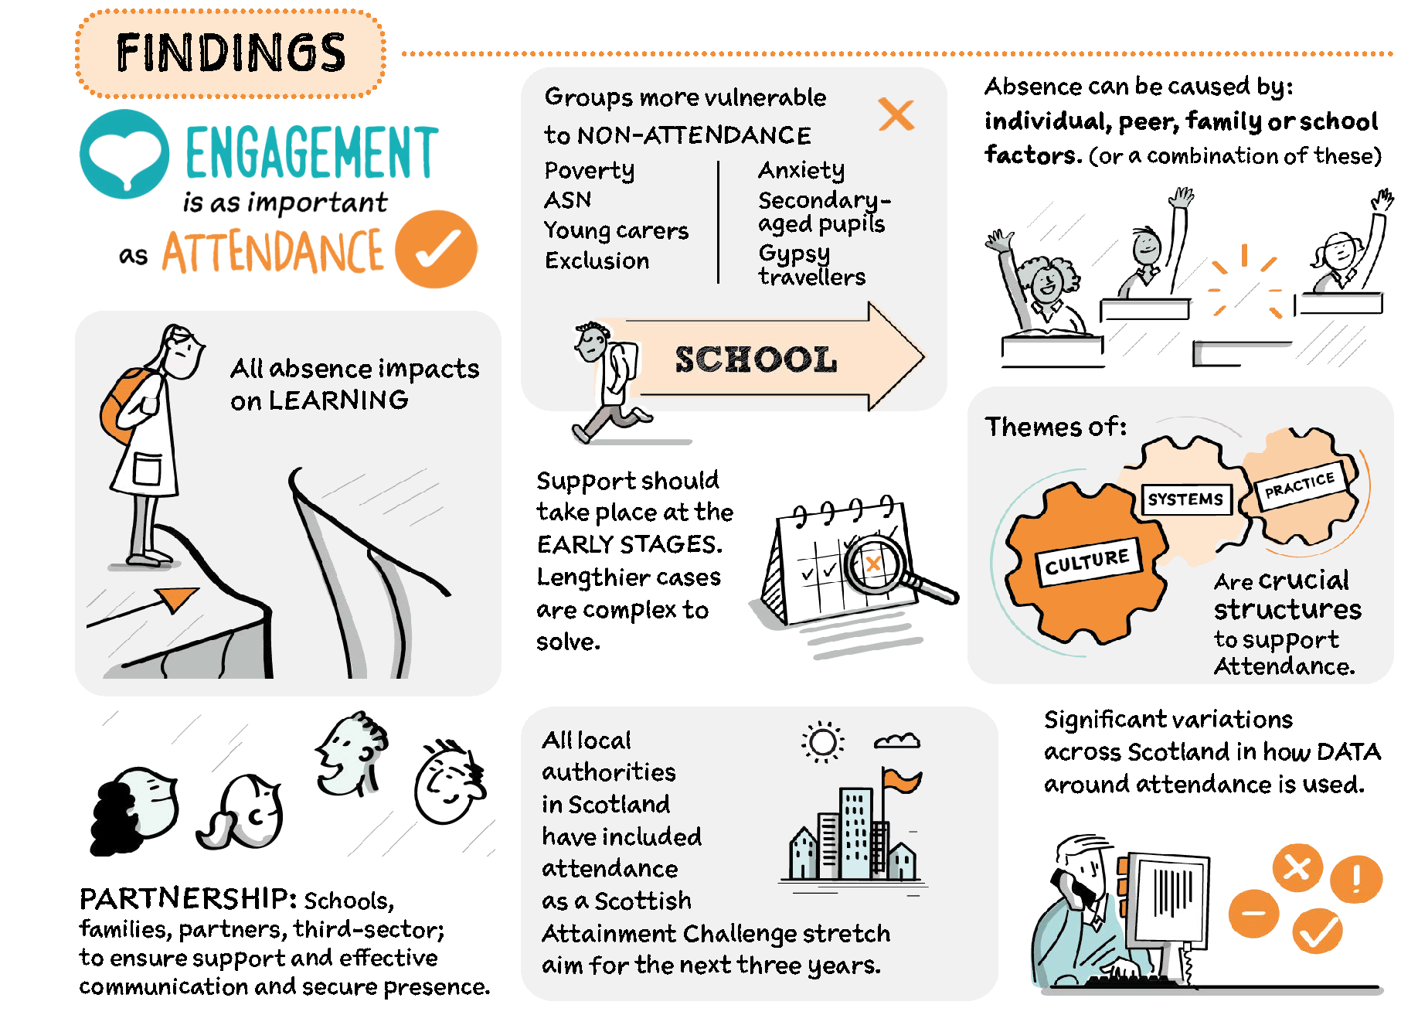
Improving attendance in Scotland
Read Improving Attendance in Scotland
Notes:
Key messages:
After a deep dive into attendance the following findings were identified (these will be further explored in the workshops)
Actions for consideration were also identified:
Local authorities should monitor the outcome of strategic and implementation plans for improving attendance or develop a plan where one is not in place
Put children and young people’s views at the centre of approaches
Education Scotland is working with stakeholders
Partners should provide bespoke support for areas where attendance remains a challenge
Approaches to tracking and monitoring attendance should be shared
Education Scotland and Scottish Government will collaborate with the wider system to bring coherence to the work on improving attendance

Slide 3
Workshop 1 Understanding the Issues
Notes:
Workshop 1

Slide 4
What is the difference between attendance and engagement?
TASK
Notes:
Suggested task:
Group discussion on what the difference is between attendance and engagement.
Key messages:
Children and young people may physically be in school but can be disengaged from learning.
Attendance, combined with engagement should support children and young people to make progress in their learning and have a positive impact on educational outcomes.

Slide 5
Engagement is as important as attendance
Engagement happens when children and young people give attention to, and are actively involved in, a learning task.
Types of engagement include:
emotional (interest, boredom, happiness)
behavioural (attention, effort, persistence)
cognitive (motivation, learning strategies)
agency (expressing interests and needs)
Notes:
Key message:
One of the main findings is that ‘Engagement is as important as attendance’.
Children and young people may physically be in school but can disengage from learning.
Without engagement, attendance is meaningless.

Slide 6
Understanding the reasons for absence
The causes of absence are multifaceted and should be considered only as part of a bigger picture of the individual child or young person.
School
Peers
Individual
Family
(Forth Valley West Lothian)
This Photo by Unknown Author is licensed under CC BY
Notes:
Key message:
Forth Valley and West Lothian have categorised the reasons for absence under four headings:
Individual factors : such as health (physical/mental) ASN, social factors, self-belief, lack of interest
School factors: such as relationship with teacher/peers, quality of learning/relevance, curriculum, transitions
Family factors: such as low interest/belief, parent mental health, loss and bereavement, worry about parents, financial concerns
Peer factors: peer pressure, social isolation, poor social skills, peer conflict, bullying, feeling of not belonging
Absence can be multifaceted and can therefore have more than one cause. Assessing the reasons will support the removal of any barriers.

Slide 7
Relationships are important
Talking Point
‘School attendance issues cannot easily be separated from the relationships, behaviours and wellbeing of the pupils and wider school community and it is important that schools view the promotion of attendance in this context.’
Included, Engaged & Involved: part 1
‘A positive culture and ethos are key determinants in promoting good attendance for all’
Journal of Positive Behaviour Interventions
Notes:
Talking point:
What does this look image like in different establishments, what are the common themes?

Slide 8
All absence impacts attainment
Research suggests all forms of absence (truancy, sickness absence, exceptional domestic circumstances, and family holidays) negatively impact achievement and attainment (Klein and Sosu, 2023).
This is echoed by John et al (2021) noting that poor attendance at school, whether due to absenteeism or exclusion, leads to multiple social, educational, and lifelong socio-economic disadvantages.
Notes:
Key message:
All absence impacts attainment
Reflective questions:
Is there a common understanding within schools, across clusters and within different local authorities?
Where are the similarities and the differences?

Slide 9
Where is the threshold in your school?
75%
80%
90%
85%
TASK
A
B
C
D
Notes:
Suggested task:
Where is the threshold for action in your school? Discuss or put in the chat.
Key messages:
All absence can affect progress. Thresholds for action are unreliable, as waiting till 90% means that attainment is already impacted.
When averaging 90% attendance over the course of their school career, by the time a young person has reached third year of secondary education, they will have missed the equivalent of an entire year of school.

Slide 10
Impact of absence
Percentage | Number of days missed | Impact
100% | 0 | Gives a learner the best chance of success.
95% | 9 days
> 90 % | 19 days | Less chance of success due to poor attendance. Learners could drop a whole grade in secondary school.
> 85% | 27 days | Serious implications on learning and progress.
> 80% | More than 36 days | Serious implications on learning and progress.
Notes:
Key messages:
Less than 90% equals 19 days resulting in less chance of success due to poor attendance. Learners could drop a whole grade in secondary school.
The higher the absence, the greater the impact on attainment, and the type of absence did affect the degree of impact.
The key message emerging from the data was that all absence, even when related to illness (therefore excused or authorised), impacts attainment and therefore all absence should be prioritised for mitigating interventions.
Early intervention is easier to deal with, chronic absence is more difficult to reverse.

Slide 11
Attendance Trend
Academic year | Percentage
2010 to 2011 | 93.1%
2012 to 2013 | 93.6%
2014 to 2015 | 93.7%
2016 to 2017 | 93.3%
2018 to 2019 | 93%
2020 to 2021 | 92%
2022 to 2023 | 90.2%
Notes:
Key messages:
In the academic year 2023 to 2024, school attendance is at a 10-year low.
Attendance was on a downward trajectory before the COVID-19 pandemic.
The data shows a sharper drop from 92% in 2020 to 2021 to 90.2 in 2022 to 2023, the pandemic hasn’t helped.

Slide 12
Attendance 2023
Notes:
Key messages:
There is a clear poverty-related attendance gap (6.7%)
In addition, pupils with additional support needs also attend less than those without needs. (4.1%)
The Commission on School Reform also report that there is variation across LAs in the number of children and young people attending 90% or below.

Slide 13
Primary School Attendance
National Attendance %
Notes:
Key messages:
There is significant poverty related gap in primary school attendance. (5.7)
In addition, pupils with an additional support need also attend less than those without needs. (2.6%)

Slide 14
Secondary School Attendance
Notes:
Key messages:
The poverty-related gap in school attendance widens further in secondary (6.7% in secondary compared to 5.7% in Primary )
Attendance of those with an additional support need and those without needs also increases. (4.1% in secondary compared to 2.6% in Primary)

Slide 15
Absence in relation to poverty
Talking Point
Klein & Sosu (2023) suggest absences may cause greater harm to children and young people living in lower socio-economic circumstances because their families may have fewer resources to compensate for lost instructional time.
Children and young people living in higher social economic circumstances appear to recover more quickly from learning loss related to sickness absence. This may be owing to fewer underlying health conditions and families using assets to catch up with missed lesson content
(Klein and Sosu, 2023)
Notes:
Key messages:
All absence can affect progress
Absences may cause greater harm to children and young people living in lower socio-economic circumstances because their families may have fewer resources to compensate for lost instructional time. Klein & Sosu (2023)
Children and young people living in higher social economic circumstances appear to recover more quickly from learning loss related to sickness absence. This may be owing to fewer underlying health conditions and families using assets to catch up with missed lesson content (Klein and Sosu, 2023).
There has been a widening of the gap in attendance between children and young people living in the most deprived and least deprived areas in Scotland since 2014-15. This gap also showed a pattern of widening pre-pandemic.
21 LAs indicating a pattern of a widening attendance gap across LAs but not universal with variation at LA level.
Talking point:
What do you have in place in your setting, which compensates for lost learning time?

Slide 16
What does the research say?
Talking Point
All absence affects attainment, even when related to illness
An average of 90% attendance is the equivalent of missing an entire school year by 3rd year of high school
School absences can be associated with lower educational attainment and a greater likelihood of non-employment
Late coming is an early indication that absence may become a problem
Absences may cause greater harm to those who experience socio‑economic deprivation
An increase in unauthorised absence from age 10 to 11 can indicate more significant absence in later years
Notes:
Talking Point:
What fact is most surprising?
Key message:
Improving Attendance: Understanding the Issues has a wealth of research that delves into the impact of absence.

Slide 17
Groups more vulnerable to low attendance
children and young people impacted by poverty
secondary-aged pupils
young people from Gypsy and Traveller communities
pupils with additional support needs including:
children and young people who have experienced care
young carers
children and young people who have experienced exclusion
children and young people with social and emotional needs linked to mental health
Notes:
Key messages:
Certain groups are more vulnerable to low attendance
Children and young people impacted by poverty:
Children and young people living in areas of high economic and social deprivation have higher absence rates
Recovery from absence is harder for these pupils are families are unable to mitigate the impact.
Secondary-aged pupils:
Attendance diminishes as pupils move through school. It is important to have an early intervention strategy.
For example, if the first unauthorised absence is not challenged this will likely lead to poor attendance later.
Children and young people who have experienced care (looked-after):
In secondary schools, the difference in attendance rates between looked after children and all pupils was greater than in primary schools and special schools in 2020-21.
Young people from Gypsy and Traveller communities:
Outcomes for these young people are among the worst in Scottish education.
Young Carers:
Around 7% of young people in Scotland have caring responsibilities.
Over a quarter of young carers aged 11 to 15 regularly miss school.
Children and young people who have been excluded:
Exclusion is associated with poor mental and physical health, substance abuse, antisocial behaviour, crime, low academic achievement, unemployment, and homelessness.
Children and young people with social and emotional needs linked to mental health
Those experiencing emotionally-based avoidance

Slide 18
Secondary schools and attendance
Talking Point
Positive perceptions of attitudes to school decrease with pupil stage, particularly up to S4.
Notes:
Key Messages:
HM Inspectors noted a common challenge which impacts attendance levels in schools is a weakness in monitoring procedures, particularly in secondary schools
Sickness absence, authorised absence and unauthorised absence were very high in S4. But in terms of high sickness absence - S2 and S3 were higher in 2020-21
S4 attendance was the lowest at 87.2% (SG, 2021).
Positive perceptions of attitudes to school decrease over the secondary experience, particularly up to S4.
Secondary pupils had, on average, an attendance rate of 89.1%, compared with a rate of 92.0% for all pupils in 2020-21.
Talking Point:
Do concerns about wellbeing lead to absence?
Key message:
The Scottish Division of Education Psychology notes that school non-attendance due to emotional factors has a cyclical impact; pupils miss school, they miss key learning and social interactions which fuel their anxiety or emotional distress making it harder and harder to return.
The more school is missed, the more this is compounded with relationships breaking down and the amount of school work missed, becoming perceived as insurmountable (ES, 2023c).
For some children and young people, emotional distress may be obvious in their presentation at school or through significant levels of non-attendance. For others, their presentation may be less obvious with sporadic attendance (Solihull Community Educational Psychology Service, 2020).

Slide 19
Workshop 2 Effective Use of Data
Notes:
Workshop 2

Slide 20
What might this be telling us?
Talking Point
The attendance of S5 in 2022-2023 has increased by 5%. From 86% in Term 1 to 91% in Term 4.
Attendance in P7 has risen by 3%. From 90% in 2021-2022 to 93% in 2022-2023.
Overall school attendance in Anytown Primary has increased from 90% to 91%.
What wrong with this data as evidence of improvement? Any other examples?
Notes:
Talking point:
In each of the boxes there is an issue with how data is being analysed.
What may be an issue with this data as evidence of improvement? Any other examples?
What does this tell us? Do we need more information?
Possible issues:
Box 1: Comparison between terms is unreliable. Better to compare improvement at the same time as the previous year.
Box 2: P7 cohort may be different or school pandemic year closure.
Box 3: Not enough information, what is this comparison timescale?

Slide 21
Data and attendance research tell us
(Klein et al., 2022).
Using the right data is critical.
Interventions which focus on attendance should consider the underlying reasons.
Health, behavioural or social factors should be important considerations for designing interventions.
Knowledge of specific reasons will aid the design of successful interventions to improve attainment by incorporating support that addresses the underlying reasons for absenteeism
Notes:
Key messages:
Using the right data is critical.
Interventions which focus on attendance should consider the underlying reasons.
Health, behavioural or social factors should be important considerations for designing interventions.
Knowledge of specific reasons will aid the design of successful interventions to improve attainment by incorporating support that addresses the underlying reasons for absenteeism

Slide 22
What data do I need?
Talking Point
All absence can affect progress
90% threshold for action is unreliable
Certain groups are more vulnerable to absence
Absence in higher as a pupil moves through secondary
Absence is only a symptom of what else is happening.
Notes:
Talking Point:
What data do I need to look at?
Key messages:
All absence can affect progress
Initial un-challenged unauthorised absences lead to more
90% threshold for action is unreliable
Assessing the reasons for non-attendance
what is pushing the child or young person away from school and pulling them towards home?
Certain groups are more vulnerable to non-attendance
those impacted by poverty
secondary-aged pupils
young people from Gypsy and Traveller communities
pupils with additional support needs including:
children and young people who have experienced care
Young carers
children and young people who have experienced exclusion
anxious children and young people
Absence in higher as a pupil moves through secondary
Patterns of unauthorised attendance in P7/S1 can lead to more persistent absence later in secondary school
The first unauthorised absence will lead to more
Absence is only a symptom of what else is happening
Knowledge of the child or young person is the strongest data
Reflective Question:
What type of data or demographic information are you using and how frequently is it analysed?

Slide 23
Data for improvement.
What does the research tell us?
Establishing the purpose and use of data
Defining and classifying data
Creating effective processes and systems
Interpreting and analysing data
Developing a data informed culture
Using data for improvement
TASK
Notes:
Suggested task Part 1:
Read https://education.gov.scot/media/vzvdpafc/the-effective-use-of-data-for-improvement-in-education.pdf
This can be done as a group read with participants reading sections each and feeding back.

Slide 24
Attendance Data
TASK Part 2
Thinking about attendance data in your establishment/local authority, consider the following:
What, if any, are the attendance issues within your establishment?
What are the main reasons for absence?
What is working well?
What are the areas for further development or what might need to be done differently?
What might be your next steps?
What support might you need?
Notes:
Suggested task part 2:
Now reflect on these questions.

Slide 25
Workshop 3 Effective Strategies
Notes:
Workshop 3

Slide 26
“I don’t think there’s ever a silver bullet to any problem. There are always several answers and solutions to a problem.” Susana Martinez
How do we improve attendance?
Notes:
Key message:
There are no silver bullets.

Slide 27
What can we do?
TASK
Notes:
Suggested task:
Read pages 16- 20 of Improving Attendance: Understanding the Issues.
This can done as a group read with participants reading sections each and feeding back.
Share in groups how are we improving attendance in our school around supporting culture, systems and practice.
Key message:
Cogs are reliant on each other. Fixing just one on its own won’t work.

Slide 28
Improving motivation and engagement
How do you promote a sense of belonging, empowerment and identity?
What impact does this have on attendance?
Talking Point
Notes:
Key Messages:
Motivation is required to be engaged.
Self-determination theory suggests that establishments may wish to consider how effectively learners have:
Affiliation: a sense of belonging. I belong
Autonomy: a sense of self-determination. I am allowed/trusted
Agency: a belief in your ability to achieve your goals. I can.
The Glasgow Motivation and Wellbeing Profile explores motivation and sense of wellbeing in the learning context.

Slide 29
Pushes and Pulls
Pull to
Push away
Push away
Pull to
Notes:
Key messages:
In thinking about how we improve attendance it is helpful to consider how we support absence and promote attendance.
To do this we need to consider what:
Pulls learners toward home? How can we mitigate or support pressures on young carers, the desire to game and peer pressure?
What pushes the learner away from home/community? As well as supporting the learner with what is happening at home, how do we capitalise on school being a solution such as strong relationships/ safe culture?
Pulls away from school that require mitigation such as peer relationships, staff relationship( affiliation), the relevance of curriculum, a curriculum that speaks to goals (agency), control over what/where they are learning (autonomy) identity as a learner (do they feel the curriculum is for them?)
Pulls towards school – What is your offer? What makes your CYP get out of bed in the morning? What happens on the days of the week you have low attendance?
When schools understand what is pushing and pulling they can remove these barriers.

Slide 30
Putting Children, Young People and Families at the Centre
1. Identify target pupils
2. Gather all views
3. Understand the causes
4. Co-create intervention plan
5. Implement, monitor and evaluate
Attendance Targeted Intervention Guidance
(Forth Valley West Lothian)
Notes:
Key message:
Forth Valley and West Lothian have created targeted intervention guidance for putting children and families at the centre.
This follows the principles of GIRFEC.
This is a flow chart for targeted intervention:
1. Identify target pupils: use attendance data and early warning systems to identify target pupils.
2. Gather all views: gather individual views from the pupil, parent/carer, and key staff, to gain a holistic understanding of attendance problems.
3. Understand the causes: analyse qualitative data to determine the cause(s) and identify suitable interventions.
4. Co-create intervention plan: agree next steps and plan interventions in partnership with parents/carers, the pupils themselves, and any appropriate agencies.
5. Implement, monitor and evaluate: once interventions are implemented, continue to monitor progress and evaluate their effectiveness, sharing this information with all involved.
Attendance Targeted Intervention Guidance: https://blogs.glowscotland.org.uk/glowblogs/fvwlric/school-refusal-assessment-scale-sras-r/

Slide 31
Resources
Included, Engaged and Involved Part 1
This national policy provides the framework for the promotion and management of attendance and absence.
Forth Valley and West Lothian RIC Attendance Toolkit
An interactive attendance toolkit, created by FVWL Regional Improvement Collaborative.
Promoting Attendance: self-reflection questions for educational settings.
This resource provides self-reflection questions for schools to further explore and implement practices which will encourage good attendance.
Notes:
Key messages:
Self-evaluation should be at the heart of improvement regardless of the resource used.

Slide 32
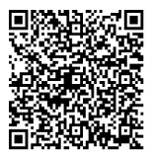
Thank you!
Improving Attendance Workshop feedback form
Notes:
We hope you found the resource to support your workshop planning useful.
Please let us know how we can improve this by answering the questions below.
https://forms.office.com/e/jC9rBVwD2M

