Slide 1


Na Seumasaich – The Jacobites
Learning about Gaelic Language and Culture Resource
Lesson 8 – After Culloden – The Prince’s escape, the impact on Gaelic, the weather, past tense
For Scotland's learners, with Scotland's educators

Slide 2
Na Seumasaich – Lesson 8
In this Learning about Gaelic Language and Culture resource lesson we will learn:
about how Bonnie Prince Charlie escaped from the British forces
about the impact of the failure of the Jacobite rebellion on the Gaelic culture of the Highlands of Scotland
to discuss the weather in Gaelic
to use the past tense structure Bha/Cha robh
to create short texts about ourselves and others in Gaelic
to reflect upon our learning about the Jacobites and Gaelic

Slide 3
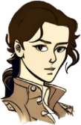
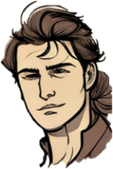
Màiri and Calum
Halò a Chaluim. tha i fuar an-diugh nach eil?
Chan eil! Tha i teth!
Och! Chan eil! Bha i teth an-dè!
Bha i grianach cuideachd!

Slide 4
Màiri and Calum 2
What happened after Culloden?
Firstly, the British Government took action to ensure there would be no further rebellions. Gaelic speaking Highlanders suffered terribly.
That’s right. We learned earlier that they banned the kilt.
Secondly, Bonnie Prince Charlie went on the run. This was an epic tale, and one which is still remembered today.
That must be some story. Tell me a little about it.

Slide 5
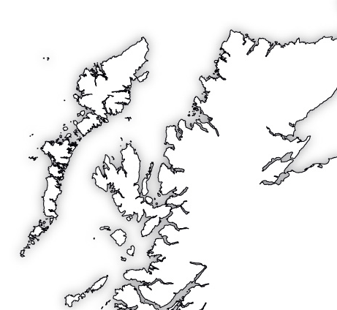
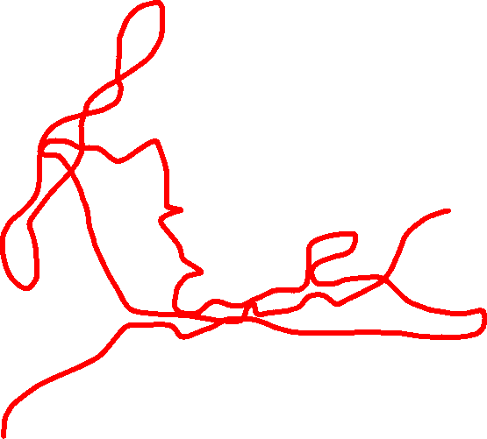
Cuairt a’ Phrionnsa
Bonnie Prince Charlie spent over 5 months on the run in the Highlands and Islands. You can use this resource to follow the Prince’s escape from Culloden until his ultimate return to France.
The Flight of Bonnie Prince Charlie - Story Map (jacobites.org.uk)

Slide 6
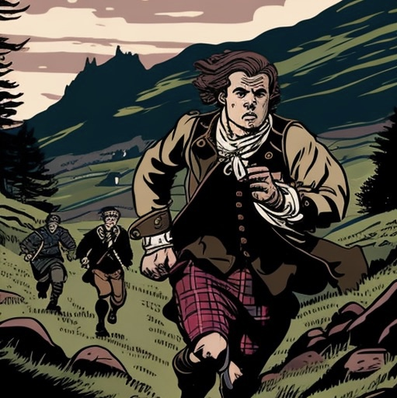
In the Hebrides
After Culloden, the Prince headed towards Lochaber, where he had first landed. Eventually he made for the Western Isles where he thought it would be easier to get a boat to France.
The Prince landed in Benbecula on the 27th of April and stayed two nights in an abandoned hut. He would then make for Scalpay off the coast of the Isle of Harris. The people of Scalpay still sing about their pride at not turning the Prince over despite the reward money available. He would try and return here when the people of Stornoway, Isle of Lewis would not let him enter their town.
The Prince would then return to Benbecula and then South Uist, where he would spend almost 3 weeks in Coradail, even getting the chance to go shooting and hunting! However, as June dragged on, Government troops started to draw near. he had many narrow escapes in Eriskay in particular.

Slide 7
In the Hebrides - Questions
Where did the Prince stay his first couple of nights in the Western Isles?
What are the people of Scalpay still proud of today and how do they show this?
What shows that the Prince was able to relax a little when he was in South Uist?

Slide 8
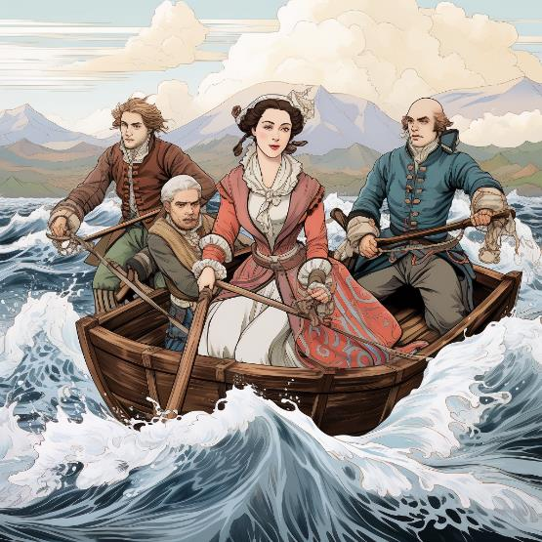
Over the Sea to Skye
On the 28th of June, the Prince dressed as the Irish servant of Flora Macdonald (Fionnghal NicDhòmhnaill) called ‘Betty Burke’ and set sail for Skye from Uist. Flora and the prince were accompanied by Neil MacEachain and four boatmen.
They tried to land in Waternish, but were fired upon by troops. They then went to Kilbride in Trotternish where the Prince was able to stay in Kingsburgh House.
A couple of days later, the Prince even spent a couple of hours in a pub in Portree. The Prince would leave from Elgol on the 4th of July 1746 for the mainland. He supposedly left the recipe for an alcoholic drink called Drambuie with Clan MacKinnon which is still popular today.
The Prince would spend just over a week in Skye and Raasay but the “Misty Isle” has become linked with the image of the runaway Prince more than any other place.

Slide 9
Over the Sea to Skye
Questions
1. What name did the Prince travel under with Flora Macdonald?
2. Why could they not land where they wanted to in Skye?
3. What did the Prince supposedly give Clan MacKinnon as a gift?
4. What is said about the Prince’s connection with Skye and Raasay?
5. Find out about the history of the “Skye Boat Song”

Slide 10
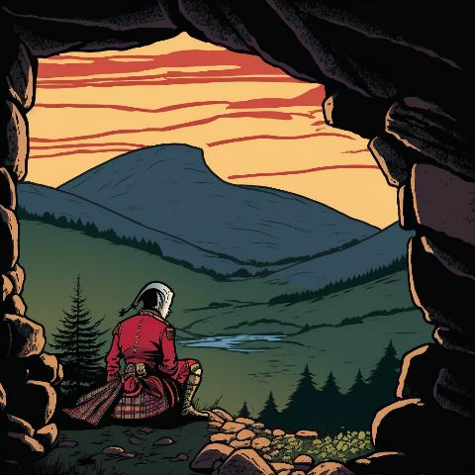
Back on the Mainland and escape to France
The Prince would spend several weeks roaming the hills and glens of Lochaber and Inverness-shire. He was able to live in relative peace in Strathglass for a few days, but often had to stay in caves, such as a famous one in Glenmoriston.
Here the Prince was protected by the Seven Men of Glenmoriston, who did not turn him in even though the reward was 30,000 pounds (around 2.6 million pounds in today’s money).
He then headed east towards the Cairngorms, before coming back to Lochaber. The Prince travelled in all sorts of weather, sometimes staying only a couple of miles ahead of the Government troops.
He would eventually leave Scotland for good on the 20th of September 1746 on a French ship from Loch nan Uamh (The Loch of the Caves). He lived out his days in Rome. His brother Henry inherited the Jacobite claim to the throne, but he was a Roman Catholic Cardinal and had no children. The Jacobite Stuart line came to an end.

Slide 11
Back on the Mainland and escape to France
Questions
What kind of places did the Prince have to stay often?
How much would the reward money for the Prince be worth today?
How did the Prince finally leave Scotland?
What happened to the Jacobite claim to the throne when Charles died?

Slide 12
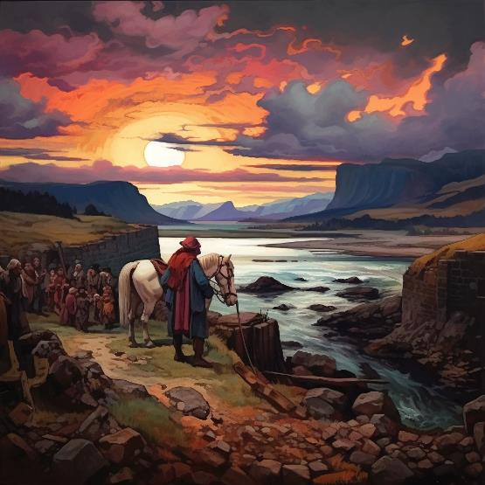
The Aftermath
The British Government were determined there would never be another rebellion from the Highlands. So they brought in lots of laws to weaken the clan system, and therefore Gaelic culture. They hunted down many Jacobite rebels and executed many of them.
The UK Parliament brought in the Act of Proscription in August 1746. This banned people in the Highlands from owning weapons. It also banned people from wearing the kilt in any part of Scotland.
People could be fined, put in jail, and then sent to the colonies in the Americas if they refused to follow the new rules. These rules didn’t just apply to Jacobites. Highlanders who supported the Government were also affected.
The Clan Chiefs also lost a lot of their rights in another Act of Parliament.. This weakened their powers, but also meant that their connection to the people and land was weakened.
The ban on the kilt and tartan was lifted in 1782. The weakening of the bonds between chiefs and clan members would contribute to the Highland Clearances in the 19th Century.

Slide 13
The Aftermath
Questions
What did the government do to Jacobite rebels?
What did the Act of Proscription ban?
What were the consequences for breaking the law?
What effect did the weakening of the Clan chiefs’ power have?
When was the ban on tartan lifted?

Slide 14
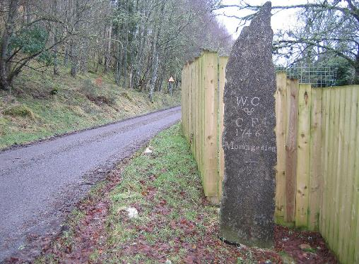
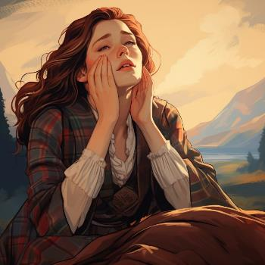
"Mo rùn geal òg" (My fair young love)
The failure of the rebellion affected thousands of people. "Mo rùn geal òg" (My fair young love) is a Scottish Gaelic lament written by Christina Fergusson for her husband, William Chisholm of Strathglass, who was killed at the Battle of Culloden in 1746.
Fergusson was possibly born in Contin, Ross-shire. She was married to William Chisholm, who was a blacksmith, armourer and standard bearer for the Chief of Clan Chisholm. In the song, Christina rebukes Prince Charles Edward Stuart, saying that the loss of her husband in fighting for his cause has left her desolate.
A roadside memorial marks the site of Chisholm and Ferguson's cottage, near Struy in Strathglass. The song has been performed by several notable singers, including Flora MacNeil, Julie Fowlis, and Anne Lorne Gillies.
Listen to the song then discuss: What emotions do you hear in the song? How does the singer sound?
Flora MacNeil MBE sings 'Mo Run Geal Og' (My fair young love) - YouTube
Traditional Celtic Song - Mo rùn geal òg - YouTube
Flora MacNeil - Mo Run Geal Og (My Fair Young Love) (celticlyricscorner.net)
CC BY-SA 2.0 – Craig Wallace

Slide 15













An aimsir – Tha i…
Here are some adjectives for the weather in Gaelic
teth
blàth
stoirmeil
tioram
fuar
sgòthach
ceòthach
gaothach
fliuch
grianach

Slide 16
An aimsir – Tha i… (support)
Here are some adjectives for the weather in Gaelic
blàth
warm
stoirmeil
stormy
teth
hot
tioram
dry
fuar
cold
sgòthach
cloudy
gaothach
windy
grianach
sunny
fliuch
wet
ceòthach
misty/foggy

Slide 17


An aimsir – Tha … ann
Here are some nouns for the weather in Gaelic
reòthadh
sneachd
tairneanaich
is
dealanaich
turadh
an t-uisge
bogha-frois
sgòthan
ceò
a’ ghaoth
a’ ghrian

Slide 18
An aimsir – Tha … ann (support)
Here are some nouns for the weather in Gaelic
reòthadh
frost
sneachd
snow
turadh
dry spell
tairneanaich
is
dealanaich
thunder & lightning
an t-uisge
rain
bogha-frois
rainbow
sgòthan
clouds
ceò
mist/fog
a’ ghaoth
the wind
a’ ghrian
the sun

Slide 19



How to talk about the weather
Ciamar a tha an t-sìde?
The weather in Gaelic an t-sìde or an aimsir is a feminine noun, that means we use the pronoun i for the weather.
Tha i fliuch – It is wet
Tha i fuar – It is cold
Chan eil i grianach – It is not sunny
If we use a noun instead we use the structure Tha…ann
Tha an t-uisge ann – There is rain
Chan eil sneachd ann – There is no snow
To ask someone how the weather is, you ask:
Ciamar a tha an t-sìde? or Ciamar a tha an aimsir?
You can also add an-diugh for today
Tha i teth
Tha i fuar
Tha sneachd ann
Tha an t-uisge ann

Slide 20
How to talk about the weather in the past
Ciamar a bha an aimsir?
To say things in the past tense in Gaelic, you change Tha to Bha (and Chan eil to Cha robh)
Bha i fliuch – It was wet
Bha i fuar – It was cold
Cha robh i grianach – It was not sunny
If we use a noun instead we use the structure Bha…ann
Bha an t-uisge ann – There was rain
Cha robh sneachd ann – There was no snow
To ask someone how the weather was , you ask:
Ciamar a bha an t-sìde? or Ciamar a bha an aimsir?
You can also add an-dè for yesterdat
Bha i teth
Bha i fuar
Bha sneachd ann
Bha an t-uisge ann

Slide 21


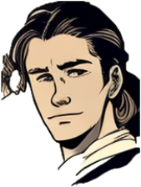

Task one – Asking how the weather is today
Your teacher will ask you Ciamar a tha an t-sìde an-diugh? Reply with Tha i… then the adjective you think is most suitable. Don’t worry if you can only say the adjective
Caleb, Ciamar a tha an t-sìde an-diugh?
Teth! Tha i teth agus grianach!

Slide 22

Task one extension – Asking how the weather was yesterday
Your teacher will ask you Ciamar a bha an t-sìde an-dè? Reply with Tha i… then the adjective you think is most suitable. Don’t worry if you can only say the adjective
Caleb, Ciamar a bha an t-sìde an-dè?
Fliuch! Bha i fliuch agus fuar!

Slide 23
Task two – Reading – Aimsir a’ Phrionnsa
Translate this weather diary of the Prince’s escape after Culloden into English.
Put the places he stayed on a map of the Highlands and Islands if you want.
27/4 – Bha i gaothach! (Washed ashore in Benbecula)
6/5 – Bha i fliuch! (Sheltered in a hut off Harris)
28/5 – Bha i blàth! (Enjoying shooting in Corodail, South Uist)
13/6 – Bha stoirm ann! (Staying overnight in a cleft in a rock in Eriskay)
25/6 – Bha an t-uisge ann (Hiding in North Uist)
3/7 - Bha i tioram (night walk from Portree to Strath, Isle of Skye)
22/7 – Bha i teth (escaping the redcoats in Glenshiel)
14/8 – Cha robh i tioram! (On the run in Glenmoriston)
8/9 – Bha ceò ann (high in the peaks of Ben Alder)
20/9 – Bha i sgòthach (leaving Loch nan Uamh late at night for France)

Slide 24
Task three - Talk
Cò às a tha thu?
Prepare your answers for these questions you have covered in the course. Then take turns with a friend to ask them and answer them.
Càit a bheil thu a’ fuireach?
Ciamar a tha thu?
A bheil Gàidhlig agad?
Dè an t-ainm a th’ ort?
Dè an aois a tha thu?
Ciamar a tha an t-sìde?

Slide 25
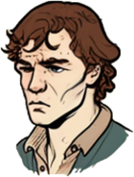
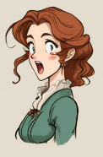
Task four - writing
You are going to complete your profile with as much Gaelic as you can provide from this course.
Write a sentence in Gaelic stating your first name and surname.
Write a sentence in Gaelic stating where you are from.
Write a sentence in Gaelic stating your age.
Write a sentence in Gaelic stating where you stay.
Write a sentence about your Gaelic skills.
Write what clothes you are wearing
Write an activity that you do and the day you do it.
Write about the weather today.
Then do the same for your Highlander.
Example
You
’S mise Kayden Reese-Jones
Tha mi à Alba. Tha mi aon deug.
Tha mi a’ fuireach anns a’ Ghearasdan
Tha beagan Gàidhlig agam
Tha mi a’ cluich ball-coise Disathairne.
Tha geansaidh gorm agus briogais ghorm orm.
Tha i fliuch agus fuar an-diugh

Slide 26
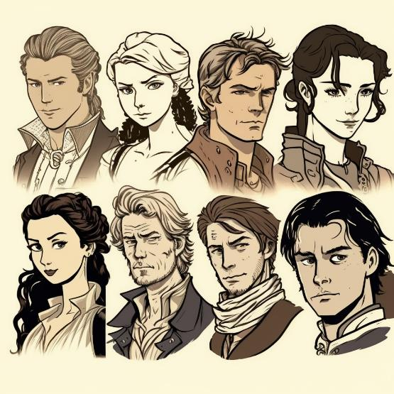
Task five - Factfile
Research one of the following using the internet and other resources. Write up to 5 bulletpoints and then discuss what you learned with others for a couple of minutes.
Long nan Daoine (Ship of the People)
The Clearances in Strathrusdale (Bliadhna nan Caorach)
The Clearances in Sutherland
The 1872 Education Act and Gaelic
The Glendale Martyrs
The Battle of the Braes
The Metagama
The Seven Men of Knoydart

Slide 27
Task six - Reflection
Think about what you have covered in all your lessons – out of 10 (with 10 being the most) how much would you agree with these statements?
I have developed my understanding of what is special, vibrant and valuable about my own and cultures and their languages.
I have had the opportunity to deepen my understanding of culture in Scotland.
I have explored the richness and diversity of language in Gaelic, but also Scots and English as well.
I have explored a period of history, and have developed an appreciation of the heritage and culture of Scotland.

Slide 28
Màiri and Calum 3 – Mar sin leibh - Goodbye
Thanks for taking me through the story of the Jacobites Mairi!
Na gabh dragh! No worries! It is a very important part of Scottish history, and Gaelic is a major part of that story.
I have a better understanding of Scottish culture, language and history.
I’m glad. There are still lots of people who speak Gaelic, and you can learn more online or in face-to-face classes.
Tapadh leat a charaid. ☺

Slide 29


For Scotland's learners, with Scotland's educators
Education Scotland
Denholm House
Almondvale Business Park
Almondvale Way
Livingston EH54 6GA
T +44 (0)131 244 5000
E enquiries@educationscotland.gsi.gov.uk

