Slide 1
Inclusion, Wellbeing and Equalities Professional Learning Framework The United Nations Convention on the Rights of the Child
Informed level
@ESInclusionTeam
For Scotland's learners, with Scotland's educators
Do luchd-ionnsachaidh na h-Alba, le luchd-foghlaim Alba
Notes:
Purpose of these Slides
Read title​
This professional learning is pitched at an informed level and suitable for anyone working with children and young people in an educational context.
How to use the slides:
To be used to facilitate professional learning in a group or whole-setting, or as a self-directed learning activity as an individual.
General Guidance
There is a requirement to cover all the slides.
Please do not change the provided slides.
Facilitators are welcome to add slides or activities relevant to your own setting, to support discussion and exploration of the topic. Facilitators will know their participants’ needs best.
Anyone who works in an educational setting can be a facilitator and use these slides.
It is important to establish a safe space which encourages respect and honesty to ensure that everyone is able to participate.

Slide 2
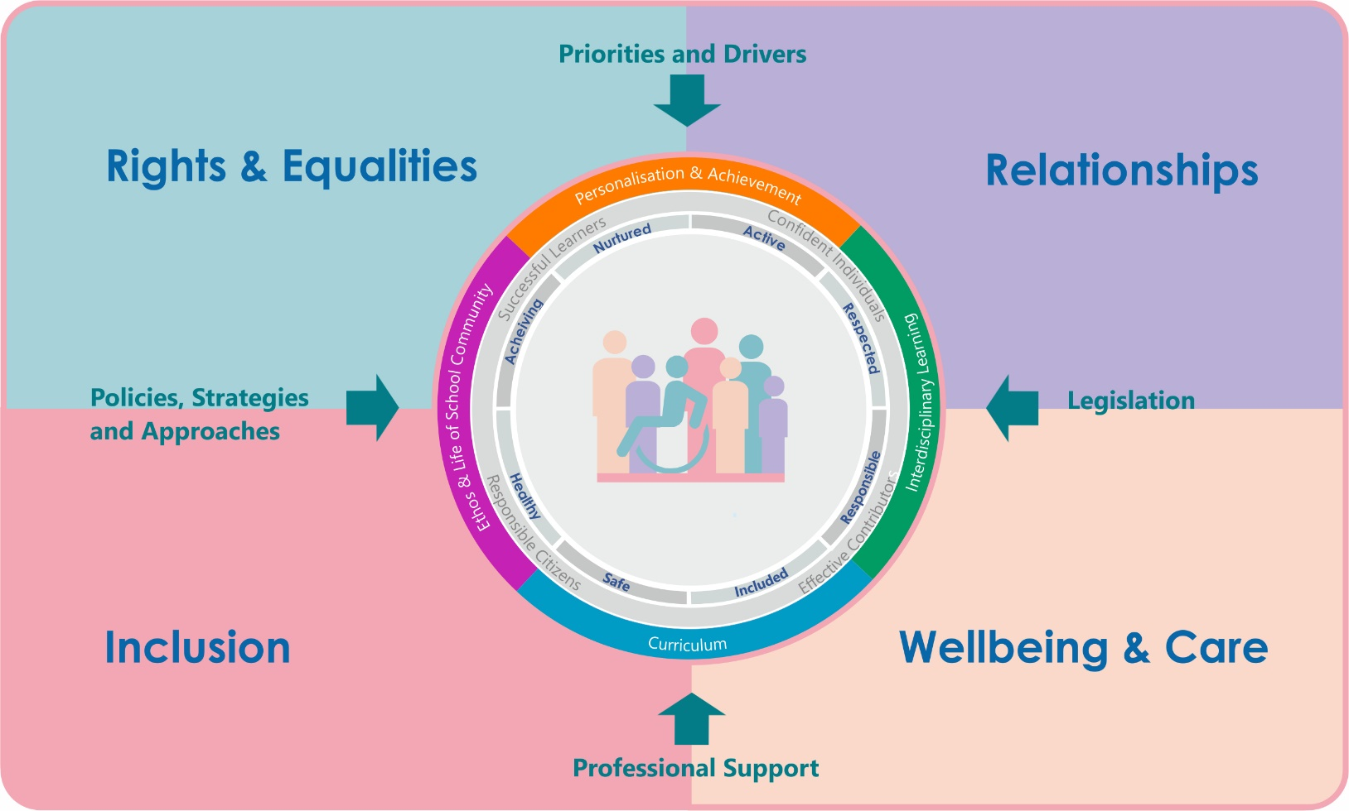
Interconnectivity
Notes:
All of the professional learning in the Framework fits into one of these four themes. The four themes are interconnected and interdependent.​
This activity forms part of the professional learning in the Rights and Equalities theme.

Slide 3
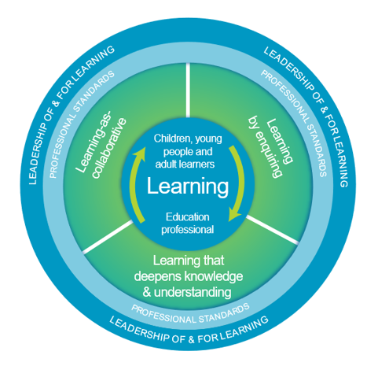
How to use this resource
These slides can be used to facilitate professional learning in a group or
whole-setting, or as a self-directed learning activity as an individual.
Facilitation notes are included at the bottom of each slide.
Please do not remove or change any of the slides included.
Facilitators are welcome to add slides or activities relevant to your own setting, to support discussion and exploration of the topic. Facilitators will know their participants’ needs best.
Anyone who works in an educational setting can be a facilitator and use these slides.
For reflection or discussion activities, it is important to establish a safe space which encourages respect and honesty to ensure that everyone is able to participate.
Notes:
Option to skip slide as these are instructions for facilitators only. No need to read to audience.

Slide 4
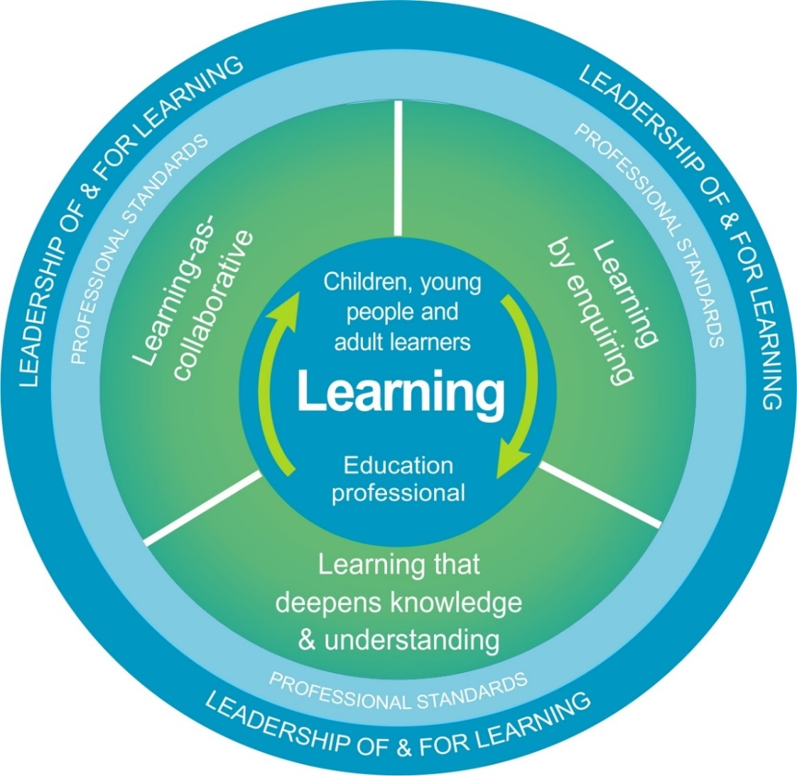
National Model for Professional Learning
This professional learning resource will support you to deepen your knowledge and understanding.
You will have the opportunity to consider how to take this learning forward on your own and with others.
The National Model of Professional Learning (education.gov.scot)
Notes:
This professional learning forms part of the national model for professional learning and is designed to help you gain more knowledge and have a deeper understanding of inclusion, wellbeing and equalities​​
On completion of this professional learning, you will be asked to consider what your next steps will be​​.
Please take some time to consider the reflection questions at the end

Slide 5
Welcome
Pause for Thought…
This session provides an opportunity to :
Find out about what the UNCRC is
Look at some ideas to put this into practice
Notes:
Link activity to national model

Slide 6
Listen to this podcast
Pause for Thought…
You can listen to a podcast here – it is in both English and Gaelic
Notes:
It is important to remember that all humans have rights – so looking at the other human rights treaties can be helpful. The last 2 links on this slide support that

Slide 7
What is the UNCRC?
54 Articles:
Part 1 (1-42): Provisions
Part 2 (42-45): Implementation and monitoring
Part 3 (46-54): Final clauses
UNIVERSAL
UNCONDITIONAL
INALIENABLE
INHERENT
INDIVISIBLE
Notes:
The UNCRC has 54 articles in total:
- 1 to 41 are substantive articles describing specific rights, the majority of which impact on services provided by Local Authorities.
- 42-54 talk about how the UN and National Governments work to ensure those rights.
Key Points:
- The UNCRC is Universal and applies to ALL children, regardless of race, religion, abilities or family circumstances.
- Rights are Unconditional: All children everywhere in the world are entitled to rights, they do not have to be earned
and they are not dependant on responsibilities – children have them regardless.
- Human rights are Inalienable: They cannot be given or taken away.
- They are Inherent: They are permanent and cannot be separated from the individual.
- Human rights are Indivisible: Rights are completely interdependent and depend on each other for their effectiveness. So for example children have the right to relax and play and they also have the right of free assembly. They need to exercise both these rights for either one to work properly.
It’s important we know the 2 U’s and the 3 I’s so that we fully understand how essential getting this right in education is.

Slide 8
Resources and information to help
Pause for Thought…
Here are some resources that might be of interest
Dignity in School - Children's Parliament
UNCRC self-eval toolkit (thinglink.com)
Together Mapping (togetherscotland.org.uk)
https://www.un.org/en/udhrbook/#4
Notes:
It is important to remember that all humans have rights – so looking at the other human rights treaties can be helpful. The last 2 links on this slide support that

Slide 9
Reflection
From what you have learned so far, think about:
How has this made you feel?
What has this made you think about?
What one action would you like to take forward?
How can you link what you plan to do with others in your setting?
How you will know that this learning has made a difference?
Notes:
Facilitation notes:
You can do this in groups.
Encourage educators to take this forward in an enquiry
Consider impact of the actions / learning

Slide 10
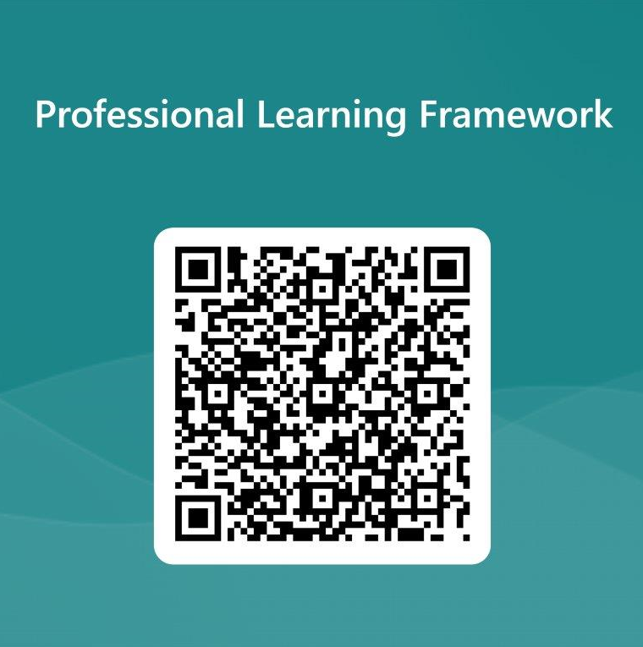
We value your feedback
From now until March 2024 we will be taking feedback on these resources so that we can make changes in advance of a formal launch of the Professional Learning Framework in June 2024
Your feedback could help us improve this resource
Please complete this short form, using the link or QR code, to let us know what you thought of it and any suggestions you have on how it could be improved
LINK: https://forms.office.com/e/b5PCpJJJ3P

Slide 11
For Scotland's learners, with Scotland's educators
Do luchd-ionnsachaidh na h-Alba, le luchd-foghlaim Alba
Education Scotland
Denholm House
Almondvale Business Park
Almondvale Way
Livingston EH54 6GA
T +44 (0)131 244 5000
E enquiries@educationscotland.gsi.gov.uk

