Slide 1



Supporting Young Carers in Education
‘There are an estimated 30,000 young carers in Scotland under the age of 18.
Three out of five of us will become carers at some stage in our lives.’
Carers Trust
For Scotland's learners, with Scotland's educators
Notes:
Welcome to the ‘Supporting Young Carers in Education’ Professional Learning Activity. This activity is designed for anyone working with young carers in an educational setting or context. This module of learning is part of a set of 4 modules. Each modules should take between 30 minutes to an hour depending on how it is undertaken. They can be studied as a group or as in-service activities with some discussion around the reflective questions or as an individual professional learning activity with written reflections in a log. Module one is designed specifically for all educational practitioners and should help them identify and support young carers. Module 2 is designed for anyone with leadership responsibility for organizing supports for young carers in their setting and includes their legal duties. Module 3 is designed for anyone hoping to develop a whole school approach towards supporting young carers. And this Module addresses Transitions.

Slide 2
Module 4: Transitions and Young Carers
Module 4A: In school transitions and specific transition challenges for young carers
This module is suitable for everyone who works with children and young people
For Scotland's learners, with Scotland's educators
Notes:
This 4th module helps educational practitioners identify the specific issues young carers experience with any type of transition. It consists of 2 short presentations and some optional reading tasks. This first presentation highlights the key information regarding transitions and young carers. The second presentation highlights the challenges young cares face when leaving school.

Slide 3
Before you undertake this module
you should have completed:
Supporting Young Carers Module 1 (and ideally also Modules 2 & 3)
Supporting transitions in education professional learning module relevant for practitioners supporting any learner

Slide 4
Revision 1: what are transitions?
Transitions and changes are part of everyone's life
Most children cope well enough with the sorts of transitions associated with education and life such as:
going to nursery or school for the first time
changes of people, place or activity throughout the day
from year to year, within a familiar establishment
between establishments, e.g. ELC to Primary, or Primary to Secondary
leaving school and moving into adulthood
life stage transitions, e.g. puberty, bereavement, moving house
Some children however, will need extra or additional support to manage these transitions well
Notes:
Read slide

Slide 5
Revision 2: Why are transitions hard?
Transitions are significant in children’s lives – nurture principle (6) emphasises that supporting changes and transitions with preparation, reassurance, and consistent routines helps to reduce anxiety and maintain engagement
Everyone working with children should understand the emotions that may be triggered by both small and large changes
Poorly supported transitions can significantly impact a child’s emotional wellbeing and potentially their social development - planning ahead is for transitions is therefore essential
For some children transitions can be much more challenging
Effective planning for children who require additional support should begin as early as required
For a young person leaving school this should be no later than 12 months before their expected leaving date
Notes:
Read slide

Slide 6
Transitions and young carers
Notes:
So what’s different for young carers when they experience transitions

Slide 7
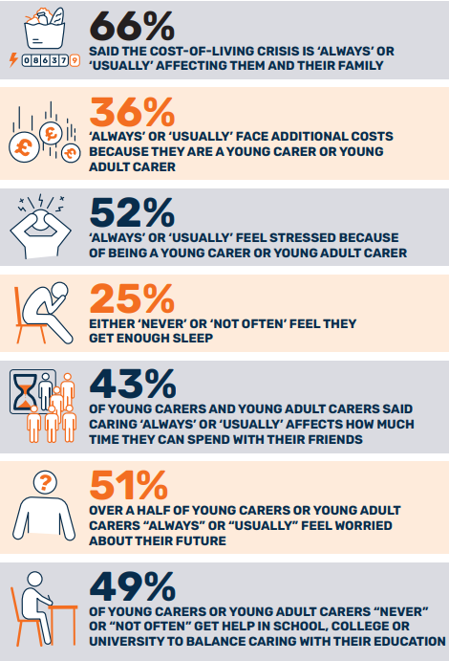
For children who have extra anxiety, responsibility, and less time to relax and decompress, transitions can be particularly difficult
From Module 1 you will remember young carers may:
worry for the people they care for all or most of the time
have more responsibility than their peers
not get the time downtime that their peers get
find it hard to make and sustain friendships
be impacted by timekeeping issues due to their caring responsibilities
From Module 1 you will remember many young carers are ‘hidden or undisclosed’ and they may be living with these worries without any extra support!
Notes:
Read LHS notes.
The statistics on the right hand side are from the ‘Being a Young Carer is not a Choice’ Report.
You can access the report from the links provided at the end of this module.

Slide 8
Specific transition challenges for young carers in school
Notes:
Young carers face challenges above and beyond other learners when it comes to transitons

Slide 9
Daily transitions for young carers
To and from school
Breaks during the day
Change in policy or practice
Leaving/returning to the person they care for
Might need to be used to complete homework or check on the person they care for
For example, change of attendance or mobile phone policy may mean the young carer gets in trouble for being late, being absent, or can’t phone/text home to check on the cared for person
Notes:
Read slide

Slide 10
Transitional events for young carers
Holidays
School trips, Proms or other events (Parties, Parents events, …)
May entail extra caring responsibilities or be a lonely time (missing friends from school or become isolated)
Often aren’t an option for young carers because there is no replacement care at home for them, cost may be a factor, or the extra time away from the cared for person is very stressful
Notes:
Read slide

Slide 11
Year to Year Transitions
Change of teacher(s) or support staff
Change of environment
May have to retell their story. New staff may not understand young carers and their needs
May not have as easy access to a cared for sibling, change or loss of safe spaces
For young carers in composite classes this may mean a change in peer group (people who know their circumstance)
Potentially extra work in terms of homework, assessments, or exams
Notes:
Read slide

Slide 12
Primary to Secondary transitions
Young carers tell us this can be really hard because of:
lots of new adults, new places, and new routines
more movement – change of class every 50 minutes
more expectations around being self-dependent
moving away from long term friends and peer group
often different transport arrangements – buses, longer journey time, …..
splitting cared for siblings – one moving up and one left behind
more homework, assessments and exams
All of these factors/stressors are layered on top of their caring responsibilities
Notes:
Read slide

Slide 13
Practical things that help children through transitions
Fostering Relationships
Building strong relationships between children, parents/carers and staff can help ease the anxiety associated with transitions. Familiar faces can provide reassurance and stability.
Preparation and Communication
Preparing children for transitions involves clear communication about what to expect. This can include sharing information about new routines, environments, and people they will encounter.
Creating Safe Spaces
Establishing safe and welcoming environments where children feel secure can significantly reduce the stress of transitions. This includes having cozy areas for children to retreat to if they feel overwhelmed.
Transitional Objects
Providing children with transitional objects, such as a small toy or a photo of a loved one, can offer comfort and a sense of security during changes.
Visual Aids
Using visual checklists or countdowns can help children understand and anticipate changes, making the transition process smoother.
Notes:
So what practical things can we do to prepare any learner for transitions and support them through transitions

Slide 14
Further approaches that help make transitions easier
Planning should be personalised and child-led - prioritise their unique needs
Identify and build on their strengths
Drawing on existing skills but also help them develop new skills they may need
Anticipate challenges – what is the young person nervous or unsure about?
Emphasise that a transition is a learning process and mistakes will be part of the process
Use accessible materials and assistive technology if necessary
Support brainstorming, goal setting, creating lists/micro-tasks and planning backwards
Use practice activities or exercises were possible
Be aware of cultural or context differences that may impact transition experiences
Celebrate small victories and accomplishments to build motivation and confidence
Notes:
Read slide

Slide 15
Advice to young carers about their primary to secondary transition
Notes:
Young Scot asked some young adult carers what advice they would give to other young carers when they move from primary school to secondary school and what helped them through the experience.

Slide 16

Notes:
Play film (1 min 3 sec)

Slide 17

Reflection Activity – Consider Elsa
Elsa is a young carer in P7
She helps to look after her young brother, Freddie, who is in P4 and her mum who has a mental health condition
Freddie is neurodiverse and often needs additional support in school
Elsa is often pulled from class when her brother is really upset to help him calm down
Elsa likes to know her brother is okay and often checks on him during breaks and lunch
Elsa is due to move to secondary school after the holidays
Elsa’s P7 teacher understands her caring roll and supports her well
She has disclosed to staff that she is worried and anxious about the transition to secondary and may not attend school so she can check on her brother and mum
Elsa feels the ‘big’ school won't understand
Question: What needs to be planned for here?
Notes:
Reflecting on the last few slides please consider Elsa’a story.
Read about Elsa
Question: What needs to be planned for here?
Please record your thoughts in the professional learning log.

Slide 18
Module 4: Transitions and Young Carers
Module 4B: Supporting young carers who are leaving school
This module is suitable for everyone who works with children and young people
For Scotland's learners, with Scotland's educators
Notes:
Now let’s consider how to support young carers who are about to leaving school

Slide 19
Specific transition challenges for young carers leaving school
Notes:
Young carers leaving school face all the same considerations as any other young person however they often have significantly more challenges and fewer choices than their peers. Let’s consider what these are and how we can best support them through this stage of their lives.

Slide 20
Post School transitions
Life change
Become an adult carer – change in support (to young adult/adult carer service or change in location/frequency of support
Move to adulthood/more expectation on and legal responsibility for self
Change in financial situation (tax, bills...)
Away from person who is cared for longer, or for work/training placements, or have to move away completely for all or part of the week
Guilt of leaving a sibling with caring responsibilities
Grief/emotional loss
Pressure of study alongside, potentially part-time work, and caring responsibilities is too much
Lack of understanding of caring responsibilities by training providers, employers, colleges/universities
Cost of study/living
Notes:
Read slide.
Now let’s hear directly from young carers about their ambitions and their concerns for life after school.

Slide 21
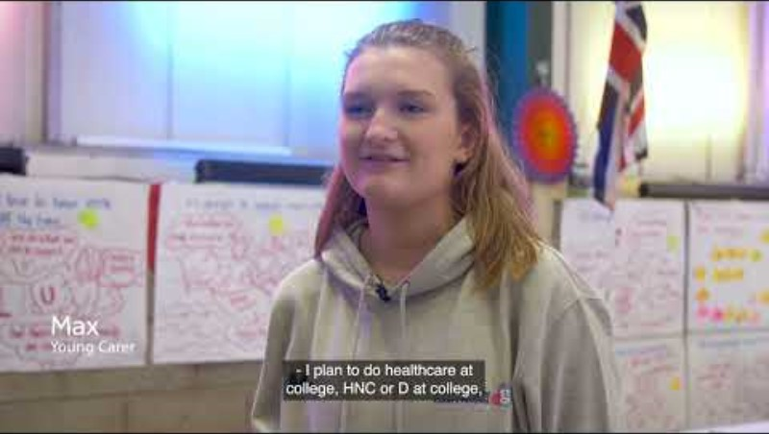
Young Carers: their ambitions and concerns for life after school
Notes:
Watch film (2 mins 47 sec)

Slide 22
Caring responsibility impact on choices for young carers
UK-wide data from the UCAS Report 2024 and the Young Carers in education report show:
Young adult carers were 39% more likely than applicants without caring responsibilities to choose to live at home
41% of young adult carers chose to study within a 30 minutes' drive of home
Young adult carers are 59% more likely to apply to health and social care courses and 57% more likely to apply to nursing and midwifery courses than applicants without caring responsibilities.
70% of young adult carer applicants identified finances as a concern and 63% of young adult carers surveyed said they took being able to balance studies with part-time work into account when researching their options
Notes:
Caring responsibilities do have an impact on the choices available to young carers.
These two UK reports show how caring affects the choices young carers make.
Read bullets

Slide 23
Considerations for Young Carers - Caring from a distance
College and university can be difficult for young carers – to move away or not, financial barriers (accommodation, transport), …
Caring doesn’t stop but may need to happen from a distance - providing emotional support remotely or regularly returning to undertake caring responsibilities.
Multiple demands on a carers’ time may make it difficult for them to attend all their classes, meet coursework deadlines and socialise with peers.
Some carers gain more time to themselves when they become a student, however some become anxious or feel guilt that they should be helping the person(s) they care for or that they are leaving the caring responsibility to others.
In potentially moving out to university, the thought that would have run through my mind would have been how quickly can I get back if I need to? Student Carer
Notes:
Applying to college and university can be difficult for young carers, faced with difficult considerations, such as whether or not they can move away from the person they care for to study, financial barriers, will they need to work part time, do they need to return home at weekends for caring responsibilities meaning additional transport costs, etc.
Student carers might maintain caring roles from a distance, for example by regularly returning to undertake caring responsibilities, or providing emotional support remotely over the phone. There can also be multiple demands on carers’ time making it difficult for them to attend all their classes, meet coursework deadlines and socialise with peers.
Some student carers have reported that they gained more time to themselves when they moved out, for others it was accompanied with feelings of anxiety and potentially guilt that they should be helping with the person(s) they care for or that they are leaving the caring responsibility to others.

Slide 24
Post School Transitions: make a plan!
Notes:
Preparing for post-school transitions require a plan!

Slide 25
YC Statements and Transition Plans
The Carers (Scotland) Act 2016 provides the legal framework for young carers statements and transition plans, ensuring that young carers have the right to a statement and that their needs are met as they grow and transition
(See Module 2: Young carers, the Law, their rights, and their voice for more information about Young Carers Statements)
Transition plans are crucial for young carers as they move into adulthood
Transition plans help young carers understand their rights and the support available to them, ensuring a smooth transition and continuation of their personal goals
Transitions plans should include life skills training

Slide 26
Examples of life skills training relevant to school leavers
Personal goal-setting, planning, time management and scheduling
Self-advocacy
Writing skills and form filling (for college/passport/drivers license applications, cover letters, resumes, …)
Technology skills (online research, email and phone etiquette, software applications)
Employability skills: communication, teamwork, problem-solving, ..
Home and self-care skills - wellness, healthy coping skills
Finding housing
Managing household tasks & personal hygiene
Grocery shopping, cooking, food, and nutrition
Navigating the healthcare system
Personal finance, budgeting, savings, and credit
Skills in accessing support - financial aid, social services, connecting to communities, …
Travel training
Notes:
Read slide.
All schools leavers would benefit from learning these life skills and some parents/carers will have more capacity to support their child to learn these skills and with things like writing applications and finding housing as they move on to the next stage of their lives. Young carers may not get this support from home.

Slide 27
Advice to young carers about post school transitions
Notes:
Young Scot asked some young adult carers what advice they would give to other young carers who are about to leave school for further education or to go into a job and what support they should expect.

Slide 28

Notes:
Watch film (1min 27sec)

Slide 29

Notes:
Watch film (54sec)

Slide 30
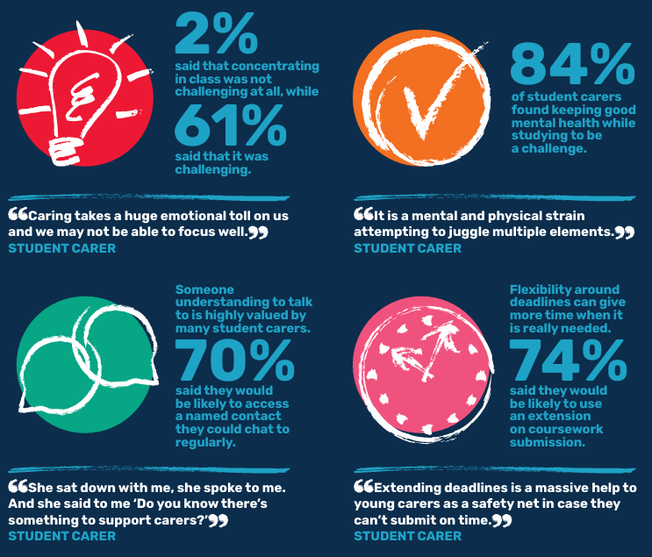
Student Carer
Experience
Scottish Report
by Carer’s Trust
Notes:
Here are some of the things Student Carers told us about their initial college or university experience.
Talking to young carers about the importance of accessing supports before or immediately on starting college or university is really important while they are still at school and can benefit from the advice and support of the school.
It may even be good to help them find the contact on the college or university website.
Here are some of the things Student Carers told us about their initial college or university experience.

Slide 31
Reflection Activity – Consider Jack
Jack is in S6 and studying for his Highers
He did not disclose he was a young carer until recently.
After being in a comma Jack’s Dad has severe memory loss and is mentally disabled
Neither of Jack’s parents speak fluent English and Jack is often the translator for his parents
This responsibility has increased since his Dad’s hospitalisation and subsequent need for full time care
Jack has less time now for studying since becoming a young adult carer
Jack has a provisional offer for medicine at a university which is too far to commute to
Jack’s mother can no longer work as she needs to care for Jack’s father full time
The family is now living in a financial crisis
Jack doesn’t know what to do…caring for his Dad and supporting his Mum or going to university
Question: What needs to be planned for here?
Notes:
Reflecting on the last few slides please consider Jack’s story.
Read about Jack
Question: What needs to be planned for here?

Slide 32
Available advice and support
For Young Carer’s:
Young Carer’s Grant and Young Carers Transitions – Young Scot
Young carers and young adult carers - Care Information Scotland
Extra support for young carers - mygov.scot
For Parents:
Young carers – Parentzone
Enquire - The Scottish advice service for additional support for learning
Carers Scotland
For Education Staff:
Supporting young carers in education
Young Carers Transitions Padlet
For carers:
Help if you're a carer - mygov.scot
Carers Trust
Notes:
If you are supporting a young carer and their family you may want to direct them to, or check out yourself, some of the available free advice from supporting organisations.

Slide 33
Resources and reading
Reports:
Being a Young Carer is not a Choice
Young Carers in Education Report
UCAS Report: Next Steps = what is the experience of young adult carers in education
The Student Carer Experience in Scotland
Notes:
We referenced stats and information throughout this presentation. You can use these links to access the full reports.

Slide 34

And finally…..
Based on today’s professional learning:
What will you, as an individual, do differently?
What will your school do differently?
How will you help your learning community do things differently?
Notes:
And finally…..
Read the questions

