Slide 1


Slide 2

Today we will learn:
What a stereotype is and identify some examples.
What a visible difference is.
How stereotypes of visible difference are often used in film and on TV.
What impact negative stereotypes of visible difference can have on people.
How all stereotypes can be challenged.

Slide 3

Remember that when we discuss a topic:
Only one person should talk at a time
– no interrupting.
Show respect for the views of others.
Challenge the ideas not the person.
Use appropriate language – no rude comments.
Allow everyone to express their view, to ensure that everyone is heard and respected.
Don’t share personal stories without permission.

Slide 4

CLASS
DISCUSSION
What does the word stereotype mean?

Slide 5

A stereotype is an idea about a particular group
of people that is often oversimplified, untrue or unfair.

Slide 6
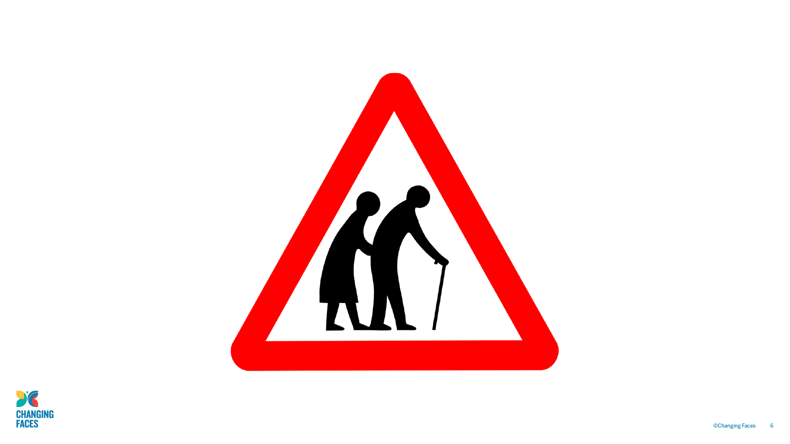

Slide 7
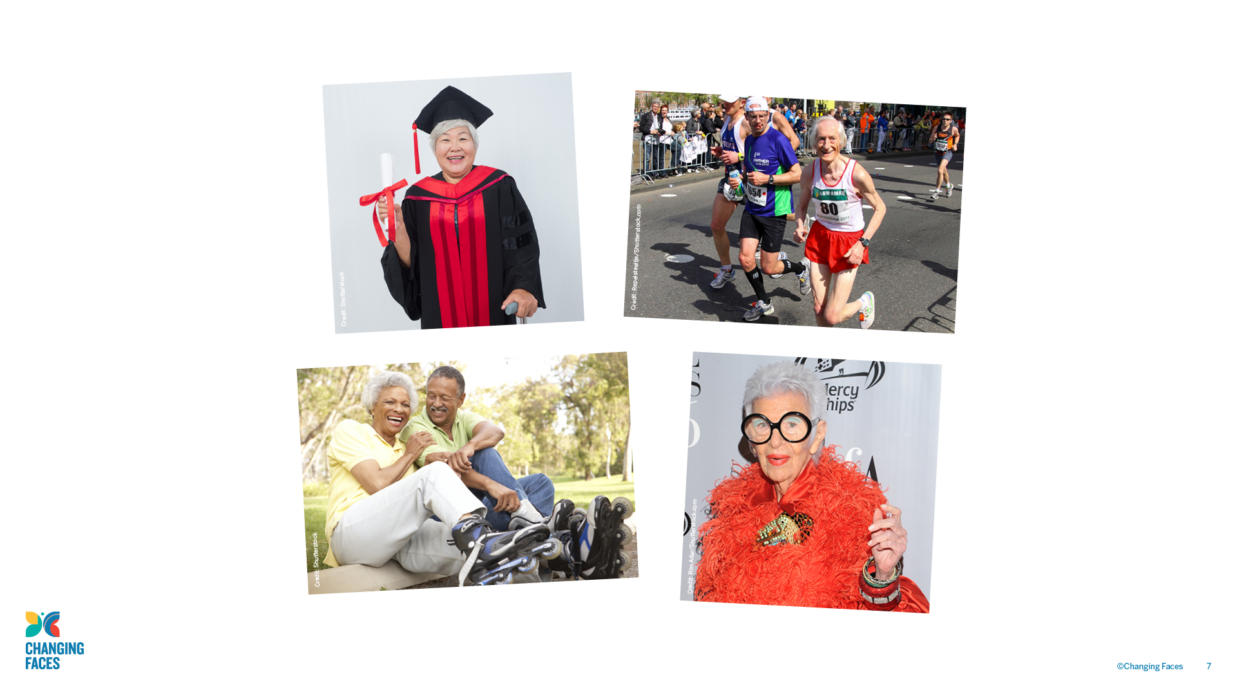

Slide 8

CLASS
DISCUSSION
What impact stereotypes have?

Slide 9

Today we’re going to be talking about how stereotypes
affect people who have a visible difference
(a mark, scar or condition that affects how they look).

Slide 10

Causes of a visible difference:
Skin conditions like eczema, acne, or vitiligo
Burns
Birthmarks
Craniofacial conditions, affecting the growth and development of the skull and face
Cleft lip/palate (a gap or split in the upper lip and/or roof of the mouth)
Cancer

Slide 11
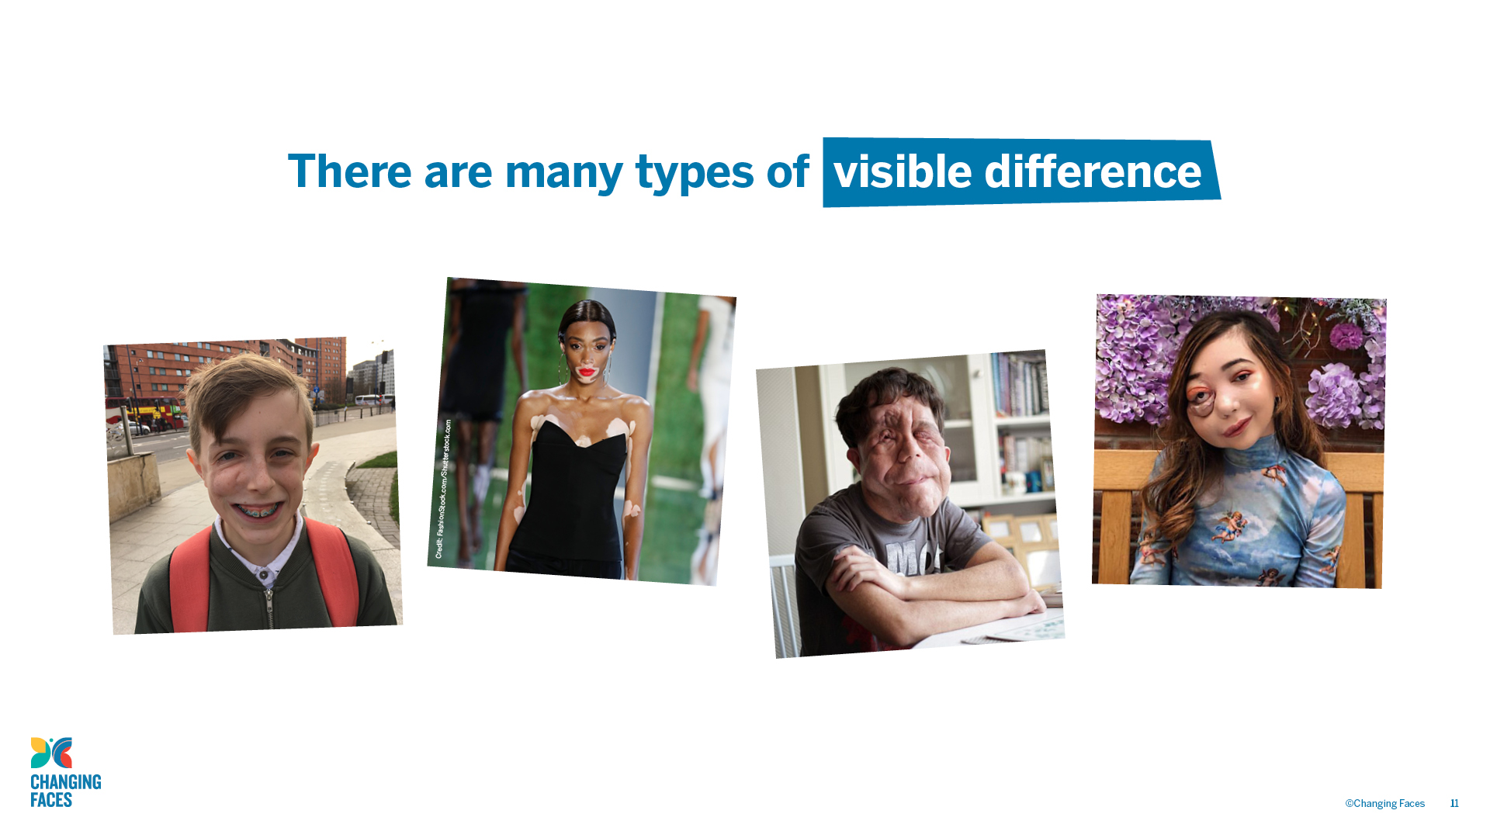

Slide 12

GROUP
ACTIVITY
Write a list of film or TV characters who have a scar, mark or condition that affects their appearance.

Slide 13
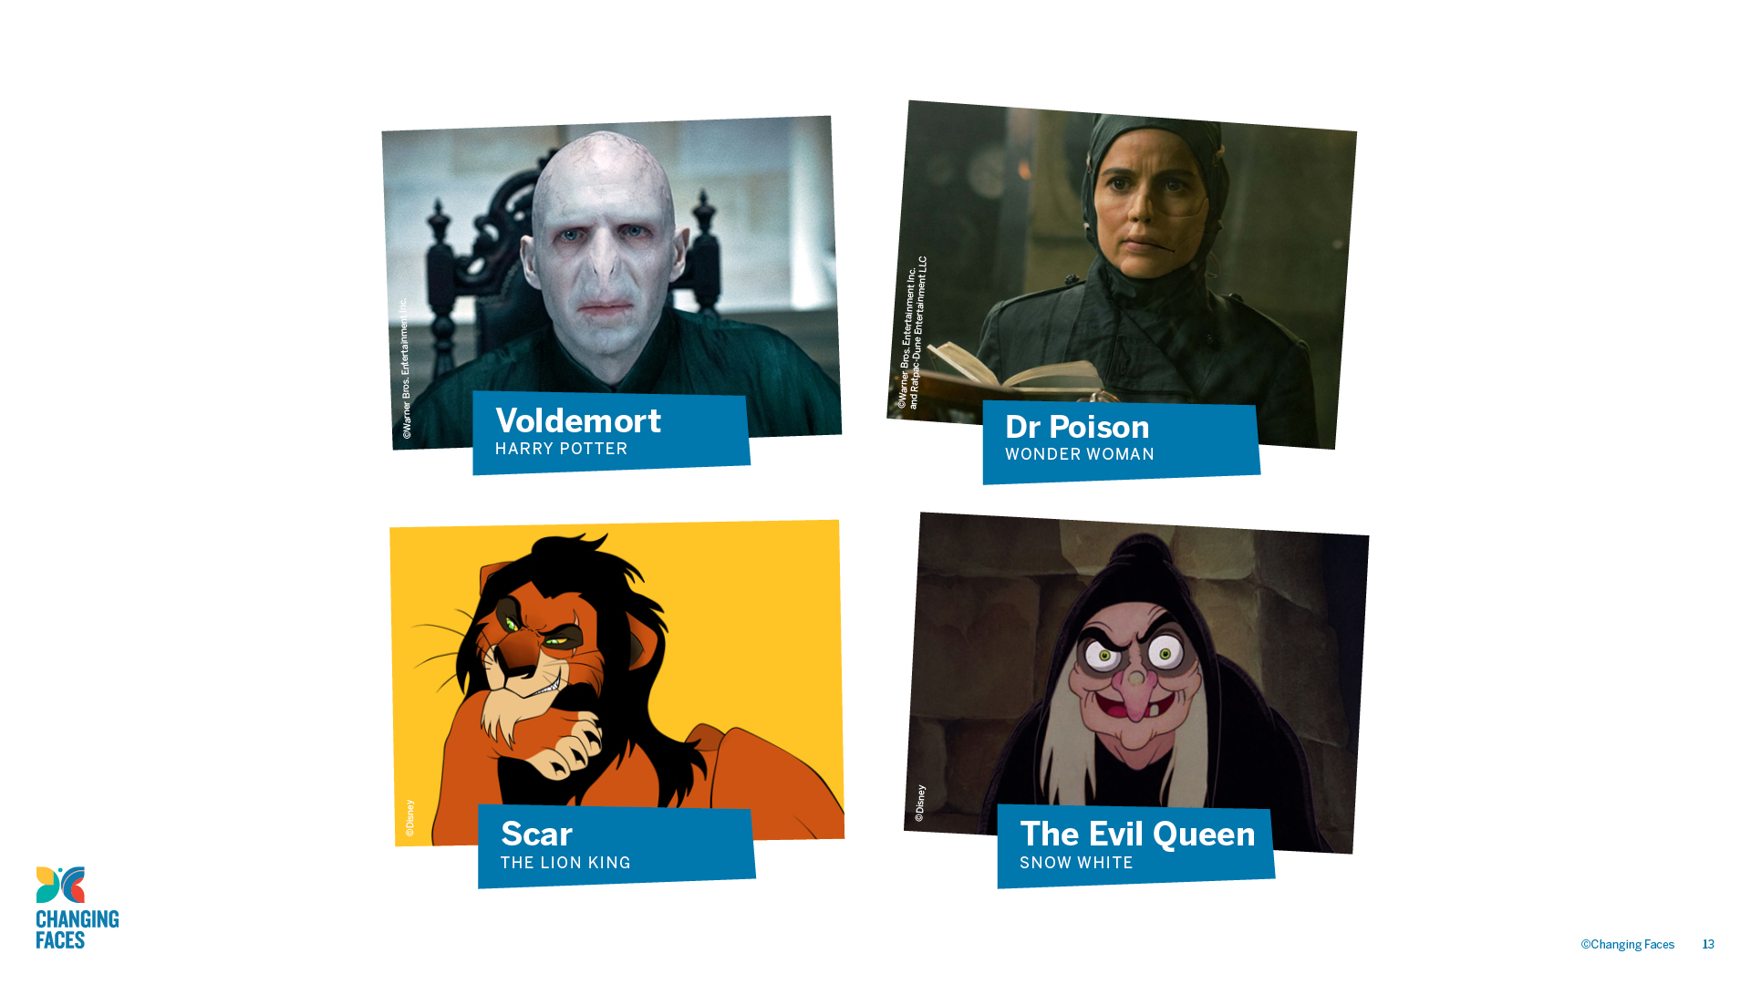

Slide 14

CLASS
DISCUSSION
What impact could stereotypical film and TV villains have on people who have a visible difference in real life?

Slide 15
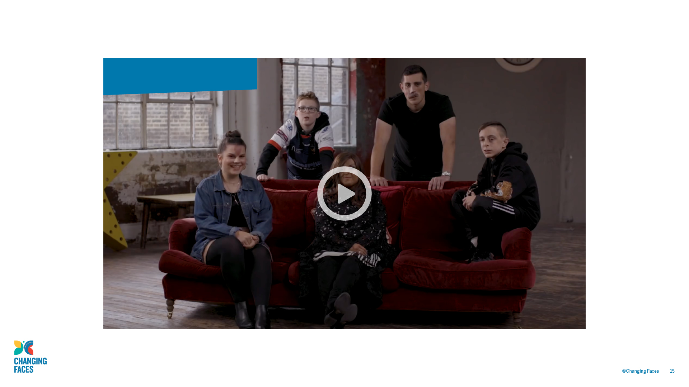
#iamnotyourvillain

Slide 16

Other helpful websites
youngminds.org.uk
respectme.org.uk
Other helpful
websites:
youngminds.org.uk
Find out more about visible differences and respecting difference: changingfaces.org.uk
Worried about anything we’ve discussed?
You can contact Childline for help:
childline.org.uk
respectme.org.uk

Slide 17


Slide 18

Today we will learn other ways that
a ‘baddie’ can be indicated without
reference to their unusual looks

Slide 19

Remember that when we discuss a topic:
Only one person should talk at a time
– no interrupting.
Show respect for the views of others.
Challenge the ideas not the person.
Use appropriate language – no rude comments.
Allow everyone to express their view, to ensure that everyone is heard and respected.
Don’t share personal stories without permission.

Slide 20

Other helpful websites
youngminds.org.uk
respectme.org.uk
Find out more about visible differences and respecting difference: changingfaces.org.uk
Worried about anything we’ve discussed?
You can contact Childline for help:
childline.org.uk

