Slide 1




EQUITY: Mitigating the impact of poverty
on Scotland’s children and young people
Group session 3:
Collaborative enquiry planning
Notes:
This PowerPoint is intended to support local authority facilitators to deliver the third group session on the Equity: Mitigating the impact of poverty on Scotland’s children and young people. This session will take place once programme participants have completed PLAs 1-4.
This PowerPoint is a template that facilitators can adapt to suit their own context and style of presenting. It can be added to, but please do not remove any slides as they are all essential to the Introductory session. You may wish to add the date, a logo alongside the Education Scotland one, and /or to add a link to a feedback form into the last slide.
Within the slides, suggested timings, key messages to get across, facilitator notes and reflective questions are included.
The session this PowerPoint is intended to support has been designed to be delivered by facilitators in 60-90 minutes, depending if the session is being delivered in person or online. We would encourage you to use that time for (more) discussion of the reflective questions and perhaps invite some feedback. Suggested approximate timings can be found in the notes for each slide.
IMPORTANT NOTES:
This PowerPoint refers to the Education Scotland Equity: Mitigating the impact of poverty on Scotland’s children and young people (Equity: Mitigating the impact of poverty on Scotland’s children and young people | Leading professional learning | Professional Learning | Education Scotland). It is anticipated the presenter will be familiar with the content of these pages. It will be particularly useful to be familiar with PLAs 1-4 before delivering this session.
While use of the Equity PL Reflective Workbook is optional, we would encourage its use as part of this facilitated programme. If used, it will be helpful for participants to have it to hand during this session.
This PowerPoint is to support group session 3, of the 4 that are part of the EQUITY programme.
You might also want to consider planning follow up sessions to check in/support those engaged in the learning, and to share learning from Professional Learning Activities undertaken throughout the programme.
It is recommended that facilitators send out an e-mail in advance of group session 3 to inform participants they will be required to bring along context specific data for this session. Facilitators can advise and suggest which data they may feel is appropriate for senior leaders to bring, depending on data systems within the local authority.

Slide 2

Ways of working together
We all work together
We learn from, with and on behalf of each other
We create a safe space to share ideas and build learning
We agree that everyone is an equal and valued participant
We remain ‘in the room’ (follow email and phone protocol)
Notes:
Slide 2
Suggested timing:
5 minutes
Key messages:
Take a moment to remind the group about the group protocols (or ‘group agreement’) from group sessions 1 and 2.
Ask participants to comment on anything they would like to add or amend.
Is there anything that participants feel is missing or anything they would like to remove?
The protocols on the slide are suggestions to be amended for your context.
Facilitator notes:
You may have some people present who missed session 2, so it's important to revisit the ways of working together at each session.
Why establish group protocols (reminder from session 2)
Effective professional learning goes beyond simply delivering information. It fosters a learning community where educators can learn with, from, and on behalf of one another. To achieve this, the facilitator of this learning should establish clear protocols and a positive learning environment at the outset. The general notes below will support the facilitator to help everyone feel comfortable participating and contribute to a rich learning experience.
1. Contract a Safe Space: Co-create a Safe Space agreement with your group. This agreement outlines expectations for respectful communication and active listening. A safe space allows trust to flourish, fostering a collaborative environment where everyone feels comfortable sharing ideas and taking risks.
2. Shift from Top-Down to Collaborative Learning: Move beyond the traditional model where one person imparts knowledge. Embrace a collaborative approach where all participants actively engage. This means learning with, from, and on behalf of one another. By leveraging the diverse perspectives within the group, gaining a richer understanding and creating a more impactful learning experience for everyone.
3. Holding the Ladder: Shared Expertise and Recognition : Holding the ladder signifies a two-fold approach: Sharing Expertise: Those with experience can share their knowledge and insights. Recognize Everyone's Contribution: Actively listen and be open to learning from the unique perspectives and experiences of colleagues. Build on each other's ideas to foster a collaborative environment where everyone feels valued, and their contributions are respected.
4. Hold Space for Silence and Respectful Discussion: Hold space for silence after someone speaks or asks a question. It can be tempting to jump in to fill silence but allowing time for quiet can avoid interrupting thought and produce more thoughtful responses. Everyone deserves to be heard and understood. Adapt the time allocation based on the size of the group and the complexity of the topic.
5. Schedule Regular Breaks: Schedule regular breaks throughout the session. This allows participants to process information, refocus, and return with renewed energy, leading to a more productive learning experience.
6. Centre Learning in Real Life: Connect the learning to real-life experiences by encouraging participants to share relevant personal anecdotes or applications. This strengthens understanding and makes the learning more relatable and impactful for all.

Slide 3

Today’s session
In this session we will:
Take part in a connector activity
Do a personal reflection
Reflect on and share learning from PLA 4
Interact with our own specific data you have brought along
Planning a collaborative enquiry
Think about your next steps.
Notes:
Slide 3
Suggested timing:
1 minute
Facilitator notes:​
It is recommended that facilitators send out an e-mail in advance of group session 3 to inform participants they will be required to bring along context specific data for this session. Facilitators can advise and suggest which data they may feel is appropriate for senior leaders to bring, depending on data systems within the local authority.
​This slide shows what will be looked at in this session, to be shared with participants. Invite any questions they may have.

Slide 4
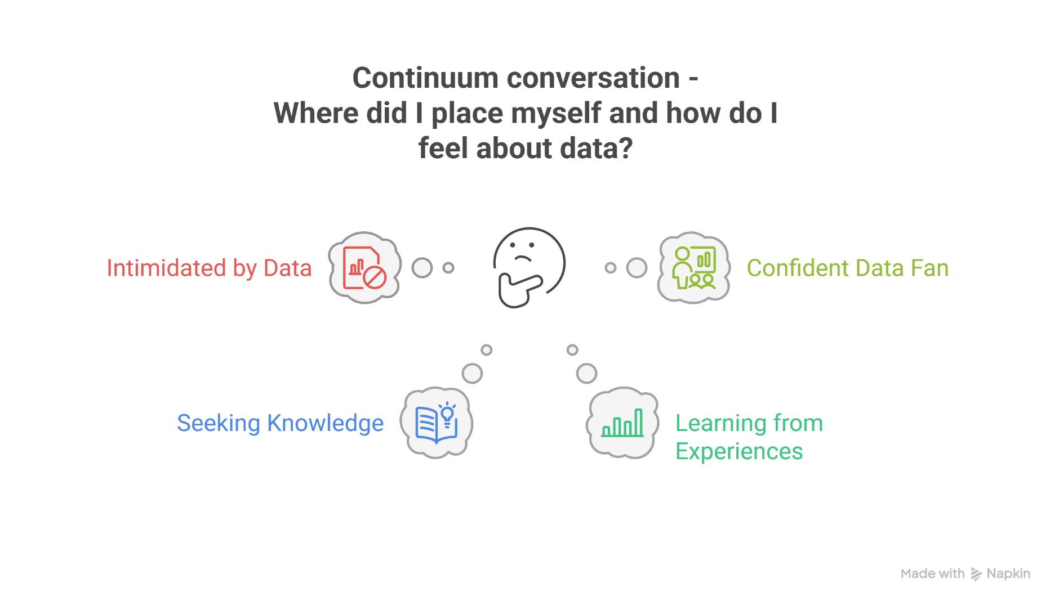
Connector
Notes:
Slide 4
Suggested timing:
5 minutes
Facilitator notes:
This opening reflection supports participants to reconnect with their individual professional learning within learning step 1 of PLA 4 and explore their own relationship with data. It sets the tone for discussion about how data is used in their context and how confidence levels vary.
Acknowledge the changes in emerging technologies and data formats and encourage participants to consider how these developments relate to current approaches within the local authority and within their sector.
If in person - Invite participants to imagine the continuum as a scale and place themselves where they feel they were during their individual learning.
Emphasise that leaders may be positioned across the continuum for many valid reasons.
Encourage honesty and highlight that this is a personal reflection rather than an evaluation.
Ask participants to discuss briefly in small groups or use a Think Pair Share approach to allow sharing of perspectives.
If online - Invite participants to share their position on the continuum using the chat function or a simple poll.
Allow a short pause for reflection before responses are posted.
Managing Feedback:
Time for feedback is valuable, although you may need to manage this carefully depending on the size of the group and the time available. Encourage contributions while keeping the session moving.

Slide 5
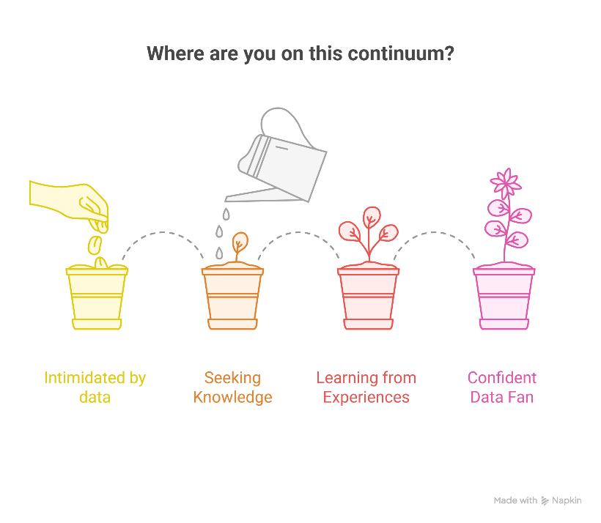
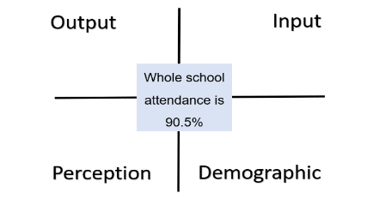
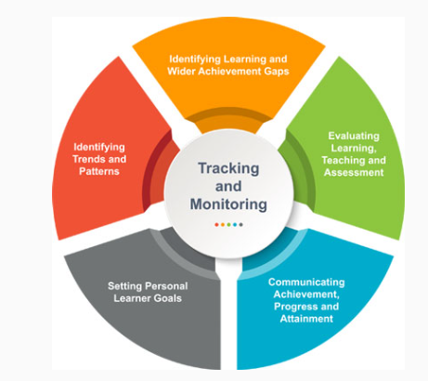




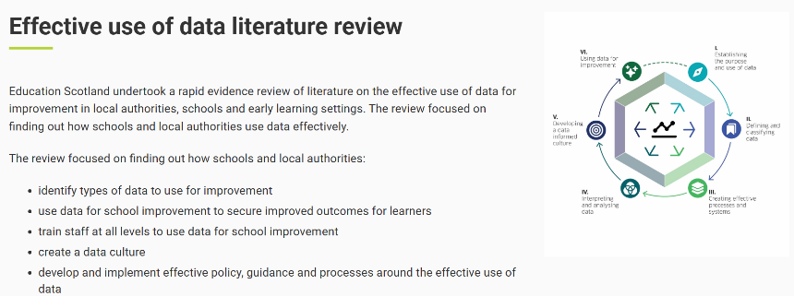
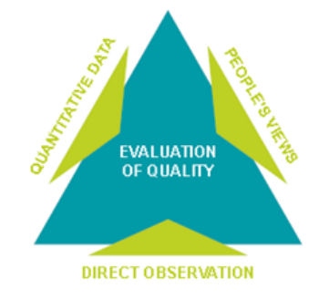

Reflecting on PLA 4: Data
Notes:
Slide 6
Suggested timing:
10 minutes
Key messages:
This part of the session is for looking back at prior learning and sharing key insights, surprises, anything that challenged thinking. Learning from PLA 4 is intended to build confidence and capability in using data meaningfully, not to overwhelm. Leaders bring varied levels of experience and this can contribute to rich discussion. The learning steps form a cycle rather than a checklist, supporting continuous improvement.
Reflecting together helps build a consistent and coherent approach across the authority or sector.
The images on the slide are to remind the group about the content of PLA 4. The learning steps were:
1. Establishing the purpose and use of data
2. Defining and classifying data
3. Creating effective processes and systems
4. Interpreting and analysing data to identify your gaps and needs
5. Developing a data informed culture
6. Self-evaluation for equity- tools and methodologies
Facilitator notes:
Remind the group about the learning steps in PLA 4 and some of the resources they looked at. The images on the slide should help remind them.
Your role here is simply to facilitate a group discussion. This could be in pairs or groups if in person, or in breakouts if you’re working online. You may prefer to stay as a whole group and use the prompt questions below to invite reflections and discussion.
You could use a selection of prompt questions (some are drawn from the Reflective Questions from PLA 4).
What were the key take aways from this learning step?
Were there any surprises that challenged your thinking?
What biases might you bring to data? (Being aware of these will help you avoid them in future.)
What, for you, is the connection between effective use of data and equity (in a nutshell)?
What are some examples of the 2 types of data – qualitative and quantitative – that you engage with your team?
How well is data analysis incorporated into planning processes in your setting, to inform next steps for learners and families?

Slide 6
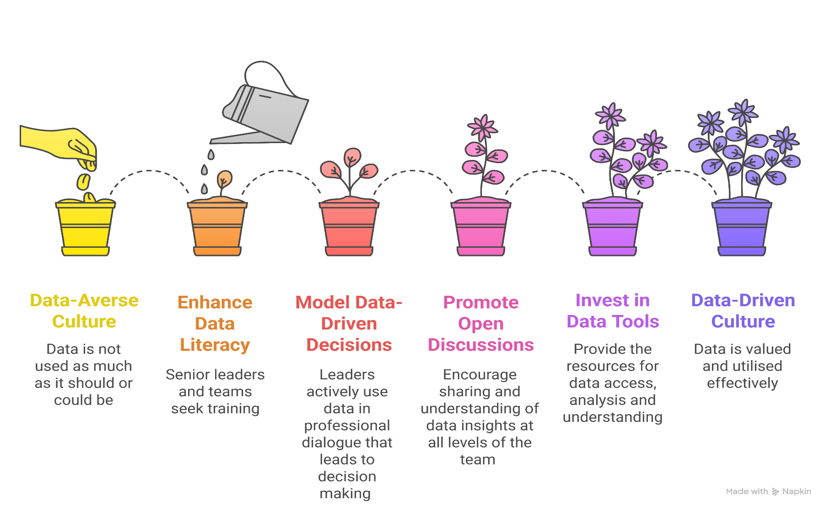
Personal reflection Considering data literacy in your current setting
Notes:
Slide 5
Suggested timing:
5 -8 minutes (sometimes in person the share back may take longer)
Facilitator notes:
Introduction and framing
Invite participants to take 5 minutes for a personal reflection. Whether in person or online, this is an individual, personal reflection and you should allow silence while people think and make notes if they want to. Try to hold the silence.
Individual reflection
In the connector we considered where we are individually. The reflection is time to consider where your setting is on this continuum and where there may be strengths and/or challenges for you as a senior leader.
You could use a selection of prompt questions (some are drawn from the Reflective Questions from PLA 4).
Where do you see your setting on this continuum?
How is your setting doing with a ‘shared language of data’? What might you do to improve this (further)?
What is your personal role in moving towards a data-informed culture?
Which stage feels most challenging for you?
How well do you think the data processes in your setting are understood by those who need to work with them? How might any gaps be addressed through professional dialogue?
Who is involved in analysing and interpreting the data, and are any voices missing?
How well is data used to understand why groups of learners have specific gaps in attainment or achievement?
How do we ensure the data collected reflects the lived experiences of your setting’s learner s and community?
Optional share back
After reflection, offer the option for participants to share one insight with their small group or the whole room. Emphasise that sharing is voluntary. Transition to next activity is to explain that this reflection will help frame the upcoming discussion on PLA 4 and an exercise for practical steps for building data literacy.

Slide 7
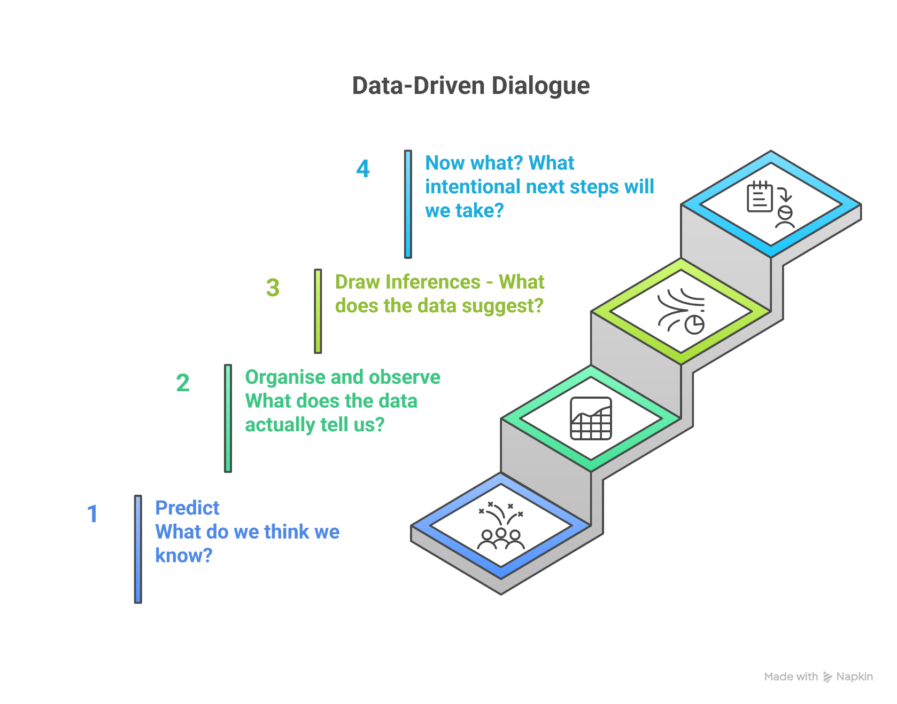
Data activity
Notes:
Slide 7
Suggested timing: 25/30 minutes
*Particularly if you are in person, you may feel it is appropriate to encourage a comfort break, during or at the end of this data driven dialogue activity in agreement with the group.
Facilitator notes:
Introduce the Activity (1 minute) Facilitator suggested instructions: Over the next 30 minutes we are going to work through the Data‑Driven Dialogue steps using the data you have brought with you today. This is an opportunity to slow down, reduce assumptions and use a clear structure to support decision making. I’ll guide you through each step and offer prompts as we go.
Participants are encouraged to select a clear focus from their own data that links directly to poverty and PEF priorities.
This may include examining attendance patterns for learners affected by poverty or exploring attainment gaps between different socioeconomic groups .
Some may focus on analysing the impact of PEF‑funded interventions, identifying which learners are benefiting and where further targeting is needed. Others may look at transitions data or variations in classroom experience that could be disadvantaging specific groups. Any of these options can form a meaningful data focus that supports intentional action and equity‑driven improvement in their setting.
Step 1 – Predict (5 minutes)
What do we think we know? Set up the step:
Before you look closely at your data, take a moment to capture your initial beliefs or expectations. This helps surface assumptions and things you think you already know.
Prompts to offer throughout:
What do you expect this data to show?
Which groups or learners do you think will feature most strongly?
Are there predictions you hold based on past experience?
What assumptions might be influencing your thinking?
Midway check‑in: Remember, you are not analysing yet. You are simply identifying what you think you know before you look more deeply.
Bring this step to a close: We are going to move into looking at what the data actually shows.
Step 2 – Organise and Observe (7 minutes)
What does the data actually tell us? Set up the step:
Now review your data closely. Focus only on observable facts. Avoid interpreting or explaining.
Prompts to offer throughout:
What do you notice first?
What concrete facts can you state without adding explanation?
Are there gaps, patterns or anomalies?
Which groups or individuals are most visible or invisible in this data?
Is the data arranged in a way that helps you see patterns clearly?
Midway prompt: Try to keep yourself in description mode. If you feel yourself starting to explain why something is happening, pause and return to what the data shows.
Bring this step to a close: Let us move into thinking about what the data might be suggesting.
Step 3 – Draw Inferences (7 minutes) What does the data suggest?
Using your observations, begin to interpret what the data might mean. These are early hypotheses, not conclusions.
Prompts to offer throughout:
What possible explanations emerge from the patterns you’ve seen?
What might be contributing to these trends?
What does this suggest about barriers or inequity?
Which questions does this analysis raise for you?
What else might you need to explore before acting?
Midway prompt : Keep your ideas tentative. Think about what the data is pointing toward, not what you already believe.
Bring this step to a close: We will now move into identifying intentional next steps.
Step 4 – Now What? (5 minutes)
What intentional next steps will we take? Set up the step
Using the inferences you have generated, identify realistic and intentional actions that will support learners and address the issues your data highlights.
Prompts to offer throughout:
What needs to happen as a result of what you have found?
What actions could remove or reduce barriers for specific learners?
Who needs to be involved?
What can be done immediately and what requires longer‑term planning?
How will you monitor the impact of these actions?
Midway prompt: Try to make your next steps precise and linked to the evidence. What is the change you expect to see?
Bring this step to a close: We will pause there. This structure is designed to avoid assumptions and strengthen the intentionality of leadership decisions.
Optional 2‑Minute Share‑Back (if time allows)
Would anyone like to share one key insight or one next step that emerged from your data?

Slide 8
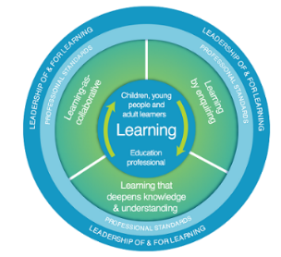
Collaborative enquiry key steps
Identify the focus and formulate the question
How effectively do we use data to target interventions for children and families impacted by poverty?
Example: How does systematic use of attainment and wellbeing data influence equity outcomes for Q1
learners?
Gather Evidence Use triangulation:
    Quantitative data (attainment, attendance, wellbeing).
    Stakeholder views (pupil voice, family engagement).
    Observations of practice.
Analyse and Reflect
  Apply Bernhardt’s 4 Lenses: Demographics, Perceptions, Inputs, Outputs.
  Use Data Dialogue Template for structured analysis.
Plan and Implement Change
  Identify interventions informed by data (e.g., targeted literacy support, family engagement strategies).
  Align with PEF priorities.
Evaluate Impact
  Use STAR model (Situation, Task, Action, Result).
  Report findings to inform next steps.
Notes:
Slide 7
Suggested timing: 10 minutes
Facilitator notes: Purpose
Support senior leaders to plan how they will apply the collaborative enquiry steps in their own school or service following the data‑informed dialogue. Focus on planning, implementation and identifying who should be involved.
Next steps:
Participants are now going to be asked to take the collaborative enquiry approach back to their school or setting and use it to plan next steps following their data‑informed dialogue.
Suggested facilitator script:
We are asking you to take this collaborative enquiry model back into your setting/school/context and use it with your senior leadership team or key practitioners.
Start by identifying an equity‑focused issue from your data and turning it into a clear enquiry question.
Gather evidence through triangulation, combining quantitative data with learner and family voice and observations of practice.
Analyse this together using Bernhardt’s lenses and the Data Dialogue structure, then plan targeted interventions that align with your PEF/SIP priorities.
Finally, agree how you will evaluate impact using the STAR model so your actions lead to meaningful improvement for children and families affected by poverty.

Slide 9

Next steps
Getting started on PLA 5 self directed online Professional Learning Activity (PLA) to be completed before Group Session 4 .
Notes:
Slide 9
Suggested timing:
2 minutes
Key messages:
Hopefully, everyone will continue to have required to access the PLAs and the group now feel ready to get started PLA 5.
Facilitator notes:
You may wish to screen-share the relevant webpage as part of the session.
Some participants may need more time for PLA 5. Assure them this is ok. The target is to have completed PLAs 1-6 by the next and last group session (4).
Remind the group a PDF summary of each PLA, with reflections, can be downloaded once complete for their records. They can also download a certificate.
Participants can also use the Reflective Workbook to record thoughts as they go through the PLA and perhaps when they have completed it as well.
Negotiate and agree a timeframe for completing PLA 5 and convening group session 4, with the group and /or leadership team. OR, if this has already been agreed, remind the group of the target date for completing PLA 5 (which should be in time for group session 4) and the date, time and location for group session 4. You may wish to add a slide with these details or add them to the final slide.

Slide 10

Aims Review
In this session we will:
Take part in a connector activity
Do a personal reflection
Reflect on and share learning from PLA 4
Planning a collaborative enquiry
Think about collaborative enquiry next steps.
Next group session – Action planning for impact
Notes:
Slide 10
Suggested timing:
2 minutes
Key Messages
Have we met the aims of today’s session?
Facilitator Notes
What are our key takeaways? As the session ends, encourage participants to take a few minutes to reflect quietly. Ask them to think about what resonated, what challenged them, and how they’ll set aside time to work through PLA 4 before the next group session.

Slide 11




Feedback
Notes:
Slide 11
Suggested timing:
1 minute
Facilitator Notes
Thank the group for their time and engagement and make sure they know who to approach with any questions and how to contact them. You may wish to add these details to the slide.
You may also wish to add a link or QR code for your own feedback form at this slide.
If you would like to provide feedback on this resource, as a facilitator, please go to https://forms.office.com/e/SZsihk0m6d

