Slide 1
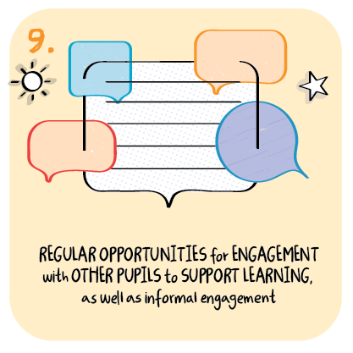
Community link workers supporting learners to mix safely with adults and peers Coupar Angus Primary and Fairview School Perth and Kinross Council
>National overviews of practice<

Slide 2
Coupar Angus Primary and Fairview School
Community link workers have continued to work with children and young people with complex needs throughout the pandemic.
They have provided valuable learning opportunities in outdoor learning and sensory communication.
School staff were particularly concerned that during the periods of lockdown children’s and young people’s abilities to mix socially and in unfamiliar environments would regress.
The work of the community link workers has ensured that these children and young people continue to mix, safely, with adults and their peers. This is supporting them to continue to develop their skills for life.
Staff worked with closely with parents to reduce any concerns they may have had regarding their child or young person mixing in groups. Ensuring all risk assessments were completed collaboratively has supported parents to engage positively with these activities.
Children and young people are engaging well with the range of outdoor learning activities.
For those with the greatest levels of need the sensory communication sessions are supporting children and young people well to continue to develop their communication skills.

