Slide 1
Inclusion Wellbeing and Equalities Professional Learning Framework Attachment: an introduction
@ESInclusionTeam
Notes:
Purpose of these Slide​:
This professional learning is suitable for anyone working with children and young people in an educational context.
How to use the slides:
There is a requirement to cover all the slides. Please do not change the provided slides.
These slides can be used to facilitate professional learning in a group, whole-setting, or as self-directed learning.
Facilitation notes are included at the bottom of each slide.
Please do not remove or change any of the slides included.
You can add slides or activities relevant to your setting, to support discussion and exploration of the topic.
You will know their participants’ needs best.
Anyone who works in an educational setting can be a facilitator and use these slides.
For reflection or discussion activities, it is important to establish a safe space which encourages respect and honesty to ensure that everyone is able to participate.

Slide 2
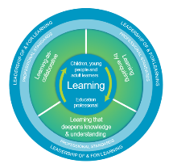
Welcome
This session provides an opportunity to:
To learn about what is meant by attachment
Explore attachment relationships
Consider the impact of these relationships on early development
Notes:
Welcome slide to introduce session.
Link activity to national model

Slide 3
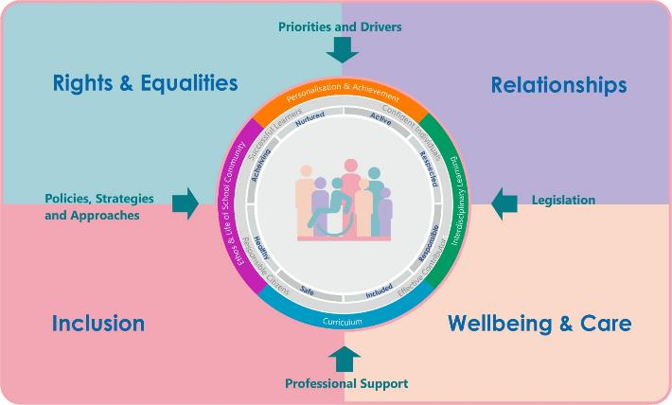
Interconnectivity
Notes:
All aspects of the professional learning framework fit into one of these four themes. The four themes are interconnected and interdependent.​
This activity forms part of the professional learning in the Relationship theme.

Slide 4
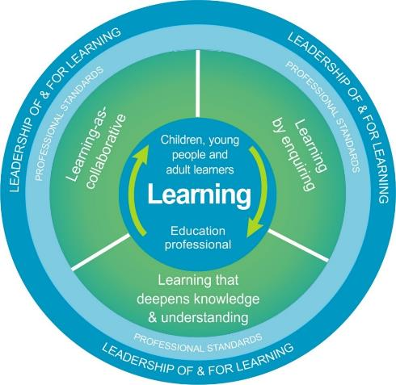
National Model for Professional Learning
This professional learning resource will support you to deepen your knowledge and understanding.
You will have the opportunity to consider how to take this learning forward on your own and with others.
The National Model of Professional Learning (education.gov.scot)
Notes:
This professional learning forms part of the national model for professional learning. It can help you gain more knowledge and have a deeper understanding of inclusion, wellbeing and equalities​​.
On completion of this professional learning, you will be asked to consider what your next steps will be​​.
Please take some time to consider the reflection questions at the end

Slide 5
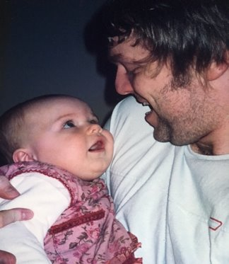
Attachment
"a lasting psychological connectedness between human beings”
Bowlby 1997
Notes:
Bowlby, John (1997) Attachment and loss. Volume 1: attachment. London: Pimlico.
Attachment theory is a psychological theory of human development.. John Bowlby, a psychiatrist, was central to much of the early work in this area. He looked at relationships from an evolutionary perspective. He suggested that children seeking proximity with their familiar caregiver when alarmed was an evolutionary-based behavioural response. Infants are born completely reliant on caregivers for the first years of their lives. Attachment theory recognises that infants instinctively attach to their caregiver and will display behaviours which try to keep the caregiver close to them particularly when they feel distressed or under threat.
All human infants , and certain other species, engage in this behaviour as a way of meeting their basic physical and emotional needs. This relationship is referred to as an attachment. Those who meet the attachment needs of an individual are attachment figures.

Slide 6
Attachment behaviour
High-quality and consistent early caregiving, particularly during times of distress, leads to attachment security.
Notes:
Attachment behaviour develops mainly in response to the quality of early caregiving. High-quality and consistent early caregiving, particularly during times of distress, leads to attachment security. Early inconsistent, rejecting, or absent caregiving by attachment figures during times of distress leads to attachment insecurity.
To explain this further we will look at both secure and insecure attachment cycles.

Slide 7
Attachment Cycles
Threat
Attachment behaviours
Threat
Attachment behaviours
Secure
Insecure
Soothed
Distress
Comfort and caregiving
No comfort/
inconsistent comfort
Notes:
In these cylces a threat leads to the release of stress hormones and the activation of what Bowlby called the ‘Attachment Behavioural System’. The child displays attachment behaviours to bring the caregiver close. When sensitive care giving is then received the infant is comforted and is soothed. The stress hormones in the child are reduced and beta endorphins are produced. Over time the child starts to learn that they are safe and that adults are secure and reliable. They develop secure attachment behaviours.
When an infant does not receive comfort and is not soothed on a consistent basis following a threat, they are flooded with stress hormones and will either tend to hide their distress to keep the caregiver available or to escalate their behaviour in order to get a response. These behaviours are a response to the caregiving received and are not intrinsic to the child. While these insecure attachment behaviours have been developed to work in this caregiving relationship, they are not helpful when the child makes these responses in other settings such as nursery or school.

Slide 8
Secure attachments
Securely Attached children and young people are :
Better able to learn
Able to make new attachments more readily (e.g. to their teachers)
Ready to seek help when experiencing difficulties (academic or social)
More willing to share the attention of adults with their peers
Secure attachments take place when:​
The adult is readily available, sensitive to the child’s signals and responsive when the child seeks protection or comfort​
The adult is consistent, reliable and predictable and provides a secure base for the child to explore from and return to.​
The child is confident that their parent/carer will be available, responsive and helpful should s/he encounter adverse or frightening situations.
Notes:
Reinforces the outcomes of having a secure attachment throughout a child’s life and how an adult caregiver helps to support secure attachments.
Louise Bomber talks about a ‘Continuum of attachment’ so not always as straightforward as a group all being secure and others being insecure – may be levels of this.

Slide 9
Insecure attachments
Insecurely attached children and young people can:
have difficulties focusing attention on learning
depend on others to regulate their emotions
be emotionally self-contained and detached
have difficulties working with others in a group
show extreme reactions to others
give up quickly and find it difficult to accept help or encouragement
Insecure attachments occur when:​
caregiver is inconsistent, unreliable or insensitive with their responses to the child’s needs​
caregiver is rejecting, interfering or controlling​
caregiving itself becomes the source of distress for the young person, e.g. is abusive or neglectful​
Different caregiving experiences can lead to different types of behaviours in children.
Notes:
Difficulties that children show may differ depending on the caregiving of the adult.
Where Caregiver is inconsistent, unreliable or insensitive with their responses to the child’s needs may have had drug, alcohol or mental health problems, can lead to:
Intensified attachment behaviour
Shows high level of stress when separated from caregiver but then may resist interaction when reunited
Attention-seeking, Dependency and pre-occupation with others for regulation of emotion, Low self-esteem
Where Caregiver is rejecting, interfering or controlling and is not responsive to child’s expression of need impact is:
self sufficiency is learned – child is emotionally self-contained.
Child may be Inhibited, detached, cool
Child avoids intimacy,
Develops need to achieve and attain cognitive mastery – needs to be the best
Could lead to difficulty cooperating in a group
Where Caregiver is the source of distress/ Associated with child abuse/neglect – child may have diverse responses
Approach-avoidance conflict
Anxiety and rage co-exist
Extreme reactions
Emotions are not able to be regulated
Difficulty when trying out new concepts in school
Gives up quickly
May sabotage good work
Links to different attachment styles – can be helpful for school staff to be aware of how child might respond – relationships are the key and need to get to know the child well so can respond appropriately.

Slide 10
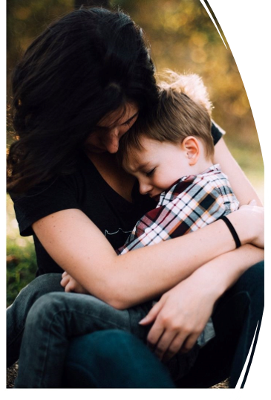
Safe Haven
A safe haven helps the individual regulate emotions during times of actual or perceived distress/threat.
Notes:
There are three major functions of attachment relationships: to promote proximity seeking to enable survival, to provide a safe haven which helps the individual regulate emotions during times of actual or perceived distress/threat, and to offer a secure base.
What do we mean by a safe haven? This refers to adult behaviour in response to a child who is distressed by a stressor in the environment or has an unmet need. The adult calms the child thus becoming their safe haven.

Slide 11
Secure Base
Notes:
For a safe base the baby needs to develop an attachment bond with a caregiver and feel that the care is consistent and predictable in order to develop trust and then begin to feel safe to go out and explore the world. When they first go out into the world they tend to return regularly to the caregiver ( this can be seen in a baby of about 10 months or so) and then they begin to venture further afield and try new things.
When this hasn’t developed in early years there is a need to develop this at a later stage. Louise Bomber calls this ‘relative dependency’ where children need to go through the stage of being dependent on an adult so that they can later develop more independence.
A secure base allows the individual to explore the world and develop greater autonomy, growth, competence, eventually resulting in better self-regulation and psychological development. (Simpson et al 2020).
Attachment research has highlighted that we need both a safe haven and a secure base to flourish both in childhood and as adults.

Slide 12
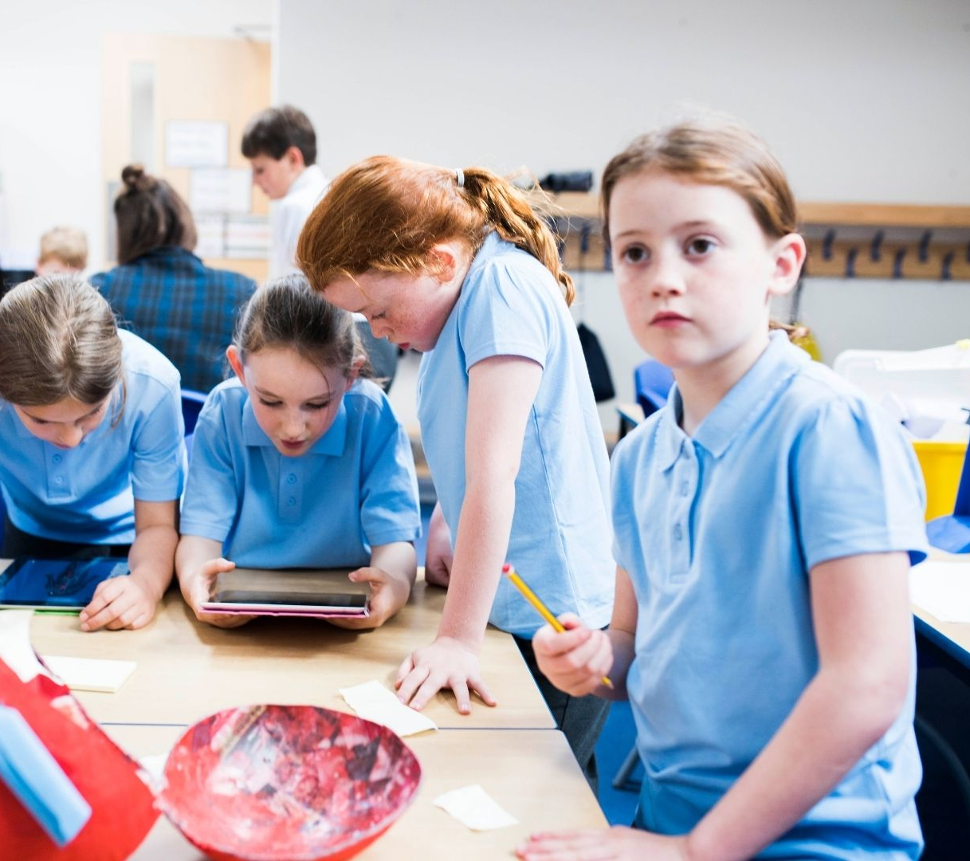
Internal working model
Notes:
Attachment figures and our types of attachments to them (secure vs. insecure), shape our internal working models (mental representations) of the self and others. Internal working models consist of preverbal and verbal memories, which shape cognitions, perceptions, emotions, attitudes, and behaviours toward the self, others, and the world more generally.
For example, a child’s experience might lead to the belief that the world is not safe, other people are not trustworthy or that they themselves don’t merit love and attention.
Experiences that contradict existing internal working models can lead to changes in this internal model.
Bowlby noted however ‘In general when new information clashes with established [working] models . . . an old model may
be replaced by a new one. Nevertheless, much evidence suggests that we undertake such replacements only very reluctantly. . . . To dismantle
a model which has played and is still playing a major part in our daily life and to replace it with a new one is a slow and arduous task. (Bowlby,
1973, pp. 230–231).
Bowlby, J. (1973). Attachment and loss: Vol. 2. Separation: Anxiety and anger. New York: Basic Books

Slide 13
Reflection
Consider how attachment security or insecurity might impact a person over their lifespan?

Slide 14
Attachment and mental health
Attachment security is a protective factor against psychopathology and related symptoms such as anxiety, depression, disassociation and antisocial behaviours.
Pascuzzo et al (2015)
Notes:
Attachment security during childhood, adolescence, and young adulthood has been shown to be a protective factor against psychopathology and related symptoms such as anxiety, depression, dissociation, and antisocial behaviors (Davila, Ramsay, Stroud, & Steinberg, 2005; Dozier, Stovall-McClough, & Albus, 2008). In contrast, internalized representations of self and others developed in response to insensitive caregiving are thought to increase the risk of developmental maladaptation across the life span (DeKlyen & Greenberg, 2008; Moss, Bureau, St-Laurent, & Tarabulsy, 2011). Therefore, although attachment insecurity is not considered a disorder in and of itself, it is viewed as an important risk factor for adult psychopathology, including symptoms of anxiety, depression, dissociation, and antisocial behaviors (Bolwby, 1988; Davila et al., 2005; Dozier et al., 2008).
From Pascuzzo, K., Moss, E., & Cyr, C. (2015). Attachment and Emotion Regulation Strategies in Predicting Adult Psychopathology. SAGE Open, 5(3). https://doi.org/10.1177/2158244015604695

Slide 15
Attachment and resilience
Secure attachment is associated with the presence of resilience.
Rasmussen et al (2019)
Notes:
Secure attachment is associated with the presence of resilience.
Darling Rasmussen, P., Storebø, O. J., Løkkeholt, T., Voss, L. G., Shmueli-Goetz, Y., Bojesen, A. B., Simonsen, E., & Bilenberg, N. (2019). Attachment as a Core Feature of Resilience: A Systematic Review and Meta-Analysis. Psychological Reports, 122(4), 1259-1296. https://doi.org/10.1177/0033294118785577

Slide 16
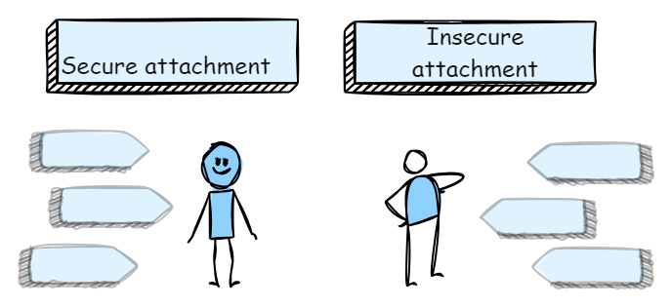
Secure and insecure attachments in class
Notes:
Think about the learners in your class: consider one who you think is securely attached. What make you think they have secure attachment?
Now think of a child or young person showing signs of insecure attachment. What signs are they showing? How might you respond to these behaviours?
Children who have experienced a secure attachment are ready to seek help from adults when required, are ready to explore the world, build friendships and trust.
Children who have not experienced a secure attachment are liable to struggle with impulse control and regulation of stress. They will probably be unable to express their internal states through language. They are likely to regularly experience shame and anxiety. They are less able to be playful, curious and joyful.
Rather than having an open interest in others they may view others in terms of what use the person is to them.

Slide 17
How can education practitioners help?
Notes:
Adults who are able to be physically and emotionally present, attentive, attuned and responsive can offer new learning for children and young people. This new evidence for the brain, produced by these experiences, can influence internal working models and sense of safety. A child or young person who feels safe is then able to explore and learn. These children need second chance learning through positive relationships with adults.
To explore attunement in more detail use the attunement module on the Framework.

Slide 18
Final Reflection
From what you have learned so far, think about:
How has this made you feel?
What has this made you think about?
What one action would you like to take forward?
How can you link what you plan with others in your setting?
How will you know that this learning has made a difference?
Notes:
Facilitation notes:
You can do this in groups...
Encourage educators to take this forward in an enquiry
Consider impact of the actions / learning

Slide 19
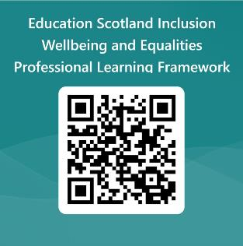
We value your feedback
Education Scotland is taking feedback on these resources so that we can continue improving our professional learning resources.
Your feedback could help us improve this resource
Please complete this short form, using the link or QR code, to let us know what you thought of it and any suggestions you have on how it could be improved.
framework feedback form
Notes:
Slide 29: Feedback slide
Education Scotland is taking feedback on these resources so that we can continue improving our professional learning resources.
Your feedback could help us improve this resource
Please complete this short form, using the link or QR code, to let us know what you thought of it and any suggestions you have on how it could be improved

Slide 20
Contact Education Scotland
Denholm House
Almondvale Business Park
Almondvale Way
Livingston EH54 6GA
Telephone: +44 (0)131 244 5000
Email: enquiries@educationscotland.gsi.gov.uk
Website: Inclusion, wellbeing and equalities framework | Education Scotland

