Slide 1
All Layers: College Regions, DYW Groups and Creative Learning Networks
Regional Improvement Collaboratives
Mapping Tool

Slide 2
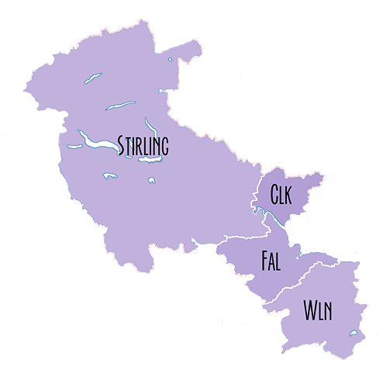
Forth Valley and West Lothian
Collaborative
Forth Valley College
Forth Valley CLN
Forth Valley DYW
West Lothian College
Creative Learning Networks
College Regions
West Lothian DYW
DYW Groups
West Lothian CLN

Slide 3
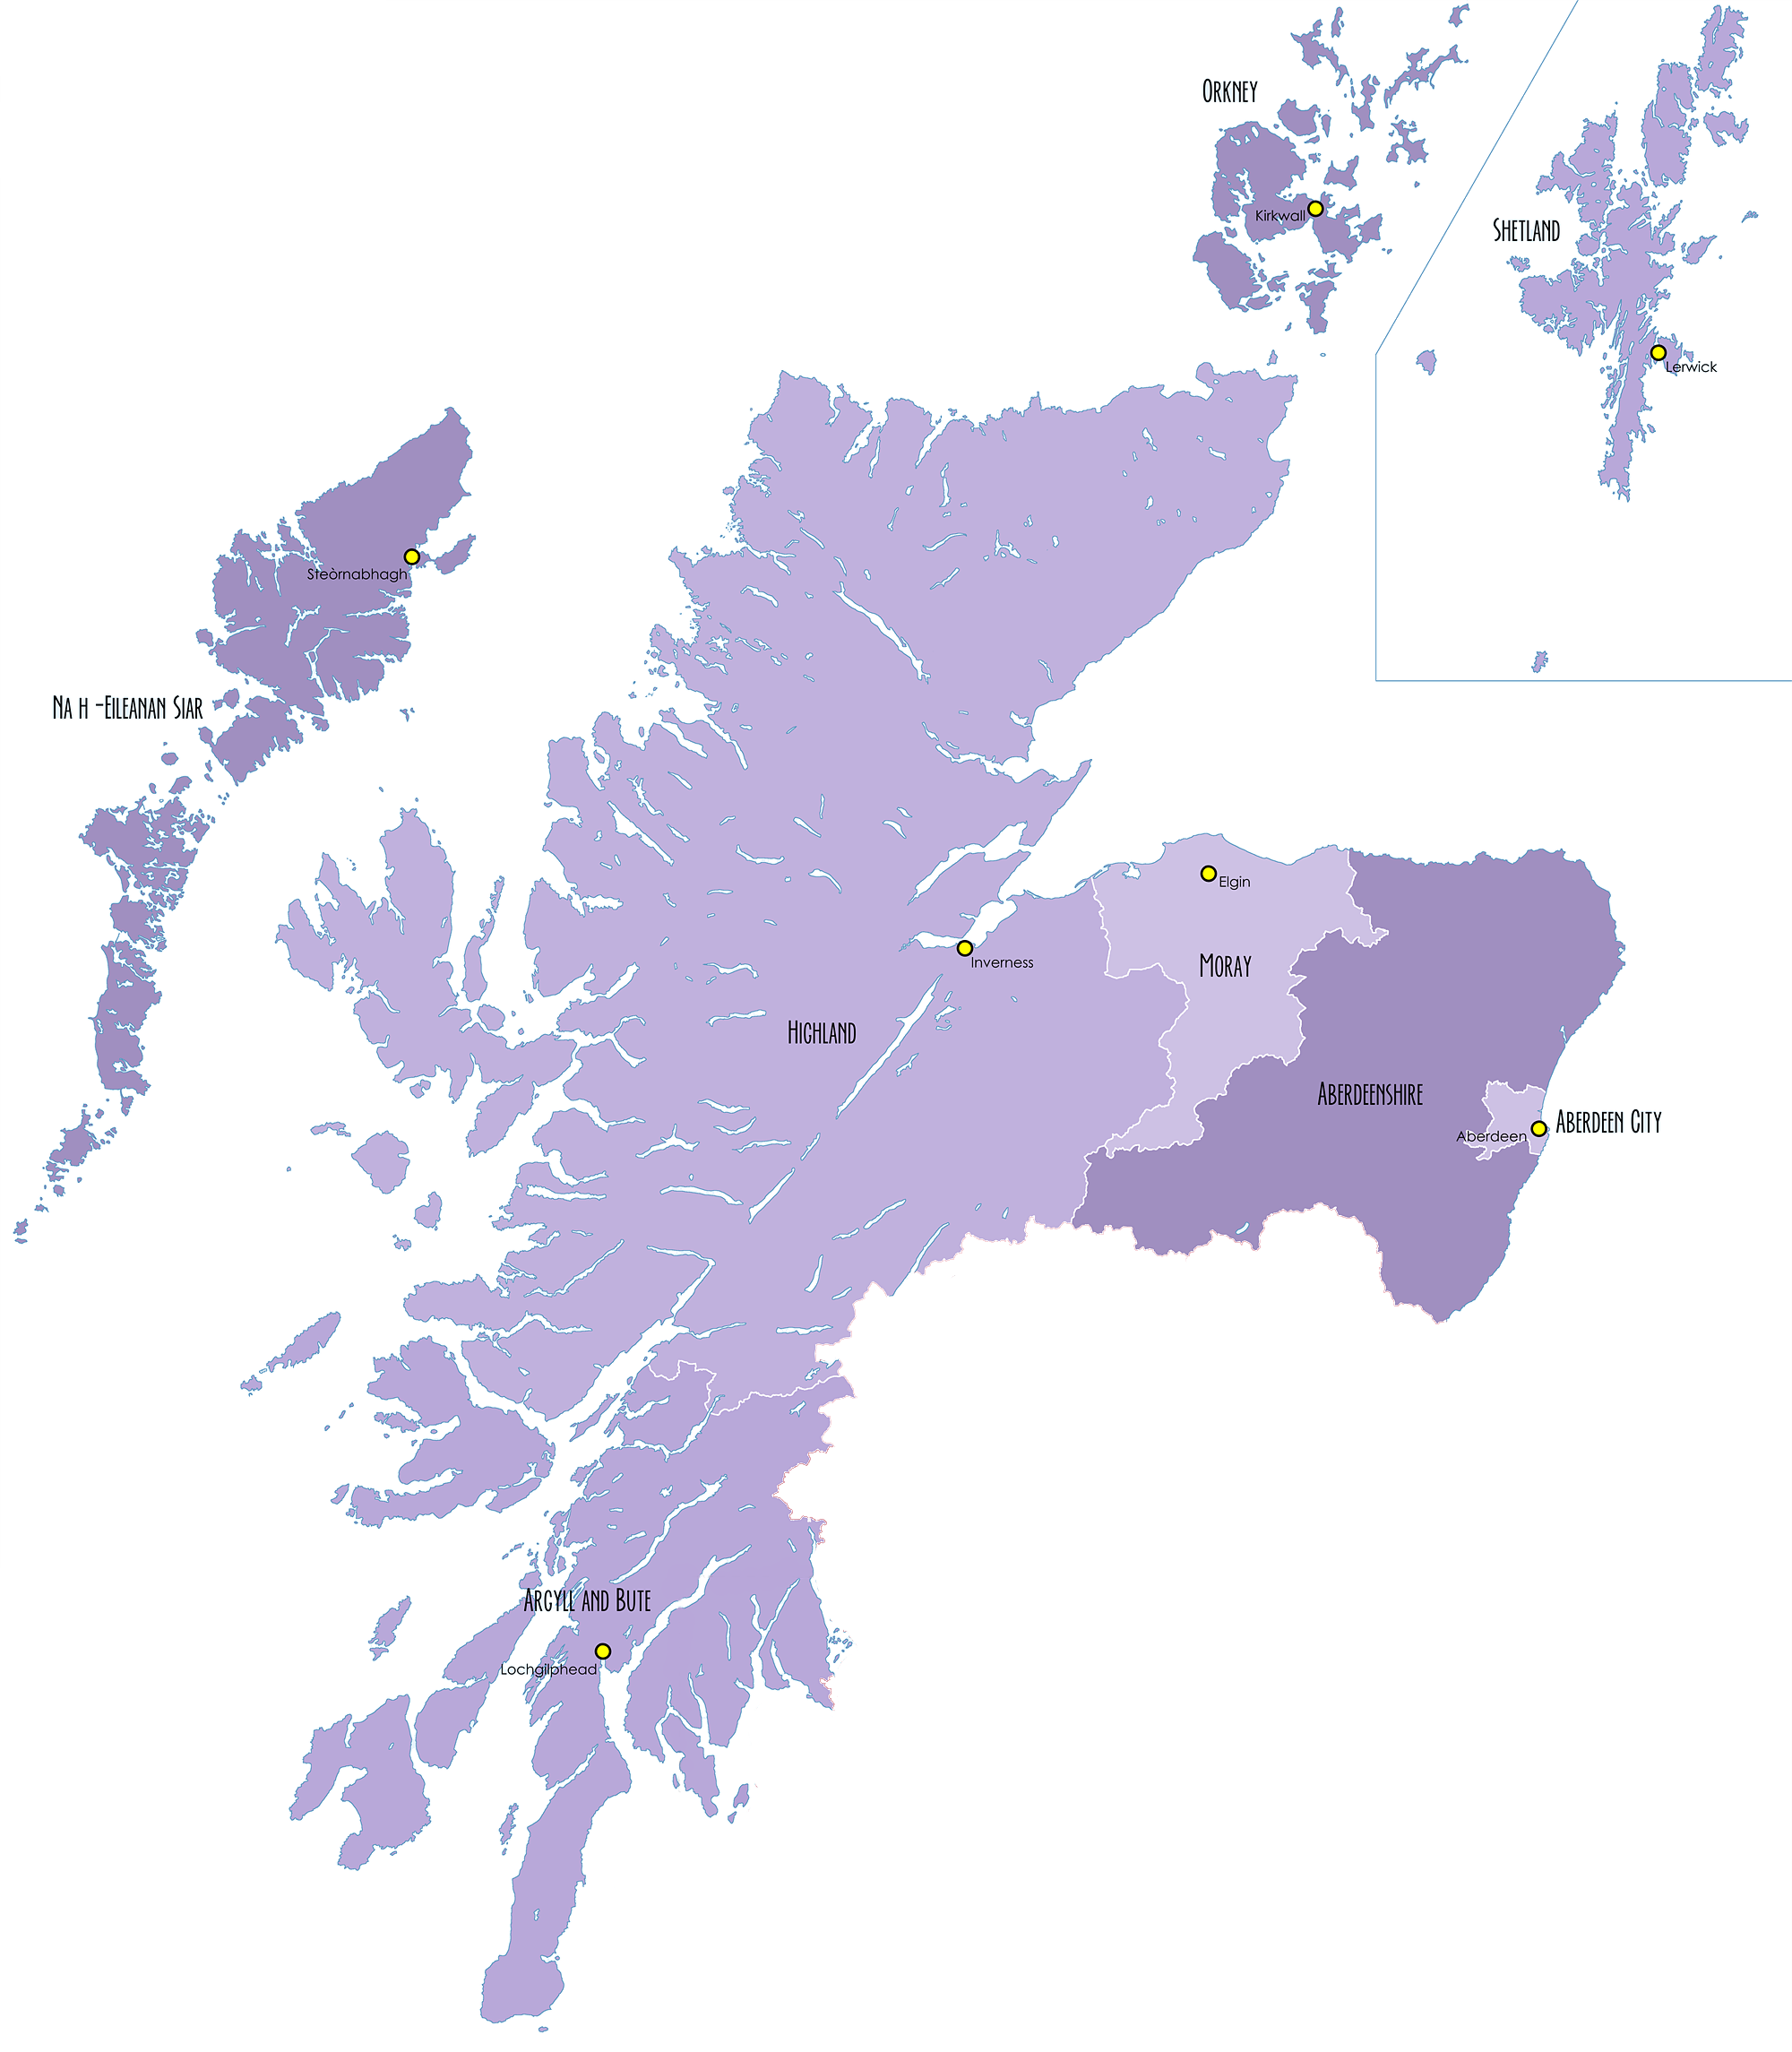
Orkney DYW
Orkney CLN
Shetland DYW
Northern Alliance
Eilean Siar DYW
Highlands and Islands
Eilean Siar CLN
Inverness & Central Highland DYW
Moray DYW
Moray CLN
North East Scotland College
Highland CLN
North East DYW
(Aberdeenshire and City)
West Highland DYW
Aberdeen City CLN
Aberdeenshire CLN
Creative Learning Networks
Argyll & Bute DYW
College Regions
DYW Groups

Slide 4
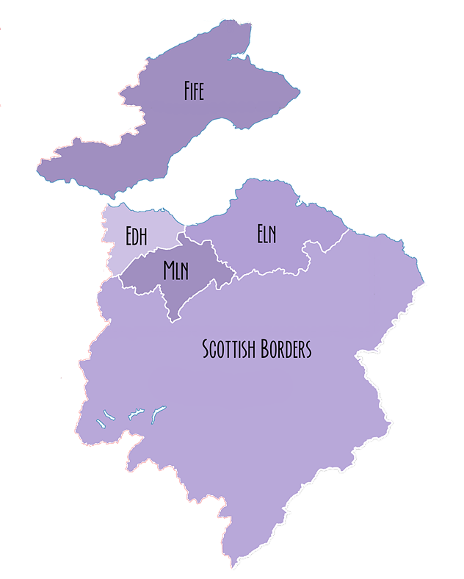
Fife College
South East Improvement Collaborative
Fife DYW
Edinburgh and Lothians
(Edinburgh College)
Edinburgh, East and Mid Lothian CLN
Edinburgh and Lothians DYW
Scottish Borders CLN
Borders DYW
Creative Learning Networks
Borders College
College Regions
DYW Groups

Slide 5
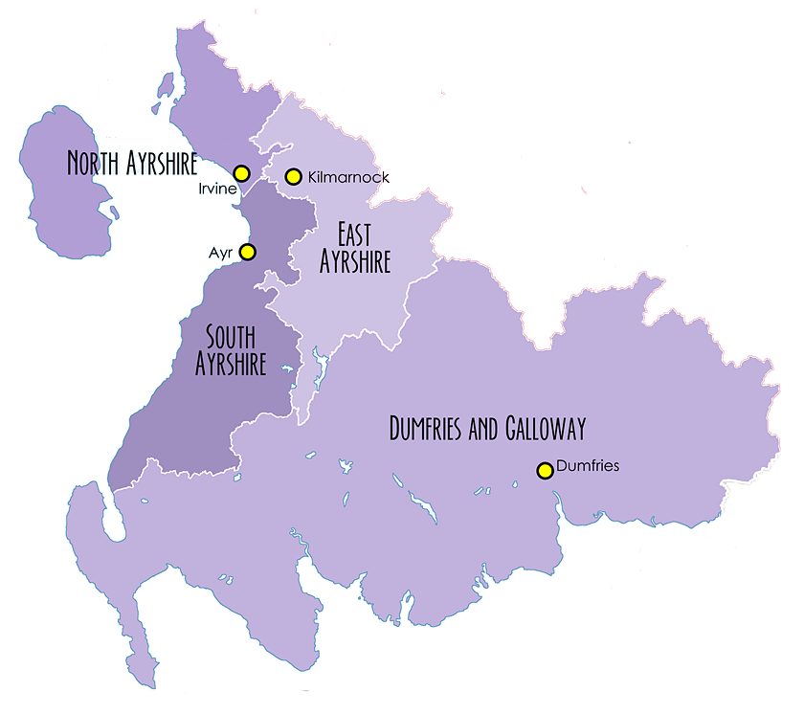
West College
Highlands and Islands
North Ayrshire CLN
South West Collaborative
Ayrshire DYW
East Ayrshire CLN
Ayrshire College
South Ayrshire CLN
Dumfries and Galloway College
Dumfries & Galloway CLN
Dumfries and Galloway DYW
Creative Learning Networks
College Regions
DYW Groups

Slide 6
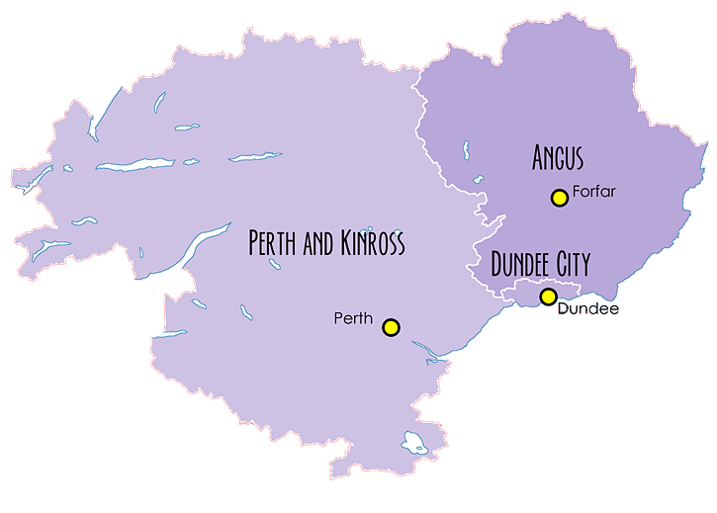
The Tayside Collaborative
Perth & Kinross DYW
Angus CLN
Perth & Kinross CLN
Dundee and Angus DYW
Highlands and Islands
(Perth College)
Tayside
(Dundee & Angus College)
Creative Learning Networks
College Regions
DYW Groups

Slide 7
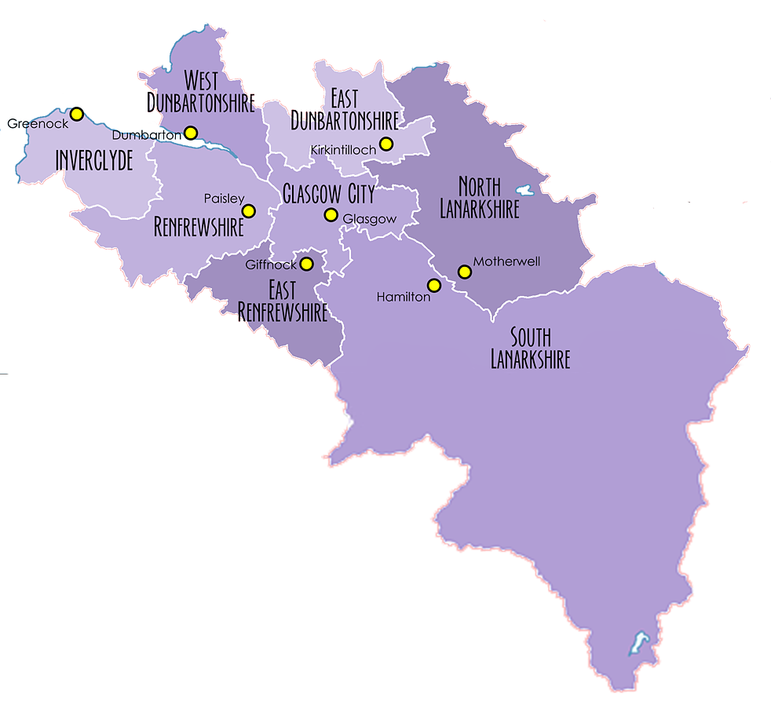
West Dunbartonshire CLN
East Dunbartonshire CLN
The West Partnership
Inverclyde CLN
Glasgow
Renfrewshire CLN
Glasgow DYW
Lanarkshire DYW
Glasgow CLN
Lanarkshire
West Region DYW
West College Scotland
South Lanarkshire CLN
Creative Learning Networks
College Regions
DYW Groups

