Slide 1
Christine Downie – HT St Luke’s High School, Barrhead Karen Hunter – DHT St Luke’s High School, Barrhead
St Luke’s High School
Leading Targeted Interventions for Excellence and Equity

Slide 2
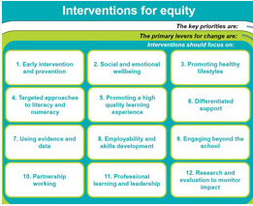
Seminar Aims
To share how leadership, at all levels, has been pivotal in our effective use of monitoring and tracking as an essential tool to identify, target and measure Pupil Equity Fund interventions.
To stimulate professional discussion on leadership as a lever for change.

Slide 3
Leadership at all Levels
 | Strategic leadership | Vision, Values & Aims Cluster Curriculum Rationale SLT Remits
 | Pupil Leadership | Pupil Voice Subject Ambassadors Peer Tutors Credit Union
 | Practitioner Leadership | Practitioner Enquiry Departmental PEF Leaders Cluster Maths
 | Middle Leadership | PTs PEF: STEM, Literacy, Wider Achievement, Health & Well Being PTs Pupil Support: refocused, Data Walls PTs Subject
MONITORING & TRACKING
PROFESSIONAL LEARNING

Slide 4
St Luke’s High School – Our School Context (BGE)
School Roll:589
S1-S3 Roll 328 SIMD 1-2 – 34%
FME – 21% SIMD 1-4 – 65%

Slide 5
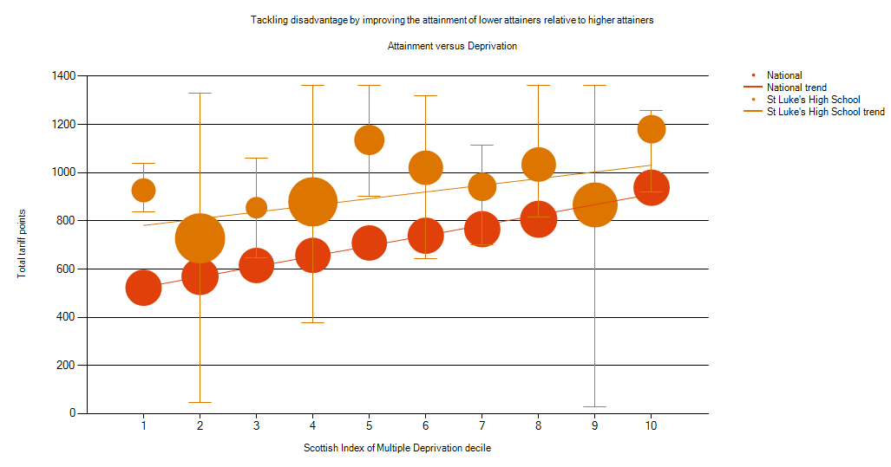
Attainment v Deprivation

Slide 6
Leadership of Excellence and Equity – School Context Reflection Activity
How has your understanding of the unique context of your school influenced your approach to PEF?

Slide 7
Planning for PEF – Curriculum Rationale

Slide 8
Planning for PEF – Tips from the Top
Which gaps exist in which year groups/faculties/departments?
What strategies are in place to close them?
Should you be refocusing the work of pupil support/support for learning on attainment gaps?
Where are there targeted interventions to close the gaps within lessons/departments?

Slide 9
Leadership is recognised as one of the most important aspects of the success of any school. Headteachers and teachers who are empowered, and who empower others to take ownership of their own learning, have a strong track record of ensuring the highest quality of learning and teaching. This in turn helps to ensure that all children achieve the best possible outcomes.
NIF

Slide 10
Leadership at all levels
Head Teacher and Senior Leadership Team
DHT Excellence and Equity
Pupil
Integrated Pupil Support Team
Learner Centred Approach
Practitioner
PT PEFs
PEF Leaders
Cluster
Approach

Slide 11
“…especially those most in need of support”
Identification
Groups/Individuals?
Big Data/ Small Data?

Slide 12
Monitoring and Tracking in the BGE
Why are we tracking?
What are we tracking?
How are we tracking it?
How are we using this data?

Slide 13
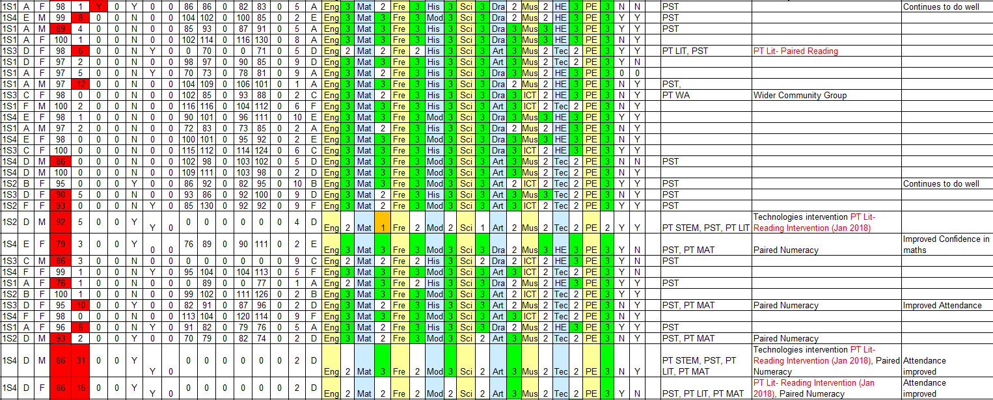

Slide 14
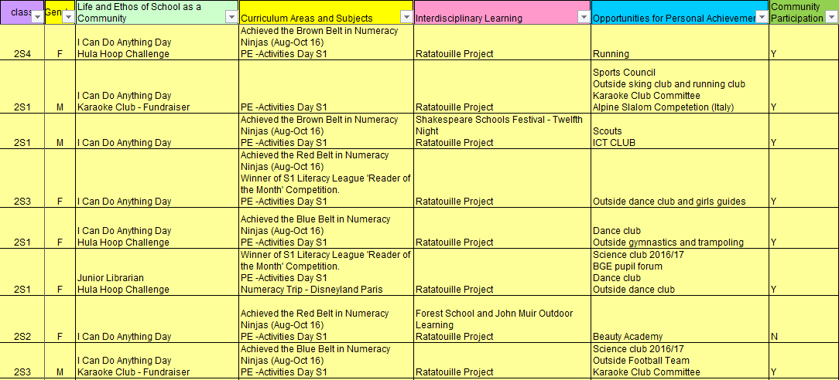

Slide 15
Interventions and Leadership

Slide 16
Leadership at all Levels – Reflection Activity
How are you identifying which gaps exist in which year groups/faculties/departments in your school context? How have you distributed leadership in your school to ensure improvements to equity for all learners?

Slide 17
Professional Learning – Know thy Impact!

Slide 18
Leading Excellence and Equity – a Learner-Centred Approach
Leading Excellence and Equity - Pupil Voice

Slide 19
Measuring Impact – Data so Far
Individual Interventions
Practitioner Enquiry Findings
PEF Leader Data
Literacy & Numeracy Data

Slide 21
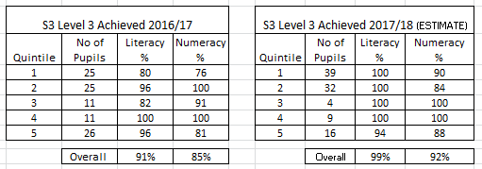

Slide 22
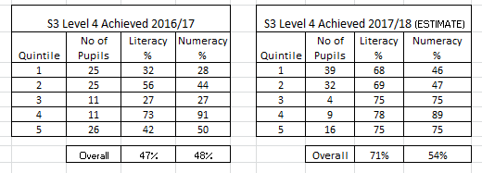

Slide 23
Leadership of Excellence and Equity – Next Steps for St Luke’s…
Monitoring and Tracking of Health and Well-being
Continued refocusing of Pupil Support Team on Excellence and Equity
Continued focus on Curriculum
Continued focus on Skills Development
Further Development of Learning Together Programme
Wider use of Stretch Aims to set targets and measure progress

Slide 24
Any Questions?

