Slide 1


Keeping the Promise Award
Notes:
Welcome everyone. I’d like to start by telling you a little bit about the Keeping the Promise Award. It was originally created in North Lanarkshire Council by a broad range of staff to support children and young people, who are care experienced on their journey through early years, school and beyond. Everyone involved in creating the original Award and this refreshed Award wanted to create a vehicle to raise awareness of care experienced children and young people and some of the challenges they face. It was designed to develop our understanding around the national commitment made by the Scottish Government and supported by (Insert Local Authority name) to improve the learning experience and educational outcomes of our care experienced young people. The professional learning in the Award helps us identify our responsibilities to these learners. The Award itself is a way to recognise settings who are striving to understand and meet the needs of these learners and in their delivery of support to them. The Award is simple and straightforward. It consists of two short training sessions delivered in conjunction with an e-learning course. When completed by a threshold of staff in the setting will receive accreditation for The Keeping the Promise Award. This first session covers the national context, the terminology around care experience and ‘good’ parenting (referred to as corporate parenting), The Promise and what all this means for our practice. Throughout the session where possible the voice and lived experience of care experienced children and young people has been used. Hopefully this session will demonstrate the positive impact both education itself and ‘we’, practitioners, can have on care experienced children and young people’s lives and learning.
This professional learning has been adapted for CLD – this has meant slight changes to language (for example replacing teacher with practitioner) but the content and messaging remains the same.

Slide 2
Keeping the Promise Award Structure
This professional learning is for ALL staff who have contact with children and young people and there is an expectation that over time ALL staff complete it
The information should or could be part of induction training for new staff and volunteers
The training should be regularly refreshed - at least every three years (to include refreshed materials)
To obtain the Award for a setting 70% of all staff need to have completed the presentations and e-Learning module
Notes:
This professional learning is for ALL staff who have contact with children and young people and there is an expectation that over time ALL staff complete it
The information should or could be part of induction training for new staff
The training should be regularly refreshed - at least every three years (to include refreshed materials)
To obtain the Award for a setting 70% of all staff need to have completed the presentations and e-Learning module

Slide 3
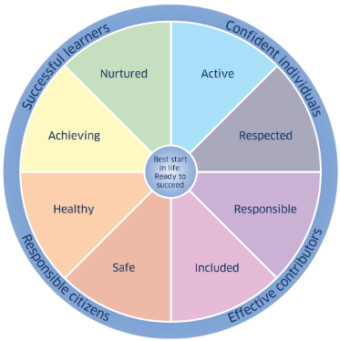
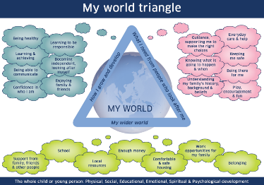
GIRFEC
GIRFEC provides Scotland with a consistent framework and shared language for promoting, supporting, and safeguarding the wellbeing of ALL children and young people.
GIRFEC promotes a common understanding of wellbeing recognising that children and young people need to grow up safe, healthy, achieving, nurtured, active, respected, responsible and included, so that they can become confident individuals, effective contributors, successful learners and responsible citizens.
GIRFEC contributes to work on family support and delivering The Promise made to all of Scotland’s children, young people and their families - a shared commitment to reorganise how we think, plan and prioritise for children, young people and their families.
Notes:
GIRFEC underpins how we work with children and young people across all services in Scotland. It provides us with a consistent framework and shared language for promoting, supporting, and safeguarding the wellbeing of ALL children and young people including those who are care experienced.
GIRFEC promotes a common understanding of wellbeing recognising that children and young people need to grow up safe, healthy, achieving, nurtured, active, respected, responsible and included, so that they can become confident individuals, effective contributors, successful learners and responsible citizens.
GIRFEC contributes to work on family support and delivering The Promise made to all of Scotland’s children, young people and their families - a shared commitment to reorganise how we think, plan and prioritise for children, young people and their families.
GIRFEC is a strengths-based approach which seeks to realise children’s rights on a day-to-day basis. GIRFEC places the child or young person and their family at the heart of everything we do. GIRFEC is about enhancing the wellbeing of all children and young people as well as building a flexible scaffold of support: where it is needed, for as long as it is needed.

Slide 4




Terminology: Looked After and Care Experienced
Care Experienced
Looked After At Home
Looked After Away from Home
Previously Looked After
Notes:
We should start by making sure we all share an understanding of who we are talking about – our care experienced children and young people. Some children and young people need to be looked after by their local authority when they don’t receive adequate care from their parents or there are other concerns about their wellbeing. You’ll be familiar with ‘looked after’, LAC, terminology and expressions such as children who are ‘in care’, children who are accommodated and more recently children with care experience or who are experiencing care. What’s the difference between these terms and does it matter?
YES it matters. It matters both legally and in terms of how we reduce the stigma around care.
‘Looked after’ is the legal term used by Scottish Government and refers to a child or young person whose care is supervised formally, on a compulsory order, by the local authority through social work services. They can be ‘looked after’ at home or away from their parental home in a range of settings or arrangements. We’ll go into the different types of care in more detail later. If a child or young person no longer needs to be formally ‘looked after’, this will be decided at a Children’s Hearing, then they become ‘Previously Looked After’. These are the codes that are used in our SEEMIS recording systems.
Children and young people however find the expression ‘looked after’ stigmatizing and ‘uncaring’! They prefer the expression ‘care experienced’. We therefore use care experience as an umbrella term for all of the types of care highlighted above.
Let’s now look into what it’s like for a young person experiencing care, some of the challenges they may face, and why the system supporting these young people needs to change.

Slide 5

Reforming Scotland’s care system with love – Jamie Dalgoutte
6 min
13 sec
Film created by Glasgow University
If viewing this as a pdf please click this link to access the film: https://youtu.be/P2H0GzxmLK8
Notes:
Play the film (6 min 13 sec)

Slide 6
Reforming Scotland’s care system with love
Notes:
That powerful film of just one young man’s life experiences and his care and educational journey gives us a flavour of the challenges faced by care experienced children and young people. His story has ended with him accessing Higher Education but this often isn’t the case for many other children and young people who experience care. For many their journey through education and the care system isn’t always as positive.
So who are our care experienced children and young people and how are they cared for?

Slide 7
National Care Population
The 2021-2022 Social Work Statistics recorded 12596 young people looked after in Scotland
These children or young people live in many different types of care:
kinship care (with friends or relatives) 34%
foster care (living with another family) 33%
looked after at home (living with parents but under the supervision of social work) 21%
residential care (living in a children’s house) 10%
with prospective adopters 1%
in other community setting 1%
(Scottish Government, published April 2023)
Notes:
To add to the complexity of the situation – these figures only represent the group of children and young people who are officially and legally ‘looked after’. The ones officially recorded. However we know that there is a much larger group of children and young people who are informally cared for by grannies and granda’s, aunties and uncles, brothers or sisters, or family friends who are not formally recorded. These are often referred to as informal kinship arrangements. These children and young people may also face challenges similar to those who are legally looked after and are likely to also need our consideration and care. These children and young people are often recognised in our recording systems as those who require additional support socially and emotionally and with their behaviour.

Slide 8
Local Care Experienced (Looked After) Data
 | ELC | Primary | Secondary | Total
Looked After at Home
Looked After Away from Home
Previously Looked After
TOTAL NUMBER OF CARE EXPERIENCED
Notes:
OPTIONAL Local authority data discussion
Insert your own local authority data and describe the cohort.
It may also be good to discuss the implications of the data.

Slide 9
Why do this Award?
What can children’s services, ‘us’ (practitioners),
mean for, and to, someone
who has experienced care?
Notes:
As a pause from the numbers it’s always good to reflect on the fact that each number is a child or young person in our care. How do we influence their lives? And what can education mean to them? Let’s hear from another young person with care experience who now works herself as a Senior Development Officer with Includem which is a Scottish Charity supporting children, young people, and their families to transform their lives.

Slide 10
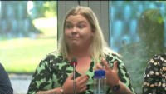
Why do this Award? What difference could it make?
7 min
58 sec
Film created by Education Scotland
If viewing this as a pdf please click this link to access the film: https://youtu.be/wfCxf0GYChs
Notes:
Play film (7 min 58 sec)

Slide 11
Corporate Parenting
What do the terms 'Parent' and 'Corporate' mean?
Notes:
So let’s move on to our legal duties towards children and young people who are care experienced. Let’s start from our current understanding of this expression ‘Corporate Parent’.
OPTIONAL ACTIVITY: This could be carried out as a discussion, or you could create a Menti, Jamboard or similar to capture responses – word clouds are also great for this.

Slide 12
Corporate Parent defined
Officially: Corporate parents are "the formal and local partnerships between all services responsible for working together to meet the needs of looked after children, young people and care leavers”
AND “they have statutory duties to collaborate with each other in upholding the rights and securing the wellbeing of looked after children.”
Children and Young People (Scotland) Act 2014
Unofficially: ‘A corporate parent is intended to carry out many of the roles a loving parent should’
Notes:
Read slide
Officially: Corporate parents are "the formal and local partnerships between all services responsible for working together to meet the needs of looked after children, young people and care leavers”
AND “they have statutory duties to collaborate with each other in upholding the rights and securing the wellbeing of looked after children.”
Children and Young People (Scotland) Act 2014
Unofficially: ‘A corporate parent is intended to carry out many of the roles a loving parent should’

Slide 13
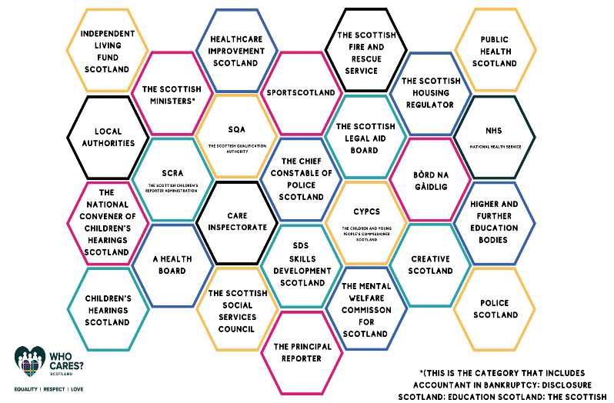
Corporate Parents in Scotland
Notes:
In the 2014 Children and Young People’s Act there are 26 Corporate Parent public bodies listed. These Corporate Parents have legal duties under the Act. Many of these Corporate Parents are large umbrella entities such as local authorities. This means, however, that every single employee within each of the 32 local authorities is a corporate parent, and as such has legal duties towards care experienced people. Another example is Education Scotland As an Executive Agency of the government acts on the instruction of Scottish Ministers and is also a corporate parent. All these corporate parents collectively have a legal duty to coordinate their efforts to support care experienced people.

Slide 14
Corporate Parent Quote
The Care Review has avoided using this term (Corporate Parent). Nevertheless Scotland must live up to its responsibilities in relation to the children it has (and has had) responsibility for and be a ‘good parent’. It is tempting to define what a ‘good parent’ is. However, like love, to do so would only apply an institutional version of parenting and create the danger of further systemisation of care.
The Promise 2020
Notes:
This is a quote from The Promise Report, 2020, in they say that they have deliberately avoided using the term corporate parent.
Read the quote from Nevertheless…..
Care experienced children and young people, through the Review, also told us that they found the care system ‘cold, overly professionalised and uncaring’.

Slide 15

What kind of Corporate Parent are you?
4 min
21
Sec
Thanks go to Edinburgh Champs
and Edinburgh City Council for this Film
If viewing this as a pdf please click this link to access the film: https://www.youtube.com/watch?v=G3BWDSyBQgg
Notes:
Play the film (4 min 21 sec)
https://www.youtube.com/watch?v=G3BWDSyBQgg

Slide 16

The ambition for Scotland’s children…
Notes:
It almost seems too simple but what Chloe has said is completely in line with ‘The ambition for Scotland’s Children’. ->That children grow up loved, safe, and respected so that they can realise their full potential.
However we know it takes a village to raise a child. Schools and educational settings in all their forms can have a massive impact on children, their lived experience, and their outcomes. They can ‘be’ the constant in a child’s life even if everything else around them is changing. So this slide reminds us that we have a duty to ensure care experienced children and young people grow up LOVED, SAFE and RESPECTED.
So how do we know what needs to change to make things better for care experienced children and young people?

Slide 17
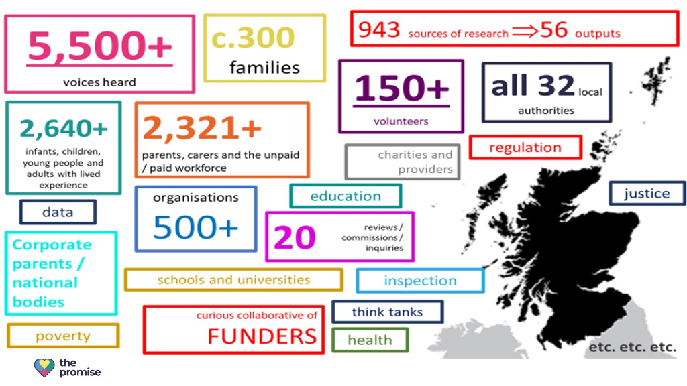

Independent Care Review
Notes:
The Independent Care Review started in 2016. It was a root and branch review as it was nationally recognised that the current care system wasn’t fit for purpose. The review was overseen by Fiona Duncan. It was extensive and included testimonials from people with lived experiences, families, carers, practitioners, corporate parents, and many other organisations and stakeholders. Over half of the voices noted in The Promise Report following on from the review were from people with lived experience.
The review took place over a 4 year period up to 2020. It exposed the fact that the care system is hugely complex, confusing and difficult to navigate. For example, there are 44 pieces of legislation, 23 pieces of secondary legislation and 3 International Conventions that govern this thing we call the ‘care system’.
To get it right for care experienced people we know we need to have a more coordinated and systematic approach. This is where everyone and more specifically Corporate Parents must work together and see a young person with care experience – holistically, in the context of their family and their community, and not just in the context of their learning or another individual aspect of their life – for example their mental health. The Promise was written to try to join up the supports and services around the lives of care experienced people and highlight how care experienced people think things need to change for the care system to be better.

Slide 18


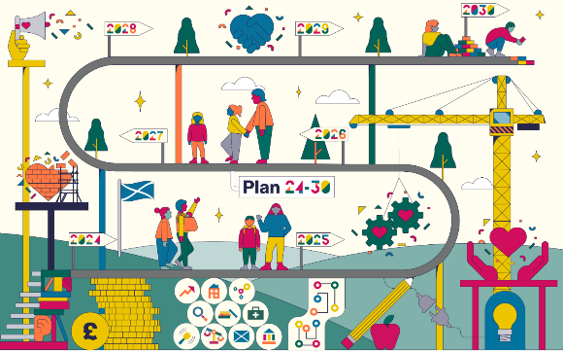
The Promise – Plan - Timeline
March 2020 March 2021 2024-2030
The Promise Reports
Notes:
The Promise isn’t one document it is actually 7 different reports including The Promise, The Pinky Promise – an easy read version of The Promise, The Rules, The Money, Follow the Money, The Plan, and a Thank you. It’s well worth your while looking further into The Promise and all the documents can be found online. Today we’ll look further at the priorities outlined in The Promise Plan 21-24 and the core principles of the Promise. These principles and priorities remain relevant today despite running to the end of the Plan. In May 2024 a Promise Route Map was published showing the continuation of the Promise journey from 2024 through to 2030. Later this year Plan 2024-30 will be published which will outline what still needs to be done to realise the Promises that we’ve made to care experienced children and their families. The new Plan will:
Build on what has come before
Be devised together
Keep everyone on track
Belong to everyone involved
Be live and constantly updated
Care Review Reports – Independent Care Review

Slide 19

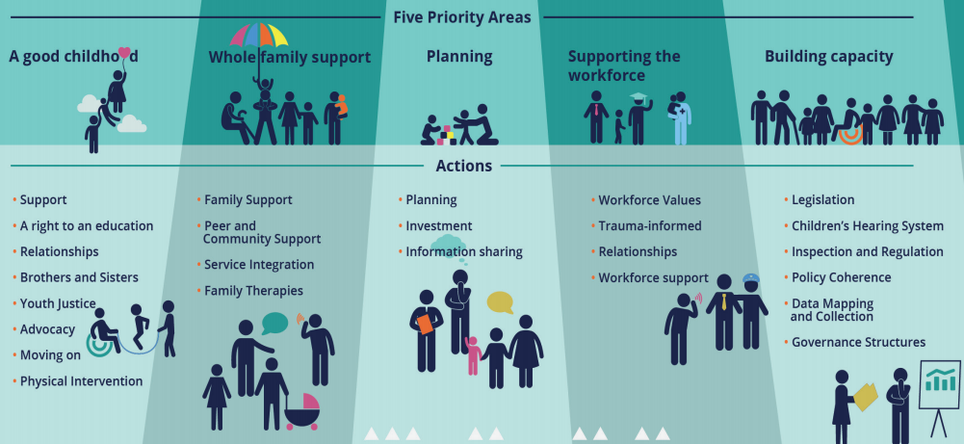
The Plan 21-24
Core Principles
POVERTY
Children’s rights
Listening
Focus on what matters to children and families
Language
Notes:
The Promise itself has five Foundations which encompasses 84 Promises or commitments made to Care Experienced children and Young People. These commitments have been made by all Scottish Political Parties in their Manifesto’s. Something that had never happened before.
Education and our work fits mostly into the ‘Scaffolding’ Foundation. We have to always remember that Education is part of the Scaffolding of Care.
The priorities cover all children’s services however the sections outlined in red have particular relevance for us.
Describe in more detail (as per your local authority action plan)
In the Plan - Principles and Priorities have been identified. The principles recognise the impact of Poverty, the importance of using non-stigmatising language, the fact that we need to listen to CYP and their families and uphold their rights. We need to focus on these things - in other words designing services and supports that meets the needs of families rather than asking families to use services and supports that don’t work for them.

Slide 20
How does the Language
around care
need to change?
Does it matter?
Notes:
Let’s take a closer look at just one of the core principles of The Promise. How does our language around care need to change? These young people from Inverclyde tell us what language they don’t like and what they would prefer.

Slide 21

Language Matters
3 min
52 sec
Film created by Inverclyde Council
If viewing this as a pdf please click this link to access the film: https://youtu.be/7vrJ1CxBlLY
Notes:
Play the film (3 min 52 sec)

Slide 22
Language
It isn’t neutral
It can help or harm
It can engender respect or stigma
Does language matter to you?
Notes:
Some of the language we’ve heard in the film is so ingrained in how we talk and write about care experienced children and young people that it’ll take time to change however we now need to start to realise the ambition of being LOVED SAFE and RESPECTED.
We need to remember that Language isn’t neutral, it can help or harm, and it can engender respect or stigma. So does language matter to you?

Slide 23
All children’s services are part of the SCAFFOLDING of care – what does this mean for us?
We should be a good parent to the children we have responsibility for. This should influence the way we act, speak and behave.
The bedrock of how we care must be consistent, loving relationships to support children to develop trusting relationships. This principle must be part of our everyday practice.
We must be trained and supported to attune to children’s physical and emotional states. This practice of ‘tuning in’ to how children are feeling, enables a process of co-regulation and stability where children can learn to manage stress and anxiety.
For more detail see The Promise and Keep the Promise - Education
Notes:
We don’t have time to go through The Promise in any sort of detail so let’s look at just a few key messages from it. How might these statements translate into our practice in our setting and also as individuals?
Read the statements.
You can contextualise this slide to your setting - For example describe how these statements relate to and link into all the professional learning undertaken collectively by your setting and as part of personal CLPL. For example PL around inclusion, relational approaches, attachment, trauma informed practice and nurture.
For more detail see keepthepromise-education.pdf

Slide 24
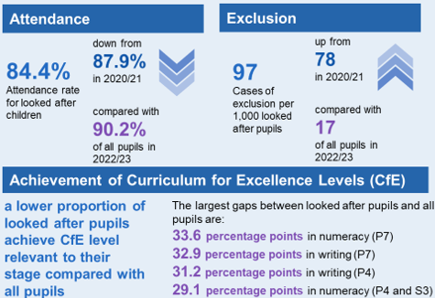
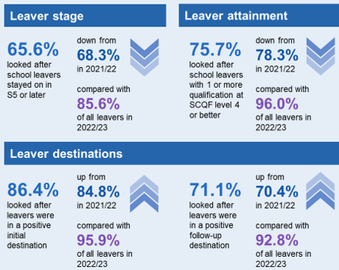
Educational outcomes for care-experienced young people
There are still large gaps in outcomes for care experienced pupils compared with all pupils.
Education Outcomes for Looked After Children 2022/23
*Of looked after children aged 5 to 15 years old, 92.7% had a valid Scottish Candidate Number. Without this a child or young person cannot be matched to their attainment or post-school destination data!!
Notes:
Ultimately we want the scaffolding we provide to have an impact on Educational Outcomes for our care experienced children and young people. What do they currently look like? This slide gives us the current picture.
DESCRIBE some of the stats that are more relevant to your setting.
However we have to remember this is a snap shot in time of educational outcomes and isn’t predictive.
Care experienced children and young people can, and sometimes do as well as their peers if they receive the right support, at the right time, from the right people.
However for many they still encounter barriers accessing and engaging in education that are likely to affect their long term educational outcomes.

Slide 25
The Promise and the right to an education
“In order to ensure that care experienced children are fully included and supported, schools in Scotland must have a clear understanding of the rights of children and how to uphold them. All children, whatever their educational setting, must learn about their rights in a developmentally appropriate way.”
The Promise, p71
Notes:
Read the slide
However, this isn’t just about children and young people knowing about their rights. It’s also about how we realise their rights.
The complexity of the life of a child or young person moving through the care system can make it much more challenging for us to ensure their rights are realised.
For example accessing full time curriculum education may be more challenging for a young person whose learning is repeatedly interrupted because they miss a lot of schooling or even have multiple school changes because they move from being ‘looked after at home’, to living with a relative, to a foster placement, to a residential house in a short period of time. This isn’t that uncommon.

Slide 26
Where do we start?
…be ambitious for care experienced children and ensure they have all they need to thrive, recognising that they may experience difficulties associated with their life story
AND
… ensure that pupils and parents understand ‘care experience’ as part of their communities and as another type of family. Teachers and school staff must be supported to be aware of the issues facing care experienced pupils so they can best engage and encourage
The Promise, p73
Notes:
Read the slide
Expand on what this might look light in your setting.

Slide 27
Collaboration and integration of services
“Improving the educational attainment of care experienced people should not be the sole responsibility of school staff, but Scotland must support the broader workforce and carers to value and engage with the educational progress of the children in their care.”
The Promise, p71
Notes:
Read the slide
We can’t support care experienced children and young people well if we only focus on what happens in education. We have to also consider how we can support, and work with, families and the wider services to improve outcomes for children and young people.

Slide 28


Reflection & Collaboration Time
What do I do as a Good Parent to
Keep The Promise?
(Possible Jamboard Activity)
Notes:
Adapt depending on delivery e.g. face to face , jamboard, menti for online etc.

Slide 29
Next steps for our setting?
So what?
Notes:
Option to delete or you may have additional actions that you want to take forward. Use this slide to outline actions.

Slide 30
Further reading and resources
REPORTS:
Care Review Reports – Independent Care Review
Five Foundations infographics – Independent Care Review
Composite stories – Independent Care Review
Keep the Promise - Education
FILMS:
I Lac nothing film https://www.youtube.com/watch?v=XPA5ftecQJQ
Reforming Scotland’s Care System with Love film https://www.youtube.com/watch?v=P2H0GzxmLK8
The power of ONE caring adult https://www.youtube.com/watch?v=u_Oapo1Q7_w
RESOURCES:
Education Scotland: Summary information relating to Corporate Parenting
Glasgow City Council’s Definitions Document
Each and Every Child Tookit: Creating a new and compelling narrative around care
Support from Corporate Parents (WhoCares?Scotland)
CELCIS Knowledge Bank
Language Leaders - Children’s Hearings Improvement Partnership
Notes:
Refer to resources available. This is not an exhaustive list but may be a starting place for any further reading or professional learning.

