Slide 1


Keeping the Promise Award
Notes:
Welcome everyone. I’d like to start by telling you a little bit about the Keeping the Promise Award. It was originally created in North Lanarkshire Council by a broad range of staff to support children and young people, who are care experienced on their journey through early years, school and beyond. Everyone involved in creating the original Award and this refreshed Award wanted to create a vehicle to raise awareness of care experienced children and young people and some of the challenges they face. It was designed to develop our understanding around the national commitment made by the Scottish Government and supported by (Insert Local Authority name) to improve the learning experience and educational outcomes of our care experienced young people. The professional learning in the Award helps us identify our responsibilities to these learners. The Award itself is a way to recognise settings who are striving to understand and meet the needs of these learners and in their delivery of support to them. The Award is simple and straightforward. It consists of two short training sessions delivered in conjunction with an e-learning course. When completed by a threshold of staff in the setting will receive accreditation for The Keeping the Promise Award. This first session covers the national context, the terminology around care experience and ‘good’ parenting (referred to as corporate parenting), The Promise and what all this means for our practice. Throughout the session where possible the voice and lived experience of care experienced children and young people has been used. Hopefully this session will demonstrate the positive impact both education itself and ‘we’, practitioners, can have on care experienced children and young people’s lives and learning.
This professional learning has been adapted for CLD – this has meant slight changes to language (for example replacing teacher with practitioner) but the content and messaging remains the same.

Slide 2
Keeping the Promise Award Structure
This professional learning is for ALL staff who have contact with children and young people and there is an expectation that over time ALL staff complete it
The information should or could be part of induction training for new staff and volunteers
The training should be regularly refreshed - at least every three years (to include refreshed materials)
To obtain the Award for a setting 70% of all staff need to have completed the presentations and e-Learning module
Notes:
This professional learning is for ALL staff who have contact with children and young people and there is an expectation that over time ALL staff complete it
The information should or could be part of induction training for new staff
The training should be regularly refreshed - at least every three years (to include refreshed materials)
To obtain the Award for a setting 70% of all staff need to have completed the presentations and e-Learning module

Slide 3
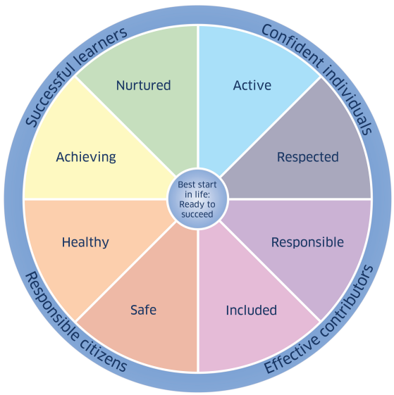
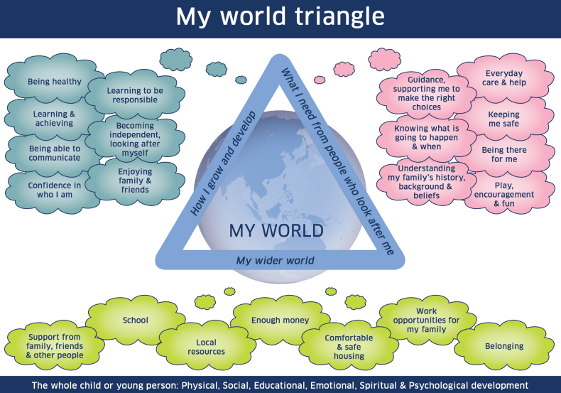
GIRFEC
GIRFEC provides Scotland with a consistent framework and shared language for promoting, supporting, and safeguarding the wellbeing of ALL children and young people.
GIRFEC promotes a common understanding of wellbeing recognising that children and young people need to grow up safe, healthy, achieving, nurtured, active, respected, responsible and included, so that they can become confident individuals, effective contributors, successful learners and responsible citizens.
GIRFEC contributes to work on family support and delivering The Promise made to all of Scotland’s children, young people and their families - a shared commitment to reorganise how we think, plan and prioritise for children, young people and their families.
Notes:
GIRFEC underpins how we work with children and young people across all services in Scotland. It provides us with a consistent framework and shared language for promoting, supporting, and safeguarding the wellbeing of ALL children and young people including those who are care experienced.
GIRFEC promotes a common understanding of wellbeing recognising that children and young people need to grow up safe, healthy, achieving, nurtured, active, respected, responsible and included, so that they can become confident individuals, effective contributors, successful learners and responsible citizens.
GIRFEC contributes to work on family support and delivering The Promise made to all of Scotland’s children, young people and their families - a shared commitment to reorganise how we think, plan and prioritise for children, young people and their families.
GIRFEC is a strengths-based approach which seeks to realise children’s rights on a day-to-day basis. GIRFEC places the child or young person and their family at the heart of everything we do. GIRFEC is about enhancing the wellbeing of all children and young people as well as building a flexible scaffold of support: where it is needed, for as long as it is needed.

Slide 4

Terminology: Looked After and Care Experienced
Care Experienced
Looked After At Home
Looked After Away from Home
Previously Looked After
Notes:
We should start by making sure we all share an understanding of who we are talking about – our care experienced children and young people. Some children and young people need to be looked after by their local authority when they don’t receive adequate care from their parents or there are other concerns about their wellbeing. You’ll be familiar with ‘looked after’, LAC, terminology and expressions such as children who are ‘in care’, children who are accommodated and more recently children with care experience or who are experiencing care. What’s the difference between these terms and does it matter?
YES it matters. It matters both legally and in terms of how we reduce the stigma around care.
‘Looked after’ is the legal term used by Scottish Government and refers to a child or young person whose care is supervised formally, on a compulsory order, by the local authority through social work services. They can be ‘looked after’ at home or away from their parental home in a range of settings or arrangements. We’ll go into the different types of care in more detail later. If a child or young person no longer needs to be formally ‘looked after’, this will be decided at a Children’s Hearing, then they become ‘Previously Looked After’. These are the codes that are used in our SEEMIS recording systems.
Children and young people however find the expression ‘looked after’ stigmatizing and ‘uncaring’! They prefer the expression ‘care experienced’. We therefore use care experience as an umbrella term for all of the types of care highlighted above.
Let’s now look into what it’s like for a young person experiencing care, some of the challenges they may face, and why the system supporting these young people needs to change.

Slide 5

Reforming Scotland’s care system with love – Jamie Dalgoutte
6 min
13 sec
Film created by Glasgow University
If viewing this as a pdf please click this link to access the film: https://youtu.be/P2H0GzxmLK8
Notes:
Play the film (6 min 13 sec)

Slide 6
Reforming Scotland’s care system with love
Notes:
That powerful film of just one young man’s life experiences and his care and educational journey gives us a flavour of the challenges faced by care experienced children and young people. His story has ended with him accessing Higher Education but this often isn’t the case for many other children and young people who experience care. For many their journey through education and the care system isn’t always as positive.
So who are our care experienced children and young people and how are they cared for?

Slide 7
National Care Population
The 2024-2025 Social Work Statistics recorded 11824 children looked after in Scotland
These children live in many different types of care:
kinship care (with friends or relatives) 35%
foster care (living with another family) 28%
looked after at home (living with parents but under the supervision of social work) 20%
residential care (living in a children’s house) 12%
with prospective adopters 1%
in other community setting 3%
(Children’s Social Work Statistics, Scottish Government, published April 2026)
Notes:
Describe in your own words the statistics on the slide.
This picture however is constantly changing as more children come into the care system and others come off a supervision order or are adopted.
To add to the complexity of the situation – these figures only represent the group of children who are officially and legally ‘looked after’. The ones we officially record on SEEMIS. However we know that there is a much larger group of children who are informally cared for by grannies and granda’s, aunties and uncles, brothers or sisters, or family friends who are not formally recorded. These are often referred to as informal kinship arrangements. These children may also face challenges similar to those who are legally looked after and are likely to also need our consideration and care. These children are often recognised in our recording systems as those who require additional support socially and emotionally and with their behaviour.
The expression ‘care experienced’ does not include children who are temporarily staying with relatives on a babysitting arrangement.

Slide 8
Unaccompanied Asylum Seeking Children
Children under the age of 18 who arrive in Scotland without parents are defined as unaccompanied asylum-seeking children (UASC)
They are the responsibility of the local authority and are entitled to the full range of supports made available to children under section 25 of the Children (Scotland) Act 1995 and associated legislation
UASC are considered ‘looked after’ children
UASC in the community 78%
- with friends/family (kinship arrangement) 2%
- with foster carers 10%
- other community setting 67%
UASC in residential accommodation 22%
(Children’s Social Work Statistics, Scottish Government, published April 2026)
Notes:
A small part of the care experienced cohort for each local authority are unaccompanied asylum-seeking children. These are children under the age of 18 who have arrived in Scotland without parents or guardians. They too are the responsibility of the local authority. Legally they are considered ‘looked after’ children and have the entitlement to all the same supports as any looked after child.

Slide 9
Local Care Experienced (Looked After) Data
 | ELC | Primary | Secondary | Total
Looked After at Home
Looked After Away from Home
Previously Looked After
TOTAL NUMBER OF CARE EXPERIENCED
Notes:
OPTIONAL Local authority data discussion
Insert your own local authority data and describe the cohort.
It may also be good to discuss the implications of the data.

Slide 10
Why do this Award?
What can children’s services, ‘us’ (practitioners),
mean for, and to, someone
who has experienced care?
Notes:
As a pause from the numbers it’s always good to reflect on the fact that each number is a child or young person in our care. How do we influence their lives? And what can education mean to them? Let’s hear from a care experienced person who now works herself as a Promise Lead Officer in the Public Protection Team in NHS Lanarkshire.

Slide 11
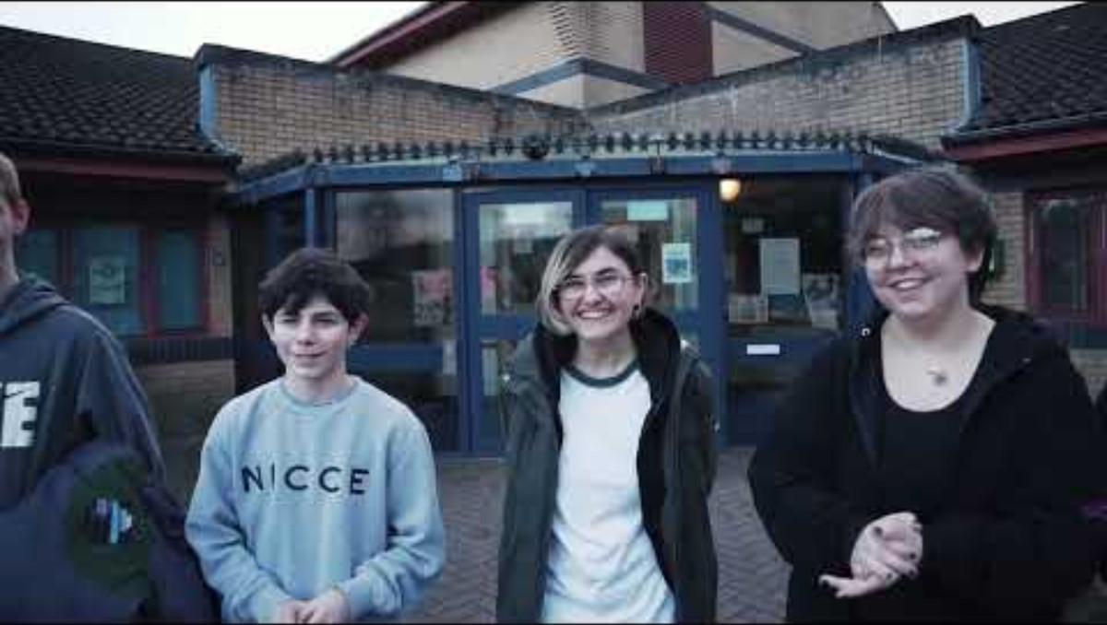
Why do this Award? What do we need to change?
7 min
57 sec
Film created by Falkirk Champions
If viewing this as a pdf please click this link to access the film: https://www.youtube.com/watch?v=31ppclsgSXQ
Notes:
Play Film

Slide 12
Corporate Parenting
What do the terms 'Parent' and 'Corporate' mean?
Notes:
So let’s move on to our legal duties towards children and young people who are care experienced. Let’s start from our current understanding of this expression ‘Corporate Parent’.
OPTIONAL ACTIVITY: This could be carried out as a discussion, or you could create a Menti, Jamboard or similar to capture responses – word clouds are also great for this.

Slide 13
Corporate Parent defined
Officially: Corporate parents are "the formal and local partnerships between all services responsible for working together to meet the needs of looked after children, young people and care leavers”
AND “they have statutory duties to collaborate with each other in upholding the rights and securing the wellbeing of looked after children.”
Children and Young People (Scotland) Act 2014
Unofficially: ‘A corporate parent is intended to carry out many of the roles a loving parent should’
Notes:
Read slide
Officially: Corporate parents are "the formal and local partnerships between all services responsible for working together to meet the needs of looked after children, young people and care leavers”
AND “they have statutory duties to collaborate with each other in upholding the rights and securing the wellbeing of looked after children.”
Children and Young People (Scotland) Act 2014
Unofficially: ‘A corporate parent is intended to carry out many of the roles a loving parent should’

Slide 14
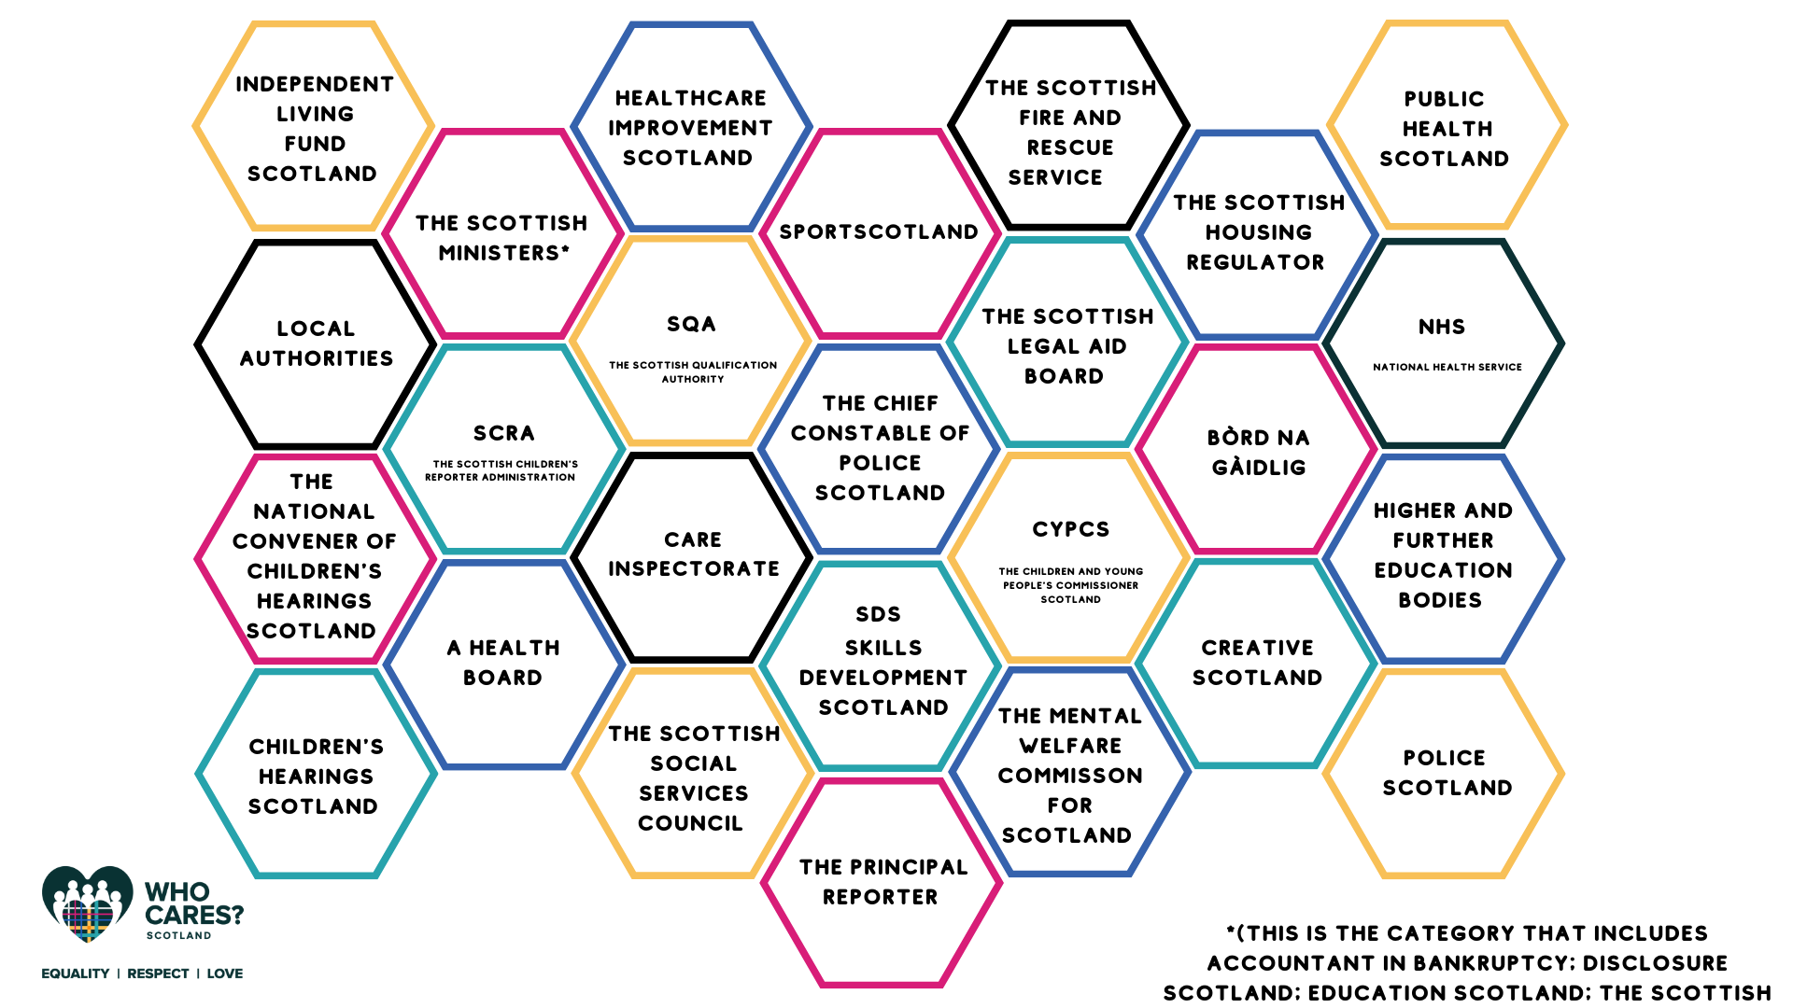
Corporate Parents in Scotland
Notes:
In the 2014 Children and Young People’s Act there are 26 Corporate Parent public bodies listed. These Corporate Parents have legal duties under the Act. Many of these Corporate Parents are large umbrella entities such as local authorities. This means, however, that every single employee within each of the 32 local authorities is a corporate parent, and as such has legal duties towards care experienced people. Another example is Education Scotland As an Executive Agency of the government acts on the instruction of Scottish Ministers and is also a corporate parent. All these corporate parents collectively have a legal duty to coordinate their efforts to support care experienced people.

Slide 15
Corporate Parent Quote
The Care Review has avoided using this term (Corporate Parent). Nevertheless Scotland must live up to its responsibilities in relation to the children it has (and has had) responsibility for and be a ‘good parent’. It is tempting to define what a ‘good parent’ is. However, like love, to do so would only apply an institutional version of parenting and create the danger of further systemisation of care.
The Promise 2020
Notes:
This is a quote from The Promise Report, 2020, in they say that they have deliberately avoided using the term corporate parent.
Read the quote from Nevertheless…..
Care experienced children and young people, through the Review, also told us that they found the care system ‘cold, overly professionalised and uncaring’.

Slide 16

What kind of Corporate Parent are you?
4 min
21
Sec
Thanks go to Edinburgh Champs
and Edinburgh City Council for this Film
If viewing this as a pdf please click this link to access the film: https://www.youtube.com/watch?v=G3BWDSyBQgg
Notes:
Play the film (4 min 21 sec)
https://www.youtube.com/watch?v=G3BWDSyBQgg

Slide 17

The ambition for Scotland’s children…
Notes:
It almost seems too simple but what Chloe has said is completely in line with ‘The ambition for Scotland’s Children’. ->That children grow up loved, safe, and respected so that they can realise their full potential.
However we know it takes a village to raise a child. Schools and educational settings in all their forms can have a massive impact on children, their lived experience, and their outcomes. They can ‘be’ the constant in a child’s life even if everything else around them is changing. So this slide reminds us that we have a duty to ensure care experienced children and young people grow up LOVED, SAFE and RESPECTED.
So how do we know what needs to change to make things better for care experienced children and young people?

Slide 18
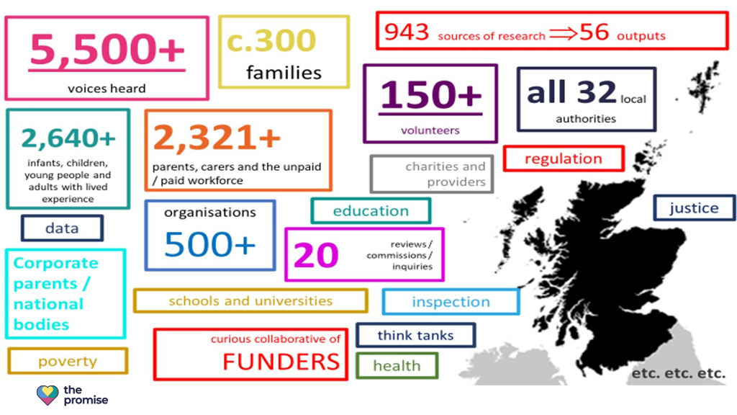

Independent Care Review
Notes:
The Independent Care Review started in 2016. It was a root and branch review as it was nationally recognised that the current care system wasn’t fit for purpose. The review was overseen by Fiona Duncan. It was extensive and included testimonials from people with lived experiences, families, carers, practitioners, corporate parents, and many other organisations and stakeholders. Over half of the voices noted in The Promise Report following on from the review were from people with lived experience.
The review took place over a 4 year period up to 2020. It exposed the fact that the care system is hugely complex, confusing and difficult to navigate. For example, there are 44 pieces of legislation, 23 pieces of secondary legislation and 3 International Conventions that govern this thing we call the ‘care system’.
To get it right for care experienced people we know we need to have a more coordinated and systematic approach. This is where everyone and more specifically Corporate Parents must work together and see a young person with care experience – holistically, in the context of their family and their community, and not just in the context of their learning or another individual aspect of their life – for example their mental health. The Promise was written to try to join up the supports and services around the lives of care experienced people and highlight how care experienced people think things need to change for the care system to be better.

Slide 19


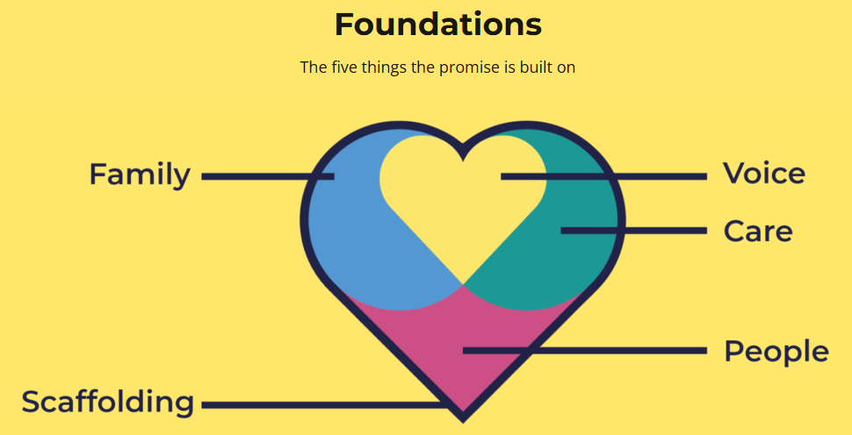
The Promise
Priority Areas:
A Good Childhood
Whole Family Support
Planning
Supporting the Workforce
Building Capacity
Principles:
Poverty
Children’s rights
Listening
Focussing on what matters
Language
March 2020 Reports
About the Foundations of the Promise
Plan 21-24
Evaluation report
Notes:
The Promise published in 2020 isn’t one document it is actually 7 different reports including The Promise, The Pinky Promise – an easy read version of The Promise, The Rules, The Money, Follow the Money, The Plan 21-24, and a Thank you.
The Promise has five Foundations which encompasses 84 Promises or commitments made to Care Experienced children and Young People. These commitments have been made by all Scottish Political Parties in their Manifesto’s.
Education and our work fits mostly into the ‘Scaffolding’ Foundation. We have to always remember that Education is part of the Scaffolding of Care.
When the Plan 21-24 was developed it was based around 5 priority areas and 5 core principles. The principles recognise the impact of Poverty, the importance of using non-stigmatising language, the fact that we need to listen to CYP and their families and uphold their rights. We need to focus on these things - in other words designing services and supports that meets the needs of families rather than asking families to use services and supports that don’t work for them.
In 2024 the progress that Scotland has made toward Keeping the Promise was independently evaluated and they concluded that while there has been progress in some areas, significant challenges remain in fully embedding the five fundamentals across all organisations and practices.

Slide 20

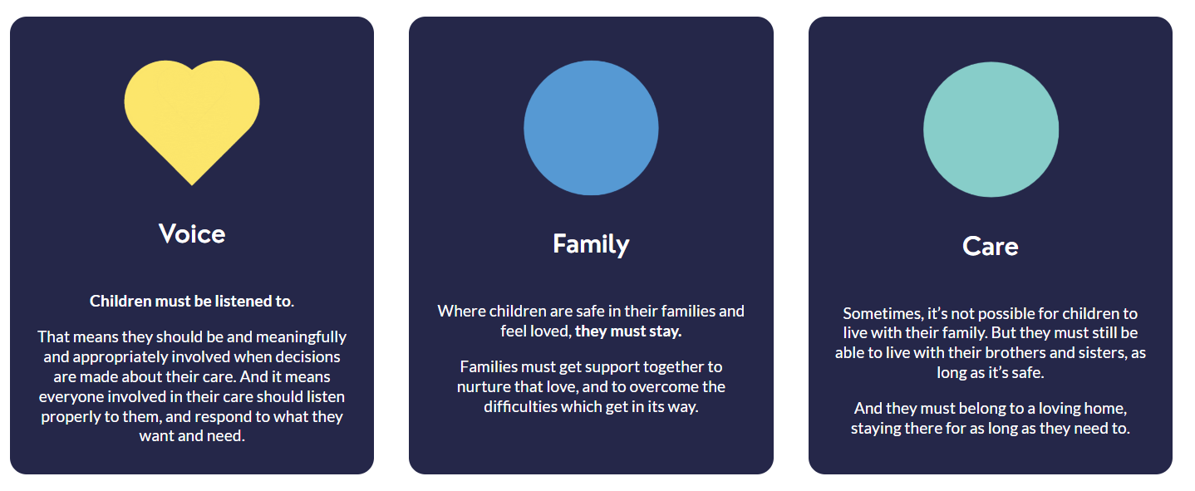
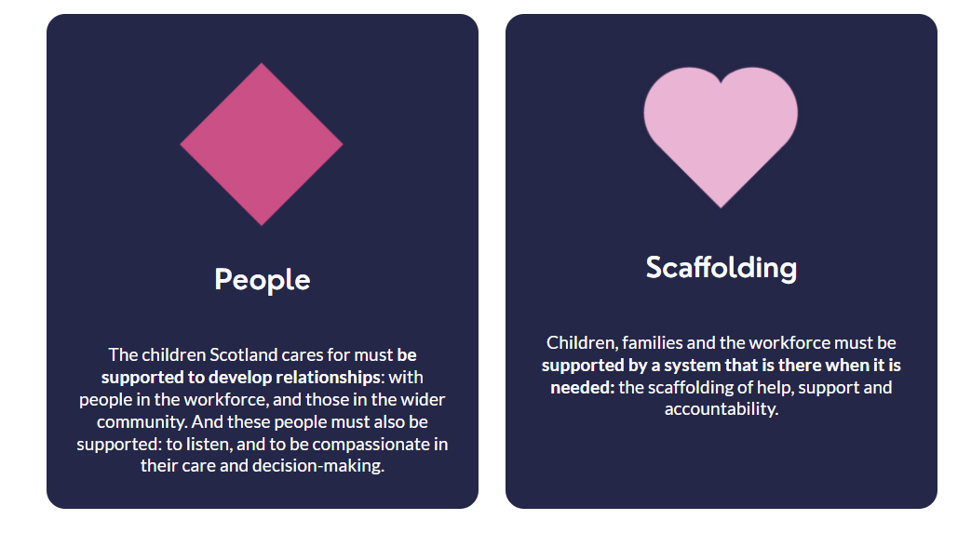
Foundations of The Promise
Notes:
What are The Promise foundations, and what do they mean? Although written in the language of care we have to always remember that Education is an important part of the scaffolding of care. These three foundations are the principal areas that education can contribute to Keeping the Promise.
Voice - Children must be listened to.
That means they should be meaningfully and appropriately involved when decisions are made about their education. It means everyone involved in their education should listen properly to them and respond to what they want and need. Cultural change may be needed to involve children more fully in decision-making. Decision making should be compassionate and caring and focused on children, their families, and those they trust.
People - The children must be supported to develop relationships: with adults who support and work with them, and those in the wider community. Adults must also be supported: to listen, and to be compassionate in their care and decision-making.
Scaffolding - Children, families and the workforce must be supported by a system that is there when it is needed: the scaffolding of help, support and accountability.
Expand on what this might look light in your setting.

Slide 21
Foundations of The Promise
Notes:
The following two foundations are also relevant in education as parents and carers are our principal partners in supporting every child’s education
Family - Families must get the support they need and to overcome any difficulties or barriers they may face.
Care – Children who don’t live with their families, as long as it's safe, should be supported to stay in touch with them including their brothers and sisters.
Expand on what this might look light in your setting.

Slide 22
What about the priorities and principles?
Such as:
Children’s rights – Right to a Good Childhood and Education
Listening
Language
Notes:
Read the slide

Slide 23
Rights of children
“In order to ensure that care experienced children are fully included and supported, schools in Scotland must have a clear understanding of the rights of children and how to uphold them. All children, whatever their educational setting, must learn about their rights in a developmentally appropriate way.”
The Promise, p71
Notes:
Read the quote
However, this isn’t just about children and young people knowing about their rights. It’s also about how we realise their rights.
The complexity of the life of a child or young person moving through the care system can make it much more challenging for us to ensure their rights are realised.
For example accessing full time curriculum education may be more challenging for a young person whose learning is repeatedly interrupted because they miss a lot of schooling or even have multiple school changes because they move from being ‘looked after at home’, to living with a relative, to a foster placement, to a residential house in a short period of time. This isn’t that uncommon.

Slide 24
How does the Language
around care
need to change?
Does it matter?
Notes:
Let's consider one of its key priorities - the importance of using non-stigmatising language. How does our language around care need to change? Children and young people from Our Hearing Our Voice give us some insight into the language of care and how it makes them feel. Watch the next animation and consider the impact of the language we all use in our professional practice

Slide 25

Our language: is it caring or is it stigmatising?
3 mins 15 sec
Film commissioned by
Our Hearings, Our Voice
and created by Braw Talent
If viewing this as a pdf please click this link to access the film: https://vimeo.com/929867493?share=copy
Notes:
The animation helps us consider the impact of the language we all use in our professional practice.
Play the ‘Articulate Animation’ (3 mins 15 secs) https://vimeo.com/929867493?share=copy
There is potential for some discussion in groups here.
If you have a ‘Language’ film created by children and young people please feel free to replace this film with your own.

Slide 26
Have we unconsciously normalised the language of care?
Care experienced children can tell us the words they want us to change
Notes:
Have we unconsciously normalised the language of care?
Some of the language we’ve heard in the film is so ingrained in how we talk and write about care experienced children and young people that it’ll take time to change however we now need to start to realise the ambition of being LOVED SAFE and RESPECTED.
Care experienced children can tell us the words they want us to change and in the next film these young people from Inverclyde tell us what language they don’t like and what they would prefer.

Slide 27

Language Matters
3 min
52 sec
Film created by Inverclyde Council
If viewing this as a pdf please click this link to access the film: https://youtu.be/7vrJ1CxBlLY
Notes:
Play the film (3 min 52 sec)

Slide 28
Language
It isn’t neutral
It can help or harm
It can engender respect or stigma
Does language matter to you?
Notes:
Some of the language we’ve heard in the film is so ingrained in how we talk and write about care experienced children and young people that it’ll take time to change however we now need to start to realise the ambition of being LOVED SAFE and RESPECTED.
We need to remember that Language isn’t neutral, it can help or harm, and it can engender respect or stigma. So does language matter to you?

Slide 29
All children’s services are part of the SCAFFOLDING of care – what does this mean for us?
We should be a good parent to the children we have responsibility for. This should influence the way we act, speak and behave.
The bedrock of how we care must be consistent, loving relationships to support children to develop trusting relationships. This principle must be part of our everyday practice.
We must be trained and supported to attune to children’s physical and emotional states. This practice of ‘tuning in’ to how children are feeling, enables a process of co-regulation and stability where children can learn to manage stress and anxiety.
For more detail see The Promise and Keep the Promise - Education
Notes:
We don’t have time to go through The Promise in any sort of detail so let’s look at just a few key messages from it. How might these statements translate into our practice in our setting and also as individuals?
Read the statements.
You can contextualise this slide to your setting - For example describe how these statements relate to and link into all the professional learning undertaken collectively by your setting and as part of personal CLPL. For example PL around inclusion, relational approaches, attachment, trauma informed practice and nurture.
For more detail see keepthepromise-education.pdf

Slide 30
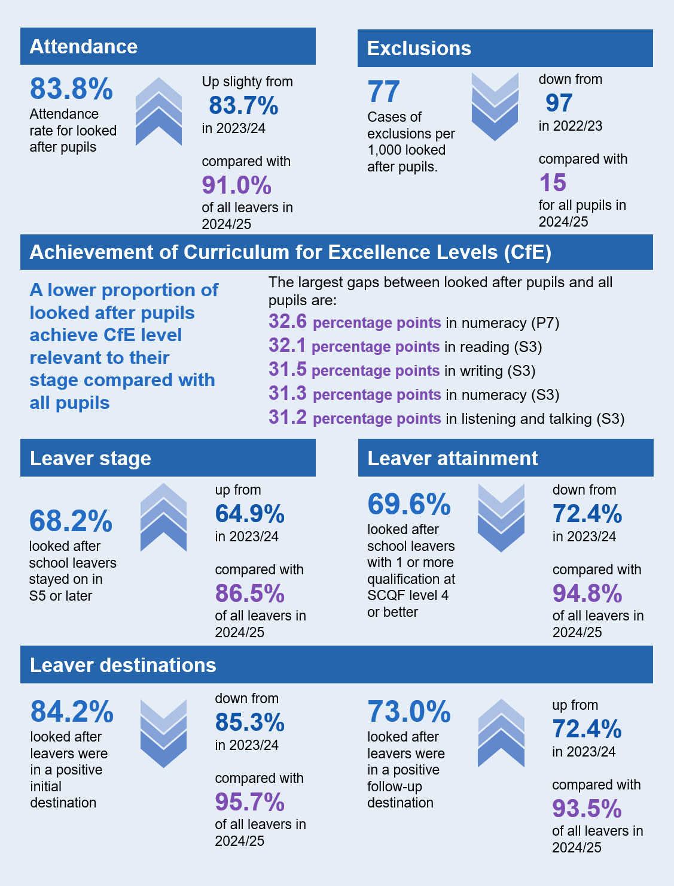
Educational outcomes for care-experienced young people
There are still large gaps in outcomes for care experienced pupils compared with all pupils.
Education Outcomes for Looked After Children 2024/25
*Of looked after children aged 5 to 15 years old, 91.4% had a valid Scottish Candidate Number.
Without this a child or young person cannot be matched to their attainment or post-school destination data!!
Notes:
Ultimately we want the scaffolding we provide to have an impact on Educational Outcomes for our care experienced children and young people. What do they currently look like? This slide gives us the current picture.
DESCRIBE some of the stats that are more relevant to your setting.
However we have to remember this is a snap shot in time of educational outcomes and isn’t predictive.
Care experienced children and young people can, and sometimes do as well as their peers if they receive the right support, at the right time, from the right people.
However for many they still encounter barriers accessing and engaging in education that are likely to affect their long term educational outcomes.

Slide 31
Plan 21-24 and the progress we’ve made
Notes:
Optional slide:
For your local authority you may wish to add in a slide with your 21-24 implementation plan and an update on your progress so far

Slide 32
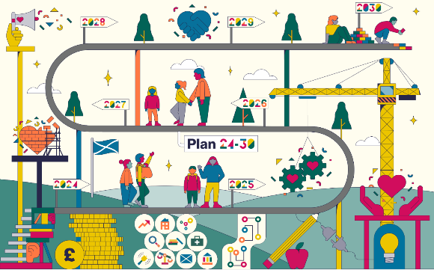
The Promise – Plan 24-30
Builds on what has come before
Evolving from Plan 21-24 and detailing who needs to do what, by when
Is devised together
Stakeholders feedback/input will shape the Plan
Keeps everyone on track
Mapped to key policy areas such as UNCRC and GIRFEC
Belongs to everyone involved
Developed in an open and collaborative way and will reflect everyone’s work
Is live and constantly updated
Updated regularly to track progress and map out what still needs to happen next
By January 2025 EDUCATION will have a Route Map to follow.
For more information about how Plan 24-30 will work see the following film:
https://youtu.be/lAdM1EunFDk
Notes:
The Promise Plan 2024-30 will take a different approach to planning and implementation. Based on these principles it will continue to evolve right through to 2030. It continues to be based on the 5 foundations however it recognises that the work programmes of many sectors and organisations will fit into more than one of the foundations.

Slide 33
Where do we start?
…be ambitious for care experienced children and ensure they have all they need to thrive, recognising that they may experience difficulties associated with their life story
AND
… ensure that pupils and parents understand ‘care experience’ as part of their communities and as another type of family. Teachers and school staff must be supported to be aware of the issues facing care experienced pupils so they can best engage and encourage
The Promise, p73
Notes:
Read the slide
Expand on what this might look light in your setting.

Slide 34
Collaboration and integration of services
“Improving the educational attainment of care experienced people should not be the sole responsibility of school staff, but Scotland must support the broader workforce and carers to value and engage with the educational progress of the children in their care.”
The Promise, p71
Notes:
Read the slide
We can’t support care experienced children and young people well if we only focus on what happens in education. We have to also consider how we can support, and work with, families and the wider services to improve outcomes for children and young people.

Slide 35


Reflection & Collaboration Time
What do I do as a Good Parent to
Keep The Promise?
(Possible Jamboard Activity)
Notes:
Adapt depending on delivery e.g. face to face , jamboard, menti for online etc.

Slide 36
Next steps for our setting?
So what?
Notes:
Option to delete or you may have additional actions that you want to take forward. Use this slide to outline actions.

Slide 37
Further reading and resources
REPORTS:
Care Review Reports – Independent Care Review
Five Foundations infographics – Independent Care Review
Composite stories – Independent Care Review
Keep the Promise - Education
FILMS:
I Lac nothing film https://www.youtube.com/watch?v=XPA5ftecQJQ
Reforming Scotland’s Care System with Love film https://www.youtube.com/watch?v=P2H0GzxmLK8
The power of ONE caring adult https://www.youtube.com/watch?v=u_Oapo1Q7_w
RESOURCES:
Education Scotland: Summary information relating to Corporate Parenting
Glasgow City Council’s Definitions Document
Each and Every Child Tookit: Creating a new and compelling narrative around care
Support from Corporate Parents (WhoCares?Scotland)
CELCIS Knowledge Bank
Language Leaders - Children’s Hearings Improvement Partnership
Notes:
Refer to resources available. This is not an exhaustive list but may be a starting place for any further reading or professional learning.

