Slide 1
Inclusion Wellbeing & Equalities Professional Learning Framework
Collaborative Working to Support Inclusive Practice
Informed Level
@ESInclusionTeam
For Scotland's learners, with Scotland's educators
Do luchd-ionnsachaidh na h-Alba, le luchd-foghlaim Alba
Notes:
Collaborative Working to Support Inclusive Practice
This professional learning is pitched at an informed level and suitable for anyone working with children and young people in an educational context.

Slide 2
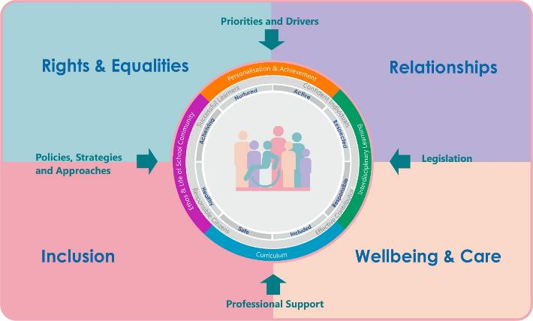
Interconnectivity
Notes:
All of the professional learning in the Framework fits into one of these four themes. The four themes are interconnected and interdependent.​
This activity forms part of the professional learning in the Inclusion theme.

Slide 3
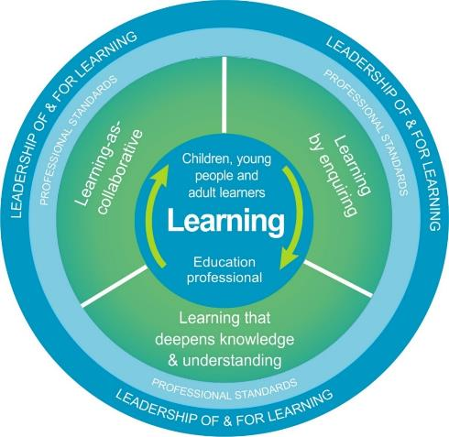
National Model for Professional Learning
This professional learning resource will support you to deepen your knowledge and understanding.
You will have the opportunity to consider how to take this learning forward on your own and with others.
The National Model of Professional Learning (education.gov.scot)
Notes:
This professional learning forms part of the national model for professional learning and is designed to help you gain more knowledge and have a deeper understanding of inclusion, wellbeing and equalities​
On completion of this professional learning, you will be asked to consider what your next steps will be
Take some time to consider the reflection questions

Slide 4
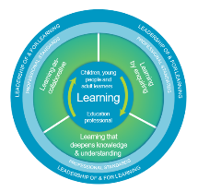
Welcome
Pause for Thought…
This session provides an opportunity to:
Consider what is meant by collaborative working
Think about partnerships with parents, carers and learners
Reflect on the effectiveness of approaches in your own practice and setting

Slide 5
Notes:
Supporting children and young people is a collaborative process that involves effective partnership working. A range of people may be involved over any period of time in working collaboratively to support the needs of the child or young person. The list you see here is not exhaustive. The role and views of the parents, carers, and child or young person are very important. The involvement of professionals will vary depending on the needs of the individual.

Slide 6
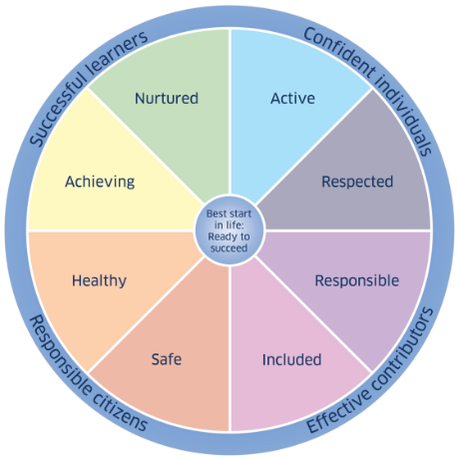
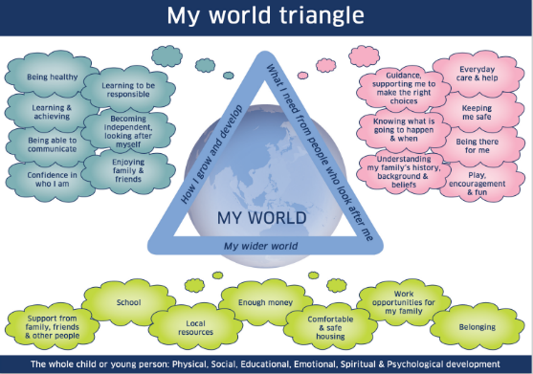
Getting it Right for Every Child:
National Practice Model
Notes:
The Getting it right for every child national practice model provides Scotland with a consistent framework and shared language for promoting, supporting, and safeguarding the wellbeing of all children and young people. Getting it Right for Every Child is evidence-based, is internationally recognised and is an example of a child rights-based approach. It is locally embedded and positively embraced by practitioners across children’s services, changing culture, systems and practice for the benefit of children, young people and their families.

Slide 7
Collaboration with Partner Services and Agencies
Notes:
We will first look at what makes for effective collaboration with partner services and agencies.

Slide 8
Notes:
This might include, but is not limited to: Local Authority supports beyond the education setting, Social Work, Allied Health Professionals and Third Sector organisations.

Slide 9
Notes:
The CIRCLE framework for inclusive practice provides guidance around effective collaborative working. Effective collaboration starts with a clear mutual focus on meeting the needs of individuals, and is supported by clear lines of communication, and an agreement of roles and responsibilities. Together with a culture of respect, which values the perspectives and contributions of everyone in the team. The CIRCLE resources can be accessed via the CIRCLE website.

Slide 10
Points for reflection or discussion
Can you think of a time when working with partner services or agencies went well? Why do you think it worked well and how did your contribution support this?
In your setting, are there any formal processes in place for collaboration with colleagues, or does it happen informally? How could this be improved?
Notes:
You may wish to press pause on this film to consider the following questions, or to discuss with your colleagues if you are watching with a group.

Slide 11
Partnership with Parents/Carers
Notes:
We will now spend some time thinking about partnership with parents and carers

Slide 12
Notes:
Effective engagement with parents/carers can lead to improved outcomes for childrena nd young people both in the education setting and at home. They can provide insight into their child’s feelings about their education experience and their abilities, the things they like and dislike, their interests and hobbies, language and culture, all of which are invaluable when trying to tap into their motivation.

Slide 13
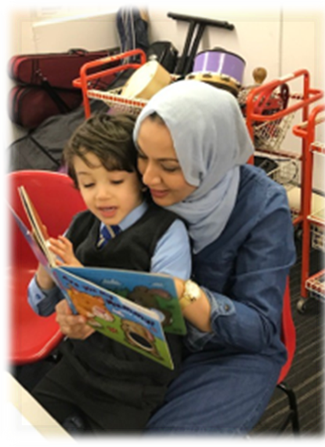
Partnership
Notes:
Regular sharing of information can help support early identification of concerns and early intervention. Working in partnership is especially important when an individual has additional support needs, as parents and carers help practitioners understand how these additional needs might impact on their child in the education setting and at home and the wider implications for the family. Partnership involves listening to, acknowledging and valuing the contributions that parents/carers can make.

Slide 14
Supporting engagement
Welcoming
Affirming
Respecting
Notes:
Not all parents/carers feel comfortable in this partnership role for a variety of reasons. For example:
They may have difficulties literacy; They may have English as an additional language or come from a country that has different educational systems and expectations
They may have had previous negative experiences of engaging with school;
They may have difficulty attending meetings, due to other responsibilities, such as caring.
Regardless of the possible barriers, it is crucial that education staff and schools make every effort to engage parents/carers. An environment and culture which is welcoming, and respectful and affirming of the contributions parents and carers make will help ensure that successful strategies are shared and implemented consistently as school and home, and should improve outcomes.

Slide 15
Communication
Two-way communication system
Point of contact
Understand barriers
Jargon
Differences in perspective
Permission
Notes:
There are steps practitioners can take to address these barriers.
Set up clear and agreed routes for two-way communication. Ask parents/carers how they would prefer to share information, whether face to face, over the phone, email, or a home/school diary for example. Use face to face discussions or phone calls from home in addition to notes for parents/carers that you know struggle with literacy. Ensure that any communication is free of jargon and that any important points are summarised or reiterated.
When required, provide notes translated into the home first language. Ensure that parents/carers who have EAL are aware that the school will provide an interpreter for all meetings and discussions if required. Practitioners should be considerate of social and cultural differences and should provide support so parents/carers can gain an understanding of the local school systems and curriculum.
In all communications, it is important that practitioners remain aware of their own feelings, views and judgements, and that the perspective and expectations of the parent/carer may differ for the views of the practitioner. It is equally important to bear in mind that the home experience of the learner maybe different from that in the education setting.
Parents/carers should be fully involved in all decisions and ensure you have their permissions to share information with partner services and agencies when required
Parents/carers should know who to contact if they need any information clarified.

Slide 16
Meetings
Notes:
Ensure parents/carers are aware that they can bring someone with them to meetings for support. It is helpful to provide an agenda and a list of the names and roles of those who will be attending the meeting in advance. Consider arranging for the parent/carer to be seated in the meeting room first, rather than having them walk into an unfamiliar room of professionals. Provide bilingual interpreters to assist non-English speaking parents/carers at meetings, and ensure written information is translated if required. Where possible, arrange meetings at times of the day or week which accommodate the parents’/carers’ lifestyle. Follow up with a summary, a timeline, who will be responsible for which action

Slide 17
Enquire
Notes:
Enquire is the national source of information and guidance around additional support needs in Scottish education settings which provides information and guidance for parents and carers, professional and young people. Here you can find further information about effective partnership working with families.

Slide 18
Points for reflection or discussion
Is there any evidence in your setting of good partnership working with parents/carers?
How could you encourage and support all parents/carers of children in your setting to become active partners in their child’s education?
Notes:
You may wish to press pause while you consider the following questions.

Slide 19
The Learner’s Views
Notes:
Next we will consider the learner’s views.

Slide 21
‘…in carrying out their duty to provide school education, local authorities and schools must have due regard, so far as is reasonably practicable, to the views (if there is a wish to express them) of the child or young person in decisions that significantly affect them.’
Standards in Scotland’s Schools etc. Act, 2000
‘…local authorities and schools must seek and take account of learners’ views in specific situations. These are when:
Identifying whether a learner has additional support needs
Reviewing what additional support a child or young person needs
Preparing or reviewing a coordinated support plan’
Education (Additional Support for Learning) (Scotland) Act 2004, amended 2009
Notes:
Article 12 of the UNCRC gives children the right to express their views freely in all matters affecting them – including their education. Children’s views should be taken seriously, in line with their age and maturity. Involving the learner in sharing their views about decisions affecting is also enshrined in law.
According to the Scotland’s Schools Act…

Slide 22
Considerations
Formal v. informal
Observation
Developmental relevance
Reflect on barriers
Who is the right person?
Do they know why you’re asking these questions and what you’re going to do with their answers?
Notes:
It is important to reflect on any barriers a child or young person may face to sharing their views. Sitting down formally with a child or young person to ask them what they think might not always be the most suitable approach. A lot too, can be learned from informal observations made by different people in different situations and contexts. Also, are you the right person to ask them these questions or is there another staff member they may feel most comfortable talking to?

Slide 23
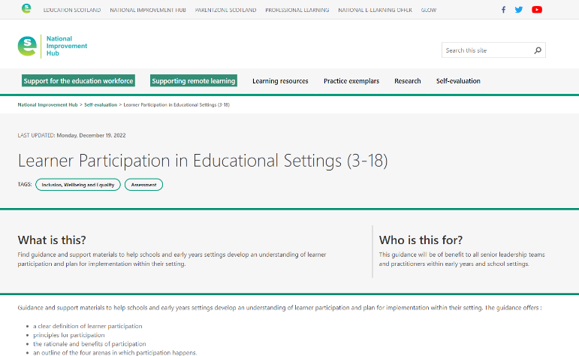
Learner Participation in Educational Settings (3-18)
Notes:
Education Scotland has created guidance and resources to support learner participation across all education settings for learners aged 3-18.

Slide 24
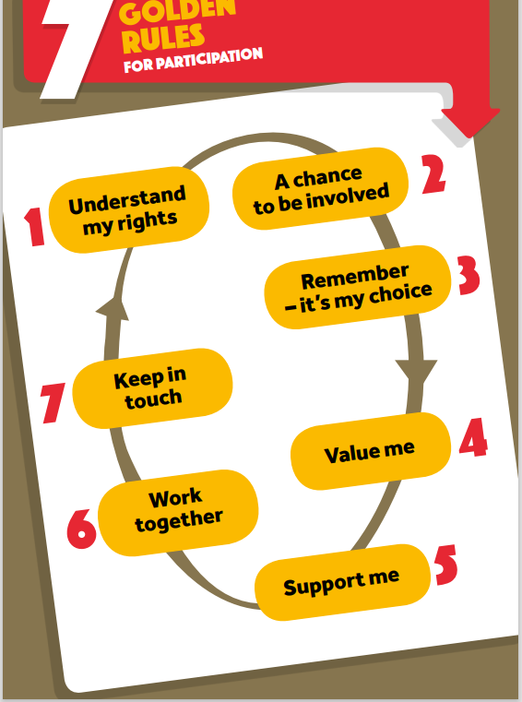
7 Golden Rules for Participation
Notes:
The Children & Young People’s Commissioner for Scotland has created to support children and young people to be meaningfully involved in decisions which affect them. The pack includes downloadable symbol cards which can help children and young people understand their rights and share their views with you.

Slide 25
Notes:
Children with additional support needs aged 12 – 15 have rights to be more involved in the decisions that affect them.
My Rights, My Say supports children aged 12-15 to use these rights. It’s independent, confidential and easy to use, and designed to ensure the voices of children with additional support needs are heard.
The site includes information about Advocacy, Resources and templates, and information and support for practitioners.

Slide 26
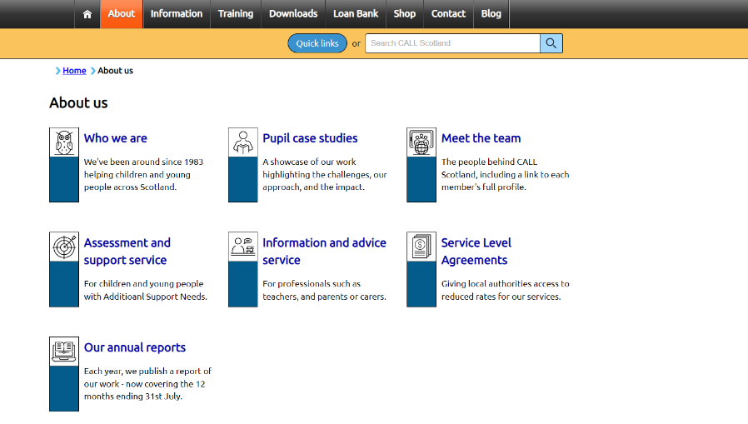
CALL Scotland
Learn about CALL Scotland
Notes:
A small minority of children and young people you come across may well have complex additional support needs, including barriers to communication. Their views must still be sought. If you’re not sure how best to go about this, you can speak to your colleague with lead responsibility for additional support for learning. The Call Scotland website is a reliable source of information and support around supporting learners with communication needs.

Slide 27
Collaboration to support transitions
Notes:
Effective collaboration is particularly important during times of transition. For learners with additional support needs, transition both within and between learning settings requires careful management to ensure that all support information is passed on effectively.

Slide 28
Solving problems
Notes:
Most concerns and disagreements about a child or young person’s additional support for learning can be resolved simply by speaking to the learners, their family and other colleagues as needed. It is important to be proactive and show learners and their families see that you’re taking any concerns seriously.
It’s always best, for everyone involved, to try and address any concerns at the earliest possible stage. Open, honest and early communication often help avoid minor concerns from escalating into disputes or relationship breakdown. Remember, you are part of a team who can work together with children and young people and their families to make sure they get the support they need.
Encouraging parents to get independent advice and support from Enquire and other services can help encourage earlier, more amicable resolutions. Visit the Enquire website for further information and advice.

Slide 29
Points for reflection or discussion
Sometimes differences of opinion occur during collaboration.
In your setting, what processes are in place to manage conflict resolution?
Notes:
You may wish to press pause while you consider this question.

Slide 30
Reflection
From what you have learned so far, think about:
How has this made you feel?
What has this made you think about?
What one action would you like to take forward?
How can you link what you plan to do with others in your setting?
How you will know that this learning has made a difference?
Notes:
Facilitation notes:
You can do this in groups...
Encourage educators to take this forward in an enquiry
Consider impact of the actions / learning

Slide 31
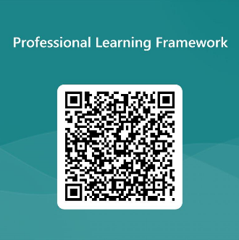
We value your feedback
From now until March 2024 we will be taking feedback on these resources so that we can make changes in advance of a formal launch of the Professional Learning Framework in June 2024
Your feedback could help us improve this resource
Please complete this short form, using the link or QR code, to let us know what you thought of it and any suggestions you have on how it could be improved
LINK: https://forms.office.com/e/b5PCpJJJ3P

Slide 32
For Scotland's learners, with Scotland's educators
Do luchd-ionnsachaidh na h-Alba, le luchd-foghlaim Alba
Education Scotland
Denholm House
Almondvale Business Park
Almondvale Way
Livingston EH54 6GA
T +44 (0)131 244 5000
E enquiries@educationscotland.gsi.gov.uk

