Slide 1
Improving Learning & Teaching through ‘Building Learning Power’
A School Improvement Partnership Approach
Jannette Black HT Hillview Primary School
Brendan Docherty HT St Thomas’ Primary, Neilston

Slide 2
Seminar objectives
This seminar will examine how a group of schools in ERC have collaborated using the School Improvement Partnership model to implement ‘Building Learning Power’
Notes:
Fits very much in with National Improvement Framework, Scottish Attainment Challenge, Pupil Equity Fund, HGIOS4- current areas of focus during inspections- child led learning, children articulating learning effectively and meaningfully.
CFE recommendation - Schools should develop further opportunities for learners to lead their own learning, express their views and follow their interests while capitalising on real-life experiences.

Slide 3
Self Evaluation
National
Pupil Equity Funding
Local Authority
HT Seminar
Professional Enquiry
Cluster and School Level
Engagement of all staff
Target groups of pupils
National Improvement Framework
How Good is our School? 4
School Improvement Partnerships
Impact for pupils – on attainment and achievement
Notes:
PEF
NIF drivers
HGIOS 4 1.3 Leadership of change – professional enquiry
Engagement of staff in research – not just SIPP Practioners or those doing Masters – bring professional enquiry to all teachers
Increase consistency of approaches – across the cluster/ across the school
Children leading learning
Increase in challenge offered to pupils

Slide 4
PEF Funding and NIF Priorities
“We want to continue to improve the professionalism of our teachers and the quality and impact of their professional learning”
“Ensuring the highest professional standards for all teachers in Scotland will help to ensure the highest standards and expectations for all children and young people.”
National Improvement Framework
Notes:
Linked with NIF drivers – looking for school improvement/ for PEF money to be used in a way that we can track through performance data/ opportunities for developing school leadership.
Main focus on Teacher professionalism –

Slide 5
Targeted Groups
Existing Data:
Lowest 20%
SIMD 1-4
Standardised test scores
Gender differences
Notes:
PEF funding
Used existing data to analyse any impact of intervention – PEF funding would be given but we would need to evaluate the impact
Then Barrhead Cluster invited two providers to do introductory presentations.
Looked at trainers –[Commercial programme] and BLP – presentation – opened out to all SLT in ERC
Small authority so sent invitations to all HTs to cascade to staff – mostly SLT

Slide 6
BLP Programme
INSET
Introduction to programme – activity based
Morning – All staff
ONLINE
TLC
Professional Dialogue
Afternoon –Session for SLT
Perseverance/Becoming Unstuck/Introducing Challenge/Dealing with Distractions
Professional Reflection (on previous months action plan)
Creation of Personal Action Plan
Whole School Implementation
Online quiz related to practice and classroom culture
Reading
Suggestions for implementation

Slide 7
Pupils response … so far

Slide 8
Target Groups of Pupils
SIPP
St Thomas’ and Hillview previous SIPP
Uplawmoor, St Thomas’ and Hillview similar groups of pupils
Interventions: Building Learning Power
Short term study of change

Slide 9
School Improvement Partnership Approach
Partnership working
The use of action research and evidence
The creation of leadership opportunities
A commitment to reciprocity
The development of arrangements to support long-term collaboration
Explicit links to strategic improvement planning
Diverse range of partners
Notes:
All guidance referenced throughout was written by East Renfrewshire Psychological Service
SIPP approach is a Solution focussed approach to raising attainment with a focus on innovating to tackle educational inequality
CORE PRINCIPLES ARE:
Partnership working across schools and local authorities with a focus on exploring specific issues relating to educational inequity.
The use of action research and evidence to identify key challenges, experiment with innovative practices and monitor developments.
The creation of leadership opportunities and professional learning of staff at all levels.
A commitment to reciprocity and mutual benefit to all involved.
The development of arrangements to support long-term collaboration and new approaches to capacity building.
Explicit links to strategic improvement planning in schools and local authorities.
The involvement of a diverse range of partners.

Slide 10
School Improvement Partnership Approach
Key features of effective school improvement partnerships:
Targeting achievement
Understanding context
Using evidence
Teachers leading change
Learning from similarity and diversity.
Moving practice and expertise around the partnership.
Building relationships and networks
Notes:
Key features of effective school improvement partnerships
Targeting achievement (attendance, attainment, exclusion/inclusion, engagement, participation) of a small key group of learners.
Understanding the importance of context and local ownership.
Using evidence to inform practice.
Teachers leading change through professional enquiry research.
Learning from similarity and diversity.
Moving practice and expertise around the partnership.
Building relationships and networks across the cluster and authority.

Slide 11
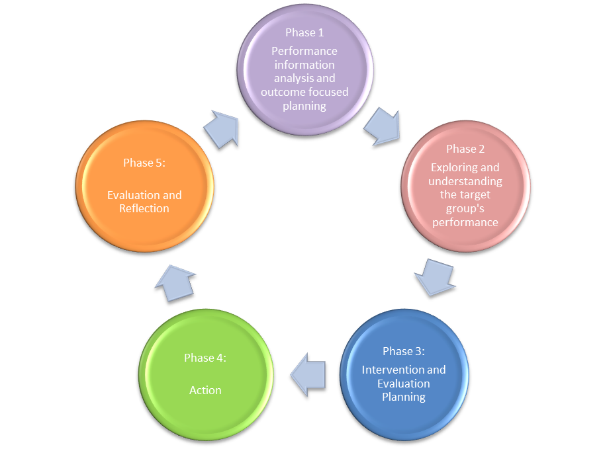
School Improvement Partnership Approach
Notes:
All guidance referenced throughout was written by East Renfrewshire Psychological Service

Slide 12
Phase One: Performance Information Analysis and Outcome Focussed Planning
Step One: Analyse pupil performance information
Target Group: Lowest performing 20% within P7 class Number of Pupils: 4 pupils per school for analysis Detail the rationale for selection Lowest performing 20% SIMD 1-4 ST scores 78-89 for Reading Children who do not identify themselves as ‘readers’ or interested in reading
Notes:
Phase One: Performance Information Analysis and Outcome Focussed Planning
Step One: Analyse pupil performance information
Through analysis of pupil performance information identify a small (no more than 6) group of learners to target in order to improve performance.
Target Group:
Lowest performing 20% working
Number of Pupils:
4 pupils per school for analysis
Detail the rationale for selection (SIMD, gender, LAC, ethnicity, lowest performing 20%):
Lowest performing 20%
SIMD 1-4
ST scores 78-89 for Reading
Children who do not identify themselves as ‘readers’ or interested in reading

Slide 13
Step Two: Identify Research question SMART outcomes for the target group
Main Research Question Can a coherent approach to implementing Building Learning Power improve literacy attainment? Does this programme: a) Develop resilience, resourcefulness, reflectiveness and reciprocity in pupils during literacy lessons? b) Improve Literacy skills in a group of identified children?
Notes:
The project will be guided by specific research questions which will then lead to the development of SMART outcomes. The main and sub research questions are detailed as follows:

Slide 14
Step Two: Identify SMART outcomes for the target group
The children will be able to:
Use [Commercial programme] Language to help them when they are learning
Demonstrate resilience when engaging with a range of texts
Demonstrate resourcefulness in literacy lessons
Demonstrate reflectiveness within literacy lessons
Ability to work independently and with others in a group.
Improve reading comprehension scores
Notes:
Small number of manageable and clearly measurable targets

Slide 15
Phase Two: Exploring and Understanding the Target Group’s Performance
Step One: Explore the strengths of and pressures on your target group
Strengths/positive factors: Very good pupil/ teacher relationships Decoding skills of pupils Small class and extra teacher support throughout the week
Notes:
What are the factors that impact (positive/negative) on this identified group of learners?
You may want to consider the following (please note these are examples and not an exhaustive list).
School learning environment – e.g. expectations of pupils, staff/pupil relationships, peer relations, quality and deployment of teaching and support staff, pedagogy, parental engagement
Parental factors – e.g. engagement with pupils learning, relationships with school staff, value for education, parental educational experiences, parental physical, mental and cognitive health, parenting skills
Pupil factors – e.g. SHANARRI, Aspirations for future, motivation for learning, pupils physical, emotional/mental and cognitive health, pupil involvement in their learning

Slide 16
Phase Two: Exploring and Understanding the Target Group’s Performance
Step One: Explore the strengths of and pressures on your target group
Pressures/negative factors: Lack of confidence in reading Lack of engagement Low levels of resilience Lack independence in terms of selecting strategies Poor comprehension scores
Notes:
What are the factors that impact (positive/negative) on this identified group of learners?
You may want to consider the following (please note these are examples and not an exhaustive list).
School learning environment – e.g. expectations of pupils, staff/pupil relationships, peer relations, quality and deployment of teaching and support staff, pedagogy, parental engagement
Parental factors – e.g. engagement with pupils learning, relationships with school staff, value for education, parental educational experiences, parental physical, mental and cognitive health, parenting skills
Pupil factors – e.g. SHANARRI, Aspirations for future, motivation for learning, pupils physical, emotional/mental and cognitive health, pupil involvement in their learning

Slide 17
Step Two: Evaluating the significance of the factors identified
Confirmed strengths/positive factors: Reading running record Pupil questionnaire on their perceptions of reading and themselves as readers Pre and post reading assessment Parental questionnaire
Notes:
Consider ways in which you can test (confirm/disprove) the significance of the factors outlined (e.g. existing school information, research evidence, assessment, professional enquiry, questionnaires, focus groups).
Confirmed strengths/positive factors:
Reading running record
Pupil questionnaire on their perceptions of reading and themselves as readers
Pre and post reading assessment
Parental questionnaire
Confirmed pressures/negative factors:
Resistance to change
New vocabulary to mindset
New teaching approaches
Assessment data
Helpful Tip
Appendix 1 may be helpful in recording the above information

Slide 18
Step Two: Evaluating the significance of the factors identified
Confirmed pressures/negative factors: Resistance to change New vocabulary to mindset New teaching approaches Assessment data
Notes:
Consider ways in which you can test (confirm/disprove) the significance of the factors outlined (e.g. existing school information, research evidence, assessment, professional enquiry, questionnaires, focus groups).
Confirmed strengths/positive factors:
Reading running record
Pupil questionnaire on their perceptions of reading and themselves as readers
Pre and post reading assessment
Parental questionnaire
Confirmed pressures/negative factors:
Resistance to change
New vocabulary to mindset
New teaching approaches
Assessment data
Helpful Tip
Appendix 1 may be helpful in recording the above information

Slide 19
Lesson Study: Why do it?
To enhance professional knowledge
An emphasis on sharing ideas and knowledge
School as a ‘professional learning community’.
Notes:
Range of improvement methodologies- we selected ‘Lesson Study’
It is a collaborative professional development process which allows for in depth exploration of an individual lesson.
• Teachers learn best from other teachers.
• Teachers have a moral obligation to share their knowledge and expertise.
• Cultivating students’ interest and observing how they learn is the focus of all activity.
Source: Lesson Study, Education Scotland, September 2015
Why do it?
The aim is to enhance professional knowledge, NOT to design a ‘perfect’ lesson. An emphasis on sharing ideas and knowledge encourages professional development and the growth of a school as a ‘professional learning community’. The focus on learning helps teachers to expand their understanding of what learning is and how it works.
What are the six key stages?
1. Setting goals – using a research theme that is relevant to your school and provides a broad and long term objective for the lesson study cycle.
2. Planning the lesson – building on what you already know about the circumstances of your school or class.
3. Teaching and observing – one teacher from the lesson study team teaches the lesson and colleagues observe. The observers focus on student responses and look for evidence of what students think.
4. Debriefing – sharing evidence of student learning.
5. Revising − on the basis of the evidence collected by observers − and re-teaching by a different member of the team to a different group of students.
6. Reflection and sharing – taking active steps to share what has been learned – for example by producing a brief report – and making sure that the knowledge generated is used wherever it can aid learning.

Slide 20
Lesson Study: Key stages
1. Setting goals
2. Planning the lesson (see handout for structure)
3. Teaching and observing
4. Debriefing – sharing evidence of student learning.
5. Revising
6. Reflection and sharing
Notes:
• Teachers learn best from other teachers.
• Teachers have a moral obligation to share their knowledge and expertise.
• Cultivating students’ interest and observing how they learn is the focus of all activity.
Source: Lesson Study, Education Scotland, September 2015
Why do it?
The aim is to enhance professional knowledge, NOT to design a ‘perfect’ lesson. An emphasis on sharing ideas and knowledge encourages professional development and the growth of a school as a ‘professional learning community’. The focus on learning helps teachers to expand their understanding of what learning is and how it works.
What are the six key stages?
1. Setting goals – using a research theme that is relevant to your school and provides a broad and long term objective for the lesson study cycle.
2. Planning the lesson – building on what you already know about the circumstances of your school or class.
3. Teaching and observing – one teacher from the lesson study team teaches the lesson and colleagues observe. The observers focus on student responses and look for evidence of what students think.
4. Debriefing – sharing evidence of student learning.
5. Revising − on the basis of the evidence collected by observers − and re-teaching by a different member of the team to a different group of students.
6. Reflection and sharing – taking active steps to share what has been learned – for example by producing a brief report – and making sure that the knowledge generated is used wherever it can aid learning.

Slide 21
Measuring Impact so far…
Leuven scale
Neale analysis
SNSA
ER Standardised tests

Slide 22
Measuring Impact and Next Steps
Pupils
Pupil surveys to gauge impact
Parents
Introduce parents to [Commercial Programme] approach and language
Staff
Continue with Online and TLC sessions (3 year cycle)
Organise inset evaluation session for staff for 6 schools (Feb 2019)
Use of [Commercial Programme] language across curricular areas
Increase in pupils leading learning across the school
Invite parents to Learning Assemblies on [Commercial Programme]
Evaluation of Staff surveys on change in practice and classroom culture
Rollout of [Commercial Programme] to other schools within Clusters
Parent evaluations
Run workshops on [Commercial Programme]
Notes:
Nationally they talk about closing the gap, in East Renfrewshire we talk about raising the bar for all. This chimes with Hattie’s description, he agrees that It’s not about closing the gap, it’s about ensuring that ALL children achieve a year’s growth.
CFE review - The Education Department should continue with its strategy to raise attainment for disadvantaged groups of learners.
CFE Review - Schools should ensure that systems to track achievement incorporate all four contexts for learning. In doing so, schools should aim to improve the engagement of disadvantaged learners in the opportunities for personal achievement that they and their partners provide.
NIF – data gathered on children’s progress is essential to achieving excellence and equity (P19)
View the focus on teacher judgments as positive
The purpose of education is to EXCEED the expectations of children, Not just ‘meet their needs’ or ‘achieve their potential’
Teachers need to understand the impact they have. Need a shared understanding of progress.
Moderation is key – Hattie applauds the collective moderation of teacher judgments based on assessment artefacts and pupil voice
CFE review - Supported by the Education Department, schools and clusters should continue with moderation activity to ensure the consistent application of teachers’ judgements.
HGIOS 4- 1.1, 2.3, 3.2
How do we know progress?
Moderation of teacher judgements/ Variety of approaches to assessment/ Pupil voice
Assessment capable learners- effect size 1.44- 3 key questions of visible learning: where am I going? How am I doing? Where to next?
Teach children how to interpret their own assessment- where to next?
Children know what you value by what you assess
Effect sizes don’t give you reasons they give you dialogue

Slide 23
Thank you for listening!
Any questions?

