Slide 1
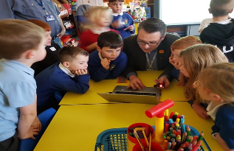

How good is OUR school?
A resource to support learner participation in self-evaluation and school improvement
Patricia Watson, HMI
25th April 2018
#HGIOS

Slide 2
We have we published this resource to:
support improvement in learner participation in self-evaluation and school improvement.
build on existing good practice in giving learners a strong voice in shaping their school.
promote children’s rights within the school context.
support schools to achieve the aims of Curriculum for Excellence.
contribute to Scotland’s Year of Young People.
#HGIOS

Slide 3

“Pupil participation is a strong feature of our approach to self-evaluation and continuous improvement…All stakeholders, including children and young people, have a shared ownership of this evidence and use it to plan continuous improvement.”
QI 1.1 Self-evaluation for self-improvement
#HGIOS

Slide 4

Guidance for school staff and partners working with children and young people.
What we mean by learner participation.
Creating the right culture for effective learner participation.
Supporting learners to triangulate evidence.
Making time for learners to participate in self-evaluation.
Ethical considerations.
#HGIOS

Slide 5

P.9
#HGIOS

Slide 6
Triangulation
P.13
If children and young people are to be recognised as full participants in self-evaluation they must be well supported to access and interpret a range evidence.
They need to develop skills that help them avoid making snap judgements or jumping to conclusions based on hearsay and limited evidence.
They will need to learn that sometimes they have to set aside their own personal views and to understand it’s their collective self-evaluation that is important.
Direct Observation
Analysing Data
Gathering views
#HGIOS

Slide 7

In schools and local authorities across Scotland, children and young people took part in workshops to tell us the things about school that are most important to them.
#HGIOS

Slide 8
#HGIOS

Slide 9
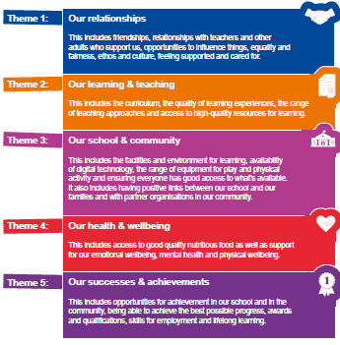
Five big themes:
P.2
#HGIOS

Slide 10
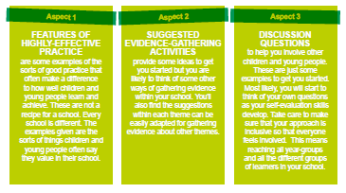
Each theme has three aspects:
P. 3
#HGIOS

Slide 11
Self-evaluation for self-improvement
No six-point scale.
Learners summarise their findings.
Their evidence contributes to whole school self-evaluation through a
- focus on one of the five themes.
- focus on QIs and look across themes.
- focus on a particular group of pupils.
- broad whole-school evaluation.
#HGIOS

Slide 12

Education Scotland
Denholm House
Almondvale Business Park
Almondvale Way
Livingston EH54 6GA
T +44 (0)141 282 5000
E enquiries@educationscotland.gov.uk
www.educationscotland.gov.uk

