Slide 1
Family Learning - Keeping the Promise Award Session 2
The following content has been adapted by Family Learning at Aberdeen City Council from the resource developed by the West Partnership Improvement Collaborative and North Lanarkshire Council’s Original Award.
Notes:
Welcome back everyone. This is the final presentation in Family Learning ‘Keeping The Promise’ Award. The purpose of the Award is to raise the awareness of Family Learning practitioners nationally to the potential challenges care experience children, young people and families may face and how we can individually and collectively keep Scotland's Promise to them in terms of improving their wellbeing, learning and educational outcomes.
This professional learning helps us identify our responsibilities to the children, young people and families. In this session, you’ll see how Family Learning can feed into the family principles of The Promise, promoting the wellbeing, attainments and participation of those we support.
This session aims to demonstrate the positive impact that early intervention and prevention can have on families. We want all children and young people to feel LOVED, SAFE and RESPECTED, especially our care experienced children and young people. By supporting families, we can demonstrate how holistic, whole-family support can have a positive impact for the whole family.

Slide 2
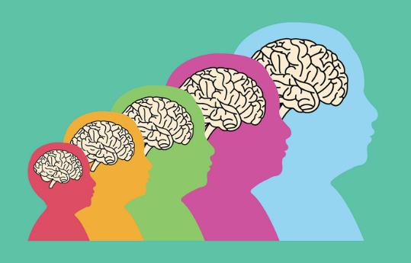
Supporting Children, Young People and Families
(including those who are care experienced)
Trauma & Risk factors
Brain development & our Window of Tolerance
Positive experiences & resilience
Nurture Principles & Maslow
Behaviour & Language
How does Family Learning fit with Family Support
The 10 principles of Intensive Family Support
Notes:
To support our care experienced children, young people and their families, and to actively engage in Keeping The Promise, we first need to understand how their experiences and development shape them.
Once we know this, we will have a clearer understanding of how best to support them while remembering that all families are unique. The information shared here is relevant for all children and young people, however, care experienced children and young people’s lives can be very complex, more so than their non-care experienced peers. Today we will spend some time understanding how their life journey may have impacted their wellbeing.
We want you to leave today knowing that there ARE things that we can do to support care experience children, young people and families, and at the end of the session we will signpost to further reading and resources but if there are any topics that we haven’t covered that you think are valuable to this learning, you can highlight these in the evaluation form at the end of the training.
Trigger Warning! Traumatic experiences are more common than we know. Today we will touch on a few difficult topics including trauma and these may be difficult to think about, either in your own personal experiences or in the experiences of the people we support. If you need to take a breather, please feel free to do so!

Slide 3
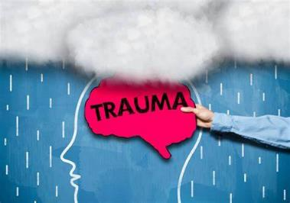
What is Trauma?
“An experience, or pattern of experiences, that impairs the proper functioning of the stress response system, making it more reactive, or sensitive.”
(Dr Bruce Perry)
Simple trauma involves experiences of events that are life threatening and/or have the potential to cause serious injury, e.g. car accidents, fires.
Complex trauma involves interpersonal threat, violence and violation. It way involve multiple incidents. Examples include child abuse, bullying, domestic violence, rape and war.
Collective trauma is the psychological reactions to a traumatic event that effects an entire society.
In Scotland we are committed to having a workforce that is Trauma Informed. To achieve this goal the NHS Education Service (NES) have developed the National Trauma Training Programme
Notes:
We start by considering trauma. Trauma is much more prevalent than we realise and many of us will have experienced trauma in our own lives.
Trauma is an emotional response to an event that is deeply frightening or distressing. It happens when a person feels so overwhelmed by difficult emotions - such as fear or anxiety, that their mind can’t make sense of it. These emotions stay with the person and can influence the way they feel in the future. For example, a loud noise might remind someone of a previous frightening experience such as a car crash, causing them to experience it as scarier and more overwhelming than it would normally be. (Anna Freud website)
Dr Bruce Perry, a renowned researcher in developmental trauma describes trauma as ‘“An experience, or pattern of experiences, that impairs the proper functioning of the stress response system, making it more reactive, or sensitive.”
There are different types of trauma as mentioned on this slide. Many care experienced children, young people and their families will have experienced some level of trauma, and their trauma may even be related to their care experience.

Slide 4
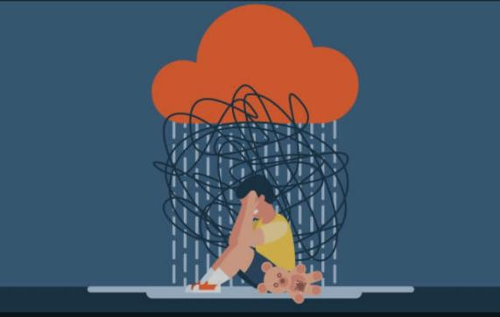
Developmental Trauma
Developmental trauma is how early childhood development can be impacted by trauma. Children and young people who have experienced trauma may have ongoing physical responses such as: re-triggering trauma memories, flashbacks, intrusive thoughts, sleep disturbance, avoidance of people, places or activities, mistrust of people and under or over-reliance on others.
“An understanding of how early experiences shape neurodevelopment is imperative if we seek to impact the lives of children. This is especially true in the case of children growing up in homes plagued by violence, maltreatment and neglect. The impact of early trauma is so profound because it occurs during those critical periods when the brain is most rapidly developing and organising.”
(Dr Bruce Perry)
Notes:
Developmental trauma is how early childhood development can be impacted by trauma. Children and young people who have experienced trauma may have ongoing physical responses such as: re-triggering trauma memories, flashbacks, intrusive thoughts, sleep disturbance, avoidance of people, places or activities, mistrust of people and under or over-reliance on others.
Read quote by Bruce Perry – “An understanding of how early experiences shape neurodevelopment is imperative if we seek to impact the lives of children. This is especially true in the case of children growing up in homes plagued by violence, maltreatment and neglect. The impact of early trauma is so profound because it occurs during those critical periods when the brain is most rapidly developing and organising.”
----------------------------

Slide 5
Childhood Trauma & the Brain
5 mins 10 mins Link to access film: https://www.youtube.com/watch?v=EFrfBJrVLbE&t=177s
Film created by Anna Freud
Notes:
We are now going to watch this animation developed by Professor Eamon McCrory and part of the Childhood Trauma and the Brain resource from the UK Trauma Council specific to developmental/childhood trauma and how it can present in children and young people.
Play film Childhood Trauma and the Brain (with English subtitles) | UK Trauma Council (youtube.com)

Slide 6
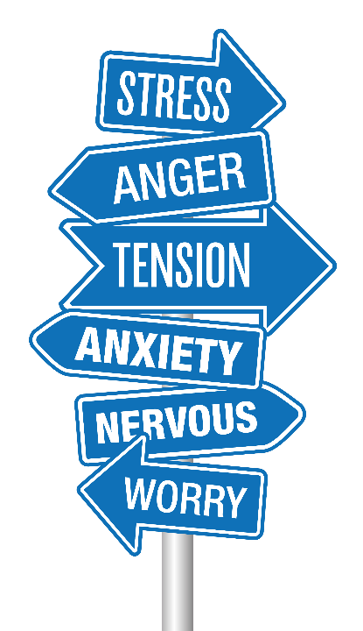
Toxic Stress
Stress is something that we all have to deal with in life, however when stress becomes chronic, or toxic, it can lead to detrimental impacts for the whole family unit
Toxic stress is when the stress in our lives doesn’t abate
Stress can be isolating and overwhelming when there are no supports in place to help
By understanding how stress impacts the families that we support, we can help share the load.
By offering a listening ear to families, signposting to relevant services and supporting access to local, community supports, we can help parents and families build resilience to buffer stress and encourage the implementation of healthy coping mechanisms.
Notes:
Stress is something that we all have to deal with in life, however when stress becomes chronic, or toxic, it can lead to detrimental impacts for the whole family unit.
Toxic stress is when the stress in our lives doesn’t abate.
Stress can be isolating and overwhelming when there are no supports in place to help break stress down into manageable loads, it can lead to a decline in mental health, physical health and resilience of parents and caregivers.
By understanding how stress impacts the families that we support, we can help share the load. By offering a listening ear to families, signposting to relevant services and supporting access to local, community supports, we can help parents and families build resilience to buffer stress and encourage the implementation of healthy coping mechanisms.

Slide 7
How toxic stress affects us
3 min 51 sec Link to access film: https://youtu.be/sutfPqtQFEc?t=1
Film created by Center on the Developing Child at Harvard University
Notes:
Play video How Toxic Stress Affects Us, and What We Can Do About It (youtube.com)

Slide 8
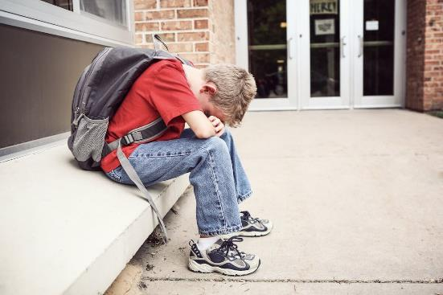
Risk factors to wellbeing and learning:
Poverty
Adversity caused by neglect or abuse
Disability
Other wellbeing or health needs
Challenging family circumstances
Loss (parental separation, bereavement)
Environment (physical, learning, social and emotional)
Notes:
Adversity of any kind can impact on children and young people’s wellbeing and learning.
Adversity experienced by children is often called an adverse childhood experience. Care Experienced children and young people are more likely to have experienced more adverse childhood experiences.
A UK study in 2014 found that 47% of people experienced at least one Adverse Childhood Experience with 9% of the population having experienced four Adverse Childhood Experiences (Bellis et al, 2014).
There are no similar studies in Scotland, however, a recent Welsh study found that the most Common Adverse Childhood Experience was verbal/emotional abuse (23% of households) and parental separation.
Refer to Further Viewing - NHS video on e-learning module and podcast from Bruce Perry & Oprah Winfrey on Childhood Trauma: ACES Podcast - 40 Mins
The following slides offer both theory and techniques to consider when supporting children, young people and their families.

Slide 9
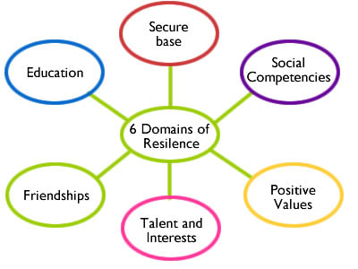
Positive Experiences & Resilience
Notes:
It’s important to remember that children and young people can have many positive experiences throughout their lives, counteracting adversity and building resilience.
These include having a safe loving home (or in attachment terms a secure base), having social competency and positive values, having interests and hobbies, having connection with friends, and access to education (which is huge factor in terms of resilience).
The takeaway here is that if even if you support only one of the six domains of resilience, an individual’s resilience is boosted, potential making a huge difference.
Potential discussion question: Are there elements of your work that support any of these six domains of resilience?
Refer to Further Reading - Building Resilience Through Positive Childhood Experiences

Slide 10
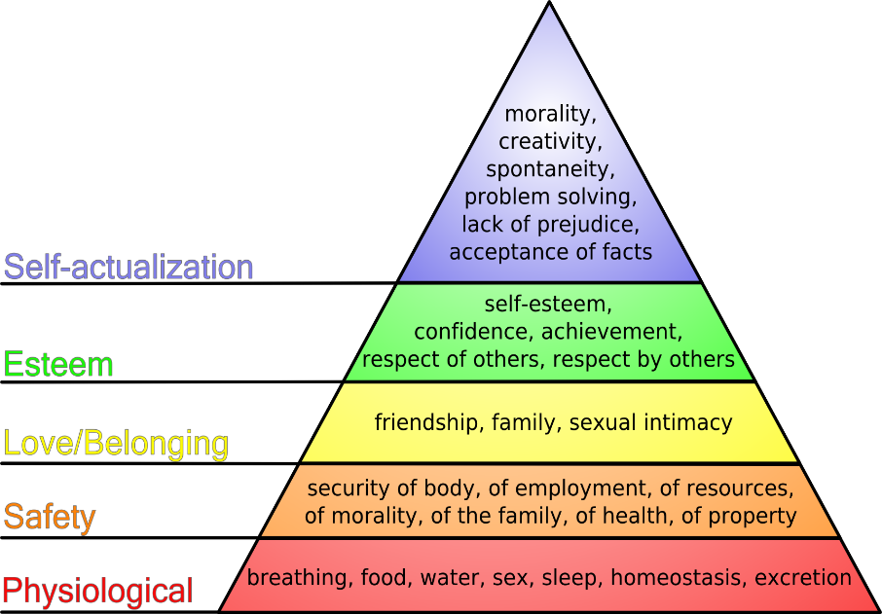
Maslow’s Hierarchy of Need
Notes:
Maslow’s hierarchy of need says that all humans share the same types of needs, and that these categories of need have a hierarchy.
This hierarchy goes from the basic things we need for survival through to a sense of fulfilling our potential and finding our purpose in life.
Physiological needs, such as breathing, food, water, sleep etc must be fulfilled before a person can move up to safety needs of health and wellness, secure employment, a safe home environment etc.
If some of our most important needs are unmet, we may be unable to progress and meet our other needs preventing us from being the best possible version of ourselves.

Slide 11
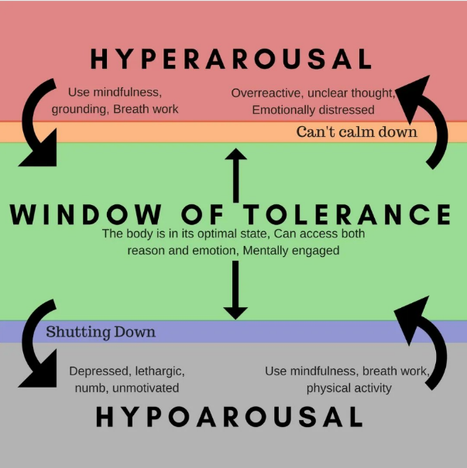
Window of Tolerance
We all have a ‘window of tolerance’ within which we can accept a range of experiences while being able to remain in a calm, regulated state – ‘optimal functioning’.
When we experience feelings of heightened stress, our bodies respond by entering ‘limbic mode’ which is responsible for the fight/flight response – Hyperarousal.
We can also become withdrawn or disassociate to escape from any traumatic situations we encounter. This accounts for the ‘freeze’ element of fight/flight/freeze response – Hypoarousal.
Notes:
The window of tolerance concept was coined by Dan Siegel in his 1999 book The Developing Mind.
Siegel proposes that everyone has a range of intensities of emotional experience which they can comfortably contain, process, and integrate. This is their ‘window of tolerance’. Some people’s window of tolerance is relatively wide: they can feel comfortable despite relatively high degrees of emotional intensity, and a broad range of emotions (from pleasant emotions such as excitement and happiness, to unpleasant emotions such as guilt or anger) may be tolerated. People with a wide window of tolerance are able to think, feel, and behave flexibly and effectively despite high degrees of arousal.
Everyone’s window of tolerance has an upper and a lower boundary. Above the upper boundary is a zone of ‘hyperarousal’, and below the lower boundary is a zone of ‘hypoarousal’. When a person’s level of arousal moves beyond the boundaries of their window of tolerance their thinking and behaviour can become disrupted.

Slide 12
Being Outside our Window of Tolerance
Many behaviours may be an attempt to cope with a narrow window of tolerance and the overwhelming emotions that come from being outside of our safe emotional range.
These behaviours can include:
Physical and emotional anger/distress
Self-harm
Social withdrawal
Over-working
Under/over-eating
Addictive behaviours
Risk taking behaviours
Suicidal behaviours/ideation
Notes:
The Window of Tolerance is subjective. We each have a unique and distinct window depending on multiple biological and social variables: our personal histories and whether or not we have experienced trauma, our temperaments, our social supports, our physiology, etc.
No two windows will look exactly the same; mine may not look the same as yours and so forth. Because of this, those who have experienced trauma in their lives may find that they have smaller windows than peers who come from non-trauma backgrounds.
Those of us with traumatic histories may find, too, that we are more frequently and easily triggered and pushed outside of the optimal emotional regulation zone into hyper or hypoarousal. When we have higher levels of stress, our “window of tolerance” becomes very narrow. That means that our stress hormones are overacting, and we can be easily pushed into unhelpful coping strategies like anxiety, agitation or numbing/dissociation.
The behaviours mentioned on this slide may typically be associated with adults, but we can likely bring to mind children and young people who are struggling who exhibit the same things.

Slide 13
Beacon House – Window of Tolerance
6 mins 26 secs Link to access film: https://youtu.be/0ehq5-P5OSs?si=SlJCLc1o6Y5NvBiI
Film created by Beacon House (Therapeutic Services & Trauma Team)
Notes:
Play Video https://youtu.be/0ehq5-P5OSs?si=SlJCLc1o6Y5NvBiI

Slide 14
Nurture Principles
Learning is understood developmentally
All behaviour is communication
Transitions are important in children’s lives
Language is a vital means of communication
Nurture is important for wellbeing
Environment offers a safe base
Nurture
Principles
Has experience impacted brain development
Think stage not age
Play is important at all ages
Notes:
Many Care Experienced children and young people have attachment issues making it difficult for them to form and maintain relationships with others and we cannot mention attachment without mentioning the 6 nurture principles.
Nurture as a practice means relating to and coaching children and young people to help them form positive relationships, build resilience and improve their social, emotional and mental health and wellbeing. These six principles help practitioners to focus on the social and emotional needs and development of children and young people.
During this professional learning session, we will only be able to touch on the Nurture Principles, but it’s important to recognise the value and relevance of them in understanding children’s behaviour and how we might be able to best support them.

Slide 15
Nurture for Wellbeing & Self Esteem
I am:
Bad
Unlovable
Useless
Others are:
Unreliable
Unresponsive
Uncaring
The world is:
Unsafe
I am:
Good
Deserving
Capable
Others are:
Understanding
Responsive
Accessible
The world is:
Safe
Insecure attachment Secure attachment
Notes:
Children who have not had those early nurturing experiences have very negative thoughts and feelings about themselves – they often operate in the brain stem, reptilian and reactive part of the brain rather than the cognitive, thinking part.
Children and young people who feel cared for and valued are much more likely to be happy and do well in life. Children who know themselves well and have self-respect are more likely to be resilient and strong, cope with change and challenge in life and make good choices.
We want all children and young people to feel safe and secure and be able to grow in a supportive environment that promotes respect. Establishing a pattern of ‘being’ and living that is healthy and which will be sustained into adult life. These children may become parents and will hopefully raise their children to be healthy and happy too.
In Family Learning we know what it is to work with those adults and carer givers who experience the same negative thoughts and feelings as a result of their own insecure attachment. It is part of our professional and ethical responsibility to help break this cycle, The Promise inspires us to do this as a collective, positive force in Scotland.

Slide 16
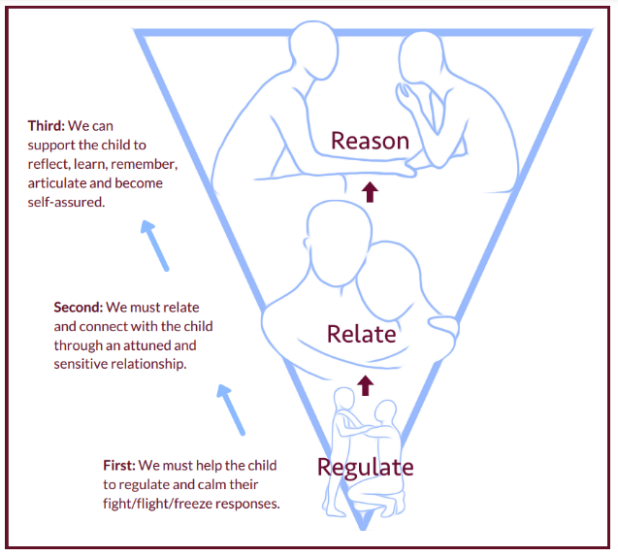
All Behaviour is Communication
Children display both ‘desirable’ and ‘undesirable’ behaviours.
All behaviour serves a purpose.
By trying to work out the reasons, we can identify what changes we need to make our own behaviour to promote desirable ones.
Behaviour should be viewed in the context of the child’s needs and environment.
The ambition of The Promise is that there should be “no barriers to engagement”.
Notes:
For example, we know that even when we provide physical and emotional safety there will still be times when we are faced with challenging behaviour. Behaviour that’s possibly a response to childhood trauma.
Some behaviour may be described as “distressed” or “dysregulated” because:
It is difficult to manage and understand
Presents a risk to those in close proximity
It is not appropriate for the environment in which it is exhibited
It is inappropriate given the child/young person’s age or developmental ability
None of these are easy to support in any environment but if we can work with the child/young person to reflect on what needs to change in order to minimise distressed behaviour, we can move towards ensuring behaviour is not a barrier to engagement or accessing social or learning environments using the sequence of engagement 1. Regulate, 2. Relate and then 3. Reason
Not reasoning until individuals are regulated, and you’ve validated their feelings, not their behaviour, means we are working with how the brain works and not against it. This gives us the best chance to re-engage the child and move on.
In a Family Learning context, we can offer this as both a tool for parents and carers to use with their children and as an opportunity for personal reflection on a parents own action or reaction.

Slide 17
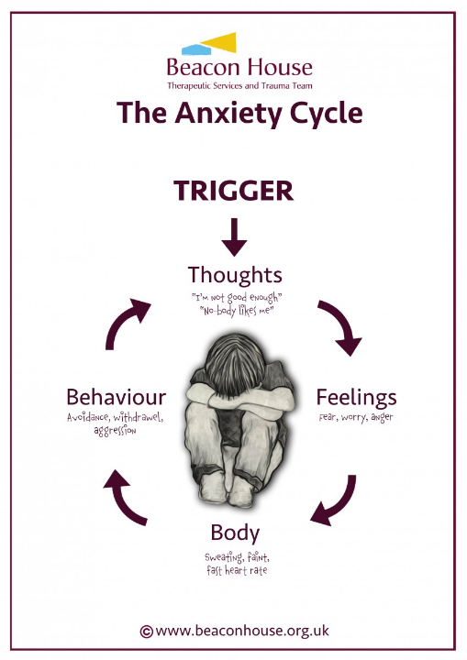
Reflection Time
What might ‘distressed’ behaviour look like?
What might this be communicating?
Notes:
This activity can be adapted depending on delivery e.g. face to face, personal reflection, jam board, menti etc.
For this reflection activity take some time to consider the questions above and reflect on what this behaviour may be telling you.
You will likely have one or two children or young people in mind.
Consider what you understand about their previous or current experiences to identify what the behaviour may be telling you and where this may be coming from.

Slide 18
What happens if we reframe our thinking and language?
Behaviour on display might be…
We can choose to reframe it as…
Angry
Aggressive
Defiant
Not engaging
Rude
Withdrawn
Attention seeking
Avoidant
Unacceptable behaviour
Distressed
Frightened
‘In fight’ survival mode
Doesn’t feel safe yet
Self-protective
Cautious
Attachment seeking/attention needing
‘In flight’ survival mode
Understandable behaviour
Notes:
Our internal use of language, how we label, describe and interpret what is happening, is important as it directly influences how we respond to every given situation.
Therefore, the more accurate we are with our language, and the more we focus on positive, helpful language that encourages us to see growth and opportunity for positive change, the better placed we will be to support the children, young people and parents/carers we are working with.
It’s time to go from our daily practice to the bigger picture and consider where Family Learning fits into the national picture and its role in Keeping The Promise.

Slide 19
Whole Family Support
Scotland must do all it can to keep children with their families.
There must be more support for families based in the communities where they live.
There must be significant, ongoing and persistent commitment to ending poverty and mitigating its impacts for Scotland’s children, families and communities.
Notes:
The Promise includes the following statements:
Scotland must do all it can to keep children with their families.
There must be more support for families based in the communities where they live.
There must be significant, ongoing and persistent commitment to ending poverty and mitigating its impacts for Scotland’s children, families and communities.

Slide 20
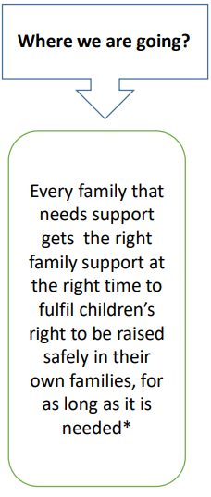
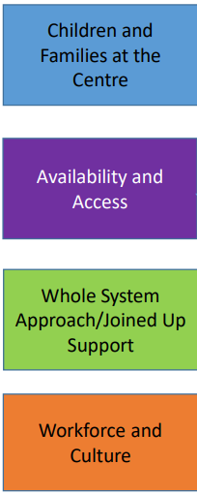
Route Map & National Principles of Holistic Whole Family Support
Meaningful and ongoing participation in service design ensures choice and control for families
Shift to needs and rights-based planning and participation
Support is stigma-free, needs/rights-led even at universal level (does not have the same level of activity across the board)
Universally accessible early help and support
Support delivery where and when suits families & Multiple points of access in communities
Better collective awareness of available support
Investment & innovation to deliver
Shared accountability for whole system/ joined up approach
Non-siloed aligned and proportionate FS funding that matches scale of need
Transforming Commissioning and Procurement (Planning, service design and purchasing)
Expand use of locally-based multi-agency services co-ordinating support
Clear & shared understanding of families across whole system
Address power dynamics & Empowerment for innovation
Additional capacity & Support delivery where and when suits families
Development of holistic workforce approach & Mechanisms to share good practice nationally
Aim supported by and delivers on GIRFEC/ The Promise/ Transforming Outcomes for CYPF/ The Feeley Review/ Children’s Services Planning Partnerships/ UNCRC/ National Performance Framework/Child Poverty Action Plans Evidence based and data led Strong collective leadership at all levels
Notes:
This slide shows a Route map and National Principles of Holistic Whole Family Support, published by The Scottish Government in July 2022. This Route map shows that our destination as whole-family support services is to ensure that “Every family that needs support gets the right family support to fulfil children’s right to be raised safely in their own families, for as long as it is needed”.
Which of these indicators do you think fits your service, or should fit your service going forward?
Non-stigmatising: Support should be promoted and provided free from stigma and judgement. Services should be as normalised as accessing universal services.
Whole Family: Support should be rooted in GIRFEC and wrapped around about the whole family. This requires relevant join up with adult services and whole system, place based, preventative addressing inequalities.
Needs based: Support should be tailored to fit around each individual family, not be driven by rigid services or structures. It should cover the spectrum of support from universal services, more tailored support for wellbeing and intensive support (to prevent or in response to statutory interventions). Creative approaches to support should be encouraged.
Assets and community based: Support should be empowering, building on existing strengths within the family and wider community. Families should be able to ‘reach in’ not be ‘referred to’. Support must be explicitly connected to locations that work for local families and the community, such as schools, health centres, village halls and sports centres.
Timely and Sustainable: Flexible, responsive and proportionate support should be available to families as soon as they need it, and for as long as it is required, adapting to changing needs.
Promoted: Families should have easy, well understood routes of access to support. They should feel empowered to do so and have choice about the support they access to ensure it meets their needs.
Take account of families’ voice: At a strategic and individual level, children and families should be meaningfully involved in the design, delivery, evaluation and continuous improvement of services. Support should be based on trusted relationships between families and professionals working together with mutual respect to ensure targeted and developmental support. Collaborative and Seamless: Support should be multi-agency and joined-up across services, so families don’t experience multiple referrals or inconsistent support.
Skilled and supported workforce: Support should be informed by an understanding of attachment, trauma, inequality and poverty. Staff should be supported to take on additional responsibilities and trusted to be innovative in responding to the needs of families.
Underpinned by Children’s Rights: Children’s rights should be the funnel through which every decision and support service is viewed
Highlight the link for more Routemap and National Principles of Holistic Whole Family Support (www.gov.scot)

Slide 21
How Does Family Learning Support Families in Keeping The Promise?
Whatever issues families face, Scotland must ensure that intensive family support is available, proactive and characterised by the 10 family support principles:
Community Based (incl. schools, health centres, village halls and sports centres etc.)
Responsive and Timely
Work with Family Assets
Empowerment and Agency
Flexible
Holistic and Relational
Therapeutic
Non-Stigmatising
Patient and Persistent
Underpinned by Children’s Rights
Notes:
These final slides are extracts from The Promise Family Support Guide created in 2020.
The 10 family principles listed here all link into how Family Learning teams across Scotland already work, and support families within our services. [Use the notes to give a slightly longer explanation of each principle]
Community Based (incl. schools, health centres, village halls and sports centres etc.)
Responsive and Timely
Work with Family Assets
Empowerment and Agency
Flexible
Holistic and Relational
Therapeutic
Non-Stigmatising
Patient and Persistent
Underpinned by Children’s Rights

Slide 22
The Promise Believes…
Scotland’s commitment to early intervention and prevention must be realised through proper, holistic support for families. There must be a significant upscale in universal family support services.
Those services must have the development of authentic human relationships as their core focus, so Scotland’s experience of support is one that builds on relationships to facilitate human connection.
Good universal support also provides the basis for the identification of risk of harm for children. Universal support will look different in every community and be delivered by a range of organisations and groups, but it must follow the journey of a family.
Scotland must support a broad understanding of the importance of the early years of parenting.
Notes:
Read each bullet point

Slide 23
The Promise Believes continued …
Scotland must ensure that there are places in every community for parents of young children to go for support and advice, to meet other local parents and to stay and play with their children.
There must be criteria free, community-based access to therapies that do not stigmatise but help and support children and young adults to work through difficulties they are facing.
If children are removed from the care of their parents, Scotland must not abandon those families. Families must continue to be provided with therapeutic support, advocacy and engagement in line with principles of intensive family support.
Parenting education should be encouraged and available for everyone in advance of parenthood as an essential part of building a healthy society. That does not mean the provision of parenting education programmes that can be stigmatising, where an invitation onto a course can be interpreted as a sign of failure. Rather there must be a broader celebration of parenting and universal, community based, accessible nurture and support.

Slide 24
A Final Thought by Sir Harry Burns
2mins 10 secs Link to access film: https://www.youtube.com/watch?v=OGCiNmXv4TU
Film created by Sciana The Health Leaders Network
Notes:
Sir Harry Burns (Chief Medical Officer for Scotland, 2005 – 2014) summarises beautifully what children, young people and families need to achieve wellbeing in our society. This very short video clip encapsulates everything that we already know about what families need to thrive.

Slide 25
Consider and Discuss:
Having completed session 1 & 2 of the Award, what small steps can you take in your practice to help ‘Keep The Promise’?
What can you challenge your service to do to ‘Keep the Promise’?
Notes:
We can use this time to have a fuller discussion to review the session and plan our next steps. Consider the following questions:
Within your role, what you do to ‘Keep The Promise’?
After today’s presentation, what are your next steps?

Slide 26
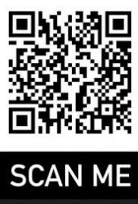
The Personal e-Learning Module
Please use the following weblink or QR code to access the E-Learning module
E-learning Module Link
On completion of the E-Learning Module please complete the Knowledge Check/Quiz (the person leading this professional learning will be able to provide you with the link to access it).
Notes:
Well done! That’s the end of the formal presentations for this course and there is now only one more step to complete the Award. That’s the e-Learning Module that you will have to complete independently.
At the end of this presentation you will find a live link to the E-Learning Module or alternatively you can use the QR Code to access it.
At the end of the e-learning module there will be a short Quiz. The Quiz link will be provided to you by the person leading this professional learning via email.
On successful completion of the Quiz you will receive an ‘I Promise Award’. This will be in the form of a Digital Certificate and a Digital Badge’.
When you complete the Quiz the lead for this training is notified and when 70% of everyone in the establishment completes the Quiz the establishment will receive the ‘We Promise Award.
The digital badges could be used as part of your digital signature. The Formal We Promise Certificates could also be displayed in your establishments foyers or reception areas.
However even more importantly we hope that this professional learning will positively impact the care experienced children and young people you work with.
Thank you for your participation today.

Slide 27
Further Reading and Resources
The Promise Family Support Guide (2020) keepthepromise-family-support.pdf
Routemap and National Principles of Holistic Whole Family Support, Scottish Government (2022) Routemap and National Principles of Holistic Whole Family Support (www.gov.scot)
Beacon House - Window of Tolerance https://youtu.be/0ehq5-P5OSs?si=SlJCLc1o6Y5NvBiI
Childhood Trauma and the Brain, Uk Trauma Council Childhood Trauma and the Brain (with English subtitles) | UK Trauma Council (youtube.com)
What is Trauma? Dr Bessel Van Der Kolk What is trauma? The author of “The Body Keeps the Score” explains | Bessel van der Kolk | Big Think (youtube.com)
Sir Harry Burns, Sciana Network (2016)
Sir Harry Burns on developing societies focused on well-being - YouTube
Aligning family learning and The Promise - A guide for family learning professionals and GIRFEC strategic leads | Resources | Education Scotland

