Slide 1

Social Media, Digital Learning and Political Literacy
Professional Learning Resource for Practitioners

Slide 2

Contents
Media Literacy
Social Media and US Elections
Social Media and Scottish Referendum
The Impact of Social Media on Political Debate
Young People and Social Media
Digital Research Skills
Digital Debate and Participation Skills
Digital Rights

Slide 3
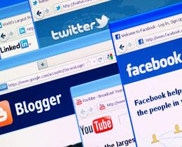
Discuss what types of media you use most often?
What types of news and information media do you access most often?
TV, Radio, newspaper, online media, social media?
What social media networks do you use?

Slide 4
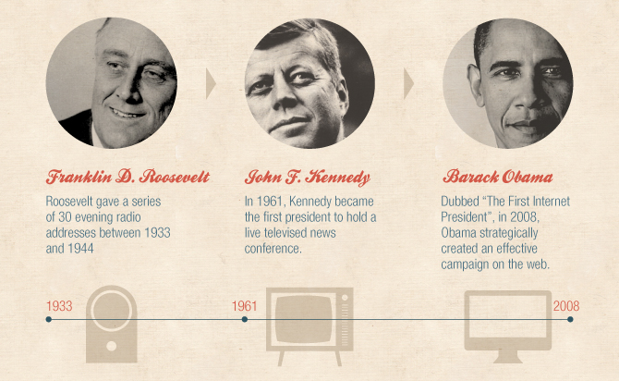
2008 US Presidential Election:
First social media election?
Barack Obama
Twitter followers
2008: 112,474
2015: 63.1 million
Facebook followers
2008: 2,379,102
2015: 44,412,744
Notes:
Source:
http://www.adweek.com/socialtimes/social-media-politics-infographic/471738

Slide 5
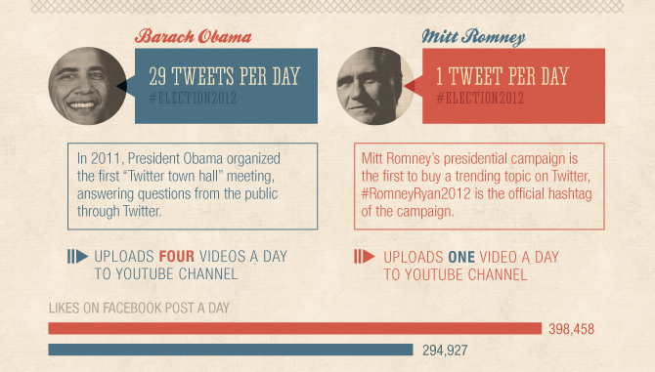
2012 US Presidential Election
Social media established as a vital campaign tool for politicians and voters.
Notes:
Source
http://www.adweek.com/socialtimes/social-media-politics-infographic/471738

Slide 6
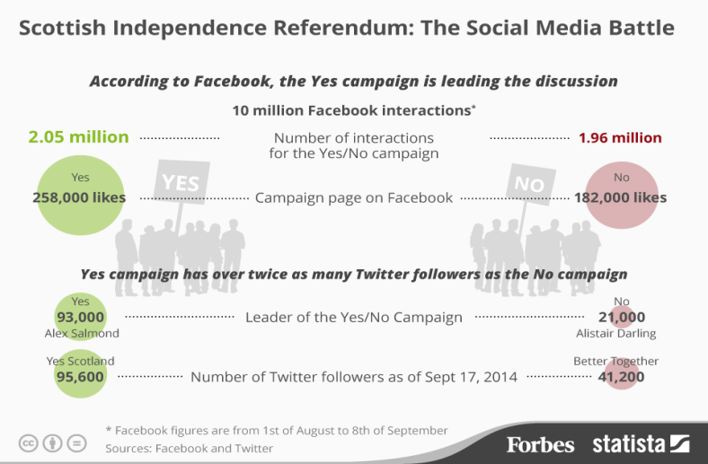
Social media during the Scottish referendum
18 Sep 2014: Polls open = 898,750 conversations
11 Sep 2014: Scots want to change postal votes = 251,513 conversations
13 Sep 2014: Three opinion polls say to close to call = 233, 361 conversations
25 Aug 2014: TV debate = 137,404 conversations
5 Aug 2014: TV debate = 89,843 conversations
Notes:
Source:
http://wallblog.co.uk/2014/09/23/infographic-the-scottish-referendum-in-online-stats/
Source:
http://www.forbes.com/sites/niallmccarthy/2014/09/18/scottish-independence-the-social-media-battle-infographic/

Slide 7

TED X talk: The impact of social media on political debate
Dr. Mark Shephard studied the content of thousands of social media posts for research into social media and the Scottish independence referendum debate online.
He illustrates tips on what to spot and what mistakes to avoid when posting online.
Watch here (12 mins): http://ed.ted.com/on/EMKPkQQ1#watch

Slide 8



Flaming keys and 5 Fs
DON’T DRINK AND DIGIT!
      Tweeting
      Tipsy tweeting
      Tanked tweeting
FOUL = writing abusive, rude comments
FALSE = fallacious or generalised post
FOGGY = unclear language or behaviour
FLANNEL = unnecessary repetition about a point or comment
FLAMING = over exaggeration using too many capitals or exclamation marks etc.

Slide 9
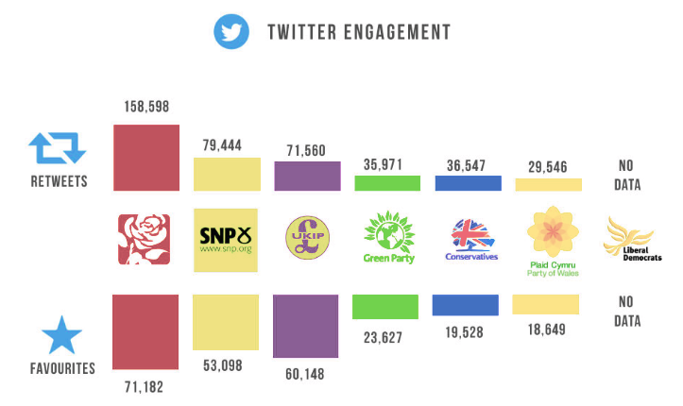
LABOUR WIN
Notes:
Source:
https://www.integritysearch.co.uk/infographics/social-media-statistics-general-election-2015/

Slide 10
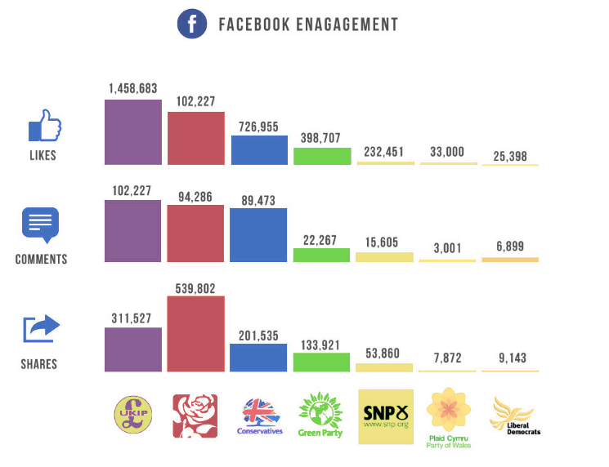
UKIP
WIN
Notes:
Source:
https://www.integritysearch.co.uk/infographics/social-media-statistics-general-election-2015/

Slide 11
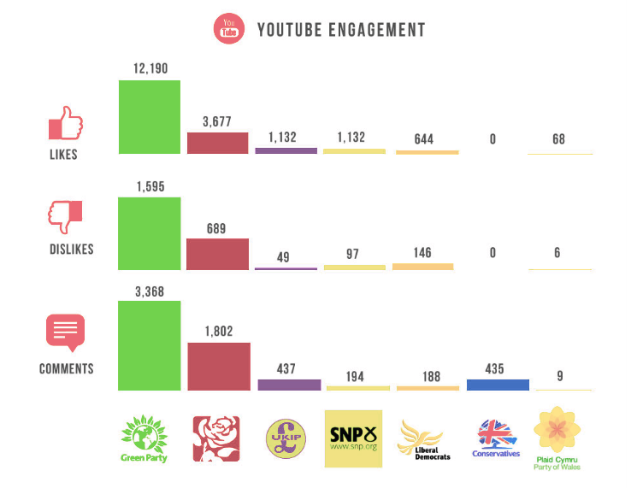
GREEN
WIN
Notes:
Source:
https://www.integritysearch.co.uk/infographics/social-media-statistics-general-election-2015/

Slide 12
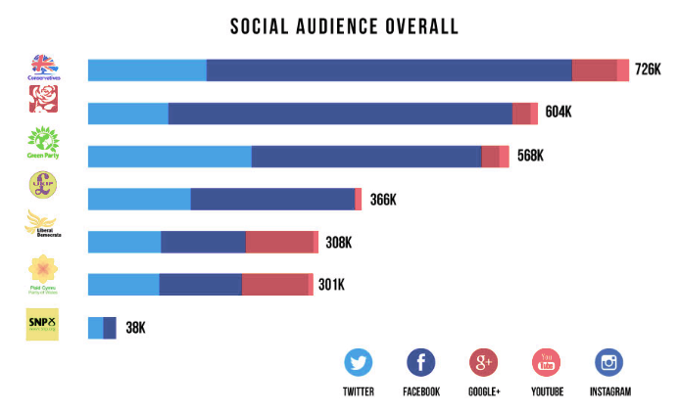
Social media during 2015 General Election
CONSERVATIVE
WIN
Notes:
Source:
https://www.integritysearch.co.uk/infographics/social-media-statistics-general-election-2015/

Slide 13
How useful is social media in researching, debating and participating in democracy
Should politicians pay attention to social media?
https://vimeo.com/57540926
Watch clips from Adam Konner, Barack Obama’s social media strategist.
How is social media changing politics?
Does social media motivate you to engage with politics offline?
https://vimeo.com/57540928
What is the impact of social media? Does it reinforce your opinion or reflect diversity?
https://vimeo.com/57540927
Notes:
Source:
http://www.debatingeurope.eu/2013/01/22/how-is-social-media-changing-politics/#.VdH0-PlVikp

Slide 14
How do young people use social media?
  6 in 10 children aged 12-15 use the internet
  on their own most of the time
  70% of UK children aged 12-15 who online have a social media profile
  How many social media platforms can you name?
  Describe the social media habits of your own children or the young people you work with?
  Are there generational similarities and differences in how we use social media?
Notes:
Source
http://stakeholders.ofcom.org.uk/binaries/research/media-literacy/media-use-attitudes-14/Childrens_2014_Report.pdf

Slide 15

Social media and digital content:
Suggested aims for practitioners and young people
  Understand the different forms of social media and how these tools can be used for sharing information, debate and discussion.
  Find examples of at least two different kinds of social media, blogs, video / podcasting sites that you can follow and use.
  Understand how to use social media safely and what to do if you have any concerns or problems.
  Reflect on what you like or dislike about using social media and how you might want to use it yourself or for your projects.
  Interact with other social media users.
Notes:
Aims taken from: http://digitalcommonwealth.co.uk/wp-content/uploads/2014/09/digital-storytelling-handbook.pdf

Slide 16
Digital research: WebQuests
WebQuests: http://webquest.org
an inquiry based method to conduct research using the Internet.
  Use Glow365 software like PowerPoint, OneNote or Word
  Or free WebQuest websites:
  http://www.createwebquest.com/
  http://zunal.com/index.php
An online lesson with 6 components
Promotes higher order questions and critical thinking skills
Teacher preselects the sources – emphasizing information use rather than information gathering
Collaborative – promotes cooperative learning methods
Notes:
6 components of a WebQuest
Introduction: The introduction section provides background information and motivational scenarios like giving students roles to play: "You are an underwater research scientist," or "You are an astronaut planning a trip to the moon." It also provides an overview of the learning goals to students.
Task: The task is a formal description of what students will have accomplished by the end of the WebQuest.
Process:This is a description of the steps learners should go through in accomplishing the task, with links embedded in each step.
Resources: This section of the WebQuest consists of a list of the resources (bookmarked Web sites, print resources, etc.) that your students will need to complete the task.
Evaluation: Each WebQuest needs a rubric for evaluating students' work. The standards should be fair, clear, consistent, and specific to the tasks set.
Conclusion: This step allows for reflection by the students and summation by the teacher.

Slide 17
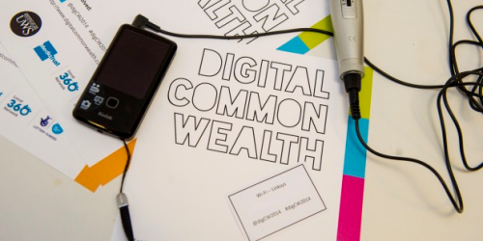
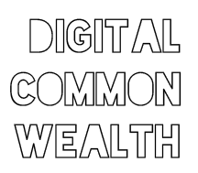
Digital participation:
Handbook of Digital Storytelling
Downloadable resource offering equipment suggestions, contexts for learning and top tips for the 4 key digital skills of:
http://digitalcommonwealth.co.uk/2014/09/18/handbook-of-digital-storytelling/
Blogging
Video
Audio
Social media
Notes:
During 2014, Digital Commonwealth ran a schools’ programme involving primary and secondary learners from across Scotland’s 32 local authorities, delivering in-school workshops on digital storytelling using audio, video, blogging and social media with supporting hard and e-copy learning materials.

Slide 18



















BLOGGING / QUIZ DISCUSSION | VIDEO / AUDIO | SOCIAL MEDIA | DIGITAL STORYTELLING
Glow Wordpress Blogs Padlet Medium Kahoots | YouTube Vimeo Audioboom Adobe Voice | Twitter Facebook Instagram Pinterest Class Tools (for lots of applications) | Glow Wikis Office Sway Prezi BookCreator Paper.li Storify
Notes:
Digital participation: suggested apps and web services

Slide 19

iRights: well informed 21st Century citizens
“iRights seeks to make the digital world a more transparent and empowering place for children and young people (under 18) by delivering a universal framework of digital rights, in order that young people are able to access digital technologies creatively, knowledgeably and fearlessly.”
http://irights.uk

Slide 20





The 5 iRights
                The Right to REMOVE
                The Right to KNOW
                The Right to SAFETY AND SUPPORT
                The Right to INFORMED AND CONSCIOUS CHOICES
                The Right to DIGITAL LITERACY
Notes:
The Right to REMOVE
Every child and young person should have the right to easily edit or delete all content they have created
The Right to KNOW
Children and young people have the right to know who is holding or profiting from their information, what their information is being used for and whether it is being copied, sold or traded
The Right to SAFETY AND SUPPORT
Children and young people should be confident that they will be protected from illegal practices and supported if confronted by troubling or upsetting scenarios online
The Right to INFORMED AND CONSCIOUS CHOICES
Children and young people should be empowered to reach into creative places online, but at the same time have the capacity and support to easily disengage
The Right to DIGITAL LITERACY
To access the knowledge that the Internet can deliver, children and young people need to be taught the skills to use, create and critique digital technologies, and given the tools to negotiate changing social norms

Slide 21
iRights links
  Watch the animated film about iRights
  http://irights.uk
  Look at the young person’s version
  http://irights.uk/young-persons-version/
  How could you use the iRights with children and young people to reflect on and improve digital and online participation, including social media?

Slide 22

Image Copyright - The Noun Project: Mazil, Ryan Beck, Luis Prado, Marek Polakovic, Blake Thompson, Creative Stall, Darin S, Brennan Novak, riyazali, Ahmed Elzahra, Desbenoit, Julynn B, Baruch Moskovits, Simple Icons, Geral Wildmoser, Mathieu Dedebant, Jon Prepeluh, Mourad Mokrane, Sarah Joy, Evan MacDonald, Juan Pablo Bravo, Dan Hetteix, Arthur Shlain
Education Scotland
Denholm House
Almondvale Business Park
Almondvale Way
Livingston EH54 6GA
T +44 (0)141 282 5000
E enquiries@educationscotland.gsi.gov.uk
https://education.gov.scot

