Slide 1


Involving Parents in Improvement Planning
For Scotland’s learners with Scotland’s educators

Slide 2
Involving parents - Legislation
Standards in Scotland’s Schools etc Act 2000
Scottish Schools (Parental Involvement) Act 2006
The Parental Involvement in Headteacher and Deputy Headteacher Appointments (Scotland) Regulations (2007)
Getting it Right for Every Child (GIRFEC) 2008
Schools (Consultation) (Scotland) Act (2010)
School Handbook Guidance (2012)
‘How Good is Our…..?’ Frameworks
Pupil Equity Funding
National Improvement Framework
Learning together: National action plan on parental involvement, parental engagement, family learning and learning at home
For Scotland’s learners with Scotland’s educators

Slide 3
Involving parents - Legislation (Cont.)
Standards in Scotland’s Schools etc Act 2000 (asp 6), Section 6(1)(a)
Purpose – to secure improvement in the quality of education.
Must be in consultation with parent council / combined parent council, teachers, pupils, parents, such persons employed or working in school on an unpaid basis, representative local bodies.
School improvement plan must:
take account of the local authority’s plan and strategy for parental involvement
set objectives for the school (including objectives to involve parents in the education provided)
contain a statement of the local authority's ambitions for the school
include an account of the ways in which, and extent to which, the headteacher of the school will consult and involve pupils regarding decisions to be made on the everyday running of the school.
http://www.legislation.gov.uk/asp/2000/6/section/6
For Scotland’s learners with Scotland’s educators

Slide 4

Involving parents - Legislation (Cont.)
Local authorities must:
prepare a report after one year as to what was done, during those twelve months in implementation of the plan;
ensure that the parents of the pupils in attendance at the school have access without cost to the plan and the report;
review the implementation of the plan from time to time.
For Scotland’s learners with Scotland’s educators
Notes:
Within the Act, there are duties on local authorities:
Must prepare a report after the first year
Must ensure that parents have access to the report
Must review the implementation of the plan

Slide 5

Involving parents – Legislation (Cont.)
​Driving Excellence and Equity: Advice on School Improvement Planning 2018/19
This resource is for schools, working with parents, carers, partners and their local communities. It provides essential advice and support on how partnership can work constructively, to create a meaningful improvement plan.
https://education.gov.scot/improvement/practice-exemplars/nifschoolimprovement
For Scotland’s learners with Scotland’s educators

Slide 6
Involving parents – Legislation (Cont.)
The Scottish Schools (Parental Involvement) Act 2006 recognises the vital role that parents play in children’s learning and development.
Duties within the Act:
Parents should receive information and support to help develop their child’s learning at home and in the community.
Schools must be open to the involvement of parents in the work they do and they should consider ways of providing information that helps parents engage with school and their children’s education.
The Act provides a framework for ensuring that parents have the opportunity to express their views and have these taken into account on policy matters affecting the education of their children.
Parental Involvement Act 2006 and Statutory Guidance
Learning at
Home
Home / School partnership
Parental representation
For Scotland’s learners with Scotland’s educators

Slide 7

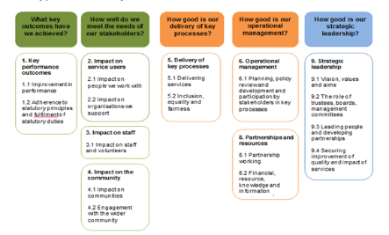


How Good is Our…Frameworks
Designed to promote effective self-evaluation as the first important stage in a process of achieving self-improvement. These resources support establishments, organisations and partnerships to evaluate progress, strengths and areas for development.
For Scotland’s learners with Scotland’s educators

Slide 8

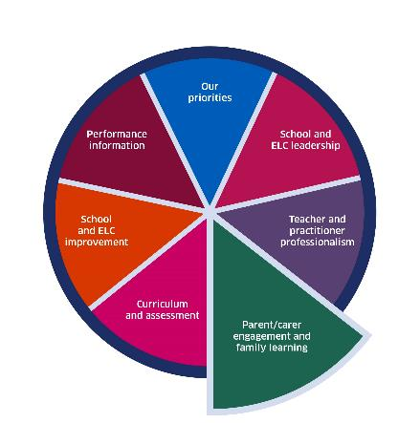
National Improvement Framework
https://www.gov.scot/policies/schools/national-improvement-framework/
For Scotland’s learners with Scotland’s educators

Slide 9
Why involve parents in Improvement Planning?
Scottish Schools (Parental Involvement) Act 2006
Schools benefit from developing positive partnerships with parents by involving them in all decisions affecting their child’s education and learning.
Parent Council functions:
  raise standards of education in the school
  secure improvements in the quality of education
  support the school in its work with pupils
  represent the view of parents
  promote contact between the school, parents, pupils, providers of nursery education and the community
  report to the parent forum
For Scotland’s learners with Scotland’s educators

Slide 10

Why involve parents? (Cont.)
Parents have creative ideas about school education and what can be done to improve the standards and quality of their child’s learning.
Collaborative approaches in partnership with parents and the wider learning community can make a positive contribution to how settings/schools/local authorities determine their ambitions/priorities and plan improvements to meet these.
For Scotland’s learners with Scotland’s educators

Slide 11
Evidence
Review of the impact of the Parental Involvement Act 2006 (NPFS, 2017)
Highly effective practice in school improvement takes place when a range of stakeholders (including parents) take lead roles (HGIOS4).
There are positive impacts and clear connections when parents are involved in school improvement.
Greatest impacts when schools consistently include and review parental involvement in school improvement – as opposed to doing so on an ad-hoc basis or predicated on what had happened previously.
For Scotland’s learners with Scotland’s educators

Slide 12

Evidence (Cont.)
Strengths
School improvement priorities and self-evaluation are having a positive impact on:
  improving learning and teaching
  children’s attainment
  achievement and wellbeing
Staff are:
  reflective
  keen to use all available information to improve not only their own but overall school improvement and performance.
For Scotland’s learners with Scotland’s educators

Slide 13

Self-evaluation
Involve parents, children, partners and the wider school community in helping to shape and influence school improvement.
Review the vision, values and aims of the setting/school in partnership with parents, partners, agencies and the school community to ensure it reflects all it wants to achieve for its children and families.
Support improvement plans with rigorous self-evaluation.
Planned collaborative and collegiate working to drive forward improvement priorities.
Involving all staff in proactively taking forward key areas for improvement.
Further information - How Good is our School 4: https://education.gov.scot/improvement/self-evaluation/HGIOS4
For Scotland’s learners with Scotland’s educators

Slide 14

Self-evaluation (Cont.)
Partners
Are partners aware of how they can contribute to improvement planning and self-evaluation?
Children and young people
Are children and young people developing and leading their own plans for improvement which reflect those of the school community?
Are children and young people involved in self-evaluation?
For Scotland’s learners with Scotland’s educators

Slide 15
Involving parents in Improvement Planning
Barriers to Parental Involvement/Engagement (Goodall, 2017)
A parent’s previous experience of school (Harris and Goodall, 2015)
Issues of parental self-efficacy and self-belief (Bandura, 1977; Goodall and Vorhaus, 2011; Green et al 2007)
Relationships often bounded by issues of positionality which suggest how they should work and how each of the individuals involved perceive they should interact with the learning of the child (Rule, 2015)
Time parents have available (Peters et al, 2008)
Differences in social and cultural capital (Bourdieu, 1997; Lareau, 1989, 2011; Lareau and Horvat 1999)
Practical issues – childcare and transport
For Scotland’s learners with Scotland’s educators

Slide 16
Involving parents (Cont.)
Local authorities and schools need to ensure that their home-school communication arrangements are appropriate for all parents, including mobile families, parents who do not live together and those whose first language is not English, and those who have difficulties with written communication.
Schools should consider what methods are most effective for communicating with parents. Having a variety of methods for sharing information and communicating with parents makes two-way communication more effective and makes it easier for parents.
As part of its communication strategy settings/schools should work with parent representatives to explore ways of allowing parents to share ideas with the school on improving practice.
Scottish Schools (Parental Involvement) Act 2006 Guidance
For Scotland’s learners with Scotland’s educators

Slide 17
Discussion
How can the challenges be overcome?
How do you involve parents in improvement planning?
What do you need to do different to involve more parents in improvement planning?
Who can help you?
For Scotland’s learners with Scotland’s educators

