Slide 1
Inclusion Wellbeing & Equalities Professional Learning Framework Self-Regulation Informed Level
@ESInclusionTeam
For Scotland's learners, with Scotland's educators
Do luchd-ionnsachaidh na h-Alba, le luchd-foghlaim Alba
Notes:
Purpose of these Slides
Read title​
This professional learning is pitched at an informed level and suitable for anyone working with children and young people in an educational context.
How to use the slides:
To be used to facilitate professional learning in a group or whole-setting, or as a self-directed learning activity as an individual.
General Guidance
There is a requirement to cover all the slides.
Please do not change the provided slides.
Facilitators are welcome to add slides or activities relevant to your own setting, to support discussion and exploration of the topic. Facilitators will know their participants’ needs best.
Anyone who works in an educational setting can be a facilitator and use these slides.
It is important to establish a safe space which encourages respect and honesty to ensure that everyone is able to participate.

Slide 2
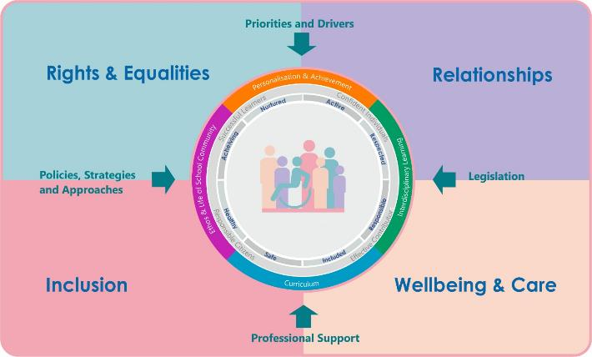
Interconnectivity
Notes:
All of the professional learning in the Framework fits into one of these four themes. The four themes are interconnected and interdependent.​
This activity forms part of the professional learning in the Relationship theme.

Slide 3
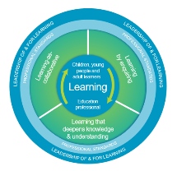
How to use this resource
These slides can be used to facilitate professional learning in a group or
whole-setting, or as a self-directed learning activity as an individual.
Facilitation notes are included at the bottom of each slide.
Please do not remove or change any of the slides included.
Facilitators are welcome to add slides or activities relevant to your own setting, to support discussion and exploration of the topic. Facilitators will know their participants’ needs best.
Anyone who works in an educational setting can be a facilitator and use these slides.
For reflection or discussion activities, it is important to establish a safe space which encourages respect and honesty to ensure that everyone is able to participate.
Notes:
Option to skip slide as these are instructions for facilitators only. No need to read to audience.

Slide 4
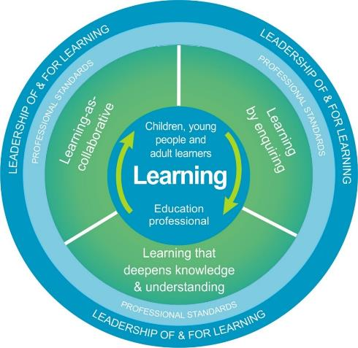
National Model for Professional Learning
This professional learning resource will support you to deepen your knowledge and understanding.
You will have the opportunity to consider how to take this learning forward on your own and with others.
The National Model of Professional Learning (education.gov.scot)
Notes:
This professional learning forms part of the national model for professional learning and is designed to help you gain more knowledge and have a deeper understanding of inclusion, wellbeing and equalities​​
On completion of this professional learning, you will be asked to consider what your next steps will be​​.
Please take some time to consider the reflection questions at the end

Slide 5
Welcome
This session provides an opportunity to:
To define regulation, dysregulation, and self-regulation
To consider the importance of self-regulation and the factors that affect self-regulation
To consider factors that contribute to regulation and some strategies to support self-regulation
To consider how our understanding of nurture is relevant in supporting regulation in our learners
Notes:
Link activity to national model

Slide 6
Regulation definitions
Emotional Regulation
The ability to maintain a state of calmness, focus and alertness. Being regulated supports the ability to process, think, interact and learn.
Emotional Dysregulation
Inability to maintain a state of inner calmness attention, focus or be alert. Results from experiencing stress beyond one's range of tolerance or ability to cope. (Links to Window Of Tolerance)
Self-regulation is the ability to monitor and control our own behaviour, emotions, or thoughts, altering them in accordance with the demands of the situation. (Cook & Cook, 2009) It refers to how efficiently and effectively a child deals with a stressor and then recovers (Porges, 2011; Lillas & Turnbull, 2009; McEwen, 2002).
Notes:
Regulation is essentially the ability to stay calm.
When we are regulated we can think, focus and learn.
Dysregulation is when we can’t find calm. It happens when we are pushed beyond our ability to cope with stressors.
Self regulation refers to the learner’s ability to monitor and control their thoughts, feelings and behaviours. And if we start to lose our calm then it’s the ability to use personal strategies to return to a calm state.
In the context of an education this means being able to regulate our own behaviour, so that we can deliberately act in a way that is consistent the learning communities expectations.
Self-regulation is not simply self-control. Self-control is about inhibiting strong impulses whereas self-regulation is about reducing the frequency and intensity of strong impulses by managing stress and improving our ability to recover. In fact, self-regulation is what makes self-control possible, or, in many cases, unnecessary (see Self-regulation vs Self-control)
Self-regulation is vital for managing life’s normal ups-and-downs: for concentration, social relationships and learning.
It is a major task for some learners to regulate their feelings and behaviour consistently.
Learning to self-regulate begins at birth and continues through-out our lives.

Slide 7
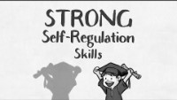
The importance of self-regulation for learning and life
2:22 min
If viewing as a PDF please click this link to watch the film https://youtu.be/m4UGDaCgo_s

Slide 8
Self-regulation vs Self-control
Self–regulation is:
recognising, managing, and responding to our emotions and impulses
using personal strategies to return to a calm state
Self–control is:
the ability to inhibit strong impulses
an act of will to restrain ourselves
Where does this happen in the brain?
primarily ‘feeling’ (limbic) brain primarily ‘thinking’(pre frontal cortex) brain
Self-regulation makes self-control possible, or, in many cases, unnecessary.
Useful Article: Self-Regulation vs. Self-Control, Psychology Today

Slide 9
Steps to developing self-regulation (Stuart Shanker)
During normal development:
Being able to identify and reduce stressors
Being self-aware
Discovering how to calm agitation
Expanded steps if stress is trauma-induced:
Being helped to feel safe and secure
Being aware and able to express emotions
Being able to identify and reduce stressors
Being aware of what it feels like to be calm
Discovering how to calm agitation
Notes:
In the film Shanker talks about 3 steps in developing self-regulation:
Identify and reduce stressors
Self awareness
Discover how to calm agitation – what works for me and what do I need to avoid and who can help
However he later expanded this out to a 5 step method when we start to consider trauma related:
Shanker talks of strategies for addressing trauma-related stress - Five key strategies for helping children suffering from the effects of trauma are:
• Providing the greatest possible feeling of safety and security in the home • Supporting them in becoming aware of and able to express their emotions • Encouraging them to become “Stress Detectives,” able to identify and reduce the things they find stressful • Helping them learn and become aware of what it feels like to be calm • Turning time when they are becoming agitated into learning experiences, so they can identify and activate what helps them to calm down

Slide 10
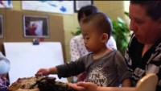
Developing Self-Regulation Skills
2.10 min
If viewing as a PDF please click this link to watch the film
https://youtu.be/gYPYbnzIkXc
Notes:
JM
https://www.youtube.com/watch?v=gYPYbnzIkXc#action=share (2.10)
So this clip shows a framework for how you might identify stressors for individual children and what helps them to be calm and relaxed
3 steps:

Slide 11
Support learners to identify (and reduce) their stressors Be a stress detective – consider factors such as:
Sensory issues
Social environment
Physical environment
Psychological factors such as safety, sense of belonging, ..
Learning factors such as readiness, support needs, …
Family & community factors
Remember – stress, often presenting as worry or agitation, can come from more than one source
Notes:
JM
46 secs PT talking about using huge bag of worries and Bob the worry monster
Milton PT3
Step 1 of 3

Slide 12
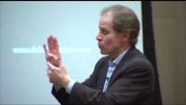
Supporting the development of self-awareness
4:20 min
Name it
to
Tame it
If viewing as a PDF please click this link to watch the film https://youtu.be/ZcDLzppD4Jc
Notes:
JM
Name the feeling and validate the feeling
Dan Siegel clip – name it to tame it (4.20)
https://www.youtube.com/watch?v=ZcDLzppD4Jc
Can pair comments about negative feelings with positive coping statements e.g. I can see you are getting really upset that ………… but you keep on trying and hopefully you will succeed
Avoid asking why questions – a child will not know why or have the words to describe the reason

Slide 13
Benefits of a (self-talk) script
Developing scripts to support self-regulation
Types of questions to try
A strategy to try when we get stressed (could initially be talked through with the support of an adult)
Encourages us to think about what works and what doesn’t work for us
Supports our understanding of how we learn
Helps us understand how we feel about a task or problem
Is this:
a big deal or a little deal?
scary, not scary?
hard to do or easy to do?
Asking ourselves the question, helps us to pause, and engage, or re-engage, our ‘thinking’ brain
Notes:
JM
Core idea is that self-regulation is ultimately achieved through self-talk
Scripts are best developed with a learner in positive circumstances not when they are distressed or dysregulated. NB. At these times they won’t be able to reason or access their cognitive brain. Initially however the adult may need to support the learner through the script.
Scripts should be age appropriate, using suitable language, and sensitive to the individual child.
They create mental routines scaffolded initially by the adult and later practiced by the learners. In this why the learner moves from co-regulation to self-regulation. Also with practice they can move from saying the script out loud to internalised self-talk.
Using scripts is a way of giving students the words to describe the problem they are facing and how to resolve it.
Adults use scripts all the time in their own self-talk.

Slide 14
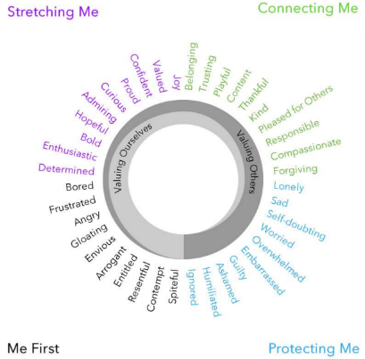
’Naming it’ – developing the language of feelings
Did that make you feel…when…
Were you feeling … when …
It sounds/looks like that made you feel …
That would make me feel … too
I feel … when … happens too
It looks like you are frustrated
I can see you are upset
Are you feeling sad?
It sounds/looks like you were very scared?
I wonder if you are feeling a bit embarrassed?
I bet that made you angry?
From The Ring of Emotions Framework
by Alan McLean – What Motivates Learning
Notes:
JM
Name the feeling and validate the feeling
Can pair comments about negative feelings with positive coping statements e.g. I can see you are getting really upset that ………… but you keep on trying and hopefully you will succeed
Avoid asking why questions – a child will not know why or have the words to describe the reason

Slide 15
Further strategies to support self-regulation
3.44 min
If viewing as a PDF please click this link to watch the film
https://youtu.be/fuymZJcRghk
Notes:
JM
Nurture teacher at Blacklands Primary, North Ayrshire describing the CALM boxes 3 minutes 35 secs
BLPT1

Slide 16
Self-regulation through the lens of nurture
Children's learning is understood developmentally
Learners of any age, particularly those who are insecurely attached or who have experienced trauma, may not have developed self-regulation and may need support with this.
In responding to dysregulated behaviour we need to ensure that our interactions are developmentally matched to were the learners ‘is’ and not where we think they should be because of their chronological age.

Slide 17
Factors that have an impact on self-regulation
The attachment bond between a child and their primary care giver influences brain development and contributes to a person’s ability to regulate their emotions which may impact on their capacity to build and maintain relationships. Exposure to adversity and trauma in childhood also plays a role in brain development, coping skills, and resilience. Both of these factors relate to our Window of Tolerance and our capacity to cope with the demands of everyday life.
Notes:
The attachment bond between a child and their primary care giver influences brain development and contributes to a person’s ability to regulate their emotions which may impact on their capacity to build and maintain relationships.
Exposure to adversity and trauma in childhood also plays a role in brain development, coping skills, and resilience.
Both of these factors relate to our Window of Tolerance and our capacity to cope with the demands of everyday life.

Slide 18
Self-regulation through the lens of nurture
The classroom offers a safe base
A safe predictable environment and caring adults will help learners who are insecurely attached or who have experienced trauma to develop both regulation skills and healthier supportive relationships.

Slide 19
Self-regulation through the lens of nurture
All behaviour is communication
Supporting adults should seek the ‘needs’ behind negative behaviours or patterns of behaviours and try to address these needs.
Without addressing underlying needs the likelihood is that the dysregulated behaviour will recur or even escalate.

Slide 20
Finally, a few things to remember:
Learning self-regulation is a natural part of the development process.
Every child develops at their own pace so we can expect children of the same age to differ in their ability to self-regulate
Some children, for a range of reason, will struggle to self-regulate. We may need to co-regulate with them first and then over time help them develop self-regulation skills (see module on Co-regulation)
If we are to respond to distress, in a way that is sympathetic to how the brain works, we first need to help a child or young person regulate before we can reason with them (see module Regulate, Relate, Reason, & Restore)

Slide 21
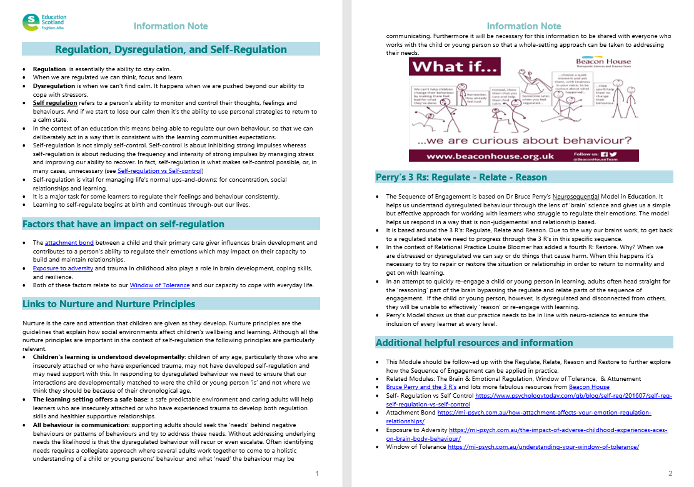
Resources and Information to help

Slide 22
Reflection
From what you have learned so far, think about:
How has this made you feel?
What has this made you think about?
What one action would you like to take forward?
How can you link what you plan to do with others in your setting?
How you will know that this learning has made a difference?
Notes:
Facilitation notes:
You can do this in groups...
Encourage educators to take this forward in an enquiry
Consider impact of the actions / learning

Slide 23
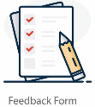
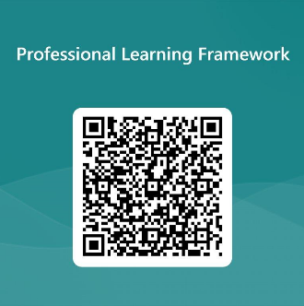
We value your feedback
From now until March 2024 we will be taking feedback on these resources so that we can make changes in advance of a formal launch of the Professional Learning Framework in June 2024
Your feedback could help us improve this resource
Please complete this short form, using the link or QR code, to let us know what you thought of it and any suggestions you have on how it could be improved
LINK: https://forms.office.com/e/b5PCpJJJ3P

Slide 24
For Scotland's learners, with Scotland's educators
Do luchd-ionnsachaidh na h-Alba, le luchd-foghlaim Alba
Education Scotland
Denholm House
Almondvale Business Park
Almondvale Way
Livingston EH54 6GA
T +44 (0)131 244 5000
E enquiries@educationscotland.gsi.gov.uk

