Slide 1
Supporting care experienced learners who are adopted
Supporting care experienced learners who are adopted
Section A: The Basics about Adoption
Section B: Hidden Care-Experience
Section C: Impact of Adoption on Education
Education Scotland supported the development of this professional learning resource
Notes:
Welcome to the ‘Supporting care experienced learners who are adopted’ professional learning activity. This activity is designed for anyone working with children and young people who are adopted in an educational setting or context.
This professional learning should take between 30 minutes and an hour depending on how it is undertaken. It can be studied as a group using this presentation as an in-service activity with some discussion around the reflective questions or as an individual professional learning activity with written reflections in a log.
If completing as an individual please log into the ES PL webpage so that your learning can be logged on your account. This professional learning is specifically for educational practitioners. It has been designed to help make the needs of adopted young people visible as well as suggesting ways to support them.

Slide 2
Section A The Basics about Adoption
Notes:
This professional learning consists of 3 short sections.
This first section highlights the key information regarding children and young people who are adopted.

Slide 3
The Basics about Adoption
Once a child has been adopted, and the court has issued an ‘adoption order’, the adoptive parent becomes the legal guardian. All parental rights transfer to the adoptive parent.
Most children who are adopted have been removed from the family home due to risks to their safety.
When a child starts school, their adoptive parents may choose not to share the child’s adoptive status.
Some children continue to have contact with birth families, through letters or face-to-face meetings, and others have no contact.
Adopted children are more often recorded as requiring additional support compared to their peers.
Adoption is lifelong.
Notes:
Adoption is the legal process by which a child or siblings who cannot be brought up within their birth family become full, permanent and legal members of their new family. Adopters become the child's legal parents with the same rights and responsibilities as if the child was born to them. Most adopted children have lived in foster care, with a foster family, for part of their childhood. Time spent in foster care can range from days to several years, and many children have more than one foster placement before they move to their adoptive family.
Most adoptive children will have been known to child protection services prior to their adoption, but once the adoption order is granted, they are given a new identity. Complexities around the legal process mean that schools can be unaware of a child’s previous care-experience and their adoptive status if a child has been adopted prior to starting school or has moved between authorities or nations. When a child remains in the same local authority after adoption, their records should still state ‘previously looked after’.
There are relatively few adopted children in our schools. There were 370 adoptions in the whole of Scotland in 2022. However, of this number, half were already adopted by the time they started school and may have moved between authorities.
Every child’s adoption story is different. Some have regular contact with birth family, and some have none. All are likely to have additional support needs, including needs directly related to trauma and adoption. Local authorities have a statutory responsibility to provide adoption support, and many adopted people need counselling, therapeutic services and mental health support at some point in their lives.

Slide 4
The challenges of adoption
A child who is adopted will have experienced multiple, and repeated losses.
A child who is adopted will have multiple families (birth, foster, adoptive) which can lead to confusion.
A child who is adopted is previously ‘care-experienced’, but this may not be recorded on SEEMIS.
The misinformation and stigma of adoption is harmful: adoptees are not ‘lucky’ and should not be ‘grateful’.
Pre-birth trauma is lifelong: the adoptee can be affected by in-utero experiences caused by substance abuse, neglect and violence.
The percentage of children with prenatal alcohol exposure is four times more likely in children who are adopted.
Procedures for diagnosing FASD are not yet embedded across all local authority health boards.
Notes:
Adoption brings specific challenges for this group of care-experienced learners. Early life experiences, and loss of carers, can have a deep impact on the child’s development of self and on how they connect with others.
The loss of successive care-givers and homes can make it difficult for a child to achieve a sense of permanence and deep-felt security. The impact of this care-experience is often hidden by the adoption as the new adoptive parents are given the same rights as birth parents and the adoptive child is no longer ‘in care’.
There is a lot of misinformation about adoption that leads to unconscious bias. Narratives that centre around the adoptee being ‘chosen’ or ‘lucky’ are incredibly harmful. The ‘lucky’ metaphor puts undue pressure on a child to be grateful. Every child deserves to be safe, loved and respected. They should not have to earn this.
There is also an assumption that babies and young children are ‘resilient’, won’t remember or be affected by adverse experiences, including the loss of their first family. Neurodevelopmental research proves this to be false. In-utero experiences can lead to long term impact. Both drugs and alcohol will affect the developing fetus.
Studies indicate that pre-natal alcohol exposure is higher in children who are adopted. This is particularly significant as children are not yet routinely diagnosed with FASD, and therefore their challenges can be left unsupported. Early assessment and diagnosis will lead to more positive outcomes. With the right support, people who have FASD can succeed in life.

Slide 5
What do young people tell us about adoption?
Watch the BBC Teach Clip
Supporting care-experienced children: Molly's Story - navigating school when you are adopted
https://www.bbc.co.uk/teach/teacher-support (Molly's Story)
Notes:
Watch this short clip from the BBC Teach series Supporting care-experienced children.
In the clip Molly talks about navigating school when you are adopted.

Slide 6
Adoption Statistics in Education
The 2024 Adoption UK Barometer provides a stock take of policy and practice:
49%
of respondents in Scotland felt their child’s school had a good understanding of the needs of care-experienced learners
53%
of respondents in Scotland felt their child required more support compared to other children of the same age
90%
of respondents said it is a continual struggle to get the help and support their children need
13%
of respondents felt wider services understood their child’s needs
Notes:
Adoption UK survey adoptive families across the UK each year. In last year’s survey almost half of respondents felt that school did not have a good understanding of their child’s needs. This is why our professional learning is so important.
Learners who are adopted are more likely to have additional needs. The Education (Additional Support for Learning) (Scotland) Act (2004) presumes that children who are looked after have additional needs and require a support plan, unless proven otherwise. Adoption UK suggests that this presumption should extend to all previously looked after children, including children who are adopted.
School is ideally placed to connect families to support yet 90% of families said it ‘was a continual struggle to get help’. Adoptive families need wider services and educators to be aware of the complexity of needs often impacting learners who are adopted. Too often learners will mask their difficulties in school and teachers mistakenly see them as ‘fine’.
If schools act quickly when adoptive parents raise concerns about their child needs, then early intervention support will lead to much more positive outcomes for the learners and their families. A staggering 87% of families did not feel that wider services (eg health, education, social services) understood their child’s needs.

Slide 7
Adoption Statistics in Education Data
At present there is no national record of how adopted children fare in school regarding:
Attendance
Wellbeing
Attainment
Positive Destination
Adopted learners should be recorded under the Previously Looked After tab on SEEMIS. However, adoptees' data cannot be disaggregated from all other types of previous care experience.
Notes:
Aside from the registration of new adoptions in Scotland, no other adoption records exist. There is no national mechanism which tracks and monitors how adopted children do in school compared with all peers.
Adopted learners should be recorded under the Previously Looked After tab on SEEMIS however adoptees data cannot be disaggregated from all other types of previous care experience. However, we know schools may not be aware of all their adopted learners, and SEEMIS cannot produce separate reports on adoptees as a group. So, tracking and monitoring of adopted young people in education remains problematic.
It is recommended that parents and teachers engage adopted children in conversation about data recording and seek consent to identify care-experience so that appropriate supports and interventions can be initiated.
Another potential pitfall occurs when learners transition to high school. At this point learners are re-registered, and information stored on SEEMIS about additional support needs, including family needs such as adoption, may be lost.

Slide 8
What do young people tell us about school?
5 min 11 sec
Film co-created by Adoption UK
For more resources see Adoption UK (Scotland)
Link to access film: https://youtu.be/r8T9AgMccn8
Notes:
Jo, a learner in S5, reflects on her experiences of adoption and school.

Slide 9
Reflection Activity 1: Discuss
Why do you think so many learners, and their families, report challenges with education?
Reflecting on your own practice:
what lesson content, routines, or practice, can you identify that might be dysregulating for some learners?
what adjustments could you make learner feel safe and regulated when they are with you?
Notes:
Reflecting on what you’ve just heard, why do you think so many adopted young people, and their families, report challenges with education, and struggle to access support?
Reflecting on your own practice:
what lesson content, routines or practices, can you identify that might be dysregulating for some learners?
what adjustments could you make to help learners feel safe and regulated when they are with you?
Discuss

Slide 10
Section B Hidden Care-Experience
Notes:
Section B: Hidden Care-Experience

Slide 11
Child Perspective
The adoptee:
may have gaps in knowledge about their personal history
may internalise thoughts about identity and personal history
may create fantasies to fill gaps in knowledge
does not see themselves or family represented positively in literature or media
may worry about being bullied or stigmatised for their adoption
does not want to be seen or treated differently
may not realise that their thoughts and reactions are a natural response to what has happened to them
Why might a learner find it difficult to focus during a class discussion on evacuees being sent away from home?
Notes:
Often, we hear from adopted children and young people, that they have been subject to unkind comments and bullying about being adopted. They feel comments are left unchallenged by adults and this can often be a factor in pupil absence.
The adoptee may not know the story of how they came into care. They may not have information about birth family. They may not have had opportunities to talk with parents, therapists or other adopted children about their experiences. In short, they may not have begun to unpack their experiences.
They may feel that they don’t have someone they can trust to talk about their adoptive identity with, so they lock down their thoughts or create a fantasy in their own head.
They may feel adoption marks them out as ‘different’ when they just want to blend in with peers, and so they don’t tell anyone about being adopted.

Slide 12
Parent Perspective
The adoptive parent:
is rarely given opportunities to declare adoptive status in forms or surveys
does not want to share sensitive information about their child or themselves to strangers
does not want to be treated differently to other families
may be worried about their child being bullied or being stigmatised for their adoption
may not realise that the challenges they face at home or school are different to other families
How do we create safe and natural opportunities for families to communicate with us?
Notes:
The general assumption in society is that children live with their birth parent. This is reflected in language used on forms and in conversation. By implication, the learner who is adopted or their adoptive parent can feel ‘unseen’.
Without a proper forum to share information, discussions with parents can lead to clumsy questions and leave the child or parent feeling awkward.
By making simple changes to forms, giving families a choice to tick ‘adopted’ or choosing to use ‘families’ instead of ‘parent / carer’ or ‘pupil progress meeting’ instead of ‘parent consultation’ can be much more inclusive.
Everyone is treated equally. Everyone belongs.
Parents may not seek support and one of the reasons for this is a worry about being seen as ‘not coping’ in their parenting role.
What they often don’t realise is that they, and their child, are dealing with the impact of difficult early life experiences and complex needs.
Learners who are adopted must unpack experiences that their non-adopted peers simply don’t have.
This isn’t an easy or quick process and both adoptees and their families can need support for this to happen safely.
Schools are ideally placed to connect adoptive families with community supports.

Slide 13
School Perspective
Schools:
may not know a child is adopted
may not make the connection between adoption and previous ‘care-experience’
may link behaviour to trauma or ‘care-experience’ rather than neurodivergent needs
may underestimate the complexity of needs
may perceive the learner to be ‘fine’ because they are adopted and no longer looked after
may use approaches that can increase a learner’s dysregulation
What information would you find useful to plan support for adopted learners?
Notes:
When learners move into a local authority after adoption, parents may not disclose adoption or previous care experience to schools which can result in difficulties being misinterpreted. We need to provide families with ample opportunities to offer information, and they are more likely to do this within the confines of warm, welcoming, safe relationships.
When children are completely removed from birth family connections, the complexity of need and trauma is likely to be high.
Adoptive parents may not know the full extent of additional support needs or genetic conditions of birth parents or have the complete early life history of their child.
Despite the high likelihood of need, this group of learners are often under diagnosed, as early symptoms are attributed to trauma. An early diagnosis will improve educational outcomes and wellbeing.
Adoptive parents learn to parent therapeutically which helps their child to heal from past trauma. Some approaches in schools can assume a base level of secure attachment, development and understanding, but when learners have experienced trauma and multiple family placements, they may need approaches that you would use with a younger child and that are rooted in nurture.
Learners who are adopted are likely to have insecure attachments and developmental profiles are likely to spikey.
This means learners can excel in some developmental areas and be lagging in others. It is important educators understand that learners are making progress all the time – but that even when learners are approaching adulthood, there may still be times when the supporting adult must provide scaffolding and nurturing approach.
With the right adult relationships, experiences and understanding, adopted children thrive and educational outcomes are positive.

Slide 14
Considering Pre-Natal Alcohol Exposure and Fetal Alcohol Spectrum
Within the general population, the prevalence of FASD is around 3-5% (1 in 20 people).
But, within the care-experienced population, particularly children and young people who are adopted, up to 75% are at risk of FASD due to prenatal alcohol exposure (3 in 4 people)*
There are ten brain functions which can potentially be affected by alcohol during pregnancy:
executive functioning
sensory and motor
academic skills
focus and attention
cognition (reasoning and thinking)
communication
brain structure
living and social skills
memory
affect regulation
FASD is a hidden disability. You cannot tell by looking at someone whether they have the condition.
Understanding FASD What Educators Need to Know
* Research in Peterborough (Gregory et.al 2015)
Notes:
The numbers of learners diagnosed with Fetal Alcohol Spectrum Disorder (FASD) in our schools is relatively low at present. However, this is due to neurodevelopmental assessment pathways not yet being well established across all local authorities, and not because we don’t have learners who have been exposed to pre-natal alcohol in our schools. Statistics provided by the FASD Hub suggest we should consider prenatal alcohol exposure until it can be ruled out. Alcohol is legal and socially acceptable in Scotland and unplanned pregnancies occur. The risks of PAE are much greater than we might think. Where neonatal abstinence syndrome has occurred, alcohol should be considered a possibility too. Stigma and lack of knowledge about FASD is an issue many families face.
Only about 10% of people have facial features associated with FASD meaning you cannot tell by looking at someone whether they have it.
The impact of FASD on an individual involves a wide range of common challenges including impulsivity, difficulties with cognition, memory, the sensory system, motor skills, executive functioning, social skills and affect regulation. These are often seen as dysregulation, developmental dysmaturity, a spikey profile of ability and inconsistent performance ‘can’t do today what they learnt yesterday – on and off days’.
Education can bring many challenges for children and young people with FASD or a history of prenatal alcohol exposure.
However, with the right support, learners can achieve great things. FASD Hub Scotland have produced a number of resources to support parents, carers and educators. This includes a series of FASD Education factsheets and FASD: Insights and Strategies for educators and professional training modules.

Slide 15
FASD Makes Me, Me
4 min 55 Sec
Film co-created by Adoption UK
and children, young people and adults with FASD.
For more information visit
FASD Hub
Link to access film: https://youtu.be/VammKhercZ8
Notes:
Watch the video

Slide 16
Reflection Activity 2
What environmental and relationship adjustments does your school make to help learners and their families feel safe and included?
What extra adjustments might you have to make to ensure adoptive families feel a sense of belonging?
Notes:
Reflecting on what you have just heard, in your educational or childcare setting what environmental and relationship adjustments have you made to help adoptive families and adopted young people feel safe and included?
What extra adjustments might you have to make to ensure adoptive families feel a sense of belonging?
Discuss

Slide 17
Section C Impact of Adoption on Education
Notes:
Section C: Impact of Adoption on Education

Slide 18
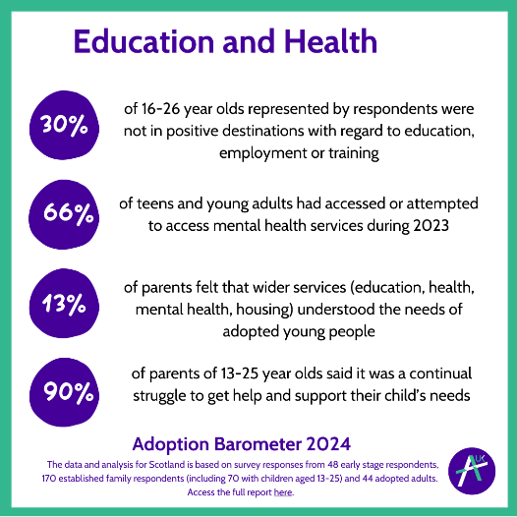
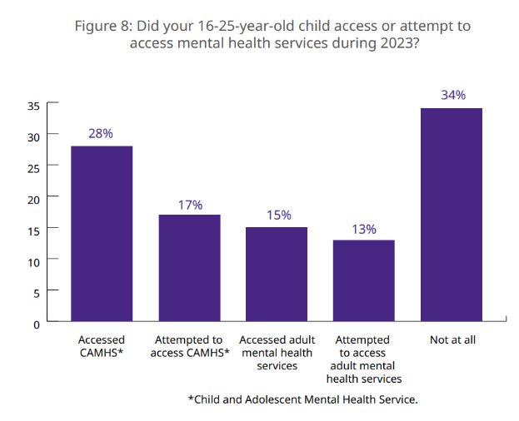
Mental Health of Children and Young People who are Adopted
Notes:
Educators must work closely with young people, their families and support services to ensure wellbeing needs are met.
The impact of adoption is lifelong and many , adopted children and adults need additional support with processing parts of their life journey.

Slide 19
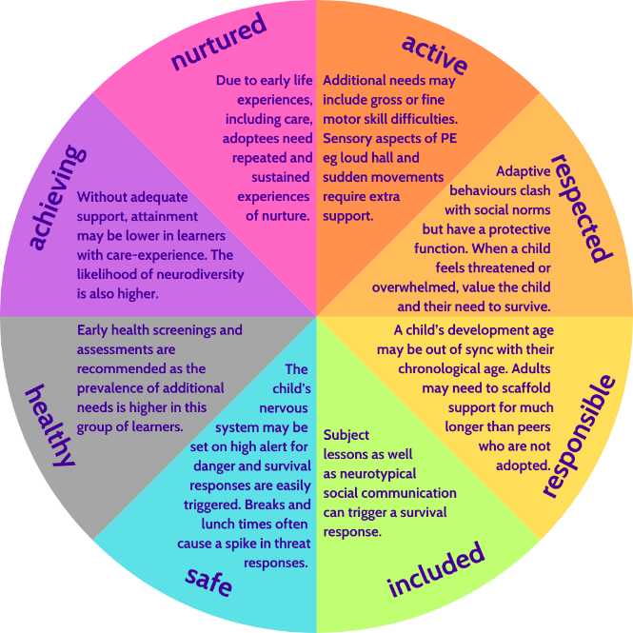
Impact of Adoption on Wellbeing
Due to a range of reasons, adopted learners' wellbeing may be compromised.
Children and young people who feel well are more likely to engage in learning and fully access education.
Wellbeing can be assessed using the Getting it Right for Every Child (GIRFEC) Wellbeing Indicators.
Wellbeing and learning support should be readily available for all learners.
Notes:
Education (Additional Support for Learning) Scotland Act 2004: All looked after children are assumed to have additional support needs unless they are assessed as not needing extra help to learn. A child or young person is ‘looked after’ if a local authority has taken on some legal responsibility for their care and wellbeing.
Scottish guidance regularly uses the broad definition of ‘care-experience’ to be inclusive. It recognises that adopted children, who were once ‘looked after’ continue to have additional needs stemming from their early life experiences. The assumption should be that adopted children still require a support plan, until proven otherwise.
Anecdotal evidence from Adoption UK suggests children, or trauma, may mask needs through primary school but adolescence can bring neurodevelopmental factors out into the open. However, it can be difficult for teenagers to engage with therapeutic interventions where they feel ‘different’.
If an assessment of need is undertaken, and regularly updated, through primary school then early intervention and supports can be employed, meaning more positive outcomes for all.
All children are different. Although the wellbeing wheel focuses on difficulties, there are learners who will excel and perform confidently in all areas.

Slide 20
Impact of Adoption on Education
In their education, learners who are adopted may:
be distracted (for example, lost in thoughts, checking where people are and if they are safe)
be quiet or withdrawn
be compliant or overly keen to please
be loud or extrovert
be overwhelmed processing sensory information from people, noises, learning, expectations, heat, etc
have difficulty managing complex social exchanges (may feel left out, argue, fight, be isolated)
have difficulty working at home due to compartmentalising home and school
be competitive (for example, desire to win, be picked or come first)
not progress onto a positive destination such as further education, training or work due to undiagnosed needs related to care-experience, neurodiversity or adoption
Notes:
How might we know that a young person in our classroom or in our school is feeling the impact of adoption? Here are some possible signs that might connect to their care-experience or adoption.
They drift off and can’t concentrate. Could be down to feeling unsafe, something has triggered a deep ingrained trauma memory, could be difficulty with executive skills, neurodivergency. It’s not wilful lack of effort.
Every adopted child is different, but they have all developed a survival strategy. Survival responses can look very different – from the compliant, fawn like response to the aggressive, angry outburst. The commonality is feeling threatened.
Adults should work hard to reduce the sense of threat and increase the feelings of safety rather than the outward behaviour itself.
They can be overwhelmed because their body is processing too much information at once. Do not mistake this for lacking resilience. Instead focus on reducing the information load.
Managing emotional responses and engaging in multiple social exchanges are executive function skills. These can take longer to develop, and can need support, due to interruptions in the child’s early development. They may appear younger than peers.
They may have additional challenges due to neurodevelopmental factors.
They may have a clear divide between home and school. Home should be a safe space. They may have difficulty with parents switching between roles. Rigid or literal thinking can be linked to neurodiversity.
All children are different. For some, being the best is part of their survival strategy. They may be highly competitive. For others, they may be juggling too many challenges to excel at one thing.
Learners come from every background and display every kind of behaviour. Some indicators that a young person might have developed a survival response related to trauma, may look ‘positive’ for example, they may present as mature for their age and be highly independent. It can also look the opposite of this where children seem very immature for their age and need attention all the time.
Having good communication with the parent and taking on board any information they provide can help you to see the full picture of need.

Slide 21
A learner’s perspective – Ava’s Story
2 min 19 sec
Film co-created by Adoption UK
For more resources see Adoption UK (Scotland)
Link to access film: https://www.youtube.com/watch?v=852S1mlqV2s
Notes:
Watch the film
As a personal reflection: what more could you do help learners like Ava cope in school?

Slide 22
Reflection Activity 3
How do you ensure early intervention of support for an adopted young person and their family?
Notes:
Reflection - How do you ensure early intervention of support for an adopted young person and their family?

Slide 23
Next steps for our educational setting?
Notes:
Based on today’s professional learning:
What will you, as an individual, do differently?
What will our school do differently?
How will you help our learning community do things differently?

Slide 24
Further resources
Raise awareness of adoption among school practitioners
BBC: Supporting care-experienced children - BBC Teach
Adoption UK Barometer
Strategies to support adopted children in school
Checklist for Teachers
Trauma Proofing the Curriculum
Talking about Adoption
Secure and Successful
Supporting organisations with resources
Adoption UK
Enquire: Care experienced learners’ rights
Kinship Care and Advice Service Scotland
Scottish Adoptee Adult Movement Facebook Group
St Andrew’s Children Society
Scottish Adoption
Notes:
Here are some resources if you would like to explore this topic further.

Slide 25
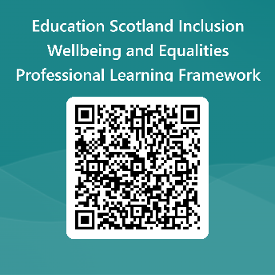
Your feedback
Your feedback could help us improve this resource and add to the overall value of the professional learning framework to the educational system
Please complete this short form, using the link or QR code, to let us know what you thought of it and any suggestions you have on how it could be improved
2025 LINK: https://forms.office.com/e/J2NQUuCHji

