Slide 1
Inclusion Wellbeing & Equalities Professional Learning Framework Differentiation – An Introduction
Informed level
For Scotland's learners, with Scotland's educators
Do luchd-ionnsachaidh na h-Alba, le luchd-foghlaim Alba
Notes:
Purpose of these Slides
Read title​
This professional learning is pitched at an informed level and suitable for anyone working with children and young people in an educational context.
How to use the slides:
To be used to facilitate professional learning in a group or whole-setting, or as a self-directed learning activity as an individual.
General Guidance
There is a requirement to cover all the slides.
Please do not change the provided slides.
Facilitators are welcome to add slides or activities relevant to your own setting, to support discussion and exploration of the topic. Facilitators will know their participants’ needs best.
Anyone who works in an educational setting can be a facilitator and use these slides.
It is important to establish a safe space which encourages respect and honesty to ensure that everyone is able to participate.

Slide 2
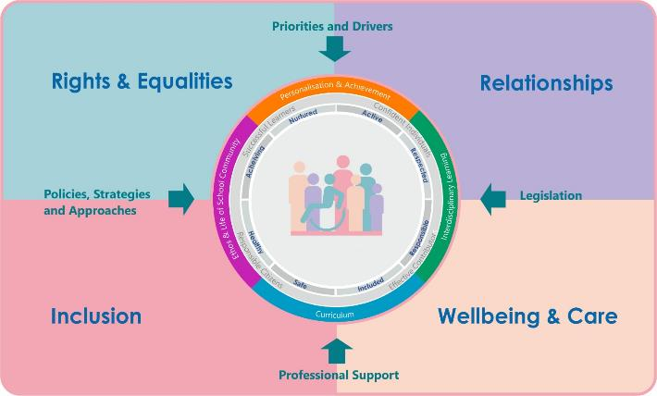
Interconnectivity
Notes:
All of the professional learning in the Framework fits into one of these four themes. The four themes are interconnected and interdependent.​
This activity forms part of the professional learning in the Inclusion theme.

Slide 3
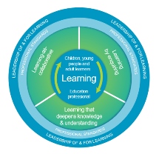
How to use this resource
These slides can be used to facilitate professional learning in a group or
whole-setting, or as a self-directed learning activity as an individual.
Facilitation notes are included at the bottom of each slide.
Please do not remove or change any of the slides included.
Facilitators are welcome to add slides or activities relevant to your own setting, to support discussion and exploration of the topic. Facilitators will know their participants’ needs best.
Anyone who works in an educational setting can be a facilitator and use these slides.
For reflection or discussion activities, it is important to establish a safe space which encourages respect and honesty to ensure that everyone is able to participate.
Notes:
Option to skip slide as these are instructions for facilitators only. No need to read to audience.

Slide 4
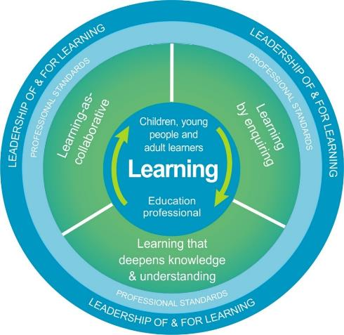
National Model for Professional Learning
This professional learning resource will support you to deepen your knowledge and understanding.
You will have the opportunity to consider how to take this learning forward on your own and with others.
The National Model of Professional Learning (education.gov.scot)
Notes:
This professional learning forms part of the national model for professional learning and is designed to help you gain more knowledge and have a deeper understanding of inclusion, wellbeing and equalities​​
On completion of this professional learning, you will be asked to consider what your next steps will be​​.
Please take some time to consider the reflection questions at the end

Slide 5
Welcome
This session aims to provide an opportunity to reflect on:
What differentiation means to you.
The roles and responsibilities of all staff in differentiation.
Your next steps in developing a deeper understanding of differentiation.
Notes:
Link activity to national model

Slide 6
Inclusive Practice, the Curriculum and Accessibility
“Curriculum for Excellence is an inclusive curriculum from 3 to 18 wherever learning is taking place”.
All children and young people are entitled to be supported through an inclusive and accessible curriculum. This will require effective differenciation.
The Scottish curriculum is defined as the totality of all that is planned for children and young people from early learning and childcare, through school and beyond.
Notes:
Using this entitlement as a baseline standard for all learners will support the development of an inclusive learning community in which all can meaningfully participate, achieve and be the best they can be. irrespective of identified additional support needs.

Slide 7
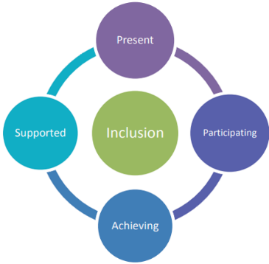
The Curriculum
The totality of the curriculum needs to be accessible for all children and young people and is underpinned by the 4 pillars of inclusion. To be included all children and young people need to be and feel:
Present
Participating
Achieving
Supported.

Slide 8
Differentiation
Opinion varies regarding agreement on the definitive methods and approaches to support differentiation within learning and teaching. However, there is consensus of understanding that:
The impact a barrier to learning has will vary in degree according to the learning and teaching environment and pedological approaches used
The differences between learners, and how they learn require to be incorporated within all planning so that all learners in a group have the best possible chance of learning.
Notes:
Notes
Opinion varies regarding agreement on the definitive methods and approaches to support differentiation within learning and teaching. However there is consensus of understanding that:
The impact a barrier to learning has will vary in degree according to the learning and teaching environment and pedological approaches used.
The differences between learners, and how they learn require to be incorporated within all planning so that all learners in a group have the best possible chance of learning.
One approach to learning and teaching does not fit everyone and developing practice which is inclusive and includes a range of differentiation is a pragmatic and time saving approach as it will support all learners to meaningfully participate in a flexible, accessible and inclusive curriculum.
Ensuring appropriate differentiation is a key factor in the provision of an inclusive learning community.

Slide 9
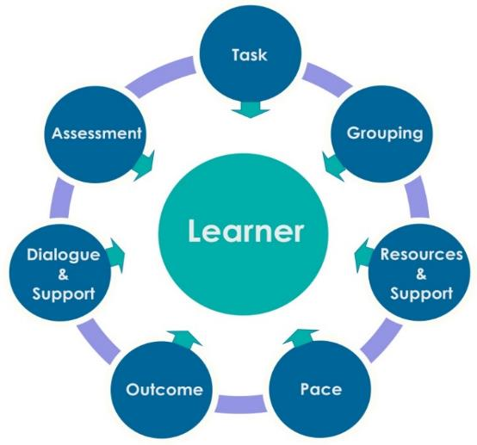
Differentiation –key factors
Approaches to consider when planning effective and meaningful differentiation.
Notes:
Notes
The image on the slide highlights different approaches to consider when planning effective and meaningful differentiation.
Depending on the activity it may not be possible to factor in all the approaches at the same time.
The focus areas are
Task
Grouping
Resources and Support
Pace
Outcome
Dialogue & support
Assessment

Slide 10
Task
Designing learning and teaching tasks for different abilities.
Ensuring appropriate challenge is included.
Designing learning and teaching which becomes progressively harder and more complex for the learner to engage with and complete.

Slide 11
Grouping
Co-operative learning approaches and activities which encourage the participation of all learners in the learning activity.
Small mixed ability group.
Peer support and learning.

Slide 12
Resources and Support
Ways of developing and supporting the learner’s independent skills.
Resource accessibility - consideration of resource design e.g. choice of formats diagrammatic, visuals, digital, audio, film, printed notes/resources or electronic files.
Access to and use of IT – software and hardware e.g. switches, text recognition software and portable devices such as tablets.
Providing a range of formats to record learners’ evidence of learning.

Slide 13
Resources and Support (continued)
Readability levels within textbooks and resources.
Digital exams and teaching resources.
Provision of key words/glossaries.
Staff, family and peer support.
Accessible sports equipment.

Slide 14
Pace
Consideration of flexibility of teaching pace and time allowed for tasks and individual learner requirements, supporting both able learners and those who require more time.
Spending more time on the initial explanation can help learners to feel more confident when they attempt a task.
Allow learners to feedback to you about the pace after the first task/activity.

Slide 15
Pace (Continued)
Stagger the instructions given; two at a time is best.
Chunk larger tasks into several smaller tasks.
Consider the length of activities.

Slide 16
Outcome
All learners undertake the same task, but a variety of results are expected and are acceptable.

Slide 17
Dialogue and Support
Teacher facilitates problem solving using appropriate levels of language to engage with learners.
Use of targeted questions to produce a range of responses.
Verbal support and encouragement.
Providing a range of formats to record learners’ evidence of learning.

Slide 18
Assessment
Meaningful purpose of the assessment
Formative, Summative
Assessing learner’s knowledge and understanding through the learning experience
A range of information, resources and good practice is available on the National Improvement Hub
Moderation - The Learning, Teaching and Assessment Cycle

Slide 19
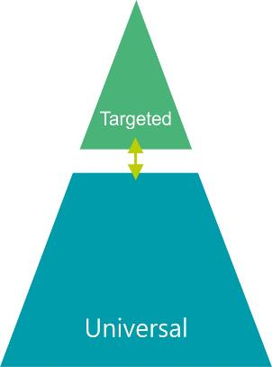
Supporting Learners Through Inclusive Pedagogy
?
Individual Plan
Class Plan
Individual Plan
Individual Plan
Individual Plan
Notes:
Notes
Within a class there will be a number of children or young people who require additional support. For the majority of children and young people this support is met through Universal support.
This level starts with the ethos, climate and relationships within every learning environment. It is the responsibility of all practitioners to take a child-centred approach which promotes and supports wellbeing, inclusion equality and fairness. As well as the Teacher’s class plan, planning and preparation may also be required to support individual plans.
To maximise efficiency of time it can be helpful to identify commonality of individual learner's need within the wider class planning.

Slide 20
Planning Tool
Support Needs /Barriers | Child A | Child B | Child C | Child D
Anxiety
Confidence
Completing tasks - in school and homework
Fine motor skills
Numeracy
Often appears very tired
Organisation
Processing
Reading
Sensory - Environmental
Short attention span
Social interactions
Spelling
Task avoidance
Transitions
Turn Taking
Working memory
Dyslexia
Dyslexia/ADHD
Autism
ADHD
Notes:
Notes
This table highlights common barriers to learning and the interconnecting and overlapping supports between children and young people. This approach is helpful for inclusive planning.

Slide 21
Planning Tool Option 2
Support Needs /Barriers | Child A | Child B | Child C | Child D
Task
Grouping
Resources /Support
Pace
Outcome
Dialogue and support
Assessment
Dyslexia
Dyslexia/ADHD
Autism
ADHD
Notes:
Notes
This slide provides another option of exploring common areas based on the 7 focus areas which support differentiation.

Slide 22
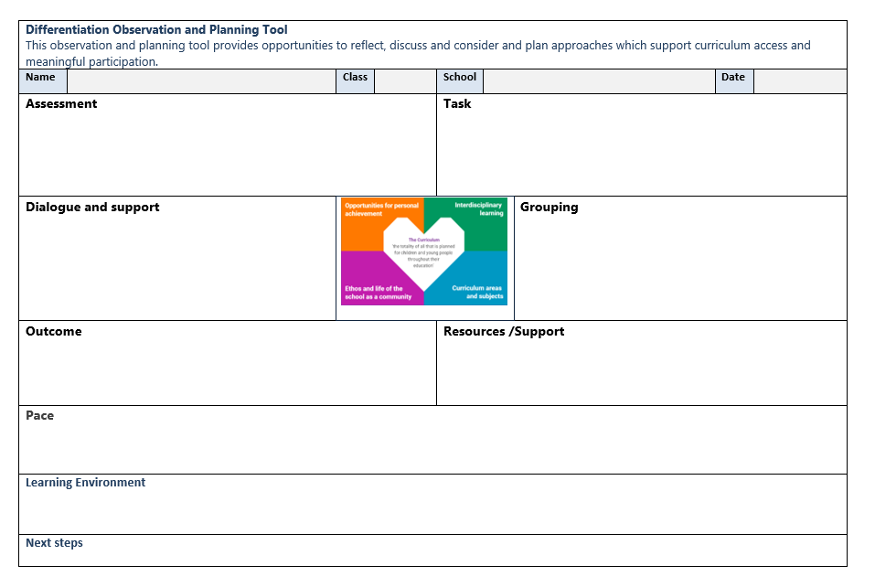
Differenciation Observation and Planning Tool
Notes:
Notes
Differentiation Observation and Planning Tool
This is an example of a planning approach which depending on how and with whom it is used can provide opportunities to reflect, discuss and consider and plan approaches which support curriculum access and meaningful participation through effective differentiation.
A down loadable version of this is available.

Slide 23
Reflection
We ought to begin to pay less attention to getting everyone over the same hill using the same path.
We may wish to encourage some to take different routes to the same end. Then we might see good reasons for paying careful attention to their descriptions of what they have found.
We may wish to follow them some day.
Tom West 1991 ‘In The Minds Eye’
Notes:
Notes
We ought to begin to pay less attention to getting everyone over the same hill using the same path.
We may wish to encourage some to take different routes to the same end. Then we might see good reasons for paying careful attention to their descriptions of what they have found.
We may wish to follow them some day.

Slide 24
Reflection
From what you have learned so far, think about:
How has this made you feel?
What has this made you think about?
What one action would you like to take forward?
How can you link what you plan to do with others in your setting?
How you will know that this learning has made a difference?
Notes:
Facilitation notes:
You can do this in groups...
Encourage educators to take this forward in an enquiry
Consider impact of the actions / learning

Slide 25
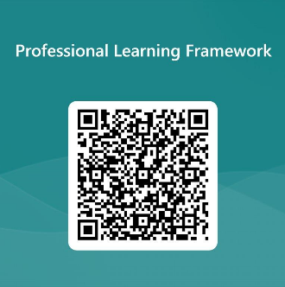
We value your feedback
From now until March 2024 we will be taking feedback on these resources so that we can make changes in advance of a formal launch of the Professional Learning Framework in June 2024
Your feedback could help us improve this resource
Please complete this short form, using the link or QR code, to let us know what you thought of it and any suggestions you have on how it could be improved
LINK: https://forms.office.com/e/b5PCpJJJ3P

Slide 26
For Scotland's learners, with Scotland's educators
Do luchd-ionnsachaidh na h-Alba, le luchd-foghlaim Alba
Education Scotland
Denholm House
Almondvale Business Park
Almondvale Way
Livingston EH54 6GA
T +44 (0)131 244 5000
E enquiries@educationscotland.gsi.gov.uk

