Slide 1
An overview
Supporting Attendance: Understanding the Issues
Notes:
All information correct as of January 2024
These slides are intended to support local authorities to provide an overview of the content of Improving Attendance in Scotland
The PowerPoint is a template that presenters can adapt to suit their own context and style of presenting.
Within the slide notes key messages.
It is anticipated the presenter will have read Improving Attendance in Scotland.

Slide 2
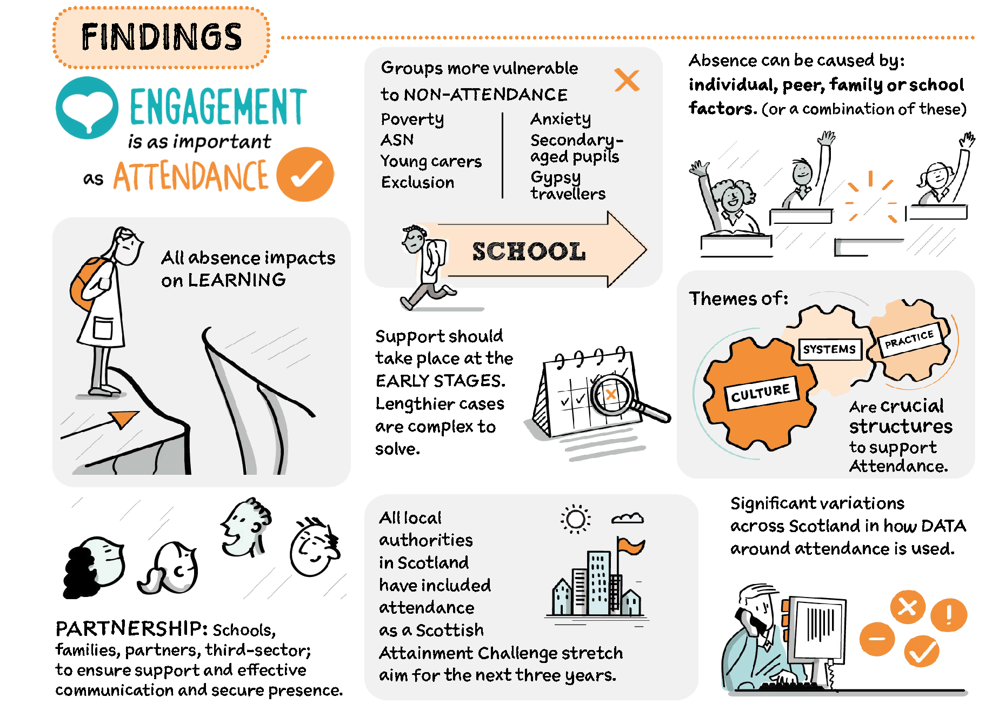
Improving attendance in Scotland
Read Improving Attendance in Scotland
Notes:
Key messages:
After a deep dive into attendance the following findings were identified (these will be further explored through the presentation)
Actions for consideration were also identified:
Local authorities should monitor the outcome of strategic and implementation plans for improving attendance or develop a plan where one is not in place
Put children and young people’s views at the centre of approaches
Education Scotland is working with stakeholders
partners should provide bespoke support for areas where attendance remains a challenge
Approaches to tracking and monitoring attendance should be shared
Education Scotland and Scottish Government will collaborate with the wider system to bring coherence to the work on improving attendance

Slide 3
Data
Academic year | Percentage
2010 to 2011 | 93.1%
2012 to 2013 | 93.6%
2014 to 2015 | 93.7
2016 to 2017 | 93.3
2018 to 2019 | 93
2020 to 2021 | 92
2022 to 2023 | 90.2
Notes:
Key messages:
In the academic year 2023 to 2024, school attendance is at a 10-year low.
Attendance was on a downward trajectory before the COVID-19 pandemic.
The data shows a sharper drop from 92% in 2020 to 2021 to 90.2 in 2022 to 2023, the pandemic hasn’t helped.

Slide 4
Attendance 2023
Notes:
Key messages:
There is a clear poverty-related attendance gap (6.7%)
In addition, pupils with additional support needs also attend less than those without needs. (4.1%)
The Commission on School Reform also report that there is variation across LAs in the number of children and young people attending 90% or below.

Slide 5
Primary School Attendance
Notes:
Key messages:
There is significant poverty related gap in primary school attendance. (5.7)
In addition, pupils with an additional support need also attend less than those without needs. (2.6%)

Slide 6
Secondary School Attendance
Notes:
Key messages:
The poverty-related gap in school attendance widens further in secondary (6.7% in secondary compared to 5.7% in Primary )
Attendance of those with an additional support need and those without needs also increases. (4.1% in secondary compared to 2.6% in Primary)

Slide 7
Engagement is as important as attendance
Engagement happens when children and young people give attention to, and are actively involved in, a learning task.
Types of engagement include:
emotional (interest, boredom, happiness)
behavioural (attention, effort, persistence)
cognitive (motivation, learning strategies)
agency (expressing interests and needs)
Notes:
Key message:
One of the key findings is that ‘Engagement is as important as attendance’.
Children and young people may physically be in school but can be disengaged from learning. Without engagement attendance is meaningless.

Slide 8
What does the research say?
Talking Point
All absence affects attainment, even when related to illness
An average of 90% attendance is the equivalent of missing an entire school year by 3rd year of high school
School absences are associated with lower educational attainment and a greater likelihood of non-employment
Individuals who missed five days of school at age 10 were 5.7% more likely to have no qualifications
1% absence = 3% decrease of a standard deviation in post-16 qualification tariff scores
Late coming is an early indication that absence may become a problem
An increase in unauthorised absence from age 10 to 11 can indicate more significant absence in later years
Absences may cause greater harm to those who experience socio‑economic deprivation
Notes:
Talking point:
What fact is most surprising?
Key message:
Improving Attendance: Understanding the Issues has a wealth of research that delves into the impact of absence.

Slide 9
Understanding the reasons for absence
The causes of absence are multifaceted and should be considered only as part of a bigger picture of the individual child or young person.
School
Peers
Individual
Family
(Forth Valley West Lothian)
This Photo by Unknown Author is licensed under CC BY
Notes:
Key messages:
Forth Valley and West Lothian have categorised the reasons for absence under four headings:
Individual factors : such as health (physical/mental) ASN, social factors, self-belief, lack of interest
School factors: such as relationship with teacher/peers, quality of learning/relevance, curriculum, transitions
Family factors: such as low interest/belief, parent mental health, loss and bereavement, worry about parents, financial concerns
Peer factors: peer pressure, social isolation, poor social skills, peer conflict, bullying, feeling of not belonging
Absence can be multifaceted and can therefore have more than one cause. Assessing the reasons will support the removal of any barriers.

Slide 10
Pushes and Pulls
Pull to
Push away
Push away
Pull to
Notes:
Key messages:
In thinking about how we improve attendance it is helpful to consider how we support absence and promote attendance.
To do this we need to consider what:
Pulls learners toward home? How can we mitigate or support pressures on young carers, the desire to game and peer pressure?
What pushes the learner away from home/community? As well as supporting the learner with what is happening at home, how do we capitalise on school being a solution such as strong relationships/ safe culture?
Pulls away from school that require mitigation such as peer relationships, staff relationship( affiliation), the relevance of curriculum, a curriculum that speaks to goals (agency), control over what/where they are learning (autonomy) identity as a learner (do they feel the curriculum is for them?)
Pulls towards school – What is your offer? What makes your CYP get out of bed in the morning? What happens on the days of the week you have low attendance?
When schools understand what is pushing and pulling they can remove these barriers.

Slide 11
Groups more vulnerable to low attendance
children and young people impacted by poverty
secondary-aged pupils
young people from Gypsy and Traveller communities
pupils with additional support needs including:
children and young people who have experienced care
young carers
children and young people who have experienced exclusion
children and young people with social and emotional needs linked to mental health
Notes:
Key messages:
Certain groups are more vulnerable to low attendance
Children and young people impacted by poverty:
Children and young people living in areas of high economic and social deprivation have higher absence rates
Recovery from absence is harder for these pupils are families are unable to mitigate the impact.
Secondary-aged pupils:
Attendance diminishes as pupils move through school. It is important to have an early intervention strategy.
For example, if the first unauthorised absence is not challenged this will likely lead to poor attendance later.
Children and young people who have experienced care (looked-after):
In secondary schools, the difference in attendance rates between looked after children and all pupils was greater than in primary schools and special schools in 2020-21.
Young people from Gypsy and Traveller communities:
Outcomes for these young people are among the worst in Scottish education.
Young Carers:
Around 7% of young people in Scotland have caring responsibilities.
Over a quarter of young carers aged 11 to 15 regularly miss school.
Children and young people who have been excluded:
Exclusion is associated with poor mental and physical health, substance abuse, antisocial behaviour, crime, low academic achievement, unemployment, and homelessness.
Children and young people with social and emotional needs linked to mental health
Those experiencing emotionally-based avoidance

Slide 12
What can we do?
Notes:
Key messages:
System is the easier to change but cogs are reliant on each other. Fixing just one on its own won’t work.

Slide 13
Reviewing systems to support attendance
effective use of data to identify early warning signs
rigorous tracking and monitoring of all absences
analysis of ‘actionable data’
identify history of absence
evidence-based support approaches
whole school approaches
highlight absence through a range of lenses systems
multi-dimensional, multi-tiered systems of support
Notes:
Key messages:
Key messages:
Consider the following to support system change
effective use of data to identify early warning signs
rigorous tracking and monitoring of all absences
analysis of ‘actionable data’
identify history of absence
evidence-based support approaches
whole school approaches
highlight absence through a range of lenses systems
multi-dimensional, multi-tiered systems of support
onsider the following to support a change in systems

Slide 14
Developing a positive culture for attendance
clear leadership is needed
equity and inclusion are embedded
compassionate, flexible relationships
support families to build their confidence
feelings of safety and belonging are prioritised
universal and targeted approaches are balanced
families, partners, and community members are valued
ensure all stakeholders understand the importance of attendance
cross-sector working - avoiding a discrete problem-solving approach
Notes:
Key messages:
Consider the following to support a change in culture
clear leadership is needed
equity and inclusion are embedded
compassionate, flexible relationships
support families to build their confidence
feelings of safety and belonging are prioritised
universal and targeted approaches are balanced
families, partners, and community members are valued
ensure all stakeholders understand the importance of attendance
cross-sector working - avoiding a discrete problem-solving approach

Slide 15
Reviewing practices to support attendance
aligning to values and culture
getting it right for every child
reflecting the views of the young person
curriculum flexibility and learning pathways
low income supports
prioritising social and emotional support
building connections with a key person
targeting underlying causes such as wellbeing and additional support needs
activating children and young peoples’ motivation
Notes:
Key messages:
Consider the following to support a change in practice
aligning to values and culture
getting it right for every child
reflecting the views of the young person
curriculum flexibility and learning pathways
low income supports
prioritising social and emotional support
building connections with a key person
targeting underlying causes such as wellbeing and additional support needs
activating children and young peoples’ motivation

Slide 16
Whole school approaches
Info Sheet 109 Restorative Communities (cycj.org.uk)
Notes:
Key messages:
Attendance should not be the role of one or a few people in a school.
A whole school approach is required.
Ethos of care and justice
Rights and relationship policy
Strong learner voice and participation
Social and emotional learning focus
Use circles to problem solve and build community
Mediation and peer mentoring
Emotional literacy focus
Prioritise belonging and connectedness
Restorative approaches
Inclusion wellbeing and equalities focus

Slide 17
Improving motivation and engagement
How do you promote a sense of belonging, empowerment and identity?
What impact does this have on attendance?
Notes:
Key messages:
Motivation is required to be engaged.
Self-determination theory suggests that establishments may wish to consider how effectively learners have:
Affiliation: a sense of belonging. I belong
Autonomy: a sense of self-determination. I am allowed/trusted
Agency: a belief in your ability to achieve your goals. I can.
The Glasgow Motivation and Wellbeing Profile explores motivation and sense of wellbeing in the learning context.

Slide 18
What data do I need?
What data are you using?
How is data gathered?
What is your early warning system?
What does your transition data look like?
How are you using data to protect vulnerable groups?
Absence is only a symptom of what else is happening.
Notes:
Key messages:
All absence can affect progress
Initial un-challenged unauthorised absences lead to more
90% threshold for action is unreliable
Assessing the reasons for non-attendance
what is pushing the child or young person away from school and pulling them towards home?
Certain groups are more vulnerable to non-attendance
those impacted by poverty
secondary-aged pupils
young people from Gypsy and Traveller communities
pupils with additional support needs including:
children and young people who have experienced care
Young carers
children and young people who have experienced exclusion
anxious children and young people
Absence in higher as a pupil moves through secondary
Patterns of unauthorised attendance in P7/S1 can lead to more persistent absence later in secondary school
The first unauthorised absence will lead to more
Absence is only a symptom of what else is happening
Knowledge of the child or young person is the strongest data
Reflective Question:
What type of data or demographic information are you using and how frequently is it analysed?

Slide 19
Putting Children, Young People and Families at the Centre
1. Identify target pupils
2. Gather all views
3. Understand the causes
4. Co-create intervention plan
5. Implement, monitor and evaluate
Targeted Intervention and Data Gathering (Forth Valley & West Lothian)
Notes:
Key messages:
Forth Valley and West Lothian have created targeted intervention guidance for putting children and families at the centre.
This follows the principles of GIRFEC.
This is a flow chart for targeted intervention:
1. Identify target pupils: use attendance data and early warning systems to identify target pupils.
2. Gather all views: gather individual views from the pupil, parent/carer, and key staff, to gain a holistic understanding of attendance problems.
3. Understand the causes: analyse qualitative data to determine the cause(s) and identify suitable interventions.
4. Co-create intervention plan: agree next steps and plan interventions in partnership with parents/carers, the pupils themselves, and any appropriate agencies.
5. Implement, monitor and evaluate: once interventions are implemented, continue to monitor progress and evaluate their effectiveness, sharing this information with all involved.
Attendance Targeted Intervention Guidance: https://blogs.glowscotland.org.uk/glowblogs/fvwlric/school-refusal-assessment-scale-sras-r/

Slide 20
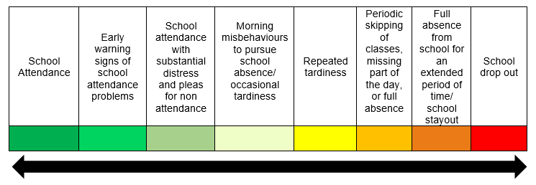
Initiating Support
School attendance through to school refusal can be considered as a spectrum which can be used as an early warning system to initiate support.
(Forth Valley West Lothian)
Notes:
Key messages:
Attendance can be considered a spectrum.
Early intervention is easier to deal with rather than chronic absence.
The scale shows:
School attendance
Early warning signs of school attendance problems
School attendance with substantial distress and pleas for non attendance
Morning misbehaviours to pursue school absence/occasional tardiness
Repeated tardiness
Periodic skipping of classes, missing part of the day, or full absence
Repeated tardiness
Periodic skipping of classes, missing part of the day or full absence
Full absence from school for an extended period of time
School drop out
How do we make our staff more aware of the early warning system?

Slide 21
Resources
Included, engaged and involved part 1 (gov.scot)
This national policy provides the framework for the promotion and management of attendance and absence.
Attendance toolkit (glowscotland.org.uk)
An interactive attendance toolkit, created by FVWL Regional Improvement Collaborative
Promoting Attendance: self-reflection questions for educational settings
This resource provides self-reflection questions for schools to further explore and implement practices which will encourage good attendance.
Notes:
Key messages:
Self-evaluation should be at the heart of improvement regardless of the resource used.

Slide 22
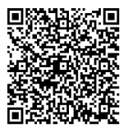
Thank you!
Notes:
We hope you found the resource useful.
Please let us know how we can improve this by answering the questions below.
https://forms.office.com/e/jC9rBVwD2M

