Slide 1


Slide 2

Today we will learn:
What a stereotype is and identify some examples.
What a visible difference is.
How stereotypes of visible difference are often used in film and on TV.
What impact negative stereotypes of visible difference can have on people.
How all stereotypes can be challenged.

Slide 3

Remember that when we discuss a topic:
Only one person should talk at a time
– no interrupting.
Show respect for the views of others.
Challenge the ideas not the person.
Use appropriate language – no rude comments.
Allow everyone to express their view, to ensure that everyone is heard and respected.
Don’t share personal stories without permission.

Slide 4

QUESTION
TIME
What do these statements
have in common?

Slide 5

All teenagers take drugs and commit crime
All women are bad drivers
Pensioners are too old to enjoy life anymore
Men are not very good at looking after children

Slide 6

They are all stereotypes.
A stereotype is an idea about a particular group of people that is often untrue or unfair.

Slide 7

QUESTION
TIME
What makes a film or TV villain scary?

Slide 8
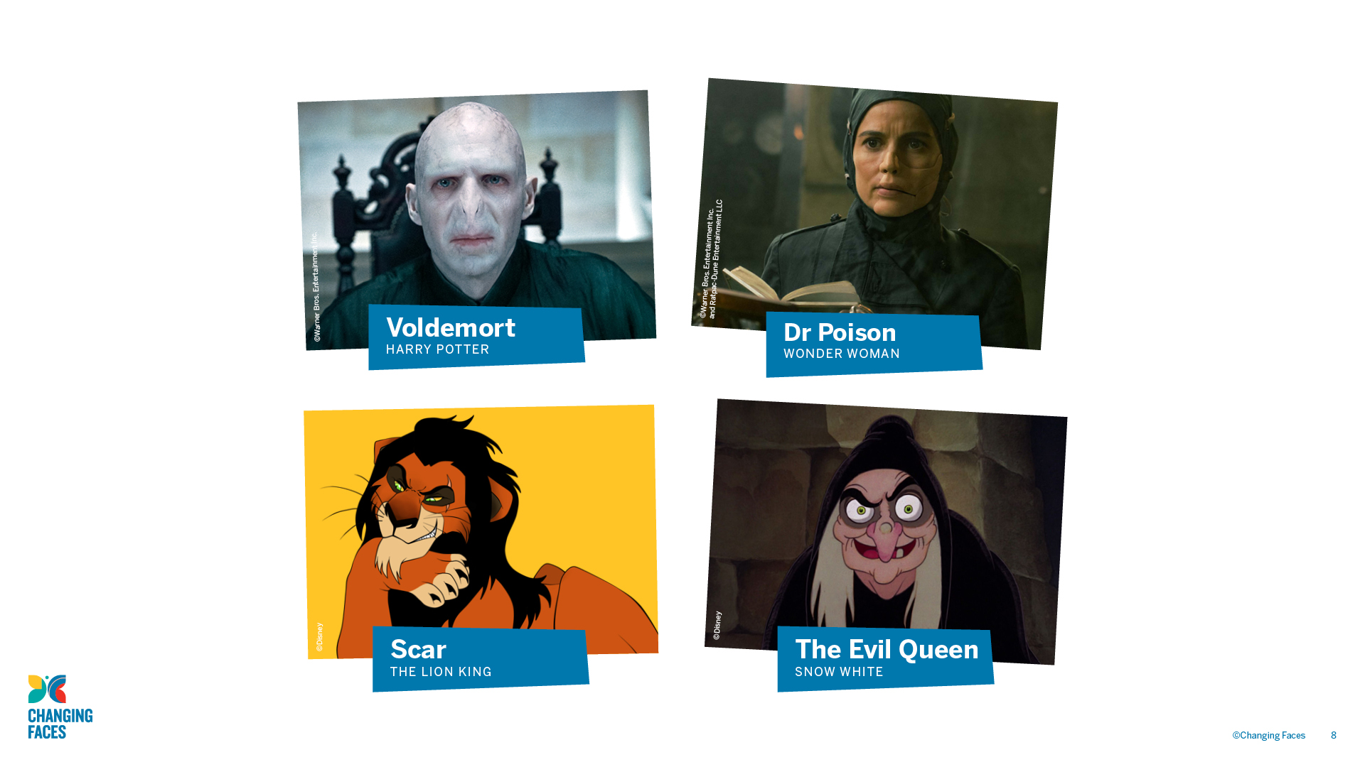

Slide 9

All of the villains on the previous slide have an unusual appearance, such as a scar.
How many heroes can you think of who have a scar, mark or condition that affects their appearance?

Slide 10

It’s common for films and TV programmes to use the stereotype that if you look different, you must be a villain.
This has a negative impact on people who look different in real life.

Slide 11

A visible difference is a mark, scar or condition that affects the appearance of someone’s face or body

Slide 12

Causes of a visible difference:
Skin conditions like eczema, acne, or vitiligo
Burns
Birthmarks
Craniofacial conditions, affecting the growth and development of the skull and face
Cleft lip/palate (a gap or split in the upper lip and/or roof of the mouth)
Cancer

Slide 13
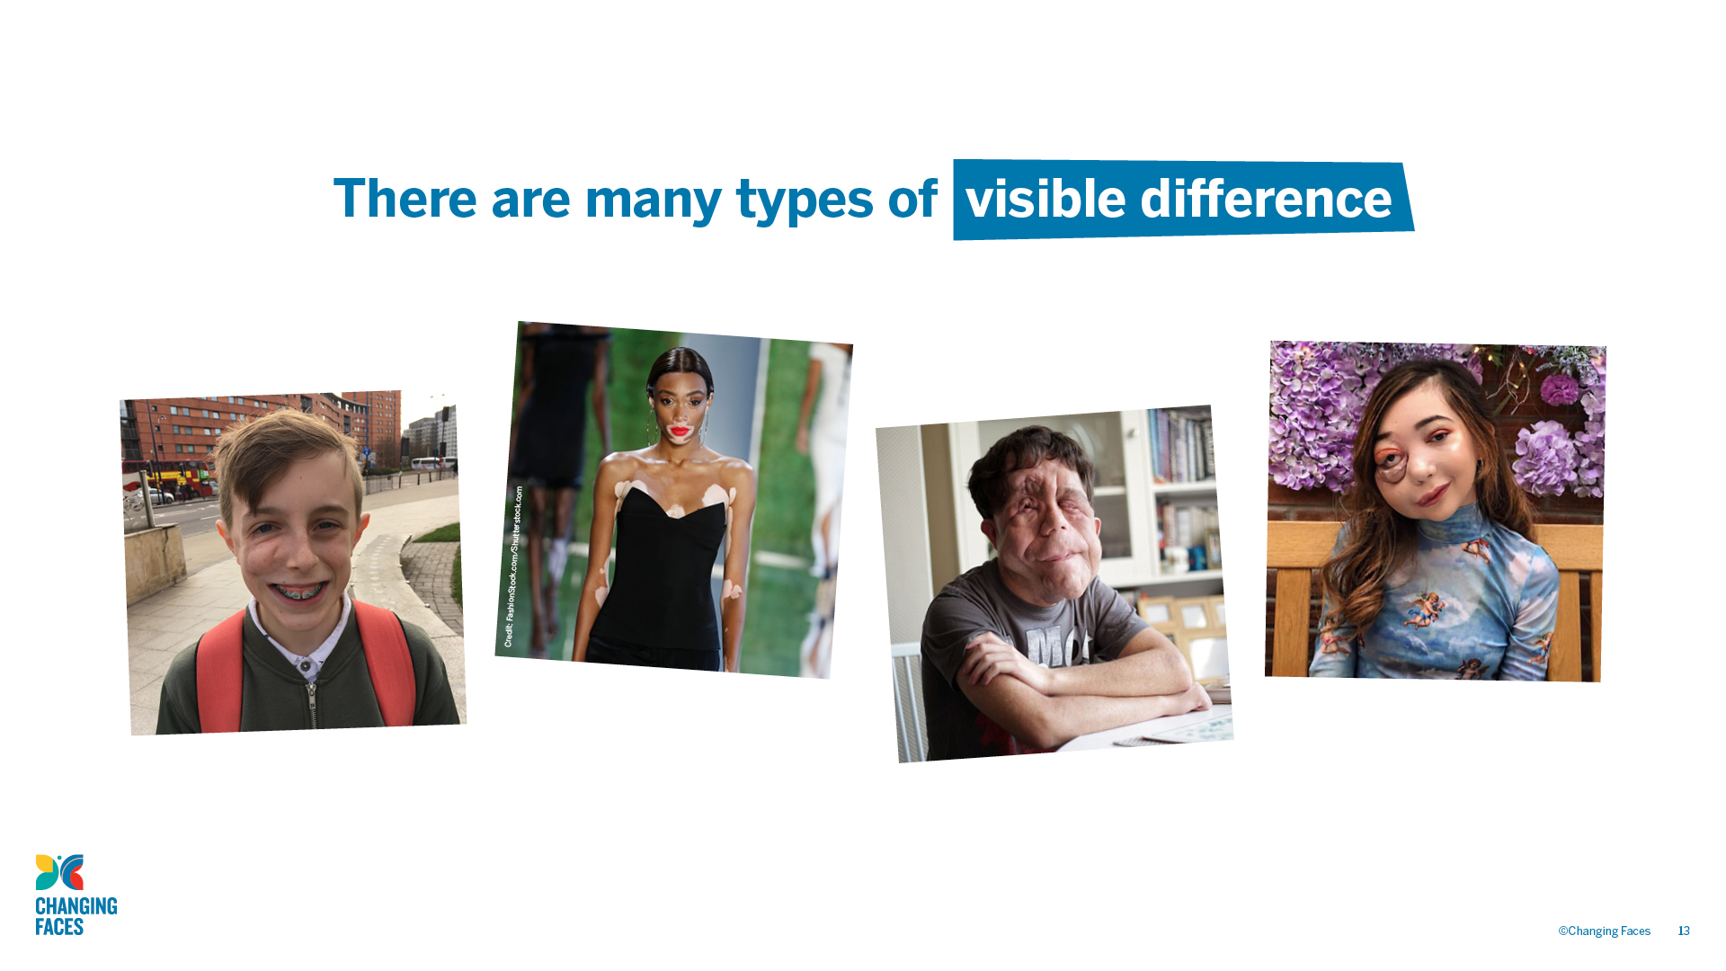

Slide 14
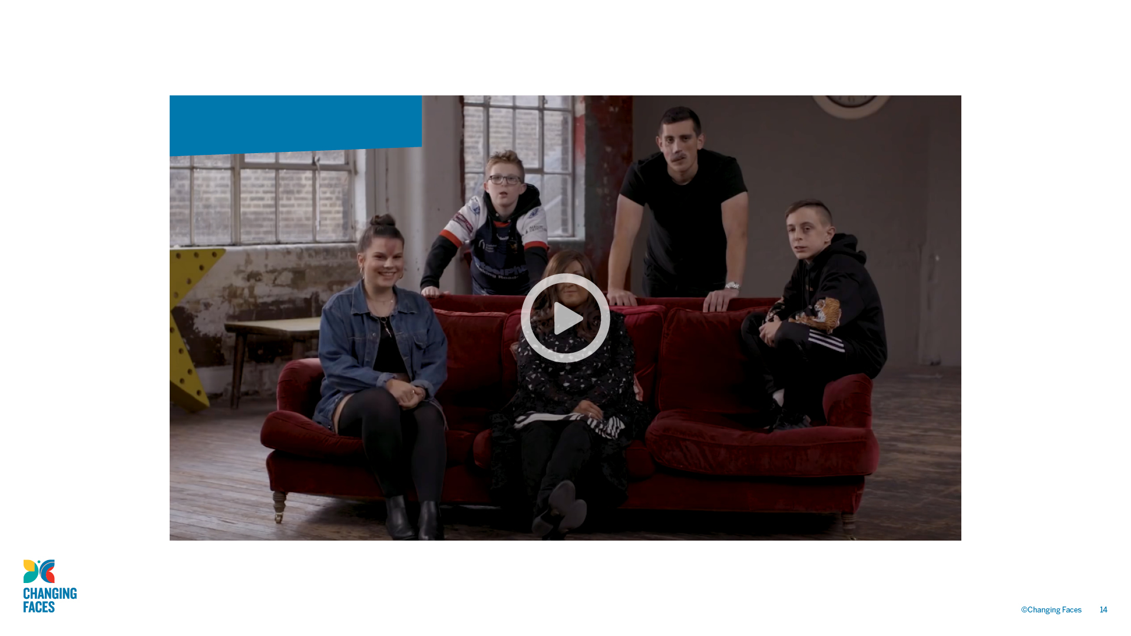
#iamnotyourvillain

Slide 15

Other helpful websites
youngminds.org.uk
respectme.org.uk
Find out more about visible differences and respecting difference: changingfaces.org.uk
Worried about anything we’ve discussed?
You can contact Childline for help:
childline.org.uk

