Slide 1


Na Seumasaich – The Jacobites
Learning about Gaelic Language and Culture Resource
Lesson 2 – Who were the Hanoverians? and Saying where you are from in Gaelic.
For Scotland's learners, with Scotland's educators

Slide 2
Na Seumasaich – Lesson 2
In this Learning about Gaelic Language and Culture resource lesson we will learn:
about the Hanoverian Royal Family
to say where we are from in Gaelic
to ask someone where they are from in Gaelic
to understand how to say this in contexts
about some Gaelic placenames for countries and areas
about the clan system in the Highlands of Scotland
to create short texts about ourselves and others in Gaelic

Slide 3
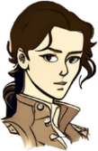
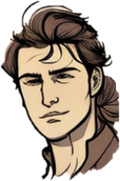
Màiri and Calum
Fàilte air ais a Chaluim
Welcome back.
Tapadh leat a Mhàiri
Cò às a tha thu?
Tha mi à Alba

Slide 4
Màiri and Calum 2
So last time we learned about the Stuarts and the Jacobites.
The Stuarts were replaced by Protestant cousins from Hanover, a part of what is now Germany. The first Hanoverian king was George I.
What is George in Gaelic? Did he speak Gaelic?
Seòras or Deòrsa as he was called in Gaelic didn’t even speak English! He was a German speaker and even died and is buried in Hanover.
Interesting. So being Protestant was more important than being British!

Slide 5
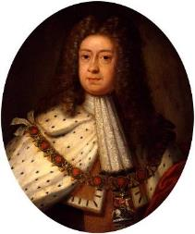
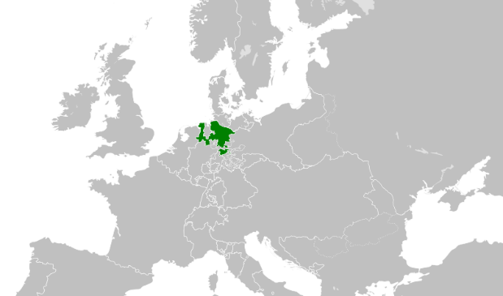
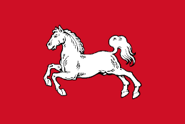
Càit a bheil Hanobhair? Where is Hanover?
’S mise Seòras. Tha mi às a’ Ghearmailt.
King George I and his sons came from Hanover. The Electorate of Hanover was an area in North West Germany (A’ Ghearmailt).
The British Royal Family would also rule Hanover until 1837 when Queen Victoria became monarch (because she had a male relation who was first in line).
At the time of the 1745 Rebellion George’s son George II was on the throne.
SCOTLAND
HANOVER
ENGLAND
Creative Commons — Attribution-ShareAlike 2.5 Generic — CC BY-SA 2.5 Oren Neu Dag

Slide 6
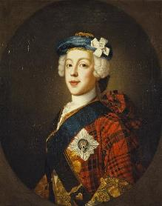
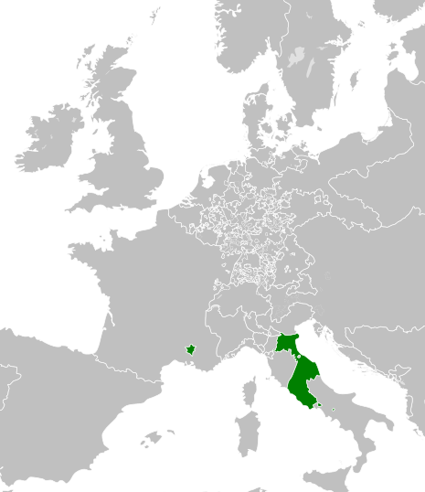
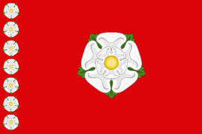
Càit an deach na Stiùbhartaich? Where did the Stuarts go?
’S mise Teàrlach. Tha mi às an Roimh.
James VIII and III (The Old Pretender) lived in lands owned by the Pope. Sometimes he lived in Avignon, which is now in France (An Fhraing). His sons Charles and Henry would be born in Rome (An Roimh) in what is now Italy (An Eadailt)
The lands owned by the Pope were called the Papal States. The only remaining area of this today is the Vatican City – the smallest country in the World – in the centre of Rome.
Avignon
PAPAL STATES
Rome
Creative Commons — Attribution-ShareAlike 3.0 Unported — CC BY-SA 3.0 MrPenguin20

Slide 7
Màiri and Calum 3
So the Jacobites were Scottish?
Not all Jacobites were Scottish. We think they were because of the most famous rebellions, but there were English and Irish ones too!
Was every Scot a Jacobite?
Not at all. In fact, many Scots were on the side of the Hanoverians. They wanted a Protestant king or at least supported their Clan Chief who was loyal to the present King.
Interesting. So it was never an England vs Scotland thing!

Slide 8
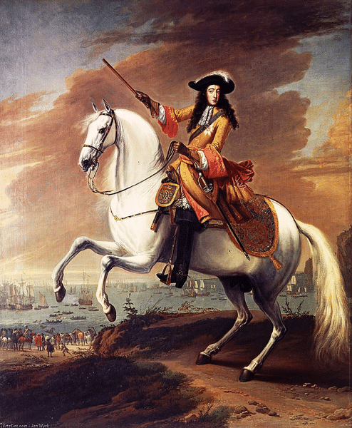

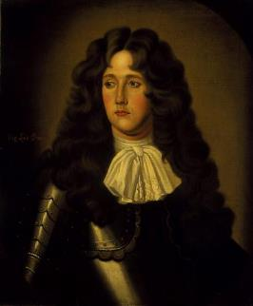
The first Jacobite Rebellion - 1689
Tha mi às an Olaind
The first Jacobite rebellion in Scotland was in 1689 – this ended with the Battle of Killecrankie. The Jacobites won that battle but their brilliant general, Viscount Dundee, James Claverhouse aka Bonnie Dundee was killed by a stray bullet.
The Jacobites won thanks to the Highland Charge, where they would run down a hill very fast with swords. At that time it could take over a minute to reload a gun so the enemy soldiers were quickly overrun. This was also the first ever battle in which grenades were used.
After this battle, King William and Queen Mary demanded every Clan Chief swear loyalty to them The Macdonalds of Glencoe were late in doing so. The Government sent troops from Campbell Argyll to kill them. This is called the Massacre of Glencoe and happened in 1692.
Tha mi à Dùn Deagh

Slide 9
The first Jacobite Rebellion – 1689
Questions
Tha mi às an Olaind
Q1 – Why did the Jacobites fail even though they won the Battle of Killiecrankie?
Q2 – Why did the Massacre of Glencoe happen in 1692?
Tha mi à Dùn Deagh

Slide 10
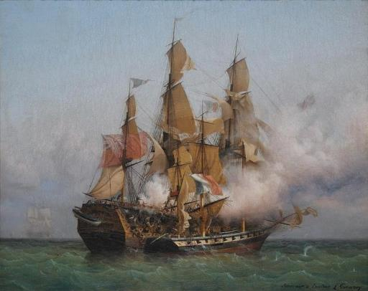


The 1708 Rebellion – Measles and Storms
Tha mi à Breatainn
In 1708, just after the Act of Union, James VIII and III tried to invade North East Scotland.
He was accompanied by 5000 French and Irish soldiers, but he caught measles, his navy was caught in a storm and the Royal Navy chased them back to France.
The French Government supported the uprising because it kept the British Navy busy. They weren’t too fussed about the Stuarts retaking the throne, so it was successful for them.
However, although many in Scotland were against the new Union with England, people in Scotland did not rise up this time for the “Pretender” as James VIII & III was called.
Tha mi às an Fhraing

Slide 11
The 1708 Rebellion – Measles and Storms - Questions
Tha mi à Breatainn
Q1 – Why weren’t the French upset that the 1708 Rebellion failed?
Q2 – What nickname did James VIII & III get?
Tha mi às an Fhraing

Slide 12
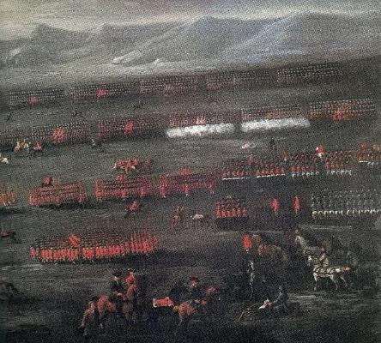

The ’15 – The 1715 Jacobite Rebellion and Sheriffmuir
In 1715, a year after George I took the throne, the Earl of Mar led a larger Jacobite Rebellion. He raised the Jacobite standard (large flag) near Braemar in Aberdeenshire. His army number over 20,000.
The Jacobites managed to take over almost all of Scotland north of the River Forth. An important battle was at Sheriffmuir near Stirling. The Earl of Mar thought he had won, so the Jacobites retreated and spared a lot of Government troops. The British claimed this as a victory.
The Earl of Mar was indecisive. This means he wasn’t good at making decisions. His army dwindled to 5000 men. This meant that when James VIII arrived in Scotland in 1716, the campaign was not going as well as expected and he returned home to France.
Tha mi à Alba
Tha mi à Alba

Slide 13
The ’15 – The 1715 Jacobite Rebellion and Sheriffmuir
Questions
Q1 – Where did the Earl of Mar begin his rebellion?
Q2 – What mistake did he make at Sheriffmuir?
Q3 – Why did James go back to France?
Tha mi à Alba
Tha mi à Alba

Slide 14
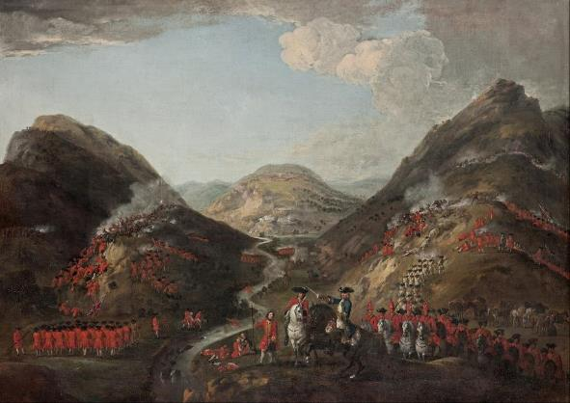

The ’19 – The 1719 Jacobite Rebellion and Glen Shiel
In 1719, some troops from Catholic Spain, supported Highland Jacobites landed in Lochalsh. The big battle here was the Battle of Glen Shiel. You drive through the battlefield on the road to the Isle of Skye.
This was the first battle to use mortars. The Spanish troops tried to escape by running up the steep sides of the glen. They were captured and sent back to Spain.
The Jacobites had stored their weapons at Eilean Donan Castle, which is now a famous tourist landmark. The British came and blew them up.
As revenge, the British invaded Vigo in North West Spain and held it for ten days. After this the Spanish stopped supporting the Jacobites.
Tha mi às an Spàinn

Slide 15
The ’19 – The 1719 Jacobite Rebellion and Glen Shiel
Questions
Q1 – What kind of weapons were used for the first time at Glen Shiel?
Q2 – What happened to Eilean Donan Castle?
Tha mi às an Spàinn

Slide 16
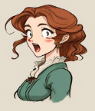

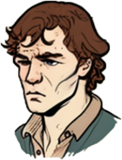
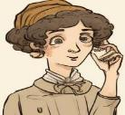

How to talk about where you are from in Gaelic.
Cò às a tha sibh?
To say I am from in Gaelic, you say Tha mi à… or Tha mi às…
To ask someone where they are from you, you ask
Cò às a tha thu?
Or if they are older or there is more than one
Cò às a tha sibh?
Tha mi à Alba
Tha mi à Èirinn
Tha mi às an Fhraing
Tha mi às an Eadailt

Slide 17
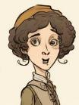
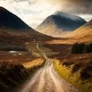
Saying where we are from in Gaelic
Research – find out the Gaelic for the following Scottish places.
There are two ways to say “from” in Gaelic à or às
We use Tha mi à… for most placenames
We use Tha mi às… for placenames which begin with “The” in Gaelic (A’, An, Am or Na) – this is common for most countries in Europe but we also see it with The Highlands - A’ Ghàidhealtachd
Glasgow
Edinburgh
Dundee
Aberdeen
Inverness
Perth
Stirling
Fort William
Oban
Dumfries
Orkney
Shetland
Elgin
Isle of Skye
Tha mi às
a’ Ghàidhealtachd

Slide 18







Dùthchannan Eòrpach
European Countries
You’ll see which countries use Tha mi à and which use Tha mi às.
Tha mi à…
Tha mi às…
Alba
Sasainn
Nirribhidh
Èirinn
Breatainn
An Spàinn
An Fhraing
A’ Ghearmailt
An Olaind
An Danmhairg
An t-Suain
An Ugrain
An Eadailt
A’ Pholainn

Slide 19

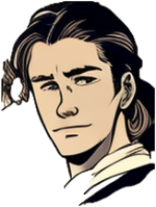
Task one – Asking and saying our names in Gaelic
Your teacher will ask you Cò às a tha thu? Reply with Tha mi à Alba – I am from Scotland If you want to say you are from another country, don’t worry, your teacher can give you the answer for that. See below for an example.
Caleb, Cò às a tha thu?
Tha mi à Alba

Slide 20

Task two - writing
You are going to add to your two profiles – one for yourself, and one for a Highlander boy or girl from the time of the Jacobites.
Write a sentence in Gaelic stating your first name and surname.
Write a sentence in Gaelic stating where you are from.
Then do the same for your Highlander.
Example
’S mise Chloe Kowalcyk
Tha mi às a’ Pholainn
’S mise Mairead NicLeòid
Tha mi à Alba
’S mise Ruairidh Caimbeul
Tha mi à Sasainn
’S mise Iseabail Stiùbhart
Tha mi à Alba

Slide 21
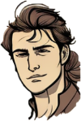
Task three - talking
Hai. Dè an t-ainm a th’ ort?
Go around the class and follow this example.
Greet each other with a simple Hai or Halò
Ask each other your name using Dè an t-ainm a th’ ort?
Then ask each other where you are from Cò às a tha thu?
Halò
’S mise Calum MacLeòid.
Cò às a tha thu a Chaluim?.
Tha mi à Alba.

Slide 22

Task four - talk
Halò. ’S mise Seumas. Tha mi à Nirribhidh.
Choose a country that you haven’t used already.
Go round the class and introduce yourself and then state where you are from.
Halò ’S mise Calum! Tha mi às an Olaind.
Hai ’s mise Anna. Tha mi à Sasainn.

Slide 23
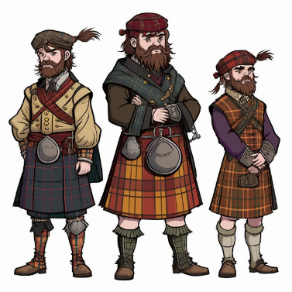
Task five - factfile
Research one of the following Battles – Killecrankie (1689), Sheriffmuir (1715) or Glen Shiel (1719). Present your findings and try and include the following.
A map of Scotland to show the location
A diagram of how the battle happened
Some statistics about how many people fought and died
Some interesting facts about things that happened or people who fought
Any other relevant information or images

Slide 24

For Scotland's learners, with Scotland's educators
Education Scotland
Denholm House
Almondvale Business Park
Almondvale Way
Livingston EH54 6GA
T +44 (0)131 244 5000
E enquiries@educationscotland.gsi.gov.uk

