Slide 1
Inclusion Wellbeing & Equalities Professional Learning Framework Accessibility – An Introduction
Informed level
For Scotland's learners, with Scotland's educators
Do luchd-ionnsachaidh na h-Alba, le luchd-foghlaim Alba
Notes:
Purpose of these Slides
Read title​
This professional learning is pitched at an informed level and suitable for anyone working with children and young people in an educational context.
How to use the slides:
To be used to facilitate professional learning in a group or whole-setting, or as a self-directed learning activity as an individual.
General Guidance
There is a requirement to cover all the slides.
Please do not change the provided slides.
Facilitators are welcome to add slides or activities relevant to your own setting, to support discussion and exploration of the topic. Facilitators will know their participants’ needs best.
Anyone who works in an educational setting can be a facilitator and use these slides.
It is important to establish a safe space which encourages respect and honesty to ensure that everyone is able to participate.

Slide 2
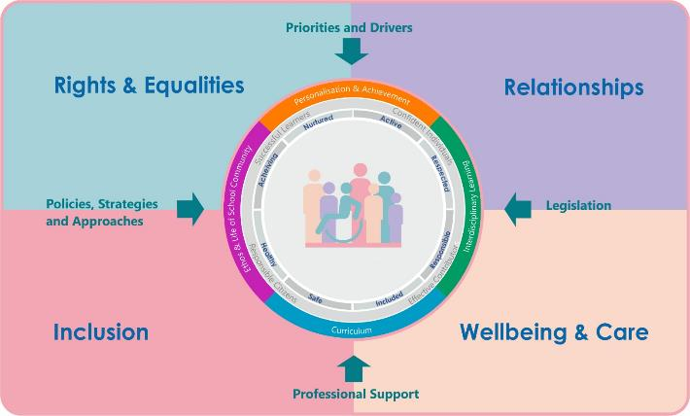
Interconnectivity
Notes:
All of the professional learning in the Framework fits into one of these four themes. The four themes are interconnected and interdependent.​
This activity forms part of the professional learning in the Inclusion theme.

Slide 3
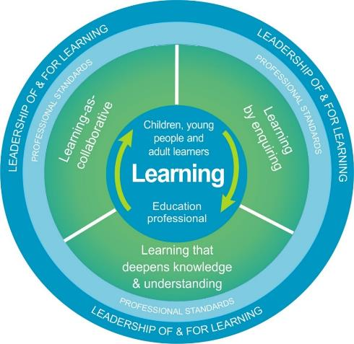
National Model for Professional Learning
This professional learning resource will support you to deepen your knowledge and understanding.
You will have the opportunity to consider how to take this learning forward on your own and with others.
The National Model of Professional Learning (education.gov.scot)
Notes:
This professional learning forms part of the national model for professional learning and is designed to help you gain more knowledge and have a deeper understanding of inclusion, wellbeing and equalities​​
On completion of this professional learning, you will be asked to consider what your next steps will be​​.
Please take some time to consider the reflection questions at the end

Slide 4
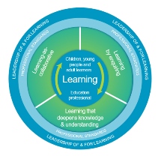
How to use this resource
These slides can be used to facilitate professional learning in a group or
whole-setting, or as a self-directed learning activity as an individual.
Facilitation notes are included at the bottom of each slide.
Please do not remove or change any of the slides included.
Facilitators are welcome to add slides or activities relevant to your own setting, to support discussion and exploration of the topic. Facilitators will know their participants’ needs best.
Anyone who works in an educational setting can be a facilitator and use these slides.
For reflection or discussion activities, it is important to establish a safe space which encourages respect and honesty to ensure that everyone is able to participate.
Notes:
Option to skip slide as these are instructions for facilitators only. No need to read to audience.

Slide 5
Welcome
This session aims to provide an opportunity to reflect on:
What accessibility means to you.
The roles and responsibilities of all staff in supporting inclusive accessibility.
Your next steps in developing a deeper understanding of accessibility .
Notes:
Link activity to national model

Slide 6
Inclusive Practice, the Curriculum and Accessibility
“Curriculum for Excellence is an inclusive curriculum from 3 to 18 wherever learning is taking place”.
All children and young people are entitled to be supported through an inclusive and accessible curriculum.
The Scottish curriculum is defined as the totality of all that is planned for children and young people from early learning and childcare, through school and beyond.
Notes:
Using this entitlement as a baseline standard for all learners will support the development of an inclusive learning community in which all can meaningfully participate, achieve and be the best they can be. irrespective of identified additional support needs.

Slide 7
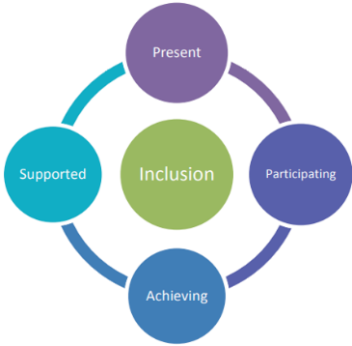
The Curriculum
The totality of the curriculum needs to be accessible for all children and young people and is underpinned by the 4 pillars of inclusion. To be included all children and young people need to be and feel:
Present
Participating
Achieving
Supported.

Slide 8
Accessible Learning and teaching resources
All children and young people must be able to demonstrate their understanding and knowledge to the best of their ability. To do this meaningfully, effectively and equitably learning and teaching resources need to be accessible. This universal design approach will
support all children, young people and educators. Evidence of the positive impact and improvement can be experienced and measured quickly and for educators, this approach will save time.
To do this educators need to be aware of:
The legal entitlements for our learners who have a ‘print disability’ these are helpful standards for all learners
What disability means - hidden or visible and the links with copyright
The key focus areas to create accessible textual resources.
Notes:
Notes
Universal design has been used in the design industry for decades and is increasing being used in education. It support the social model of disability approach very well.

Slide 9
Barriers
Disabled children and young people face particular barriers to accessing learning experiences. However, these barriers are not an inevitable result of their difficulties or medical conditions. The most significant disadvantages these learners experience often stem from attitudinal and environmental factors. These are factors which can be changed.
Ensuring establishments are inclusive and accessible is an entitlement.

Slide 10
Entitlements
All children and young people have entitlements to access the curriculum. However, those who have a disability – hidden or visible, have additional legal entitlements to ensure that they can inclusively access:
The Physical building/buildings that their learning is provided in – this includes areas their peers access – classrooms – including practical classes, communal areas, social spaces and inclusion on trips and excursions.
Communication shared within and through the establishment
Curriculum ( which is the totality of all experiences)
Notes:
Notes
Further Information and guidance is available in the link below.
Planning improvements for disabled pupils' access to education: guidance for education authorities, independent and grant-aided schools - gov.scot (www.gov.scot)

Slide 11
Areas for consideration to support all learners
Use the three accessibility entitlements shared on the previous slide as a baseline for all learners. This learner centred approach:
Increases independence, reduces stigma, distress and dysregulation.
Saves educators planning, preparation and teaching time.
Is more cost effective, reducing the requirement ‘retro-fitting’.

Slide 12
Reflection
In your setting, what approaches used to ensure all children and young people can access the:
The physical building/buildings
Communication
Curriculum
How do you know if they are effective?

Slide 13
Disability in Context
Disability is defined in the Equality Act 2010 as:
‘a long-term limiting mental or physical health condition, that has a substantial negative effect on your ability to do normal daily activities that has lasted, or is expected to last, more than 12 months’.
This includes visible and hidden disabilities. A few examples are blindness and partial hearing, cystic fibrosis, cancer, autism, dyslexia, mental health conditions e.g. anorexia , depression, social anxiety.
Notes:
Notes
There are a number of ‘models’ of disability which have been defined over recent years. The two which are most frequently discussed and highlighted are the ‘social’ and the ‘medical’ models of disability. In Scotland we are increasing using the social model of disability.
Medical model - looks at what is ‘wrong’ with the person and not what the person needs. It creates low expectations and leads to people losing confidence, independence, choice and control in their own lives. This model considers impairments or differences need to be ‘fixed’ or changed by medical and other treatments, even when the impairment or difference does not cause pain or illness.
Social Model
Assumes that people are not ‘disabled’ because of their diagnosis, condition or needs but because aspects of society, like public transport, schools or services often it difficult for them to participate fully and that they face barriers in their everyday life because of this.
The social model of disability says that disability is caused by the way society is organised, rather than by a person’s impairment or difference. It looks at ways of removing barriers that restrict life choices for disabled people. When barriers are removed, disabled people can be independent and equal in society, with choice and control over their own lives.
Disabled people developed the social model of disability because the traditional medical model did not explain their personal experience of disability or help to develop more inclusive ways of living.
The Social model of disability is more in line with the vision for inclusion in Scotland for all our learners both disabled and non-disabled. The social model is more inclusive in approach for the following reasons
Anticipatory thought is given to how disabled people can participate in activities on an equal footing with non-disabled people. Certain adjustments are made, even where this involves time or money, to ensure that disabled people are not excluded.
The Scottish educational context also supports this model. All 3 modules in this online collection highlight the range of educational and equality legislation along with the policies which have inclusion within their foundation and support a ‘needs led’ inclusive education system for all learners.

Slide 14
Accessibility - Print Disability
Who may have a print disability?
A person who cannot effectively read print because of a visual, physical, perceptual, developmental, cognitive, or learning disability. The printed text prevents the person from enjoying a copyright work to the same degree as a person who does not experience that difficulty. This includes individuals who:
Are blind or partially sighted
Have a physical disability e.g. They experience difficulties turning a page
Have significant processing difficulties which can include Autism, intellectual disabilities and Specific Learning Differences e.g. Dyslexia.

Slide 15
Accessibility Text – Key Factors
Images
Format
Readability
Colour
Accessible
Text
Typeface
Design/Layout
Font
An overview of the key factors above to consider when developing accessible textual resources are on the following slides.
Notes:
Notes
Key factors to include when creating new resources which have text within them are highlighted on this slide.

Slide 16
Format
Paper – physical textbooks , worksheets, workbooks, jotters etc
Many children and young people will experience difficulties in accessing the information or demonstrating their knowledge and views using paper.
Digital – Word files, PowerPoint, audio recordings, visual recordings, SQA Digital exams etc.
Most children and young people can be more independent in accessing the information or demonstrating their knowledge and views using a digital format. Make use of the ‘Check accessibility’ tools.
However, be aware that not all digital formats are automatically accessible. Knowing your learner’s individual support needs and ensuring your choice of digital format is appropriate for them is essential. For example:
SWAYs are not Immersive Reader enabled and often the design and layout can be over stimulating to the viewer.
PDFs, unless enabled with separate software cannot be typed or dictated into.
Thinglinks are Immersive Reader enabled and support many learners, however this format does not work well with a screen reader.

Slide 17
Readability
Ensure the text and resource has been written at the appropriate reading age for the child or young person. For example:
Barrier
A resource/book for S3 or S4 class has a reading age of 14 years however, some learners in the class have a chronological reading age below 10 years.
Support
Ensuring that the resource/book can be accessed digitally through an audio version or though using text to speech recognition software will provide an inclusive and accessible approach for learner engagement and participation. It will also support the reduction of distracting, distressed or dysregulated behaviour which, for some learners may happen because they feel excluded and do not want to share that they are experiencing difficulties accessing the information.

Slide 18
Typeface and Font
What is a Typeface?
This is the collection, or entire family of letters, numbers and symbols (these are called characters) – for example Arial or Times New Roman.
What is a Font?
The added effects or variation that can be made to the typeface characters for example - size , bold , italic, underline, strike through and character spacing .

Slide 19
What Typeface Design is Best?
F
F
Use Sans Serif Typefaces – they are easier to read
Serifs on
the ends
No serifs on the ends
x
✓
Serif
Sans-Serif
Notes:
To make text as visually accessible as possible, it is recommended that a Sans Serif design is used. This means the Typeface does not have curves, or tails at the top, bottom and sides of the letters – these are called characters. For some readers, the curls/tails can make it more difficult distinguish individual characters, reducing reading fluency and pace . It can also make it visually uncomfortable to read. .

Slide 20
Accessibility Considerations Typeface Choice
Inclusion is the corner stone of Scottish education.
It is an entitlement and a right for all learners to be
present, participate, achieve and be supported.
Arial (body) italics 18pt
Inclusion is the corner stone of Scottish education.
It is an entitlement and a right for all learners to be
present, participate, achieve and be supported.
Times New Roman 18pt
Inclusion is the corner stone of Scottish education.
It is an entitlement and a right for all learners to be
present, participate, achieve and be supported.
Arial (body) 18pt
Inclusion is the corner stone of Scottish education.
It is an entitlement and a right for all learners to be
present, participate, achieve and be supported.
Segoe - Dark grey 18pt
Inclusion is the corner stone of Scottish education.
It is an entitlement and a right for all learners to be
present, participate, achieve and be supported.
Century Gothic dark Grey 18pt
Notes:
Notes
When creating a new typeface designers use the duplication of geometrical measurements to make new letters, for example b and d – these are the same geometrical measurements and design, just reversed. This saves time and also makes the typeface recognisable and atheistically pleasing. However, for some readers this can lead to letter reversal as they experience difficulties in visually processing the information.
The amount of space between each character (letter) is also very important and if they are too close together it can create difficulty in accessing the information in the text. This can be altered though when creating the resource using the Font options and character spacing in the menu bar.
This slide highlights the visual difference various typefaces can have. They are all in the same font size – 18pt
The last sentences on each column are usually easier to read because the individual character spacings are slightly bigger , there is no underlining, italics are not used and the font colour is a dark grey instead of a stark black.

Slide 21
Typeface and Font
San Serif
Arial
Arial Narrow
Bradley Hand ITC
Calibri Light
Comic Sans
Microsoft Sans Serif
Segoe UI
Papyrus
Serif
Times New Roman
Georgia
These are all font size 24 – notice the variation in both size and how close the individual characters are to each other.
This can have a significant impact on how easy it is to access the text.
Notes:
On this side are a selection of Typefaces.
To make text as visual accessible as possible it is recommended that a Sans Serif design is used. This means the Typeface does not have curves at the top and bottom of the letters – these are called characters. For some readers the curls can make it more difficult to make out individual characters, slow reading pace and make it visually uncomfortable.

Slide 22
Design and Layout - Using Tables
This slide highlights the difficulties that can be experienced when tables are used to present information to individuals with a print disability and who need to use a screen reader or text recognition software.
Animal | Mammal | Number of legs
Bird | No | 2
Dog | Yes | 4
Snake | No | 0
Software would automatically read the information in the table as
‘Animal, Mammal?, Number of legs, Bird, No, 2, Dog Yes, 4, Snake, No, 0’
Hearing the information in this way would not be helpful to the reader.
Notes:
Note
This slide highlights the difficulties that can be experienced when table are used to present information to individuals with a print disability and who need to use a screen reader or text recognition software. The Software would automatically read the information in the table in horizontal lines and this would not make sense to the reader, particularly if they were blind or partially sighted. It would read
‘Animal, Mammal?, Number of legs, Bird, No, 2, Dog Yes, 4, Snake, No, 0’
The table used on this slide is also an image and again which would require manipulation for a reader who has a print disability.

Slide 23
Design and Layout
Keep it simple, less is best – displays, presentations, worksheets that are too ‘busy’ over stimulate and reduce processing.
Choose an appropriate typeface and font style – do not underline or use italics, use bold text for titles, sub-headings or to draw attention to important information or key vocabulary.
Align text to the left, do not centre or justify.
Keep instructions simple.
Use bullet points for important information.
Lists of why’s, ‘do’s’ and ‘don'ts’ can be more useful than continuous text.
Use short paragraphs or blocks of text.
Avoid bright colours - yellows, reds, greens
Avoid text boxes and tables – these are barriers for screen reader navigation, see example on next slide.
Flow charts can be helpful to explain procedures.
Hyperlinked content page at the beginning helps navigation.

Slide 24
Colour and Images
Avoid brightly coloured text, backgrounds, fills and outlines as they can be difficult to process e.g. yellow or red
x
Avoid strong contrasts e.g. white background and black text
Pictograms and graphics can help to locate and visualise information
Use Alternative text (Alt text) to describe images and any text within the image
Ensure learners know how to alter background colours and text colours on digital devices.

Slide 25
Signposting
Disability in context - Supporting disabled children, young people and their families: guidance - gov.scot (www.gov.scot)
Planning improvements for disabled pupils' access to education: guidance for education authorities, independent and grant-aided schools - gov.scot (www.gov.scot)
Microsoft 365 has a range of free accessibility tools. Further information can be found on DigiLearn (glowscotland.org.uk) for example What is Microsoft Immersive Reader? – DigiLearn (glowscotland.org.uk).
Make slide presentations accessible - How Do I Make My Slide Presentations Accessible for My Learners (callscotland.org.uk)
Books for All (callscotland.org.uk)
The Scottish digital voices (thescottishvoice.org.uk)
Notes:
Notes
This slide signposts a range of further resources, professional learning and reading to support accessibility and inclusive practice

Slide 26
Reflection
We ought to begin to pay less attention to getting everyone over the same hill using the same path.
We may wish to encourage some to take different routes to the same end. Then we might see good reasons for paying careful attention to their descriptions of what they have found.
We may wish to follow them some day.
Tom West 1991 ‘In The Minds Eye’
Notes:
Slide 17
We ought to begin to pay less attention to getting everyone over the same hill using the same path.
We may wish to encourage some to take different routes to the same end. Then we might see good reasons for paying careful attention to their descriptions of what they have found.
We may wish to follow them some day.

Slide 27
Reflection
From what you have learned so far, think about:
How has this made you feel?
What has this made you think about?
What one action would you like to take forward?
How can you link what you plan to do with others in your setting?
How you will know that this learning has made a difference?
Notes:
Facilitation notes:
You can do this in groups...
Encourage educators to take this forward in an enquiry
Consider impact of the actions / learning

Slide 28
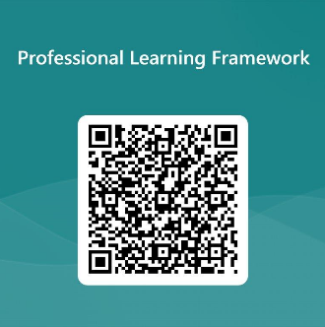
We value your feedback
From now until March 2024 we will be taking feedback on these resources so that we can make changes in advance of a formal launch of the Professional Learning Framework in June 2024
Your feedback could help us improve this resource
Please complete this short form, using the link or QR code, to let us know what you thought of it and any suggestions you have on how it could be improved
LINK: https://forms.office.com/e/b5PCpJJJ3P

Slide 29
For Scotland's learners, with Scotland's educators
Do luchd-ionnsachaidh na h-Alba, le luchd-foghlaim Alba
Education Scotland
Denholm House
Almondvale Business Park
Almondvale Way
Livingston EH54 6GA
T +44 (0)131 244 5000
E enquiries@educationscotland.gsi.gov.uk

