Slide 1


Slide 2


Progression from First to Second Level in Language Learning
A guide for teachers
For Scotland's learners, with Scotland's educators

Slide 3
NB These slides give an easy-to-access overview of progression in language learning across the four skills from first to second level. It is intended that parts of the presentation will be used by primary teachers to focus on specific skills progression. The slides complement the other sections of the first to second level progression framework.
For Scotland's learners, with Scotland's educators

Slide 4

The aims….
To look at how to create a strong gradient of learning in the classroom
To give examples of what progression looks like across the four skills of language learning from first to second level :
Listening
Talking
Reading
Writing
For Scotland's learners, with Scotland's educators

Slide 5

Creating a gradient of progression
As learners move from stage to stage, it is imperative that their language learning develops in the same way as their other skills, such as those in literacy and numeracy.
Therefore planning for progression is key!
The experiences and outcomes, as well as the modern languages benchmarks, clearly lay out the progress from stage to stage for learners through the broad general education (BGE).
Having in place a framework for each stage will ensure the correct level of expectation for learners in their target language, so that development is clearly laid out for all teachers in the school/ cluster/ authority.
Ideally, this framework will contain resources and helpful links to support the teaching of languages.
For Scotland's learners, with Scotland's educators

Slide 6
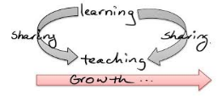
Creating a gradient of progression
Through careful planning for learning, teaching and assessment, teachers will be able to evidence progress.
This is a learning journey that must be shared with all: learners, teachers, parents/carers.
In order to have the most success, the learner needs to know what is being learned, why it is being learned, what success will looks like and how it will be measured.
Schools and departments need to be clear on what progress at a level looks like; this is achieved through discussion which supports professional judgements consistent with national standards.
For Scotland's learners, with Scotland's educators

Slide 7
For Scotland's learners, with Scotland's educators

Slide 8
Creating a gradient of progression
In the overarching framework ‘Approaching language learning from primary 1 onwards’, there are clearly laid out expectations of what learners should be able to achieve in their language learning journey as they progress from stage to stage through the BGE.
The grounding learners get from the embedding the language through routine, day-to-day exposure, coupled with discrete language lessons as learners progress through the primary stages, ensures that the pace, challenge and ambition for their learning builds steadily from P1 onwards.
For Scotland's learners, with Scotland's educators

Slide 9
A 1+2 approach
“Primary teachers do not have to be fluent in the modern language(s) they teach. However, they do need to have enough language and sufficient expertise in using and accessing appropriate resources so that they can include modern language teaching readily in lessons.”
A 1+2 approach to language learning
Framework for primary schools – Guidance for P1
For Scotland's learners, with Scotland's educators

Slide 10
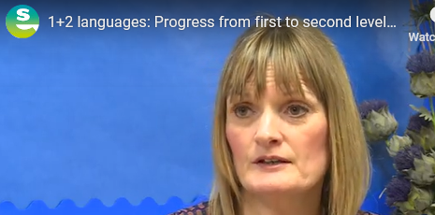

Slide 11
Creating a gradient of progression
By the end of first level (around P4), language learning should have developed incrementally to the point where learners are able to:
exchange personal information;
understand and respond to familiar questions;
read aloud with increasing confidence;
show awareness of pronunciation rules if confronted with some unknown text;
use some support to assist understanding- word list picture prompts ; environmental print; and
demonstrate increasing confidence across the 4 skills.
For Scotland's learners, with Scotland's educators

Slide 12
Creating a gradient of progression
By the end of second level (around P7), the learning should develop steadily to the point where learners are able to:
give a short presentation about themselves;
take part in conversations and transactions;
understand classroom instructions and personal information;
enjoy listening to a story, a song or poem;
read aloud a simple text;
read and understand a short text; and
write about themselves and others.
For Scotland's learners, with Scotland's educators

Slide 13

Listening and Talking
Developing listening skills in the target language is essential.
Understanding will develop in non- verbal ways in young learners long before they can respond at the same level.
Remember ANY exposure to the language provides an opportunity for listening!
Levels of engagement with learners will vary as in any other area of the curriculum
Some will be eager to mimic and respond immediately, whereas others will need more time.
Consistent exposure to the language will build learner (and teacher) confidence.
For Scotland's learners, with Scotland's educators
Notes:
.

Slide 14

Listening and Talking
Talking at first level will typically include frequent repetition of simple, solid structures with lots of opportunities to repeat and mimic accent and intonation.
As the learning progresses and becomes more complex, teachers should not be worried if the learner doesn’t respond with the full sentence, native speakers do this all the time!
As learner confidence builds , then these structures can be extended by adding e.g. an opinion.
This demonstrates understanding but also allows the learner to develop their response e.g
Tu aimes les maths? → Oui j’aime les maths.
Pourquoi? → Car c’est super!
For Scotland's learners, with Scotland's educators

Slide 15

Listening and Talking
As pupils move towards second level, it is important that the demands on their listening and talking skills increase.
Learners are encouraged to extend their answers by adding more detail, such as connectives, which can be done with cue cards and other visual prompts.
Reading aloud a prepared piece of writing or a shorter piece of reading allows learners to use prior learning of sounds and blended sounds to read aloud more unfamiliar words.
Therefore, the consistent embedding of the language begun in P1 is the foundation upon which learners progress, giving them a solid understanding of phonics and sounds.
For Scotland's learners, with Scotland's educators

Slide 16

Listening and Talking
In the following example, learners are reading aloud a prepared text, which contains challenging vocabulary related to their topic.
The information is out of their ‘comfort zone’ in terms of names and ages.
The learners are thinking through pronunciation rules as they go.
Although this is a very prepared talking activity, each listens carefully to the other.
For Scotland's learners, with Scotland's educators

Slide 17
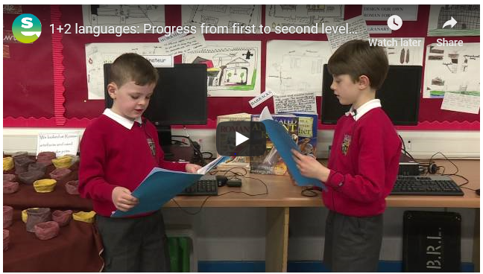
INSERT Melrose video

Slide 18

Creating a gradient of progression
There is no doubt that in order to create a gradient of progression, teachers need to work closely together to ensure the transition from stage to stage acknowledges and builds on prior learning.
Repetition of a particular aspect of the language learning should only be there as a confidence builder before moving the learning forward.
Pupils should challenged by moving beyond the contexts covered at first level.
Although day-to-day routines will inevitably contain familiar words, phrases and constructions, it is important that these are used creatively to provide more challenge.
For Scotland's learners, with Scotland's educators

Slide 19
Progression through daily routines
For example :
pupils taking on the role of the teacher in completing the register;
taking a note of the lunch numbers;
bringing in the lines;
using the target language for mental maths;
using the target language alphabet in a dictionary activity supporting a reading activity in L1;
doing some sport /game using the target language; and
supporting this through environmental print so all learners build confidence.
All verbal and non verbal interaction consolidates and supports! understanding.
For Scotland's learners, with Scotland's educators

Slide 20

Pronunciation
To correct or not to correct pronunciation ?!
Should you let errors in pronunciation go in order to allow the language to flow, or correct to make sure learners make themselves understood?
Teachers should use their judgement and develop their own approach : they know their learners best.
They know when some learners need a nudge to be more accurate, or when they’re doing their best.
The key approach here is always to be supportive and allow the learners to hear the phrase again correctly, as often as you can to reinforce the sounds and structures.
For Scotland's learners, with Scotland's educators

Slide 21
Listening and talking
In the following activity, the learners are synthesising their skills, through listening to the teacher and responding by selecting their snack.
The teacher reinforces correct pronunciation and offers subtle support to the more hesitant pupils.
Pupils respond to different questions by either saying the snack, or finding the correct snack.
The teacher extends the question by asking them which colour. ‘Une pomme rouge ou une pomme verte?’ and the pupil responds with more information.
A 1+2 approach to language learning
Framework for primary schools – Guidance for P1

Slide 22
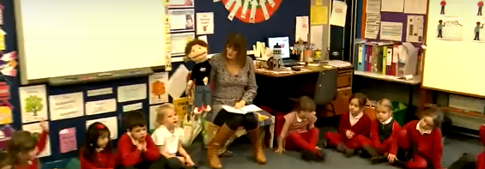
1+2 Approach

Slide 23

L1/ L2 interference
As we extend the language in the classroom it is natural that at times the learners may get mixed up!
This is a natural side effect and actually shows that the flexible pathways in the brain that deal with Ianguage learning are making new connections.
This effect is also often seen in children who are raised in a immersive bi-lingual situation.
At times pupils might respond to the target language in their mother tongue and vice versa.
This is a sign of success that the language is embedding!
A 1+2 approach to language learning
Framework for primary schools – Guidance for P1

Slide 24

Reading
Two brains are better than one!
As pupils progress beyond first level in their reading, challenge them with group and paired reading tasks.
Collaboration benefits all in the group with careful monitoring and structure.
Allow learners to link this to their own experiences through rich literacy questions e.g. How does this compare with your school/ family/ home area? How would you feel if ..?
A 1+2 approach to language learning
Framework for primary schools – Guidance for P1

Slide 25

Reading
Reading skills learners already have in English / Gaelic such as skimming and scanning are all relevant in the target language (TL)
Tackling texts in the TL to show understanding could include:
sequencing pictures to show understanding of the story;
highlighting sections of longer texts to create focus;
breaking down the text to insert questions along the way;
using visuals or environmental print as prompts to support understanding; and
giving hints by numbering each part of a sentence for languages with more complex word order.
A 1+2 approach to language learning
Framework for primary schools – Guidance for P1

Slide 26

A 1+2 approach
The use of the modern language in the classroom can be supported by appropriately chosen bilingual environmental print and pictures, with careful consideration of children’s learning in English / Gaelic.
A 1+2 approach to language learning
Framework for primary schools – Guidance for P1
A 1+2 approach to language learning
Framework for primary schools – Guidance for P1

Slide 27
Reading
Using these techniques, learners can become more independent in their understanding of more complex texts.
They know how to support their understanding through the use of glossaries or a bilingual dictionary.
They gain confidence in their ability to find and use information in a text.
They can then use these skills to choose texts in the target language that are of interest to them.
A 1+2 approach to language learning
Framework for primary schools – Guidance for P1

Slide 28
A 1+2 approach
Teachers of children at P1 already possess an extensive range of skills and understanding of how young children learn. Working with language colleagues in their own school or cluster, they will continue to develop teaching approaches to enable the best possible outcomes in modern languages.
A 1+2 approach to language learning
Framework for primary schools – Guidance for P1
A 1+2 approach to language learning
Framework for primary schools – Guidance for P1

Slide 29

Cluster collaboration
A clear information exchange on learners’ progress with the associated secondary school creates a shared understanding of the learning taking place in the primary classroom.
It will allow secondary schemes of work to take into account the prior learning and avoid needless repetition.
Ensures the progression gradient from second to third level continues.
A win–win all round!
A 1+2 approach to language learning
Framework for primary schools – Guidance for P1

Slide 30

Writing skills
The point at which learner should begin writing in the target language can cause much debate amongst primary teachers.
However, most learners should begin to experiment with the written word in the TL with support and direction around the Primary 4 stage.
At this point, learners should be more secure in their grasp of spelling and structure in English / Gaelic and therefore “other tongue” interference should be limited.
At this point writing in the L2 should be enhancing literacy in English / Gaelic.
A 1+2 approach to language learning
Framework for primary schools – Guidance for P1

Slide 31
Expected outcomes by the end of Primary 4
Through frequent and regular practice, with continuing opportunities for repetition and the embedding of the modern language children will be able to demonstrate that they can:
• Exchange personal language – orally and written
• Use the modern language with increasing confidence and accuracy in the four skills of reading, writing, listening and talking
A 1+2 approach to language learning
Framework for primary schools – Guidance for P1
Primary Language Learning Overarching Framework

Slide 32

Writing skills
Creating frequent opportunities for small amounts of writing helps build confidence.
Copywriting at this stage can consolidate a talking activity with support from the written word e.g. simple tongue twisters.
Creating their own environmental print with support, learners can play around with homonyms, creating their own simple rhymes and poems from similar sounds.
Creating caligramme shapes, writing pyramids and word snakes also supports spelling in the TL.
A 1+2 approach to language learning
Framework for primary schools – Guidance for P1

Slide 33
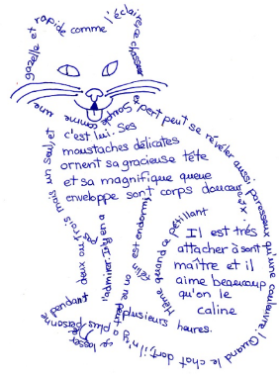

Writing skills
The shapes can be made with simple sentences adjectives e.g.
Le papillon est petit et mignon. Le chat est blanc et noir.
A 1+2 approach to language learning
Framework for primary schools – Guidance for P1

Slide 34

Writing
Build the writing activities in small steps e.g.
copy and illustrate
copy and colour
copy, underline and change
for more challenge, use cloze activities and word banks.
A 1+2 approach to language learning
Framework for primary schools – Guidance for P1

Slide 35

Writing
Creative writing tasks, offering a choice of formats, allows for differentiation.
The level of support offered allows all learners an opportunity to write in the target language.
Using ICT to support writing e.g. blogs, emails, (phone)texts, with supported writing frames give a variety of ‘real life’ writing opportunities to engage learners.
The example on the next slide is from a P5 pupil, who had a P1 start to learning French and used a writing frame to support her with the more complex words eg ‘matières préférées’
A 1+2 approach to language learning
Framework for primary schools – Guidance for P1

Slide 36
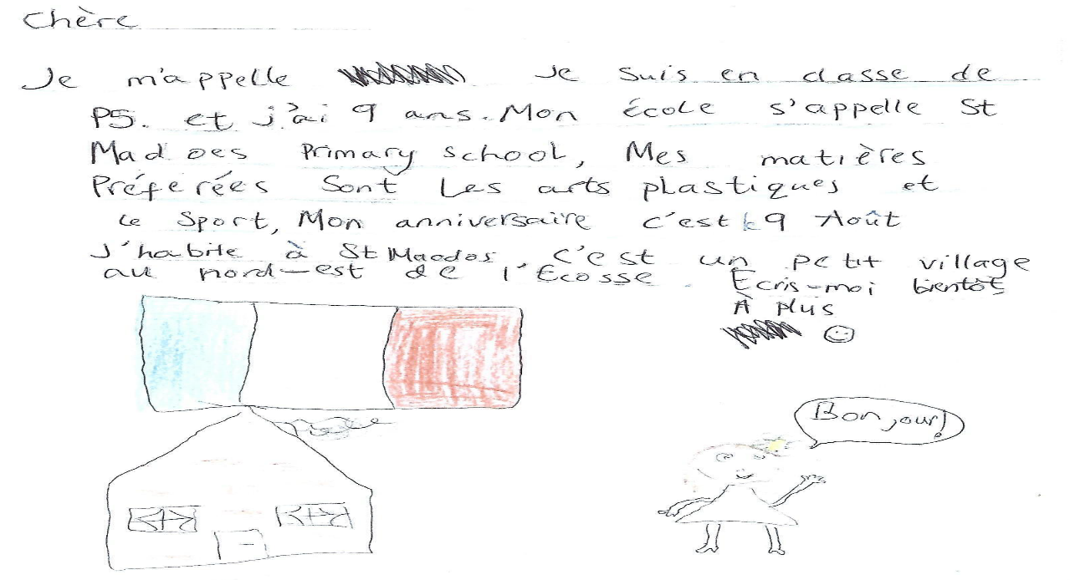

Slide 37
Writing
By the time learners have reached P7 from a P1 start, they will have a much deeper understanding of the language and should be able to write across a range of contexts.
At this point, with support, learners should be able to write a little under a number of headings, such as:
‘Myself’ ‘My family’ ‘My freetime’ ‘Food and drink’ ‘My school’ etc.
This would be ideal to support a presentation or a placemat activity using the target language.
A 1+2 approach to language learning
Framework for primary schools – Guidance for P1

Slide 38

Writing
This would be an ideal opportunity for pupils to showcase their learning as they move into S1 with a small portfolio of their work.
This kind of activity could be built up over time and would provide an opportunity to revise and refresh language covered in the early stages.
A 1+2 approach to language learning
Framework for primary schools – Guidance for P1

Slide 39

Knowledge about Language
If pupils are to progress in their language learning at any level, it is essential that they know some grammatical structures.
Grammar allows learners to understand the ‘building blocks’ of language and compare and contrast this with their understanding of English / Gaelic.
These grammar inserts can fall naturally into the current context for language learning (see the KaL framework)
A 1+2 approach to language learning
Framework for primary schools – Guidance for P1

Slide 40
Knowledge about Language (continued)
Using question forms in transactions e.g. Oὺ … ? Il y a … ?
Using first, second and third singular in questions ; answers and reporting back.
  Joe, Tu aimes le sport?
  Oui, j’aime le sport.
  Joe aime le sport?
  Oui, il aime le sport
These structures can be supported by environmental print and classroom displays.
A 1+2 approach to language learning
Framework for primary schools – Guidance for P1

Slide 41

Creating a gradient of progression- Reflective Questions
How are you ensuring sufficient emphasis on all four skills?
How are you including grammatical development (KAL) into your contexts for learning?
How can you use a familiar context to practise different skills?
Does your planning allow for recap and review?
Are you confident in the language you will need to cover the chosen themes effectively?
Where can you find further support?
For Scotland's learners, with Scotland's educators

Slide 42


Education Scotland
Denholm House
Almondvale Business Park
Almondvale Way
Livingston EH54 6GA
T +44 (0)131 244 5000
E enquiries@educationscotland.gsi.gov.uk
For Scotland's learners, with Scotland's educators
Notes:
This is a back cover page in green. You may edit the address if needed only. It can only be once and at the end of the PowerPoint presentation. Use the corresponding green front and internal pages if you are using this page.

