Slide 1
Introduction to Additional Support and Equality
For Scotland's learners, with Scotland's educators
Do luchd-ionnsachaidh na h-Alba, le luchd-foghlaim Alba

Slide 2
Scottish Context for Inclusion, Equality and Equity
Scottish education is based on the belief that education is a human right and that all children and young people should be supported to reach their fullest potential. Children’s rights and entitlements are fundamental to Scotland’s approach to inclusive education. It is supported by the legislative framework and key policy drivers
Scotland’s education system is designed to be an inclusive one for all children and young people in Scottish schools, with or without additional support needs.

Slide 3
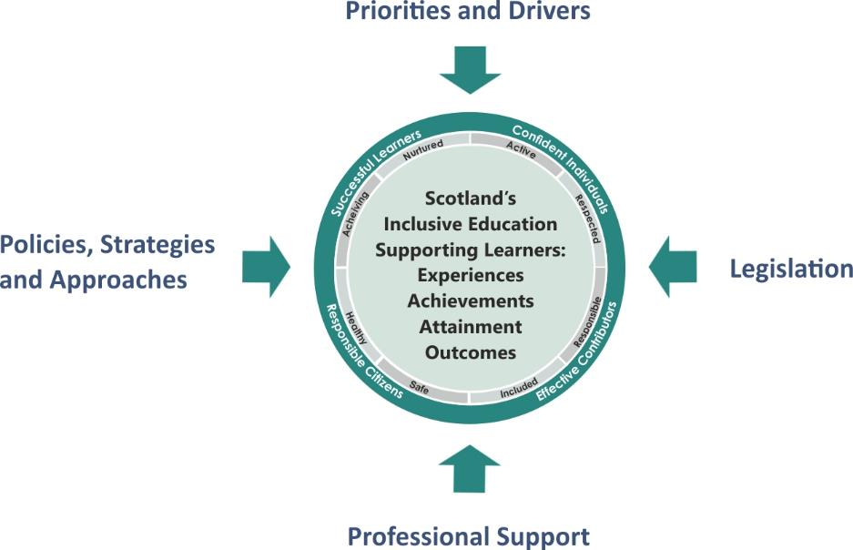
Scottish Context for Inclusion, Equality and Equity – Overview
Attainment, Curriculum, Empowerment, Equality, Outcomes
DYW
Inclusive ELC/schools
Positive Relationships
Safeguarding
The GIRFEC approach
Additional Support
Accessibility
Equality
Inclusion
Learner Voice and Participation
Rights
Education Scotland
Professional Organisations and Standards

Slide 4
Children’s rights and entitlements
Children’s rights and entitlements are fundamental to Scotland’s approach to inclusive education. It is supported by the legislative framework and key policy drivers including,
Curriculum for Excellence
The getting it right for every child approach
Framework for Professional Standards for practitioners

Slide 5
Reflective Activity
Consider the following questions
What does the term ‘inclusion’ mean to you?
2. Reflect on why you/your colleagues feel your early years setting/school is, or is not an inclusive one for all learners.

Slide 6
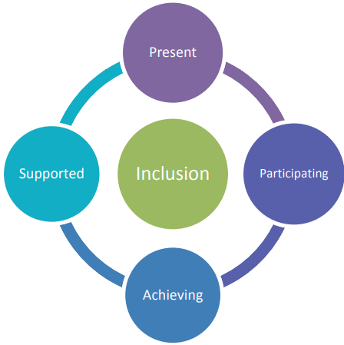
Inclusion
To be included all children and young people need to be and feel:
Present
Participating
Achieving
Supported.

Slide 7
Inclusion
Inclusions means taking positive action and intervening in order to enable achievement for all by building and fulfilling the potential of every child, young person and adult.
Curriculum for Excellence was design to be an inclusive curriculum.

Slide 8
What makes effective and inclusive learning and teaching that meets the needs of all learners – including those who require additional support?
Relationship based approaches
Child centred planning
Inclusive pedagogy - maximising universal support
Professional learning opportunities
Collaborative approaches - partnerships
No ‘one-size-fits-all’ approach
Progression pathways – flexible pathways – flexible curriculum*
Balance, progression and coherence
Tackling bureaucracy
Continuous cycle of improvement - effective use of reflection, self-evaluation robust data.

Slide 9
Equality
Equality is described as the removal of discrimination, disadvantage, inequality and / or barriers which can affect people on the grounds of the protected characteristics set out in the Equality Act 2010: age, disability, gender, gender reassignment, pregnancy and maternity, race, religion or belief and sexual orientation.

Slide 10
Equity
Equity means treating people fairly, but not necessarily treating people the same.
Equity in education means that personal or social circumstances such as gender, ethnic origin or family background are not obstacles to achieving educational potential and that all our young people are well supported to secure wellbeing, skills for learning, life and work and the best possible post-school destination, HGIOS 4 (2016).
Equity is generally understood to refer to fairness and impartiality for people in general and sometimes especially relating to fairness for people facing socio-economic disadvantage.

Slide 11
“Curriculum for Excellence is an inclusive curriculum from 3 to 18 wherever learning is taking place”.
Curriculum for Excellence is a world-class example of universal design for learning. Its principles of curriculum design include relevance, personalisation and choice and challenge and enjoyment. At its development stage, special school head teachers and support for learning teachers advised on building experiential learning into the curriculum through experiences and outcomes across its levels.

Slide 12
Additional Support Needs
‘Additional Support Needs’ is the standard terminology used in Scotland when children and young people need more – or different - support to what is normally provided in schools or pre-schools to children of the same age.
Additional support is a broad and inclusive term which applies to children or young people who, for whatever reason, require additional support, long or short term, in order to help them make the most of their school education and to be included fully in their learning.

Slide 13
Here are some examples
Hearing and or Visual Impairment
Trauma
Interrupted Learning
Dyslexia
ADHD
Dyscalculia
Living with Parental Substance Misuse
Anxiety
Tourettes
Autism
Particularly Able or Talented
Care Experienced
Poverty
Disability and or Health Need
Loss/Bereavement
Young Carer
Family Changes/Breakdown

Slide 14
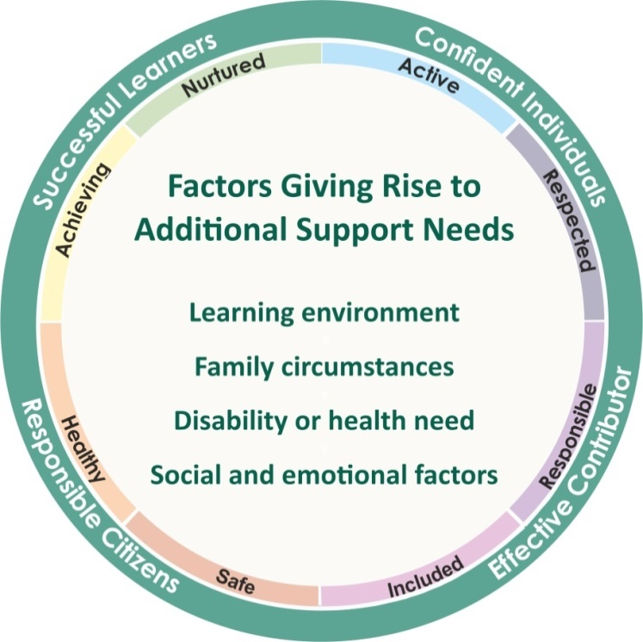
Barriers to Learning
Within Curriculum for Excellence,
all children and young people are entitled
to support to enable them to achieve.
Education authorities are required to identify
the additional support needs of each child
or young person for whose school education
they are responsible. This can be achieved in a range of ways.
Any person working with the child, or the young person himself/herself, could draw attention to the fact that difficulties with learning exist. For example, this person might be the parent, class teacher, a member of the school health team, educational psychologist, social worker or any person who has been working with a child or young person.

Slide 15
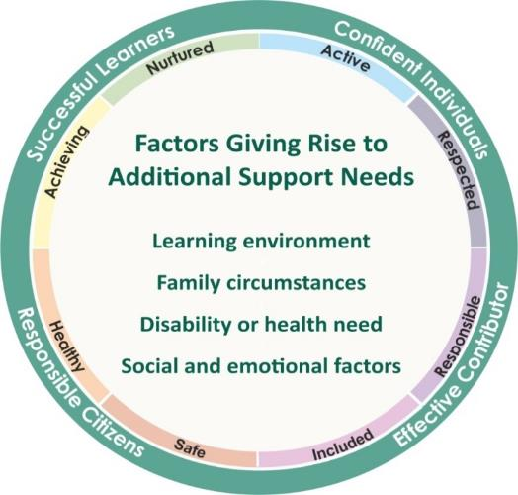
ASN, Co-occurrence and Disability
The next slide has a list which highlights the overlap between ASN and disability. This is often referred to as co-occurrence. The list is not exhaustive
It should not be assumed that inclusion in the list inevitably implies that additional support will be necessary.
However, the ASL Act automatically deems that all looked after (care experienced) children and young people have additional support needs unless the education authority determine that they do not require additional support in order to benefit from school education.

Slide 16
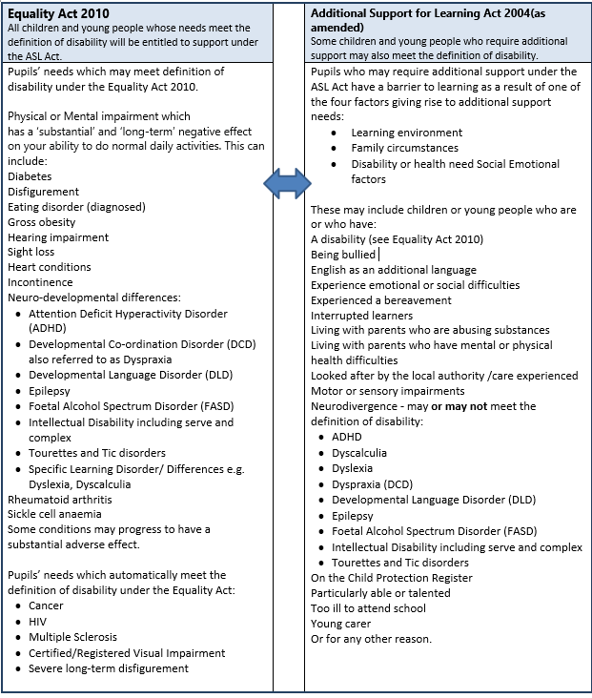
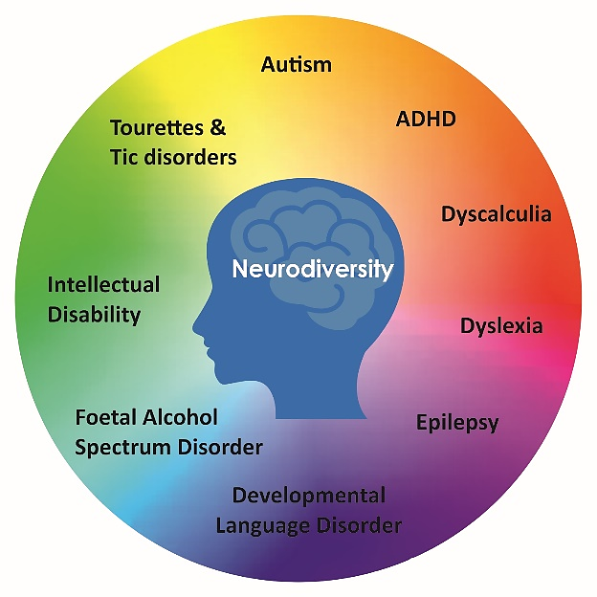
ASN, Co-occurrence and Disability

Slide 17
Staged Intervention
Staged intervention is used as a means of identification, assessment, planning, recording and review to meet the learning needs of children and young people. Staged intervention:
Provides a solution-focused approach to meeting needs at the earliest opportunity and with the least intrusive level of intervention.
Involves the child, parents/carers, school staff and, at some levels, other professionals. All working in partnership to get it right for every child.
Staged intervention is designed to be flexible and allows for movement between stages depending on progress. There are variations between local authorities regarding the number of stages within their process

Slide 18
Universal Support
The entitlement to universal support for all children and young people is provided from within the existing pre-school and school settings.
Universal support starts with the ethos, climate and relationships within every learning environment. It is the responsibility of all practitioners to take a child-centred approach which promotes and supports wellbeing, inclusion equality and fairness

Slide 19
Universal Support - Examples
Note – this list is not exhaustive.
Personalised learning plans
Literacy, numeracy or health and wellbeing support
Enhanced transition e.g. P7 – S1
Use of ICT e.g. digital learning and teaching resources such as course work, P1, P4, P7 & S3 Scottish National Standardised Assessments (SNSA) , prelims and digital SQA exams Quiet spaces
Visual time tables

Slide 20
Targeted Support
Targeted support is usually, but not exclusively, co-ordinated and provided by staff with additional training and expertise through a staged intervention process. This may be by staff other than the class teacher and outwith the pre-school or school setting but within education services
Targeted' support is any focused support which children or young people may require for short or longer periods of time to help them overcome barriers to learning or to ensure progress in learning.

Slide 21
Targeted Support - Examples
Note – this list is not exhaustive.
Higher attaining children (ensuring progression)
Bereavement
Input from Allied Health Professionals e.g. speech and language therapist
Specific Learning difficulties
Trauma
Complex needs

Slide 22
Support approaches and strategies education staff need to know.
Awareness of the Scottish context and inclusion
Awareness of ASN and co-occurrence
Effective learning and teaching pedagogy & learner participation
Effective moderation and assessment
Differentiation
Accessible curriculum

Slide 23
Activity – True or False?
All children and young people receive targeted support.
False: Targeted support is very focused support and is not provided to every child or young person because it is not needed for all children and young people.
Universal support for all children and young people is provided from within the existing pre-school
and school settings – True
Universal support is the responsibility of staff with additional training and expertise through a
staged intervention process.
False: Class teachers have a responsibility for universal support.
Targeted support is usually, but not exclusively, co-ordinated and provided by staff with additional
training and expertise through a staged intervention process. - True
Targeted support is usually coordinated by class teachers.
False: Class teachers do not usually coordinate targeted support. this is usually done by staff with additional
training and expertise

Slide 24
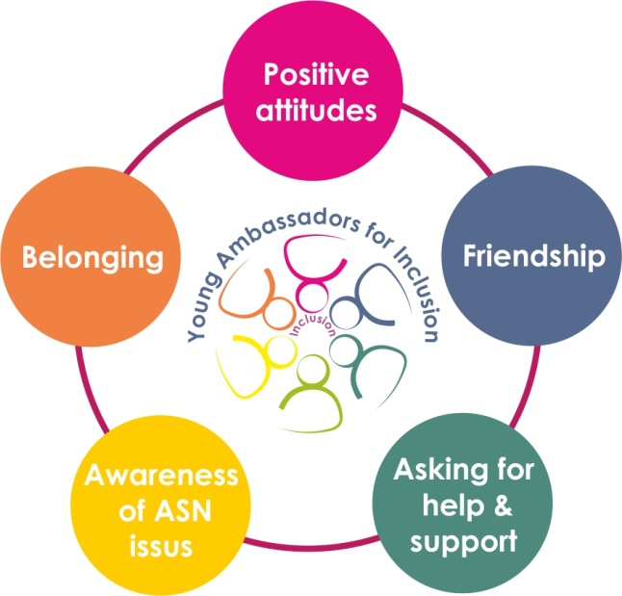
Young Ambassadors for Inclusion
These are the 5 areas the young ambassadors said made them feel included in their school community.
They develop[ed a pledge for schools to adopt and a vision statement which is on the next slide.

Slide 25
Inclusion
Young Ambassadors for Inclusion Vision Statement
School should help me be the best I can be.
School is a place where children and young people learn, socialise and become prepared for life beyond school.
Success is different for everyone.
But it is important that all the adults that children and young people come in to contact with in school get to know them as individuals. They should ask, listen and act, on what the young people say about the support that works best for them.
04.08.21. Young Ambassadors for Inclusion vision statement for success - gov.scot (www.gov.scot)

Slide 26
‘Ask us, Hear us, Include us’
Notes:
Show film – 7 minutes long

Slide 27
Supporting all learners - Inclusive classrooms
An inclusive classroom is one where positive relationships are at the centre of learning.
Staff routinely incorporate supports and strategies that focus on adapting the physical and social environment; establish structures and routines throughout the school day; and implement learner-centred approaches to enhance motivation and engagement.
Setting up an inclusive classroom is a practical way of providing support for all learners in the class by optimising the physical and social environment of the classroom; putting in place structures and routines to support engagement; and by utilising approaches to support motivation.
All learners are influenced by the ethos, physical environment and social environment, how they feel about themselves and their interest in the tasks they have been asked to do. The social environment concerns the attitudes, expectations and actions of peers and adults
These notes form part of the CIRCLE module

Slide 28
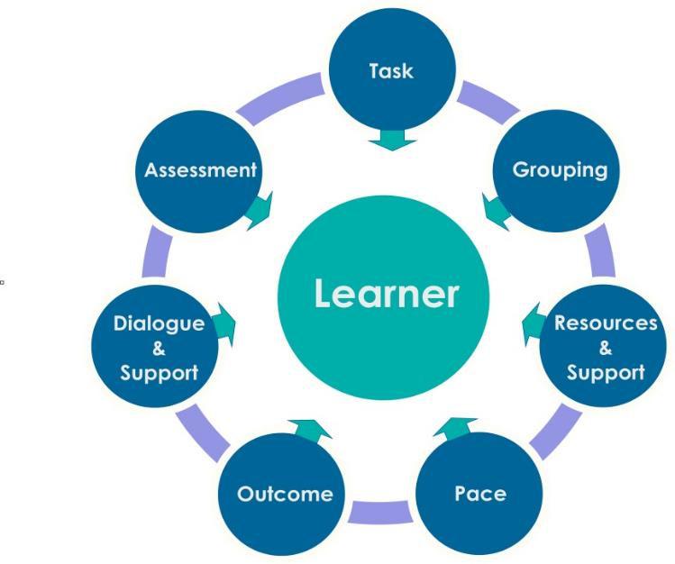
Differentiation
The impact any additional support need has on learning varies in degree according to the learning and teaching environment.
It is the responsibility of all who work with children to respond appropriately to their needs.
Recognising early signs of difficulties and adapting learning and teaching approaches are a regular part of the daily routine for teachers supporting all children in an educational environment.
Notes:
Share Differentiation handout

Slide 29
Self Evaluation Activity
This activity can be done individually or with colleagues
Supporting learners who require additional support.
Reflection | In my role | In our school community | In our local authority
What I /we do well
What needs to improve
How to improve

Slide 30
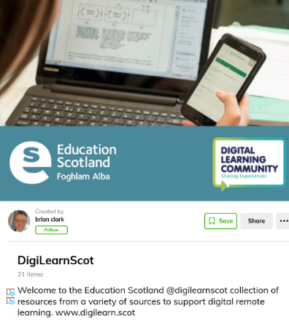
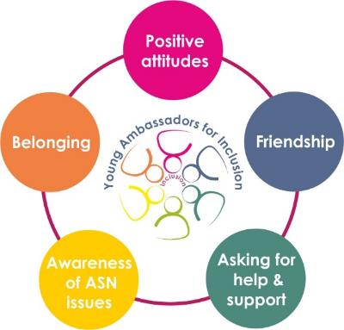
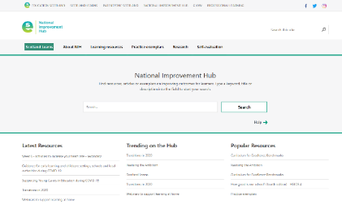
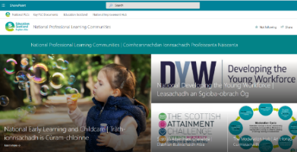
Useful information/resources
All images are hyperlinked
Do luchd-ionnsachaidh na h-Alba, le luchd-foghlaim Alba

Slide 31
Education Scotland
Denholm House
Almondvale Business Park
Almondvale Way
Livingston EH54 6GA
T +44 (0)131 244 5000
E enquiries@educationscotland.gsi.gov.uk
For Scotland's learners, with Scotland's educators

