Slide 1


Children’s Rights and the Current Context
What are they? Why do they matter? How do we embed them?
Part 2 – Why do they matter?
For Scotland's learners, with Scotland's educators
Do luchd-ionnsachaidh na h-Alba, le luchd-foghlaim Alba
Notes:
Hi, I’m … and welcome to the 3 session course on Children’s rights and the current context. This is Part 2 – Why do Rights matter?

Slide 2
Protocols
• Turn off your camera
• Mute your microphone
• Post comments, questions and thoughts into the chat window
• The chat will be facilitated by one of our team
• If you would like to speak type SPEAK in chat window or use RAISE HAND facility
• The event will not be recorded
Please introduce yourself in the chat!
For Scotland's learners, with Scotland's educators
Do luchd-ionnsachaidh na h-Alba, le luchd-foghlaim Alba
Notes:
Trainer Tip: Different sessions may have slightly different protocols based on the platform you are delivering the session through or who has asked you to run the session, so it’s worth double checking beforehand if your protocols match the expectations of the people who have asked you to run the sessions, in particular around recording the session.
Please take a moment to read through the protocols of this session.
Please take a moment to introduce yourselves in the chat!

Slide 3
Children’s Rights – What? Why? How?
Aims of professional learning resource (all 3 sessions):
To raise practitioner’s awareness and develop their knowledge/understanding of the United Nations Convention of the Rights of the Child (UNCRC)
To support rights-based practice across schools and other organisations
To link rights-based practice to the Scottish legislation and policy context
To support individuals, establishments and organisations to begin to reflect on and self-evaluate their current practice in light of the UNCRC
(To enable children to know, understand and claim their rights)
For Scotland's learners, with Scotland's educators
Do luchd-ionnsachaidh na h-Alba, le luchd-foghlaim Alba
Notes:
This training is intended to support practitioners knowledge but should also be delivered by those attending the training to other practitioners, so although it can be a stand-alone training, it can also be a training for trainers.
These are the aims for all 3 of the sessions connected with this 3-session course:
- To raise practitioner’s awareness and develop their knowledge/understanding of the United Nations Convention of the Rights of the Child (UNCRC). Through promoting practitioners understanding and knowledge, we want to support children and young people to recognise and realise their rights.
- To support rights-based practice across schools and other organisations.
- To link rights-based practice to the Scottish legislation and policy context.
- To support individuals, establishments and organisations to begin to reflect on and self-evaluate their current practice in light of the UNCRC.
- The final aim (To enable children to know, understand and claim their rights) is in brackets since this highlights the intended impact from the training rather than suggesting that the pack is directly for children or young people.

Slide 4
Session Two - Why
This session aims to:
Reflect on the previous session
Consider the relevance of UNCRC to understand how the UNCRC connects to everyday life and current issues
Understand the legislative and policy context that underpins UNCRC
For Scotland's learners, with Scotland's educators
Do luchd-ionnsachaidh na h-Alba, le luchd-foghlaim Alba
Notes:
This session aims to:
- Enable you to reflect on the previous session.
- Consider the relevance of UNCRC to understand how the UNCRC connects to everyday life and current issues.
- Understand the legislative and policy context that underpins UNCRC.
Activity: Consider, what made you think most from last week?
Trainer Tip: You can do this activity in any way you like. We have found that posing the questions and getting people to answer in the chat pane is a great way to get quick participant engagement.

Slide 5

General Principles
(underpinning rights) -
Article 2 – without discrimination
The Convention applies to EVERYONE.
Article 3 – best interests of the child
The best interests of the child must be a top priority in all things that affect children.
Article 6 – survival & development
Every Child has the right to life. Governments must do all they can to ensure that children survive and develop to their full potential.
Article 12 –
respect for the views of the child
Every child has the right to say what they think in all matters affecting them, and to have their views taken seriously.
Look at your rights sheets – reflect on which of the General Principles Go to padlet
For Scotland's learners, with Scotland's educators
Do luchd-ionnsachaidh na h-Alba, le luchd-foghlaim Alba
Notes:
Although the articles are indivisible and interdependent, there are 4 underpinning rights which can be seen to support all the others and are called General Principles:
- Article 2 covers the principle of Universality.
- Article 3 puts the best interest of the child first – before any other consideration – in all actions concerning children.
- Article 6 recognises that every child has the inherent right to life and that States must ensure ‘to the maximum extent possible the survival and development of the child’.
- Article 12, the right to be heard, is seen as a gateway right. Without Article 12 it is very difficult for children and young people to exercise their other rights. Participation therefore is often the first step to raising awareness of rights.
Some articles you may feel are only underpinned by one of these four general principles, other articles may be underpinned by multiple. When you look at article 9 for instance, which says you should not be separated from your parents unless it is for your own good, you have to remember that this applies to all children, without discrimination, that any decision about taking a child away from it’s parents has to be in the best interests of the child, that all children have the right to life and to survive and develop healthily and that children and young people have the right to be heard and express their views about any decision to separate them from their parents.
Activity: Reflect on different articles and consider which of the general principles underpin the different articles
Trainer Tip: You can do this activity in any way you like. We have found that picking out an article, reading it out for the participants and then getting them to type in the chat pane which general principle(s) underpin the article read out, is a great way to get quick participant engagement. If you have more time available, it might be worth facilitating this activity as a padlet activity where there are four headings set up and participants are able to sort the articles into which general principles they think each article sits under
To deepen discussion, you may want to ask a few people to unmute and share why they chose the general principle that they did to associate with the article in question. If time is short, it might just be worth saying that it’s nice to see commonalities coming through.
It’s important to know about the general principles so that we have these four articles at the front of our mind, in particular when we are planning for and with children, so that we can ensure that their rights are respected.

Slide 6


Articles Activity: General Principles
Sort the rights into the four domains of the General Principles.
Please open a new browser tab and go to: insert link
For Scotland's learners, with Scotland's educators
Do luchd-ionnsachaidh na h-Alba, le luchd-foghlaim Alba
Notes:
This slide is only needed if you choose to facilitate the activity through padlet. This can also be done using Jamboard or with flip chart paper and post its

Slide 7
Why are rights relevant today?
How are rights linked to:
Inclusion?
Equality?
Use the chat pane to suggest ideas.
For Scotland's learners, with Scotland's educators
Do luchd-ionnsachaidh na h-Alba, le luchd-foghlaim Alba
Notes:
Activity: Ask participants to consider why rights are relevant today. How are rights linked to inclusion and equalities?
Trainer Tip: You can do this activity in any way you like. We have found that posing the question and getting people to answer in the chat pane is a great way to get quick participant engagement.
Depending on the group, facilitators may want to spend a bit of time going over what the definitions and differences are between inclusion and equality, and what the different equalities are under the protected characteristics.

Slide 8
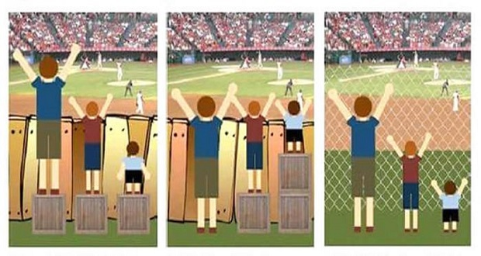
Equality, Equity, Social Justice
Equality
Equity
Social Justice
For Scotland's learners, with Scotland's educators
Do luchd-ionnsachaidh na h-Alba, le luchd-foghlaim Alba
Notes:
This slides is fantastic for looking at the difference between equality, equity and social justice: equality is treating everyone the same, equity is giving people what they need in order to overcome a barrier, and social justice is about making decisions that ensure fairness, so in this context changing the systems and removing the barrier so that all people can access whatever it is the barrier was preventing them for accessing.
To have their rights met – an equity issue – Children need a box/no fence – to help them realise their rights.
There are certain groups that may need an equitable or social just solution in order to have their rights met. Consider persons with disabilities, the disabilities act helps to ensure their rights are met. Care experienced young people may require Corporate parenting/additional support. If we look at the government initiative of the Scottish Attainment Challenge, that is a government programme put in place to help those experiencing poverty realise their rights.
Activity: Consider, are there any other ‘groups’ of people who would need specific consideration for them to be able to experience their entitlement to fundamental dignity? And if so, can you think of any examples of initiatives, activities or support that is either an equitable approach or a social just approach to helping these group realise their rights?
Trainer Tip: You can do this activity in any way you like. We have found that posing the question and getting people to answer in the chat pane is a great way to get quick participant engagement.
If participants are struggling to come up with groups, facilitators might want to give prompts for potential groups such as women, migrant workers, people with disabilities etc.
If participants are struggling to come up with examples, facilitators might want to prompt them to think at potential approaches that might occur at a classroom level, whole-school level, national level, world level.

Slide 9
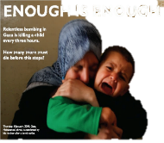

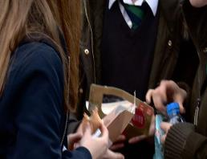

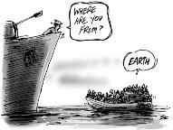
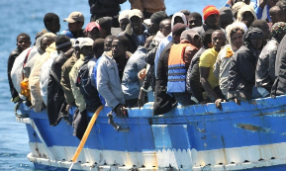
Recognising Children’s rights today
For Scotland's learners, with Scotland's educators
Do luchd-ionnsachaidh na h-Alba, le luchd-foghlaim Alba
Notes:
The following examples are given of rights not being realised
Activity: Ask participants to look at the articles in their booklet and consider which rights are not being realised.
The next activity will ask to consider whether any of the following images, articles or films might be helpful to explore with children and young people through learning activities, and if so, how they might go about it.
Trainer Tip: You can do this activity in any way you like. We have found that posing the question and getting people to answer in the chat pane is a great way to get quick participant engagement.

Slide 10
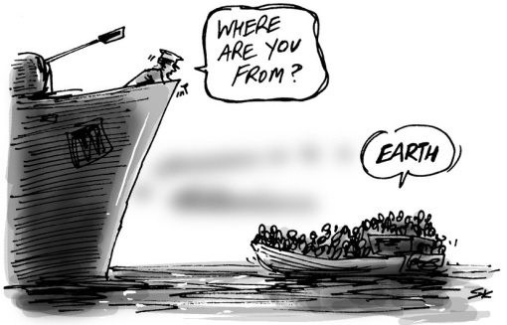
Cartoon – Where are you from?
For Scotland's learners, with Scotland's educators
Do luchd-ionnsachaidh na h-Alba, le luchd-foghlaim Alba
Notes:
COPYRIGHT CONFIRMED: https://www.indy100.com/news/the-cartoon-that-sums-up-the-world-s-migrant-crisis-7268021
Facilitators may want to consider these prompt questions to encourage reflections:
- What’s happening in this picture?
- Which rights aren’t being realised?

Slide 11
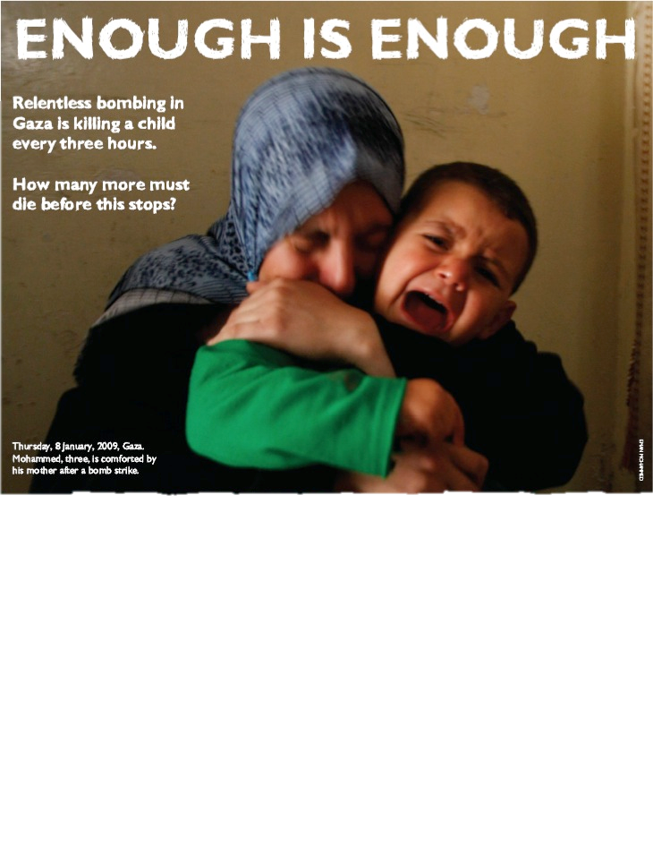

Enough is Enough poster from Save the Children
For Scotland's learners, with Scotland's educators
Do luchd-ionnsachaidh na h-Alba, le luchd-foghlaim Alba
Notes:
Save the Children Advert used with permission.
Facilitators may want to consider these prompt questions to encourage reflections:
- What’s do we know from looking at this image/reading the tags?
- Which rights aren’t being realised?

Slide 12
Exclusion from school
Exclusion rates for pupils with ASN are more than 4 times higher than those with no ASN
Exclusion rates are 6 times higher for those in the 20% most deprived areas
For Scotland's learners, with Scotland's educators
Do luchd-ionnsachaidh na h-Alba, le luchd-foghlaim Alba
Notes:
Facilitators may want to consider these prompt questions to encourage reflections:
- What’s do we know from looking at this image/reading the tags?
- Which rights aren’t being realised?

Slide 13


Tesco denies pupil lunchtime discrimination at Edinburgh store
For Scotland's learners, with Scotland's educators
Do luchd-ionnsachaidh na h-Alba, le luchd-foghlaim Alba
Notes:
Article link: https://www.bbc.co.uk/news/uk-scotland-edinburgh-east-fife-38065679
Facilitators may want to consider these prompt questions to encourage reflections:
- What’s do we know from looking at this image/reading the tags?
- Which rights aren’t being realised?

Slide 14

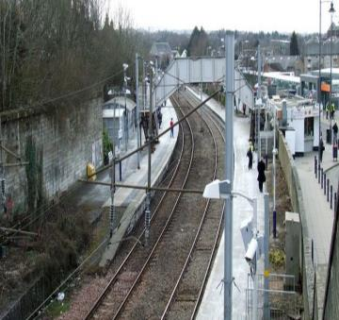
Scotland’s children’s commissioner has condemned Scotrail for installing a sound device to deter young people from gathering at a train station in South Lanarkshire
For Scotland's learners, with Scotland's educators
Do luchd-ionnsachaidh na h-Alba, le luchd-foghlaim Alba
Notes:
Article link: https://www.bbc.co.uk/news/uk-scotland-glasgow-west-40715995
Facilitators may want to consider these prompt questions to encourage reflections:
- What’s do we know from looking at this image/reading the tags?
- Which rights aren’t being realised?

Slide 15

Film – The Journey
View video on ES YouTube channel: https://youtu.be/gc1bc_XQ0TI
For Scotland's learners, with Scotland's educators
Do luchd-ionnsachaidh na h-Alba, le luchd-foghlaim Alba
Notes:
Video of parents discussing young person’s future while they are in back of the car. Made by Children’s parliament in association with Fife council.
Facilitators may want to consider these prompt questions to encourage reflections:
- What’s do we know from watching this film?
- Which rights aren’t being realised?

Slide 16
Recognising Children's Rights – Discussion
In small groups discuss some of the images:
Which ones were most thought provoking and why?
How could these be used as a teaching stimulus?
For Scotland's learners, with Scotland's educators
Do luchd-ionnsachaidh na h-Alba, le luchd-foghlaim Alba
Notes:
Activity: Consider whether any of the previous images, articles or films might be helpful to explore with children and young people through learning activities, and if so, how might you go about it?
Trainer Tip: You can do this activity in any way you like. We have found that posing the question and getting people to answer in the chat pane is a great way to get quick participant engagement.

Slide 17


What infringements of children’s rights can you think of?
In the school or community- this will be used to create a bank of anonymous statements
Or open a new browser using:
Insert link
If you have a smartphone, please go to
www.menti.com
Use the code:
For Scotland's learners, with Scotland's educators
Do luchd-ionnsachaidh na h-Alba, le luchd-foghlaim Alba
Notes:
Activity: Can you think of some real life examples either within school life or in the local community where children’s rights may still be infringed in some way?
Trainer Tip: You can do this activity in any way you like. If you’re running low on time, utilising the chat pane might be the quickest solution. However, if all the participants are from the same school, it might be worth taking time to use the speech bubble format on menti so that a visual can be created that you can export and send to all the participants in the session, which might help with further sessions that the school might do around children’s rights in their setting.

Slide 18
Recognising Children’s Rights Today
How are children supported and provided for?
Can you think of some real-life examples either within school life or in the local community where children’s rights may still be infringed in some way?
How are children protected?
How are children participating in wider society?
How might this right be restored?
For Scotland's learners, with Scotland's educators
Do luchd-ionnsachaidh na h-Alba, le luchd-foghlaim Alba
Notes:
Once participants have inputted suggestions to the question, it might be worth looking at commonalities and asking participants to unmute and expand on their points.
Having looked at examples of how children’s rights may be infringed upon, it’s worth thinking about how we might begin to go about restoring those rights. Some prompt questions that might help to consider how we restore those rights are considering the 3 P’s of provision, protection and participation:
- How are children supported and provided for?
- How are children protected?
- How are children participating in wider society?
Depending on time, you may want to either get some suggestions as to how they might begin to restore the rights, or you may want to leave it as a question for them to take away and reflect on.

Slide 19
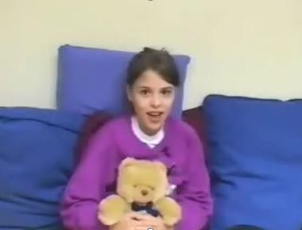
Recognising Children’s rights today – A case study
Use your article summary sheets to help you.
Watch film clip
Identify which rights are engaged or are in jeopardy?
Discuss what might a rights-based approach look like for this young person
View video on ES YouTube channel: https://youtu.be/3d1SJ8wnuNY
For Scotland's learners, with Scotland's educators
Do luchd-ionnsachaidh na h-Alba, le luchd-foghlaim Alba
Notes:
Activity: Watch the film clip and then consider:
- Which rights are being supported or infringed in this situation?
What could you or your team do to try and ensure young people’s rights are supported and not infringed here?
Trainer Tip: You can do this activity in any way you like. We have found that posing the question and getting people to answer in the chat pane is a great way to get quick participant engagement.
If participants are unsure, it may be worth prompting them to consider that Tara is a young carer who is not able to play and have fun – Article 15 – meet friends and join groups, article 31 – right to relax and play.

Slide 20
The New Bill was passed at the Reconsideration Stage on the 7th December – unanimous again.
It received Royal Assent on 16th January and commencement for most sections will be from 16th July (some are earlier such as producing statutory guidance)
For Scotland's learners, with Scotland's educators
Do luchd-ionnsachaidh na h-Alba, le luchd-foghlaim Alba
Notes:
“In June 2019 the Deputy First Minister announced that the United Nations Convention on the Rights of the Child (UNCRC) would be incorporated into law.
Following a consultation period, it has been agreed that full incorporation will go ahead by the end of the current parliamentary session (May 2021), and in September the Bill was presented to Parliament. Some articles will not be able to be included as they are not devolved matters (for example, the provision on military recruitment).
The Bill passed its 3rd stage on 16th March with unanimous, cross-party support. It was expected that commencement of the legislation will be by 1st November 2021. However, following a challenge from the Westminster Government, aspects of the Bill were deemed outwith the power of a devolved government and a review was needed. The Bill went back to parliament on 7th December 2023 and received Royal Assent on 16th January 2024 – commencement will be on 24th July. The legislation requires all public bodies to embed the UNCRC in their policies and practice.
This means these rights will become law and children and families may hold local authorities to account if a child’s rights are infringed upon.
Trainer Tip: It is essential that all facilitators keep up to date with the progression of the Bill into legislation and update this slide accordingly. If you are unsure of how it needs to be updated, it would be worth contacting Maxine Jolly prior to your session, so that all information getting put into the system is up to date.
United Nations Convention on the Rights of the Child (Incorporation) (Scotland) Act 2024 (legislation.gov.uk)
Supreme Court Judgment: here’s what you need to know – Together (Scottish Alliance for Children's Rights)
Pledge on children’s rights.

Slide 21


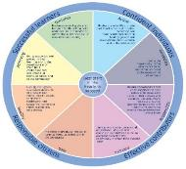




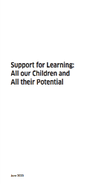
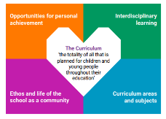
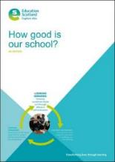

Policy, Guidance and self-evaluation
For Scotland's learners, with Scotland's educators
Do luchd-ionnsachaidh na h-Alba, le luchd-foghlaim Alba
Notes:
How can we link out work to UNCRC and make this explicit to colleagues / LAs / schools / ELC and CLD settings? Again ask for volunteers to speak / use chat
Emphasise the new NIF plan – reference to ELC and also new priority – ‘Placing the human rights and needs of every child and young person at the centre of education’
achieving-excellence-equity-2022-national-improvement-framework-improvement-plan (1).pdf

Slide 22
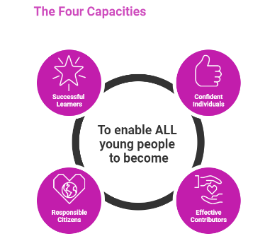
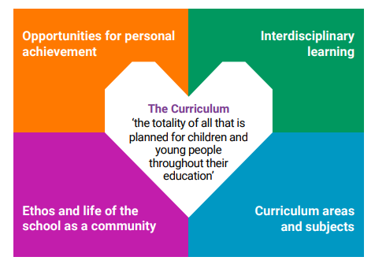




How does it fit?
For Scotland's learners, with Scotland's educators
Do luchd-ionnsachaidh na h-Alba, le luchd-foghlaim Alba
Notes:
Scotland’s curriculum places learners at the heart of education. We know that the curriculum is defined as the totality of all that is planned for children and young people from early learning and childcare, through school and beyond.
The Refreshed Narrative , refocused on 4 Contexts- & 4 capacities-
As part of their learner journey, all children and young people in Scotland are entitled to experience a coherent curriculum from 3 to 18, in order that they have opportunities to develop the knowledge, skills and attributes they need to adapt, think critically and flourish in today’s world- our interconnected, digital and rapidly changing world
We also have the 4 arenas of participation, and a resource / professional learning to support that
Understanding the learners
• Knowing children and young people and where they are on their individual
learner journeys
• Listening to learners and being informed by their motivations and aspirations
• Empowering learners to have agency in their learning with opportunities
for personalisation
• Using observations, assessments and feedback to design and develop
the learning

Slide 23
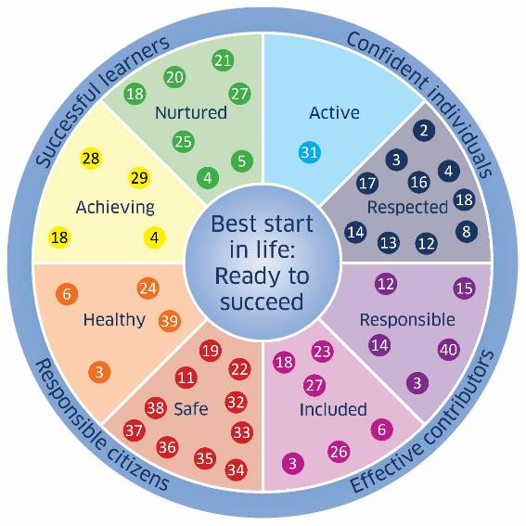

UNCRC Articles and the Wellbeing Indicators
UNCRC: The Foundation of Getting it Right for Every Child
For Scotland's learners, with Scotland's educators
Do luchd-ionnsachaidh na h-Alba, le luchd-foghlaim Alba
Notes:
The government’s answer to this question was to create the document: https://www.gov.scot/publications/uncrc-the-foundation-of-getting-it-right-for-every-child/
This might be widely known knowledge for most people, but I know a number of people always find it surprising to hear that Getting it Right for Every Child came out of the UNCRC. All the articles can fit into the wellbeing indicators, and it’s actually quite a nice task to get children / staff / parents to place articles on the wellbeing indicator wheel.

Slide 24

The Children and Young People's Commissioner
for Scotland is Bruce Adamson.
The children’s commissioner can help children and
young people to:
Know their rights
Protect their rights
Influence change
They also develop useful research and resources to support children’s rights
www.cypcs.org.uk
For Scotland's learners, with Scotland's educators
Do luchd-ionnsachaidh na h-Alba, le luchd-foghlaim Alba
Notes:
The Children and Young People's Commissioner for Scotland is Bruce Adamson. The children’s commissioner can help children and young people to:
- Know their rights.
- Protect their rights.
- Influence change.
They also develop useful research and resources to support children’s rights.

Slide 25
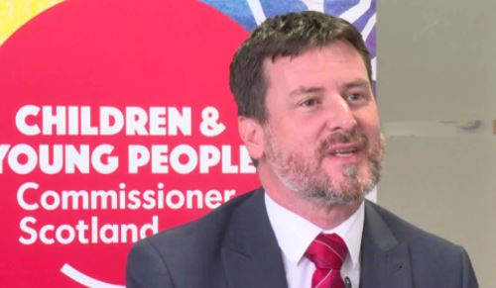
Film – The Role of the Children and Young People’s Commissioner
View video on ES YouTube channel: https://youtu.be/DIRg2AyYK58
For Scotland's learners, with Scotland's educators
Do luchd-ionnsachaidh na h-Alba, le luchd-foghlaim Alba
Notes:
Activity: Watch this clip of the Children’s commissioner Bruce Adamson discussing the role of the children and young people’s commissioner.

