Slide 1
Effective use of data
2. Defining and classifying data
Practitioners
Notes:
All information is correct as of May 2024
These slides are intended to support senior leaders, middle leaders and practitioners in schools and local authorities to explore the effective use of data for improvement. There are a set of six workshops available for senior leaders and middle leaders and a set of 6 workshops for practitioners. The workshops were co-designed with educators from across Scotland and are based on an Education Scotland literature review: The Effective use of data for improvement in education.
Establishing the purpose and use of data
Defining and classifying data
Creating effective processes and systems
Interpreting and analysing data
Developing a data informed culture
Using data for improvement
(hyperlinks for each workshop can be found on the next slide)
The PowerPoint is a template that presenters can adapt to suit their own context and style of presenting.
The workshops can be delivered individually or grouped together and delivered in a longer session. Individual workshops have been designed for facilitators to deliver in 1 to 2 hours.
Suggested timings for each workshop can be found on the content coverage slide.
Within the slide notes key messages, suggested tasks, ‘talking-points’ and reflective questions are included.
It is anticipated the presenter will have read the Education Scotland literature review: The Effective use of data for improvement in education.

Slide 2
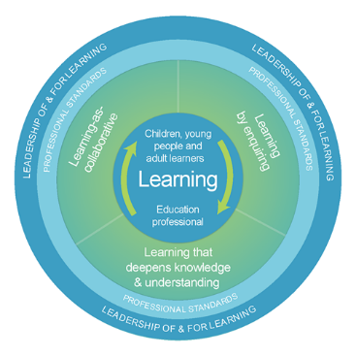
The national model of professional learning
The national model of professional learning | Professional Learning | Education Scotland
Notes:
Key Messages
This module has been designed using the national model of professional learning and the principles of adult learning or andragogy. It has been designed to think about:
The why – opportunities for participants to understand the rationale through professional standards, research, current policy landscape and national/local priorities.
The what – opportunities for participants to consolidate and develop relevant knowledge and skills
The how – opportunities for participants to take part in peer discussion, explore case studies or share experiences
Apply – a chance to reflect on learning, next steps and further support
A link to further information about the national model of professional learning can be found below.
edscot-model-of-professional-learning-outline.pdf (education.gov.scot)

Slide 3
Draft Group Agreement and Protocols
Work together
Learn from, with, and on behalf of each other
Create a safe space to share ideas and build learning
Agree that everyone is an equal and valued participant
Remain in the room (emails and phone protocol).
Notes:
Key messages
Take a moment to establish group protocols.
Ask participants to check and comment on anything they would like to add or amend.
The protocols on the slide are suggestions and may be amended for your school context.

Slide 4
Connector
In groups/pairs:
Share your favourite film or TV show.
Notes:
Key Messages
This is an example of a simple connecter activity. It is recommended that facilitators use a connector activity that allows participants to take part in an informal discussion.
This is to ensure that participants are relaxed, focused and ready for an interactive workshop.

Slide 5
Re-cap
In workshop 1 we looked at:
the purpose and use of data including: the meaning of data and evidence
the ways in which data is used and what we mean by ‘big’ and ‘small’ data
data bias and limitations
Notes:
Key Messages
This slide summarises coverage in previous workshops.

Slide 6
Aims
In this workshop we will consider:
the definitions of data related terms and vocabulary
different data categories
why we might intersect data to support improvement; and
how to intersect data to understand an identified gap, pattern or trend.
Notes:
Key Messages
This slide shows the aims of the session to be shared with participants.

Slide 7
Content coverage
National guidance and research
Developing a shared language
Categories of data
Intersecting data
Group activity
Reflection and feedback
Notes:
Key Messages
This slide shows the content covered throughout the workshop. Further details and suggested timings are provided below. Facilitators can amend content and timings to suit their needs and context.
National guidance and research – allow 5 minutes for this section (10 if module 1 has not been covered). It can be extended to 15 minutes if facilitators wish to include an extra activity that allows participants to read the relevant section of the national evidence review.
Developing a shared language – allow 15-20 minutes for this section which contains discussion.
Categories of data – allow 25 minutes for this section. This section contains a data categories quiz for participants to embed understanding of different data types.
Intersecting data – allow 10 mins for this section.
Group activity – allow approximately 20-30 mins for this group activity in which participants consider the data that they would intersect to understand a trend and address the issue.
In total, this workshop can be expected to take between 1 hour 30 and 1 hour 45 minutes to complete.

Slide 8
GTCS Standards for Full Registration and Career Long Professional Learning
Curriculum and Pedagogy
3.1.1 - Plan effectively to meet learners’ needs
3.1.4 - Effectively employ assessment, evaluate progress, recording and reporting as an integral part of the teaching process to support and enhance learning.
Professional Learning
3.3.2 - Engage in reflective practice to develop and advance career-long professional learning.
GTCS The Standard for Full Registration
GTCS - The Standard for Career-Long Professional Learning
Notes:
Key messages
The GTCS Standard for full registration and for Career Long Professional Learning highlights the importance of the use of data in decision-making.
The standard is the same for both groups.
This standard emphasises the importance of data being used to support planning and enhancing learning.
Reflective Questions
How wide ranging and robust is the data you are using in school? How do you know?

Slide 9
Data as defined in HGIOS 4
HGIOS 4 references the use of data in relation to effective triangulation for the evaluation of quality.
Quantitative data is combined with people's views and direct observations to allow for the evaluation of quality.
Taken from HGIOS 4, Fig. 4: Triangulation.
Notes:
Key messages
HGIOS 4 references the use of data in relation to effective triangulation for the evaluation of quality. Quantitative data is combined with people's views and direct observations to allow for evaluation of quality. To make this process reliable and informative, a shared approach must be taken.
This is emphasising the importance of using multiple sources of data to support any evaluative judgements.
Understanding different categories of data will help educators to select from a range of sources and effectively triangulate.

Slide 10
Rapid Evidence Review Paper
Section two of the Education Scotland Rapid Evidence Review on defining and classifying data highlights that:
It is important to develop a shared language around data and have clarity of key terminology.
Time should be taken to ensure all educators, partners, learners and key stakeholders understand the key terminology as appropriate and necessary to each role.
Data can be classified as demographic, input, output and perception.
Notes:
Key Messages
Section two of the rapid evidence review on establishing the purpose and use of data highlights that:
It is important to develop a shared language around data and have clarity around key terminology.
Time should be taken to ensure all educators, partners, learners and key stakeholders understand the key terminology as appropriate and necessary to each role.
Data can be classified as demographic, input, output and perception.
The Effective use of data for improvement in education
Talking Points
This may be a good point to ask participants to read section two on establishing the purpose and use of data.
Reflective Questions
What does ‘data’ mean to you? Is that meaning consistent across your setting?

Slide 11
Terminology / Shared Language
research
evidence
data
is information collected to be examined and considered and used to inform decision making
is gathered systematically
has different categories
is information used to demonstrate impact and support decision making
can be data, in many forms, and a knowledge base about what works
gathering information in a structured way to answer specific questions about education
can be carried out by professional researchers, or by practitioners.
Notes:
Key messages
Data
The terminology around data, evidence and research can be confusing as these terms are often used in slightly different, but overlapping ways by different people.
Module 1 focused on defining data, module 2 will explore the different categories of data in more detail.
Evidence
Evidence can be described as information used to demonstrate impact and support decision making. Evidence can be data, in many forms, and also a ‘knowledge base about what works’.
A knowledge base can be drawn from a number of sources including research, shared practice and case studies.
Research
Different levels of research but can be carried out both formally and informally. Might be a professional research study or could be a more formal practitioner inquiry approach.
Important to note that not all evidence is drawn from research – see next slide for further information.

Slide 12
Terminology / Shared Language – part 2
quantitative
formative
summative
qualitative
Data which evaluates learning at the end of a unit or a block of learning.
Examples include; tests, exams, projects, presentations.
Data which is ongoing and evaluates learning during the process.
Often used to monitor progress and enable timely adjustments to learning and teaching to take place.
Data which can be counted or measured
Data which can be given a numerical value
Data which deals with descriptions
Data that can be observed and recorded but not necessarily measured
Notes:
Key messages
This slide draws on previous knowledge of participants and should require only a brief recap.

Slide 13
Research Evidence
 | Research Evidence | School-based data | Other sources of information
Definition | Evidence generated through planned and systematic processes that answer specific questions, often assessing the impact of practices or approaches | Evidence generated by setting through the collection and analysis of pupil assessments and other sources of data. | Other information concerning schools and teaching that is no generated through systematic collection and analysis of data
Examples | Experiments (such as randomised control trials) Case studies Surveys Systematic reviews Interviews and focus groups | Samples of pupils' work Pupil and teacher feedback Behaviour logs Pastoral and wellbeing information Special Educational Need (SEN Parents and carer involvement and communication | Blogs and social media Newspapers Podcasts Accounts from education professionals (e.g. teachers, school leaders, consultants)
Using research evidence | EEF (educationendowmentfoundation.org.uk)
Notes:
Key messages
Research evidence can be drawn from different sources. This table taken from EEF research provides examples.
Talking points
Facilitators may wish to provide time to discuss:
What examples from each section are most familiar to us as practitioners?
What examples have we used most to enhance our practice?
What was the impact of this?
What evidence would we like to make more use of?

Slide 14
Terminology / Shared Language – part 3
achievement
progress
attainment
how much a learner has learned or mastered in relation to curricular expectations
how much progress a learner has made relative to their starting point
this could be related to progress in terms of attainment, or in relation to other goals
can also be referred to as ‘value-added’
what a learner has accomplished
this could be accomplishments in terms of attainment or refer to wider achievement within and beyond school.
Notes:
Key messages

Slide 15
Terminology / Shared Language – part 4
What is my role, as a practitioner, in measuring and recording attainment data?
How is progress measured or assessed in my own class/setting?
How is achievement measured or recorded in my own class/setting?
TASK
Notes:
Key messages
This is a discussion task.
Talking Points
It could be helpful to refer back to the different types of data and evidence more widely. For example, attainment will be recorded in a formal, quantitative way, but it is less likely that progress or achievement are. Are these being measured using qualitative data or small data? What role does professional judgement play – for example, in more individualised cases, like assessing the progress of a learner with significant ASN?

Slide 16
Categories of data (Victoria Bernhardt)
School processes (Input)
Views (Perceptions)
Demographics
Pupil learning (Output)
Multiple Measures (ed.gov)
Notes:
Key messages
Victoria Bernhardt proposes four data sets or categories of data as shown on the screen
Demographic data is data that provides descriptive information about the school community.
School process data or input data, defines what educators are doing or what provision is being provided to and for learners.
Pupil learning or output data refers to the attainment and achievement of learners. This may be big data or small data.
Perception data refers to the views of key stakeholders such as learners, families, educators and partners.
Bernhart places attendance within the demographic category however it may be an example of something that can cross categories as in education we also think of attendance as an output.

Slide 17
Categories of data – part 1
Demographics
Descriptive information about the school community.
This may include details such as:
age
gender
ethnicity
language proficiency
socioeconomic background
special needs status
geographical location.
Notes:
Key messages
Educational demographic data refers to information specifically related to the characteristics of students within an educational setting.
Such data helps educators understand the diversity of their student population and tailor educational approaches to meet their unique needs.

Slide 18
Categories of data – part 2
School processes (Input)
Defines what teachers are doing. Pedagogy, interventions, relationships, curriculum offer etc.
This may include information related to:
administrative processes
curriculum implementation
teaching methods
assessment practices
behaviour management strategies
room organisation e.g. layout, resources.
Notes:
Key messages
School process data refers to information about the procedures and operations within a school.
Analysing school process data helps us identify areas for improvement and make informed decisions to enhance the efficiency and effectiveness of our approaches
Talking Points
How often do we reflect on these processes and make changes based on our reflections? Are there some processes that we reflect on more often?

Slide 19
Categories of data – part 3
Pupil learning (Output)
Attainment and achievements. Can be ‘big’ data or ‘small data’.
This may include:
Achievement data e.g. test scores, exam results, completion of learning objectives
Qualitative data e.g. observations of learners, dialogue with learners.
Notes:
Key messages
Output data refers to information or evidence that demonstrates the results or outcomes of educational activities or interventions.
Output data provides insight into the effectiveness of teaching methods, curriculum design, and educational programs, helping educators assess student progress and make informed decisions to improve learning outcomes.

Slide 20
Categories of data – part 4
Helps us understand what all stakeholders think. Surveys, questionnaires, feedback, etc.
Views (perceptions)
perception data involves gathering viewpoints, opinions, or attitudes from various stakeholders such as students, parents, teachers, and administrators
It can provide insight into how individuals perceive different aspects of the educational environment, including teaching methods, school climate, and overall effectiveness.
Notes:
Key messages
Perception refers to the way individuals interpret or understand information based on their own experiences, beliefs, and perspectives.
Analysing perception data helps educators understand stakeholders' perspectives and make informed decisions to improve communication, engagement, and satisfaction within the educational community.
Talking Points
Facilitator may wish to provide time for a short discussion on how we currently collect these views in our classroom/settings and whether there are stakeholders we could engage with further?

Slide 21
Categories of data (Victoria Bernhardt) – part 2
School processes (Input)
Views (Perceptions)
Demographics
Pupil learning (Output)
Can you think of examples of where you see or use these different types of data?
Which category of data is most/least used in your experience?
Notes:
Key messages
Victoria Bernhardt proposes four data sets or categories of data as shown on the screen
Demographic data is data that provides descriptive information about the school community.
School process data or input data, defines what educators are doing or what provision is being provided to and for learners.
Pupil learning or output data refers to the attainment and achievement of learners. This may be big data or small data.
Perception data refers to the views of key stakeholders such as learners, families, educators and partners.
Bernhart places attendance within the demographic category however it may be an example of something that can cross categories as in education we also think of attendance as an output.

Slide 22
Name the data example 1
Class A Data | Percentage of pupils
SIMD 1 &2 | 62%
Free school meals | 75%
Sex | 57% boys 43% girls
Additional support needs | 35%
English as an additional language | 22%
Demographic
Perception/views
Input/school processes
Output/pupil learning?
Data for illustrative purposes only
Notes:
Key Messages
This is a quick quiz task to embed understanding of different categories of data.
Ask participants - Which category of data is this?
Talking Points
This is demographic data as it shows descriptive details of parts of the class.

Slide 23
Name the data type example 2
(a) Demographic (b) Perception/views
(c) Input/school processes (d) Output/pupil learning?
Data for illustrative purposes only
Notes:
Key Messages
This is a quick quiz task to embed understanding of different categories of data.
Ask participants - Which category of data is this?
For reference:
SIMD Q1 – Scottish Index of Multiple Deprivation Quintile 1 (learners living in most deprived areas).
EAL – English as an additional language
ASN – Additional Support Needs
BME – Black, minority ethnic.
Talking Points
This is demographic data as it summarises the demographic context of two-year groups in a secondary school.

Slide 24
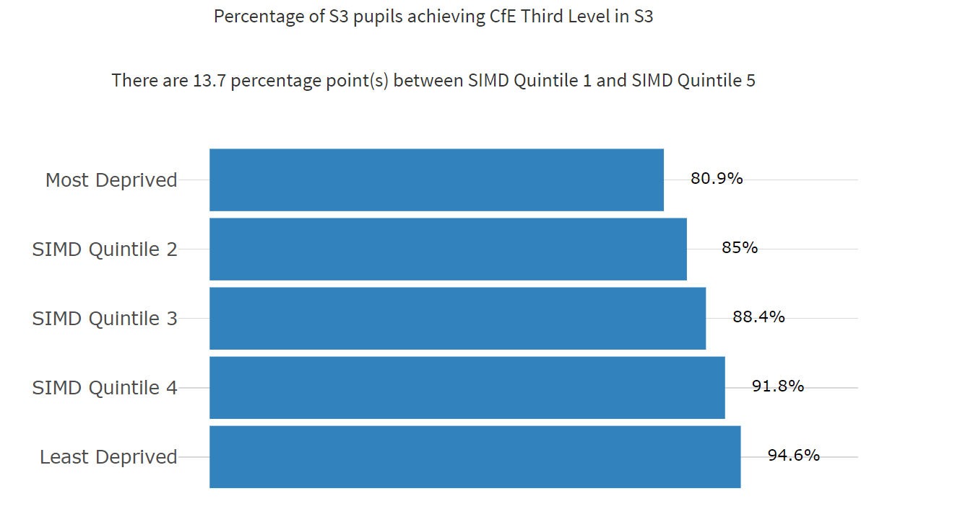
Name the data type example 3
Demographic
Perception/views
Input/school processes
Output/pupil learning?
NIFIER Dashboard (shinyapps.io)
Data for illustrative purposes only
Notes:
Key Messages
This is a quick quiz task to embed understanding of different categories of data.
Ask participants - Which category of data is this?
Talking Points
This is output data as it shows the percentage of S3 pupils achieving Third Level in S3.
This is ‘big’ data.

Slide 25
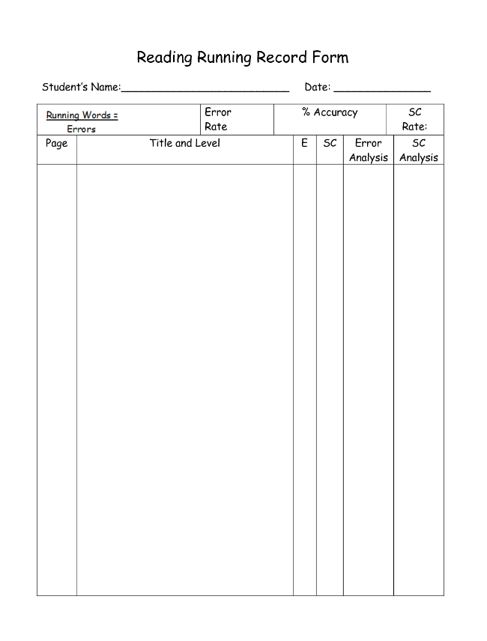
Name the data type example 4
Demographic
Perception/views
Input/school processes
Output/pupil learning?
Notes:
Key Messages
This is a quick quiz task to embed understanding of different categories of data.
Ask participants - Which category of data is this?
Talking Points
This is output data as it is a template for a running reading record. This is ‘small’ data collected by educators working closely with a learner.

Slide 26
Name the data type example 5
Summary pupil survey | Disagree | Agree | Don’t know
Most of the time my work is not too hard or too easy | 37% | 58% | 5%
I know my next steps and my learning targets | 22% | 78% | 0%
I am involved in planning my own learning | 78% | 12% | 10%
I have opportunities for personalisation and choice | 22% | 73% | 5%
I have opportunities to use digital technologies to help support my learning | 49% | 51% | 0%
(a) Demographic (b) Perception/views
(c) Input/school processes (d) Output/pupil learning?
Data for illustrative purposes only
Notes:
Key Messages
This is a quick quiz task to embed understanding of different categories of data.
Ask participants - Which category of data is this?
Talking Points
This is perception data as it shows a summary taken from a pupil survey.
Perception data can be gathered in lots of ways such as smaller focus groups or surveys.

Slide 27
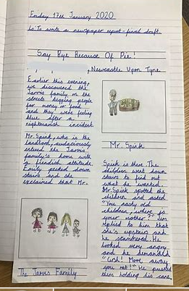
Name the data type example 6
Demographic
Perception/views
Input/school processes
Output/pupil learning?
Notes:
Key Messages
This is a quick quiz task to embed understanding of different categories of data.
Ask participants - Which category of data is this?
Talking Points
This is learner output data as it shows a page of writing from a child in a primary school.
Output data can be ‘big’ such as ACEL, SCQF or ‘small’ such as evidence taken from observations, jotters etc.

Slide 28
Name the data type example 7
The provision of manipulative resources in numeracy.
(a) Demographic
(b) Perception/views
(c) Input/school processes
(d) Output/pupil learning?
Notes:
Key Messages
This is a quick quiz task to embed understanding of different categories of data.
Ask participants - Which category of data is this?
Talking Points
This is learner input data as it references the use of manipulative resources to support learning in numeracy.
Afl or observations of learners using the equipment would be output data.

Slide 29
Name the data type example 8
Duke of Edinburgh Gold Award
Demographic
Perception/views
Input/school processes
Output/pupil learning?
Data for illustrative purposes only
Notes:
Key Messages
This is a quick quiz task to embed understanding of different categories of data.
Ask participants - Which category of data is this?
Talking Points
This is output data as it shows a learning having achieved a Gold Duke of Edinburgh Award.
It is important to remember outputs are achievement as well as attainment.

Slide 30
Intersecting data
Demographics
Perceptions
Inputs/ school processes
Outputs/pupil learning
Notes:
Key messages
The key to the effective use of data is in how we intersect or cross reference different sources of data to fully understand an identified issue, gap, pattern or trend.
This helps us to overlap information and ensure that we have a clear picture of an identified area of improvement or the progress we are making against an improvement outcome.

Slide 31
Intersecting data – part 1
Intersecting data categories allows us to ask and answer different questions about:
the profile of learners
who is progressing
what is working well to support progress
what learners, parents and others say about their learning
No School Left Behind, Using Data To Improve Student Achievement, Victoria Bernhardt, 2003
Demographics
Perceptions
Inputs/ school processes
Outputs/pupil learning
Notes:
Key messages
Intersecting data categories in education allows us to ask and answer different questions about:
the profile of learners
who is progressing
what is working well to support progress
what learners, parents and other say about their learning

Slide 32
Intersecting data – part 2
Intersecting data also supports us to:
Demographics
Perceptions
Inputs/ school processes
Outputs/pupil learning
fully understand an identified gap or area of improvement.
check and challenge our assumptions or ‘felt knowledge’
question whether our data reflects common patterns or ‘bucks the trend’.
improve our knowledge, understanding and outcomes for learners.
Notes:
Key messages
Intersecting data also supports us to:
fully understand an identified gap or area of improvement.
check and challenge our assumptions or ‘felt knowledge’ (felt knowledge is knowledge based on a feeling, belief or a ‘hunch’)
question whether our data reflects common patterns or ‘bucks the trend’.
improve our knowledge, understanding and outcomes for learners.

Slide 33
Intersecting data to answer questions
Is the attainment of learners who participate in outside-of-school activities higher? (achievement/output)
Do boys’ attitudes to science differ from those of girls in secondary school and does that difference influence the decisions that they make regarding course selection? (achievement/output, demographic, programme/input and perception)
Notes:
Key messages
Intersecting data can help us to answer questions. Two examples are explained below.
Is the attainment of learners who participate in outside of school activities higher? This would involve intersecting achievement data against attainment data to see if there is indeed a correlation between these two things.
Do boys’ attitudes to science differ from those of girls in secondary school and does that difference influence the decisions that they make regarding course selection? This would involve consideration of demographic data by selecting boys and girls, comparing output data in science by looking at their attainment, collecting perception data to find out what they think about science and considering input data by looking at course content and selection.
Reflective Questions
What other questions can you answer by intersecting data?

Slide 34
Intersecting data to understand a gap, a pattern or a trend
Boys are underperforming in literacy.
EAL boys are underperforming in writing.
The attendance of this group of learners is below 90%.
Dialogue with these learners indicates that they find writing lessons ‘boring’.
Data for illustrative purposes only
Notes:
Key Messages
This diagram shows how we can intersect data to understand an identified gap, pattern or trend. (Example data)
In this example, ‘big’ attainment data has suggested that boys are underperforming in literacy.
By intersecting data and looking further at the demographic breakdown we can see it is EAL boys. By looking further at the input, we find out that the element of literacy that this group are underperforming in is writing.
By intersecting more data, we may find out that attendance in these learners is low and they find the lessons boring. In this case an attendance rather than a literacy intervention may be most appropriate in the first instance / alongside tailoring the writing contexts to their interests and seeking a targeted literacy approach.

Slide 35
Group Activity
Output
Input
TASK
Numeracy standardised assessments results are lower than expected for this class.
Perception
Demographic
Notes:
Key Messages
This is an intersecting data group activity.
Ask participants to consider the class issue (this can be changed to another curricular area or a different example provided as appropriate).
What data would they collect to find out why this issue exists?
This activity can be completed using an online interactive tool or by using post it notes on a large sheet of paper.
It may be helpful to provide copies of slides 18 – 21 so that participants can refer to the definitions of the data categories.
An example is provided on the next slide of potential responses.

Slide 36
Group Activity questions
Input
Output
What pedagogical approaches are we using in this curriculum area?
How are these lessons currently organised?
What current supports are provided? Could we provide further or different types of support?
Is there any emerging research in teaching approaches in this particular area of the curriculum?
How does this relate to other assessment results (both summative and formative)?
What are we observing in our day-to-day lessons?
Numeracy standardised assessments results are lower than expected for this class.
Are children enjoying lessons
within this area?
How confident do they feel?
How do parents/carers feel about this curricular area?
Which specific children has this affected?
Do these children have similar characteristics, e.g. gender, EAL, ethnicity, etc?
Perception
Demographic
Data for illustrative purposes only
Notes:
Key Messages
This provides potential responses to the task on the previous slide.
Participants may have come up with appropriate alternative solutions

Slide 37
Aims review
In this workshop we will consider:
the definitions of data related terms and vocabulary
different data categories
why we might intersect data to support improvement; and
how to intersect data to understand an identified gap, pattern or trend.
Notes:
Key Messages
This slide shows the aims of the session to be reflected upon at the end of the session.
Reflective Question
Did we cover all our aims?

Slide 38
Reflection Activity
TASK
What types of data are we most confident in using?
How can we make better use of intersecting data to improve outcomes for our learners?
Notes:
Reflective Questions
A final reflective task. Ask participants to consider the question and then feedback into the room.

Slide 39
Feedback
Insert you own evaluation code here
Notes:
You can insert your own feedback link here.
Thank-you. We hope that you found this resource useful.
Please provide feedback on the materials here https://forms.office.com/e/viKTsvQj9d
Your comments are appreciated and will be used to inform future resources.
This link should not be shared with the audience.

