Slide 1

Supporting Attendance:
Putting Children, Young People and Families at the Centre
Notes:
All information correct as of August 2024
These slides are intended to support local authorities and schools.
The PowerPoint is a template that presenters can adapt to suit their own context and style of presenting.
Within the slide notes key messages.
It is anticipated the presenter will have read Improving Attendance in Scotland.

Slide 2
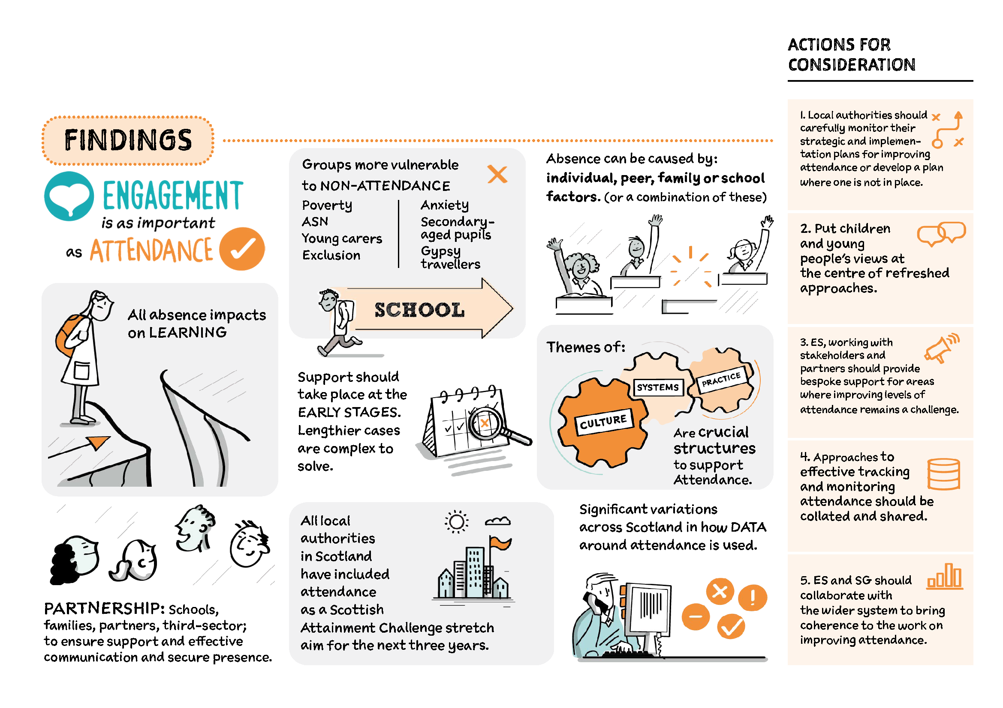

Improving attendance in Scotland
Read Improving Attendance in Scotland
Notes:
Key messages:
After a deep dive into attendance one of the key findings was the importance of partnerships including families.
We will explore how partnerships can be developed with families throughout this presentation.

Slide 3


Goals of Education
Talking Point
4 main articles
  28 – Right to an education. This must respect children’s dignity
  29 – Education must develop every child’s personality, talents and abilities to the full
  30 – Right to language, customs and religion of your family
  31 – Relax, play and take part in a wide range of cultural and artistic activities
Do luchd-ionnsachaidh na h-Alba, le luchd-foghlaim Alba
Notes:
Key message:
Reflect on how this is linked to attendance and how the curriculum enables every learner to reach their potential

Slide 4

Engagement is as important as attendance
Engagement happens when children and young people give attention to, and are actively involved in, a learning task.
Types of engagement include:
emotional (interest, boredom, happiness)
behavioural (attention, effort, persistence)
cognitive (motivation, learning strategies)
agency (expressing interests and needs)
Notes:
Key messages:
One of the key findings is that ‘Engagement is as important as attendance’.
Children and young people may physically be in school but can be disengaged from learning. Without engagement attendance is meaningless.
To support attendance and engagement we need to understand the reasons why children and young people are not coming to school.
We also need to change the narrative- it is our role to engage children and young people – not their responsibility to engage

Slide 5




Understanding the reasons for absence
The causes of absence are multifaceted and should be considered only as part of a bigger picture of the individual child or young person.
School
Peers
Individual
Family
(Forth Valley West Lothian)
This Photo by Unknown Author is licensed under CC BY
Notes:
Key messages:
Forth Valley and West Lothian have categorised the reasons for absence under four headings:
Individual factors : such as health (physical/mental) ASN, social factors, self-belief, lack of interest
School factors: such as relationship with teacher/peers, quality of learning/relevance, curriculum, transitions
Family factors: such as low interest/belief, parent mental health, loss and bereavement, worry about parents, financial concerns, not having access to the right equipment and clothing
Peer factors: peer pressure, social isolation, poor social skills, peer conflict, bullying, feeling of not belonging
Absence can be multifaceted and can therefore have more than one cause. Assessing the reasons will support the removal of any barriers.

Slide 6
Top tips for engaging with families
Talking Point
Start with the positives - what motivates them to come to school / go into class
Ask about the barriers to attending school / class
Any conversation or meeting must be voluntary, with the possibility for views to be shared in other ways if necessary - such as talking mats, a voice recording, drawing
Any meeting should be with a trusted adult who won’t be defensive or make judgements
The meeting should be in a safe, familiar place where there will be no interruptions - it does not have to be in school
Ensure that everyone involved understands the need for confidentiality
Inform all that if they say anything that indicates they may be at risk, that this will have to be shared
Give comfort breaks
Allow time for reflection on any questions and for participants to come back to earlier questions
Make sure questions are open and conversational - start with things such as ‘tell me about’; ‘what happens when’
The meeting should be transparent and informative - learners need to know about their right to be heard
Be accountable - commit to following-up with learners and families on their feedback
Notes:
Suggested task:
Discuss what is working for them, not working or missing.
Key messages:
Make sure that conversations are in a safe space that learners and their parents/carers are comfortable with.
Make sure that any outcomes or decisions are followed up and fed back to the learner and parent /carer.

Slide 7
Voice is not enough, Lundy (2007)
Notes:
Key messages:
This is a model by Professor Laura Lundy who takes article 12 as her starting point and interprets what that means.
Not just a case of listening to children and young people, but giving them a safe space to form and express their views. This is about the culture and ethos/values in a school that allows learners to feel safe to share their views. If they don’t feel safe or feel that they will be ridiculed, challenged, ignored, etc – they are unlikely to share their views.
Voice – children need to be given the skills, support to enable them to use their voice and find a way of expressing themselves.
Audience – when a view is given it should be listened to respectfully and given due weight, not just done in a tokenistic way.
Influence – this doesn’t mean that we will always follow through on what children and young people want, that might be in contravention of some of their other rights, eg. keeping them safe, but where it is appropriate and there are things that can be changed that will improve children and young people’s experience then we should change them.

Slide 8
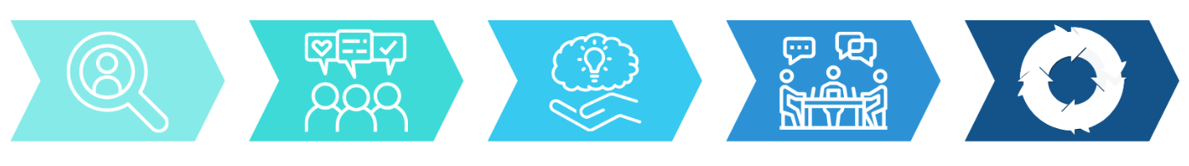
Putting Children, Young People and Families at the Centre
1. Identify target pupils
2. Gather all views
3. Understand the causes
4. Co-create intervention plan
5. Implement, monitor and evaluate
Targeted Intervention and Data Gathering (Forth Valley & West Lothian)
Notes:
Key messages:
Forth Valley and West Lothian have created targeted intervention guidance for putting children and families at the centre.
This follows the principles of GIRFEC.
This is a flow chart for targeted intervention:
1. Identify target pupils: use attendance data and early warning systems to identify target pupils.
2. Gather all views: gather individual views from the pupil, parent/carer, and key staff, to gain a holistic understanding of attendance problems.
3. Understand the causes: analyse qualitative data to determine the cause(s) and identify suitable interventions.
4. Co-create intervention plan: agree next steps and plan interventions in partnership with parents/carers, the pupils themselves, and any appropriate agencies.
5. Implement, monitor and evaluate: once interventions are implemented, continue to monitor progress and evaluate their effectiveness, sharing this information with all involved.
Attendance Targeted Intervention Guidance: https://blogs.glowscotland.org.uk/glowblogs/fvwlric/school-refusal-assessment-scale-sras-r/

Slide 9

Considerations for all adults who support me
Do I have what I need?
How do you ensure all children and young people have everything they need for learning at school, home and in the community, and is this done in a way that is sensitive?
2. Have my barriers been removed?
Are you ensuring all barriers are removed to allow all learners to participate in the totality of the curriculum, including school trips and clubs?
3. Have I been encouraged to attend school?
How have you raised the profile of the importance of attendance with learners and families?
Do you ensure that all children are welcomed regardless of when they arrive at school?
4. Am I consulted and listened to in school?
When initial concerns around attendance arise do you have an initial conversation with all stakeholders – including children, young people and families?
Notes:
Key messages:
Have parents and carers been made aware of the importance of attendance? Have learners? What is in place to support children who are often late – are they humiliated if they arrive after the start of the school day?

Slide 10
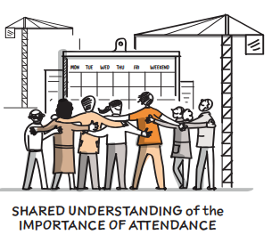
Considerations for all adults who support me Part 2
5. When does my attendance become a concern?
Are you aware of children and young people whose attendance is at risk of becoming a concern, and put in early intervention(s)?
Is the tracking you have in place able to identify early thresholds?
Do you know who your most vulnerable to absence; those impacted by poverty, young people from Gypsy and Traveller communities, children and young people who have been excluded learners with additional support needs; including young carers, those who have experienced care, health issues and anxiety?
Do you have systems in place to report children and young people who may be missing, or at risk, in the community when not in school?
6. Who can help me?
How strong are your partnerships across services in supporting families and learners?
What processes are there to support families with routine in the home, including bedtime and mornings?
Notes:
Key messages:
Think about the wider community setting and how other partners can support attendance.

Slide 11



Pushes and pulls to support attendance
Pull to
Push away
Push away
Pull to
Notes:
Key messages:
In thinking about how we improve attendance it is helpful to consider how we support absence and promote attendance.
To do this we need to consider with families what:
Pulls learners toward home? How can we mitigate or support pressures on young carers, the desire to game and peer pressure?
What pushes the learner away from home/community? As well as supporting the learner with what is happening at home, how do we capitalise on school being a solution such as strong relationships/ safe culture?
Pulls away from school that require mitigation such as peer relationships, staff relationship( affiliation), the relevance of curriculum, a curriculum that speaks to goals (agency), control over what/where they are learning (autonomy) identity as a learner (do they feel the curriculum is for them?)
Pulls towards school – What is your offer? What makes your CYP get out of bed in the morning? What happens on the days of the week you have low attendance?
When schools understand what is pushing and pulling they can remove these barriers.
Children and young people are at the heart of any solution.

Slide 12
Resources
Included, engaged and involved part 1 (gov.scot)
This national policy provides the framework for the promotion and management of attendance and absence.
Improving attendance in Scotland | Resources | Education Scotland
Resource page for supporting attendance
https://education.gov.scot/resource-themes/childrens-rights-in-scotland/
Help to take forward a children’s rights approach to policy and practice.
Insert link
Support to data to identify groups for improved attendance.
Notes:
Key messages:
Self-evaluation should be at the heart of improvement regardless of the resource used.

Slide 13

Thank you!
Notes:
We hope you found the resource useful.
Please let us know how we can improve this by answering the questions below.
https://forms.office.com/e/jC9rBVwD2M

