Slide 1
Aspiring to Middle Leadership
Introductory session
Notes:
All information is correct as of June 2024.
This PowerPoint is intended to support senior leaders, middle leaders and practitioners in schools and local authorities to deliver an introduction to a group on the Aspiring to Middle Leadership (AML) programme.
This PowerPoint is a template that presenters can adapt to suit their own context and style of presenting. It can be added to, but please do not remove any slides as they are all essential to the Introductory session. You may wish to add the date, a logo alongside the Education Scotland one, and /or to add a link to a feedback form into the last slide.
Within the slides, suggested timings, key messages to get across, facilitator notes and reflective questions are included.
The session this PowerPoint is intended to support has been designed to be delivered by facilitators in 60 minutes. If you have longer, we would encourage you to use that time for (more) discussion of the reflective questions, and perhaps invite some feedback. Suggested approximate timings can be found in the notes for each slide.
IMPORTANT NOTES:
This PowerPoint refers to the Education Scotland Aspiring to Middle Leadership programme [Aspiring to Middle Leadership | Programmes | Professional learning programmes, webinars and events | Professional Learning | Education Scotland]. It is anticipated the presenter will be familiar with the content of these pages. It will be particularly useful to be familiar with Introductory Activities 1-3, before delivering this session.
You may wish participants to bring their devices for slides 11-13, when you present ‘The Learning ahead’ that is accessed through the website. Alternatively, you could share your screen whilst viewing the AML area of the website, to show/remind participants how and where to access the Professional Learning Activities.
While use of the AML Reflective Journal is optional, we would encourage its use as part of this facilitated programme. If used, it will be helpful for participants to have it to hand during this session.
You might also want to consider planning follow up sessions to check in/support those engaged in the learning and to share learning from Professional Learning Activities undertaken throughout the programme.

Slide 2
Ways of working together
We all work together
We learn from, with and on behalf of each other
We create a safe space to share ideas and build learning
We agree that everyone is an equal and valued participant
We remain ‘in the room’ (follow email and phone protocol)
Notes:
Suggested timing:
5 minutes
Key messages:
- Why establish group protocols?
Effective professional learning goes beyond simply delivering information. It fosters a learning community where educators can learn with, from, and on behalf of one another. To achieve this, the facilitator of this learning should establish clear protocols and a positive learning environment at the outset. The general notes below will support the facilitator to help everyone feel comfortable participating and contribute to a rich learning experience.
Facilitator notes:
Take some time to establish group protocols (ways of working together) for this session and any further Aspiring to Middle Leadership sessions you may deliver.
Ask participants to comment on anything they would like to add or amend.
Is there anything that participants feel is missing or anything they would like to remove?
The protocols on the slide are suggestions to be amended for your context or group.
Further notes on creating protocols:
1. Contract a safe space
Co-create a safe space agreement with your group. This agreement outlines expectations for respectful communication and active listening. A safe space allows trust to flourish, fostering a collaborative environment where everyone feels comfortable sharing ideas and taking risks.
2. Shift from top-down to collaborative learning
Move beyond the traditional model where one person imparts knowledge. Embrace a collaborative approach where all participants actively engage. This means learning with, from, and on behalf of one another. By leveraging the diverse perspectives within the group, gaining a richer understanding and creating a more impactful learning experience for everyone.
3. Holding the ladder: Shared expertise and recognition
Holding the ladder signifies a two-fold approach:
Sharing expertise: Those with experience can share their knowledge and insights.
Recognising everyone’s contribution: Actively listen and be open to learning from the unique perspectives and experiences of colleagues. Build on each other's ideas to foster a collaborative environment where everyone feels valued, and their contributions are respected.
4. Hold space for silence and respectful discussion
Hold space for silence after someone speaks or asks a question. It can be tempting to jump in to fill silence but allowing time for quiet can avoid interrupting thought and produce more thoughtful responses. Everyone deserves to be heard and understood.
Adapt the time allocation based on the size of the group and the complexity of the topic.
5. Schedule regular breaks
Schedule a break into the session (as a minimum, one 5–minute break per hour). This allows participants to process information, refocus, and return with renewed energy, leading to a more productive learning experience.
6. Centre learning in real life
Connect the learning to real-life experiences by encouraging participants to share relevant personal anecdotes or applications. This strengthens understanding and makes the learning more relatable and impactful for all.

Slide 3
Today’s session
In this session we will:
Introduce the Education Scotland Aspiring to Middle Leadership (AML) programme
Take a look at the roles of middle leadership explored through AML
Familiarise with the programme ahead, including
- using the PLAs
- inclusion, wellbeing and equalities
Consider the benefits of working with a peer supporter
Think about our next steps
Notes:
Suggested timing:
1 minute
Facilitator notes:​
​
This slide shows what will be looked at in this session, to be shared with participants. Invite any questions they may have.

Slide 4
National Model of Professional Learning
Notes:
Suggested timing:
2 minutes
Key messages:
Aspiring to Middle Leadership has been designed using the national model of professional learning and the principles of adult learning or andragogy.
If you want to explore the model further, use the QR code on the slide. – THIS QR CODE IS NOT WORKING FOR ME
Facilitator notes:
Briefly talk through each part of the model:
The heart (centre) of the model - the professional learning in this programme should impact on you as educators and in turn impact on your learners. All effective professional learning links the educator’s learning with that of the children, young people or adult learners you work with. You will be in the role of a learner in this programme too. Please reflect throughout on the potential of your learning to impact on your learners.
The next three elements in green – the programme involves enquiry, collaboration and learning that deepens your knowledge and understanding, because these approaches are known to support effective learning that can transform practice.
The programme is linked to professional standards, whether the General Teaching Council (Scotland) (GTCS) Standard for Middle Leadership, the Scottish Social Services Council (SSSC) Codes of Practice or Standard for Childhood Practice (2015), or the Community Learning and Development Standards Council (CLDS) Competent Practitioner Framework.
Leadership of and for learning is about creating a culture of learning in a setting, with everyone playing a part in creating that ethos, not just leadership teams.
Reflective question:
Is there anything that resonates with you and if so, why?

Slide 5
Connector
Think of a middle leader you’ve worked with in the past, what different roles did you observe them undertaking as a middle leader? What are the different functions of being a middle leader in your experience?
Share the roles you observed (but do not identify the middle leader you’re thinking of)
Notes:
NEEDS EDITED
Suggested timing:
2 + 10 mins
Key messages:
Reflecting on the activities already done will bring the group ‘back into’ the learning, having already done Introductory activities 1-3, and provide a good starting point for today’s thinking and learning.
Facilitator notes:
If participants have used the optional Reflective Journal for the Introductory activities, it will be useful to have it to hand.
If time permits, you may wish to ask each small group to feed back any key points or themes from their discussion. If not, invite one or two reflections on the Introductory activities.
Further notes on connectors:
A connector activity allows participants to take part in an informal discussion.
This is to ensure that participants are relaxed, focused and ready for an interactive workshop.

Slide 6
A theoretical model of middle leadership
The roles of middle leaders
Student Focused (SF)
Administration (AD)
Organisational (OR)
Supervisory (SU)
Staff Development (SD)
Strategic (ST)
Adapted from De Nobile, 2017
Notes:
NEEDS UPDATED
Suggested timing:
7 minutes
Key messages:
This model presents the evidence that underpins this programme and the roles of middle leadership on which the PLAs are based.
Facilitator notes:
Recap the model briefly (participants will have learned about it already in the Introductory activities).
For your own reference, in the model:
Inputs are the influences on middle leaders that determine how effectively they can carry out their role
Notes: Principal support = Headteacher support;
C, P & A = Curriculum, Pedagogy and Assessment;
‘Other??’ is included as John De Nobile acknowledged this list not to be exhaustive.
Roles are where the acronyms stand for:
SF Student focused - concerns instances when middle leaders are dealing with learner issues that are not related to the other roles. Examples of activity in this area would
include: assisting learners with academic issues, dealing with behaviour problems and addressing the welfare needs of learners.
AD Administration - concerns the development of procedures and putting them in place so that a variety of tasks can be carried out by staff members and the organisational role can be executed effectively. The ultimate goal of the administration role is efficient use of time and resources. This role includes the organisation of systems, such as files and databases for the keeping of records relating to a variety of things ranging from purchases and inventory through to learner achievement and behaviour. The middle leader develops these systems, or does so as part of a team, or may even engage school administration staff to produce the necessary resources.
OR Organisational has to do with the organisation of physical and human resources through tasks that help schools to achieve their goals and objectives. Coordination of people
and materials is the main activity. As part of this role, middle leaders organise duty rosters and teaching timetables. The role also involves planning, executing and implementing a range of programmes, events and activities. These are increasingly collaborative tasks with others in a team, department or committee. The organisational role also requires middle leaders to collect data on student achievement through the monitoring of assessment results, which can provide the basis for work in other roles.
SU Supervisory - involves monitoring and evaluating the performance of staff, including perhaps junior leaders (such as assistant department heads). The focus of this particular role is monitoring and reporting on the competency of individuals they have authority over as well as the quality of their work. This role suggests that middle leaders may be required to assess teachers. However, in some studies, middle leaders preferred a softer, collegial notion of supervision where performance was discussed rather than observed and measured. The supervisory role links to the staff development role when discussions extend to suggestions about in-service training, such as short courses or other activities to lessen knowledge gaps and improve skills.
SD Staff development - concerns building the capacity and competence of staff members so that they can do their jobs more effectively. This role is carried out in several ways. The simplest acts are offerings of encouragement, praise or support for work being done, the aim of which is to keep teachers and other staff motivated to develop their abilities and reach their potential. Another well-known way to carry out the staff development role is to lead by example. Middle leaders are often regarded as effective teachers and role models,
often reaching their position because of their capacity for leading by example. They might enhance their reach as role models by letting other staff members
observe them, providing advice to teachers, mentoring and coaching their colleagues in a
grade or subject area, or simply working the way they want their colleagues to work. Middle leaders have also been observed to organise and even run professional development for teachers based on their particular expertise.
ST Strategic - primarily concerns vision forming and goal setting and acquiring the resources to achieve these. Middle leaders are increasingly being asked to develop a vision for
their area of responsibility. This means that they must also persuade those in their area of responsibility to ‘buy in’ and work towards that vision. Collaborative styles of leadership that cultivate positive trusting relationships will be useful , especially where teaching practices may need to change. The strategic role also involves motivating and persuading others to follow a
particular policy line or get involved in implementing new ideas. The strategic role is likely to be much easier to carry out if middle leaders are good staff developers, supervisors,
administrators and managers because they are creating the optimal conditions for influence and change. The larger theoretical model (De Nobile, 2017) suggests that middle leadership roles are
at the centre of what these important people do and their potential impacts on school effectiveness through their influence on the quality of teacher work.
(For full article and references please access The Roles of Middle Leaders in Schools: Developing a Conceptual Framework for Research, De Nobile, 2017 via EBSCO).
Tell participants that John De Nobile worked with Scottish Middle Leaders in 2021 through Education Scotland’s Middle Leaders Leading Change programme, and they identified some additional roles, including:
External liaison – concerns interaction with third parties such as specialists and social workers, facilitating work experience and interacting with employers or universities
Staff health and wellbeing – concerns looking after staff mental and physical health issues and other aspects of staff inclusion.
Managing and Leading are distinct but complementary and the middle leader roles will involve aspects of both. The 6 roles are distinct but interrelated.
Outputs are the impacts middle leaders can have.
How? are the skills and behaviours demonstrated by middle leaders in carrying out their roles.
Reflective Questions:
What are your thoughts about the model? Does it ring true for you in relation to what you know about middle leadership? Were there any surprises?
What might be the other inputs (influences on) and outputs (impacts)? What other aspects of the How? might there be?

Slide 7
A theoretical model of middle leadership
De Noble
Notes:
NEEDS UPDATED
Suggested timing:
7 minutes
Key messages:
This model presents the evidence that underpins this programme and the roles of middle leadership on which the PLAs are based.
Facilitator notes:
Recap the model briefly (participants will have learned about it already in the Introductory activities).
For your own reference, in the model:
Inputs are the influences on middle leaders that determine how effectively they can carry out their role
Notes: Principal support = Headteacher support;
C, P & A = Curriculum, Pedagogy and Assessment;
‘Other??’ is included as John De Nobile acknowledged this list not to be exhaustive.
Roles are where the acronyms stand for:
SF Student focused - concerns instances when middle leaders are dealing with learner issues that are not related to the other roles. Examples of activity in this area would
include: assisting learners with academic issues, dealing with behaviour problems and addressing the welfare needs of learners.
AD Administration - concerns the development of procedures and putting them in place so that a variety of tasks can be carried out by staff members and the organisational role can be executed effectively. The ultimate goal of the administration role is efficient use of time and resources. This role includes the organisation of systems, such as files and databases for the keeping of records relating to a variety of things ranging from purchases and inventory through to learner achievement and behaviour. The middle leader develops these systems, or does so as part of a team, or may even engage school administration staff to produce the necessary resources.
OR Organisational has to do with the organisation of physical and human resources through tasks that help schools to achieve their goals and objectives. Coordination of people
and materials is the main activity. As part of this role, middle leaders organise duty rosters and teaching timetables. The role also involves planning, executing and implementing a range of programmes, events and activities. These are increasingly collaborative tasks with others in a team, department or committee. The organisational role also requires middle leaders to collect data on student achievement through the monitoring of assessment results, which can provide the basis for work in other roles.
SU Supervisory - involves monitoring and evaluating the performance of staff, including perhaps junior leaders (such as assistant department heads). The focus of this particular role is monitoring and reporting on the competency of individuals they have authority over as well as the quality of their work. This role suggests that middle leaders may be required to assess teachers. However, in some studies, middle leaders preferred a softer, collegial notion of supervision where performance was discussed rather than observed and measured. The supervisory role links to the staff development role when discussions extend to suggestions about in-service training, such as short courses or other activities to lessen knowledge gaps and improve skills.
SD Staff development - concerns building the capacity and competence of staff members so that they can do their jobs more effectively. This role is carried out in several ways. The simplest acts are offerings of encouragement, praise or support for work being done, the aim of which is to keep teachers and other staff motivated to develop their abilities and reach their potential. Another well-known way to carry out the staff development role is to lead by example. Middle leaders are often regarded as effective teachers and role models,
often reaching their position because of their capacity for leading by example. They might enhance their reach as role models by letting other staff members
observe them, providing advice to teachers, mentoring and coaching their colleagues in a
grade or subject area, or simply working the way they want their colleagues to work. Middle leaders have also been observed to organise and even run professional development for teachers based on their particular expertise.
ST Strategic - primarily concerns vision forming and goal setting and acquiring the resources to achieve these. Middle leaders are increasingly being asked to develop a vision for
their area of responsibility. This means that they must also persuade those in their area of responsibility to ‘buy in’ and work towards that vision. Collaborative styles of leadership that cultivate positive trusting relationships will be useful , especially where teaching practices may need to change. The strategic role also involves motivating and persuading others to follow a
particular policy line or get involved in implementing new ideas. The strategic role is likely to be much easier to carry out if middle leaders are good staff developers, supervisors,
administrators and managers because they are creating the optimal conditions for influence and change. The larger theoretical model (De Nobile, 2017) suggests that middle leadership roles are
at the centre of what these important people do and their potential impacts on school effectiveness through their influence on the quality of teacher work.
(For full article and references please access The Roles of Middle Leaders in Schools: Developing a Conceptual Framework for Research, De Nobile, 2017 via EBSCO).
Tell participants that John De Nobile worked with Scottish Middle Leaders in 2021 through Education Scotland’s Middle Leaders Leading Change programme, and they identified some additional roles, including:
External liaison – concerns interaction with third parties such as specialists and social workers, facilitating work experience and interacting with employers or universities
Staff health and wellbeing – concerns looking after staff mental and physical health issues and other aspects of staff inclusion.
Managing and Leading are distinct but complementary and the middle leader roles will involve aspects of both. The 6 roles are distinct but interrelated.
Outputs are the impacts middle leaders can have.
How? are the skills and behaviours demonstrated by middle leaders in carrying out their roles.
Reflective Questions:
What are your thoughts about the model? Does it ring true for you in relation to what you know about middle leadership? Were there any surprises?
What might be the other inputs (influences on) and outputs (impacts)? What other aspects of the How? might there be?

Slide 8
Our ‘why’
Why do we do what we do?
‘...to promote social justice... to navigate contexts...to flourish in creativity...to open doors of opportunity...to bridge the present to the future...to feel that education is important for the sake of our collective humanity...’
Jeffrey Boakye, ‘I Heard What You Said -
‘A Black Teacher, A White System’, 2023
Notes:
Suggested timing:
3 minutes
Key messages:
Reflecting on your own professional 'why' will help you remember why you educate and get you thinking about what kind of leader you want to become.
Facilitator notes:
Here's the view of Jeffrey Boakye, author and education commentator, on why he teaches and what he feels education is for. Read the quote out and invite reflections on these questions:
What is your why?
Why educate?
What is education for?
Why aspire to lead?
Invite the group to share any reflections.

Slide 9
‘Teach children how to learn, not merely how to be taught’
Santiago Rincon-Gallardo
Our ‘how’ matters too
‘Flawlessly perfect leadership is unattainable and undesirable’
Prof. Andy Hargreaves
Notes:
Suggested timing:
3 minutes
Key messages:
Our 'how' is also very important - our skills, experiences, knowledge, abilities, attitudes, values and unique qualities matter!
Facilitator notes:
Another couple of quotes that might tell us something about how to lead in education, and how to be as a leader; the importance of authenticity and modelling to learners how to be a lifelong learner.
Encourage the group to tell their learners they are on a learning programme.
Mention that the professional standards and values also help us with the 'why' and the 'how' and encourage participants to check in with them from time to time as they as they proceed through the programme.
Invite the group to share any reflections.

Slide 10
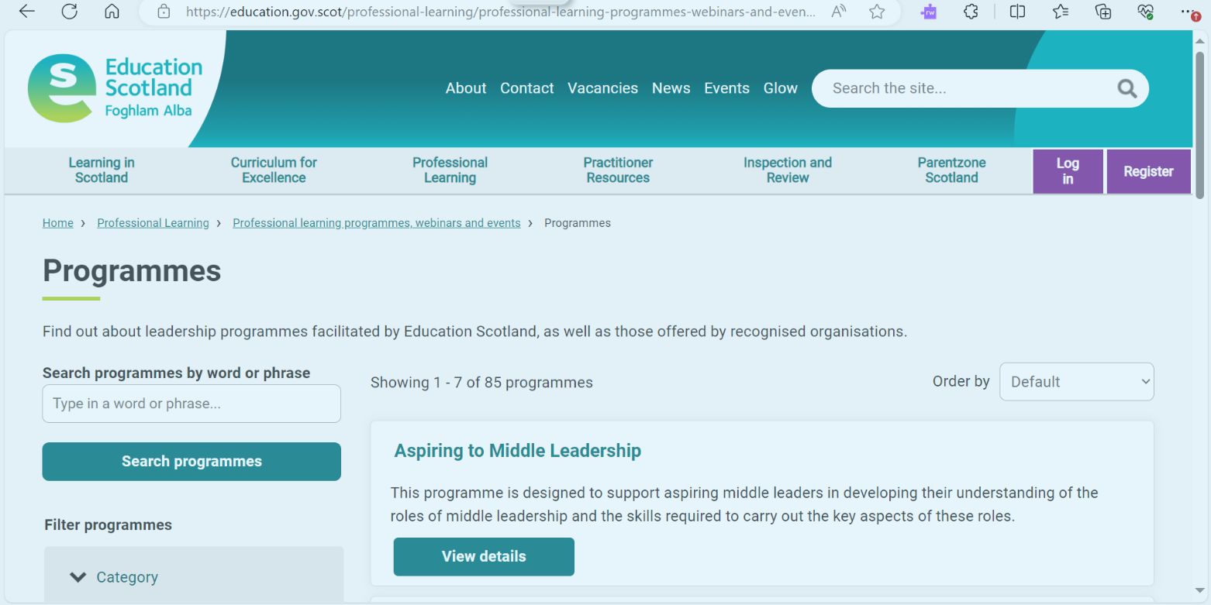
The learning ahead
Notes:
Suggested timing:
3 minutes
Key messages:
Remind the group that all the learning for the programme is contained in the Aspiring to Middle Leadership webpages [insert link].
Next steps are to choose the 2 ‘Roles of Middle Leadership’ PLAs based on the self-evaluation wheel and complete these within an agreed timeframe.
Facilitator notes:
You may wish to share the webpages as part of the session, or if participants have devices, allow some time for them to access the pages and read through them.
Further notes:
It will be useful to to check that participants are confident in accessing the website and have accounts set up so they can access the PLAs.
Reflective questions:
You may wish to invite any questions at this point.

Slide 11
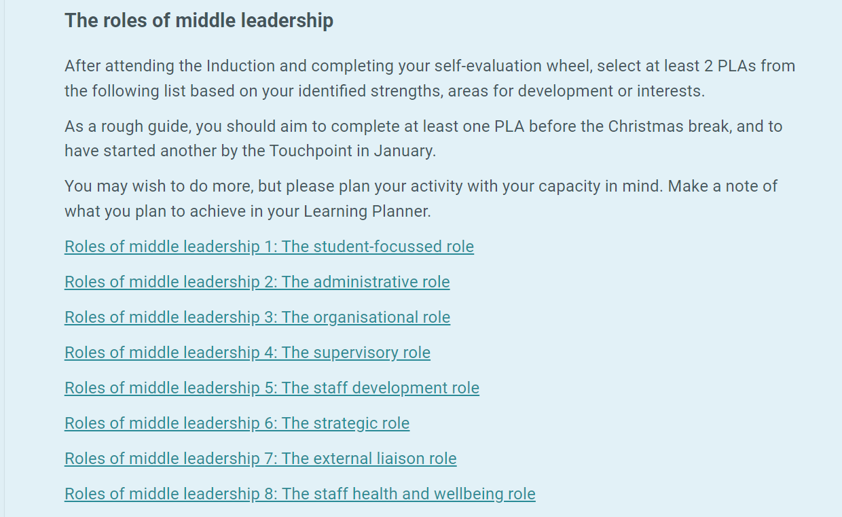
The learning ahead:
1. ‘Roles of middle leadership’ PLAs
Notes:
Suggested timing:
3 minutes
Key messages:
Remind the group that all the learning for the programme is contained in the Aspiring to Middle Leadership webpages.
Next steps are to choose the 2 ‘Roles of Middle Leadership’ PLAs based on their self-evaluation wheel and complete these within an agreed timeframe. The links to the 8 ‘Roles of middle leadership’ PLAs are found within the AML webpages. Remember an account is required to access the PLAs. Once logged in, the links to the PLAs will work.
Facilitator notes:
You may wish to screen-share the relevant webpage as part of the session, or if participants have devices, allow some time for them to access the pages and read through them.
Tell the group each PLA takes 2-3 hours and is in ‘bite-sized’ steps that can be saved as they go along. There are reflective questions in each step with space to record reflections. Every PLA ends with an ‘impact step’. A PDF summary of each PLA, with reflections, can be downloaded once complete. Participants can also use the Reflective Journal to record thoughts as they go through the PLA and perhaps when they have completed it as well.
A suggested timeframe for completing 2 PLAs is a term, but this should be negotiated and agreed with the group and /or leadership team.
Reflective questions:
Invite any questions at this point. How are the group feeling about the learning now? Are there any hopes / concerns?

Slide 12
Where are you in all this?
Student-focused
Staff health and wellbeing
Administration
External liaison
Organisational
Strategic
Supervisory
Staff development
Notes:
CHANGE THIS TO SIGNPOST THIS ASPECT OF THE PROGRAMME
Suggested timings:
10 minutes (more time should be taken on this activity after the session, when participants are ready to start choosing which PLAs they will do).
Key messages:
This slide is about Introductory activity 4- the self-evaluation wheel. This activity is important. Participants’ learning will be determined by this activity, as they will select their Professional Learning Activities (PLAs) based on the outcomes of it. Each item around the wheel has a corresponding PLA.
A self-evaluation wheel is a valuable tool for supporting self-evaluation. Using a wheel can help you to explore your current reality and critically reflect on yourself as a professional and your practice. It can support you to create clarity about the areas of learning you wish to focus on and perform a simple gap analysis about where you are now, and where you would like to be. You can use it independently or as part of a dialogue.
Facilitator notes:
Tell the group that this is a self-evaluation wheel with 8 boxes showing John De Nobile’s 8 roles of middle leadership. If participants are using the Reflective Journal, they will find it in there and can make a start using the Journal now. If not, encourage them to draw a wheel of their own with the 8 roles of middle leadership as shown.
Allow the group some quiet, individual time to begin scoring themselves on the wheel, by marking a cross on the ‘spokes’ to indicate a score between 0 and 10, where:
0 = not confident/ lots of areas to develop or work on/ no experience of this role
10 = very confident/ accomplished in this area/ lots of experience of this role
Tell the group they can spend more time with this later to help them plan their learning. They can select 2 ‘AML Roles of Middle Leadership’ PLAs based on their wheel. They can choose areas of strength, areas for development or areas of interest.
Reflective questions:
Questions for now: What do you think of the self-evaluation wheel as a tool? How else might you use it with colleagues?
Questions for later: After completion of the self-evaluation wheel (these appear in the Reflective Journal)-
What do you notice? What’s most important? What stands out? What’s the gap? What’s my priority? What’s a key strength? How might these roles impact on each other?
Which 2 PLAs do I want to focus on?

Slide 13
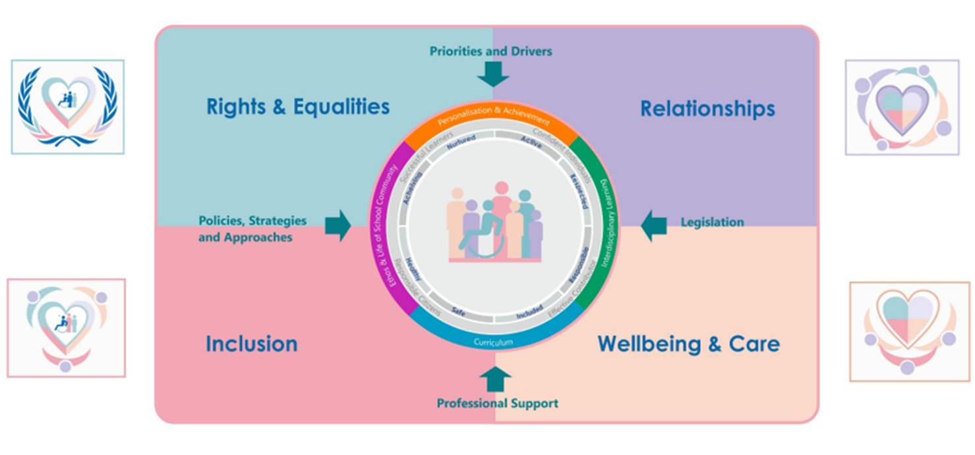
The learning ahead:
2. Inclusion, wellbeing and equalities PLAs
Notes:
Suggested timing:
3 minutes
Key messages:
This slide shows the national framework for inclusion wellbeing and equalities. Participants will move onto learning about 2 specific areas in the second part of the programme, once 2 ‘Roles of middle leadership’ have been completed.
Facilitator notes:
You may wish to screen-share the AML webpage on Inclusion, wellbeing and equalities at this point, or if participants have devices, allow some time for them to access the pages and read through them. Some context is provided for the IWE learning and additional resources signposted at the relevant webpage.
Tell the group they will select 2 further PLAs on Inclusion, wellbeing and equalities themes from a list available at the Aspiring to Middle Leadership webpages. These may be individual choices based on the needs of their learners, or PLAs the whole group will do, based on the school improvement plan, or perhaps one of each.
Again, a suggested timeframe for completing 2 PLAs is a term, but this should be negotiated and agreed with the group, as before.
Reflective questions:
Invite any questions at this point. How are the group feeling about the learning now? Are there any aspects of IWE they are interested in or want to learn more about?

Slide 14
Working with a peer supporter:
Example schedule of meetings
At the beginning: Agree dates, duration, approach and expectations
After Introductory activities 1-3: Reflect on learning
After self-evaluation wheel activity: Reflect on areas of focus
After Roles of Middle Leadership PLAs: Reflect on learning and next steps
After Inclusion, wellbeing and equalities PLAs: Reflect on learning and impact of the programme as a whole on self, learners and others
Notes:
Suggested timings:
3 minutes
Key messages:
Working with a peer supporter can have benefits for both people involved. A peer supporter will hold space for professional dialogue about your learning. A peer supporter guide [insert link] provides more information and is available at the AML webpages.
Facilitator notes:
This slide provides a suggested schedule of meetings, assuming the programme is taking place over 8-12 months. If participants are to work with a peer supporter, this can be someone from within the group who is also part of the programme, but doesn’t have to be. The peer supporter can be a current middle leader or someone the participant has a good existing relationship with. They do not need to be working in the same setting.
Suggested timing for meetings is 20-40 minutes of focused reflection/discussion.
Reflective questions:
What do you want from a peer supporter relationship?
What might be the benefits?
Who might be a good fit to support me in my learning?

Slide 15
Leading from the middle….
...where are your spheres of influence?
Notes:
Suggested timing:
3 minutes
Key messages:
Middle leaders have a wide sphere of influence and are key brokers of change and improvement.
Facilitator notes:
Tell the group that Professor Andy Hargreaves in his book Leadership from the Middle describes leading from the middle as a privilege of being in a place where real change can be made. The middle is sometimes seen as the bridge between practice and SLT. This can be both an opportunity and a challenge. For Hargreaves, the middle isn't a hierarchical placemarker but more like being right in the thick of things - where the action is - and where your influence can be both far-reaching and lasting.
Dr Kylie Lipscombe describes middle leaders as 'brokers' of change.
Reflective questions:
Thinking of the ripples spreading outward from the drop of water, who do you reach?
Where are your spheres of influence as an aspiring leader?

Slide 16
Next steps
Getting started
You are now ready to get started on the programme. If you haven’t already done so, use the following link to find out more:
Aspiring to Middle Leadership | Programmes | Professional learning programmes, webinars and events | Professional Learning | Education Scotland
Sharing the Learning sign-up
We offer an annual online Middle Leadership Sharing the Learning event in May which you are welcome to attend to share and discuss your learning with colleagues.
There is more information on this, including how to sign up, in the programme webpages.
Notes:
Suggested timing:
2 minutes
Key messages:
Hopefully the group now feel ready to get started. They can use the link or QR code on the slide to access the AML webpages or the link in the chat pane. Explore the webpages more and look for the ‘Get started’ section to get straight into the learning.
Facilitator notes:
The group is also welcome to sign up for the online Middle Leadership Sharing the Learning event in May. This is an opportunity to meet others from across Scotland who have completed AML, share reflections on learning with them, and hear about their learning too. Education Scotland would love to see you there. Full details are at the AML webpages. It may be that you hold a local sharing session for the group, in which case share details as appropriate.

Slide 17
Feedback
We hope that you found this session useful.
Notes:
Thank the group for their time and engagement and make sure they know who to approach with any questions and how to contact them. You may wish to add these details to the slide.
You may also wish to add a link or QR code for your own feedback form at this slide.
If you would like to provide feedback on this resource, as a facilitator, please go to https://forms.office.com/e/edkPTYNNDC

