Slide 1




Supporting Young Carers in Education
‘There are an estimated 30,000 young carers in Scotland under the age of 18.
Three out of five of us will become carers at some stage in our lives.’
Carers Trust
For Scotland's learners, with Scotland's educators
Notes:
Welcome to the ‘Supporting Young Carers in Education’ Professional Learning Activity. This activity is designed for anyone working with young carers in an educational setting or context. This module of learning is part of a set of 3 modules. Each modules should take between 30 minutes and an hour depending on how it is undertaken. They can be studied as a group or as in-service activities with some discussion around the reflective questions or as an individual professional learning activity with written reflections in a log. Module one is designed specifically for all educational practitioners and should help them identify and support young carers. Module 2 is designed for anyone with leadership responsibility for organizing supports for young carers in their setting and includes their legal duties. Module 3 is designed for anyone hoping to develop a whole school approach towards supporting young carers.

Slide 2
Module 2: Young Carers and The Law, Their Rights, and Their Voice
Module 2A: Legislation and Young Carers Statements
This module is suitable for anyone with specific responsibility for supporting young carers
For Scotland's learners, with Scotland's educators
Notes:
This second module helps those with a leadership responsibility towards young carers to know their legal duties and responsibilities including information about the young carers statement. It consists of 3 short presentations and some optional reading tasks. This first presentation highlights the key information regarding the Young Carers Act and Young Carer Statements.

Slide 3
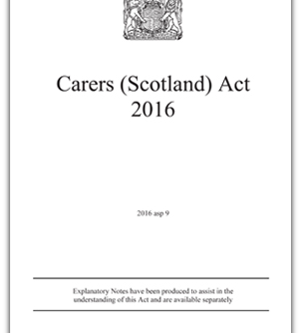
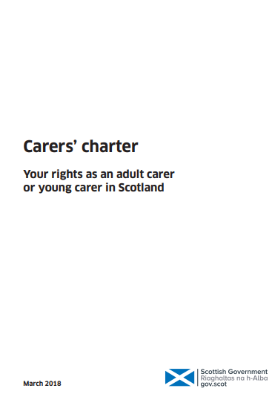
The Legal Bit - Legislation, Policies and Guidance
In April 2018, the Scottish Government launched the Carers (Scotland) Act 2016.
Under the Carers (Scotland) Act the definition of a young carer is anyone aged 18 and under, or 18 and still in school, who provides, or intends to provide care.
The Carers' charter summarises the key provisions and rights from the Carer’s Act
The Carers (Scotland) Act 2016 places specific duties on local authorities to support carers’ health and wellbeing and help make caring more sustainable.
These duties include:
providing support to carers, based on their identified needs which meet the local eligibility criteria
providing a Young Carer Statement to identify young carers’ needs and personal outcomes
to have an information and advice service for carers
Notes:
Legislation, Policies and Guidance around young carers - The Legal Bit
In April 2018, the Scottish Government launched the Carers (Scotland) Act 2016.
Under this act the definition of a young carer is anyone aged 18 and under, or 18 and still in school, who provides, or intends to provide care. It’s really important that we understand it’s anyone under 18. There are young carers services and other supporting agencies that provide support for young carers as young as 5. Iit can be a taboo subject so please look out for those very young, young carers.
The Carers (Scotland) Act 2016 places specific duties on local authorities to support carers’ health and wellbeing and help make caring more sustainable.
Some of these duties involve: providing support to carers, based on their identified needs which meet the local eligibility criteria; providing a Young Carer Statement to identify young carers’ needs and personal outcomes; and to have an information and advice service for carers
The Carers Charter summarises the key provisions and rights from the carers act and you can find out more about it with this link.

Slide 4
Implications of the Carer’s (Scotland) Act 2016
In your educational setting if you identify a young carer, you should inform them about their right to have a Young Carer Statement.
This Young Carer Statement will detail any additional support needs the young carer may have and how they would like to receive that support. This includes support in education.
Your local authority will be able to tell you who is leading on Young Carer Statements. It may be education, social work or a commissioned service such as a local young carer service. It may also be the health board where a young carer is in early learning and child care.
Details for each local authority can be found on the Carers Trust Digital Education Hub
Notes:
Implications of the Carer’s (Scotland) Act 2016
In your educational setting if you identify a young carer, you should inform them about their right to have a Young Carer Statement.
This Young Carer Statement will detail any additional support needs the young carer may have and how they would like to receive that support. This includes support in education or in other outcomes they might identify.
Your local authority will be able to tell you who is leading on Young Carer Statements. It may be education, social work or a commissioned service such as a local young carer service. It may also be the health board where a young carer is in early learning and child care.
Details for each local authority can be found on the Carers Trust Digital Education Hub

Slide 5
What is the Young Carers Statement?
When and how the Young Carer Statement conversation is to take place is agreed with the young carer
The young carer gets a copy of the Statement and any other person that the young carer requests, unless there is a reason that this would not be appropriate. For example, it might not be considered appropriate (or there may not be consent) to share sensitive medical information about the person who is cared for
When a young carer turns 18 their Statement will continue until they are provided with an Adult Carer Support Plan. If they do not wish to continue providing care, they can choose not to have an Adult Carer Support Plan.
Notes:
What is the Young Carers Statement?
It’s when and how the Young Carer Statement conversation is to take place is agreed with the young carer. There is a different young carers statement in every local authority so there should be 32 different versions.
The young carer should get a copy of the Statement and any other person that the young carer requests, unless there is a reason that this would not be appropriate. For example, it might not be considered appropriate (or there may not be consent) to share sensitive medical information about the person who is cared for.
When a young carer turns 18 their Statement will continue until they are provided with an Adult Carer Support Plan. If they do not wish to continue providing care, they can choose not to have an Adult Carer Support Plan.

Slide 6
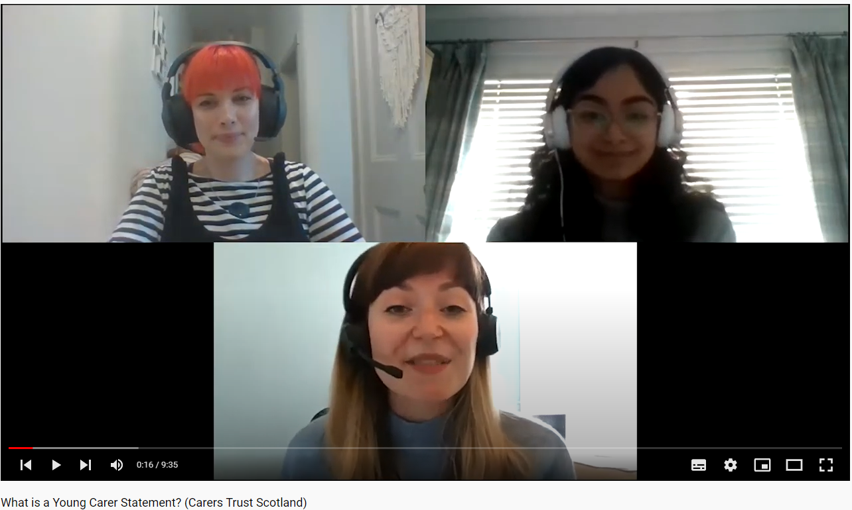

More about Young Carers Statements
Listen to a Young Carer ask about the Statements:
what they are,
how to get one, and
who should help them get one
For easy read information about Young Carers Statements please visit:
What is a Young Carer Statement? – Young Scot
What is a Young Carer Statement?
https://www.youtube.com/watch?v=2ti-R-NsT-U&list=PLV0wpVbwgJcEdkHVBu0YyvwD1ieBvn0Lm&index=7 (9min 35sec)
Notes:
https://www.youtube.com/watch?v=2ti-R-NsT-U&list=PLV0wpVbwgJcEdkHVBu0YyvwD1ieBvn0Lm&index=6
In the following film you will hear a young carer ask a policy lead in Scottish Government about YC statements. In it you will find out what they are, how to get one, and who should help a young carer get one. There is also a link to some very simple information about the statement that you could be using with a young carer. This information is also found in the resources provided immediately after this presentation.

Slide 7
In summary a Young Carer Statement should contain
information about the young carer’s circumstances and caring role, such as:-
the nature and extent of the care provided and the impact on the young carers wellbeing and day-to-day life including education
the extent to which the young carer is able and willing to provide care
emergency and future care planning, including any arrangements that are in place
what 'personal outcomes' matter to the young carer in order continue to provide care, to have a life alongside caring, and to improve their health and wellbeing
support available if they live in a different local authority from the person they care for
whether support should be provided as a break from caring
any support which the responsible authority intends to provide to the young carer
the circumstances in which the Young Carer Statement is to be reviewed.
Notes:
Responsible authorities must offer a ‘Young Carer Statement’ to anyone they identify as a young carer. In each local authority the Young Carer Statement is different some come in the form of an app and others as a short colourful document or professional form. For any young carer who accepts this offer they must prepare a statement which should contain information about the young carer’s circumstances and caring role such as:-
the nature and extent of the care provided and the impact on the young carers wellbeing and day-to-day life
the extent to which the young carer is able and willing to provide care
whether the responsible authority thinks that it is appropriate for the young carer to be a carer for the person they care for
emergency and future care planning, including any arrangements that are in place
what 'personal outcomes' matter to the young carer in order continue to provide care, where that is appropriate, to have a life alongside caring, and to improve their health and wellbeing
support available if they live in a different local authority are from the person you care for
whether support should be provided as a break from caring
support available locally
any support which the responsible authority intends to provide to the young carer
the circumstances in which the Young Carer Statement is to be reviewed.

Slide 8

Activity Reflection question 4
In your educational authority who is responsible for supporting a young carer to complete their Young Carer Statement and can you view a template of it?
(record your thoughts in the professional learning log)
Notes:
Reflecting on what you’ve just heard and read consider: In your educational authority who is responsible for supporting a young carer to complete their Young Carer Statement and can you view a template of it? Please record your thoughts in the professional learning log.

