Slide 1


The Additional Support for Learning Engagement Event 2026
Sharing What Works: Improving ASN Together
12 March 2026

Slide 2


Session 1:
East Ayrshire ELC and Children and Young People Improvement Collaborative (CYPIC)
Laura Haggarty – Improvement Advisor, Scottish Government
Gwyneth Quinn - Early Years Service Manager (Development)
Alana Speirs - Depute Manager, Catrine Early Childhood Centre

Slide 3



Improving Outcomes for Children with Additional Support Needs
www.cypic.co.uk

Slide 4



This work began in one setting in East Ayrshire when they experienced a significant rise in the number of children with complex additional support needs who were struggling to settle, struggling with emotional regulation and dysregulated behaviours making it more and more challenging for staff to meet the needs of all children.

Slide 5
2022
296 children aged 2-5
(10.6%)

Slide 6



How to spread the work

Slide 7
data
2025
413 children aged 2-5
(15.7%)
2022
296 children aged 2-5
(10.6%).

Slide 8
The Children and Young People Improvement Collaborative brings focus, connection and method where it is most needed to improve the wellbeing and life chances of children and young people in Scotland.

Slide 9
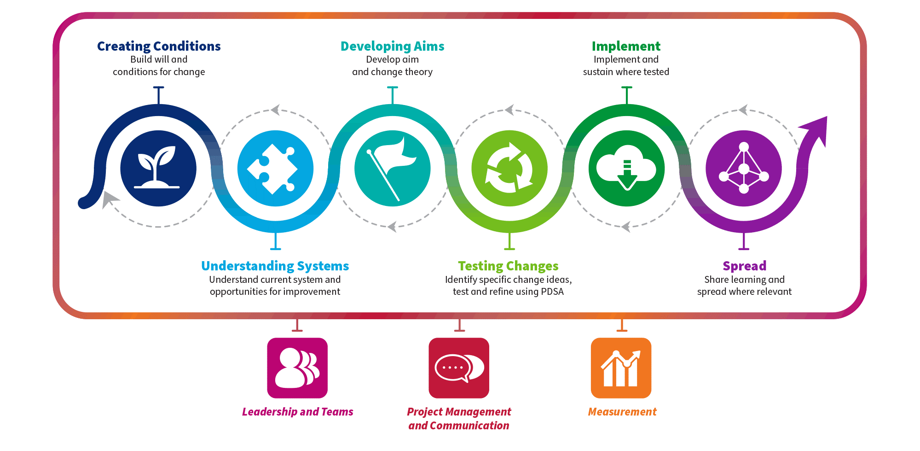
Quality Improvement Journey

Slide 10
Quality Improvement Journey.

Slide 11

Fishbone: Cause and Effect Diagram

Slide 12


Fishbone Activity
Staff CONFIDENCE to support children with ASN
ENVIRONMENT
The wellbeing of children with ASN is lower than we would like
Potential causes
PARTNERSHIP working (with families/professionals)
TRANSITIONS
Root Causes
Solutions/change ideas

Slide 13
Quality Improvement Journey con’t.

Slide 14
Vision: All children in ELC thrive and reach their full potential
In order to achieve this aim…
By April 2026, in 6 East Ayrshire ELC settings, improve the average WELLBEING score of children with additional support needs from 2.8 to 4

Slide 15
Vision: All children in ELC thrive and reach their full potential.
In order to achieve this aim…
We must ensure…
Which requires…
Regular, solution focused conversations to develop practice and support reflection
Use of QI tools and regular data to support decision making
Consistent, predictable routines and approaches by all staff
Confident staff that are empowered to make changes
By April 2026, in 6 East Ayrshire ELC settings, improve the average WELLBEING score of children with additional support needs from 2.8 to 4
An environment which meets the needs of all children
Meal times are adapted to meet the needs of identified children
A separate safe/quiet space is available
Consistent use of visuals to support transitions
Individualised approach for all children
Daily high-quality input on emotional regulation
Children are involved in the process
Partnership working with families and professionals

Slide 16
Quality Improvement Journey con’t

Slide 17

Impact?

Slide 18
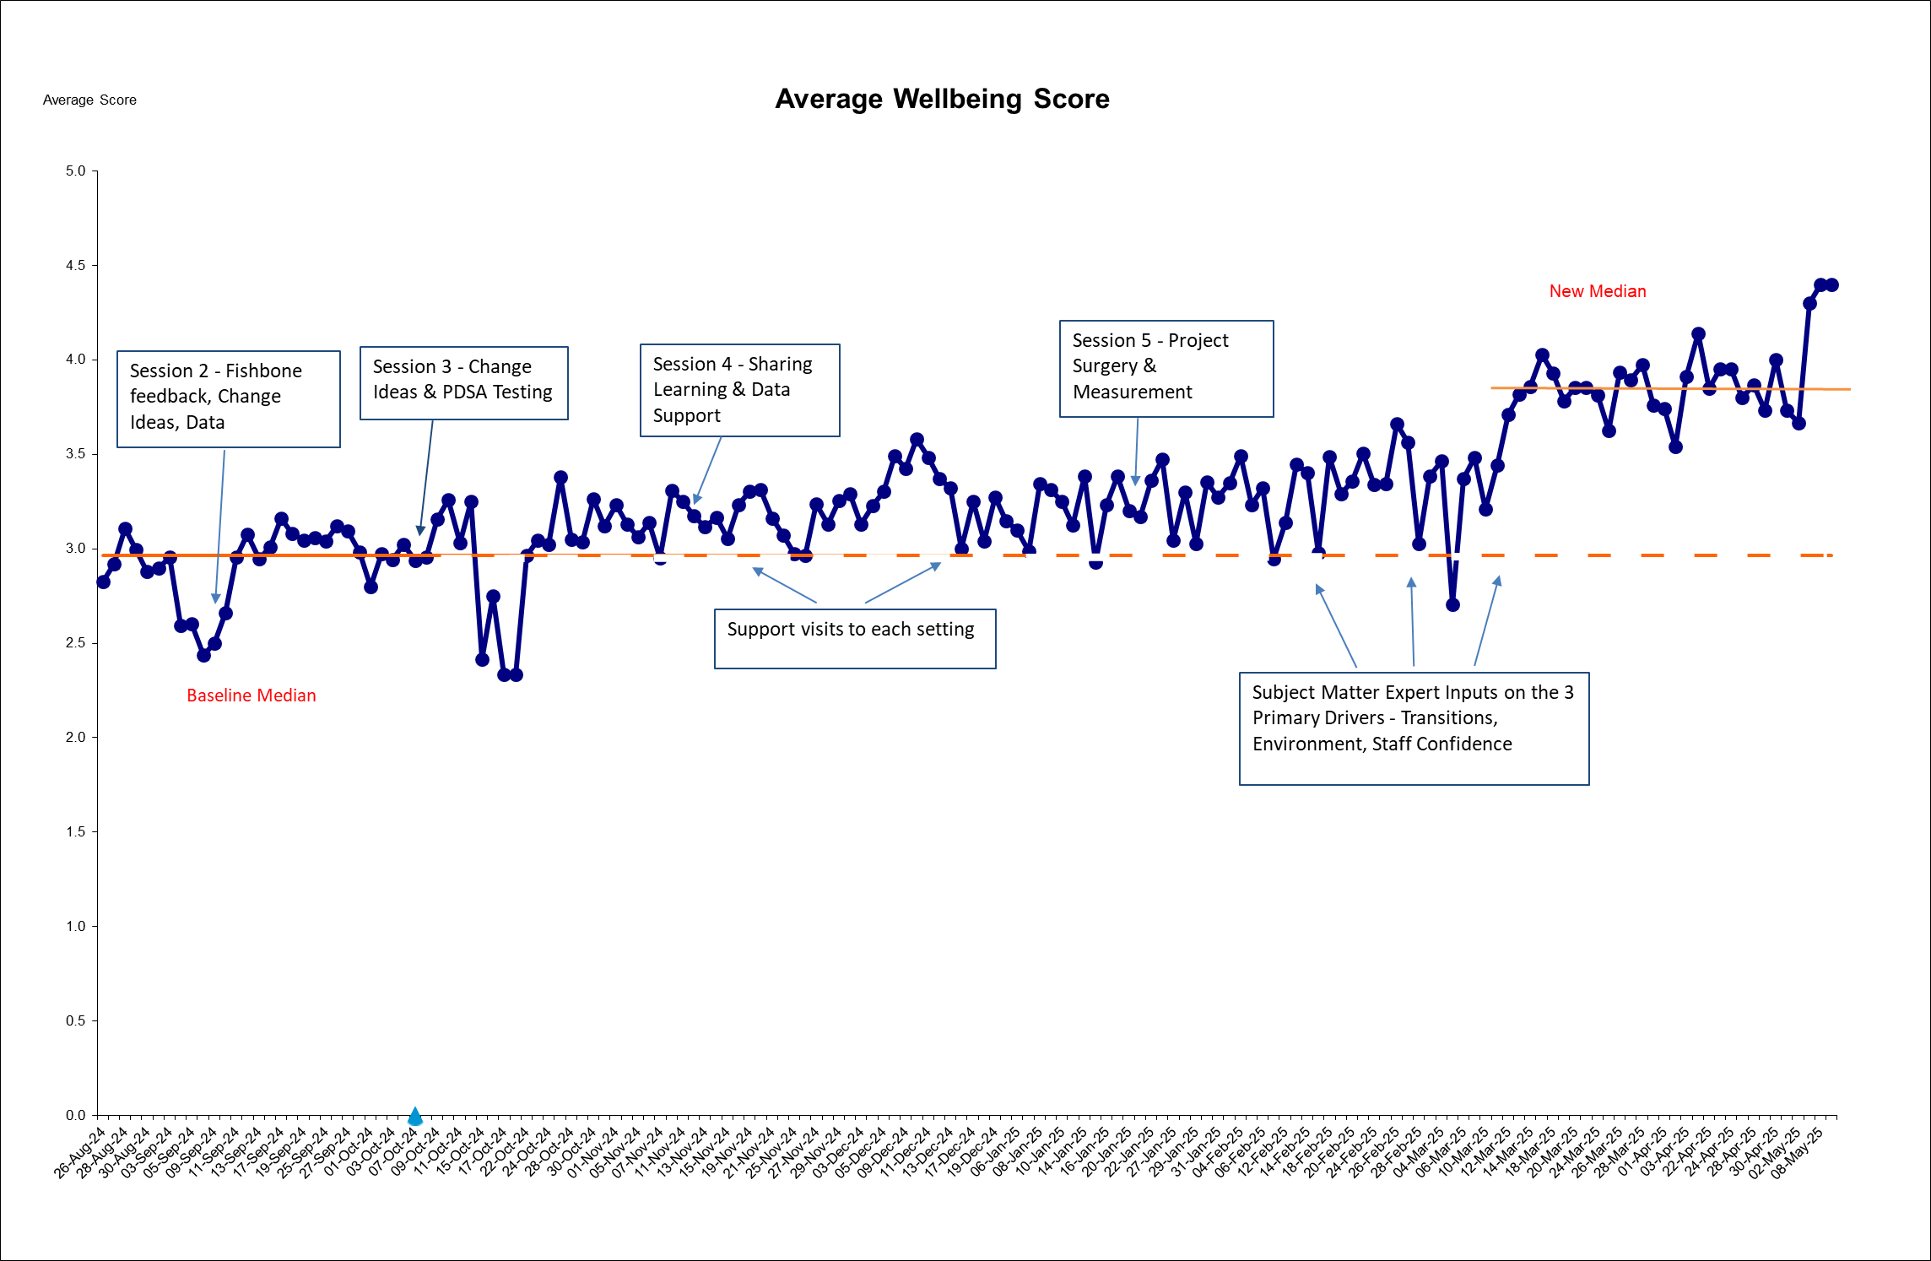
Average Wellbeing Score across 2024/25 Settings
Change Ideas & PDSA Testing
New Median
Sharing Learning & Data Support
Project Surgery
Measurement,
Fishbone Tool
Support Visits
Baseline Median
Specialist input from OT, SaLT, Educational Psychologist

Slide 19
Quotes
‘The programme helped us define exactly where we needed to focus our attention, then provided a clear path showing where to go next with support every step’
‘How amazing are our staff team – we just needed to change our approach to allow them to shine! (much like our children!)’
‘You can’t change everything straight away, the importance of regular data highlights the journey and the why!’
‘Everyone has these same challenges – now we have a method to use’

Slide 20
Quality Improvement Journey..

Slide 21
Quality Improvement Journey Sustainability

Slide 22
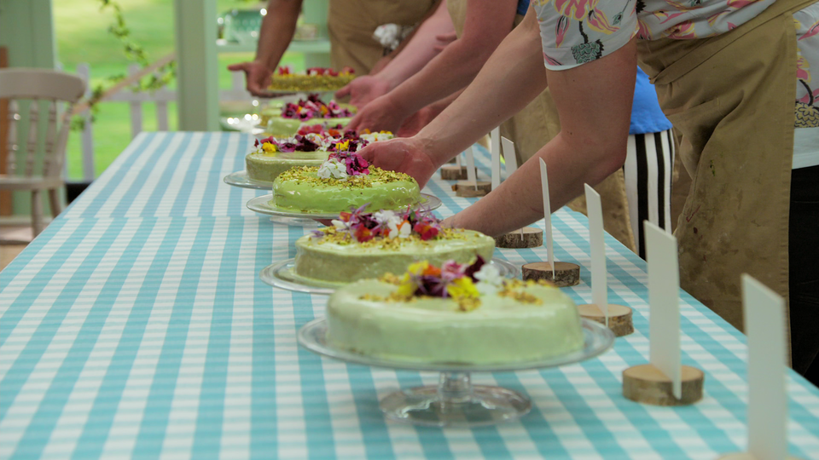
Making a cake analogy

Slide 23
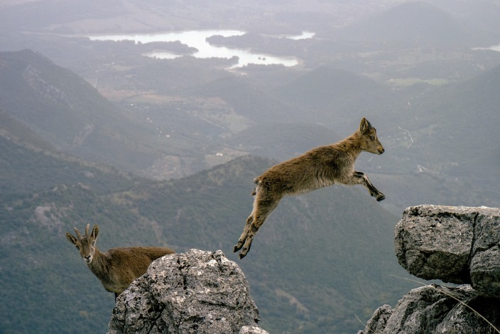
With challenge comes opportunity!

Slide 24
Change designed with staff, not for staff

Slide 25

Improvement begins with us. When adults adapt, children thrive.
Notes:
Following on from what Laura and Gwyneth has said, with the significant rise in children requiring additional support across the country, we, at Catrine Early Childhood Centre, were no different.
ASN was on our centre Improvement Plan. What was once considered occasional is now part of everyday practice, and the statistics are not just about diagnosed conditions.
Experienced practitioners were feeling overwhelmed with the rising needs of ASN, staff confidence and moral was low, and children’s emotional wellbeing was at times difficult and saddening to watch
We knew something had to change, but until we joined this project I don’t think we really truly knew that it was actually us that needed to make the change.
Myself, my senior and one of our support assistants attended the first training session in Oct 2024. Pretty much instantly I was sold on the concept and couldn’t wait to get started.
We took it back to the staff team, who to be fair at first weren’t as convinced on it as we were but, they were willing to try and that was all I asked of them.
We began gathering the data, discussed as a team what we believed the root causes could be using the fishbone and prioritised together what change we would begin with.
As the year went on, we attended more sessions, grew in confidence, became more aware of our own priorities and ultimately staff were seeing noticeable improvements to children’s wellbeing scores. They had the belief that by changing their mindset, THEY could make the differences and now, we have an abundance of quality improvement tools to carry this on and adapt it to each new cohort that comes through our doors every year.

Slide 26
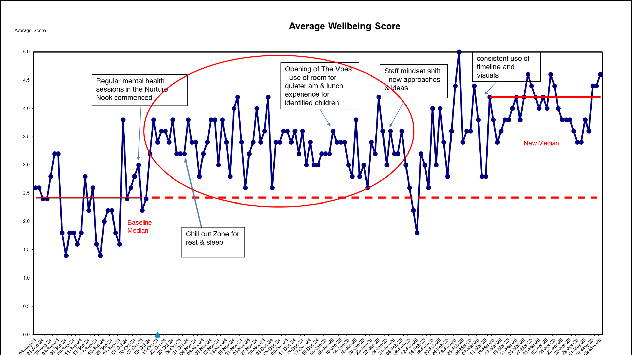
Run chart
Notes:
As you can see, our run chart began to show significant improvements
Without the data, all you have are opinions and some days it’s hard to remember how far you have come, so these were a huge benefit and reminder to staff of the impact they were making
Although the collective data on the chart is great, it’s also about those individual children that we made a difference to…….
One child in particular and the majority of our professional discussions and PDSA cycles had him, and his wellbeing, at the heart of them all.
He came to us so dysregulated for a number of reasons that we had no control over. But we recognised the things we could control and we acted on them.
He wouldn’t allow us to touch him in any way, sometimes even making eye contact with him was enough to trigger his emotions further. His speech was poor therefore it was difficult to talk things through with him and the high levels of violence and aggression led to a multitude of health and safety reports, incident sheets, first aid treatments on others and safety plans.
Throughout the project, we made changes to the deployment of our staff, offered daily nurture sessions, purchased more schematic play resources to suit the age and stage of his development, offered a breakaway area and tailored lunchtimes to meet his needs.
Over time and building upon trust and continued predictability for him, we got to a place where he would allow myself and our senior to take his hand, we saw a reduction in harm towards others and he slowly began to allow peers and staff to carry out massage on him which was a huge step in the right direction.

Slide 27
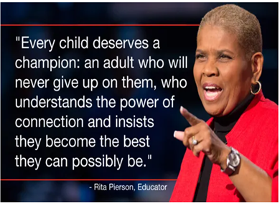
Quote

Slide 28
Laura.Haggarty@gov.scot
Gwyneth.Quinn@east-ayrshire.gov.uk
Alana.Speirs@eastayrshire.org.uk

Slide 29
Education Scotland logo: white on teal background

