Slide 1


Na Seumasaich – The Jacobites
Learning about Gaelic Language and Culture Resource
Lesson 3 – Who was Bonnie Prince Charlie? Counting and saying your age in Gaelic.
For Scotland's learners, with Scotland's educators

Slide 2
Na Seumasaich – Lesson 3
In this Learning about Gaelic Language and Culture resource lesson we will learn:
about Charles Edward Stuart “Bonnie Prince Charlie” or the “Young Pretender”
about the Prince raising his standard at Glenfinnan
to learn the numbers 1-100 in Gaelic
to ask someone their age in Gaelic
to state your age in Gaelic
a short chorus of a Gaelic song
to create short texts about ourselves and others in Gaelic

Slide 3
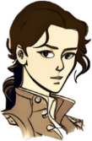

Màiri and Calum
Fàilte air ais a Chaluim
Welcome back.
Tapadh leat a Mhàiri
Dè an aois a tha thu?
Tha mi fichead

Slide 4
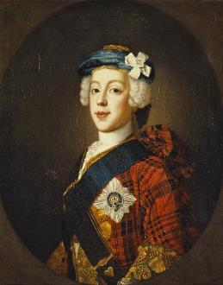



Màiri and Calum 2
So this is the guy who it’s all about?
Yes, this is Charles Edward Stuart better known as Bonnie Prince Charlie. He was James VIII & III’s son
James – The Pretender?
Tha sin gu math òg. That is very young.
James was now called “The Old Pretender”, Charlie was “The Young Pretender”. He was only 24 when he came to Scotland in 1745

Slide 5
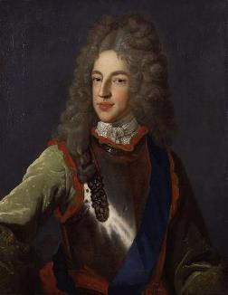
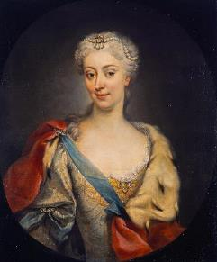

Cò bh’ anns a’ Phrionnsa? Who was Prince Charles?
’S mise Màiri. Tha mi às a’ Pholainn.
Prince Charles Edward Louis Philip John Casimir Stuart was born in Rome in 1720. His father was James VIII & III, the Jacobite Pretender to the thrones of Scotland, England and Ireland. His mother was Maria Sobieski, a Polish noblewoman. She would die in 1735.
Charles was educated in Rome by a range of tutors. He could speak English, French and Latin, but wasn’t a strong reader. He enjoyed hunting, horseriding, dancing and golf. As a teenager he attended the Siege of Gaeta to learn about war.
’S mise Seumas. Tha mi à Sasainn.
’S mise Teàrlach. Tha mi às an Roimh.

Slide 6
Màiri and Calum
Why did the Prince decide to go to Scotland?
Previous Jacobite rebellions had depended on foreign troops. Charles believed that homegrown rebellion would be more successful.
So he travelled alone?
His father had ordered him to Paris believing the French would support him with troops. They didn’t, so Charles set off on his own accompanied by some friends and a couple of boats.
He was very young. It would be good to know the numbers in Gaelic.

Slide 7
Na h-àireamhan 1-10 – The Numbers 1-10
a h-aon - 1
a dhà - 2
a trì - 3
a ceithir - 4
a còig - 5
a sia - 6
a seachd - 7
a h-ochd - 8
a naoi - 9
a deich – 10

Slide 8
Na h-àireamhan 11-20 – The Numbers 11-20
a h-aon deug - 11
a dhà dheug - 12
a trì deug - 13
a ceithir deug - 14
a còig deug - 15
a sia deug - 16
a seachd deug - 17
a h-ochd deug - 18
a naoi deug - 19
fichead – 20

Slide 9
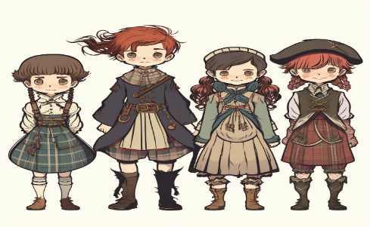
How to talk about your age in Gaelic.
Dè an aois a tha sibh?
To say I am (age) from in Gaelic, you say Tha mi (number)
To ask someone what age they are, you ask
Dè an aois a tha thu?
Or if they are older or there is more than one
Dè an aois a tha sibh?
Tha mi aon deug
Tha mi deich
Tha mi naoi
Tha mi ochd

Slide 10

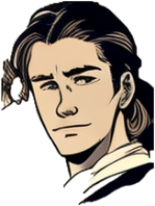
Task one – Asking and saying our age in Gaelic
Your teacher will ask you Dè an aois a tha thu? Reply with Tha mi (number) See below for an example.
Caleb, Dè an aois a tha thu?
Tha mi sia deug

Slide 11
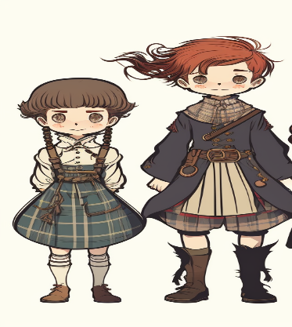
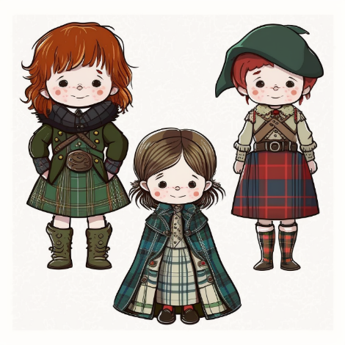
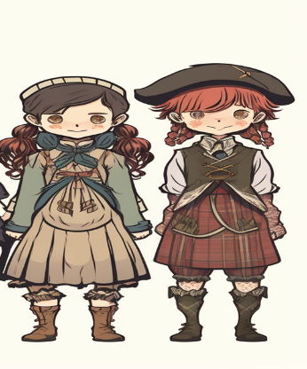
Task two – Read and write in English the persons’ name, where they are from and their age.
Is mise Iain.
Tha mi trì deug.
Is mise Maryam.
Tha mi sia deug.
Is mise Anna.
Tha mi à Alba.
Tha mi seachd.
Is mise Seumas.
Tha mi à Alba.
Tha mi ceithir deug.
Is mise Mei.
Tha mi à Alba.
Tha mi deich.
Is mise Akeem.
Tha mi à Alba.
Tha mi naoi.
Is mise Màiri.
Tha mi sia.

Slide 12
Na h-àireamhan 21-100 – The Numbers 21-100
fichead - 20
trithead – 30
ceathrad – 40
caogad – 50
seasgad – 60
seachdad – 70
ochdad – 80
naochad – 90
ceud - 100
fichead ’s a h-aon – 21
fichead ’s a dhà - 22
trithead ’s a trì – 33
ceathrad ’s a ceithir – 44
caogad ’s a còig – 55
seasgad ’s a sia – 66
seachdad ’s a seachd – 77
ochdad ’s a h-ochd– 88
naochad ’s a naoi – 99

Slide 13
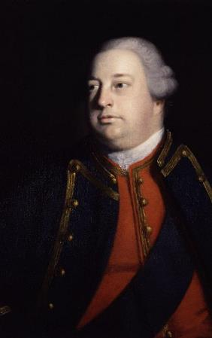
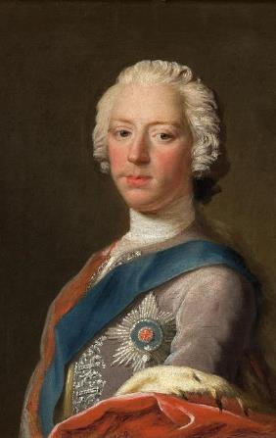
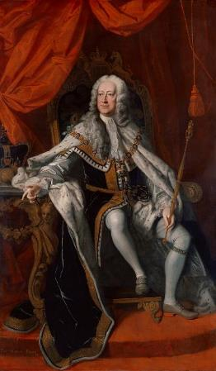
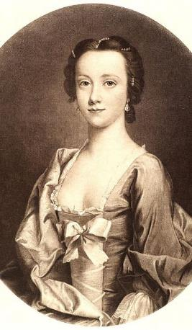
Task two – Read and write in English the persons’ name, where they are from and their age. (extension)
Is mise Uilleam.
Tha mi à Sasainn.
Tha mi fichead ’s a ceithir.
Is mise Deòrsa.
Tha mi às a’ Ghearmailt.
Tha mi seasgad ’s a dhà
Is mise Sìne Chamshron.
Tha mi à Alba.
Tha mi ceathrad ’s a seachd
Is mise Teàrlach.
Tha mi às an Eadailt.
Tha mi fichead ’s a còig.

Slide 14
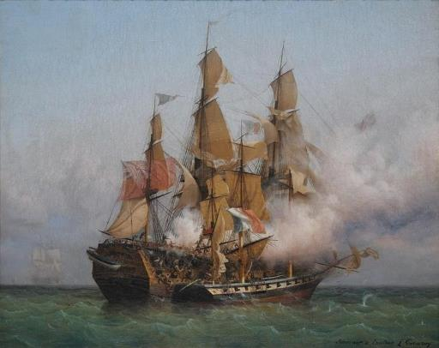


Am Prionnsa air an t-Slighe – The Prince enroute
Tha mi à Breatainn
Charles went to Paris in 1745. He raised money and used this to buy weapons and to hire two ships. The Elisabeth, which had 66 guns, and the Du Teillay, which had 16 guns.
On the 5th of July 1745, they sailed for Scotland. The HMS Lion, a British ship attacked them. The Elisabeth allowed the Du Teillay on which the Prince was, to escape. However, the Elisabeth had to return to France for repairs. The Elisabeth had most of Charles’ weapons on board including 1800 broadswords, 8 artillery guns and 1500 musket guns.
However, the Prince got away, and set sail for Scotland, determined to start his rebellion.
Tha mi mach à seo!
Tha mi às an Fhraing

Slide 15
Am Prionnsa air an t-Slighe – The Prince enroute - Questions
Tha mi à Breatainn
Q1 – How many guns did the Prince’s two ships have between them?
Q2 – How many weapons in total did the Prince lose when the Elisabeth was forced to return to France?
Q3 – Find out what “Mach à seo” means using the internet or a Gaelic dictionary
Tha mi às an Fhraing

Slide 16
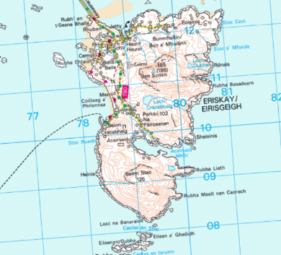
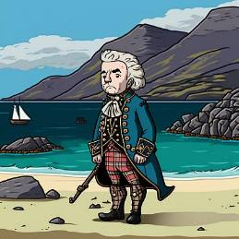
Am Prionnsa ann an Eirisgeigh – The Prince lands in Eriskay
On the 23rd of July 1745, the Prince landed with just seven companions on the beach in Eriskay. This beach is named Coilleag a’ Phrionnsa to this day.
The representatives of the Clan Chiefs who met him told him to go back to France, including the Chief of the Macdonalds of Sleat and the Chief of Clan MacLeod.
The Chief of Clan MacLeod was nicknamed An Droch Dhuine – The Wicked Man - because he had tried to sell several of his own clansmen into slavery – this incident known as Soitheach nan Daoine or Long nan Daoine – the Ship of the People - was a horrible incident still remembered today.
The Macdonalds of Sleat and the MacLeods of Skye and Harris would not support the Prince. Plenty of other clans did.

Slide 17
Am Prionnsa ann an Eirisgeigh – The Prince lands in Eriskay – Questions
Q1 – Using the dates from the last two slides, how long did the Prince’s voyage from France to Scotland take.
Q2 – How many people were with the Prince when he landed in Eriskay?
Q3 – Why was the Chief of Clan MacLeod called An Droch Dhuine?

Slide 18
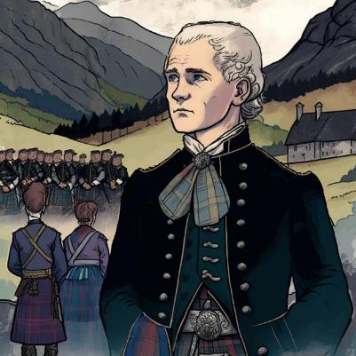
Gleann Fhionnain – The Prince raises his standard
On the 19th of August 1745, he raised his standard (or flag) at Glenfinnan in Lochaber. Here he was met by the clansmen of Clan Cameron. Their chief Donald Cameron of Locheil had pledged his support.
There is a monument at Glenfinnan which is a popular attraction, but the area is almost as famous now for the railway viaduct which was filmed in the Harry Potter film series in the 2000s.
Amongst the Camerons were over 200 men who were raised by Jean Cameron of Glendessary. This woman would be one of many women who are part of the Jacobite story. We will learn more about her later.
As they marched south, the Prince also started taking Gaelic lessons from a Gaelic poet and teacher called Alasdair Mac Mhaigshtir Alasdair. All of the clansmen would have spoken Gaelic, and many would not have spoken English at all.

Slide 19
Gleann Fhionnain – The Prince raises his standard - Questions
Q1 – Which Clan pledged its support to the Prince?
Q2 – For what is Glenfinnan also famous for in modern times?
Q3 – Why did the Prince need to learn to speak some Gaelic?
Q4 – What have you learned to say in Gaelic so far?

Slide 20
Tha tighinn fodham èirigh - song
This is a famous Jacobite song connected with the risings. It was written as a eulogy for Ailean Dearg Muideartach who died in the 1715 Rebellion. It means “I am minded to rise”. The tune (which is the same for verse and chorus) and words stayed popular and is still sung today. The Scottish folk duo “The Corries” sing an English version with this Gaelic chorus (and a different tune for the verses) called “Sound the Pibroch or Rise and Follow Charlie”. You may want to learn the song in English or in Gaelic and sing along with the chorus.
Tha tighinn fodham, fodham, fodham
Tha tighinn fodham, fodham, fodham
Tha tighinn fodham, fodham, fodham
Tha tighinn fodham èirigh
Tha Tighinn Fodham Èirigh - Tobar an Dualchais
The Corries --- Sound The Pibroch - YouTube

Slide 21
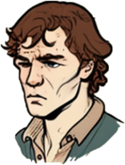
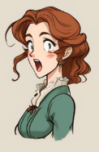
Task two - writing
You are going to add to your two profiles – one for yourself, and one for a Highlander boy or girl from the time of the Jacobites.
Write a sentence in Gaelic stating your first name and surname.
Write a sentence in Gaelic stating where you are from.
Write a sentence in Gaelic stating your age
Then do the same for your Highlander.
Examples
’S mise Chloe Kowalcyk
Tha mi às a’ Pholainn
Tha mi naoi
’S mise Mairead NicLeòid
Tha mi à Alba
Tha mi trì deug

Slide 22

Task three - talking
Hai. Dè an t-ainm a th’ ort?
Halò
’S mise Calum MacLeòid.
Go around the class and follow this example.
Greet each other with a simple Hai or Halò
Ask each other your name using Dè an t-ainm a th’ ort?
Then ask each other where you are from Cò às a tha thu?
Then ask each other what age you are Dè an aois a tha thu?
Cò às a tha thu a Chaluim?
Tha mi à Alba.
Dè an aois a tha thu?
Tha mi sia deug.

Slide 23
Task four - extension
Halò ’S mise Calum! Tha mi sia bliadhna deug a dh’aois
The Gaelic for a year is Bliadhna
The 1745-46 rebellion was called in Gaelic Bliadhna Theàrlaich – Charlie’s Year.
The Gaelic for Happy New Year is Bliadhna Mhath Ùr
To say “I am … years of age” You say Tha mi (number) bliadhna a dh’aois.
If you are aged 11 to 19 you say
Tha mi (number 1-9) bliadhna deug a dh’aois
Hai ’s mise Anna. Tha mi naoi bliadhna deug a dh’aois.
Go back to Task Two and rewrite your age so that you use this more advanced structure.

Slide 24
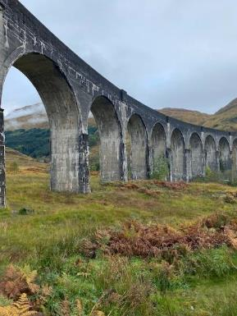
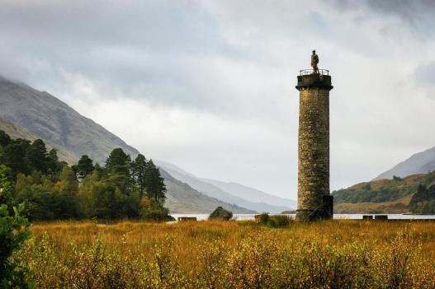
Task five - factfile
Research Glenfinnan – present your information in any way you would like
Show the Gaelic spelling of Glenfinnan
A map of Scotland to show the location
A more detailed map of Glenfinnan
How many people live there nowadays
Some information about Bonnie Prince Charlie being there
Find out the history of the monument and the viaduct
How could you travel there
Any other interesting information or images

Slide 25

For Scotland's learners, with Scotland's educators
Education Scotland
Denholm House
Almondvale Business Park
Almondvale Way
Livingston EH54 6GA
T +44 (0)131 244 5000
E enquiries@educationscotland.gsi.gov.uk

