Slide 1







Inclusion Wellbeing & Equalities Professional Learning Framework
Co-Regulation and De-escalation
Informed Level
@ESInclusionTeam
For Scotland's learners, with Scotland's educators
Do luchd-ionnsachaidh na h-Alba, le luchd-foghlaim Alba
Notes:
Purpose of these Slides
Read title​
This professional learning is pitched at an informed level and suitable for anyone working with children and young people in an educational context.
How to use the slides:
To be used to facilitate professional learning in a group or whole-setting, or as a self-directed learning activity as an individual.
General Guidance
There is a requirement to cover all the slides.
Please do not change the provided slides.
Facilitators are welcome to add slides or activities relevant to your own setting, to support discussion and exploration of the topic. Facilitators will know their participants’ needs best.
Anyone who works in an educational setting can be a facilitator and use these slides.
It is important to establish a safe space which encourages respect and honesty to ensure that everyone is able to participate.

Slide 2

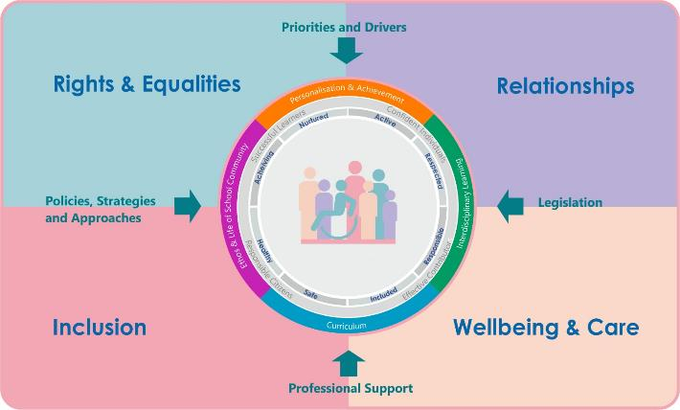





Interconnectivity
Notes:
All of the professional learning in the Framework fits into one of these four themes. The four themes are interconnected and interdependent.​
This activity forms part of the professional learning in the Relationship theme.

Slide 3
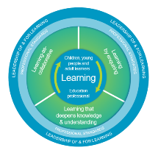
How to use this resource
These slides can be used to facilitate professional learning in a group or
whole-setting, or as a self-directed learning activity as an individual.
Facilitation notes are included at the bottom of each slide.
Please do not remove or change any of the slides included.
Facilitators are welcome to add slides or activities relevant to your own setting, to support discussion and exploration of the topic. Facilitators will know their participants’ needs best.
Anyone who works in an educational setting can be a facilitator and use these slides.
For reflection or discussion activities, it is important to establish a safe space which encourages respect and honesty to ensure that everyone is able to participate.
Notes:
Option to skip slide as these are instructions for facilitators only. No need to read to audience.

Slide 4
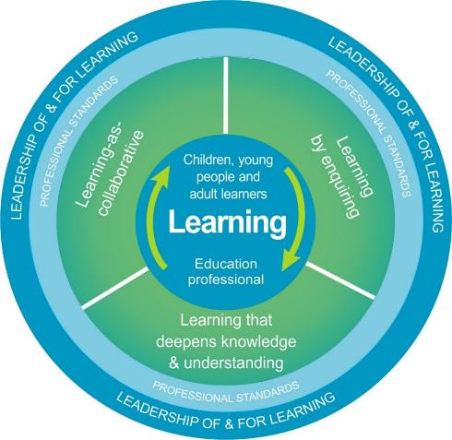
National Model for Professional Learning
This professional learning resource will support you to deepen your knowledge and understanding.
You will have the opportunity to consider how to take this learning forward on your own and with others.
The National Model of Professional Learning (education.gov.scot)
Notes:
This professional learning forms part of the national model for professional learning and is designed to help you gain more knowledge and have a deeper understanding of inclusion, wellbeing and equalities​​
On completion of this professional learning, you will be asked to consider what your next steps will be​​.
Please take some time to consider the reflection questions at the end

Slide 5
Welcome
This session provides an opportunity to:
To learn about co-regulation and de-escalation and how they are different
To reflect on how we can use co-regulation to help learners develop the ability to self-regulate
To explore the elements of conflict and how it can escalate
To learn when and how to de-escalate conflict
To reflect on a range of ways to resolve conflict
Notes:
Link activity to national model

Slide 6
How to use this resource
These slides can be used to facilitate professional learning in a group or
whole setting, or as a self-directed learning activity as an individual.
Facilitation notes are included at the bottom of each slide
Please do not remove or change any of the slides included.
Facilitators are welcome to add slides or activities relevant to your own setting, to support discussion and exploration of the topic. Facilitators will know their participants’ needs best.
Anyone who works in an educational setting can be a facilitator and use these slides.
For reflection or discussion activities, it is important to establish a safe space which encourages respect and honesty to ensure that everyone is able to participate.
Notes:
Option to skip slide as these are instructions for facilitators only. No need to read to audience.

Slide 7
Co-regulation
Part 1

Slide 8
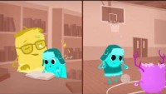
Co-regulation
5.22 min
Video by Administration for Children & Families (ACF)
If viewing as a PDF please click this link to watch the film https://youtu.be/RRMBHQ-Bmk0

Slide 9
Co-regulation is:
Self-regulation is:
the ability to regulate emotions and behaviours, manage stress (internal or external ), and return to a calm state, with the support and direction of a connecting person
the nurturing connection of another person that supports regulation through the use of strategies, tools, and calming techniques
the ability to recognise, manage, and respond to our own emotions
the ability to monitor and control our thoughts, feelings and behaviours
the ability to use personal strategies to return to a calm state
(See self-regulation module)
Co-regulation and self-regulation are part of the developmental process

Slide 10
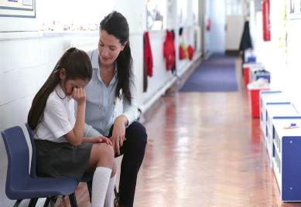
In other words
The feelings and behaviour of someone in close proximity to another person, directly impacts how they feel, and respond to their own emotions.
If when someone is dysregulated and outside their window of tolerance, someone else close to them stays calm, and models how to calm down, this can help a dysregulated person to, in turn, calm down themselves.
Ideally the role of the adult is to support someone to stay within their window of tolerance however co-regulation is something to try if hey become emotionally over-whelmed and go beyond their ability cope with a situation or circumstance

Slide 11
Development of self-regulation through co-regulation
Dependence
Interdependence
Independence
EXTERNAL (Co-regulation)
INTERNAL (Self- Regulation)
We look to parents or care-givers to help us co-regulate strong emotions when we are young
Attunement and Active Listening are key co-regulation skills
Regular co-regulation helps us develop the ability to self-regulate moving from dependence on the external support to the ability to independently self-regulate
Even as adults we benefit from co-regulation from others when we become overwhelmed
Notes:
Children look to parents or care-givers to help them co-regulate strong emotions when they are young.
With regular co-regulation we develop the ability to self-regulate moving from complete dependence on the external support of their parent/care-giver, through stages when co-regulation becomes less necessary, to a stage when they can self-regulate without any external support.
If a child or young person doesn’t receive the support of a parent or care-giver to co-regulate, or their emotional development is delayed or arrested, perhaps due to trauma or adversity, then they may struggle with self-regulation even into their teens or beyond.
However, any trusted adult who has a healthy relationships with a child, or young person, can use co-regulation techniques at any stage of their lives to help them learn how to self-regulate. This trusted person could be a ‘key adult’ in school or an educational setting. That’s the good news.
The bad news is, if children and young people haven’t received this type of nurturing care when they are young, they may have learned that they can’t rely on adults for support and will not automatically seek support from adults. So when support is offered they may not accept it or may even reject it. This is why relationships and trust building is essential, when times are good, so that when support in the form of co-regulation is offered they feel safe enough to accept it.

Slide 12
Arrested development of self-regulation skills
If we don’t receive co-regulation when we need it, our emotional development could be delayed, or arrested, and we may struggle with self-regulation even into adulthood
Any trusted adult who has a healthy relationships with us, can use co-regulation techniques, at any stage of our lives, to help us learn to self-regulate.
A trusted person could be a ‘key adult’ in school or an educational setting
However, we haven’t received this type of nurturing care when we are young, we may have learned that we can’t rely on adults (others) and will not automatically seek support
So when support is offered we may not accept it or may even reject it
This is why relationships and trust building is essential, when times are good, so that when support in the form of co-regulation is offered we feel safe enough to accept it
Notes:
Children look to parents or care-givers to help them co-regulate strong emotions when they are young.
With regular co-regulation we develop the ability to self-regulate moving from complete dependence on the external support of their parent/care-giver, through stages when co-regulation becomes less necessary, to a stage when they can self-regulate without any external support.
If a child or young person doesn’t receive the support of a parent or care-giver to co-regulate, or their emotional development is delayed or arrested, perhaps due to trauma or adversity, then they may struggle with self-regulation even into their teens or beyond.
However, any trusted adult who has a healthy relationships with a child, or young person, can use co-regulation techniques at any stage of their lives to help them learn how to self-regulate. This trusted person could be a ‘key adult’ in school or an educational setting. That’s the good news.
The bad news is, if children and young people haven’t received this type of nurturing care when they are young, they may have learned that they can’t rely on adults for support and will not automatically seek support from adults. So when support is offered they may not accept it or may even reject it. This is why relationships and trust building is essential, when times are good, so that when support in the form of co-regulation is offered they feel safe enough to accept it.

Slide 13
Staff wellbeing!! Please take this caution seriously!!
Co-regulation can be exhausting
At times we may become dysregulated ourselves (this is normal)
During these times we need colleagues to help us regulate, or we may need to take some time to self-regulate
Regular honest and open conversations with colleagues about what we find difficult and what we finds helps fosters greater understanding and trust amongst colleagues
It’s aways helpful to proactively develop a colleague network of support either formally or informally
This is particularly relevant in setting where crisis situations are more likely, and staff more regularly need to use co-regulation and de-escalation

Slide 14
Part 2
De-escalation

Slide 15
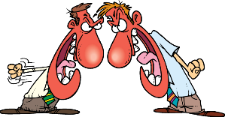

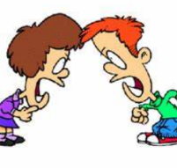
What is conflict?
Conflict means different things to different people and there are various types of conflict
In basic terms conflict is a disagreement or argument
Conflict usually happens between people when they have different opinions on things. A conflict can happen between two or more people or between groups of people
Conflict is going to happen!

Slide 16
Conflict:
is interpersonal - involving two or more people
happens when people disagree and is a natural outcome of human interaction
can be verbal or non-verbal
can be mild or severe
happens because people have different - personalities, values, expectations, attitudes, opinions, or goals
isn’t always serious nor negative
Learning how to recognise and work through interpersonal conflict in productive, healthy ways is an important skill that can help us have better relationships in life
Notes:
In broad terms, conflict happens when two or more people disagree.
It may be verbal conflict, such as an argument.
Or nonverbal conflict, which might involve someone turning their back or walking away from the other person.
Both situation happen in educational settings.

Slide 17
Types of Conflict
misunderstandings or differences of opinion
disagreement over information or the truth of something
different personal values and those involved can’t respectfully disagree
when those involved can’t back down from an argument or accept a loss
when those involved can’t agree on an approach or action
Notes:
In broad terms, conflict happens when two or more people disagree.
It may be verbal conflict, such as an argument.
Or nonverbal conflict, which might involve someone turning their back or walking away from the other person.
Both situation happen in educational settings.
No matter what the conflict looks like it can be helpful to identify the type of conflict in order to strategise how to resolve it.
Pseudo: comes from a misunderstanding, a difference of opinion, or sometimes badgering
Fact: happens when two or more people disagree over information or the truth of something (usually easily resolved)
Value: when different personal values lead to disagreement (often difficult to resolve and may require parties to respectfully disagree)
Ego: when neither person involved can back down from an argument or accept a loss (often happens when conflict of another type gets personal)
Meta: resulting from communication issues (that’s not what I’m talking about, you aren’t listening etc.)
Policy: when people can’t agree on a problem-solving strategy or action plan in a given situation
Remember managing conflict doesn’t necessarily mean preventing it. Different opinions and perspectives can provide opportunities to better understand how other people feel and relate to them on a deeper level.
When conflict does happen, respectful communication is key to resolution.

Slide 18
Conflict, stress, and anger
In a situation where, one person involved in the conflict is stressed or angry, then the conflict can quickly escalate
This happens because anger in one person is often met with anger, or fear, in another
This is called emotional transference
Emotional transference often creates a conflict cycle which, if not interrupted or broken, can escalate the severity of the conflict

Slide 19
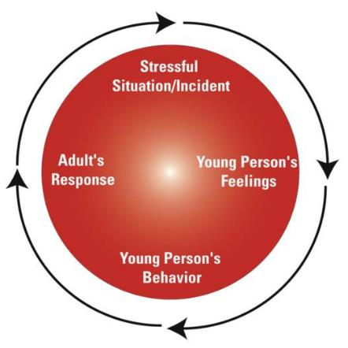
The Conflict Cycle in an adult-child context
Components of the conflict are stress, thoughts, feelings, and behaviour
A young person is stressed, this triggers strong emotions which results in inappropriate or distressed behaviour
The young person’s behaviour then triggers stress, strong feelings and a response (behaviour) from the adult
The adult’s response can then trigger more stress in the young person and the cycle begins!
From Small steps = Big Rewards North East Education Center
PBIS Summit January 23, 2014
Notes:
When you approach conflict with flexibility, respect, and the willingness to listen and consider others’ perspectives, you’ll have a better chance of successfully collaborating to find the best solution for everyone.
However at times conflict can become hostile or personal and we find ourselves in a conflict cycle. The diagram illustrates how easily this can happen. This can happen when we don’t notice a learners distress and respond in a way that escalates their distress rather than reducing it.

Slide 20
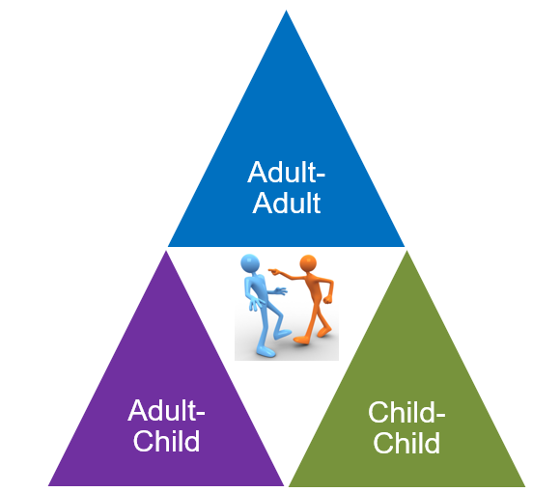
Conflicts in an educational context
Where there are stressors there is the potential for conflict
Adults and children both get stressed creating the conditions needed for conflict and getting into a conflict cycle

Slide 21
Stressful triggers
NB: SOURCES OF STRESS
Sensory
Social
Physical
Psychological
Learning
Family/community
See Self-regulation Module for more detail
NB: For adults this could include workload, working conditions, etc.
The initial stress can come from anywhere, or from an earlier incident/event, and may not be obvious (to others – adult or child)
Stressors can come from more than one source and can accumulate (trigger stacking)
Remember - the stressor could be negative thoughts (perhaps from shame/pain origins)

Slide 22
To reduce risk prioritise breaking the conflict cycle
The conflict may still need to be resolved however breaking the conflict cycle is the first step to de-escalating the situation and reducing risk
De-escalation is reducing the intensity of a conflict (or potentially violent situation)
De-escalation may also involve co-regulation with one or more of those involved in the conflict
HOWEVER co-regulating with someone is not possible if you are one of the people caught in the conflict cycle

Slide 23

De-escalation involves:
using strategies that take the ‘heat’ out of the conflict at the earliest point
identifying risk and intervening in a calm and controlled manner
preventing a situation from getting worse
If you are not CALM it is impossible to effectively de-escalate a situation

Slide 24
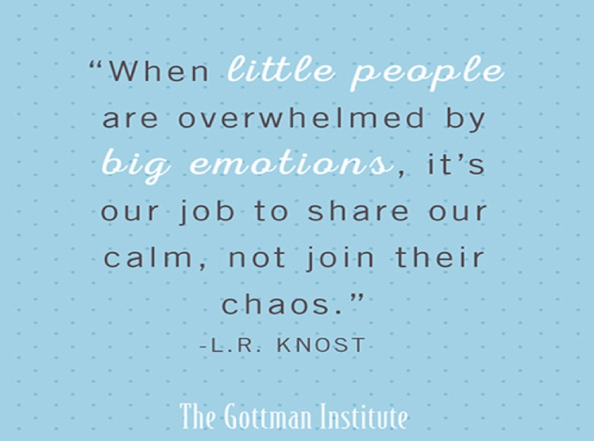
A quote to consider
Notes:
It is our job to break this cycle, whether it is between us and them, or between two children.
We do this by allowing ‘our calm’ to become ‘their calm’.
This can be difficult because it isn’t just little people who are overwhelmed at times, adults can become overwhelmed too.

Slide 25
Research-based approaches to de-escalate conflict
The Basics: stay calm and if possible, nip things in the bud
Being aware of your body language (non-threatening, culturally sensitive,..)
Using attunement (see separate module)
Actively listening and using non-verbal communication (see separate module)
Being Curious not Furious
Using a ‘no blame’ approach and offering positive choices (and being solution focussed)
See the other modules for details about some of these approaches. The following slides gives some tips about things to try however the list is not exhaustive and always remember some things will work for some people and some will not. It comes to knowing the people (children and adults) you work with and lots of practice.
Notes:
The Basics: Staying calm, Using non-verbal communication, and Nip things in the bud
Active Listening. Acknowledge the opinion of the other person and their feelings towards the situation (e.g. I understand why that would be frustrating). Communicate openly to help them see that you are on their side. This will help you work together towards a solution instead of fighting against each other.
Stay Calm (even if you’re not). This will help the student feel less threatened and more likely to communicate with you. Keep your temper and model respectful behaviour towards your student. It also helps to try and keep a friendly tone and lighten the situation with humor where appropriate.
Offer Positive Choices. Instead of telling a student what to do, or trying to force them to behave in a certain way, try giving them a few different options to choose from. This will prevent the student from feeling powerless or unheard and help direct them towards displaying desirable classroom behaviour.
Ask Questions. Perhaps the student is struggling with something you can help with, or needs something in order to focus. If you ask a student what you can do to help them focus, they may surprise you with some practical solutions.
Choose your battles wisely. If something doesn’t need to be a big deal, don’t turn it into one. Consider how important an issue is in the grand scheme of things and don’t sweat the small stuff, especially if it could escalate into a much bigger problem.
Use non-threatening body language. Try using your proximity in the classroom to correct bad behaviour without saying a single word. Using simple hand gestures, such as tapping lightly on a desk or placing a finger to your lips can be much more effective than more aggressive approaches, like raising your voice.

Slide 26
Control what you can: yourself & how you respond
Ask yourself: how am I feeling now?
Use any strategies that work for you to maintain, or return to, your calm
  Take a few breaths
  Reframe your thoughts and use positive self-talk
  If necessary, and possible, give yourself some time, or some space
  If necessary, and possible, seek some support
Notes:
The Basics: Staying calm, Using non-verbal communication, and Nip things in the bud
Active Listening. Acknowledge the opinion of the other person and their feelings towards the situation (e.g. I understand why that would be frustrating). Communicate openly to help them see that you are on their side. This will help you work together towards a solution instead of fighting against each other.
Stay Calm (even if you’re not). This will help the student feel less threatened and more likely to communicate with you. Keep your temper and model respectful behaviour towards your student. It also helps to try and keep a friendly tone and lighten the situation with humor where appropriate.
Offer Positive Choices. Instead of telling a student what to do, or trying to force them to behave in a certain way, try giving them a few different options to choose from. This will prevent the student from feeling powerless or unheard and help direct them towards displaying desirable classroom behaviour.
Ask Questions. Perhaps the student is struggling with something you can help with, or needs something in order to focus. If you ask a student what you can do to help them focus, they may surprise you with some practical solutions.
Choose your battles wisely. If something doesn’t need to be a big deal, don’t turn it into one. Consider how important an issue is in the grand scheme of things and don’t sweat the small stuff, especially if it could escalate into a much bigger problem.
Use non-threatening body language. Try using your proximity in the classroom to correct bad behaviour without saying a single word. Using simple hand gestures, such as tapping lightly on a desk or placing a finger to your lips can be much more effective than more aggressive approaches, like raising your voice.

Slide 27
Control what you can: the physical & social environment
Ask yourself: how is the environment affecting this person or the situation?
remove any objects (or people) that may increase the risk level
use your knowledge of the person to know if you need to give them physical space, or move closer, to give them comforting support
if necessary, and possible, give them some time to regain their calm
say very little, do not reason with them (remember RRR*)
if they are ready to talk isolate the conversation (or if possible, move to a quieter area)
* RRR= Regulate, Relate, Reason – the sequence of engagement (see separate module)
Notes:
The Basics: Staying calm, Using non-verbal communication, and Nip things in the bud
Active Listening. Acknowledge the opinion of the other person and their feelings towards the situation (e.g. I understand why that would be frustrating). Communicate openly to help them see that you are on their side. This will help you work together towards a solution instead of fighting against each other.
Stay Calm (even if you’re not). This will help the student feel less threatened and more likely to communicate with you. Keep your temper and model respectful behaviour towards your student. It also helps to try and keep a friendly tone and lighten the situation with humor where appropriate.
Offer Positive Choices. Instead of telling a student what to do, or trying to force them to behave in a certain way, try giving them a few different options to choose from. This will prevent the student from feeling powerless or unheard and help direct them towards displaying desirable classroom behaviour.
Ask Questions. Perhaps the student is struggling with something you can help with, or needs something in order to focus. If you ask a student what you can do to help them focus, they may surprise you with some practical solutions.
Choose your battles wisely. If something doesn’t need to be a big deal, don’t turn it into one. Consider how important an issue is in the grand scheme of things and don’t sweat the small stuff, especially if it could escalate into a much bigger problem.
Use non-threatening body language. Try using your proximity in the classroom to correct bad behaviour without saying a single word. Using simple hand gestures, such as tapping lightly on a desk or placing a finger to your lips can be much more effective than more aggressive approaches, like raising your voice.

Slide 28
Get Curious Not Furious!
Get to know those you work with to be able to identify:
their early warning signs
their stressors
their interests/motivators
ideas to distract or divert their attention
effective calming activities
Knowing these things will help you during de-escalation
Notes:
Through curiosity, you can develop your understanding of what will work with children and young people both from a preventative and responsive viewpoint.
By getting to know the child or young person you are working with, you will be able to identify:
their early warning signs when they are finding it difficult to regulate their emotions (situations, stressors, tell-tale signs in their communication both verbal and non-verbal)
their interests and motivators
ideas that can be used to distract or divert attention
effective calming activities and de-escalation strategies
Ultimately it is through curiosity, that we demonstrate our commitment to helping children and young people when they are in crisis, and strengthen our relationships with them as a result.
Again refer to the Self-Regulation video in the Further Resources section

Slide 29
When you can talk - language is very important
Language patterns, vocabulary and ways of talking can shift the emotional state of the listener (Mahoney, 2003: viii).
So regardless of what we say, how we say it is vitally important.
We should try to:
  show empathy and be attuned to the other person
  be as neutral as possible
  use non-judgemental language
  use solution-orientated language if problem solving is needed

Slide 30
Remember Nurture Principle 4:
Language is a Vital Means of Communication
Try using PACE
Playfulness
Acceptance
Curiosity
Empathy
Big gestures
Cheeky grin
Varying tone of voice
Laughing together
“Help me understand…”
“Let me see if I have this right…”
“I’ve just realised…”
“What if…”
“I can see that…”
“I’m wondering if…”
“I can see how…”
“I imagine that was…”
“It’s such a big ask…”
Be cautious about using playfulness in a crisis as it may be perceived as not understanding the severity of the situation for the other person/child who may escalate their behaviour so that you see what they are experiencing
Notes:
One of the six nurture principles, language is a vital means of communication, applies to our internal narrative and to how people view us externally.
We want to use all the verbal and non-verbal language that we can to encourage positive interactions with children and young people, to give them a sense of safety, that they are worthy of positive attention and acceptance, that people can be playful, kind and curious and want to be there for them.
That people can be empathic to what they are needing, and to what they are going through. We can remember this through PACE. We all need to go at the right PACE with our children and young people.

Slide 31
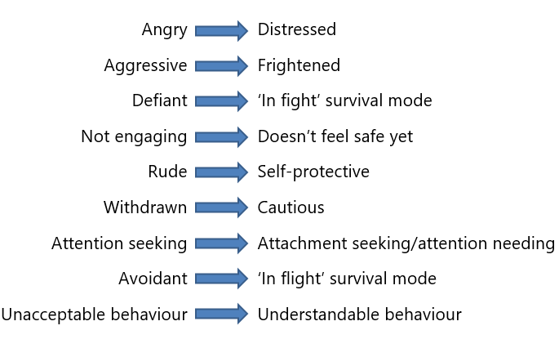
What Happens If We Reframe Our Thinking and Language?
Our internal use of language is important as it directly influences how we respond to a situation
Use accurate, positive, and helpful language to help us think differently about the situation and support the person we are working with
Notes:
Our internal use of language, how we label, describe and interpret what is happening, is important as it directly influences how we respond to every given situation.
Therefore, the more accurate we are with our language, and the more we focus on positive, helpful language that encourages us to see growth and opportunity for positive change, the better placed we will be to support the young people we are working with.

Slide 32
After de-escalation and the risk is reduced
The reason for the conflict may still need to be resolved
There are 5 key approaches to resolving conflict:
  Withdrawal
  Accommodation
  Competition
  Compromise
  Collaboration
The approach taken will depend on a range of factors including who is involved in the conflict
The following slide provides some things to consider about each approach

Slide 33
Conflict resolution: 5 key approaches
Withdrawal
Avoidance –can cause problems with relationships
When to purposely withdraw:
Intense situations
the conflict is unimportant
Accommodation
Involves putting someone else’s needs first
Remember all relationships should involve some give and take
So one party should not always be accommodating
Competition
Involves pushing for your own perspective
Doesn’t always mean using aggression or manipulation
Persuasion, when respectful, can lead to good outcomes
Compromise
Involves both parties giving some ground
It’s generally better to get some of what you want than none
Can lead on to collaborative problem-solving
Collaboration
Win-win result but requires effort on everyone’s part
More long-term benefits than other strategies
However it may be less popular than quicker solutions
There are plenty of healthy ways to work through conflict, though some won’t work in every situation
Notes:
There are plenty of healthy, productive ways to work through conflict, though some won’t work in every situation. Generally, conflict resolution falls into one of the these categories.

Slide 34
Things to remember:
Find your calm – you may need to pro-actively practice doing this
Co-regulation may be necessary before you try to resolve a conflict (patience required)
Stress, anger, or fear can easily create a conflict cycle (emotional transference)
Conflict cycles can quickly escalate in intensity and increase risk
If possible, break the cycle to begin de-escalation
Reduce risk using some of the strategies mentioned - you may need to pro-actively practice using the strategies with different people in different situations to see what works for you and for them
Consider the full range of approaches to conflict resolution

Slide 35
Final reminder: staff wellbeing and support
Co-regulation and de-escalation takes it’s toll on those regularly involved in both
Plan for colleague support as a regular part of practice to avoid compassion fatigue/burnout
Plan staff wellbeing sessions
Be non-judgemental of each other and offer compassion as well as practical support
Show yourself self-compassion and practice self-care (we generally aren’t good at this)
If you work in a setting where co-regulation and de-escalation is more likely to be needed regularly consider setting up a system of supportive supervision

Slide 36
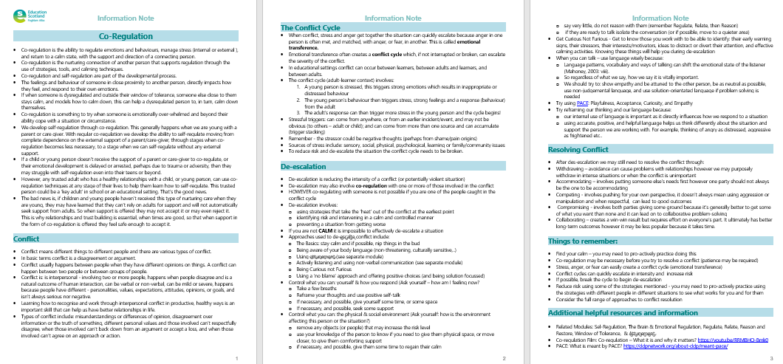
Resources and Information to help

Slide 37

Reflection
From what you have learned so far, think about:
How has this made you feel?
What has this made you think about?
What one action would you like to take forward?
How can you link what you plan to do with others in your setting?
How you will know that this learning has made a difference?
Notes:
Facilitation notes:
You can do this in groups...
Encourage educators to take this forward in an enquiry
Consider impact of the actions / learning

Slide 38

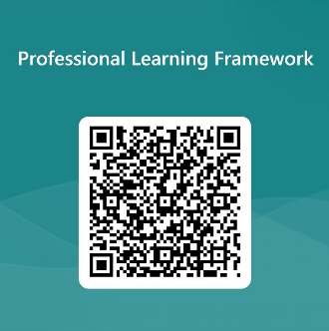
We value your feedback
From now until March 2024 we will be taking feedback on these resources so that we can make changes in advance of a formal launch of the Professional Learning Framework in June 2024
Your feedback could help us improve this resource
Please complete this short form, using the link or QR code, to let us know what you thought of it and any suggestions you have on how it could be improved
LINK: https://forms.office.com/e/b5PCpJJJ3P

Slide 39

For Scotland's learners, with Scotland's educators
Do luchd-ionnsachaidh na h-Alba, le luchd-foghlaim Alba
Education Scotland
Denholm House
Almondvale Business Park
Almondvale Way
Livingston EH54 6GA
T +44 (0)131 244 5000
E enquiries@educationscotland.gsi.gov.uk

