Slide 1
Inclusion Wellbeing & Equalities Professional Learning Framework Why Nurture? Is there an evidence base for responding to current challenges in Scotland by strengthening the nurturing approach in schools?
Notes:
Purpose of these Slides
This professional learning is pitched at an informed level and suitable for anyone working with children and young people in an educational context.
How to use the slides:
To be used to facilitate professional learning in a group or whole-setting, or as a self-directed learning activity as an individual.
General Guidance
There is a requirement to cover all the slides.
Please do not change the provided slides.
Facilitators are welcome to add slides or activities relevant to your own setting, to support discussion and exploration of the topic. Facilitators will know their participants’ needs best.
Anyone who works in an educational setting can be a facilitator and use these slides.
It is important to establish a safe space which encourages respect and honesty to ensure that everyone is able to participate.

Slide 2
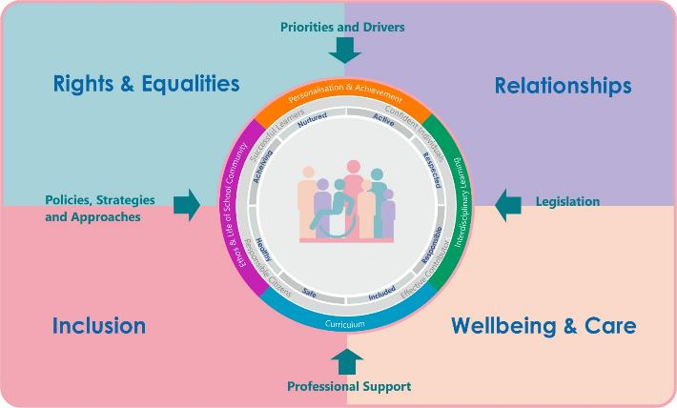
Interconnectivity
Notes:
All of the professional learning in the Framework fits into one of these four themes. The four themes are interconnected and interdependent.​
This activity forms part of the professional learning in the Wellbeing and Care theme.

Slide 3
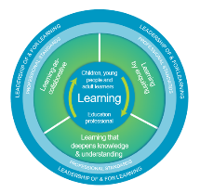
How to use this resource
These slides can be used to facilitate professional learning in a group or
whole-setting, or as a self-directed learning activity as an individual.
Facilitation notes are included at the bottom of each slide.
Please do not remove or change any of the slides included.
Facilitators are welcome to add slides or activities relevant to your own setting, to support discussion and exploration of the topic. Facilitators will know their participants’ needs best.
Anyone who works in an educational setting can be a facilitator and use these slides.
For reflection or discussion activities, it is important to establish a safe space which encourages respect and honesty to ensure that everyone is able to participate.
Notes:
Option to skip slide as these are instructions for facilitators only. No need to read to audience.

Slide 4
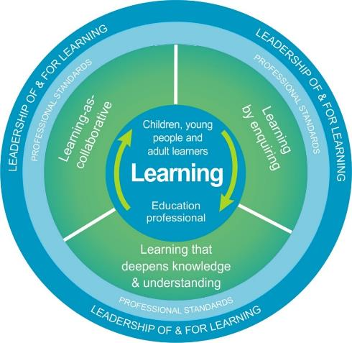
National Model for Professional Learning
This professional learning resource will support you to deepen your knowledge and understanding.
You will have the opportunity to consider how to take this learning forward on your own and with others.
The National Model of Professional Learning (education.gov.scot)
Notes:
This professional learning forms part of the national model for professional learning and is designed to help you gain more knowledge and have a deeper understanding of inclusion, wellbeing and equalities​​
On completion of this professional learning, you will be asked to consider what your next steps will be​​.
Please take some time to consider the reflection questions at the end

Slide 5
Welcome
This session provides an opportunity to:
Understand the current educational context in terms of the need for nurture
Consider the evidence for nurture
Notes:
This session provides an opportunity to:
Understand the current educational context in terms of the need for nurture
Consider the evidence for nurture

Slide 6
The challenges facing our children, young people and their families
Adverse Childhood Experiences
Increase in social deprivation/cost of living crisis
Reduced attendance at school
Increase in dysregulation
of children
and young people
Exclusion rates in Scotland 2010-2023
Increase in young people
with Additional Support Needs
Although trend in exclusion is downwards there
has been an increase in 2023
Notes:
Adverse Childhood Experiences
This refers to studies showing the link between adverse childhood experiences and ill-health in adulthood. In England 9% of the population have experienced 4 or more ACE’s and 14% of those in Wales. Exact figures for Scotland are not known but thought to be higher than in England. https://www.scotphn.net/projects/adverse-childhood-experiences/introduction/
Recent research suggests young people and young adults with more ACES were more vulnerable to Covid-19 stressors and reduced mental health with adolescents with 4 or more ACES more at risk of suicide ideation and poor mental health during the Covid-19 pandemic. Alradhi MA, Moore J, Patte KA, O'Leary DD, Wade TJ. Adverse Childhood Experiences and COVID-19 Stress on Changes in Mental Health among Young Adults. Int J Environ Res Public Health. 2022 Oct 8;19(19):12874. doi: 10.3390/ijerph191912874. PMID: 36232173; PMCID: PMC9566166.
Anderson KN, Swedo EA, Trinh E, et al. Adverse Childhood Experiences During the COVID-19 Pandemic and Associations with Poor Mental Health and Suicidal Behaviors Among High School Students — Adolescent Behaviors and Experiences Survey, United States, January–June 2021. MMWR Morb Mortal Wkly Rep 2022;71:1301–1305. DOI: http://dx.doi.org/10.15585/mmwr.mm7141a2
Increase in social deprivation/cost of living crisis
The ongoing cost of living crisis is likely to push many more children and their families into poverty. Children living in poverty are more likely to have health issues including mental health problems.
Reduced attendance in schools
Reduced attendance leads to multiple social, educational, and lifelong socio-economic disadvantages
John, A., Friedmann, Y., DelPozo-Banos, M., Frizzati, A., Ford, T. and Thapar, A. (2021) ‘Association of school absence and exclusion with recorded neurodevelopmental disorders, mental disorders, or self-harm: a nationwide, retrospective, electronic cohort study of children and young people in Wales, UK’, Lancet Psychiatry, 9, pp. 23–34. Available at: https://doi.org/10.1016/S2215-0366(21)00367-9
Increase in dysregulation of children and young people
The ‘Behaviour in Scottish schools: research report 2023’
found an increase in verbal abuse, physical aggression and physical violence in both primary and secondary school.
Scottish Government The ‘Behaviour in Scottish schools: research report 2023’
These factors have strong implications for a collective need to refocus on positive relationships and nurturing approaches in Scotland’s schools.
Increase in young people with Additional Support Needs
More children are being identified with additional support needs through the pupil census.
In 2022 the number of children being referred for mental health care in Scotland had risen by 22% since the previous year.
Pupil census supplementary statistics - gov.scot (www.gov.scot)
Public Health Scotland (2022) Child and Adolescent Mental Health Services (CAMHS) waiting times - Quarter ending March 2022 - Child and Adolescent Mental Health Services (CAMHS) waiting times - Publications - Public Health Scotland
World Health Organisation found particular groups experienced greater COVID-19-associated mental health impacts include children and adolescents and those with pre-existing mental and physical health conditions.
World Health Organisation (2022) Technical Advisory Group on the Mental Health Impacts of COVID-19 in the WHO European Region
Exclusions in Scottish schools have increased in last year although trend is downwards
Exclusions have increased in the last year although have more than halved since 2010/12

Slide 7
The most frequently cited reason for additional support needs being identified is social and emotional needs.
Notes:
Many of the children with additional support needs in Scotland have social and emotional needs. In fact, this is the most frequently cited reason for why pupils need additional support.

Slide 8
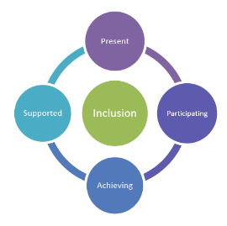
Scottish guidance/policy that fits with a nurturing approach
Children’s Rights
The Promise
The Presumption of mainstream
A trauma-informed workforce
A relational approach
Action plan in response to Behaviour in Scottish Schools Report 2024
Notes:
Children’s right to education is for all children therefore we need to design schools in ways in which all children, including the most vulnerable, can belong and flourish.
The Promise-where we promised to care experienced children and young people that they will grow up loved, safe and respected. Nurture can give the care and structure that our care experienced learners need.
The presumption of mainstream works to ensure learners are present, participating, achieving and supported. Evidence suggests that nurture groups and approaches can support those with social and emotional needs to succeed in school.
Scotland has committed to being a trauma informed nation: nurture can support those who have experienced trauma in their lives.
Relational approaches emphasise the pillars of nurture: care and challenge.
The joint action plan remains grounded in a relational approach but recognises the challenges of applying these in our current context. It details a range of actions designed to ‘empower staff to address the spectrum of dysregulated, distressed, violent and aggressive behaviour seen in schools’.

Slide 9
Where are we going in Scottish education?
Corporal Punishment
Discipline
Relational approaches
Behaviour Management
Notes:
The move to relational approaches acknowledges the human rights of children and acknowledges that punitive approaches disadvantage vulnerable learners and learners witnessing this punishing approach. They reduce pupil engagement and are associated with poorer educational outcomes and disadvantage in adulthood. Exclusionary discipline increases the chances of more exclusions and reduced general attendance. Higher levels of exclusionary discipline have also been found to negatively affect the academic achievement of learners who have not received these punishments but are in the same setting.
Perry, B. L., & Morris, E. W. (2014). Suspending progress: Collateral consequences of exclusionary punishment in public schools. American Sociological Review, 79(6), 1067–1087. https://doi.org/10.1177/0003122414556308
Licalsi. Osher and Bailey (2021) ‘Brief: An Empirical Examination of the Effects of Suspension and Suspension Severity on Behavioural and Academic Outcomes’ Advancing Evidence, Improving Lives

Slide 10
Thought piece
Notes:
This verse from Tom Herner illustrates that while we automatically assume children need to be taught a variety of skills we somehow don’t so readily expect to have to teach them how to behave.

Slide 11
Reflection
What does nurture mean to you?
Notes:
Pause for a few moments and note down what you think nurture means.

Slide 12
Nurture: a Dictionary Definition
Care for and protect someone (thing) while they are growing
Help or encourage the development of
Cherish
- Oxford Dictionary Online
Notes:
Review the dictionary definition
This dictionary definition of nurture cover the two aspects –warm, available support but also help to develop and progress. Cherish communicates the positive regard and empathy that is important.
Note that nurture is sometimes perceived as permissive: this is a misconception- nurture at its best has high support but also high expectations of positive change

Slide 13
The two pillars of nurture
Notes:
Nurture is therefore described as having two pillars: care and challenge. Care refers to attuned adults displaying warmth, empathy and building connection while the challenge refers to the structures, expectations and press or challenge given to learners to achieve and attain.

Slide 14
Why nurture?
Nurturing approaches fit with the evidence base for: resilience, the positive impact of relational approaches in schools, authoritative schools and the importance of social and emotional learning.
It builds on the work in Scotland to recognise and realise Children’s Rights and to promote relational approaches in schools.
Children and young people need the opportunity to experience secure relationships in order to help them develop their social, emotional and behaviour skills.
It is well-established that healthy socio-emotional development is foundational to a successful school life as well as wellbeing in adult life.
Notes:
Nurturing approaches fit with the evidence base for: resilience, the positive impact of relational approaches in schools, authoritative schools and the importance of social and emotional learning. Brief descriptions of the related evidence is detailed in the ‘Why Nurture?’ information note.
Children and young people need the opportunity to experience secure relationships in order to help them develop their social, emotional and behaviour skills. Nurture offers this opportunity to build secure and trusting relationships wih adults.
It is well-established that healthy socio-emotional development is foundational to a successful school life as well as wellbeing in adult life
Gedikoglu, M. (2021) ‘Social and emotional learning An evidence review and synthesis of key issues’ Education Policy Institute
SEL-paper-Nov2021-EPI.pdf

Slide 15
Definition of nurture groups and nurturing approaches
Nurture Groups | ‘A nurture group is a school-based intervention run by two members of staff with up to twelve pupils. The aim is to replace missing early experiences by developing positive pupil relationships with both teachers and peers in a supportive environment. Effective nurture group practice follows the Six Principles of Nurture.’ Nurture UK
A Nurturing approach | ‘A nurturing approach recognises that positive relationships are central to both learning and wellbeing. A key aspect of a nurturing approach is an understanding of attachment theory and how early experiences can have a significant impact on development. It recognises that all school/Early Learning Centre settings staff have a role to play in establishing the positive relationships that are required to promote healthy social and emotional development and that these relationships should be reliable, predictable and consistent where possible…the school environment…incorporates attunement, warmth and connection alongside structure, high expectations and a focus on achievement and attainment’ Education Scotland 2017
Notes:
Before looking more closely at the evidence for nurture it is important to define nurture groups and nurturing approaches. Nurture UK state that ‘A nurture group is a school-based intervention run by two members of staff with up to twelve pupils. The aim is to replace missing early experiences by developing positive pupil relationships with both teachers and peers in a supportive environment. Effective nurture group practice follows the Six Principles of Nurture’
The Applying Nurture Framework states that ‘A nurturing approach recognises that positive relationships are central to both learning and wellbeing. A key aspect of a nurturing approach is an understanding of attachment theory and how early experiences can have a significant impact on development. It recognises that all school/Early Learning Centre settings staff have a role to play in establishing the positive relationships that are required to promote healthy social and emotional development and that these relationships should be reliable, predictable and consistent where possible…the school environment…incorporates attunement, warmth and connection alongside structure, high expectations and a focus on achievement and attainment’

Slide 16
The Nurture Principles
Children’s learning is understood developmentally
The importance of nurture for the development of wellbeing
Language is a vital means of communication
The importance of transitions in children’s lives
All behaviour is communication
The classroom offers a safe base
Notes:
1. Children’s learning is understood developmentally 2. The classroom offers a safe base 3. The importance of nurture for the development of wellbeing 4. Language is a vital means of communication 5. All behaviour is communication 6. The importance of transition in children’s lives

Slide 17
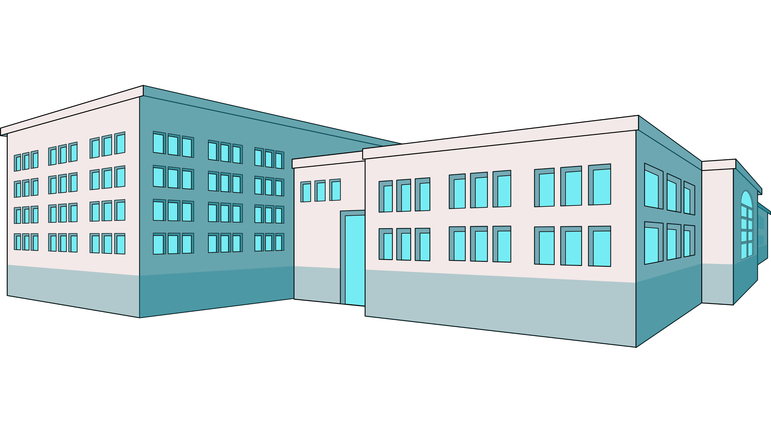
Evidence for Impact of Nurture Groups
Improved behaviour at home
Whole school impact
Decrease in social, emotional and behavioural difficulties: less acting out and increased emotional regulation
Increased educational engagement
Notes:
Bennett’s (2015) systematic review of 62 relevant research papers concluded that there was a consensus among the studies that NGs can have a positive impact on children’s social, emotional and behavioural needs especially in the short term. The most reported benefits for the children were found to be reducing displays of acting out behaviour and improving emotional regulation. A whole school impact was found, with children outwith the nurture group faring better than those in comparison schools without a nurture group. There was also some evidence of improvements in children’s behaviour at home. Gains tend to be seen first in social and emotional issues and then in cognitive progression and educational engagement.
Most of the studies have been in primary schools with only 9 in secondary schools. These studies of secondary NGs used perceptions of children’s improvement rather than quantitative data so there is a gap in the evidence here. It was also noted that very few longitudinal studies have been undertaken to understand the long-term impact of NGs.
Sloan et al (2016) in a large-scale evaluation of nurture groups in Northern Ireland, found strong evidence for improvements in social and emotional functioning and more mixed results for academic progress, with enjoyment of learning being the strongest improvement in the short-term. It could be argued that this increased enjoyment and engagement is likely to lead to academic gains.
There is evidence that NGs existing for more than two years had a greater impact on pupils than those in place for less than two years (Cooper, P. & Whitebread, D. 2007).
Bennett, H. (2015). Results of the systematic review on nurture groups’ effectiveness. The International Journal of Nurture in Education, 1(1) 3 – 8
Sloan, S., Winter, K., Lynn, F., Gildea, A., & Connolly, P. (2016). The impact and cost effectiveness of Nurture Groups in primary schools in Northern Ireland. Belfast: Centre for Effective Education, Queen’s University Belfast
Cooper, P. & Whitebread, D. (2007) The effectiveness of nurture groups on student progress: Evidence from a national research study, Emotional and Behavioural Difficulties, 12 (3), 171-190

Slide 18
Evidence for Impact of Nurturing Approaches
Nolan, Amy D.; Hannah, Elizabeth F. S.; Lakin, Elizabeth; Topping, Keith J. (2021) ‘Whole-School Nurturing Approaches ‘Educational and Child Psychology
Notes:
Most of the evidence to date centres on the longer established nurture groups rather than nurturing approaches. A review in 2021 of available evidence (Nolan et al) found the majority of papers suggested that the existence of NGs had a significant positive impact on pupils’ social, emotional and behavioural functioning across the pupil population. There were some indications that it increased the capacity of mainstream staff They found that there was some evidence that nurturing approaches impact on pupils’ academic progress. Measures of academic progress were predominantly based on national assessments/ curriculum or validated self-evaluation. One Scottish example of this was a Glasgow study (March and Kierney 2017) where 50 schools used the ‘How Nurturing is Our School self-evaluation framework’ resulting in ‘an increase in attainment, achievement and school attendance, a decrease in exclusion, school staff demonstrated good understanding of nurture and attachment and vulnerable pupils were better included’.
As with nurture groups, the length of time a nurturing approach was in place supported the effectiveness of the approach.
Nolan, Amy D.; Hannah, Elizabeth F. S.; Lakin, Elizabeth; Topping, Keith J. (2021) ‘Whole-School Nurturing Approaches ‘Educational and Child Psychology
Doyle, R. (2004). A social development curriculum: Applying nurture group principles and practices to support socially and emotionally vulnerable children within mainstream classrooms. British Journal of Special Education, 31(1), 24-30.
March and Kierney (2017) ‘ A psychological service contribution to nurture: Glasgow’s nurturing city, Emotional and Behavioural Difficulties, 22:3, 237-247, DOI: 10.1080/13632752.2017.1331972

Slide 19
Final Reflection
From what you have learned so far, think about:
How has this made you feel?
What has this made you think about?
What one action would you like to take forward?
How can you link what you plan to do with others in your setting?
How you will know that this learning has made a difference?
Notes:
Now consider the following reflective questions. Thank-you for taking part.

Slide 20
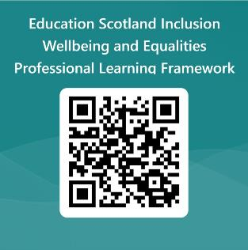
We value your feedback
Education Scotland is taking feedback on these resources so that we can continue improving our professional learning resources.
Your feedback could help us improve this resource
Please complete this short form, using the link or QR code, to let us know what you thought of it and any suggestions you have on how it could be improved
LINK: https://forms.office.com/e/J2NQUuCHji
Notes:
Slide 29: Feedback slide
Education Scotland is taking feedback on these resources so that we can continue improving our professional learning resources.
Your feedback could help us improve this resource
Please complete this short form, using the link or QR code, to let us know what you thought of it and any suggestions you have on how it could be improved

Slide 21
Contact us
Education Scotland
Denholm House
Almondvale Business Park
Almondvale Way
Livingston EH54 6GA
T +44 (0)131 244 5000
E enquiries@educationscotland.gsi.gov.uk

