Slide 1
Inclusion Wellbeing & Equalities Professional Learning Framework
What is trauma?
Level – Informed
@ESInclusionTeam
For Scotland's learners, with Scotland's educators
Do luchd-ionnsachaidh na h-Alba, le luchd-foghlaim Alba
Notes:
Read title​
This professional learning is pitched at an informed level and suitable for anyone working with children and young people in an educational context.

Slide 2
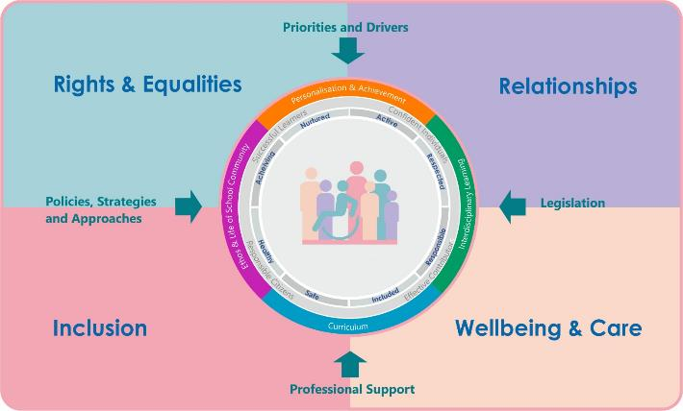
Interconnectivity
Notes:
All of the professional learning in the Framework fits into one of these four themes. The four themes are interconnected and interdependent.​
This activity forms part of the professional learning in the Wellbeing and Care theme.

Slide 3
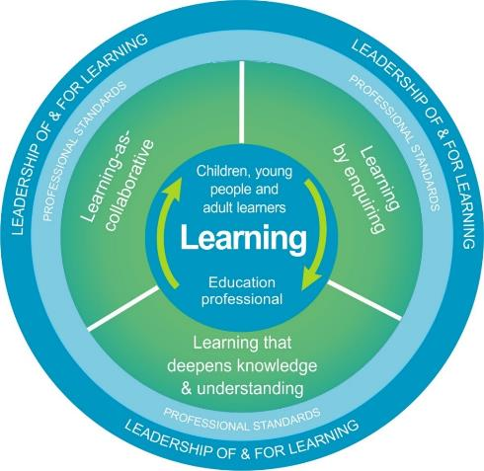
National Model for Professional Learning
This professional learning resource will support you to deepen your knowledge and understanding.
You will have the opportunity to consider how to take this learning forward on your own and with others.
The National Model of Professional Learning (education.gov.scot)
Notes:
This professional learning forms part of the national model for professional learning and is designed to help you gain more knowledge and have a deeper understanding of inclusion, wellbeing and equalities​​
On completion of this professional learning, you will be asked to consider what your next steps will be​​.
Please take some time to consider the reflection questions at the end

Slide 4
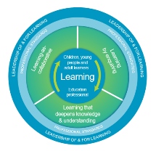
How to use this resource
These slides can be used to facilitate professional learning in a group or
whole-setting, or as a self-directed learning activity as an individual.
Facilitation notes are included at the bottom of each slide
Please do not remove or change any of the slides included.
Facilitators are welcome to add slides or activities relevant to your own setting, to support discussion and exploration of the topic. Facilitators will know their participants’ needs best.
Anyone who works in an educational setting can be a facilitator and use these slides.
For reflection or discussion activities, it is important to establish a safe space which encourages respect and honesty to ensure that everyone is able to participate.
Notes:
Option to skip slide as these are instructions for facilitators only. No need to read to audience.

Slide 5
Welcome
This session aims to provide an opportunity to reflect on:
What accessibility means to you.
The roles and responsibilities of all staff in supporting inclusive accessibility
Your next steps in developing a deeper understanding of accessibility .
Notes:
Link activity to national model

Slide 6
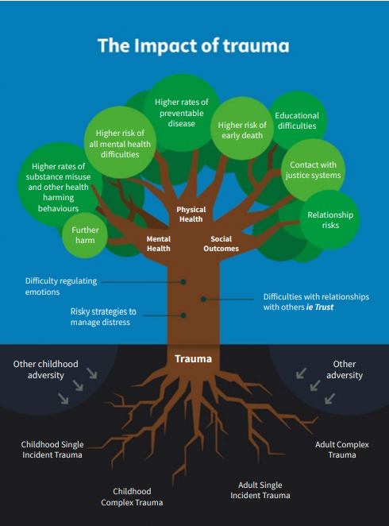
Trauma is everyone’s business
‘The vision of a trauma informed and
responsive nation that is capable of recognising
where people are affected by trauma and
adversity, and that responds in ways that
prevent further harm, support recovery, address
inequalities and improve life chances.’
NES Trauma Informed - National Trauma Training Programme Online Resources Summary (transformingpsychologicaltrauma.scot)
Notes:
Diagram taken from Transforming Psychological Trauma Framework to highlight why trauma matters and that it is everyone’s business.
The roots highlight types of traumatic event and adversity
The leaves show the impact that these events can have on physical and mental health and social outcomes (links to ACEs research)
The trunk shows examples of how we may see the impact of trauma in terms of an individuals behaviour.
There is now widespread agreement that experiences of adversity and trauma are prevalent within our society and have the potential to significantly affect the quality of a person’s life over the course of their lifetime, particularly where these experiences occur in childhood and are not buffered by supportive adults.
Research shows that childhood adversity and trauma can have a significant impact on a child’s ability to learn, to relate to and trust thers and to cope with stress.
Safe and supportive relationships are known to be key in fostering resilience and in enabling recovery following adversity and trauma. For this reason, it is important that we recognise the potential for each contact we have with people affected by trauma to afford safety, enhance resilience and promote recovery.
Children who experience adversity and trauma are, in adulthood, more likely to become parents at a young age, experience poor mental health, use substances, have contact with the criminal justice system, experience poor physical health and die prematurely
What this means is that exposure to adversity and trauma in early life can significantly affect a child’s life chances, and, because children grow into adults who shape the next generation, potentially the life chances of their children.

Slide 7
What is trauma?
“an event, a series of events or a set of circumstances that is experienced by an individual as physically or emotionally harmful or life threatening.” (SAMHSA, 2014)
Trauma is the unique individual experience of an event or enduring conditions in which the individual's ability to integrate his/her emotional experience is overwhelmed and the individual experiences (either objectively or subjectively) a threat to his/her life, bodily integrity, or that of a caregiver or family
(Saakvitne, K. et al, 2000).
(Trauma is) an exceptional experience in which powerful and dangerous stimuli overwhelm the child's capacity to regulate emotions.
(Early Trauma Treatment Network, ND)
Notes:
Trauma:
Ask participants to raise hand / use chat function to say what they think trauma is / means
A deeply distressing or disturbing experience, emotional shock following a stressful event or a physical injury, which may lead to long term neurosis (Oxford English Dictionary)
Definitions in NHS TPT framework: This term is a widely used but in this context refers to a “an event, a series of events or a set of circumstances that is experienced by an individual as physically or emotionally harmful or life threatening.” (Substance Abuse and Mental Health Services Administration - SAMHSA, 2014, p. 7)
Trauma is when the event continues to have an effect on the mind and body that is problematic – the after effect – without this there is no trauma
Make point about positive post traumatic growth
PTG is a direct contrast to post-traumatic stress disorder where individuals find no benefit from their trauma only pain and anxiety (Hadit, 2006).Where feeling stronger and finding hidden abilities and strengths; this changes the persons self concept and gives them confidence to face new challenges, e.g. If I can survive this I can survive anything;
good relationships are strengthened, which is reflected in how people often speak of “finding out who their true friends are” after they have experienced a trauma; and,
priorities and philosophies concerning the present day and other people are altered, e.g. living for the moment and prioritising your loved ones (Haidt, 2006 and Joseph & Linley, 2005).
http://positivepsychology.org.uk/post-traumatic-growth/

Slide 8
What is Trauma?
Trauma is our emotional response to distressing events or experiences
We are unlikely to go through life without encountering some kind of trauma
Trauma can be caused by sudden, unpredictable frightening events or can be caused by longer term experiences such as witnessing violence or abuse, living in a traumatic atmosphere, or being emotionally affected by trauma in the community
Trauma is personal and cannot be predicted by someone else’s reaction to a similar experience

Slide 9
Types of trauma
Complex trauma involves interpersonal threat, violence and violation. It may involve multiple incidents. Examples include child abuse, bullying, domestic violence, rape and war
Simple trauma involves experiences of events that are life threatening and/or have the potential to cause serious injury, e.g. car accidents, fires
Collective trauma the psychological reactions to a traumatic event that affects an entire society
Notes:
Due to the evidence of the differential impact of short‑term, one‑off and long‑term, repeated traumatic events, Terr (1991) has devised a commonly used categorization, as follows.
• Type 1 trauma: sudden and unexpected events experienced as isolated incidents, such as road traffic accidents, rapes or terrorist attacks. These can happen in childhood or adulthood.
Simple trauma (type 1) involves exposure to a single traumatic event, and is associated with PTSD
• Type 2 trauma: repeated or ongoing traumatic events, such as generally happens in childhood sexual abuse . In recent years, however, this has by convention been referred to as ‘complex trauma’
Complex trauma (sometimes referred too as developmental trauma) refers to traumatic events which are repeated, interpersonal and often (although not always) occur in childhood, with significant potential risk of developmental impact. The most commonly studied example of complex trauma is child sexual abuse, but other examples would include domestic abuse

Slide 10
Developmental trauma
Developmental trauma describes how complex trauma can impact on children and young people.
It describes how their development can slow down or become impaired following trauma
Developmental trauma describes the impact of early, repeated abuse, neglect, separation and adverse experiences that happens within the child’s important relationships
Notes:
Developmental trauma describes how complex trauma can impact on children and young people. It describes how their development can slow down or become impaired following trauma.
It is important to note that not all experiences of trauma lead to a trauma response or trauma-related disorder or diagnosis. There is a normal period of time, following a traumatic event or experience that we might expect to see trauma related responses or signs that do not necessarily develop into a post-traumatic stress disorder. However, when signs and symptoms of traumatic stress endure over time (one month or longer), disrupt a child's or adult's daily life, impact their social and emotional health, and meet specific diagnostic criteria, there are two types of trauma diagnoses:
Below taken from:
https://www.ecmhc.org/tutorials/trauma/mod1_2.html
PTSD
Post traumatic stress disorder (PTSD) describes symptoms associated with a traumatic event — such as a car accident, witnessing violence, natural disaster, etc (see list of types of traumatic experiences below). The symptoms may include recurrent bad dreams, physical reactions, flashbacks, startle reaction, loss of interest in usual activities, avoiding reminders of the event, etc.
Complex Trauma
Complex Trauma or Developmental Trauma Disorder — describes how children's exposure to multiple or prolonged traumatic events impacts their ongoing development. Typically, complex trauma exposure involves the simultaneous or sequential occurrence of child maltreatment and may include psychological maltreatment, neglect, physical and sexual abuse, and witnessing domestic violence.
Complex trauma is:
Chronic
Begins in early childhood, and
Occurs within the child's primary caregiving system and/or social environment
Exposure to these initial traumatic experiences, the resulting emotional dysregulation, and the loss of safety, direction, and the ability to detect or respond to danger cues may impact a child's development over time and can lead to subsequent or repeated trauma exposure in adolescence and adulthood without supports that might buffer the negative effects.

Slide 11
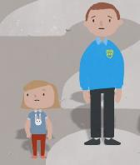
Developmental trauma – what can this look like?
Young children
Reluctance to separate from parent/carer
Difficulty in calming and reassuring them
Feelings of helplessness and difficulty describing in words what is bothering them
Sleep issues
Develop new fears
Recreate trauma trough play, drawings
Change in appetite
Complain of sore tummy/head
Changes in behaviour
Return to bed wetting
Older children
Persistent concern over safety
Experience of guilt/shame
Constant retelling of traumatic event
Complain of sore tummy/head
Sleep disturbances including nightmares
Flashbacks
Agitated, startles easily
Mental health issues – anxiety, anger, depression, self harming
Risk taking behaviour
Develop eating disorders
Changes in behaviour
https://beaconhouse.org.uk/useful-resources/
Notes:
Useful link in reference list to Beacon house – signs of developmental trauma
https://beaconhouse.org.uk/useful-resources/

Slide 12
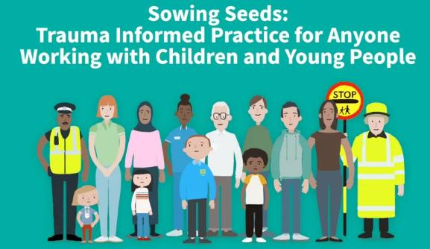
Sowing Seeds
Watch this video (11.01 minutes) to gain further understanding of the impact of trauma and to know how to adapt the way they work to make a positive difference to the lives of children and young people affected by trauma.
Take notes of aspects which resonate with you in your role.
Sowing Seeds: Trauma Informed Practice for Anyone Working with Children and Young People on Vimeo
Notes:
Useful link in reference list to Beacon house – signs of developmental trauma
https://beaconhouse.org.uk/useful-resources/

Slide 13
Sowing Seeds video reflection / discussion
From your notes, what aspects of the film resonate with you in your current role and context?
What does the impact of trauma on the development of children and young people (or adults) look like within your current role?
Notes:
Honest reaction

Slide 14
Reflection
From what you have learned so far, think about:
How has this made you feel?
What has this made you think about?
What one action would you like to take forward?
How can you link what you plan to do with others in your setting?
How you will know that this learning has made a difference?
Notes:
Facilitation notes:
You can do this in groups...
Encourage educators to take this forward in an enquiry
Consider impact of the actions / learning

Slide 15
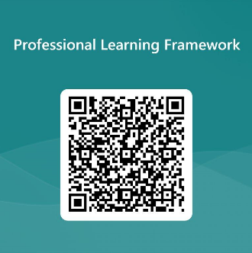
We value your feedback
From now until March 2024 we will be taking feedback on these resources so that we can make changes in advance of a formal launch of the Professional Learning Framework in June 2024
Your feedback could help us improve this resource
Please complete this short form, using the link or QR code, to let us know what you thought of it and any suggestions you have on how it could be improved
LINK: https://forms.office.com/e/b5PCpJJJ3P

Slide 16
For Scotland's learners, with Scotland's educators
Do luchd-ionnsachaidh na h-Alba, le luchd-foghlaim Alba
Education Scotland
Denholm House
Almondvale Business Park
Almondvale Way
Livingston EH54 6GA
T +44 (0)131 244 5000
E enquiries@educationscotland.gsi.gov.uk

